Slide 1
Grails Views

Slide 2
Agenda
Understanding GSPs
Predefined Variables available on page
Built in Tags
Templates
Grails Layout
Debugging GSP pages
Notes:
A set of services, APIs and protocols. Multi Tiered web applications.
A Standardized way of doing things. Decreases the need for programming a lot of features which are already available as re-usable components.

Slide 3
Understanding GSPs
Typically a mix of mark-up and GSP tags which aid in view rendering.
Lives in the grails-app/views directory
Rendered automatically or by using render method
Notes:
A set of services, APIs and protocols. Multi Tiered web applications.
A Standardized way of doing things. Decreases the need for programming a lot of features which are already available as re-usable components.

Slide 4
GSP Basics
${book.author} //using groovy expression
<%=book.author %> //using JSP style
<%-- This is my comment --%>
<%@ page import="java.awt.*" %>
Notes:
A set of services, APIs and protocols. Multi Tiered web applications.
A Standardized way of doing things. Decreases the need for programming a lot of features which are already available as re-usable components.

Slide 5
Predefined Variables
params
request
response
session
application
applicationContext
webRequest
Notes:
A set of services, APIs and protocols. Multi Tiered web applications.
A Standardized way of doing things. Decreases the need for programming a lot of features which are already available as re-usable components.

Slide 6
GSP Tags
Mixing mark-up and code is a bad thing and most GSP pages contain no code and needn't do so.
Use GSP built-in tags or create your own and call them in GSP.
All the built in tag starts with g: where g is called namespace.
Notes:
A set of services, APIs and protocols. Multi Tiered web applications.
A Standardized way of doing things. Decreases the need for programming a lot of features which are already available as re-usable components.

Slide 7
GSP Tags Examples
Basic tags
  message, img, set, each, if, link, createLink
Tags related to Forms and Fields
  form, textField, passwordField,
  checkBox, radio, hiddenField,
  select, localeSelect,
  currencySelect, timeZoneSelect
Notes:
A set of services, APIs and protocols. Multi Tiered web applications.
A Standardized way of doing things. Decreases the need for programming a lot of features which are already available as re-usable components.

Slide 8
Templates
Reusable GSPs.
name starts with an _ (underscore)
In GSP pages
<g:render template="relative/absolutePathWihtout _" model="a map" />
In controller/actions
render(template : "relative/absolute path wihtout _", model:"a map")
Tag as method call
String content = g.render(template:"bookTemplate", model:[book:b])
Notes:
A set of services, APIs and protocols. Multi Tiered web applications.
A Standardized way of doing things. Decreases the need for programming a lot of features which are already available as re-usable components.

Slide 9
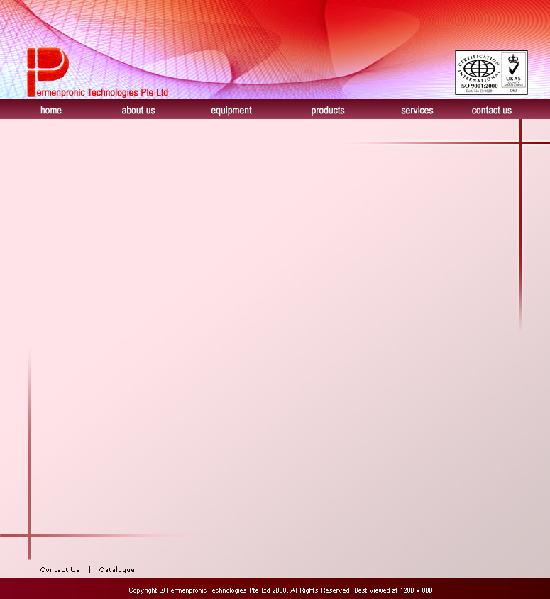
Grails Layout
This presentation uses a layout
  Different on title slide and remaining slides
Grails uses Sitemesh : a decorator engine.
Located in grails-app/views/layouts dir
Tags for including target page content
layoutTitle
layoutHead
layoutBody
Notes:
A set of services, APIs and protocols. Multi Tiered web applications.
A Standardized way of doing things. Decreases the need for programming a lot of features which are already available as re-usable components.

Slide 10
Grails Layout : Triggering ...
Inside Head of GSP pages
  <meta name="layout" content="main" />
Inside controllers
  static layout = 'customer'
Inside Config.groovy
  grails.sitemesh.default.layout = 'myLayoutName'
Applying layout to templates
  <g:applyLayout name="myLayout" template="bookTemplate" />
Notes:
A set of services, APIs and protocols. Multi Tiered web applications.
A Standardized way of doing things. Decreases the need for programming a lot of features which are already available as re-usable components.

Slide 11
Debugging Gsp pages
append "?showSource=true" or "&showSource=true" to the url
append "?debugTemplates" or "&debugTemplates" to the url and view the source of the result
Available only in DEV env
Notes:
A set of services, APIs and protocols. Multi Tiered web applications.
A Standardized way of doing things. Decreases the need for programming a lot of features which are already available as re-usable components.

Slide 12
Questions??
Notes:
A set of services, APIs and protocols. Multi Tiered web applications.
A Standardized way of doing things. Decreases the need for programming a lot of features which are already available as re-usable components.

Slide 13
Thank You!
Notes:
A set of services, APIs and protocols. Multi Tiered web applications.
A Standardized way of doing things. Decreases the need for programming a lot of features which are already available as re-usable components.

