Slide 1




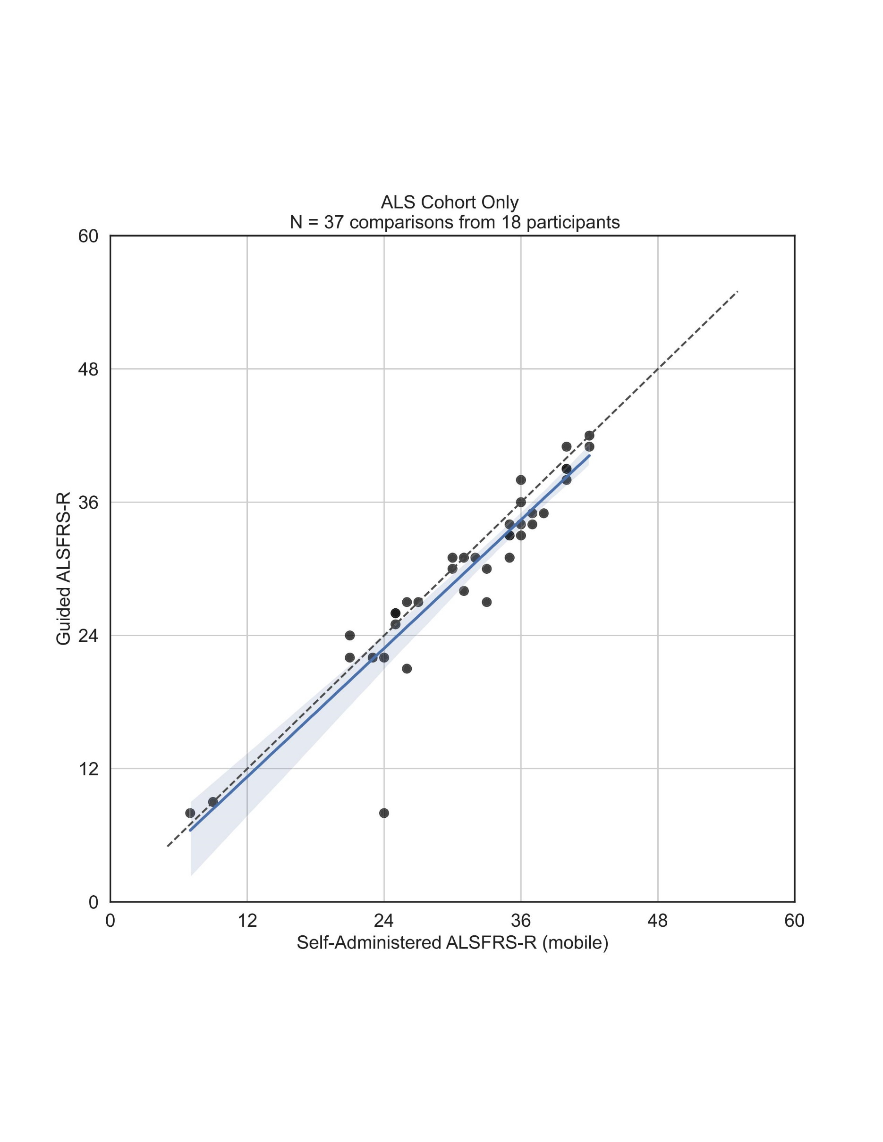
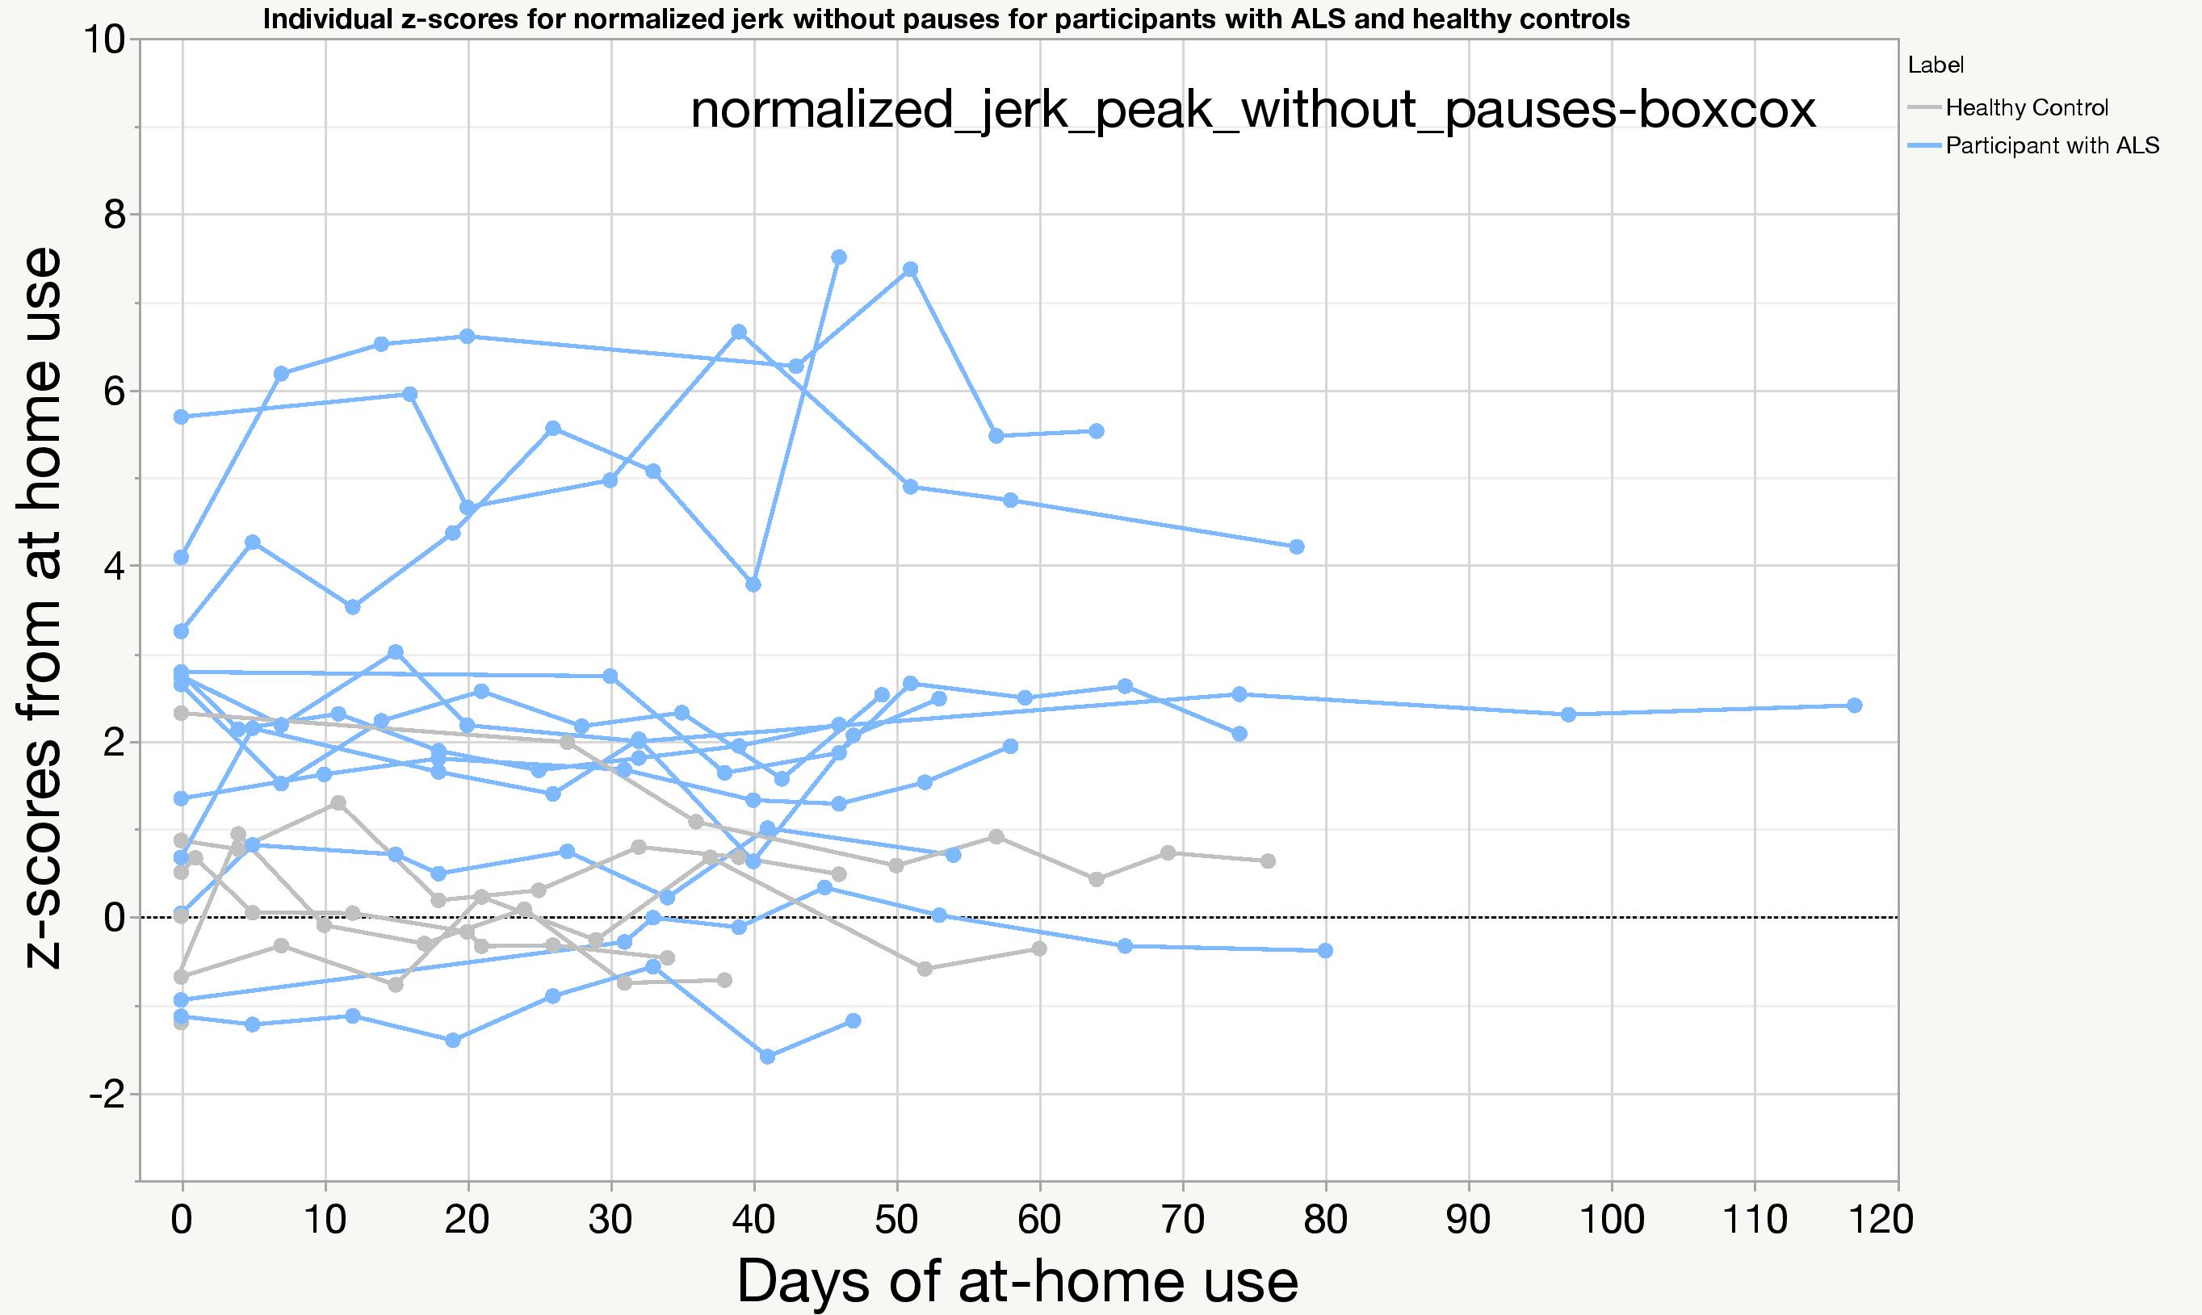
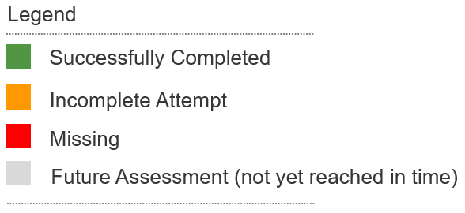

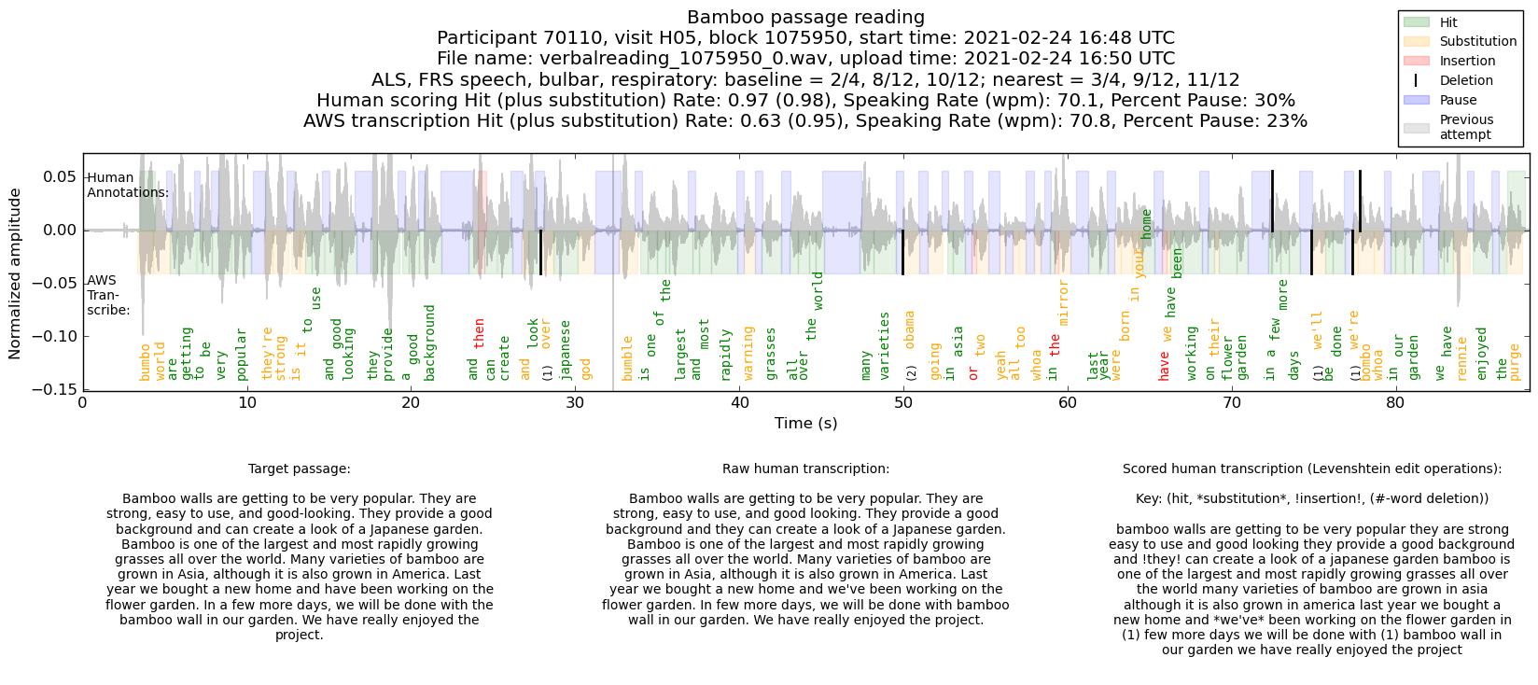
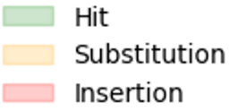

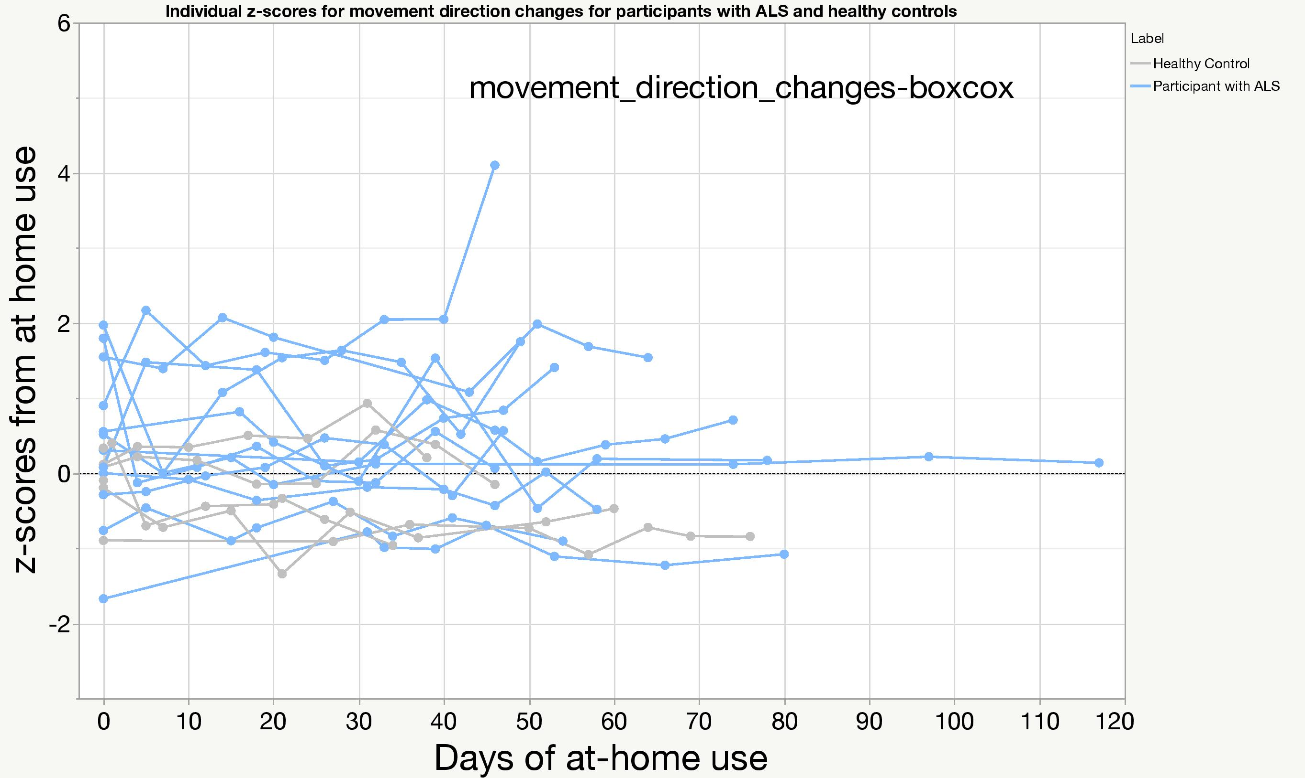
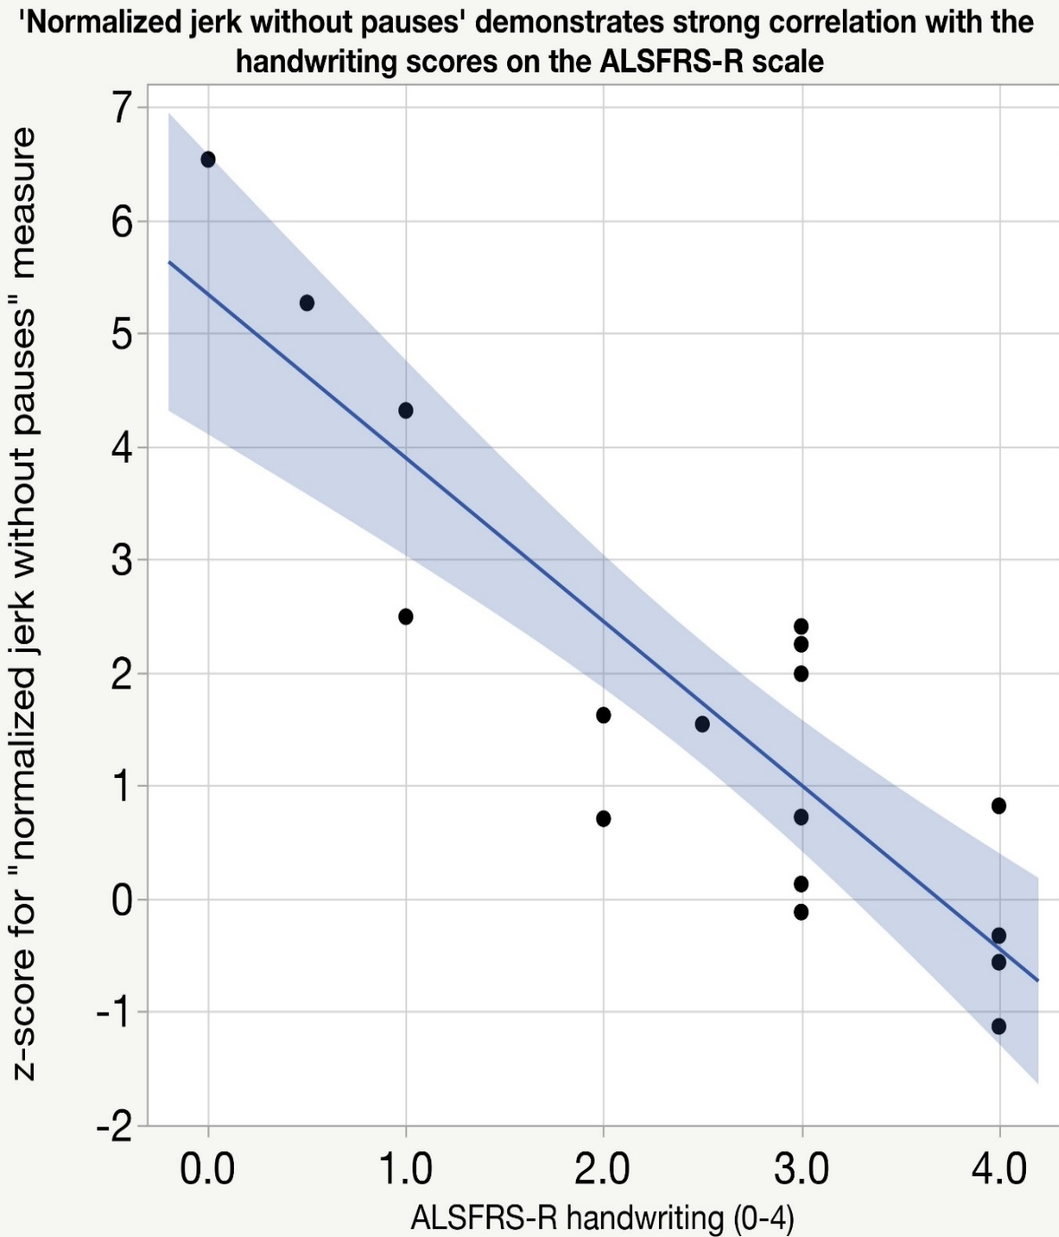
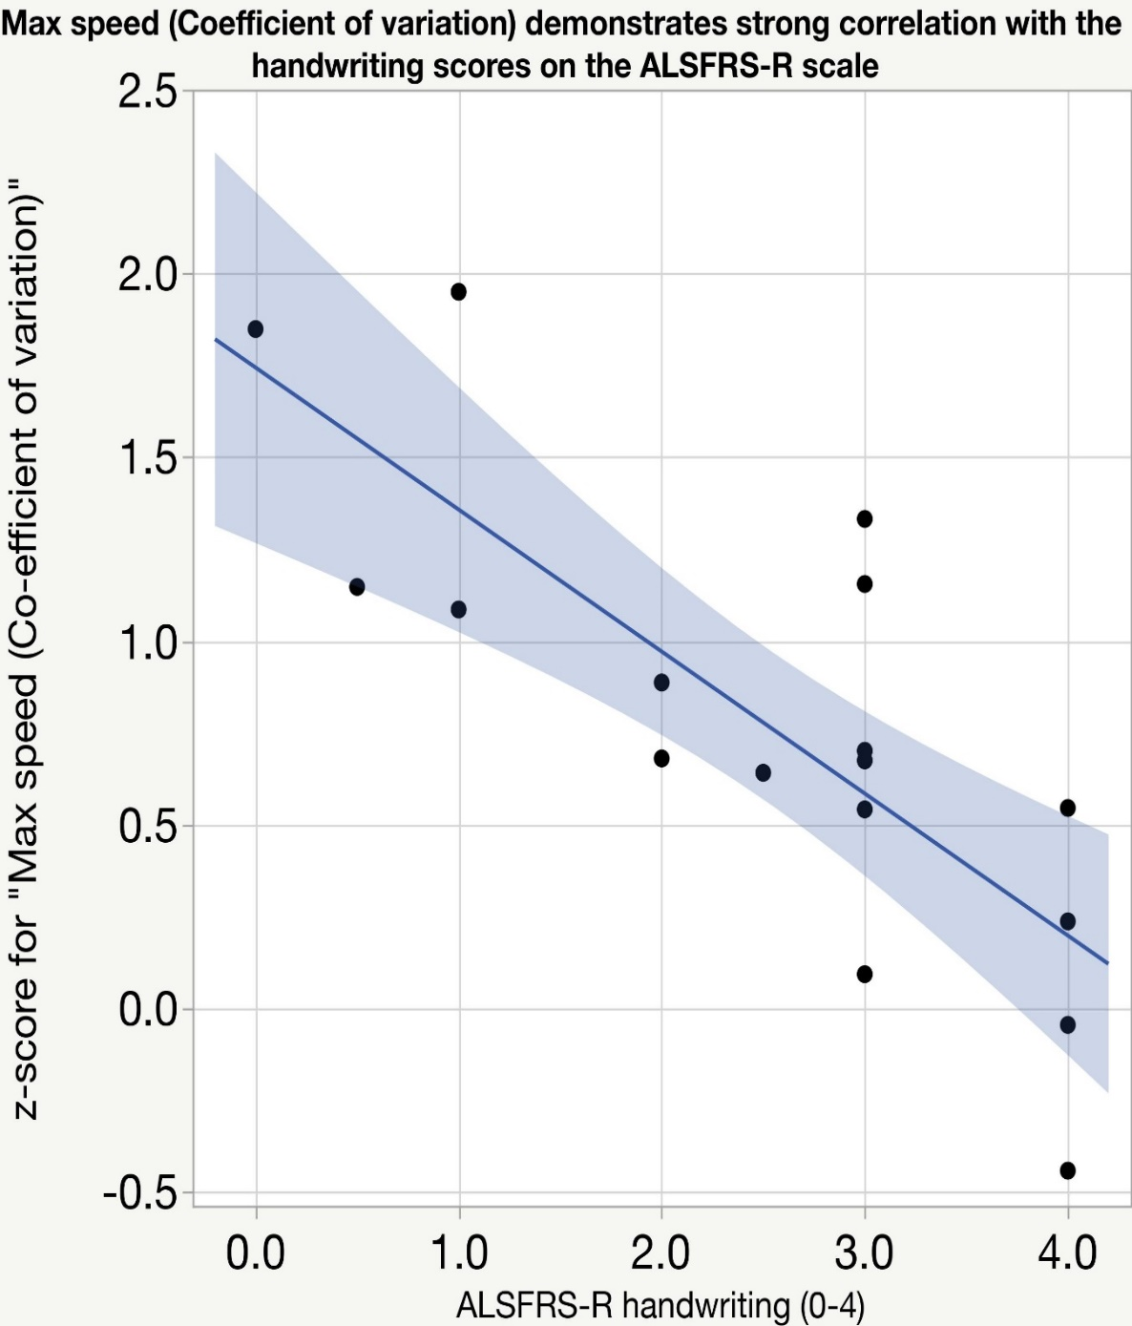
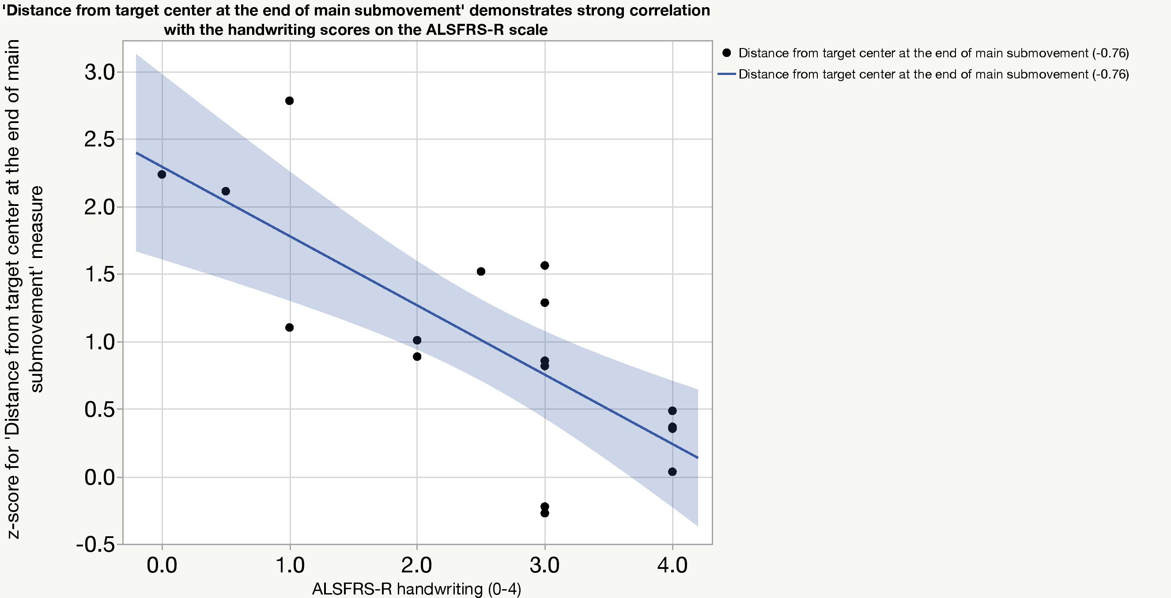
Using Active Digital Phenotyping to Quantify Function and Cognition in Amyotrophic Lateral Sclerosis (ALS)
Zoe Scheier¹, Alison P. Clark¹, Mackenzie Keegan¹, Kelley Erb², Evan Remington², Sheena Chew², Roland Brown², Jessey Ouillon¹, Nicole Eklund¹, Stephen Johnson¹, Vineet Pandey³, Krzysztof Z. Gajos³, Anoopum S. Gupta¹, Katherine M. Burke¹, James D. Berry¹
1) Healey Center for ALS, Massachusetts General Hospital, Harvard Medical School, Boston, MA, USA. 2) Biogen Inc, Cambridge, MA, USA. 3) Harvard School of Engineering and Applied Sciences, Cambridge, MA, USA
Background
Results
ALS clinical trials rely on a standard set of outcome measures, including:
ALS Functional Rating Scale – Revised (ALSFRS-R)
Vital Capacity (VC)
Handheld Dynamometry (HHD)
Digital Quantitative Monitoring (DQM) are tasks performed on digital devices
DQM can obtain more frequent quantitative and granular measurements of function than current outcome measures
Used alongside patient reported outcome measures, DQM can help improve standard ALS outcome measures
Table 1. Participant demographics
WatchALS App Data
Figure 4. WatchALS session adherence plot
Figure 5. Strong intraclass correlation between self-administered and guided ALSFRS-R (ICC = 0.96)
Characteristic | Percent (N) or Mean (SD)
 | Remote PALS (N =19) | Remote HC (N = 23*)
Age (years) | 60.6 (5.6) | 58.0 (8.2)
Male | 73.7% (14) | 39.1% (9)
White | 94.7% (18) | 91.3% (21)
Location of Onset
Lower Extremity | 47.4 (9)
Upper Extremity | 31.6 (6)
Bulbar | 10.5 (2)
Generalized | 10.5 (2)
Table 2. Overall app session compliance out of 695 possible sessions
Complete Sessions | 85.99% | (675/785)
Incomplete Sessions | 3.57% | (28/785)
Missed Sessions | 10.45% | (82/6785)
*1 HC terminated study participation before contributing any DQM data. This participant has been included for demographics but was removed from data analysis.
Hevelius Computer Task Data
Objective
Figure 1. Individual z-scores for normalized jerk without pauses for participants with ALS and healthy controls
The purpose of this study is to:
investigate the utility of digital tools for quantifying in-clinic neurological examinations; and
utilize digital tools to examine patient behavior outside of clinic
for use as biomarkers of neurological change over time in people with ALS.
Figure 6. AWS transcription of a participant with ALS reading the Bamboo Passage
z- scores from at home use
Methods
Days of at-home use
Enrollment Goal: 25 People with ALS (PALS), 25 Healthy Controls (HC)
Initial Pre-COVID in-person study design (N = 8)
Two clinic visits separated by 1 week of daily self-administered tests and continuous passive data collection
Clinic visits involved a traditional neurological exam, a digital neurological exam, standard ALS outcome measures, and various cognitive tasks.
Remote longitudinal redesign (in the setting of COVID, N= 42)
Weekly self-administered testing via mobile app
Weekly self-administered fine-motor assessment
Telemedicine visits at baseline, week 12, week 24
Staff administered ALSFRS-R, Neurological Fatigue Index – Motor Neuron Disease (NFI-MND), and quality of life scale
Digital Quantitative Monitoring (DQM)
Digital Artefacts Mobile Application - WatchALS
Downloaded on study provided iPhone and Apple Watch
Includes symptom questionnaire, self-administered ALSFRS-R and NFI-MND, fine motor, gait, stance, speech, and cognitive tests, and collected continuous passive data
Hevelius Computer task
Self-administered point and click fine motor assessment
Completed on participants’ personal computer
We present preliminary analysis of Hevelius and WatchALS data for the remote portion of this study.
Figure 2. Individual z-scores for movement direction changes for participants with ALS and healthy controls
Figure 3. Many metrics measured by the Hevelius task demonstrate strong correlation with ALSFRS-R handwriting scores
Figure 3.1. Normalized Jerk (r = -0.88)
Figure 3.2. Max speed coefficient of variation
(r = - 0.84)
Figure 3.3. Distance from target center at the end of main submovement (r = -0.76)
z- scores from at home use
Days of at-home use
Conclusion
Future Directions
Acknowledgments
Early WatchALS data suggests compliance is acceptable
A strong correlation between normalized jerk and ALSFRS-R handwriting score indicates potential for Hevelius to reliably assess fine motor impairment
Self-entry and guided ALSFRS-R show very high correlation, though self-entry scores are just over one point higher, on average.
Self-entry is a reasonable means for obtaining ALSFRS-R data
Self-entry and guided ALSFRS-R are not interchangeable
Remote longitudinal data collection is scheduled to complete in March of 2022
In-person data will be used to assess test-retest validity
Further data analysis is needed to evaluate the WatchALS app data for
Evaluation of fine motor, gait, and cognitive function at baseline
Ability to identify changes over time related to ALS disease progression
We would like to thank our patients and their families for their kind contribution to research on amyotrophic lateral sclerosis.

