Slide 1
Make the best of Big Data Developer Course
Beginners – Go through every video in the same order that is presented
Intermediate – Choose the sessions you want to learn and start from there
Always plan and have a realistic goal
Ask your questions in Q and A forum in udemy. Respond to other student’s Q and A and share knowledge
Practise, Practise, Practise
Have good internet connectivity and good system configuration
Provide feedback and Rating when requested

Slide 2









SPARK RDD
SPARK DATAFRAME
SPARK SQL
SPARK STRUCTURED STREAMING
SPARK COMPLEX DATA PROCESSING

Slide 3
What is Big Data
Big data is collection of data that is huge in volume, is growing exponentially with time.
Example of Big Data : Data from social media, sales details from big retailers like Walmart, Jet Engine data which can generate more than 10 terabytes in 30 mins of flight time etc

Slide 4
Types of Big Data
Structured . Eg : Tables
Semi Structured . Eg : XML
Unstructured

Slide 5
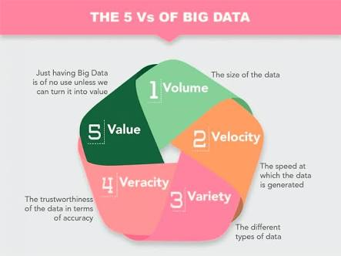

Slide 6
Processing Big Data
There are many tools and programs which help in processing big data. Some of them are :
Hive
Spark
Kafka
NoSQL Db
Presto
Flink
Hudi
Druid …..

Slide 7
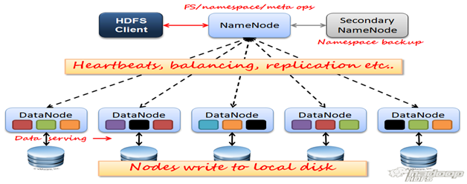
Hadoop 1.0 Architecture

Slide 8
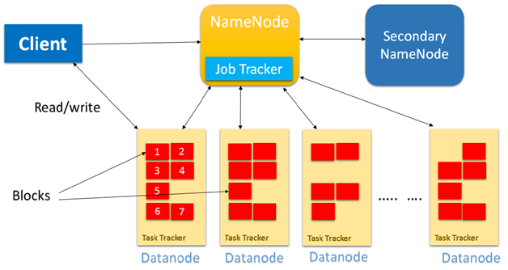
Internal process of 1.0 architecture

Slide 9
Drawbacks of 1.0
Name node failure : If Name node fails, then the current fsimage is lost. So recent transactions are lost
Name node size increase: If the data in name node increases, scalability becomes an issue
Block size : Block size was just 64 MB in Hadoop 1.0

Slide 10
Hadoop 2.0
Name node failure →High Availability
Name node filling up → Federation
Block size 64 mb increased to 128 mb

Slide 11
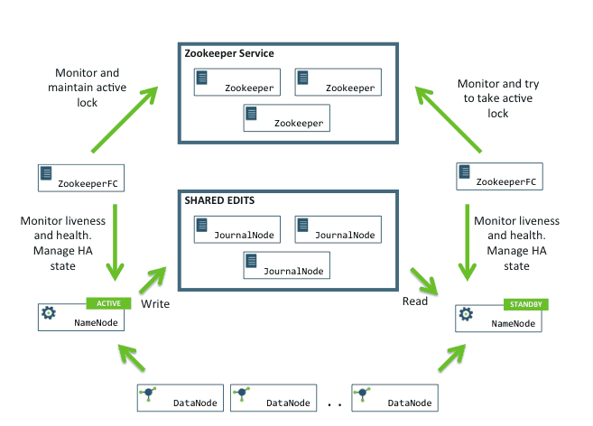
High Availabality
Notes:
11

Slide 12
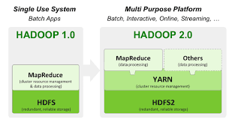

Slide 13
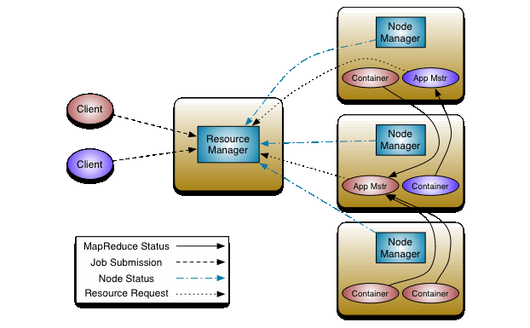

Slide 14
Hadoop 3.0 New Features
You would need Java 8 to compile the Hadoop jars
Default Port has been changed for multiple services
Support for more than 2 Name Nodes → One active and 2 Passive Name nodes
Several other optimizations
Support for Erasure Coding

Slide 15
Erasure Code
Erasure code is an error correcting code that ensures survival of data by breaking the data into many blocks and then adding a parity block. Using the parity block, we can reconstruct the original block if it is lost.Parity block contains parity checks(parity bits). Parity bits are simple form of error code.

Slide 16
Erasure Coding
FILE
A1
+
A2
+
B1
+
B2
+
C1
+
C2
A1
A1
A1
B1
A2
B1
A2
A2
B2
B2
C1
B1
B2
C1
C2
C1
C2
C2

Slide 17
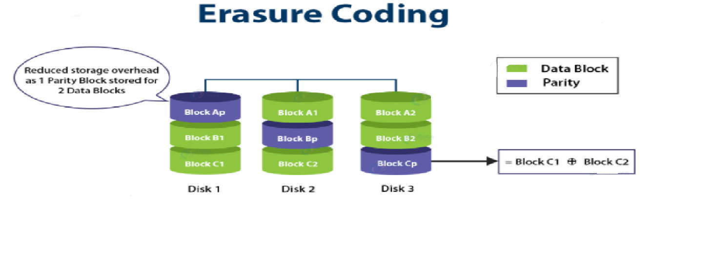

Slide 18
A B C D
F Q M
5 3 4
Data Block 1
Data Block 2
Data Block 3
Parity Block

Slide 19
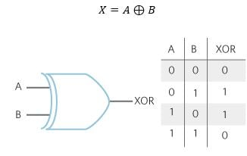
Input: A = “1010”, B = “0101” Output: 1111
Parity : 1 1 1 1
B : 0 1 0 1
--------------------------
XOR : 1 0 1 0 → A

Slide 20
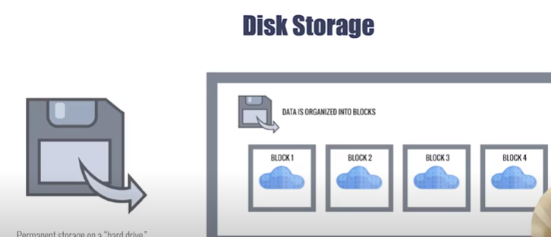

Slide 21
ID | Name | Country
1 | John | India
2 | Kevin | Australia
3 | Michael | America
4 | Pooja | India
…..
90000 | Balor | Ireland
Row Based Storage
1 John India|2 Kevin Australia|3 Michael America|4 Pooja India|.....90000 Balor Ireland

Slide 22
……………………………………………….
Block 1
Block 2
Block ?
1 John India|2 Kevin Australia
3 Michael America|4 Pooja India
90000 Balor Ireland

Slide 23
Column Based Storage
Id | Name | Country
1 | John | India
2 | Kevin | Australia
3 | Michael | America
4 | Pooja | India
…..
90000 | Balor | Ireland
Column Storage
1 2 3 4 …… 90000|John Kevin Michael Pooja… Balor|India Australia America India… Ireland

Slide 24
Block 1
Block 2
Block ?
1 2 3 4 …… 90000
John Kevin Michael Pooja… Balor
India Australia America India… Ireland

Slide 25
Row store vs Column Store
Row Store | Column Store
Keeps the data for the objects on the same block | Keeps the entire column on the same block
Easy to read and manipulate one object at a time | Easy to analyze entire columns quicklyE
Easy to insert new data | Easy to compress the data
Slow to analyze large amount of data | Slow to analyze new data or manipulate old data

Slide 26
Serialization
Serialization is the process of converting a data structure or an object into a format that can be easily stored or transmitted over a network and can be easily reconstructed later.
De-Serialization
Data
Streams of Bytes
Data
Serialization

Slide 27
Advantages of Serialization
Serialized data are easy and fast to transmit over a network. Read and write are fast
Some serialized file formats offer good compression, they can be encrypted
Deserialization also does not take much time

Slide 28
Serialized File Formats in Big Data
Sequence File Format
RC File Format
ORC File Format
Avro File Format
Parquet File Format

Slide 29
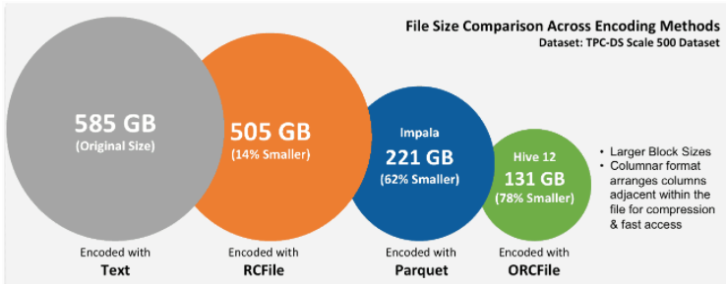

Slide 30
Avro Vs ORC Vs Parquet
AVRO is a row Format while ORC and Parquet are columnar format. Because AVRO is row Format, it is write heavy while ORC and Parquet are read heavy.
In all these 3 file formats, along with data, the schema will also be there. This means you can take these files from one machine and load it in another machine and it will know what the data is about and will be able to process
All these file formats can be split across multiple multiple disks. Therefore scalability and parallel processing is not an issue.
ORC provides maximum compression followed by Parquet followed by AVRO
If the schema keeps changing then AVRO is preferred as AVRO supports superior schema evolution. ORC also supports to some extent but AVRO is best
AVRO is commonly used in streaming apps like Kafka, Parquet is commonly used in Spark and ORC in Hive. Parquet is good in storing nested data. So usually in spark, parquet is used
Because compression of ORCFile is more, it is used for space efficiency. Query time will be little more as it has to decompress the data. In case of AVRO, the time efficiency would be good as it takes little less time to decompress. So if you want to save space, use ORC . if you want to save time, use Parquet

Slide 31
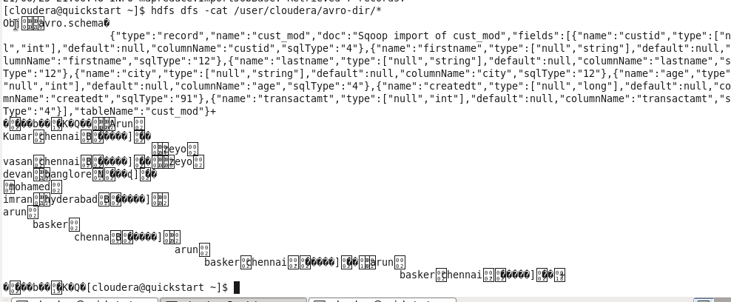
AVRO File

Slide 32
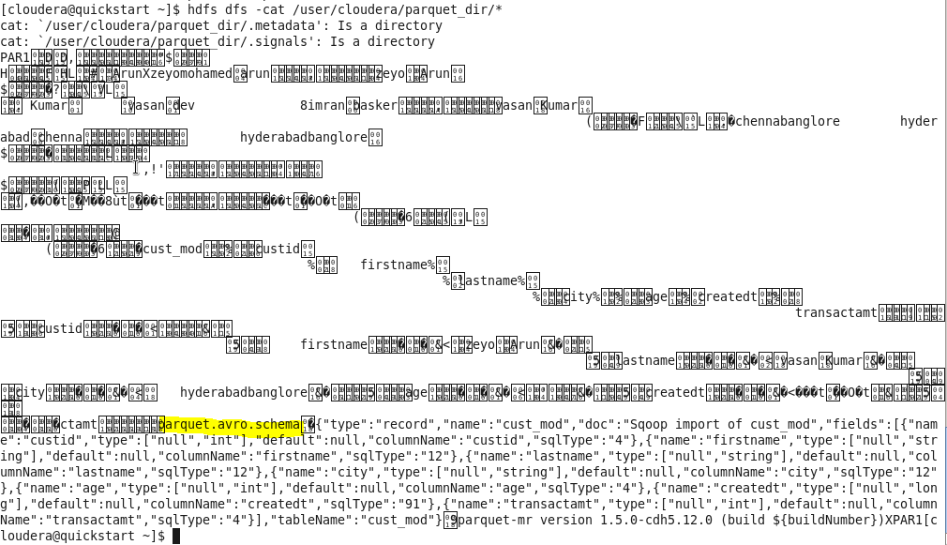
Parquet File

Slide 33
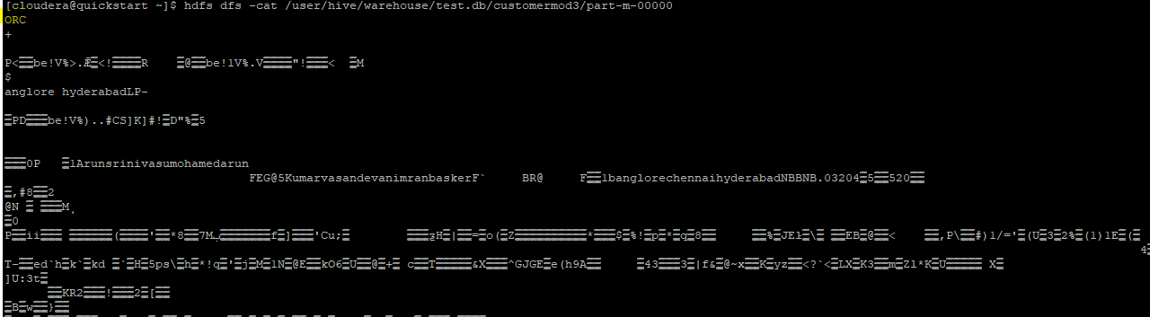
ORC File

Slide 34
What is Sqoop
Sqoop is an Integration between RDBMS and Hadoop. Using sqoop you can import the data from RDBMS into Hadoop and also export the data from Hadoop to the RDBMS

Slide 35
Features of Sqoop
Sqoop can handle huge amount of data
Uses multi threading concept for parallelism
Can import all of the data. It can also import a portion of data
Can work with incremental data very well
Can work with data that is changed (CDC)
Can import into multiple file formats including serialized file formats
Data is imported directly into the Hadoop system. It is not stored in the edge node

Slide 36
Sqoop Command Template - Import
sqoop import --connect jdbc:mysql://<hostname>:<port>/<dbname>
--username <username> --password <password> --m 1
--table <tablename> --target-dir <target-dir>

Slide 37
Sqoop Command Template - Export
sqoop export --connect jdbc:mysql://<hostname>:<port>/<dbname>
--username <username> --password <password> --m 1
--table <tablename> --export-dir <target-dir>

Slide 38
Import portion of the data
--where → Using –where we specify the condition and data is filtered based on that condition. Similar to where in sql
--query → Here we specify the query to fetch the data from table

Slide 39
Sqoop incremental append
sqoop import
--connect jdbc:mysql://localhost:3306/retail_db
--username root --password cloudera
--m 2 --table customers --split-by customer_id
--target-dir /user/cloudera/customer1
--incremental append
--check-column customer_id
--last-value 0

Slide 40
Password encryption
hadoop credential create encrytpassword -provider jceks://hdfs/tmp/mypassword
hdfs dfs -cat /tmp/mypassword
sqoop import -Dhadoop.security.credential.provider.path=jceks://hdfs/tmp/mypassword --connect jdbc:mysql://localhost:3306/retail_db --username root --password-alias encrytpassword --table customers -m 1 --target-dir /user/cloudera/data_import_encrypted

Slide 41
Sqoop import as ORC
sqoop import --connect jdbc:mysql://localhost:3306/retail_db --username root --password-file file:///home/cloudera/passfile --m 1 --table order
--m 1
--hcatalog-database test
--hcatalog-table order
--create-hcatalog-table
--hcatalog-storage-stanza "stored as orcfile";

Slide 42
Sqoop import All tables
sqoop
import-all-tables
--connect jdbc:mysql://localhost:3306/retail_db
--username root
--password-file file:///home/cloudera/passfile
--m 1
--warehouse-dir /user/cloudera/tables;

Slide 43
Sqoop Export
sqoop export
--connect jdbc:mysql://localhost:3306/retail_db
--username root
--password-file file:///home/cloudera/passfile
--table test
--staging-table test_stg
--m 1
--export-dir /user/cloudera/test_null

Slide 44
Performance Tuning – Sqoop Imports
Using mappers
Using –direct option. if you give --direct instead of connectin to jdbc driver, it will connect using native library sqoop import --connect jdbc:mysql://localhost:3306/retail_db --username root --password cloudera --m 1 --table customers --delete-target-dir --target-dir /user/cloudera/data_import1 –direct
--fetch-size : How many rows should each mapper fetch at a time. By default it is 1000 rows

Slide 45
Performance Tuning – Sqoop Export
In Sqoop export, 10k rows will be inserted per sqoop statement by default. We can tune this using below 2 properties : sqoop export -Dsqoop.export.statements.per.transcation=100
-Dsqoop.export.records.per.statement=100

Slide 46
Hive Features
Hive is open source. We can use it for free
HQL(High Query Language) is very similar to your SQL
Hive is schema on read
Hive can be used as an ETL Tool and can process huge amount of data
Hive supports partitioning and Bucketing
Hive is warehouse tool designed for analytical purpose. Not for transactional purpose
Can work with multiple file formats
Can be plugged into BI tools for data visualization

Slide 47
Limitations of Hive
Hive is not designed for OLTP operations. Used for OLAP
It has limited subquery support
Latency of Hive is little high
Support for Updates and Deletion is very minimal
Not used for real time queries as it takes a bit of time to give the results

Slide 48
Hive Table Types
Managed Table : When table dropped, backend directory associated with the table is deleted as well. Use it for staging purpose
External Table : When table dropped, backend directory associated with the table would still exist. Use it for target system

Slide 49
Hive Partitions
Partition is a way of dividing the data in a table into related parts using a partition column.
Types:
Static Partition : Partitions are created whenever user specifies
Dynamic Partition : Partitions are created dynamically

Slide 50
Hive Static Partition
Static Load Partition : Here, we specify the partition name to which the data needs to be loaded
Static Insert Partition : Here, we first create a non partitioned table and then insert the data from this non partitioned table into a partitioned table

Slide 51
Hive Bucketing
Bucketing in hive is the concept of breaking data down into ranges, which are known as buckets, to give extra structure to the data so it may be used for more efficient queries.

Slide 52
Hive Date Formats
Default date Format : yyyy-MM-dd
unix_timestamp : This will return the number of seconds from the unix time. Unix time is 1970-01-01 00:00:00 UTC. It uses the default time zone for conversion.
from_unixtime : The result of unix_timestamp is fed into from_unixtime and it converts it back to the desired date format
TO_DATE : The TO_DATE function returns the date part of the timestamp in the format 'yyyy-MM-dd’
YEAR( string date ), MONTH(String date), DAY(String date), HOUR(string date), MINUTE(String date), SECOND(String date) → Returns Year, Month, Day, Hour, Minute, Second part of the date
DATEDIFF( string date1, string date2 ) : DATEDIFF function returns the number of days between the two given dates
DATE_ADD( string date, int days ) : DATE_ADD function adds the number of days to the specified date
DATE_SUB( string date, int days ) : DATE_SUB function subtracts the number of days to the specified date

Slide 53
Hive Joins
Map Join
Bucket Map Join
Sort merge bucket join
Skew join

Slide 54
Bucket Map Join
Properties to set:
set hive.optimize.bucketmapjoin = true set hive.enforce.bucketing = true;
Query:
SELECT /*+ MAPJOIN(table2) */ table1.emp_id, table1.emp_name, table2.job_title FROM table1 inner JOIN table2 ON table1.emp_id = table2.emp_id;
Here, table2 is the smaller table

Slide 55
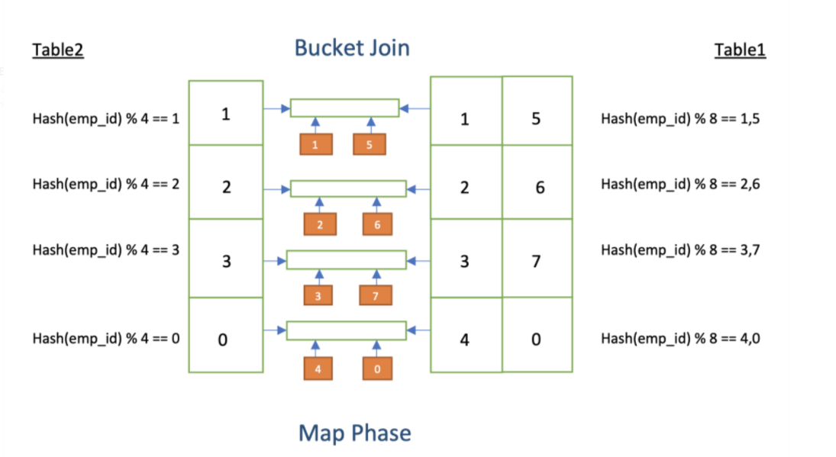
Bucket Map Join

Slide 56
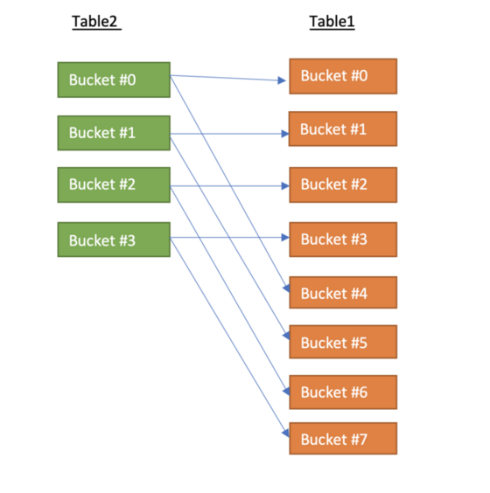
Bucket Map Join

Slide 57
Sort merge bucket join
Below properties needs to be set:
set hive.auto.convert.sortmerge.join=true;
set hive.optimize.bucketmapjoin = true;
set hive.optimize.bucketmapjoin.sortedmerge = true;
set hive.auto.convert.sortmerge.join.noconditionaltask=true;

Slide 58
What is data skew
Data skewness primarily refers to the non-uniform distribution of data.
Dno | Count
10 | 3
20 | 7800
30 | 300

Slide 59
EMPLOYEE
DEPT
dno | count
10 | 10,00,000
20 | 20
30 | 12
dno | count
10 | 10
20 | 1
30 | 1

Slide 60
Skew join properties to be set
set hive.optimize.skewjoin=true;
set hive.skewjoin.key=500000;
set hive.skewjoin.mapjoin.map.tasks=10000;
set hive.skewjoin.mapjoin.min.split=33554432;

Slide 61
Hive Performance Tuning Techniques
Partitions
Bucketing
Map Joins, Skew Joins
Vectorization set hive.vectorized.execution.enable=true
Hive Parallel execution

Slide 62
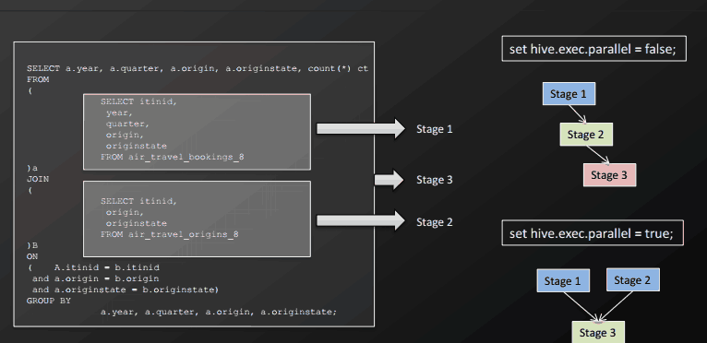
set hive.exec.parallel=true

Slide 63
SQL vs Hive
Hive is schema on read while sql is schema on write
Hive is for analytics while SQL is for transcational
Hive is a datawarehouse and SQL is a database
SQL supports only structured data while hive supports structured and semi structured data

Slide 64
Scala
Scala is compatible with Java
Semicolons are optional in scala
Scala is statically typed
Everything in Scala is an object

Slide 65
Scala – Conditional Statements
If statement
If-else statement
Nested if-else statement
If else if Ladder statement

Slide 66
If condition
if(condition)
{
// Statements to be executed
}

Slide 67
Scala If else
if(condition)
{
// If block statements to be executed
} else
{
// Else bock statements to be executed
}

Slide 68
If Else If Ladder Statement
if (condition1)
{
//Code to be executed if condition1 is true
}
else if (condition2)
{
//Code to be executed if condition2 is true
}
...
else
{
//Code to be executed if all the conditions are false
}

Slide 69
Nested If else
if (condition_1)
{
if (condition_2)
{
// Executes when condition_2 is true
}
else
{
// Executes when condition_2 is false
}
}
else
{
//can have else statement or nested if else here
}

Slide 70
While loop
while(condition)
{
// Statements to be executed
}

Slide 71
For Loop
for( i <- range)
{
// statements to be executed
}

Slide 72
The Break statement
Break is used to break a loop or program execution. It skips the current execution. Inside inner loop it breaks the execution of inner loop.

Slide 73
Class and Object
A class is basically collection of similar objects.
An object is an instance of that class.
Eg: Vehicle is a class and Bus is an instance of that class.
When we define a class, we can then create new objects of that class

Slide 74
What is a constructor
A constructor is a special method of a class or structure in object-oriented programming that initializes a newly created object of that type. Whenever an object is created, the constructor is called automatically.

Slide 75
Auxiliary Constructor
The constructor name should be ‘this’ and signature of each constructor must be different than other constructors in the class
Each auxiliary constructor must call any of the previously defined constructor of the class

Slide 76
Inheritance in Scala
Single Inheritance
Multilevel Inheritance
Hierarchical Inheritance
Multiple Inheritance
Hybrid Inheritance

Slide 77
Single Inheritance
Grand Father
Base Class / Parent Class
Father
Sub Class / Child Class

Slide 78
MultiLevel Inheritance
Grand Father
Father
Child

Slide 79
Hierarchical Inheritance
Father
Child1
Child2

Slide 80
Multiple Inheritance
Class A
Class B
Class C

Slide 81
Hybrid Inheritance
Class A
Trait
Trait
Class B
Class C
Class D

Slide 82
Case class
Case class cannot inherit another case class
It supports pattern matching
No need to use the new Keyword to initiate the case class
By default, case class creates a companion object
All the arguments in case class will be val
Case class are immutable. They are helpful for modelling immutable data.

Slide 83
Abstraction and Final
Abstraction is the process of hiding implementation. You can define an abstract class, abstract method. Any class that extends the abstract class must implement all its abstract methods else the class that extends it will become abstract.
final keyword is used to represent a constant value that cannot be changed. If you specify final keyword before a variable, then that variable value cannot be changed. If you specify final keyword in front of a method, it means that the implementation of that method is final and that method cannot be overidden. If you specify final in front of abstract class that means that the abstraction is final and it cannot be implemented

Slide 84
Higher Order Functions
Higher Order functions are those functions that contain another functions. In higher order functions, we pass another function as an argument or return a function as a result.
Eg : print(sf.addzero(sf.sub_reverse(“Robin")))

Slide 85
Lambda
Lambda function are also called Anonymous function. An anonymous function is a function which has no name but works as function. Lambda expressions are basically shorthand notation of functions.
Val square_1=(x:Int) => x*x

Slide 86
Option Type
Option Type is a container which specifies whether we have zero or more elements.

Slide 87
Scala Pattern Matching
<expression> match {
case pattern=> logic
case pattern=>logic
……………..
case_ => default_logic
}

Slide 88
Scala Collections
Scala collections are containers that hold sequenced linear set of elements .
The Scala collections can be mutable and immutable.
Scala.collection.mutable contains all mutable collections. If you want to use the mutable collections, you must import this package
Scala.collection.immutable contains all immutable collections. Scala by default imports this package.

Slide 89
Collection | Description
Set | Set stores Unique elements. Does not maintain any order. Elements can be of different datatypes Eg: val games=Set(“cricket”,”Football”,”Hockey”)
Seq | Represents indexed sequences that are guaranteed to be immutable. Eg: var seq:Seq[Int] = Seq(52,85,1,8,3,2,7,”sa”) You can iterate through elements using for loop. It returns a List.
List | Store ordered elements.It can take combination of different types. Eg: val games=List(“cricket”,”football”,”hockey”)
Vector | Vector is a general-purpose, immutable data structure. It provides random access of elements. It is good for large collection of elements Eg : var vector2 = Vector(5,2,6,3)
Queue | Queue implements a data structure that allows inserting and retrieving elements in a first-in-first-out (FIFO) manner. In scala, Queue is implemented as a pair of lists. One is used to insert the elements and second to contain deleted elements. Elements are added to the first list and removed from the second list. Eg : var queue = Queue(1,5,6,2,3,9,5,2,5)

Slide 90
Collection | Description
Map | Map is used to store elements. It stores elements in pairs of key and values. In scala, you can create map by using two ways either by using comma separated pairs or by using rocket operator var map = Map(("A","Apple"),("B","Ball")) var map2 = Map("A"->"Aple","B"->"Ball") Using map.keys we will get key values. Using map.values we get the values
Tuple | A tuple is a collection of elements in ordered form. If there is no element present, it is called empty tuple. It can take any datatype val t1=(1,2,"Robin",222.5) access elements using dot eg: to get first element t1._1 To iterate through tuple we use : productIterator. so it will be t1.productIterator.foreach(println)
Array | Array is a collection of similar datatypes.Elements are accessed using index var arr = Array(1,2,3,4,5)

Slide 91
Collection Methods
Method | Description
Map | Takes a function and applies that function to every element in the collection. Eg: val mul=num.map(x=>x*2)
flatMap | It does what map does.It also flattens the elements Val fl=list.flatMap(x=>x.split(“~”))
filter | Filters the elements. Val fil=list.filter(x=>x%2==0)
count | Count will have filter condition.It will give the count of elements that satisfies the filter condition. Val cc=num.count(x=>x%2)
exists | Return true if a particular condition is met val exist_even=num.exists(x=>x%2==0)

Slide 92
Collection Methods
Method | Description
foreach | Loop through collection Eg :List.foreach(println)
partition | Grouping the elements. You specify some condition. Elements satisfying that condition will be grouped into one partition and the remaining elements into another group. val part_even=num.partition(x=>x%2==0) It will create two lists. One with even elements and other with non-even elements
reduce reduceLeft reduceRight | Reduce methods are applied on collection. You can apply binary operations on the collection. It takes 2 elements in the collection at a time and does the operation Val num=List(1,2,3,4) Eg : num.reduceLeft(_+_) Eg : num.reduceRight(_+_)

Slide 93
Collection Methods
Method | Description
foldLeft foldRight | foldLeft and foldRight does what reduceLeft and reduceRight does. The only difference is foldLeft and foldRight will have an initial value val fold_left=name.foldLeft(“robin")(_+_)
scanLeft scanRight | Same as fold. The basic difference is , in fold we have the final output while in scan we get the intermediate results as well as output. val scan_right=name.scanRight("ron")(_+_)

Slide 94
groupBy and grouped
val ages=List(1,2,7,30,32,35)
val gr=ages.groupBy(age=>if(age>30) "Senior" else "Junior")
val grp=ages.grouped(2).foreach(x=>println(x+" "))

Slide 95
Spark
Apache Spark is an open source parallel processing framework for running large-scale data analytics applications across clustered computers. It can handle both batch and real-time analytics and data processing workloads.

Slide 96

Spark Architecture

Slide 97


Programming Languages
Scala
Python
Java
R
Libraries
Spark Streaming
Spark SQL
Graph X
Mlib
Spark Core ( Processing Engine)
Resource
Management
Standalone

Slide 98
Word Count Steps
Hadoop
User
Scala
Scala
Hadoop
Spark
User
User
Hadoop
Scala
Scala
Scala
Hadoop,1
User,1
Scala,1
Scala,1
Hadoop,1
Spark,1
User,1
User,1
Hadoop,1
Scala,1
Scala,1
Scala,1
Hadoop User Scala
Scala Hadoop Spark
User User Hadoop
Scala Scala Scala
Hadoop,3
User,3
Scala,5
Spark,1
Disk
Disk

Slide 99
Resilient Distributed Datasets (RDD)
RDD is an immutable collection of objects. It is read only , partition collection of records. RDD basically represents the data across nodes in the cluster.
Operations of RDD:
Transformations
Actions

Slide 100
Spark Vs MapReduce
Spark | Map Reduce
Map Reduce follows Linear evaluation | Spark follows lazy evaluation
Map Reduce follows top to bottom approach | Spark follows bottom to top approach(action to rdd)
There are frequent hits to hard disk | This is in-memory processing

Slide 101
Common Transformations
Transformation | Description
map | Takes a function and applies that function to all the elements in the collection
flatMap | Does the same functionality as map except that flatMap will flatten the result
filter | Filter will filter the records based on the condition
distinct | Distinct is to remove the duplicates

Slide 102
Common transformations on 2 RDDs
Transformation | Description
union | Union combines two RDDs and returns all elements from these two RDDs
intersection | Returns elements present in both the RDDs
subtract | Returns an RDD with the contents of the other RDD removed

Slide 103
Common RDD Actions
Action | Description
collect | Returns all elements from RDD and stores in memory
count | Returns the number of elements in the RDD
take(n) | Returns ‘n’ number of elements from RDD
reduce | The reduce() function takes the two elements as input from the RDD and then produces the output of the same type as that of the input elements. The simple forms of such function are an addition
foreach | Apply function to each element in the RDD

Slide 104
Pair RDD Functions
Function | Description
groupByKey | groups all the values that belong to the same key as one
reduceByKey | Returns a merged RDD by merging the values of each key.
mapValues | mapValues takes a function and applies that function to only the values of the pairRDD
keys | Returns the keys of a pair RDD
values | Returns the values of a pair RDD
countByKey | countByKey simply counts the number of elements per key in a pair RDD

Slide 105
Spark Dataframes
Data frames are distributed collection of data orgnanized into name columns
Process the data frame by : 1) Creating a temp view
2) Using the DSL

Slide 106
Spark DataFrames
Using schema RDD: Eg: rdd1.toDF()
Using row RDD:
val df = spark.createDataFrame(rowrdd, structschema)

Slide 107
Spark DataFrame Seamless
For Reading: spark.read.format().option().load()
For Writing:
df.write.format().option().save()

Slide 108
Spark XML Write Jars
Jar | Jar location in MVN
commons-io-2.8.0.jar | https://mvnrepository.com/artifact/commons-io/commons-io/2.8.0
txw2-2.3.3.jar | https://mvnrepository.com/artifact/org.glassfish.jaxb/txw2/2.3.3
xmlschema-core-2.2.5.jar | https://mvnrepository.com/artifact/org.apache.ws.xmlschema/xmlschema-core/2.2.5

Slide 109
Spark Write Modes
Write Mode | Description
Error | This is the default mode. If directory found, it will throw error
Append | If directory found, append to that directory
Ignore | If directory found, just ignore. Do not fail the job
Overwrite | If directory found, overwrite it

Slide 110
Spark SQL – Working with Columns
Function | Description
select | Used to select the required columns
selectExpr | Does what select does. In addition, it helps in applying sql transformation on the columns.
withColumn | Similar to selectExpr, it allows you to apply transformation on the selected column while retaining all other columns in the dataframe
withColumnRenamed | withColumnRenamed is used to rename a column
case when | Acts like a case statement in sql , if then else in programming language
drop | Drops the column from the dataframe

Slide 111
String Functions
Function | Description
concat_ws(sep: String, exprs: Column*) | Concatenates multiple input string columns together into a single string column, using the given separator
instr(str: Column, substring: String) | Locate the position of the first occurrence of substr column in the given string. Returns 0 if no match found
length(e: Column) | Computes the character length of the given string
lower(e: Column) | Converts a string to lower case
upper(e: Column) | Converts a string to upper case
lpad(str: Column, len: Int, pad: String) | Left-pad the string column with pad to a length of len. If the string column is longer than len, the return value is shortened to len characters
rpad(str: Column, len: Int, pad: String) | Right-pad the string column with pad to a length of len. If the string column is longer than len, the return value is shortened to len characters

Slide 112
String Functions
Function | Description
repeat(str: Column, n: Int) | Repeats a string column n times, and returns it as a new string column
ltrim(e: Column) | Trim the spaces from left end for the specified string value
rtrim(e: Column) | Trim the spaces from right end for the specified string value.
split(str: Column, regex: String) | Splits str around matches of the given regex
substring(str: Column, pos: Int, len: Int) | Substring starts at `pos` and is of length `len`
regexp_replace(e: Column, pattern: String, replacement: String) | Replace all substrings of the specified string value that match regexp with rep

Slide 113
Working with Dates
Function | Description
current_date () | Returns the current date as a date column.
date_format(dateExpr: Column, format: String): Column | Converts a date/timestamp/string to a value of string in the format specified by the date format given by the second argument.
to_date(e: Column) | Converts the column into `DateType` by casting rules to `DateType`.
to_date(e: Column, fmt: String) | Converts the column into a `DateType` with a specified format
add_months(startDate: Column, numMonths: Int) | Returns the date that is `numMonths` after `startDate`.
date_add(start: Column, days: Int) | Returns the date that is `days` days after `start`
datediff(end: Column, start: Column) | Returns the number of days from `start` to `end`.

Slide 114
Working with Dates
Function | Description
months_between(end: Column, start: Column) | Returns number of months between dates `start` and `end`.
next_day(date: Column, dayOfWeek: String) | Returns the first date which is later than the value of the `date` column that is on the specified day of the week.
trunc(date: Column, format: String) | Returns date truncated to the unit specified by the format. For example, `trunc("2018-11-19 12:01:19", "year")` returns 2018-01-01
year(e: Column) | Extracts the year as an integer from a given date/timestamp/string
quarter(e: Column) | Extracts the quarter as an integer from a given date/timestamp/string.
month(e: Column) | Extracts the month as an integer from a given date/timestamp/string
dayofweek(e: Column) | Extracts the day of the week as an integer from a given date/timestamp/string. Ranges from 1 for a Sunday through to 7 for a Saturday

Slide 115
Working with Dates
Function | Description
dayofmonth(e: Column) | Extracts the day of the month as an integer from a given date/timestamp/string.
dayofyear(e: Column) | Extracts the day of the year as an integer from a given date/timestamp/string.
weekofyear(e: Column) | Extracts the week number as an integer from a given date/timestamp/string. A week is considered to start on a Monday and week 1 is the first week with more than 3 days, as defined by ISO 8601
last_day(e: Column): Column | Returns the last day of the month which the given date belongs to. For example, input "2015-07-27" returns "2015-07-31" since July 31 is the last day of the month in July 2015.

Slide 116
Join Strategy Types
Broadcast hash join val left_join=df1.join(df2, df1(“dno")===df2(“dno"),"left")
val left_join= df1.join( df2.hint(“broadcast”), df1(“dno")===df2(“dno"),"left")
Shuffle Hash Join
Sort Merge Joins

Slide 117
Use case – bank Transactions
In each location, identify the record with the highest CustAccountBalance
In which location we have most number of transactions
Which location has the highest sum of total_transaction_amount

Slide 118
Spark-submit example
spark-submit --master local[*] --class sparkPack.SparkObj /home/cloudera/jarpath/SparkDeployment-0.0.1-SNAPSHOT.jar

Slide 119
Spark-submit
Spark-submit --master yarn
--deploy-mode cluster
--executor-cores 5
--executor-memory 19g
--num-executors 15
--driver-memory 2g
--conf “spark.driver.extraClassPath==/user/cloudera/jarpath/*”
--class sparkPack.obj1 /home/cloudera/jarpath/SparkDeployment-0.0.1-SNAPSHOT.jar

Slide 120
What is NoSQL
NoSQL, also referred to as “not only SQL”, “non-SQL”, is an approach to database design that enables the storage and querying of data outside the traditional structures found in relational databases

Slide 121
Types of NoSQL Databases
Key Value Store
Document Oriented
Graph Db
Columnar Oriented

Slide 122
Features of NOSQL Database
They have dynamic schema
Auto sharding
Replication
No Joins
Integrated caching
Easily Scalable
Highly distributable

Slide 123
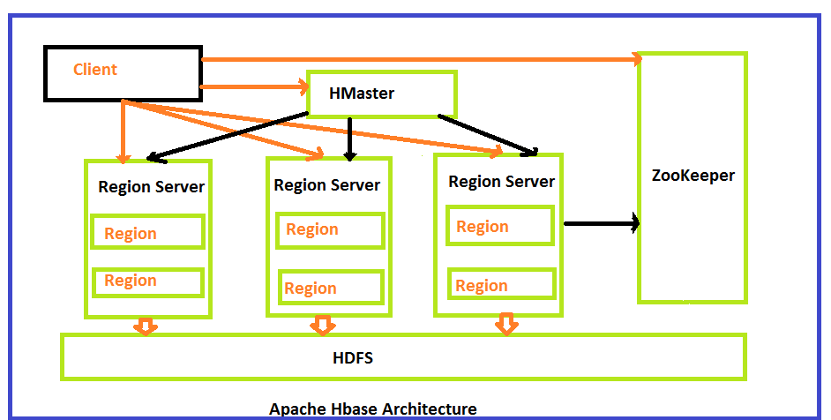
Hbase Architecture

Slide 124
Hbase
hadoop dfsadmin -safemode leave
hadoop fs -rmr /hbase
hadoop fs -mkdir -p /hbase/data
sudo service hbase-master restart
sudo service hbase-regionserver restart

Slide 125
Hbase Connectors
hbase-client-1.1.2.2.6.2.0-205.jar
hbase-common-1.1.2.2.6.2.0-205.jar
shc-core-1.1.1-2.1-s_2.11.jar
hbase-protocol-1.1.2.2.6.2.0-205.jar
hbase-server-1.1.2.2.6.2.0-205.jar

Slide 126
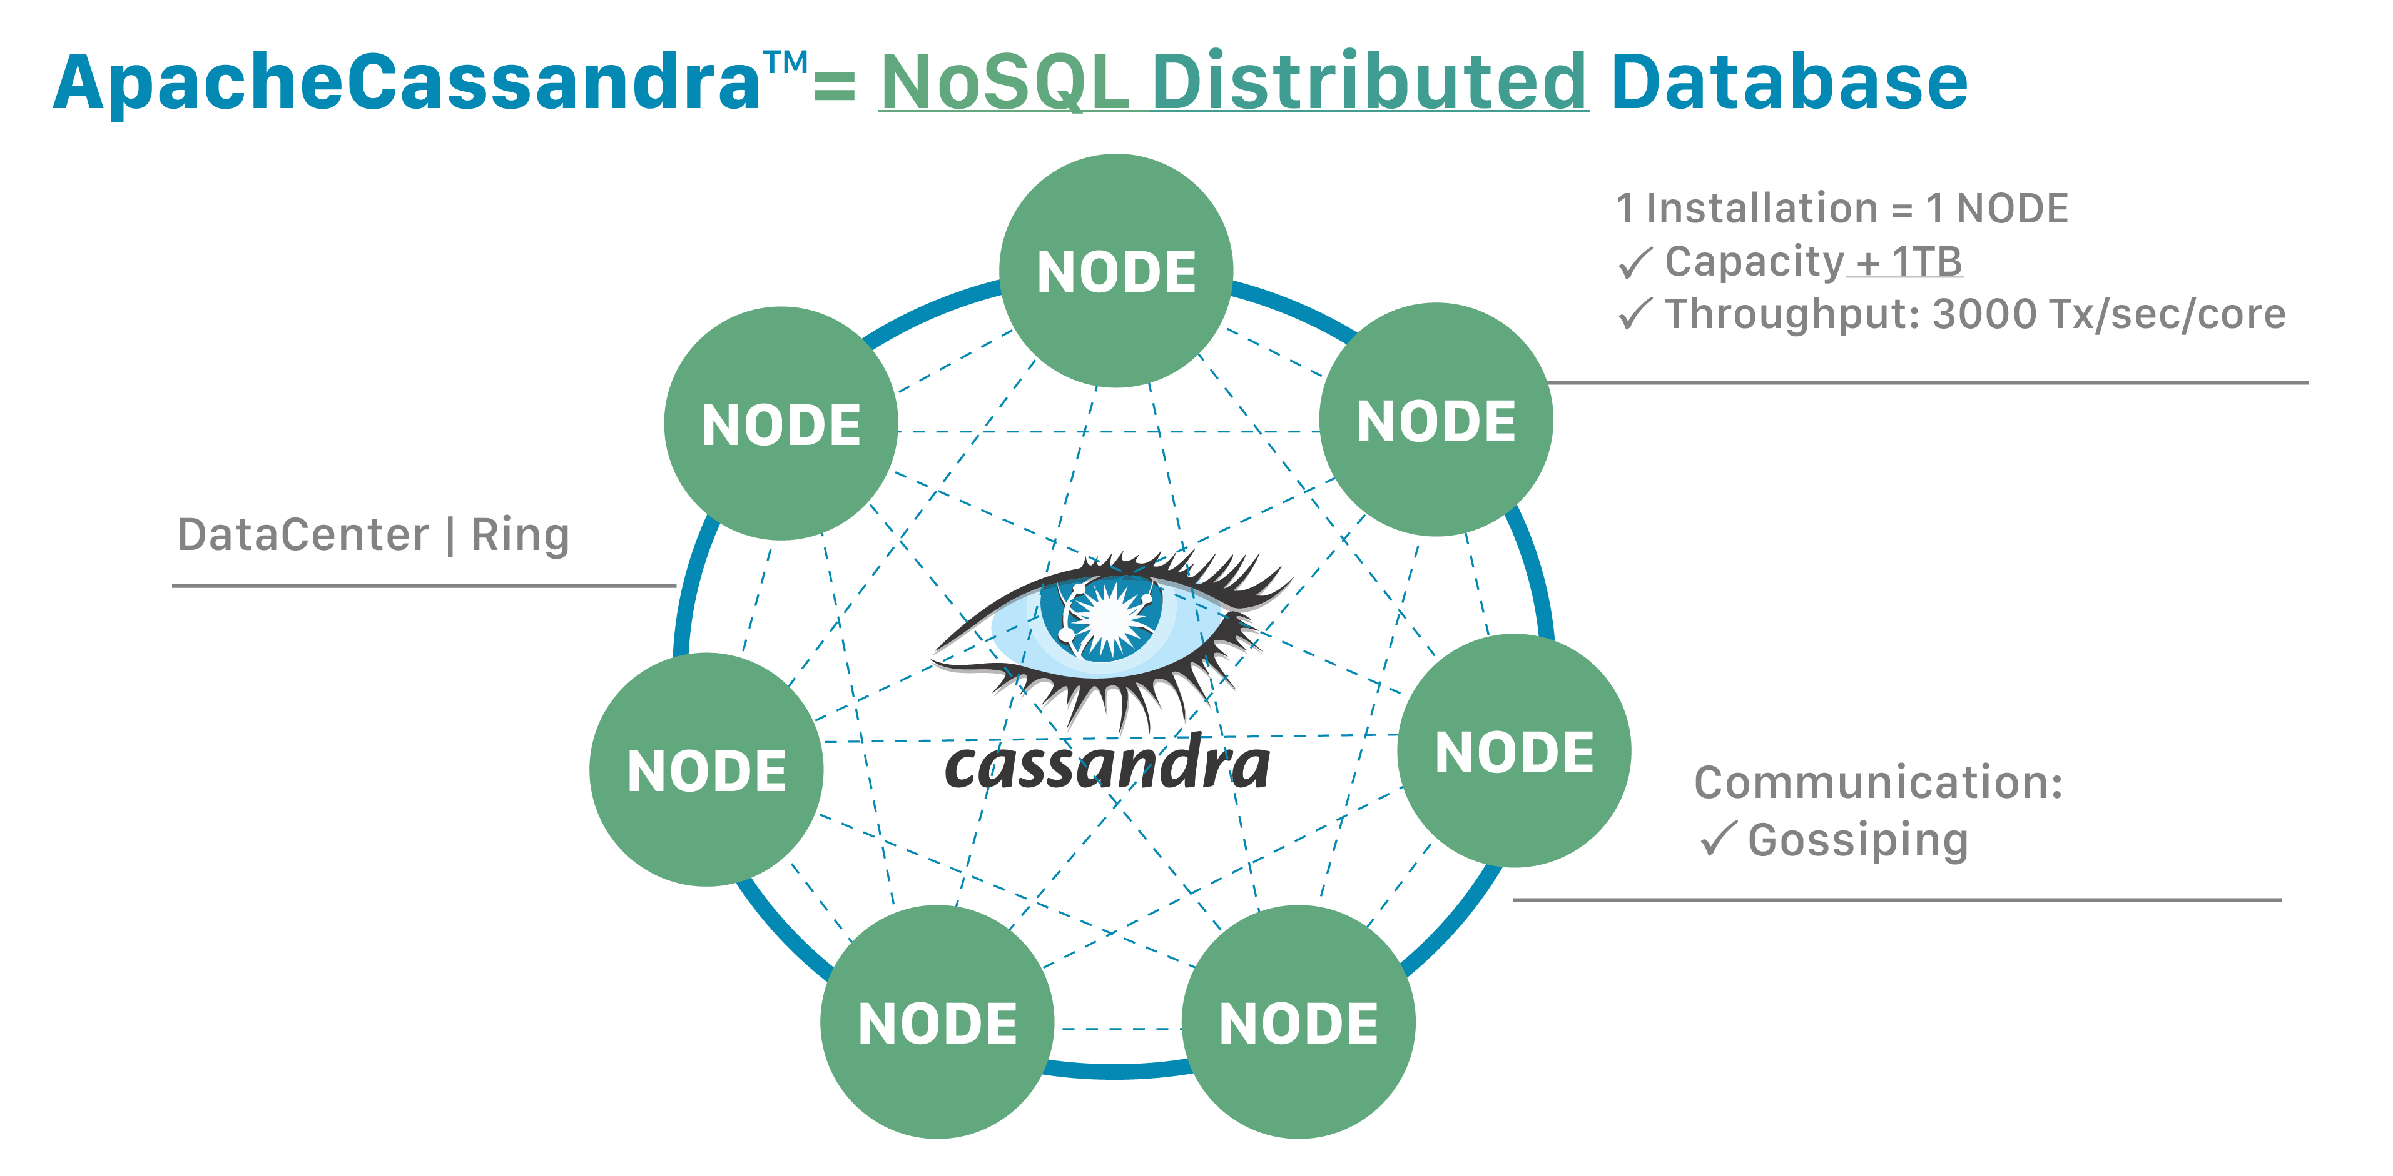
Cassandra

Slide 127
C
K
Tables

Slide 128
Cassandra Placement Strategy
Simple Strategy
Network Strategy

Slide 129
Simple Strategy

Slide 130
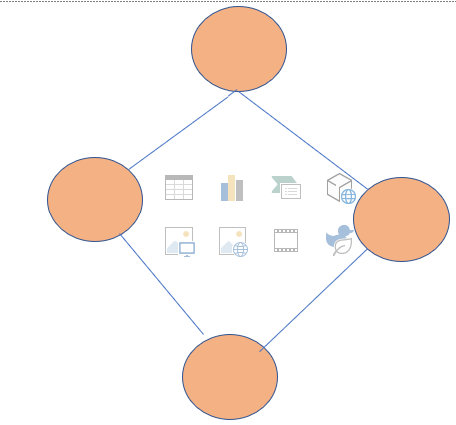
Network Topology

Slide 131
Cassandra Query Limitations
CQL does not support aggregation queries like max, min, avg
CQL does not support group by, having queries.
CQL does not support joins.
CQL does not support OR queries.
CQL does not support wildcard queries.
CQL does not support Union, Intersection queries.
Table columns cannot be filtered without creating the index.
Greater than (>) and less than (<) query is only supported on clustering column.
Cassandra query language is not suitable for analytics purposes because it has so many limitations.

Slide 132
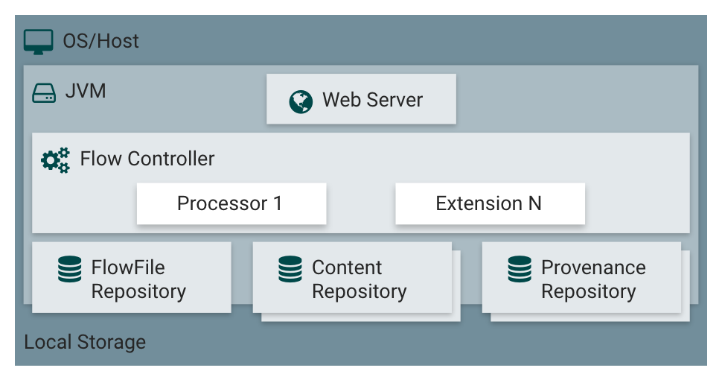
Apache NIFI

Slide 133
Apache NIFI
Processor : This is a component that does a specific task
Processor Group : Group many processors
Controlled Service
Flow File : How the data propagates in the processor

Slide 134
What is Streaming
Streaming is experiencing the data in real time.
Eg : YouTube, Netflix, Amazon Prime, Whatsapp stream the data in real time to the user

Slide 135
Kafka
PRODUCER
TOPICS Topic1,Topic2
CONSUMER
Group-ID

Slide 136
Consumption Model
Earliest
Latest
val kparams = Map[String, Object]("bootstrap.servers" -> "localhost:9092",
"key.deserializer" -> classOf[StringDeserializer],
"value.deserializer" -> classOf[StringDeserializer],
"group.id" -> “consumer_1_demo_topic",
"auto.offset.reset" -> "latest",
"enable.auto.commit" -> (false: java.lang.Boolean))

Slide 137
Kafka Delivery Guarantee
Fire and Forget
Async
Sync

Slide 138
Spark Structured Streaming
File Streaming : It will continuously read the files from a directory
Socket Streaming : Keep listening to a port and read the data
Kafka : Read and write into Kafka
Kinesis : Integrates with AWS Kinesis

Slide 139
Structured Streaming with Kafka
Input Table
Kafka Streaming
Key | Value | Topic | Partition | Offset | timestamp

Slide 140
Spark Performance Tuning Tips
Improve the performance at Code Level
Use the Right File Format
Have the optimized configurations
Spark Optimizations

