Slide 1
Y(1S) R_{AA} in HIN-10-006
Vineet Kumar
Nuclear Physics Division
BARC Mumbai

Slide 2
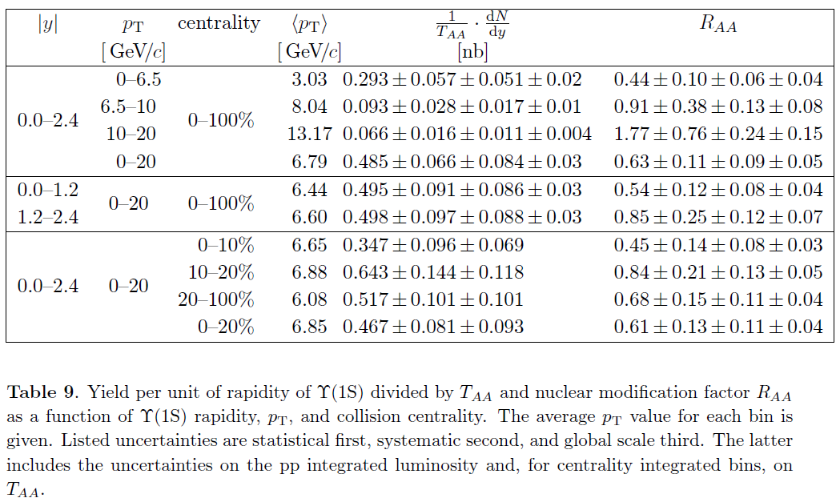

Slide 3
