Slide 1
Feasibility of J/psi polarization studies
Evgeny Kryshen (PNPI)
Outline
Definitions
Theoretical overview
Experimental overview
Polarized meson generator
Reconstructed distributions
Acceptance corrected distributions
Conclusions

Slide 2

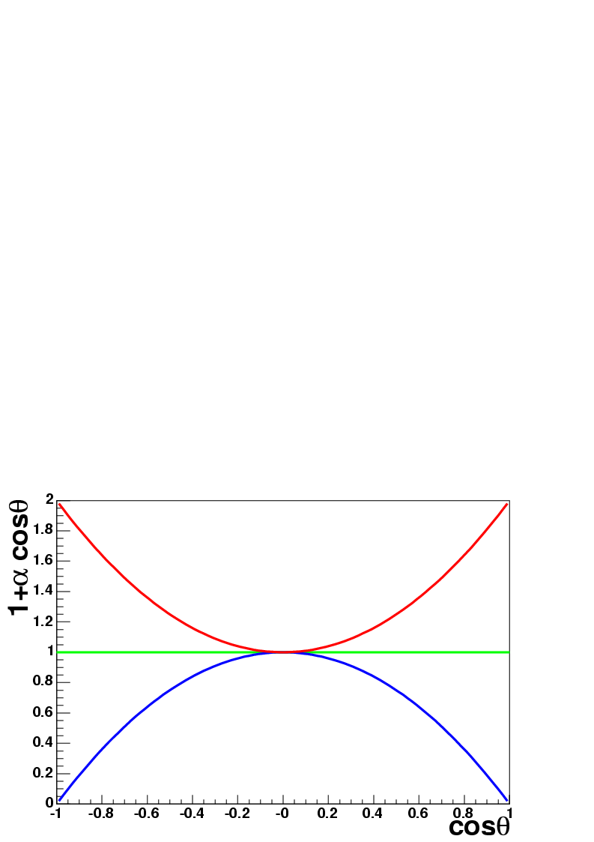

Definitions
The decay angular distribution of the vector particle in general case:
where θ and φ – the angles of the positive lepton in the rest frame of the decaying particle
parameters α, β, γ
are related to the density matrix elements
depend on kinematical variables
depend on the definition of coordinate system
In most experiments flat distribution in φ angle is assumed, and integrated cross-section is measured as a function of cos θ:
α = 0 – No polarization
α > 0 – Transverse polarization
α < 0 – Longitudinal polarization
2
α = 1
α = 0
α = -1

Slide 3
Reference systems
Decay angular distribution depends on the choice of the polarization axis (z). Various possibilities exist:
Collins-Soper – usually used in fixed target experiments
Helicity frame – usually used in collider experiments (CDF, BaBar etc)
Collins-Soper:
Z axis is parallel to the bisector of the angle between beam and target directions in the quarkonium rest frame
Helicity (recoil) reference frame:
Z axis coincides with the J/ψ direction in the target-projectile center of mass frame
y
z
⁺
θ_{H}
p_{µ+}
x
x
ϑ_{CS}
J/ψ
z axis
p_{projectile}
p_{target}
y
projectile
target
Viewed from J/ rest frame
All reference systems are equivalent for J/ψ having p_{t} = 0
One must be careful when comparing experimental results with theoretical predictions

Slide 4
Theoretical overview
Polarization in pp collisions - test of quarkonium production mechanisms:
CSM – Color Singlet Model:
Perturbative QCD, underestimates quarkonium production cross-sections
Transverse polarization
CEM - Color Evaporation Model:
Soft gluon emission from the cc-pair during hadronization randomizes spin and color
No polarization
NrQCD – Non-relativistic Quantum Chromodynamics:
Takes into account non-perturbative effects in quarkonium production
Dominance of the gluon fragmentation mechanism for p_{t} >> M, the fragmenting gluon is almost on-mass shell, and is therefore transversely polarized.
The produced quarkonium inherits transverse polarization at high p_{t}
Khoze, Martin, Ryskin, Stirling, Eur. Phys. J., C39, 163 (2005):
Perturbative calculations only. The basic subprocess: g(gg)_{8s} → J/ψ
Cross sections are in agreement with CDF and RHIC experiments
Transverse polarization at small p_{t}, longitudinal polarization at high p_{t} >> M.
Polarization in AA collisions: test for HIC dynamics and QGP formation
B.L. Ioffe and D.E. Kharzeev: Phys. Rev. C68 061902 (2003):
“Quarkonium Polarization in HIC as a possible signature of the QGP”
Formation of quarkonia takes place in the plasma; changes in ratio of feed-down and direct production; non-perturbative effects are screened away
Transverse polarization ~ 0.35 - 0.4 in the case of QGP formation

Slide 5
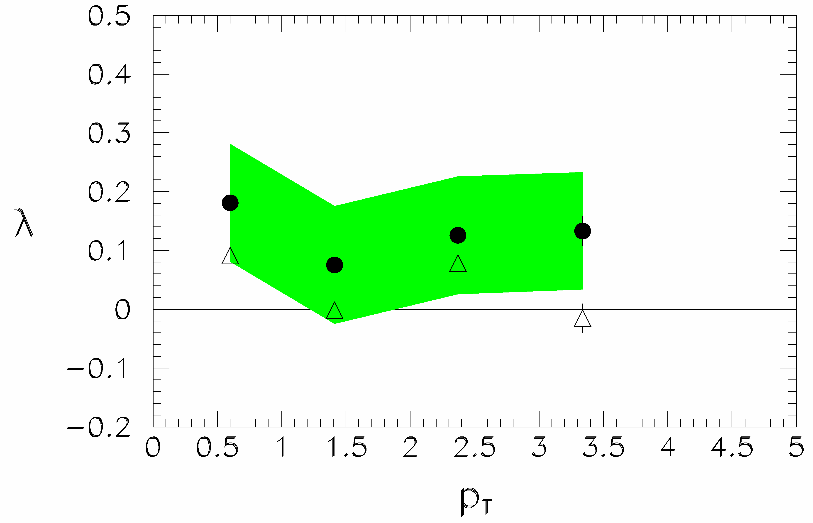
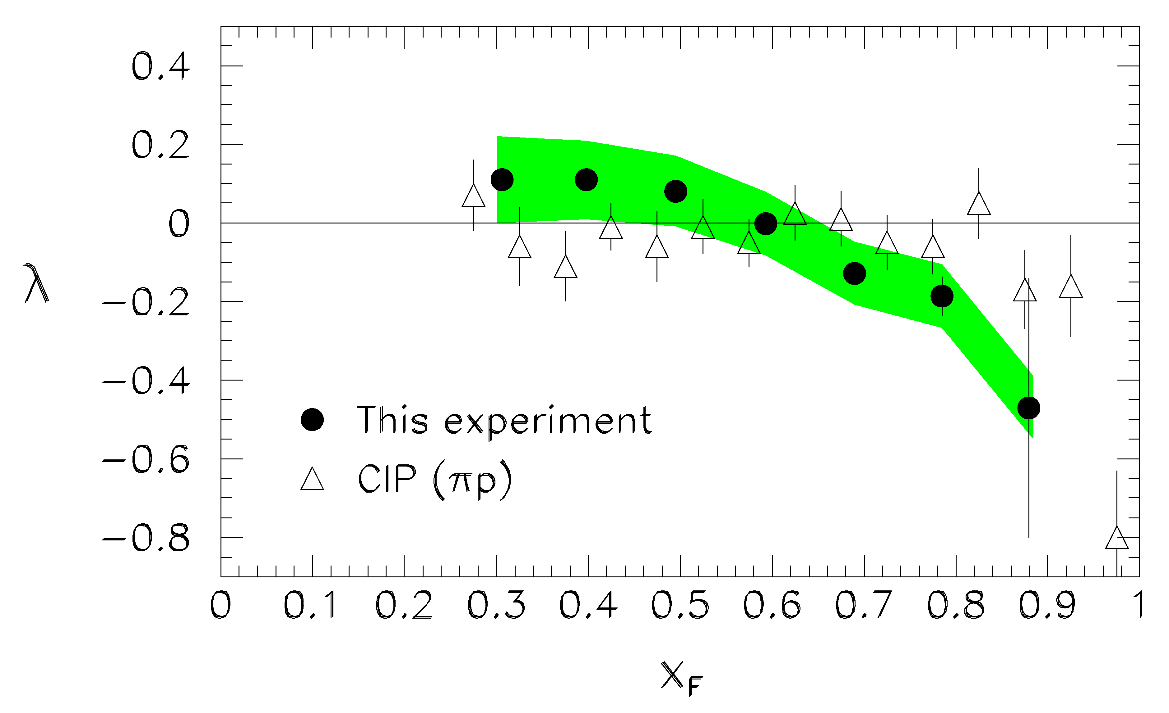
J/ψ polarization in E866 experiment
9 million J/ψs in p-Cu collisions @ 800 GeV
Study vs x_{F}, p_{T}
Integrating over x_{F} and p_{T} → λ = 0.069 ± 0.004 ± 0.08
NrQCD predicts 0.31 < λ < 0.63
Feed-down from χ_{c1} (longitudinal) and χ_{c2} (transverse) complicates the issue
Nuclear effects can also play a role
Phys.Rev.Lett.,91,211801 (2003)
Notes:
lambda = 0.069 pm 0.004 pm 0.08 in agreement with earlier measurements which were not able to study differential dependence
The results are not in agreement with published predictions for $ J/\psi $polarization based on NRQCD, which are in the range$ 0.31<\lambda <0.63 $~\cite{Beneke:1996tk}, or with similar predictions~\cite{Vanttinen:1995sd} based on an early modelthat considers only color-singlet intermediate states.
almost half ofthe produced $ J/\psi $'s are the decay products of higher-masscharmonium resonances, mainly the $ ^{3}P_{J} $ states $ \chi _{cJ} $.Feed-down from $ \chi _{c2} $, produced exclusively in the $ J_{z}=2 $state from gluon-gluon fusion, results in 100\% transverse $ J/\psi $'s,increasing the observed values of $ \lambda $. The turn-over athigh $ x_{F} $ may reflect the transition, at $ x_{F} \simeq 0.6 $,to the quark-annihilation graph~\cite{Kowitt:1994ns},which produces a mix of $ \chi _{c2} $ spin states.As for the overall level, it cannot be explained without a substantial contributionfrom $ \chi _{c1} $, which in general produces longitudinal $ J/\psi $'s.Beneke and Rothstein~\cite{Beneke:1996tk} originally estimated the$ \chi _{c1} $ contribution to be about 10 times smaller than that from$ \chi _{c2} $, but it was later found experimentally~\cite{Alexopoulos:1999wp}to be of comparable size. NRQCD calculationswhich retain higher orders in $ v $ can alsoaccommodate substantial $ \chi _{c1} $ contributions~\cite{Beneke:1997jh}.It wouldprobably require a contribution near the experimental and theoreticalupper limits in order to obtain $ \lambda $ values as small asexperimentally measured, within the context of NRQCD.In addition, it must be noted that no existing calculation takes intoaccount nuclear effects, which strongly affect the production crosssection~\cite{Leitch:2000bz}. The formation length of the $ J/\psi $at these energies is generally longer than the nuclear size \cite{Farrar:1990ei}and it is conceivable that color-singlet and -octet components of the wave function are absorbed differently while propagating through the nuclear medium, resulting in a different mix of Fock states compared to the free-nucleon production, thus altering the polarization. Furthermore, the polarization of the $ \chi_c $ states themselves is predicted to have a nuclear dependence~\cite{Gerland:1998bz} which would feed down to the $ J/\psi $ polarization. Finally, at the highest values of $ x_{F} $, higher-twist effects may becomeimportant~\cite{Vanttinen:1995sd}.

Slide 6
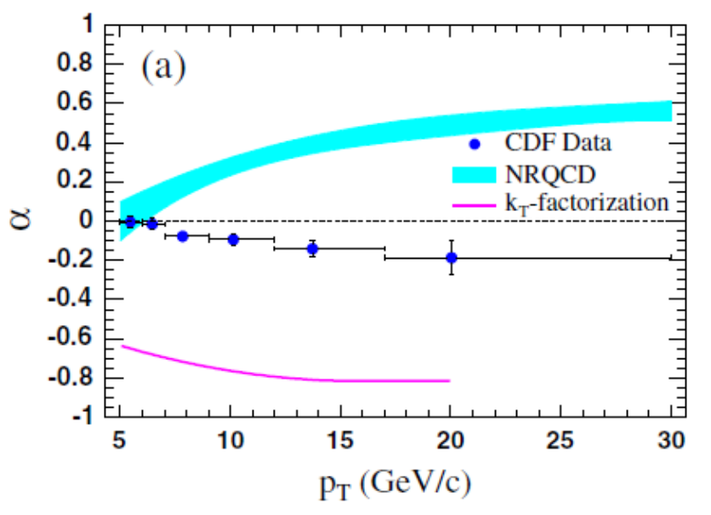
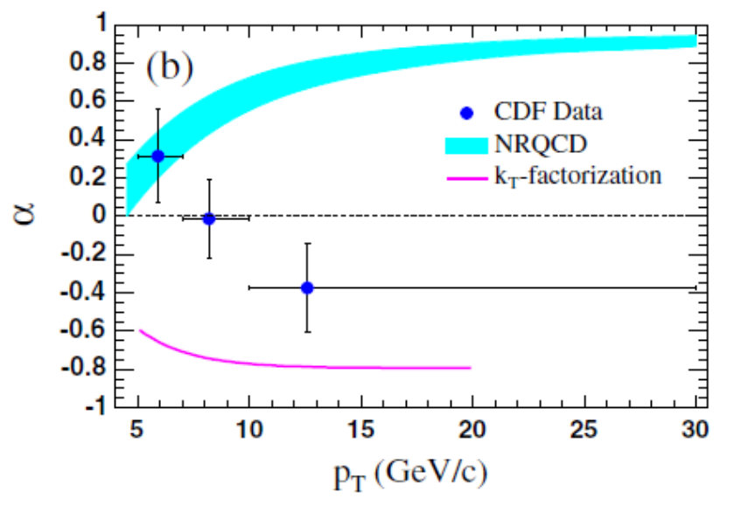
J/ψ polarization in CDF
p – p @ √s = 1.8 TeV
Disagreement at high pt with NrQCD predictions. But in agreement with approach of Khoze et al.
Ψ’
J/ψ prompt
Phys.Rev.Lett. 99,132001 (2007)
Notes:
Braaten et al. Polarization of prompt Jpsi at Tevatron. hep-ph/9911436 - NrQCD
Beneke et al. Inelastic photoproduction of polarized J/Phys. Rev. D 57, 4258–4274 (1998) – NrQCD – calculation made in 4 different frames
kT-factorization model [9], that accomodate vector-meson cross sections at both HERA and the Tevatron and predict the vector-meson polarizations as functions of pT.

Slide 7
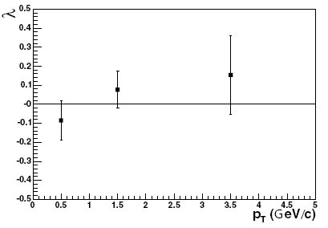
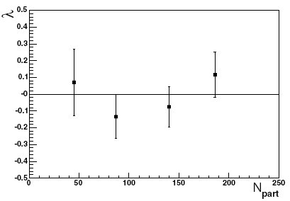
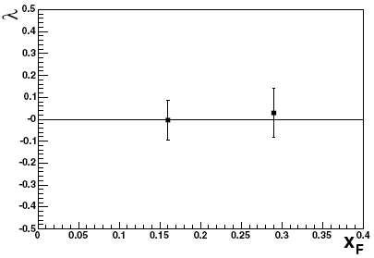
J/ψ polarization in NA60
In-In @ 158 AGeV
Statistics: 30K J/ψ
Negligible background at J/ψ mass (~2-3%)
λ vs N_{part}, p_{t}, x_{F} measured
Result: λ close to 0
In the case of QGP formation λ ~ 0.3-0.4 is predicted by Ioffe and Kharzeev
R. Arnaldi et al. (NA60 Coll.), Eur. Phys. J. C43, 167 (2005 )

Slide 8
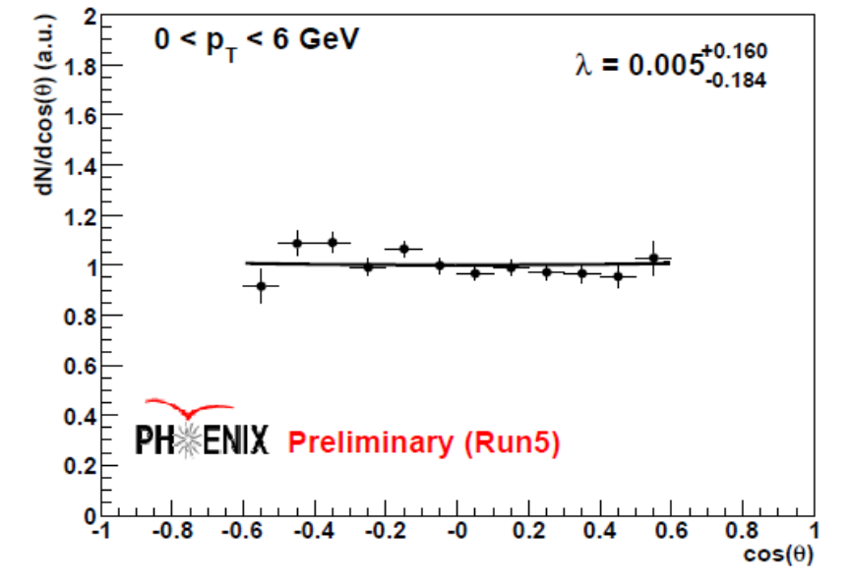

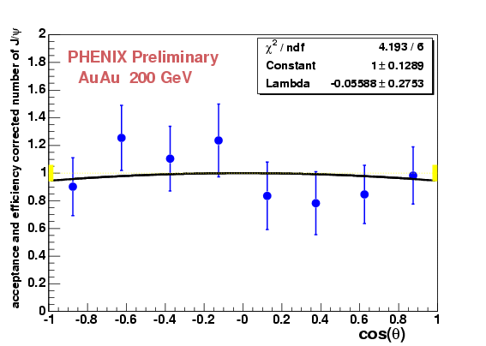
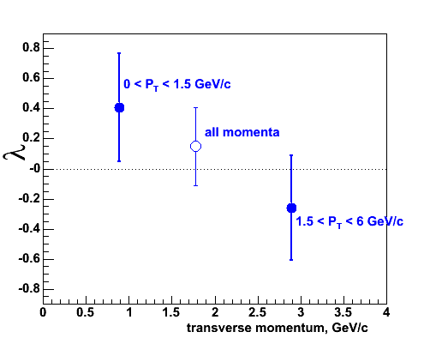
J/ψ polarization in PHENIX
AuAu @ 200 AGeV,
dAu @200 AGeV,
pp @200 AGeV,
J/ψ →e⁺ e⁻ , J/ψ →μ⁺ μ⁻
Central arm: |η|<0.35, p > 0.2 GeV
Low statistics
polarization is consistent with zero
Larger statistics is expected
μ+μ- in p-p @200 GeV
λ = 0.15 ± 0.26(stat) ± 0.04(syst)
Au-Au
dAu @200 GeV
λ = 0.06 ± 0.28(stat) ± 0.05(syst)
d-Au: λ vs p_{t}

Slide 9
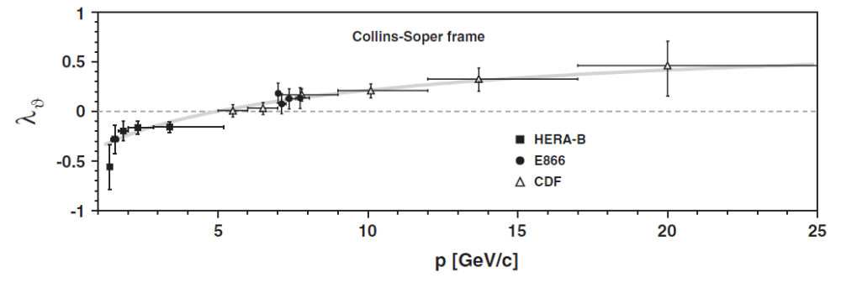

Other experiments
Fixed target experiments E537, E672, E771, CIP showed unpolarized results.
BaBar (e⁺e⁻ annihilation) –J/ψ are produced mostly longitudinally polarized:
p*<3.5 GeV/c: α = -0.46 +- 0.21
p*>3.5 GeV/c: α = -0.80 +- 0.09
PRL 102, 151802 (2009)
Most experimental results are in contradiction with theoretical predictions – polarization measurements @ CBM should help to clarify this puzzle

Slide 10
Simulation framework
The main goal: take expected J/psi yield from the Physics book and try to estimate feasibility of J/psi polarization reconstruction with this statistics:
Particle | Multiplicity in Min. Bias | BR | Efficiency | Yield / 10 weeks
J/ψ | 3.8 · 10⁻⁶ | 0.06 | 14% | 2.2 · 10⁶
Ψ’ | 5.1 · 10⁻⁸ | 7.3 · 10⁻³ | 16% | 4.3 · 10³
Trunk version of cbmroot
No background, pure vector meson decays (~2·10⁶)
Try to reconstruct polarization in several pt bins
Generator of polarized vector meson decays:
trunk/analysis/much/CbmPolarizedGenerator.cxx
Helicity reference frame
Transverse polarization as an input
z
⁺
θ_{H}
x
J/ψ
projectile
y
target

Slide 11
Polarized meson generator
Generates polarized vector mesons assuming Gaussian rapidity shape and termal pt distribution. Both dielectron and dilepton channels are available. Helicity and Collins-Soper reference frames for polarization. Possibility to use box distribution in rapidity and pt.
Available methods:
SetPDGType (Int_t pdg)
SetMultiplicity (Int_t mult)
SetDistributionPt (Double_t T=0.176)
SetDistributionY (Double_t y0=1.987, Double_t sigma=0.228)
SetRangePt (Double_t ptMin=0, Double_t ptMax=3)
SetRangeY (Double_t yMin=0, Double_t yMax=4)
SetAlpha (Double_t alpha=0)
SetRefFrame (Frame_t frame=kColSop)
SetDecayMode (DecayMode_t decayMode=kDiMuon)
SetBox (Bool_t box)
This generator can be used instead of Pluto input file.

Slide 12
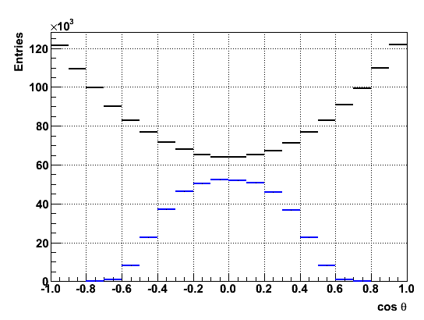
Reconstructed angle distribution
Generated
Reconstructed
Statistics:
  Generated: 1.70 · 10⁶
  Reconstructed: 0.43 · 10⁶
  This statistics can be collected in 2 weeks (according to Physics book).
Acceptance strongly depends on cos θ

Slide 13
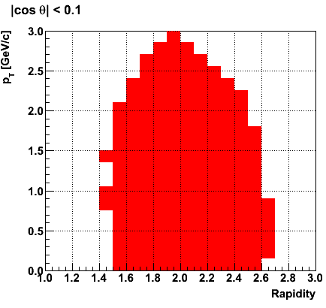
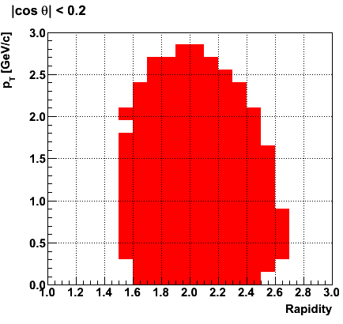
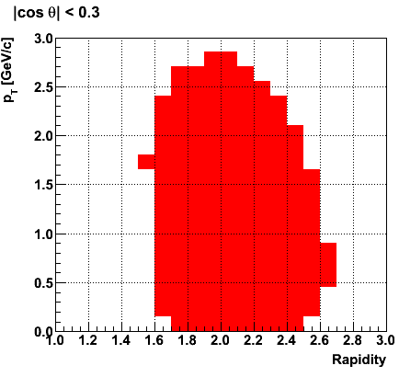
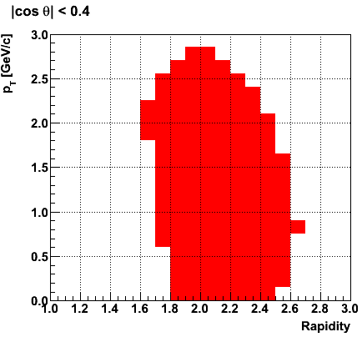
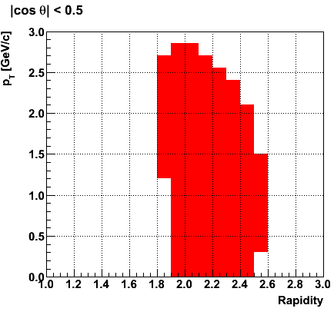
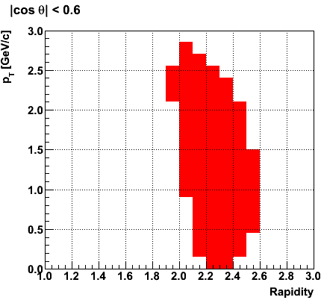
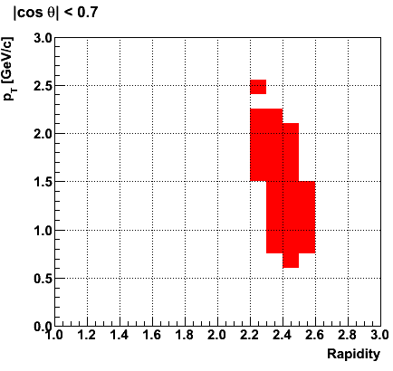
Fiducial regions
Polarization analysis should be restricted to a certain region in cos θ, since accessible phase space strongly depends on the selected window.
|cos θ| window should be as large as possible in order to fit cos θ distribution better.
On the other hand, we should try to get as much statistics as possible.
The window |cos θ|<0.6 has been selected
Polarization analysis is performed in 3 pt bins

Slide 14
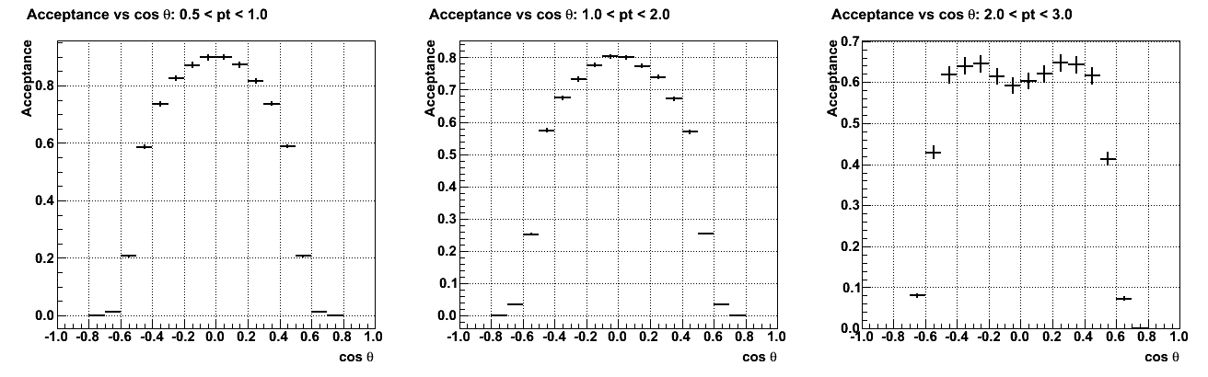
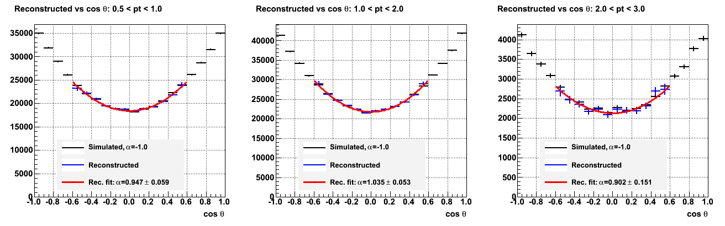
Acceptance corrected distributions

Slide 15
Conclusions and future steps
Conclusions:
Quarkonium polarization measurement is an important test for our understanding of quarkonium production mechanisms and HIC dynamics
J/ψ polarization measurement with MuCh is feasible
The technique for polarization measurement is well established, acceptance properties understood.
To do:
Realistic background simulation
Optimization of fiducial regions and acceptance cut
Optimization of p_{t} and cos θ binning
Estimation of systematic errors, check the consequences of unknown kinematical distributions, check the convergence of the method

Slide 16
Methods for polarization measurements
3D-acceptance correction method (used in E866, NA60)
Invariant mass distributions are plotted in bins of p_{t}, x_{F} and cos θ and fitted to a Gaussian peak + background.
The number of events under the peak give the triple-differential yield
Uncorrected cos θ distributions are plotted in each (p_{t}, x_{F}) bin
3D acceptance plot is calculated with predicted distribution in p_{t}, x_{F} and cos θ.
Acceptance-corrected cos θ distributions are obtained for each (p_{t}, x_{F}) bin
cos θ distributions are fitted with the function: f(cos θ) = N(1 +α cos² θ)
Advantage: exact knowledge of the differential cross-section is not crucial
Requirement: significant statistics in each (p_{t}, x_{F} and cos θ) bin or negligible background
Inclusive acceptance correction (used in Phenix)
In the case of low statistics polarization is measured inclusively in a wide kinematical range, where quarkonium cross-section changes significantly.
Inclusive acceptance is calculated in this kinematical range with realistic kinematical distributions as an input.
Acceptance-corrected cos θ distributions are fitted with the function:
f(cos θ) = N(1 +α cos² θ)
Disadvantage: is sensitive to J/ψ kinematics. Non-negligible systematic error

