Slide 1



<number>
New probes for QGP: quarkonium polarisation at LHC and AFTER
A long standing puzzle
General remarks on the measurement method
A rotation-invariant formalism to measure vector polarizations and parity asymmetries
Quarkonium polarization
Heavy Ion applications
João Seixas – CERN
(also @LIP & Physics Dep. IST Lisbon) in collaboration with Pietro Faccioli, Carlos Lourenço, Hermine Wöhri
Workshop AFTER@ECT , Trento, 4-13 February 2013
Notes:
<number>

Slide 2
<number>
A varied menu for the LHC (and AFTER)
Measure polarization = determine average angular momentum composition of the particle, through its decay angular distribution
It offers a much closer insight into the quality/topology of the contributing production processes wrt to decay-averaged production cross sections
Polarization analyses are particularly important to (for example):
understand still unexplained production mechanisms [J/ψ, χ_{c} , ψ’, ϒ, χ_{b}]
characterize the spin of newly (eventually) discovered resonances [X(3872), Higgs, Z’, graviton, ...]
Understand the properties of dense and hot matter
Notes:
<number>

Slide 3
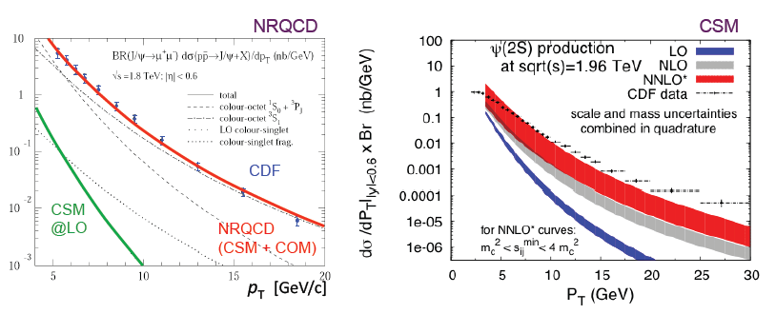
<number>
Task list
One assumes that the production of quark-antiquark states can be described using perturbative QCD, as long as we “factor out” long-distance bound-state effects
An inescapable prediction of the semi-perturbative approach (NRQCD) is that
“high” p_{T} quarkonia come from fragmenting gluons and are fully tranversely polarized
Despite good success in describing cross sections...
Notes:
<number>

Slide 4
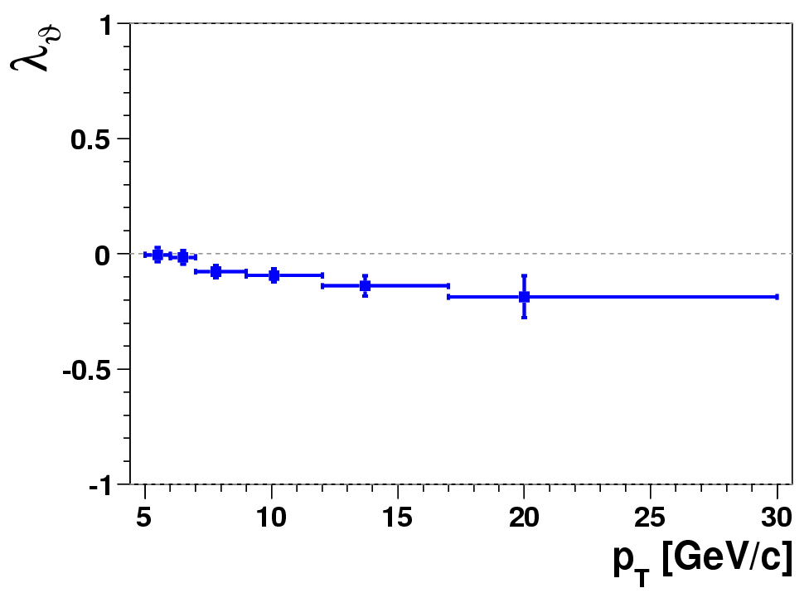
<number>
Task list
One assumes that the production of quark-antiquark states can be described using perturbative QCD, as long as we “factor out” long-distance bound-state effects
An inescapable prediction of the semi-perturbative approach (NRQCD) is that
“high” p_{T} quarkonia come from fragmenting gluons and are fully tranversely polarized
The first comparisons with data were not promising…
J/ψ @1.96 TeV
NRQCD factorization Braaten, Kniehl & Lee, PRD62, 094005 (2000)
CDF Run II
CDF Coll., PRL 99, 132001 (2007)
HX frame
But:
the current experimental situation is contradictory and incomplete, as it was emphasized in Eur. Phys. J. C69, 657 (2010) → improve drastically the quality of the experimental information
maybe the theory is only valid at asymptotically high p_{T} → extend measurements to p_{T} >> M
contributions of intermediate P-wave states have not been fully calculated yet and are still unknown experimentally → measure polarizations of directly produced states, ψ’ and ϒ(3S) → measure polarizations of P-wave states, χ_{c} and χ_{b}, and their feeddown to S states
Notes:
<number>

Slide 5
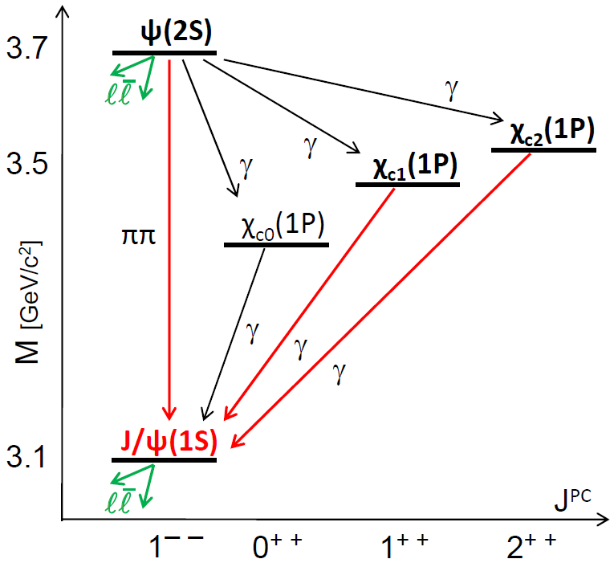
<number>
Strongly interrelated measurements
cc family
Measuring the properties of all family members is essential to fully understand quarkonium production
For example, the observed prompt J/ψ embodies production properties of all charmonium states in a global “average”:
directly produced
J/ψ in
CDF data
from
ψ(2S)
from χ_{c2}
non-prompt
(b-hadrons)
from χ_{c1}

Slide 6
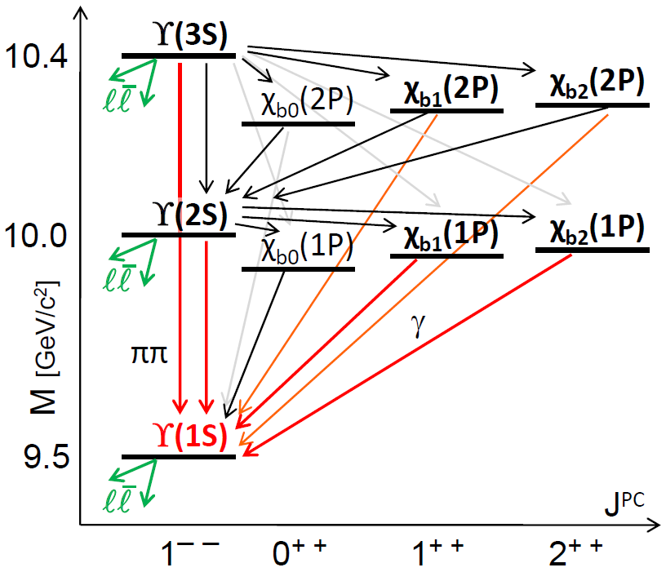
<number>
Strongly interrelated measurements
bb family
Composition of the observed ϒ(1S):
directly produced
ϒ(1S) in
CDF data
from ϒ(2S)
+ϒ(3S)
from χ_{b1}(2P)
+ χ_{b2}(2P)
from
χ_{b1}(1P)+ χ_{b2}(1P)

Slide 7
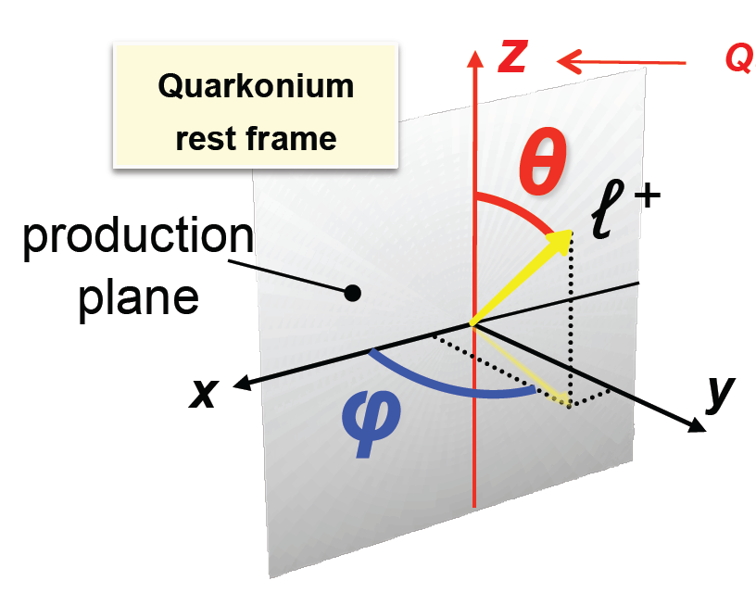

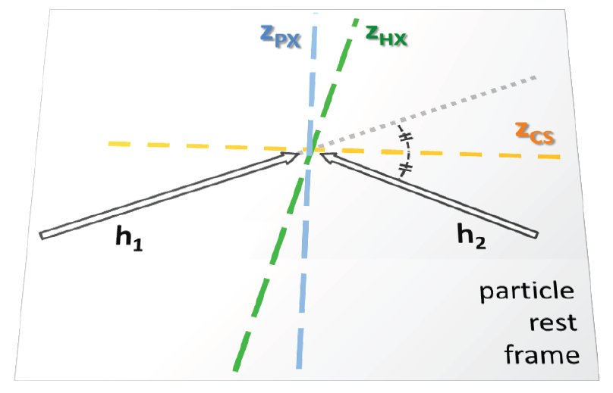
<number>
Definition of observables
In Quantum Mechanics the study of angular momentum requires a quantization axis (aka “z-axis”)
Many possible (known) choices:
Gottfried-Jackson (GJ)
Collins-Soper (CS)
Helicity (HX)
Perpendicular Helicity (PX)
Notes:
<number>

Slide 8

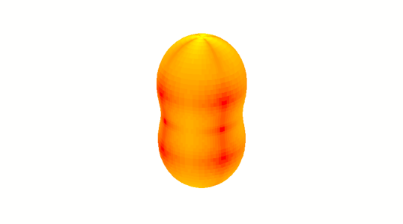
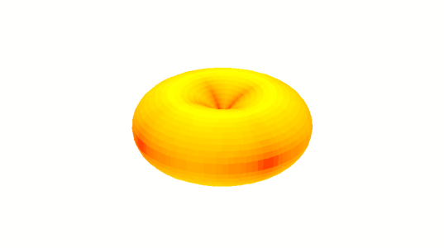
Frames and parameters
<number>
z
Collins-Soper axis (CS): ≈ dir. of colliding partons
Helicity axis (HX): dir. of quarkonium momentum
quarkonium rest frame
θ
ℓ ⁺
production plane
x
φ
y
λ_{θ} = +1
λ_{φ} = λ_{θφ} = 0
J_{z} = ± 1
λ_{θ} = +1 : “transverse” (= photon-like) pol.
λ_{θ} = –1
λ_{φ} = λ_{θφ} = 0
J_{z} = 0
λ_{θ} = −1 : “longitudinal” pol.
z
z′
CS
CS ⊥ HX for mid rap. / high p_{T}
HX
90º
x
y
x′
y′
Notes:
In general 8 parameters, for parity conserving and symmetric detectors, 3
<number>

Slide 9
Frames and parameters
<number>
z
Collins-Soper axis (CS): ≈ dir. of colliding partons
Helicity axis (HX): dir. of quarkonium momentum
quarkonium rest frame
θ
ℓ ⁺
production plane
x
φ
y
λ_{θ} = +1
λ_{φ} = λ_{θφ} = 0
J_{z} = ± 1
λ_{θ} = +1 : “transverse” (= photon-like) pol.
λ_{θ} = –1
λ_{φ} = λ_{θφ} = 0
J_{z} = 0
λ_{θ} = −1 : “longitudinal” pol.
z
z′
CS
CS ⊥ HX for mid rap. / high p_{T}
HX
90º
x
y
x′
y′
Notes:
<number>

Slide 10
<number>
The azimuthal anisotropy is not a detail
Case 1: natural transverse polarization
Case 2: natural longitudinal polarization, observation frame ⊥ to the natural one
z
z
J_{x} = 0
x
J_{z} = ± 1
λ_{θ} = +1
λ_{φ} = 0
x
λ_{θ} = +1
λ_{φ} = − 1
y
y
Two very different physical cases
Indistinguishable if λ_{φ} is not measured (integration over φ)
Notes:
<number>

Slide 11
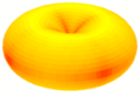

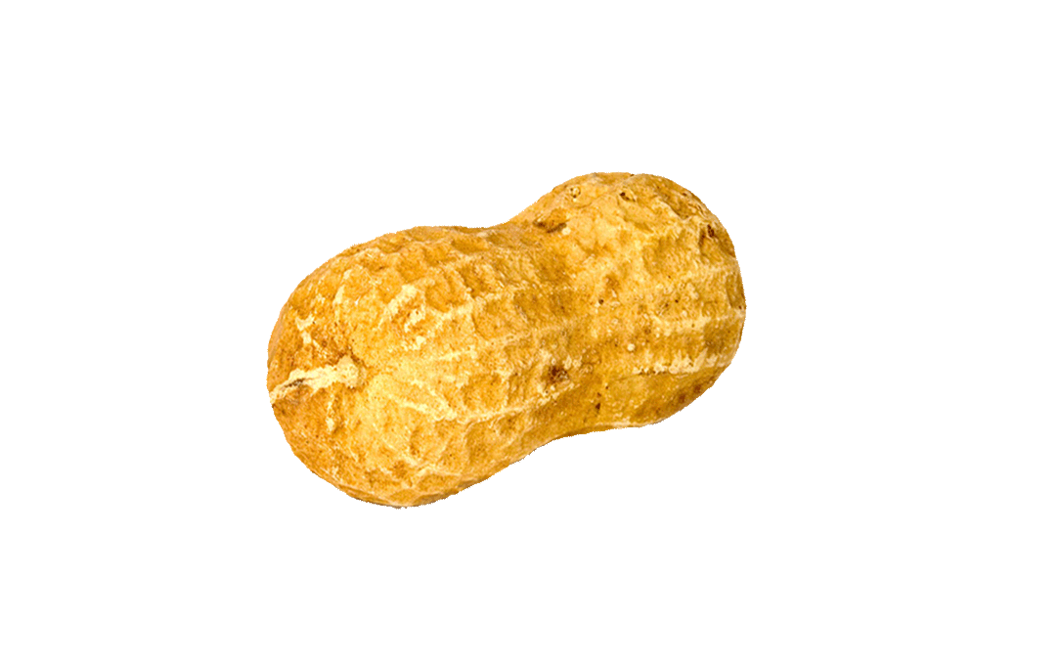

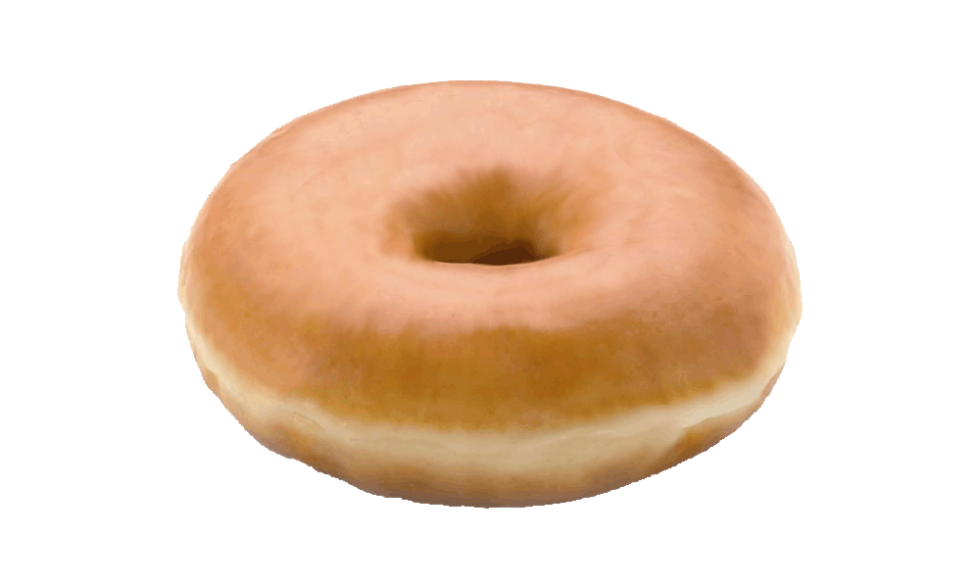
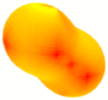
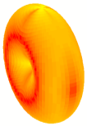
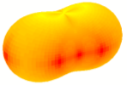
Frame-independent polarization
<number>
The shape of the distribution is obviously frame-invariant.
→ it can be characterized by a frame-independent parameter, e.g.
z
λ_{θ} = –1
λ_{φ} = 0
λ_{θ} = +1
λ_{φ} = 0
λ_{θ} = –1/3
λ_{φ} = –1/3
λ_{θ} = +1/5
λ_{φ} = +1/5
λ_{θ} = +1
λ_{φ} = –1
λ_{θ} = –1/3
λ_{φ} = +1/3
FLSW, PRL 105, 061601; PRD 82, 096002; PRD 83, 056008
Notes:
<number>

Slide 12

<number>
J=1 states are intrinsically polarized
Single elementary subprocess:
There is no combination of a₀, a₊₁ and a₋₁ such that λ_{θ} = λ_{φ} = λ_{θφ} = 0
The angular distribution is never intrinsically isotropic
Only a “fortunate” mixture of subprocesses
(or randomization effects)
can lead to a cancellation of all three observed anisotropy parameters
To measure zero polarization would be (in fact, is) an exceptionally interesting result...
Notes:
<number>

Slide 13
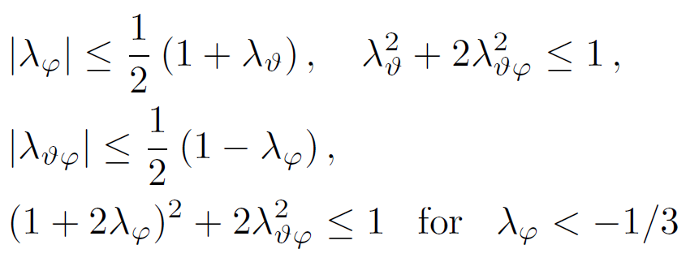
<number>
Positivity constraints for dilepton distributions
P. F., C.L., J.S., Phys. Rev. D 83, 056008 (2011)
General and frame-independent constraints on the anisotropy parameters of vector particle decays
λ_{φ}
J_{y} |V⟩ = 0
J_{x} |V⟩ = ±|V⟩
~
λ = +1
J_{z} |V⟩ = 0
J_{z} |V⟩ = ±|V⟩
~
J_{y} |V⟩ = ±|V⟩
λ = –1
J_{x} |V⟩ = 0
λ_{θ}
λ_{θφ}
λ_{θφ}
physical
domain
λ_{θ}
λ_{φ}

Slide 14
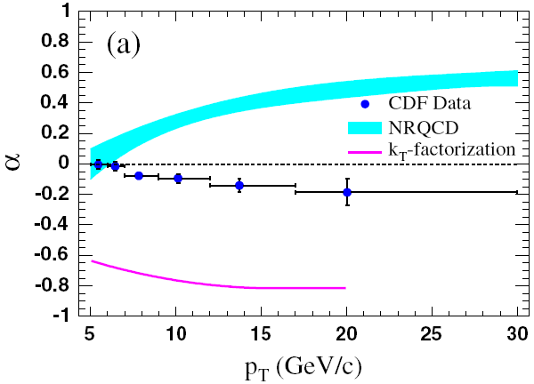
What polarization axis?
<number>
1)
helicity conservation (at the production vertex)
→ J =1 states produced in fermion-antifermion annihilations (q-q or e⁺e–) at Born level have transverse polarization along the
relative direction of the colliding fermions (Collins-Soper axis)
1
.
5
Drell-Yan is a paradigmatic case
but not the only one
Drell-Yan
1
.
0
ϒ(2S+3S)
λ_{θ}
0
.
5
z_{(HX)}
0
.
0
E866 (p-Cu)
Collins-Soper frame
high p_{T}
90°
-
0
.
5
z_{(CS)}
0
1
2
p_{T} [GeV/c]
c
2)
g
( )
NRQCD → at very large p_{T} , quarkonium produced from the fragmentation of an
on-shell gluon, inheriting
its natural spin alignment
g
c
J/ψ
NRQCD
g
g
λ_{θ}
CDF
→ large, transverse polarization
along the QQ (=gluon) momentum (helicity axis)
p_{T} [GeV/c]
Notes:
<number>

Slide 15
<number>
Example: Drell-Yan, Z and W polarization
always fully transverse polarization
but with respect to a subprocess-dependent quantization axis
V = γ*, Z, W
_
Due to helicity conservation at the q-q-V (q-q*-V) vertex,
J_{z} = ± 1 along the q-q (q-q*) scattering direction z
z
_
q
z = relative dir. of incoming q and qbar
(Collins-Soper)
V
_
~
q
λ = +1
q
V
q
V
z = dir. of one incoming quark
(Gottfried-Jackson)
~
q*
q*
λ = +1
_
~
q
g
λ = +1
QCD
corrections
q
V
z = dir. of outgoing q
(cms-helicity)
q*
g
q
~
λ = +1
Note:
the Lam-Tung relation simply derives from
rotational invariance + helicity conservation!
Notes:
<number>

Slide 16
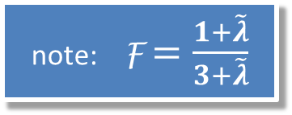
<number>
Basic meaning of the frame-invariant quantities
Let us suppose that, in the collected events, n different elementary subprocesses yield angular momentum states of the kind
(wrt a given quantization axis), each one with probability .
The rotational properties of J=1 angular momentum states
imply that
The quantity
is therefore frame-independent. It can be shown to be equal to
In other words, there always exists a calculable frame-invariant relation of the form
the combinations are independent of the choice of the quantization axis
Notes:
<number>

Slide 17
<number>
Simple derivation of the Lam-Tung relation
Another consequence of rotational properties of angular momentum eigenstates:
for each state
there exists a quantization axis wrt which
→ dileptons produced in each single elementary subprocess have a distribution of the type
wrt its specific “ ” axis.
DY:
q
q
γ*
q
γ*
γ*
γ*
q*
_
q*
q*
q
q
_
Due to helicity conservation at the q-q-γ* (q-q*-γ*) vertex,
along the q-q (q-q*) scattering direction
_
→ for each diagram
sum independent of
spin alignment directions!
→
Lam-Tung identity
Notes:
If all a’s are real then z* belongs to the xz plane
<number>

Slide 18
<number>
Essence of the LT relation
The existence (and frame-independence) of the LT relation is the kinematic consequence of the rotational properties of J = 1 angular momentum eigenstates
Its form derives from the dynamical input that all contributing processes produce a transversely polarized (J_{z} = ±1) state (wrt whatever axis)
More generally:
Corrections to the Lam-Tung relation (parton-k_{T}, higher-twist effects) should continue to yield invariant relations. In the literature, deviations are often searched in the form
But this is not a frame-independent relation. Rather, corrections should be searched in the invariant form
For any superposition of processes, concerning any J = 1 particle (even in parity-violating cases: W, Z ), we can always calculate a frame-invariant relation analogous to the LT relation.
Notes:
The Lam-Tung relation corresponds to the special case
when all processes produce transversely polarized dileptons
with respect to quantization axes belonging to the
production plane
<number>

Slide 19
<number>
Reference frames are not all equally good
Especially relevant when the production mechanisms and the resulting polarization
are a priori unknown (→quarkonium, but also newly discovered particles)
Gedankenscenario:
how would different experiments observe a Drell-Yan-like decay distribution
1 + cos²θ in the Collins-Soper frame
with an arbitrary choice of the reference frame?
Consider ϒ decay.
For simplicity: each experiment has a flat acceptance in its nominal rapidity range:
CDF | |y| < 0.6
D0 | |y| < 1.8
ATLAS & CMS | |y| < 2.5
ALICE e⁺e⁻ | |y| < 0.9
ALICE μ⁺μ⁻ | -4 < y < -2.5
LHCb | 2 < y < 5
Notes:
<number>

Slide 20
<number>
The lucky frame choice
(CS in this case)
ALICE μ⁺μ⁻ / LHCb
ATLAS / CMS D0 ALICE e⁺e⁻ CDF
Notes:
<number>

Slide 21
<number>
Less lucky choice
(HX in this case)
λ_{θ} = +0.65
+1/3
−1/3
λ_{θ} = −0.10
ALICE μ⁺μ⁻ / LHCb
ATLAS / CMS D0 ALICE e⁺e⁻ CDF
artificial dependence on p_{T}
and on the specific acceptance
look for possible “optimal” frame
avoid kinematic integrations
Notes:
<number>

Slide 22
<number>
Advantages of “frame-invariant” measurements
Gedankenscenario:
Consider this (purely hypothetic) mixture of subprocesses for ϒ production:
• 60% of the events have a natural transverse polarization in the CS frame
• 40% of the events have a natural transverse polarization in the HX frame
As before:
CDF | |y| < 0.6
D0 | |y| < 1.8
ATLAS & CMS | |y| < 2.5
ALICE e⁺e⁻ | |y| < 0.9
ALICE μ⁺μ⁻ | -4 < y < -2.5
LHCb | 2 < y < 5
Notes:
<number>

Slide 23
<number>
Frame choice 1
All experiments choose the CS frame
ALICE μ⁺μ⁻ / LHCb
ATLAS / CMS D0 ALICE e⁺e⁻ CDF
Notes:
<number>

Slide 24
<number>
Frame choice 2
All experiments choose the HX frame
ALICE μ⁺μ⁻ / LHCb
ATLAS / CMS D0 ALICE e⁺e⁻ CDF
No “optimal” frame in this case...
Notes:
<number>

Slide 25
<number>
Any frame choice
~
λ_{θ} + 3 λ_{φ}
λ =
The experiments measure an invariant quantity, for example
1 − λ_{φ}
ALICE μ⁺μ⁻ / LHCb
ATLAS / CMS D0 ALICE e⁺e⁻ CDF
~
Using λ we measure an “intrinsic quality” of the polarization
(always transverse and kinematics-independent, in this case)
Frame-invariant quantities
are immune to “extrinsic” kinematic dependencies
minimize the acceptance-dependence of the measurement
facilitate the comparison between experiments, and between data and theory
can be used as a cross-check: is the measured λ identical in different frames? (not trivial: spurious anisotropies induced by the detector do not have the qualities of a J = 1 decay distribution)
~
[PRD 81, 111502(R) (2010),
EPJC 69, 657 (2010)]
Notes:
<number>

Slide 26
<number>
Some remarks on methodology
Measurements are challenging
A typical collider experiment imposes p_{T} cuts on the single muons; this creates zero-acceptance domains in decay distributions from “low” masses:
helicity
Collins-Soper
φ_{HX}
φ_{CS}
Toy MC with
p_{T}(μ) > 3 GeV/c (both muons)
Reconstructed
unpolarized ϒ(1S)
p_{T}(ϒ) > 10 GeV/c, |y(ϒ)| < 1
cosθ_{HX}
cosθ_{CS}
This spurious “polarization” must be accurately taken into account.
Large holes strongly reduce the precision in the extracted parameters
In the analyses we must avoid simplifications that make the present results sometimes difficult to be interpreted:
only λ_{θ} measured, azimuthal dependence ignored
one polarization frame “arbitrarily” chosen a priori
no rapidity dependence
Notes:
<number>

Slide 27
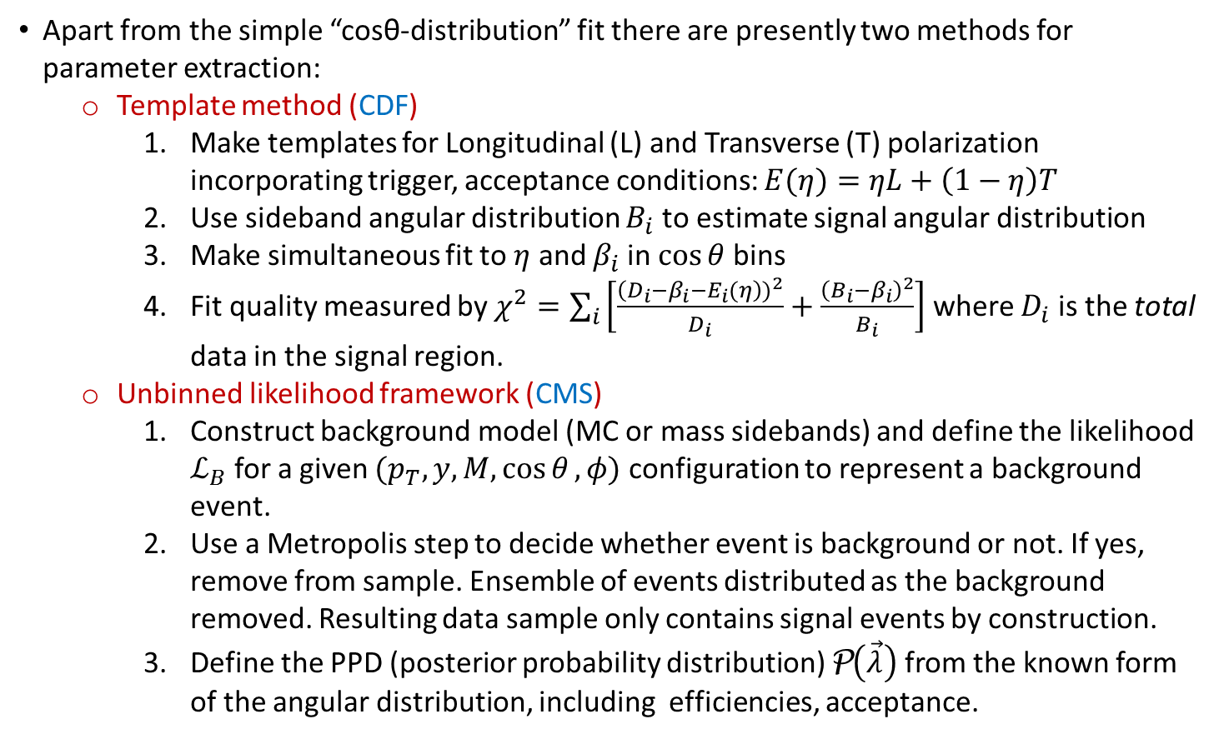
<number>
Some remarks on methodology
Notes:
<number>

Slide 28
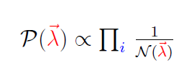

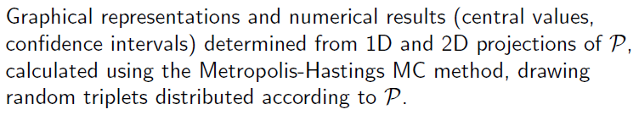
<number>
Some remarks on methodology
Definition of the PPD
uniform integral of W ε over cosθ, φ (with distributions of remaining lepton degrees of freedom taken from data)
general shape of the angular distribution
dimuon efficiency as function of muon momenta
Notes:
<number>

Slide 29
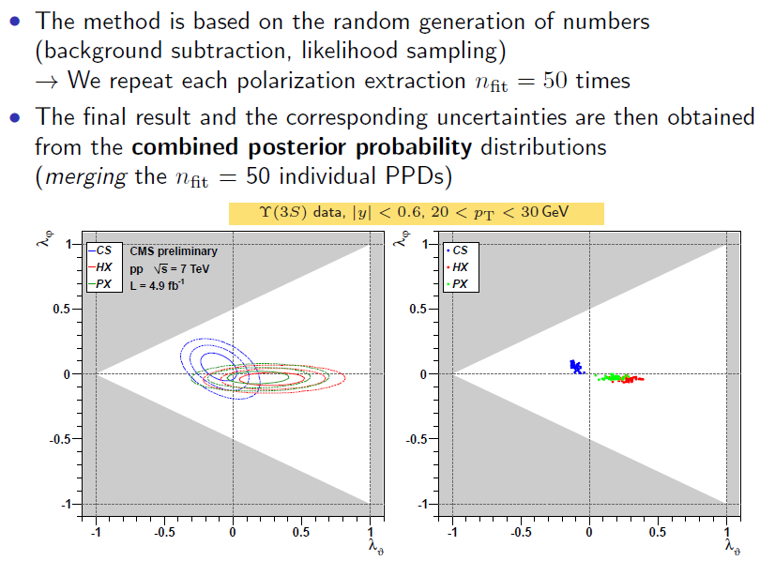
<number>
Some remarks on methodology
Extraction of results
Notes:
<number>

Slide 30
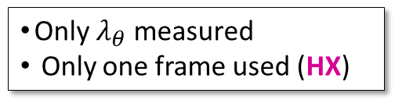
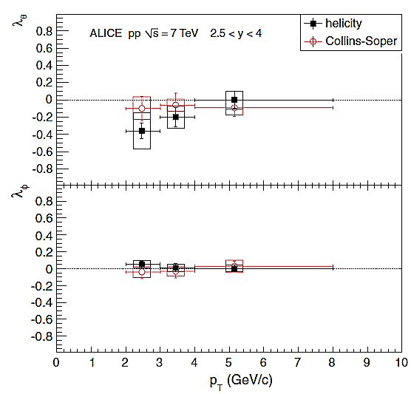
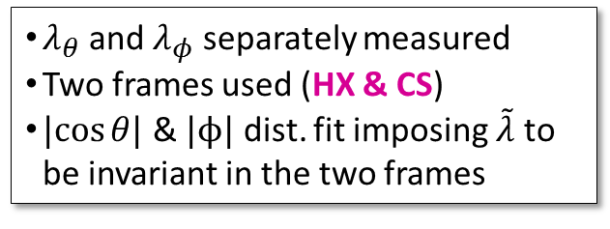

<number>
Quarkonium polarization: a “puzzle”
J/𝜓: Measurements at Tevatron , LHC (ALICE)
_
J/ψ, pp √s = 1.96 TeV
CDF Run I
CDF Run II
|y| < 0.4
|y| < 0.6
CDF II vs CDF I
→ not known what caused the change
Helicity frame
PRL 85, 2886 (2000)
PRL 99, 132001 (2007)
J/ψ, pp √s = 7 TeV
ALICE
2.5 < y < 4,
2 < p_{T} < 8 GeV/c
PRL 108, 082001 (2012)
Notes:
<number>

Slide 31
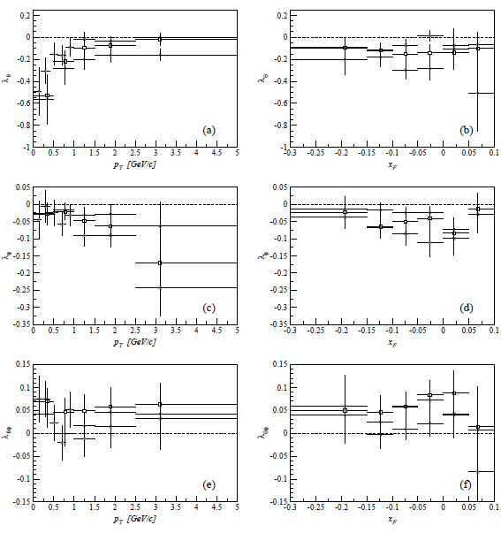
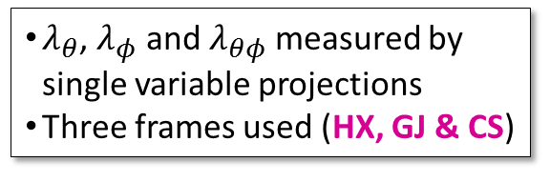
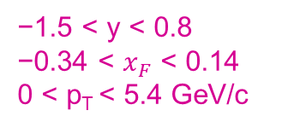
<number>
Quarkonium polarization: a “puzzle”
J/𝜓: HERA-B
J/ψ, p-Cu and p-W √s = 41.6 GeV
EPJ C60 517 (2009)
Notes:
<number>

Slide 32

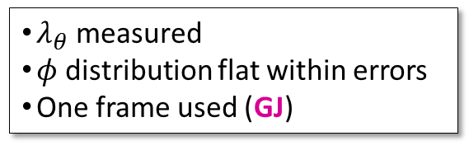
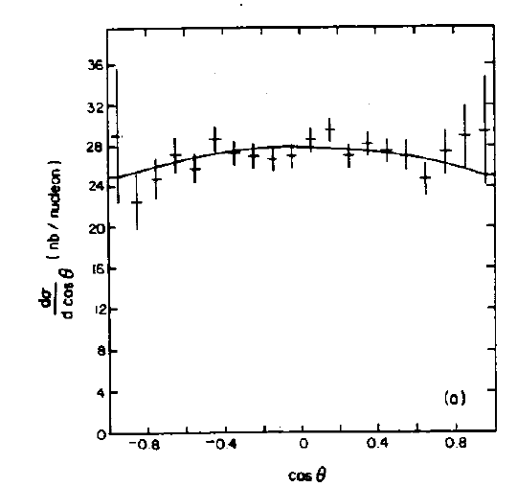
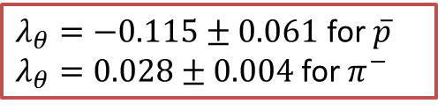
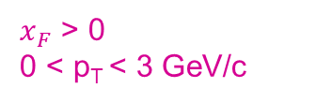
<number>
Quarkonium polarization: a “puzzle”
J/𝜓: Other fixed target experiments (E537- fixed target A=(Cu, W, Be))
PRD 48, 5076 (1993)
Notes:
<number>

Slide 33
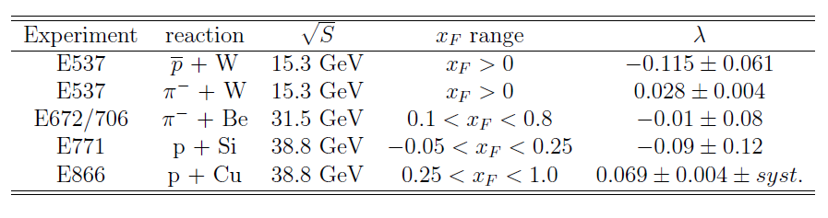


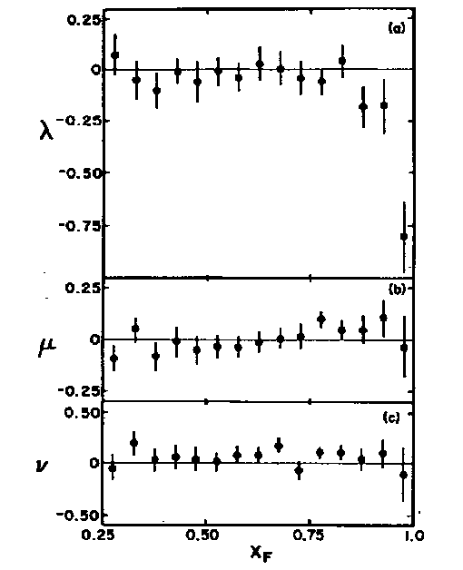

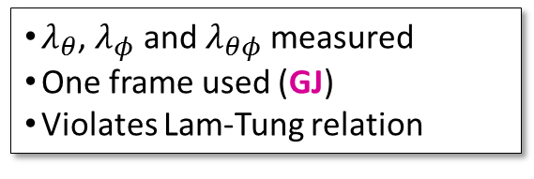


<number>
Quarkonium polarization: a “puzzle”
J/𝜓: Other fixed target experiments
Chicago-Iowa-Princeton Coll.
PRL 58, 2523 (1987)
Notes:
<number>

Slide 34
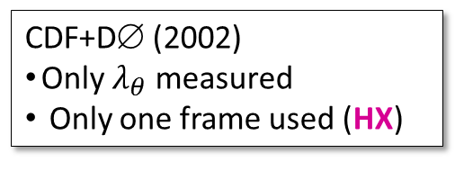
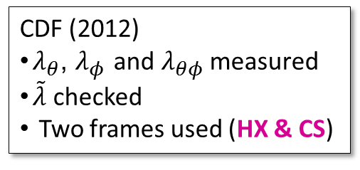
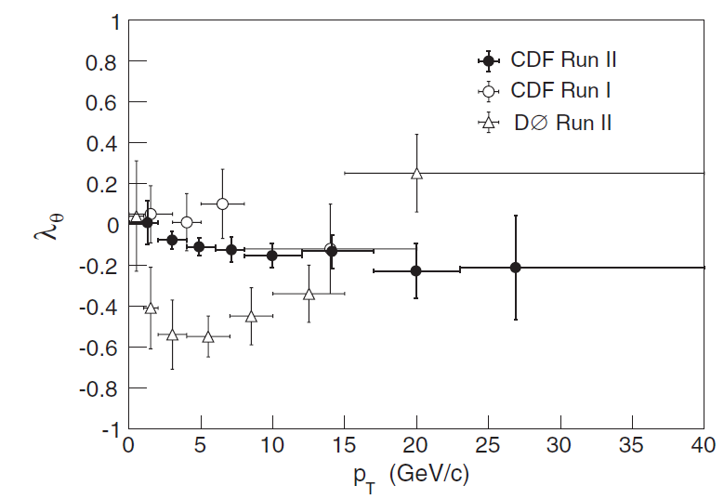
Quarkonium polarization: a “puzzle”
<number>
𝜰(nS): Measurements at Tevatron (2002-2012)
_
ϒ(1S), pp √s = 1.96 TeV
|y| < 0.4 √s = 1.8 TeV (2002)
|y| < 0.6
|y| < 1.8
PRL 88, 161802 (2002)
PRL 108, 151802 (2012)
PRL 101, 182004 (2008)
CDF vs D0 : Can a strong rapidity dependence justify the discrepancy?
Notes:
<number>

Slide 35
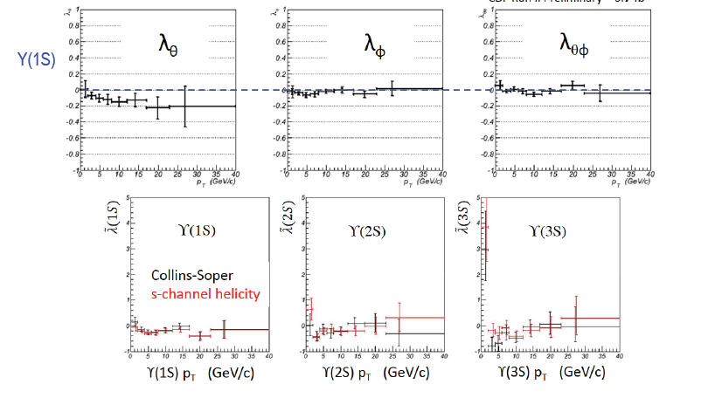
Quarkonium polarization: a “puzzle”
<number>
𝜰(nS): Measurements at Tevatron (2002-2012)
_
ϒ(1S), pp √s = 1.96 TeV
Notes:
<number>

Slide 36
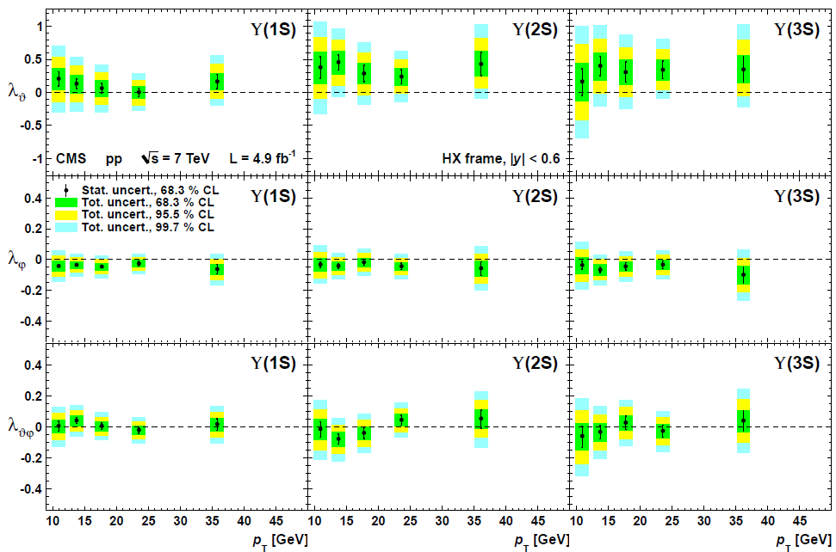
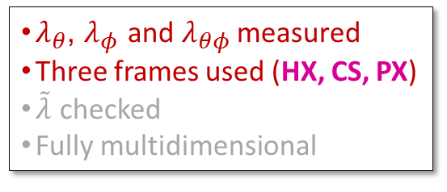

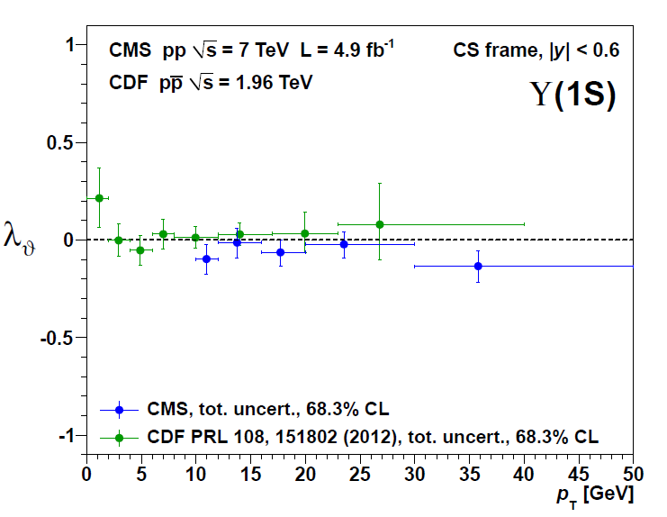
<number>
Quarkonium polarization: a “puzzle”
𝜰(nS): Measurements at LHC (CMS)
ϒ(nS), pp √s = 7 TeV
|y| < 0.6
0.6<|y| < 1.2
arXiv:1209.2922[hep-ex] to appear in PRL
Comparison with CDF results
Notes:
252 000 Y(1S), 94 000 Y(2S), and 58 000 Y(3S)
<number>

Slide 37
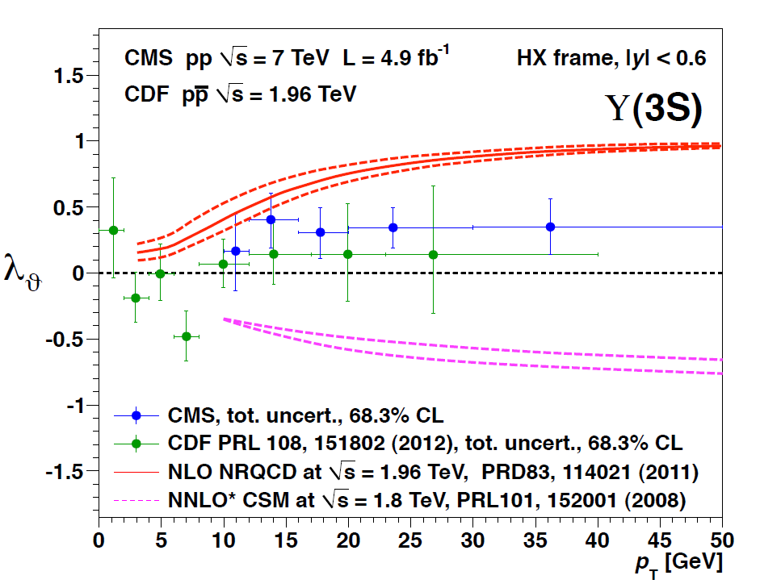
<number>
Quarkonium polarization: a “puzzle”
𝜰(nS): Measurements at LHC (CMS)
ϒ(nS), pp √s = 7 TeV
|y| < 0.6
0.6<|y| < 1.2
arXiv:1209.2922[hep-ex] to appear in PRL
Comparison with CDF results
Notes:
252 000 Y(1S), 94 000 Y(2S), and 58 000 Y(3S)
<number>

Slide 38
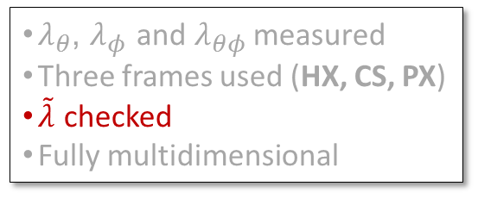
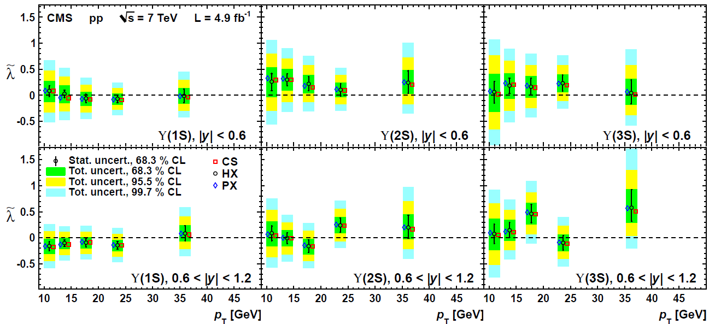
<number>
Quarkonium polarization: a “puzzle”
𝜰(nS): Measurements at LHC (CMS)
ϒ(nS), pp √s = 7 TeV
Notes:
<number>

Slide 39
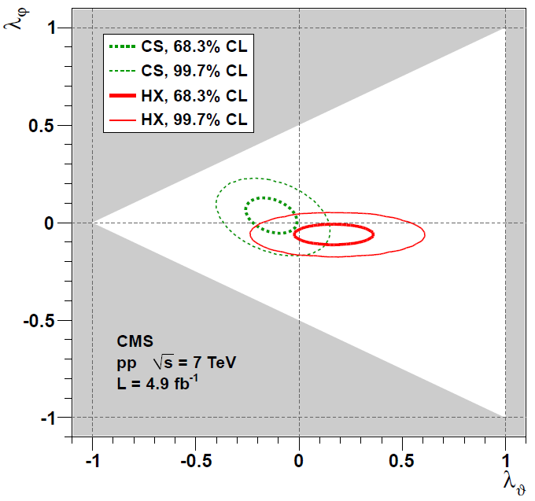
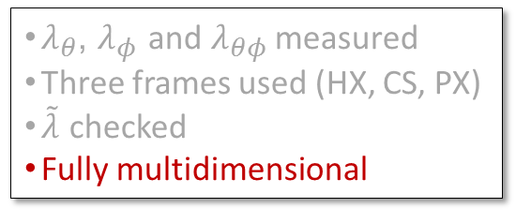
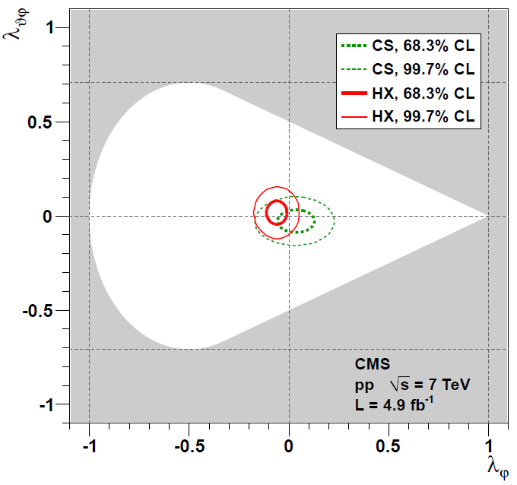
<number>
Quarkonium polarization: a “puzzle”
𝜰(nS): Mesurements at LHC (CMS)
ϒ(nS), pp √s = 7 TeV
Notes:
<number>

Slide 40
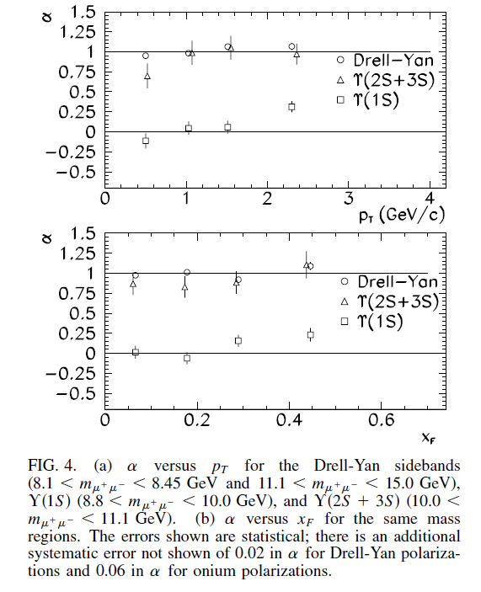
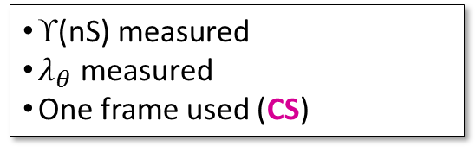
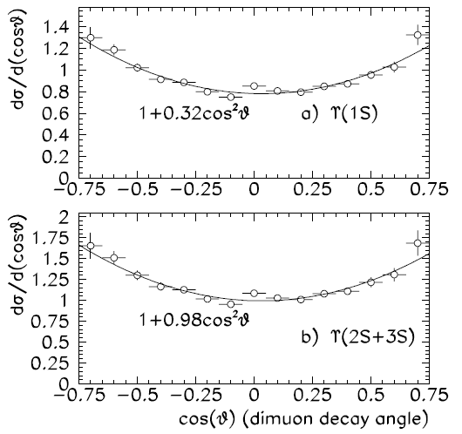
<number>
Quarkonium polarization: a “puzzle”
𝜰(nS): E866/NuSea
Most reasonable explanation is that most 𝜰(1S) come from χ_{b} and have very different polarization
ϒ(nS), p-Cu √s = 38.8 GeV
p_{T}> 1.8 GeV/c
Notes:
In particular,
while for directly produced S states 1<# < þ1, for
those from decays of P1 and P2 states the lower bound is
1=3 and3=5, respectively. More
In the assumption that all directly produced S states have the same polarization one can turn this into a lower limit of the feed-down fraction from chi states (will not be used here). More than 50% of the Y(1S) are produced from P states for <pT>~ 0.5 GeV/c and more than 30% for <pT>~ 2.3 GeV/c. These limits are appreciably higher than the value of the feed-down fraction of J/psi from c measured at similar energy, low pT and
mid rapidity [18].
<number>

Slide 41



<number>
Direct vs. prompt J/ψ
The direct-J/ψ polarization (cleanest theory prediction) can be derived from
the prompt-J/ψ polarization measurement of CDF knowing
the χ_{c}-to-J/ψ feed-down fractions
the χ_{c} polarizations
CDF data
R(χ_{c1})+R(χ_{c2}) = 30 ± 6 %
R(χ_{c2})/R(χ_{c1}) = 40 ± 2 %
CDF prompt J/ψ
CDF prompt J/ψ
extrapolated direct J/ψ
CSM direct J/ψ
extrapolated direct J/ψ
taking
central values
using the values R(χ_{c1})+R(χ_{c2}) = 42 % (+2σ) R(χ_{c2})/R(χ_{c1}) = 38 % (-1σ) the CSM prediction of direct-J/ψ polarization agrees very well with the CDF data in the scenario
h(χ_{c1}) = 0 and h(χ_{c2}) = ±2
possible combinations of
pure χ_{c} helicity states
h(χ_{c1}) | h(χ_{c2})
±1 | 0
±1 | ±1
±1 | ±2
0 | 0
0 | ±1
0 | ±2
helicity frame
helicity frame
Direct-J/ψ: 𝜆_{θ} = -0.6
From χ_{c}: 𝜆_{θ} = +1
χ_{c} measurements are crucial !
Notes:
<number>

Slide 42
<number>
A lot of measurements to do...
Measurement of χ_{c0}(1P), χ_{c1}(1P) and χ_{c2}(1P) production cross sections
Measurement of χ_{b} (1P), χ_{b}(2P) and χ_{b}(3P) production cross sections;
Measurement of the relative production yields of J = 1 and J = 2 χ_{b} states
Measurement of the χ_{c1} (1P) and χ_{c2}(1P) polarizations versus p_{T} and rapidity
Measurement of the χ_{b} (1P) and χ_{b} (2P) polarizations
…

Slide 43


<number>
J/ψ polarization as a signal of colour deconfinement?
≈ 0.7
≈ 0.7
NRQCD
λ_{θ}
λ_{θ}
HX frame
CS frame
p_{T} [GeV/c]
Starting “pp” scenario:
J/ψ significantly polarized (high p_{T})
feeddown from χ_{c} states (≈ 30%) smears the polarizations
S_{i}
Sequential suppression
J/ψ cocktail:
≈ 30% from χ_{c} decays
≈ 70% direct J/ψ
+ ψ’ decays
Recombination ?
ε
As the χ_{c} (and ψ’) mesons get dissolved by the QGP, λ_{θ} should change to its direct value
Notes:
<number>

Slide 44

<number>
J/ψ polarization as a signal of sequential suppression?
P. Faccioli, JS, PRD 85, 074005 (2012)
CMS data:
up to 80% of J/ψ’s disappear from pp to Pb-Pb
more than 50% ( fraction of J/ψ’s from ψ’ and χ_{c}) disappear from peripheral to central collisions
~
>
CMS PAS HIN-10-006
sequential suppression gedankenscenario: in central events ψ’ and χ_{c} are fully suppressed and all J/ψ’s are direct
It may be impossible to test this directly:
measuring the χ_{c} yield (reconstructing χ_{c} radiative decays) in PbPb collisions is prohibitively difficult due to the huge number of photons
However, a change of prompt-J/ψ polarization must occur from pp to central Pb-Pb!
prompt J/ψ polarization in pp
χ_{c}-to-J/ψ fractions in pp
χ_{c} polarizations in pp
prompt J/ψ polarization in PbPb
Reasonable sequence of measurements:
χ_{c} suppression
in PbPb!
Notes:
<number>

Slide 45

<number>
J/ψ polarization as a signal of sequential suppression?
Example scenario:
CDF prompt J/ψ
Extrapolated* direct J/ψ
CSM direct J/ψ
prompt-J/ψ polarization in pp: λ_{θ} ≅ – 0.15
direct-J/ψ polarization: λ_{θ} ≅ – 0.6
helicity frame
(assumed to be the same in pp and PbPb)
* R(χ_{c1})+R(χ_{c2}) = 42 % R(χ_{c2})/R(χ_{c1}) = 38 % h(χ_{c1}) = 0
h(χ_{c2}) = ±2
Notes:
Use a model as shown before and use the expression to calculate the prompt lambdas from the direct and feeddown lambdas
<number>

Slide 46


<number>
J/ψ polarization as a signal of sequential suppression?
If we measure a change in prompt polarization like this...
λ_{θ}
“prompt”
“direct”
... we are observing the disappearance of the χ_{c}
relative to the J/ψ
R(χ_{c}) in PbPb
R(χ_{c}) in pp
Simplifying assumptions:
direct-J/ψ polarization is the same in pp and PbPb
normal nuclear effects affect J/ψ and χ_{c} in similar ways
χ_{c1} and χ_{c2} are equally suppressed in PbPb
Notes:
the polarization should become significantly
more longitudinal (in the helicity frame) after the disappearance
of the transversely polarized feed-down contribution
due to c decays. We are assuming that the ‘‘base’’
polarizations of the directly produced S and P states remain
essentially unaffected by the nuclear medium and are,
therefore, not distinguishable
<number>

Slide 47


<number>
J/ψ polarization as a signal of sequential suppression?
When will we be sensitive to an effect like this?
CMS-like toy MC with
p_{T}(μ) > 3 GeV/c,
6.5 < p_{T} < 30 GeV/c, 0 < |y| < 2.4
prompt-J/ψ polarization
as observed in pp (and peripheral PbPb)
prompt-J/ψ polarization
as observed in central PbPb
efficiency-corrected
|cosθ_{HX}| distribution
precise results
in pp very soon
~20k evts
~20k evts
In this scenario, the χ_{c} disappearance is measurable at ~5σ level with
~20k J/ψ’s in central Pb-Pb collisions
Notes:
<number>

Slide 48

<number>
J/ψ polarization as a signal of sequential suppression?
When will we be sensitive to an effect like this?
CMS-like toy MC
Notes:
<number>

Slide 49
<number>
Summary
The new quarkonium polarization measurements have many improvements with respect to previous analyses Will we manage to solve an old puzzle?
General advice: do not throw away physical information! (azimuthal-angle distribution, rapidity dependence, ...)
A new method based on rotation-invariant observables gives several advantages in the measurement of decay distributions and in the use of polarization information
Charmonium polarization can be used to probe QGP formation
Notes:
<number>

Slide 50
<number>
Backup slides
Notes:
<number>

Slide 51



<number>
Frame-independent angular distribution
~
xz
xz
λ determines the event distribution of the angle α of the lepton w.r.t. the y axis of the polarization frame:
y
y
(transverse)
(longitudinal)
Example: lepton emitted at small cos α is more likely to come from directly produced W / Z
W from top
WW / ZZ from H
M(H) = 300
GeV/c²
W from
q-qbar / q-g
WW / ZZ from q-qbar
independent of W/Z kinematics
Notes:
<number>

Slide 52


~
<number>
λ_{θ}(CS) vs λ
Example: W polarization as a function of contribution of LO QCD corrections, p_{T} and y:
case 1: dominating q-qbar QCD corrections
case 2: dominating q-g QCD corrections
~
~
λ = +1
λ = +1
y = 2
(indep. of y)
y = 2
y = 0
p_{T} = 50 GeV/c
p_{T} = 50 GeV/c
y = 0
p_{T} = 200 GeV/c
p_{T} = 200 GeV/c
f_{QCD}
f_{QCD}
λ_{θ}^{CS}
CDF+D0:
QCD contributions
are very large
1
~
λ, constant, maximal and independent of the process mixture,
gives a simpler and more significant representation of the polarization information
0
.
5
0
0
1
0
2
0
3
0
4
0
5
0
6
0
7
0
8
0
p_{T} [GeV/c]
Notes:
<number>

Slide 53
~
<number>
λ_{θ}(CS) vs λ
case 1: dominating q-qbar QCD corrections
case 2: dominating q-g QCD corrections
~
~
λ = +1
λ = +1
y = 2
(indep. of y)
y = 2
y = 0
p_{T} = 50 GeV/c
p_{T} = 50 GeV/c
y = 0
p_{T} = 200 GeV/c
p_{T} = 200 GeV/c
f_{QCD}
f_{QCD}
~
On the other hand, λ forgets about the direction of the quantization axis.
In this case, this information is crucial if we want to disentangle the qg contribution, the only one giving maximum spin-alignment along the boson momentum, resulting in a rapidity-dependent λ_{θ}
Measuring λ_{θ}(CS) as a function of rapidity gives information on the gluon content
of the proton!
Notes:
<number>

Slide 54
<number>
Using polarization to identify processes
If the polarization depends on the specific production process (in a known way), it can be used to characterize “signal” and “background” processes.
In certain situations the rotation-invariant formalism can allow us to
estimate relative contributions of signal and background in the distribution of events
attribute to each event a likelihood to be signal or background (work in progress)
Notes:
<number>

Slide 55
<number>
Example n. 1: W from top ↔ W from q-qbar and q-g
Hypothetical, illustrative experimental situation:
selected W’s come either from top decays or from direct production (+jets)
we want to estimate the relative contribution of the two types of W, using polarization
longitudinally polarized:
transversely polarized,
wrt 3 different axes:
q
wrt W direction in the top rest frame
(top-frame helicity)
W
relative direction of q and qbar (Collins-Soper)
_
q
W
q
W
q
W
t
b
_
direction of
q or qbar
(Gottfried-Jackson)
independently of top production mechanism
q
g
q
q
W
_
_
q
W
q
W
The top quark decays almost 100% of the times to W+b
→ the longitudinal polarization of the W is a signature of the top
q
W
direction of outgoing q
(cms-helicity)
g
q
Notes:
<number>

Slide 56
<number>
a) Frame-dependent approach
We measure λ_{θ} choosing the helicity axis defined wrt the top rest frame
+ …
y_{W} = 2
y_{W} = 0.2
directly produced W
+
y_{W} = 0
t
W from top
+
The polarization of W from q-qbar / q-g
depends on the actual mixture of processes
we need pQCD and PDFs to evaluate it
depends on p_{T} and y
if we integrate we lose discriminating power
is generally far from being maximal
we should measure also λ_{φ} for a sufficient discrimination
Notes:
<number>

Slide 57
<number>
b) Rotation-invariant approach
~
We measure λ, choosing any frame defined using beam directions (cms-HX, CS, GJ...)
+
+
+ …
~
same λ for all “background” processes
no need of theory calculations
no dependence on p_{T} and y
we can use a larger event sample
difference wrt signal is maximized
more significant discrimination
t
~
From the measured overall λ we can deduce the fraction
E.g.
Notes:
<number>

Slide 58
<number>
Example n. 2: Z (W) from Higgs ↔ Z (W) from q-qbar
ZZ-HX frame
y_{Z} = 2
y_{Z} = 0.2
Z bosons from H → ZZ are
longitudinally polarized.
The polarization is
stronger for heavier H
y_{Z} = 0
H
m_{H} = 300 GeV/c²
even larger overlap if the Higgs is lighter:
~
λ is better than λ_{θ} to discriminate
between signal and background:
m_{H} = 200 GeV/c²
Notes:
<number>

Slide 59
<number>
Rotation-invariant parity asymmetry
parity-violating terms
is invariant under
any rotation
It represents the magnitude of the maximum observable parity asymmetry, i.e. of the net asymmetry as it can be measured along the polarization axis that maximizes it
(which is the one minimizing the helicity-0 component)
V → f f
f
helicity(f f ) = ±1
z
θ
z
helicity(V) =0, ± 1
f
[PRD 82, 096002 (2010)]
Notes:
<number>

Slide 60
<number>
Frame-independent “forward-backward” asymmetry
The rotation invariant parity asymmetry can also be written as
Z “forward-backward asymmetry”
(related to) W “charge asymmetry”
experiments usually measure these in the Collins-Soper frame
can provide a better measurement of parity violation:
it is not reduced by a non-optimal frame choice
it is free from extrinsic kinematic dependencies
it can be checked in two “orthogonal” frames
Notes:
<number>

Slide 61



~
<number>
A_{FB}(CS) vs A
In general, we lose significance when measuring only the azimuthal “projection” of the asymmetry (A_{FB}) wrt some chosen axis
This is especially relevant if we do not know a priori the optimal quantization axis
Example: imagine an unknown massive boson
70% polarized in the HX frame and 30% in the CS frame
By how much is A_{FB}(CS) smaller than A if we measure in the CS frame?
~
~
A_{FB} /A
p_{T} = 300 GeV/c
mass = 1 TeV/c²
mass = 1 TeV/c²
4
3
p_{T} = 300 GeV/c
y = 2
y = 2
p_{T} = 1 TeV/c²
y = 0
y = 0
Larger loss of significance for smaller mass, higher p_{T} , mid-rapidity
Notes:
<number>

Slide 62
<number>
Quarkonium polarization: a “puzzle”
“Should be right, but we are not there yet” (meaning p_{T} >> M)?
How important are long-distance effects (formation of the q-qbar bound state) in the observed rates and polarizations? Two opposite approaches:
Colour Singlet Model: pure perturbative calculations, ignoring long-distance effects
NRQCD: quarkonia are also produced as coloured quark pairs; long distance colour-octet matrix elements are adjusted to the cross section data σ(p_{T})
Both approaches reproduce the magnitude of decay-averaged cross sections, but…
λ_{θ}
NRQCD factorization: prompt J/ψ Braaten, Kniehl & Lee, PRD62, 094005 (2000)
CDF Run II data: prompt J/ψ @1.96 TeV
CDF Coll., PRL 99, 132001 (2007)
Colour-singlet @NLO: direct J/ψ
Gong & Wang, PRL 100, 232001 (2008)
Artoisenet et al., PRL 101, 152001 (2008)
Notes:
<number>

Slide 63

<number>
ψ’→ J/ψ x-section ratio experimental parameters

Slide 64

<number>
R(χ_{c}) experimental parameters

