Slide 1
EXPLORATORY DATA ANALYSIS (eda)
REPORT
SUBMITTED BY-
VINEET KUMAR SHUKLA
( vineetshukla14u@gmail.com )
(https://www.linkedin.com/in/vineetshuklauit/ )

Slide 2
OVERVIEW
This report presents a comprehensive analysis of given dataset which is collection of data of vehicles, focusing on statistical insights and key findings from univariate and bivariate analyses. The primary aim is to get meaningful insights from the data that can inform us about vehicle’s health including their engine load, fuel levels, fuel economy, adblue level, coolant, rpm, runtime of the engine, distance travelled by vehicles and so on.

Slide 3
Initial Intution from the Data
Total 18434 rows × 141 columns
Out of 141 columns, 108 have all null values.
3 column that is adblue_level, fuel_level, and runtime, have very few missing values.
The dataset is a collection of data which are generated by sensors, installed in vehicles.
The sensors giving some valuable data like, fuel level, fuel economy, time stamp, location, engine load, rpm etc.
From these data, we can extract some meaningful insights which can help to monitor the vehicle’s health.
And also can be helpful in giving recommendation to what can be improved.

Slide 4
Data Cleaning and Preprocessing
Findings:
Which column have all null value, dropped from the dataframe.
Which have few, filled with mean or median of the rest data.
As timestamp was given in ‘epoch’ format, converted to ‘datetime’ format.
By using standard deviation method, outliers are calculated.
Found that coolant have significant number of outliers, that makes nearly 3.4 percent, while other’s have even less than 1% outliers.

Slide 5
Univariate Analysis
Descriptive Statistics:
Univariate analysis helps us to get insights from individual variables.
Variables | Min | Max | Mean | Median | Mode | Standard Deviation | Skewness
Engine Load (%) * | 1 | 100 | 45.02 | 44.0 | 10 | 27.29 | 0.25
Coolant (%) | 30 | 98 | 84.57 | 85 | 84 | 7.7 | -2.89
Adblue Level (%) | 44.4 | 100 | 84.79 | 84.79 | 84.79 | 13.93 | -0.79
Vehicle Speed (Km/hr) * | 0.015 | 81.70 | 37.96 | 40.71 | 50.26 | 13.81 | -0.65
RPM | 49 | 2011.25 | 998.40 | 982.0 | 749.62 | 229.48 | 0.50
Obd distance (km) * | 0 | 11094.01 | 5719.95 | 5751.58 | 10190.10 | 3256.33 | -0.04

Slide 6
Variables | Min | Max | Mean | Median | Mode | Standard Deviation | Skewness
Runtime (hr) * | 0 | 316.25 | 161.56 | 162.15 | 289.40 | 92.41 | -0.03
Fuel Level (%) | 0.4 | 100 | 54.99 | 57.20 | 68.0 | 26.76 | -0.06
Fuel Rate | 0 | 36.4 | 9.32 | 6.35 | 0.0 | 8.20 | 0.49
Fuel Economy * | 0.0019 | 19.98 | 4.32 | 2.68 | 1.97 | 4.15 | 1.83
*Engine load is filtered, on the condition when load is greater than zero.
*The value of Vehicle speed is also taken only greater than zero, to get realistic analysis.
* OBD distance is total distance travelled by vehicle so far, adjusted here to start from 0 to get better analysis.
*As the same, runtime is also adjusted to start from zero.
*Fuel economy has some very unrealistic values, filtered here on the condition when value lie between 0 and 20.

Slide 7
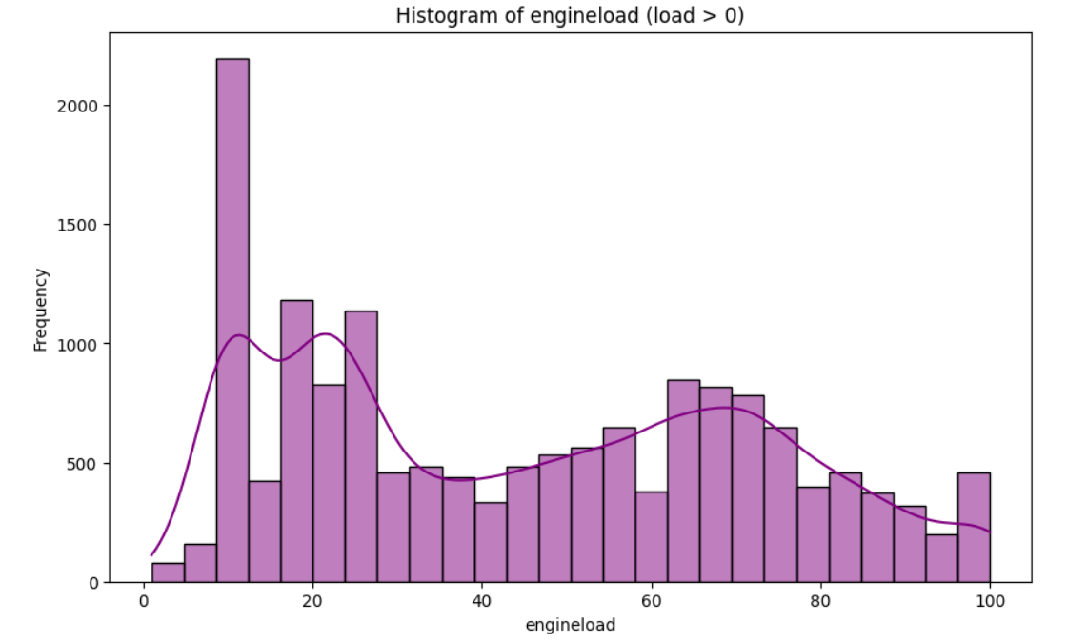
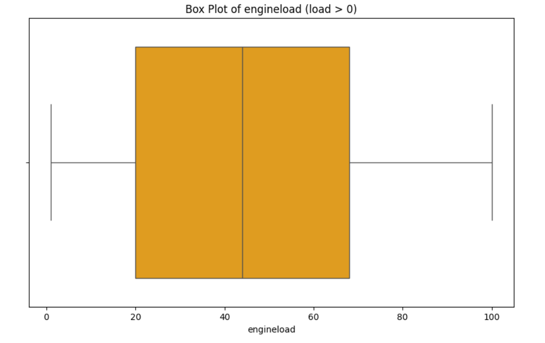
From Visualization:
Engine Load
Findings-
Most values between 0 and 30, with higher frequency near 10.
Box plot shows that 50% of values lie between 20% and 70% engine load.
50% of the time, the engine load are bellow the 45%.
Operating within the 60% to 80% load range often results in better fuel efficiency, as per expert.
There is scope of improvement, because the average is near 45%.

Slide 8
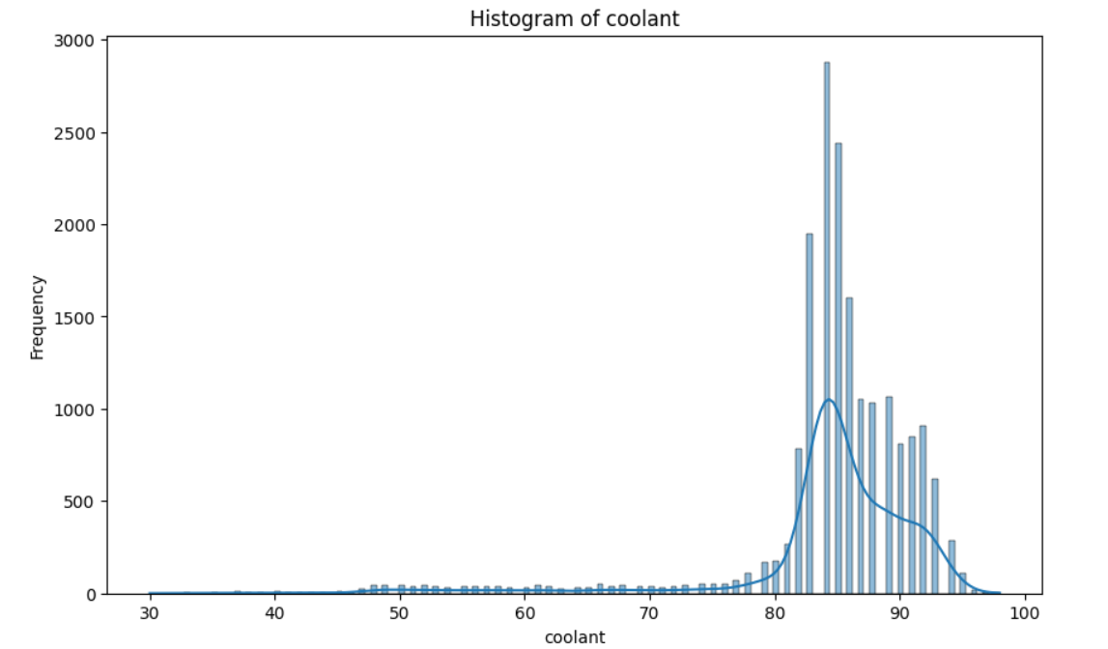
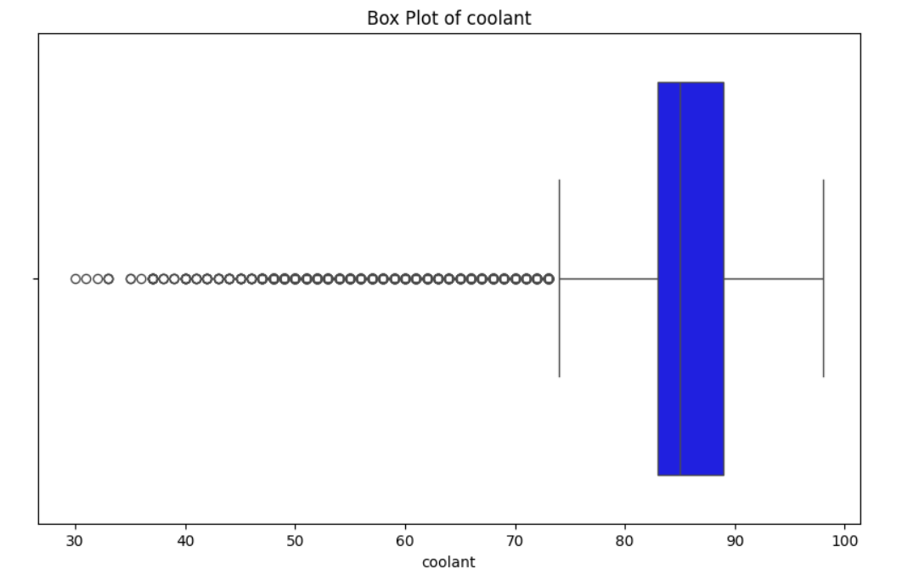
Coolant Temperature
Findings:
Higher concentration of values of the coolant temperature lie between 80 to 95 percent.
Range starts from nearly 30% but still temperatures are mostly on higher sides.
50 % times the temperature are above the 85 percent.
The number of outliers are significantly higher.
The average temperature is nearly 85%.

Slide 9
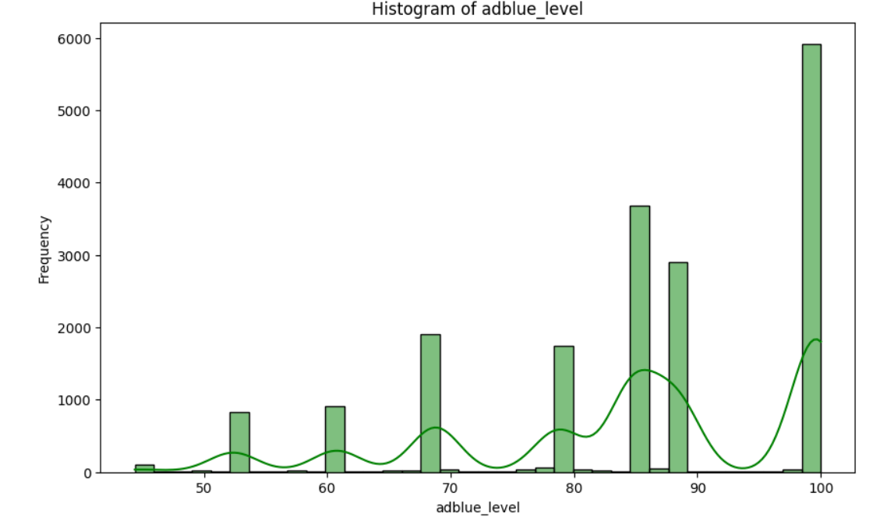
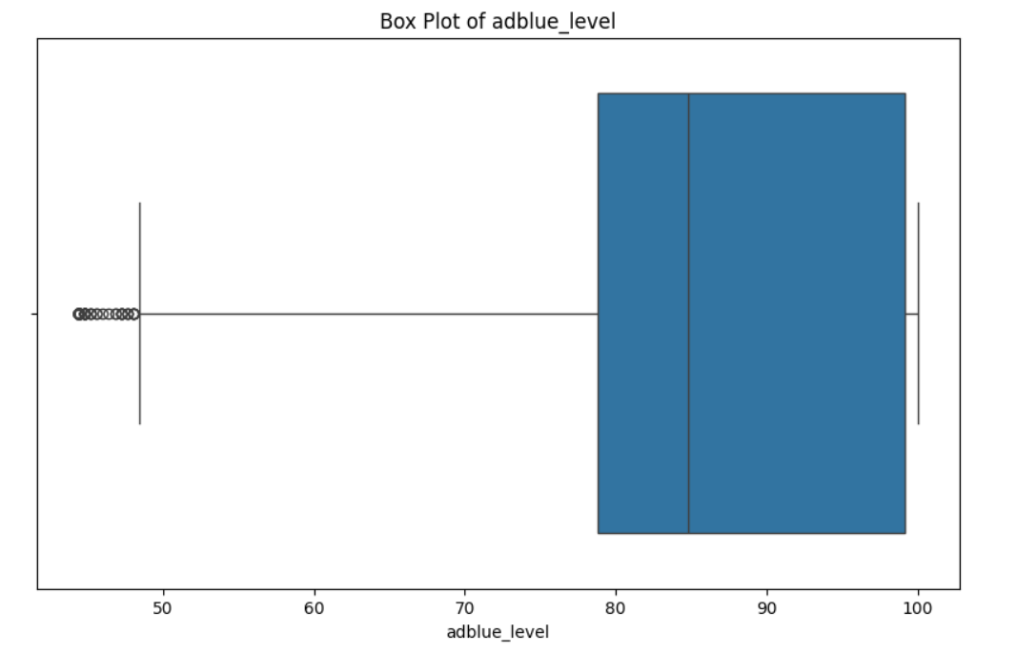
Adblue Level
Findings:
Nearly 30% of the time, the adblue level is 100% full.
And nearly 50 % times, the adblue level is more than 80% full.
The average adblue level is nearly 85%
There are some outliers also presented.

Slide 10
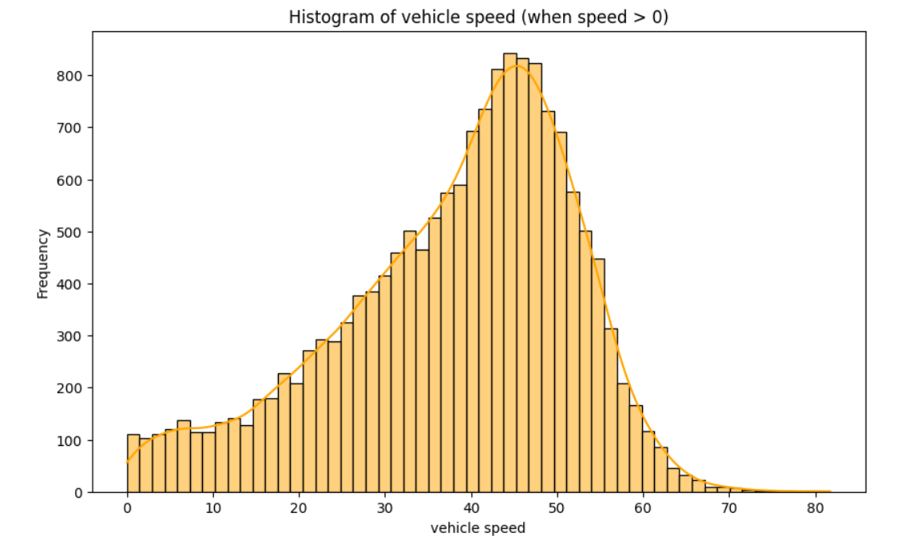
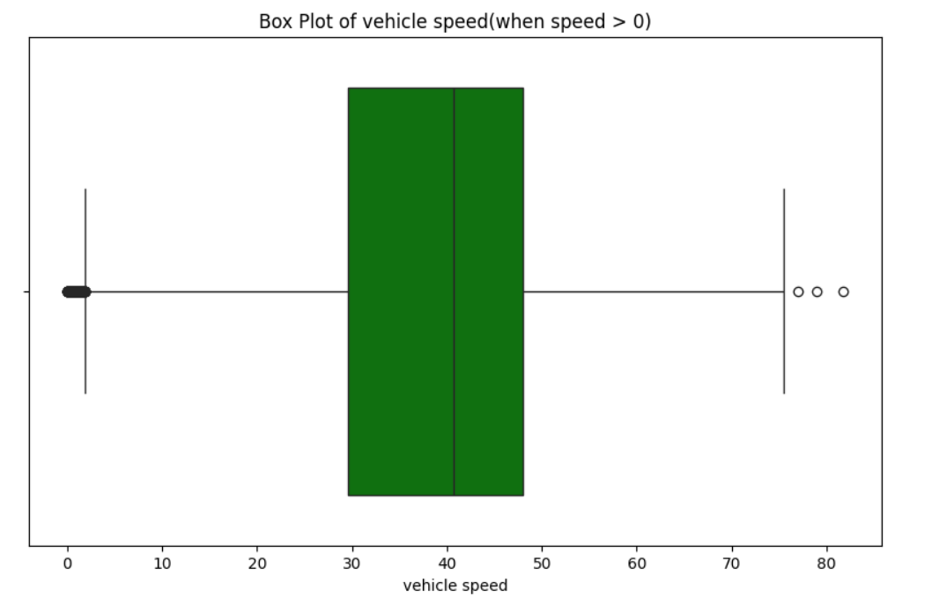
Vehicle Speed
Findings:
For better analysis, speed > 0 has been considered only.
Approximately 50% times, it is found that the speed lie between 30 and 50 km/hr.
The average speed is nearly 40 km/hr.

Slide 11
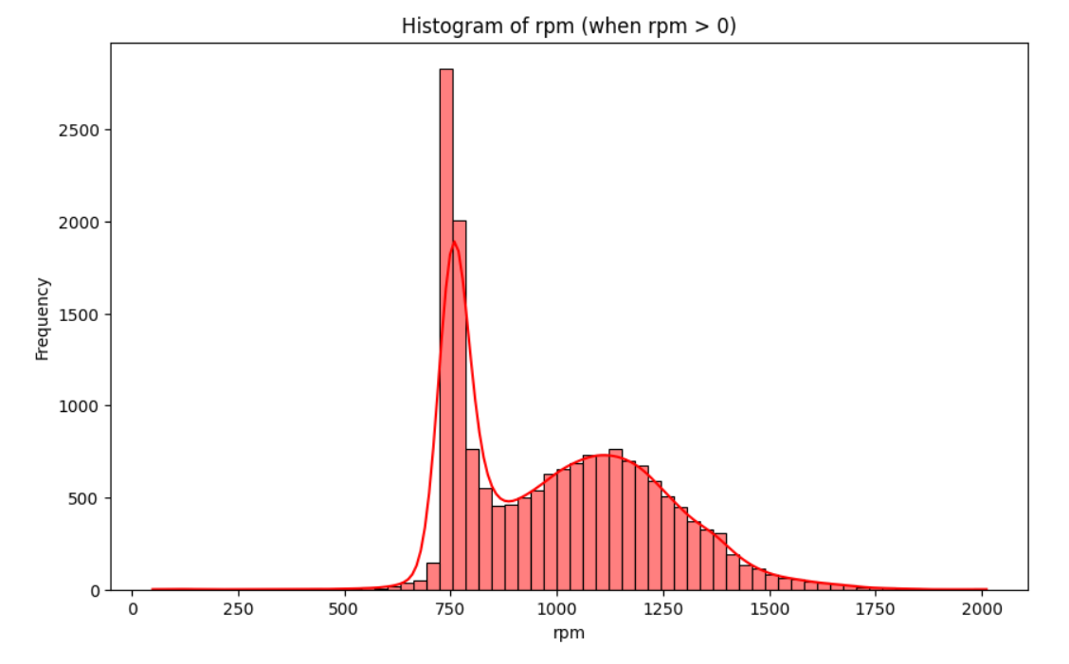
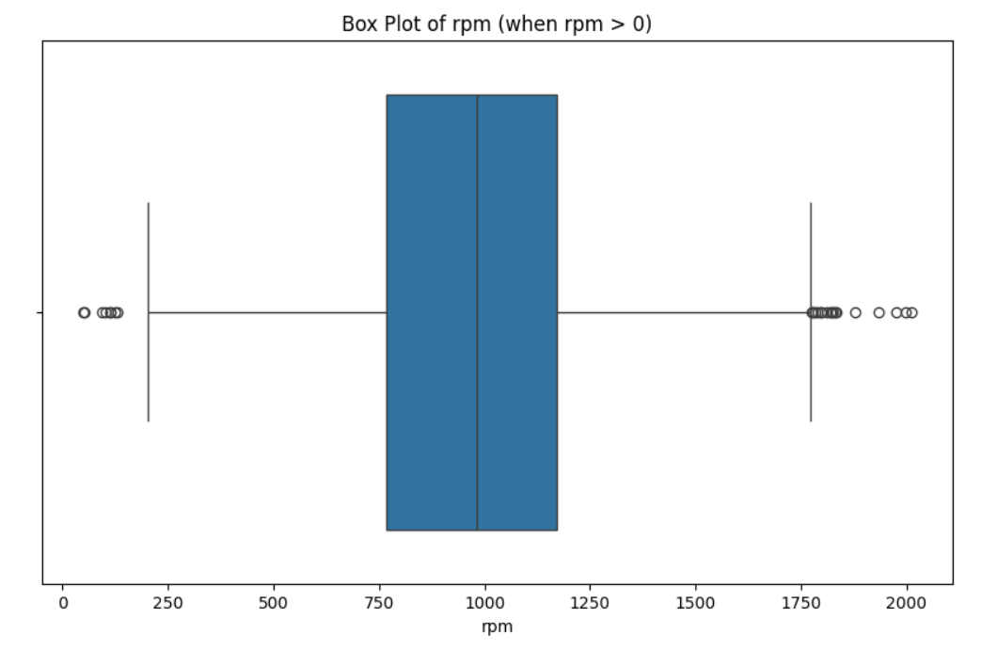
RPM
Findings:
Around 750 RPM is most likely to repeat.
Approximately, 50% times the RPM lie between 750 and 1250.
The average rpm is about 1000.
There are significant number of outliers.
0 rpm is ignored to get realistic picture.

Slide 12
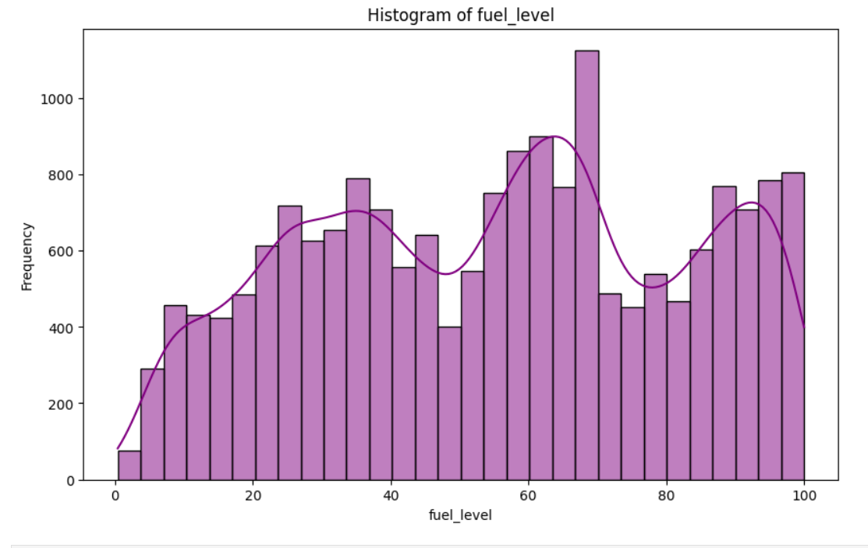
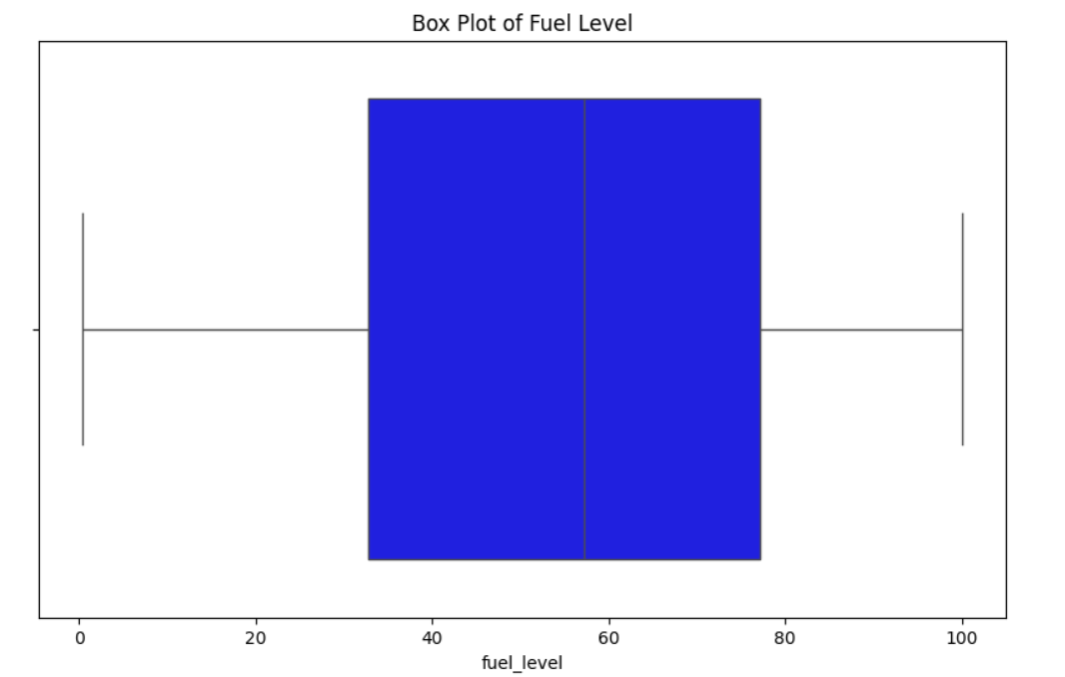
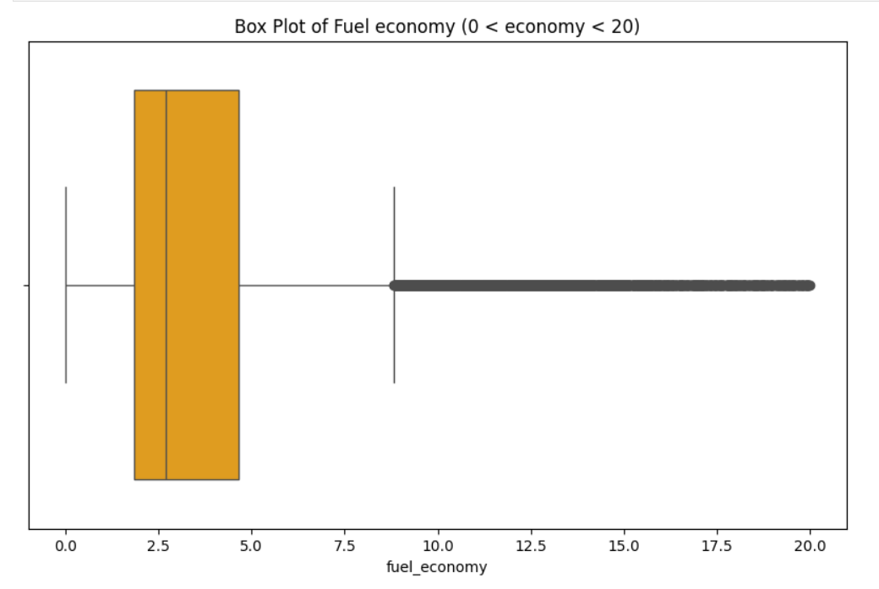
Fuel Level & Fuel Economy
Findings:
50% times, the fuel level lie between 35 to 80 percent of the tank capacity.
The average of fuel level is about 55%.
It is also found that more than 50 percent times, the fuel level is more than 60% of tank capacity.
50% times, the fuel economy lie between 2 and 5 km/L.
The average fuel economy is nearly 4.5 km/L

Slide 13
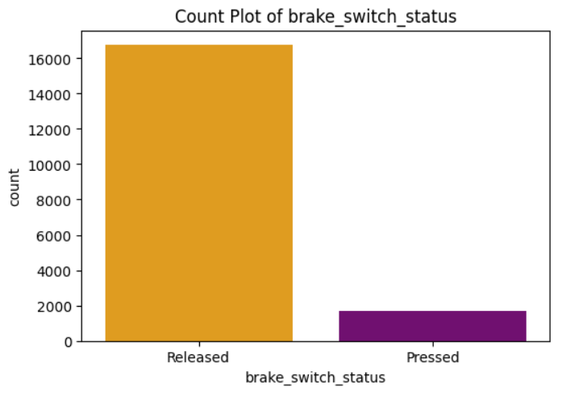
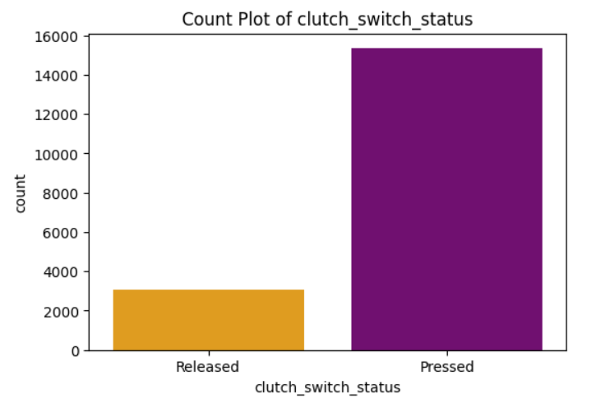
Status of Clutch and Brake
Findings:
Approximately, 10% of the time, the brake was found pressed.
About 80% of the time, pressed clutch was found.
80% of the time of pressed clutch seems a bit high, but to changing the gears of vehicle needs to press the clutch frequently.

Slide 14
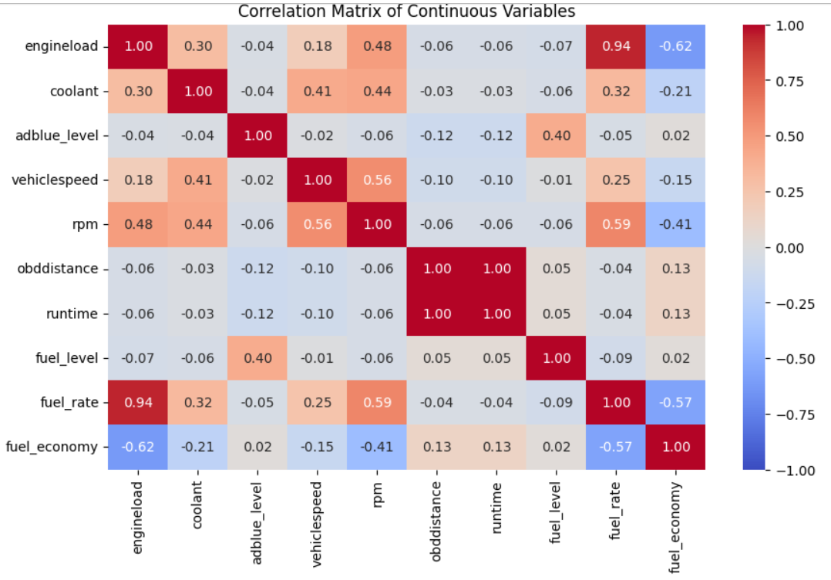
Bivariate Analysis
Bivariate analysis involves examining the relationships between two variables to understand how they influence each other.
Calculating the correlation matrix for numerical variables to get correlation between variables.

Slide 15
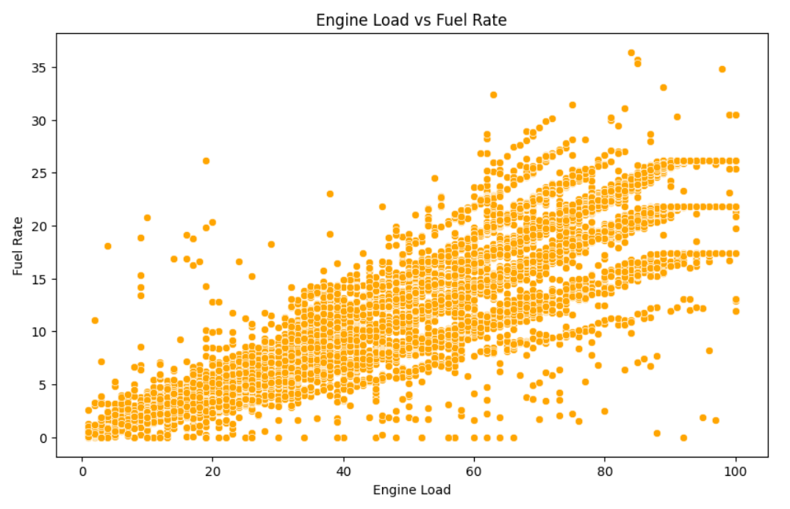
Engine Load Vs Fuel Rate
Findings:
With increasing the engine load, fuel rate increases automatically.
Means, Whenever, the engine load is in higher side, the amount of fuel consumed by engine will also increased.
Fuel rate and engine load have very high and linear relationship.

Slide 16
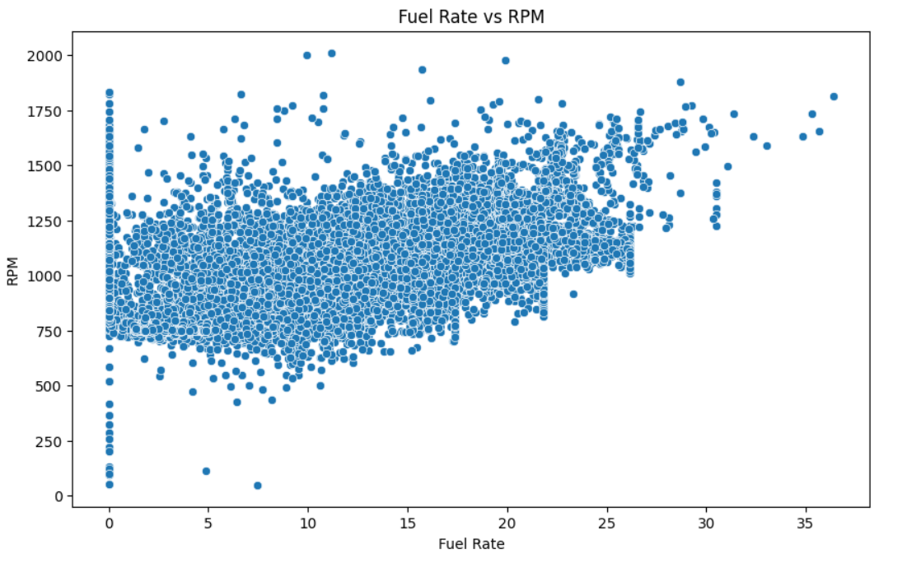
Fuel Rate Vs RPM
Findings:
In previous slide, we found that engine load is directly proportional to fuel rate.
Here we can see that fuel rate is also directly proportional to RPM.
It means, with increasing rpm, fuel rate automatically increases.
We can conclude that, these 3 variables influence each other, like if rpm will increase, engine load will also increases and when load will increase, fuel rate will automatically increases.

Slide 17
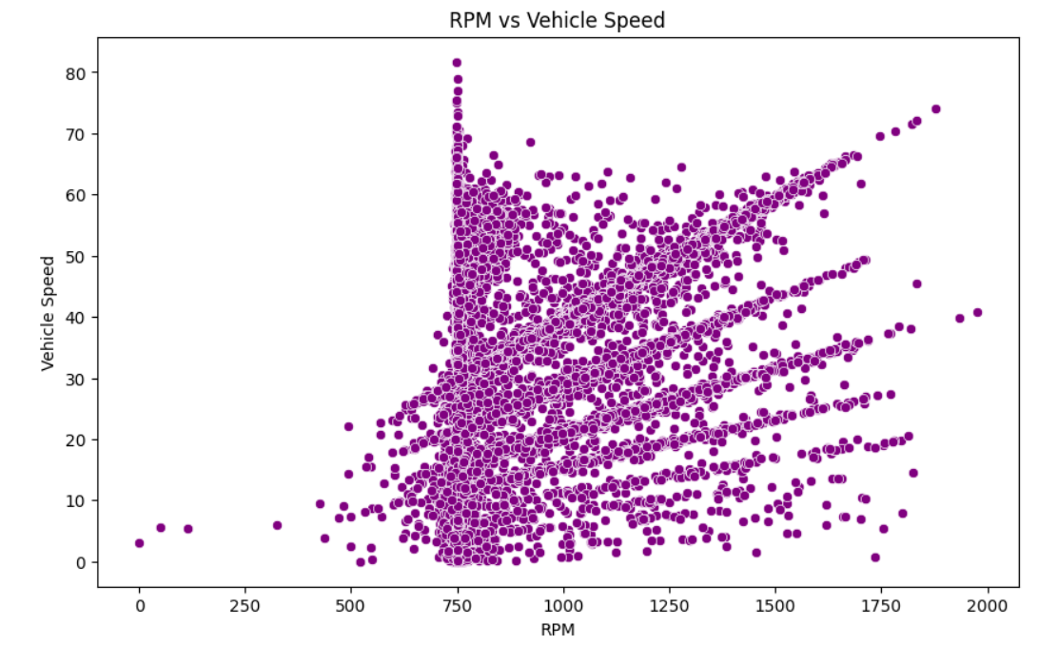
RPM Vs Vehicle Speed
Findings:
As the bubbles are very scattered here, but we can see a clear trend that with increasing vehicle speed, RPM also increases.
Most of the time, rpm was around 750 rpm.
As previously, we concluded that rpm, engine load and fuel rate influences each other. As the same vehicle speed also influence the above three.
As vehicle speed will increases, rpm will automatically increases and once rpm increases, it will lead to increase the engine load and engine load will increase the fuel consumption by the engine.

Slide 18
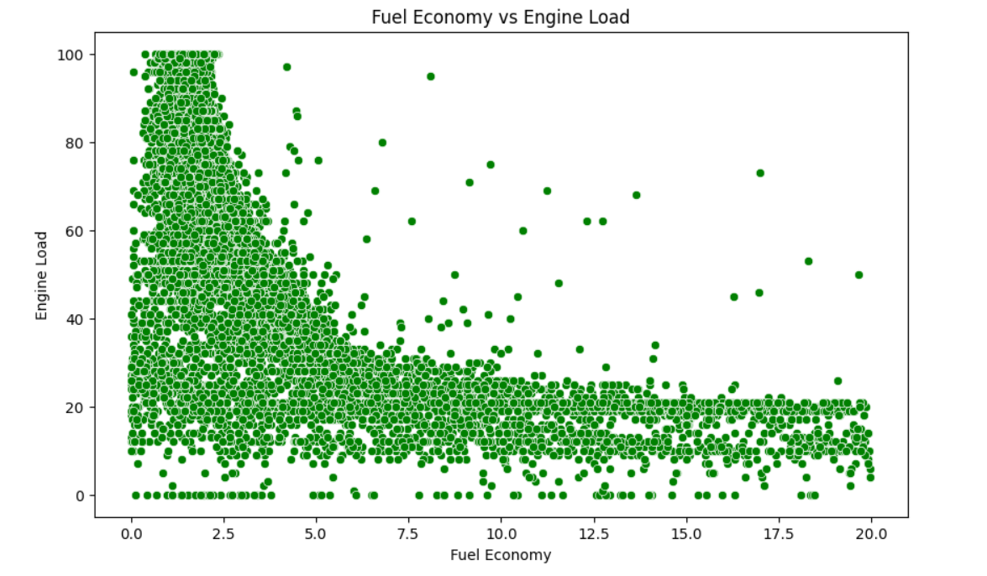
Fuel Economy Vs Engine Load
Findings:
When engine load increases, the fuel economy tends to decrease.
Here, we filter the value of fuel economy in the range of 0 and 20, to get better analysis.
As we know that the Fuel economy refers to the distance a vehicle can travel on a specific amount of fuel.
Again there can be a relation can be established. Like as previously, vehicle speed, rpm, engine load and fuel rate, all increases each other.
And here as same, these all above parameter will lead to decrease the fuel economy.

Slide 19
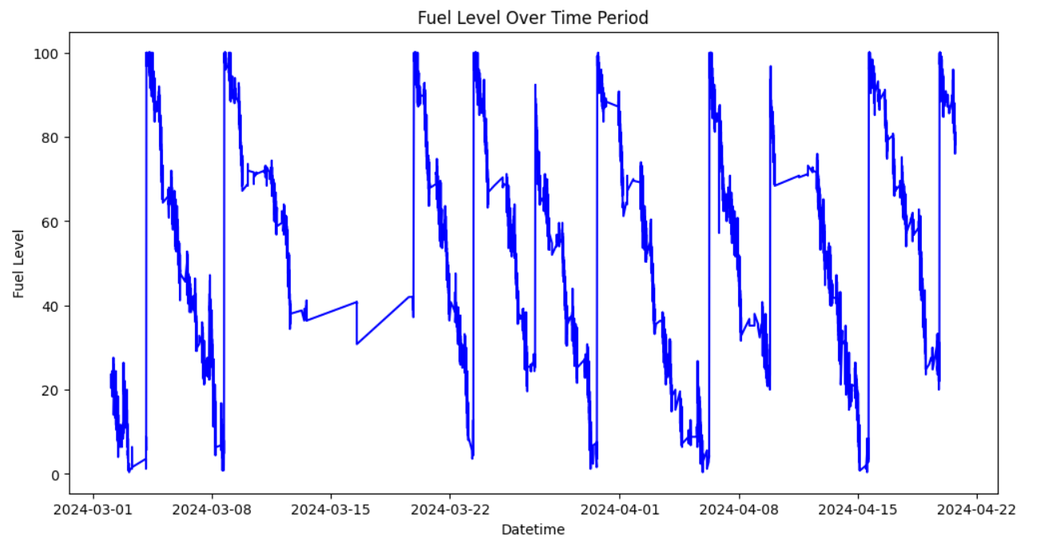
Fuel Level Vs Datetime
Findings:
From this graph, we can see that there is no any clear relationship established.
But we can extract some insight from here, like the behaviour of driver. Means when driver used to refuel the tank?
It generally found that driver refuel the tank once when fuel level is very near to zero.
We can also informed that when fuel level suddenly dropped, which can be the case of theft of the fuel.

Slide 20
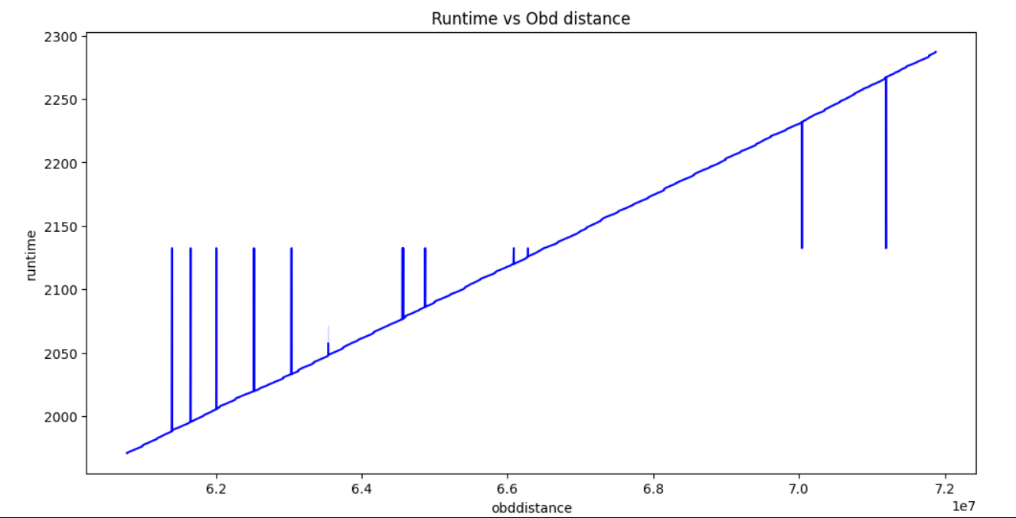
Run Time Vs OBD Distance
Findings:
From the graph, it is evident that runtime is linearly proportion to OBD distance.

Slide 21
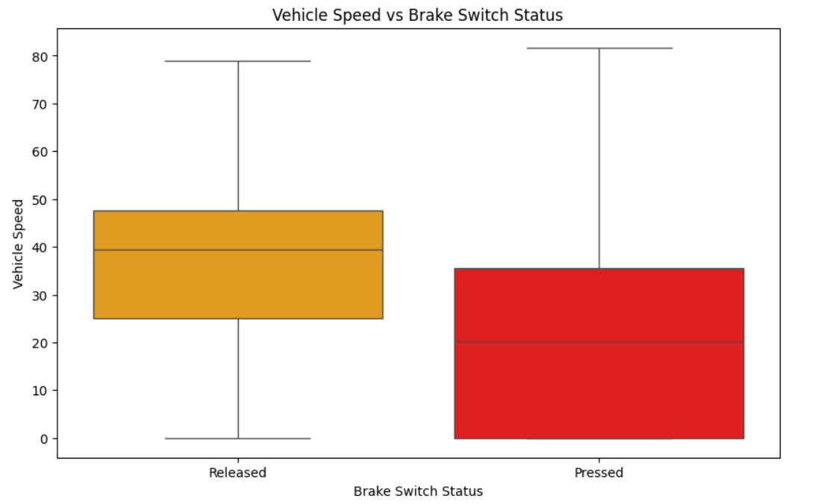
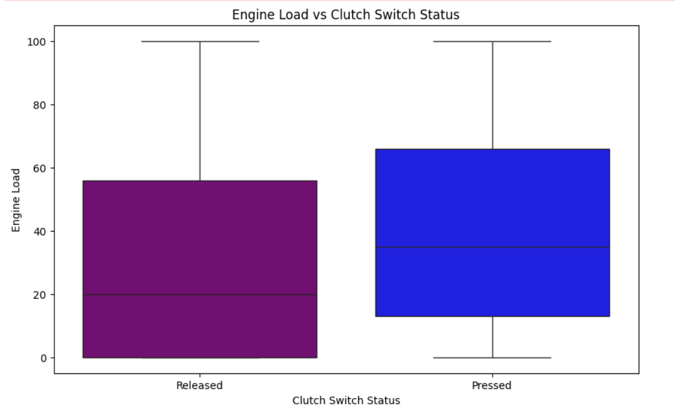
Vehicle Speed Vs Brake and Clutch Status
Findings:
With low vehicle speed, brakes are mostly pressed. but by increasing the speed, brakes are found released.
By pressing the clutch, engine load automatically increases. Whereas, with releasing the clutch, engine load tends to decrease.

Slide 22
Final Thoughts
Operating within the 60% to 80% engine load range often results in better fuel efficiency.
Higher concentration of coolant temperature values lies between 80% and 95%.
Most of the time adblue level was found 100% full.
Vehicle speed was mostly between 30 to 45 km/hr.
The average RPM is about 1000, whereas around 750 was very frequent.
50% of the time, the fuel level lies between 35% and 80% of tank capacity.
The average fuel economy is nearly 4.5 km/L.
RPM, engine load, and fuel rate influence each other and also influenced by vehicle speed.
Fuel economy tends to decrease with increasing engine load.
It is found that refueling have mostly done, when the fuel level is near to zero.
Brakes are mostly pressed at low vehicle speeds, where as engine load increases with pressing the clutch.

Slide 23
THANK YOU

