Slide 1
Node.js Path Module
The Path module provides a way of working with directories and file paths.
The syntax for including the Path module in your application:
var path = require('path');

Slide 2
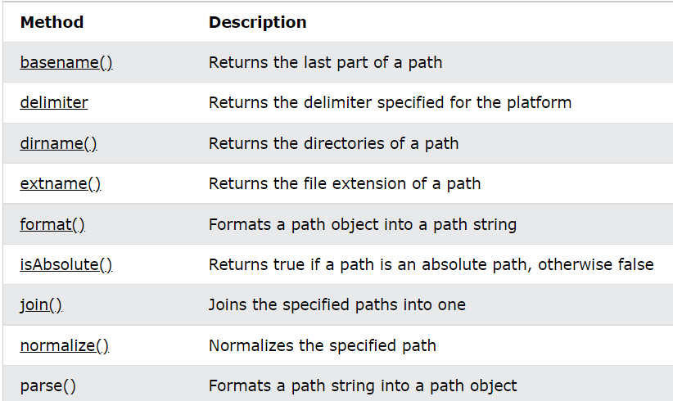
Path Properties and Methods

Slide 3
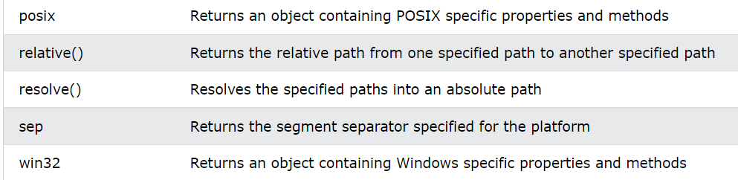
Path Properties and Methods

Slide 4
Node.js Path Module
Extract the filename from a file path:
var path = require('path'); var filename = path.basename('/Users/Refsnes/demo_path.js'); console.log(filename);

