Slide 1
Socket.IO
Socket.IO is a library that enables real-time, bidirectional and event-based communication between the browser and the server. It consists of:
a Node.js server
a Javascript client library for the browser (which can be also run from Node.js)

Slide 2
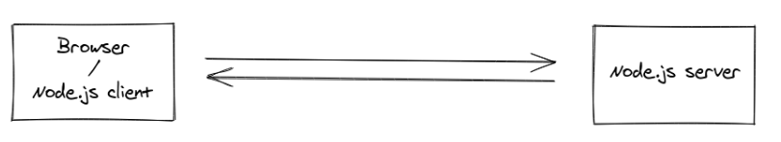
Socket.IO

Slide 3
Basic Terminology Of Socket.io
io.on(‘connection’,()=>{}) // whenever connection is stablished between client and server this function is called.
socket.on(‘name of event’,()=>{}) this is used both in client side and server side to listen to the event which is emitted by socket.emit and run the code inside it
socket.emit(‘name of event’,()=>{}) // this is used in both client side (js) and server side this emits the event which the client or server will listen to

Slide 4
Basic Terminology Of Socket.io
socket.on(‘disconnect’,()=>{}) internal socket function use it when you want to know when a client disconnects

Slide 5
Broadcasting
Broadcasting is defined as sending a message to all connected clients.
There are different levels of broadcasting the message

Slide 6
Broadcasting
socket.emit() vs socket.broadcast.emit() vs io.emit() these 3 events are used for emitting the difference between them is that socket.emit() will emit to only specific socket like it will emit to its only client , socket.broadcast.emit() will emit to all clients excepts to its own client (self client) and io.emit() will emit to all clients no exception.

Slide 7
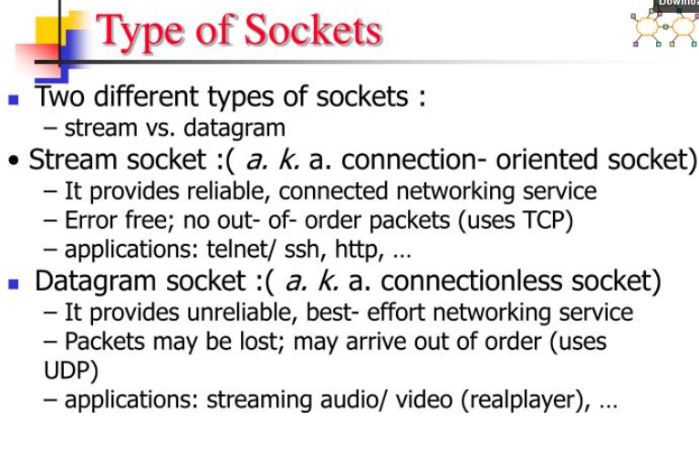

Slide 8
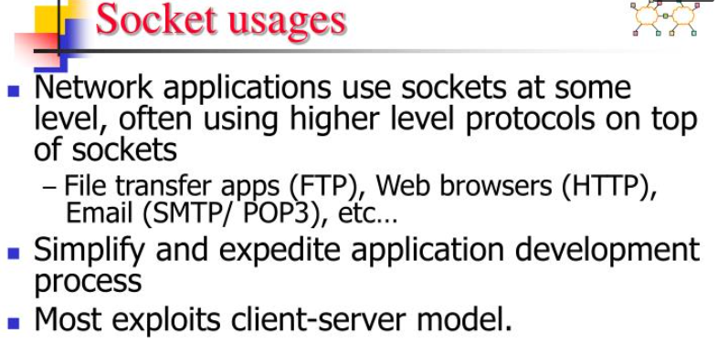

Slide 9
Set Up TCP Client/Server App with Node.js
What is TCP?
TCP stands for Transmission Control Protocol and is one of the TCP/IP internet protocols.
Using TCP, you can exchange data between a client and server in a reliable way.

Slide 10
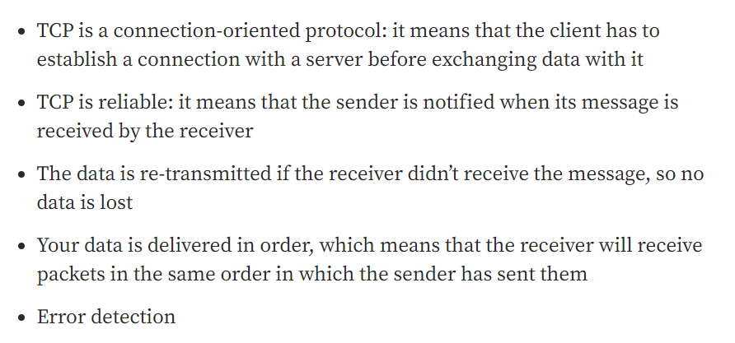
Main Features

Slide 11
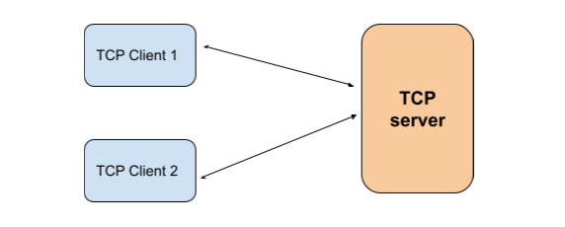
Application architecture
The server: it will listen on a specific port in which the client messages will come and will send a response to the client request.
The client will send to a server a message and wait for a response to its request

Slide 12
The TCP clients
“The net module provides an asynchronous network API for creating
stream-based TCP” , each client will:
connect to the server
send a message
wait for server response

Slide 13
The TCP server
After starting it, the server will listen on a specific port (Example: 2000) and will:
wait for a client connection
receive data from each connected client
send back a response to each connected client

Slide 14
Transport Layer Security
TLS is a set of protocols that rely on a public key infrastructure (PKI) to enable secure communication between a client and a server.
For most common cases, each server must have a private key.
With TLS, all servers (and some clients) must have a certificate.
Certificates are public keys that correspond to a private key.

Slide 15
Transport Layer Security
TLS (Transport Layer Security) represents the current standard for communications privacy in the Internet.
TLS is used in server and client applications ranging from web browsers to electronic banking software and e-commerce sites.

Slide 16
Transport Layer Security
Transport Layer Security (TLS) encrypts data sent over the Internet to ensure that eavesdroppers and hackers are unable to see what you transmit which is particularly useful for private and sensitive information such as passwords, credit card numbers, and personal correspondence.

