Slide 1

PROJECT NAME: Student Marksheet and Ranking System
SUBMITED BY: GUIDENCE/SUBMITED TO:
VINEET VIDYARTHI MISS.NAINA DEVI
1ST SEMESTER IBM SME
BTECH CSE (AI/ML) SESSION:2025-26
SECTION: B ERP=RU- 25-11679
IBM

Slide 2
📌title
Student Marksheet & Ranking System using C
Developed using C programming
Demonstrates arrays, loops, and logic building
Automates marksheet, ranking, and toppers

Slide 3
🧾 INTRODUCTION TO PROJECT
Project Overview
Manual marksheet preparation is time-consuming and error-prone
  This project automates:
  Marksheet generation
  Percentage calculation
  Rank list
  Subject toppers
Implemented using C programming language

Slide 4

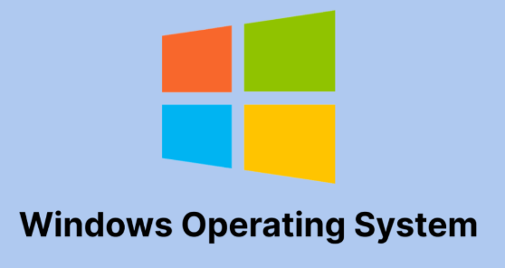
🛠️ TOOLS & TECHNOLOGIES USED
💻 Visual Studio Code (VS Code)
Used as the source code editor for writing and managing the C program.
Provides syntax highlighting and an easy-to-use interface.
⚙️ GCC Compiler
Used to compile and execute the C program.
Converts C source code into executable machine code.
⌨️ C Programming Language
Used to implement program logic using loops, conditions, and variables.
🖥️ Windows Operating System
Provides the environment to run VS Code and GCC compiler.

Slide 5
⚙️ PROJECT WORKING
1 .User enters:
  Number of students
  Number of subjects
2 .Marks are entered for each student
3 .Program calculates:
  Total marks
  Percentage
  Rank
  Subject toppers
Final output displayed on console.

Slide 6
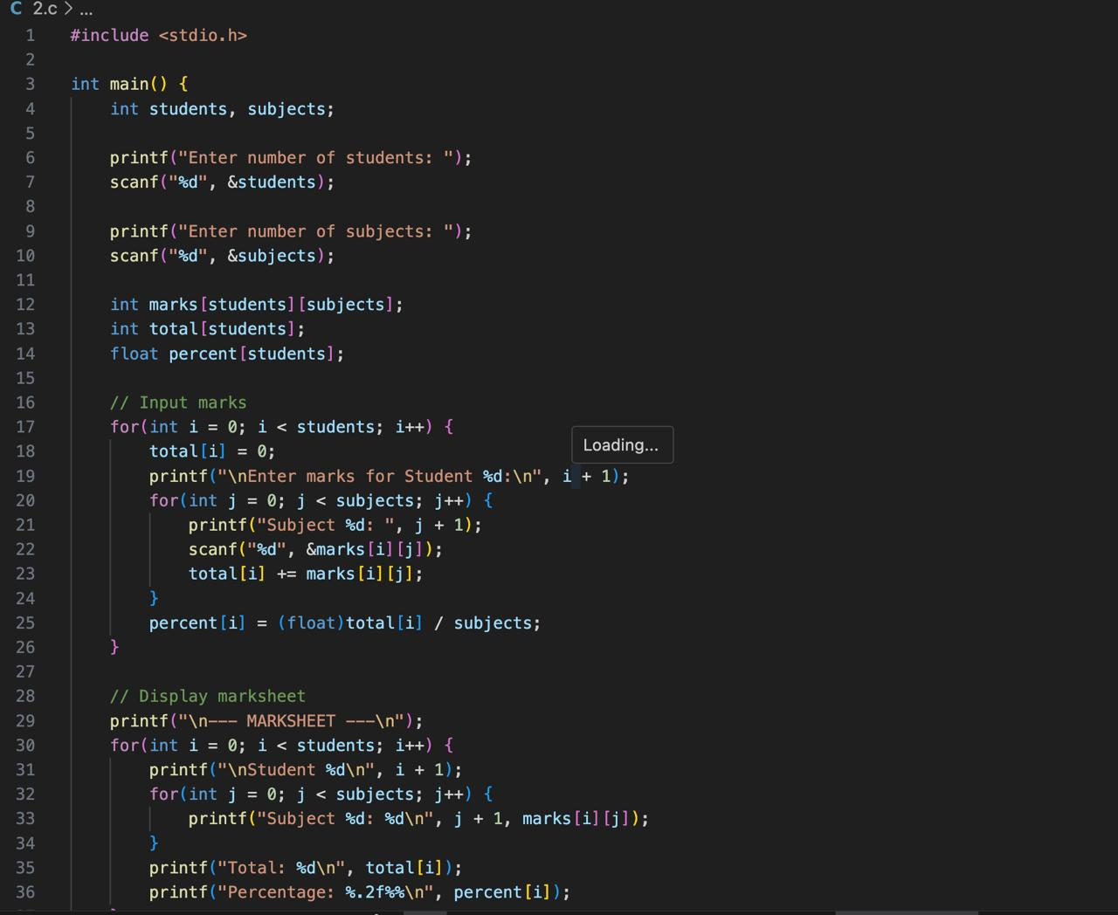
📸 SCREENSHOT

Slide 7
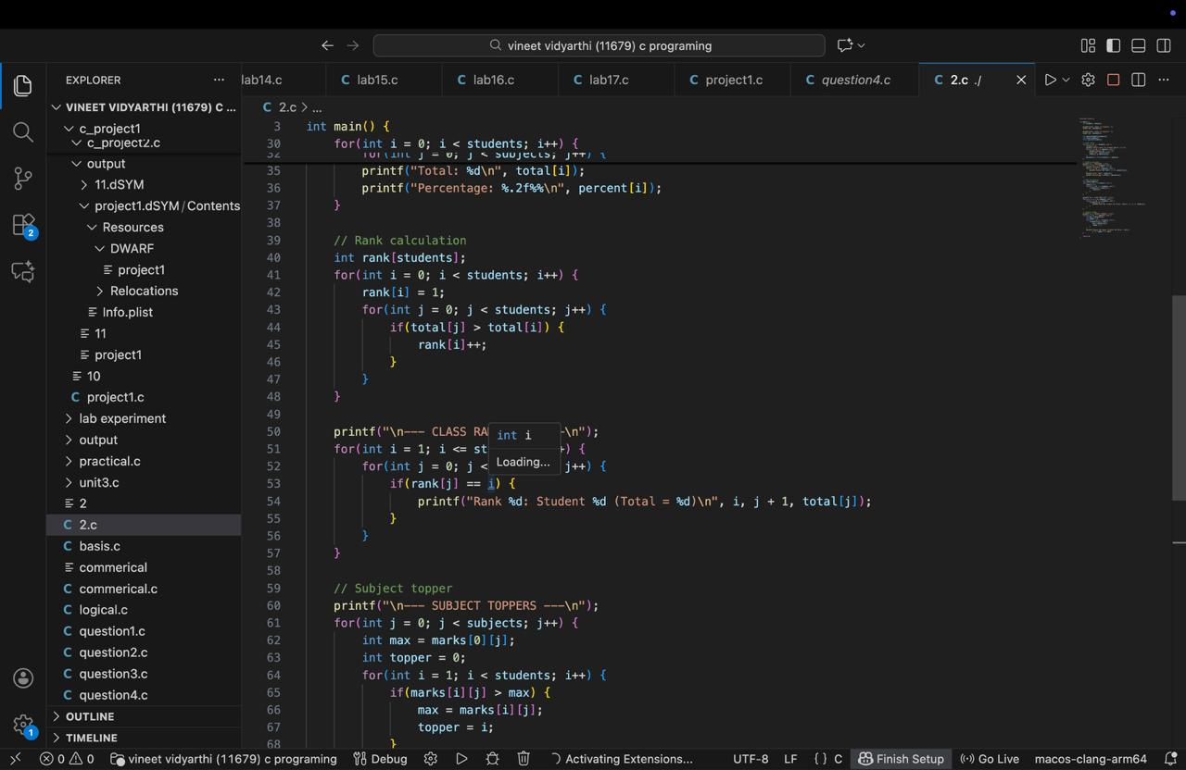

Slide 8
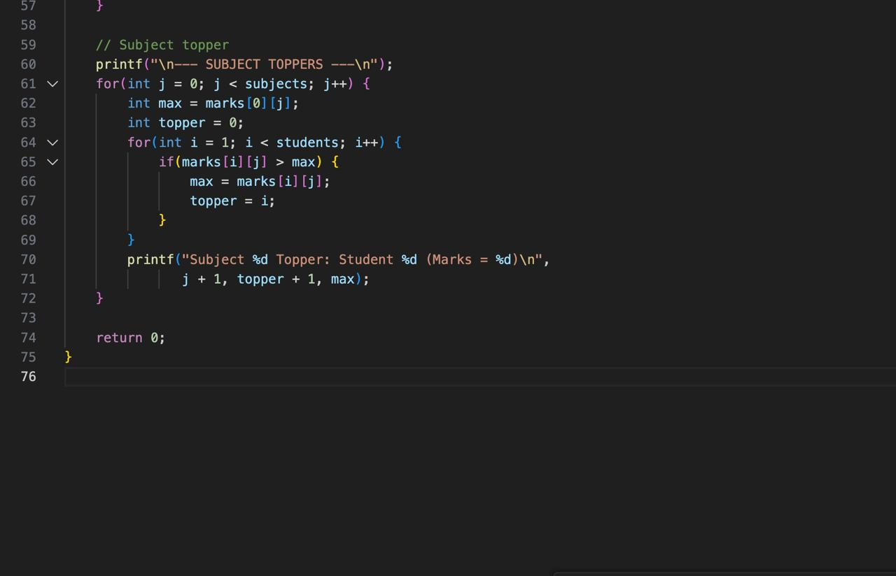

Slide 9
CORE LOGIC EXPLANATION
Key Concepts Used
int marks[students][subjects] → stores marks
total[] → total marks per student
percent[] → percentage calculation
Nested loops → input and processing
Rank logic → compares totals
Subject topper logic → finds highest marks

Slide 10
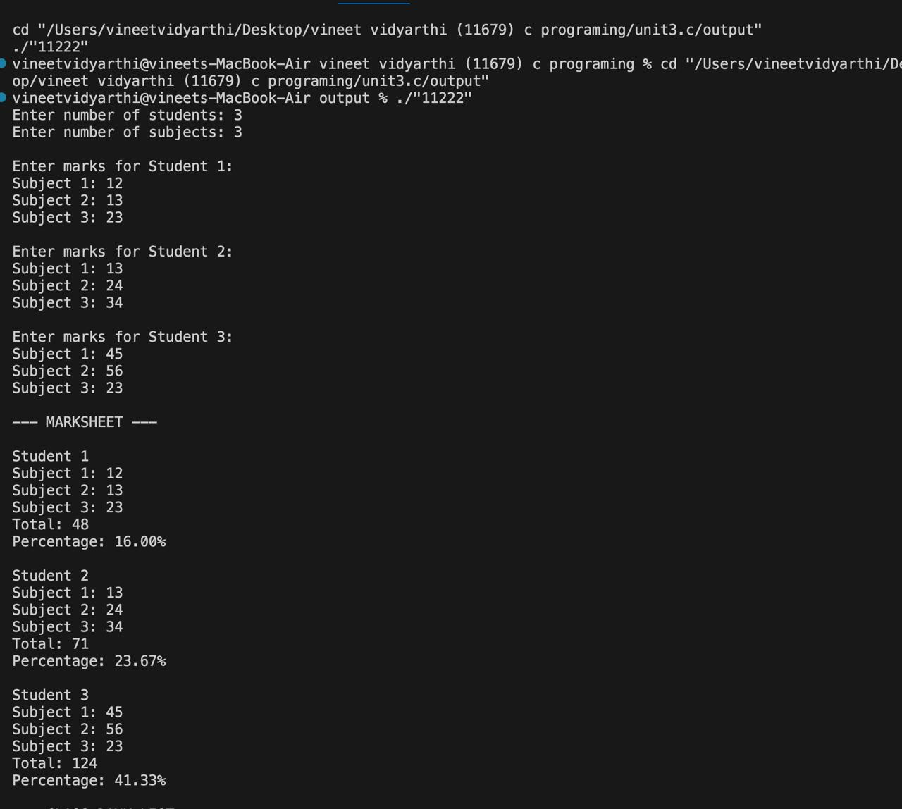
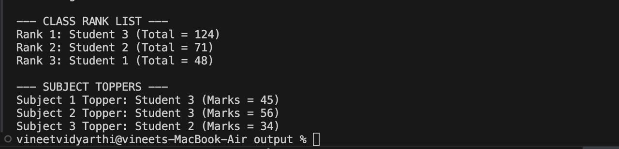
📊 Output

Slide 11

✅ Advantages
Simple and easy to understand
Reduces manual errors
Efficient processing
Demonstrates core C concepts
Beginner-friendly project.

Slide 12
🔮 Future Scope
Add grade calculation
Store data in files
Menu-driven interface
Add student names
Convert to GUI application
Database integration

Slide 13


