Slide 1
Oauth In DID
oauth server with did
luyu
2019.04

Slide 2
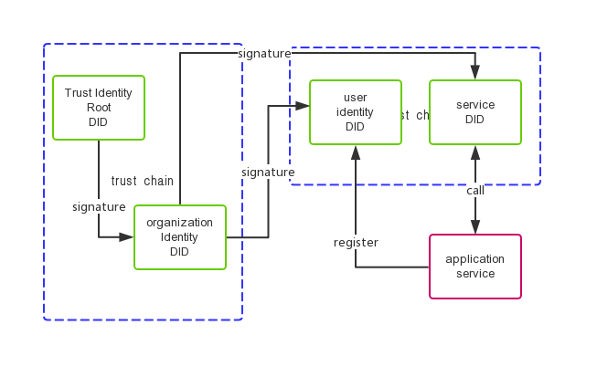
Trusted Identity
Signature Authentication
DID Public key management
Distributed PKI

Slide 3
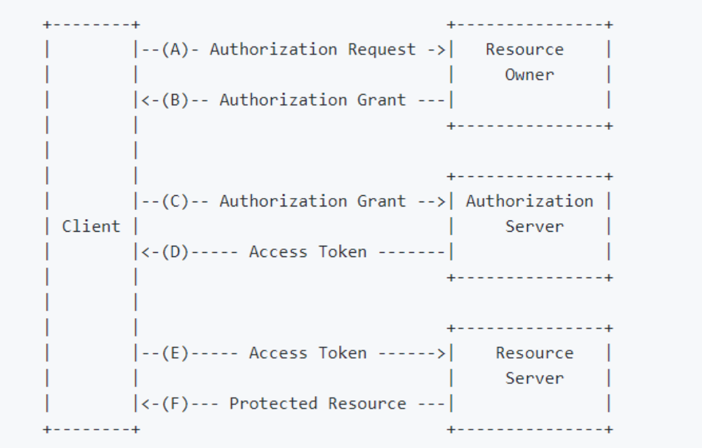
OAuth flow
Grant Access
Token Service

Slide 4
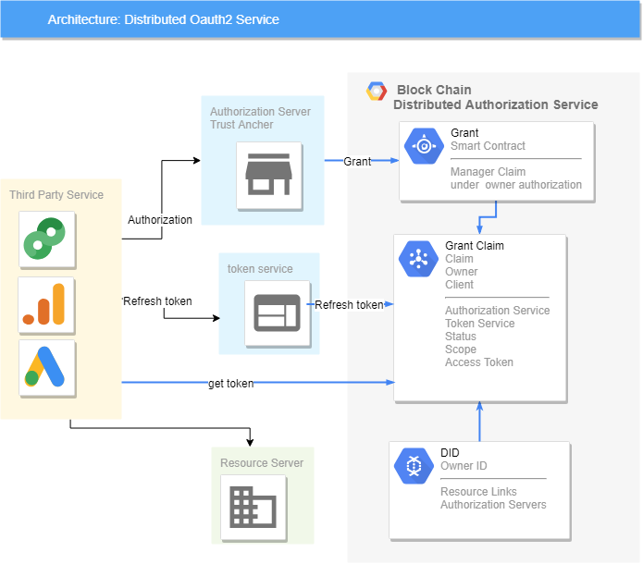
Distributed Authorizateion Service
Get Token from Trusted DID Directly
Authorization as Grant
Refresh Token

Slide 5
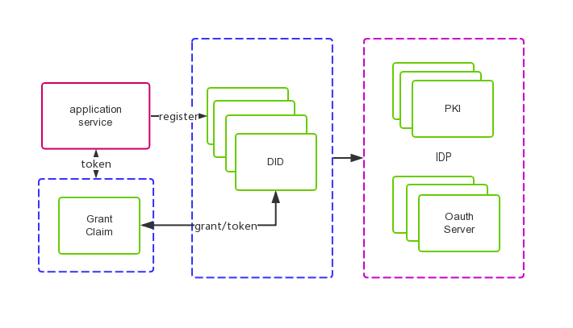
Identity Proxy
Identity Provider (PKI/Oauth)
IDP Proxy

