Slide 1
Docker Theory

Slide 2
why docker is came?
when developer devolpes an application which includes like dependency,libraryes,some computer osi etc. then we pack it in jar file(in springboot). then we send to
tester.or production like that. but here application run perfectly in our computer. but it is not working in our tester computer. tester says application not working
send it back to devloper. but it working good at developer computer. here is the problem. There may be missing some dependency (or) libraries some computer osi etc.
In order to avoid these type of problem. docker is came to game.

Slide 3
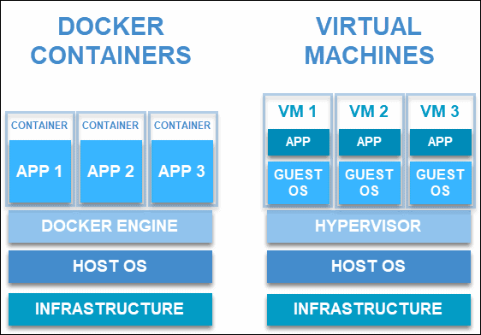
what is docker?
simply put, a tool which is designed to make it easier to create, deploy, and run applications by using containers is what we call Docker.
It is an open platform for developing, shipping, as well as running applications.
See in computer we have base hardware. upon operating system(any os ).then we install Docker up on it. where docker can have many containers(image inside container). each container have one
application. where we pack our conatiner which includes all our dependency,libraries, computer osi. then we shift to tester or other system. or we can also deploy
in server.

Slide 4
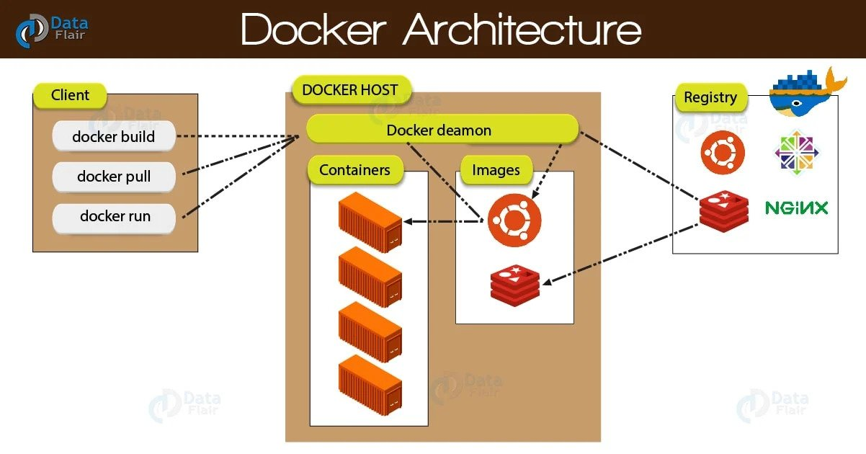
Docker architecture diagram?

Slide 5
it uses a client-server architecture.
Where client side we have
Docker build, docker pull , docker run.

Slide 6
Docker host
Basically docker host run docker deamon. Which listens docker client request. Such has docker build, docker pull, docker run. nd also manages Docker objects like images, containers, networks, etc.
Docker client-servere communicate with Docker API. (Rest API). You know how rest-api works.

Slide 7
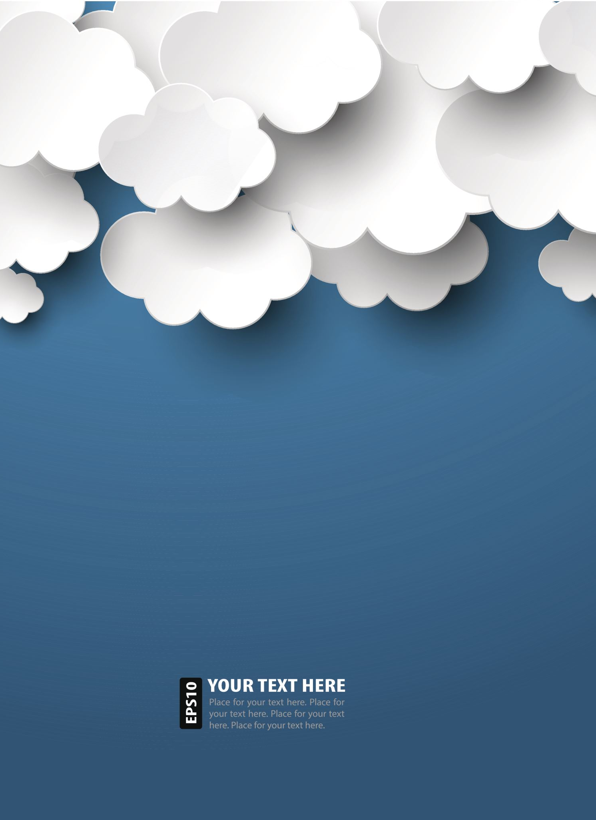
Docker Registries
A stateless, highly scalable server-side application, which stores and lets us distribute Docker images is what we call the Registry.
There is a flexibility that either we can create our own image or we can use public registries such as Docker Hub and Docker Cloud.
Docker is configured to look for images on one of its public registries “Docker Hub”. One of the advantages it offers is we can create our own registry as well.
while we run the docker pull . it is possible to pull the required images from our configured registry.
Basically, our image is pushed to our configured registry, while we use the docker push command.

Slide 8
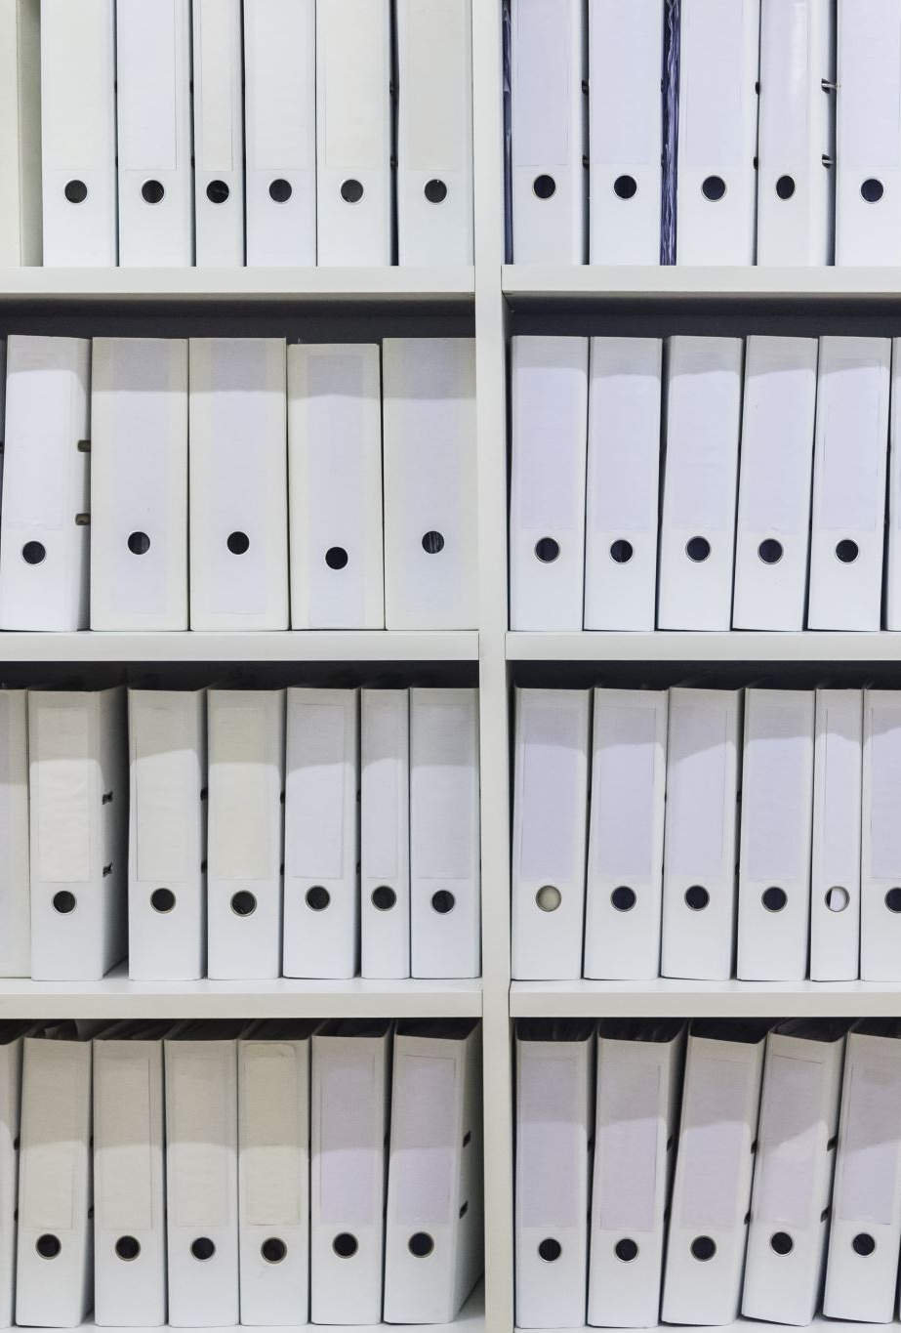
Docker Objects
There are several objects we create as well as use while we use Docker, like images, containers, networks, volumes, plugins, and many more

Slide 9
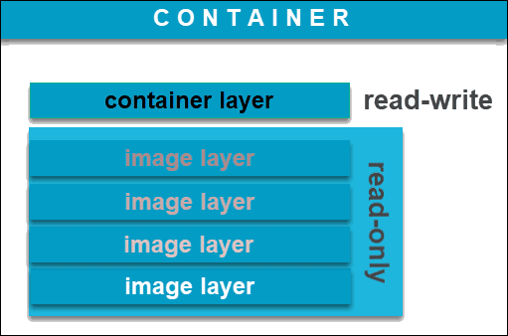
Docker Image
A Docker image is an immutable (unchangeable) file that contains the source code, libraries, dependencies, tools, and other files needed for an application to run.
Due to their read-only quality, these images are sometimes referred to as snapshots.
Since images are, in a way, just templates, you cannot start or run them. What you can do is use that template as a base to build a container. A container is, ultimately, just a running image. Once you create a container, it adds a writable layer on top of the immutable image, meaning you can now modify it.
You can create an unlimited number of Docker images from one image base. Each time you change the initial state of an image and save the existing state, you create a new template with an additional layer on top of it.

Slide 10
Write the Dockerfile
Docker builds images automatically by reading the instructions from a Dockerfile. It is a text file that contains all commands needed to build a given image.
Example we are creating Dockerfile. I n spring boot application.
Synatx of Dockerfile name is Dockerfile.

Slide 11

Docker Container
Let’s understand about containers in a different way that, if an image is a class, then a container is an instance of a class—a runtime object. So, a runnable instance of an image is what we call a container.
We can only run image by creating container. One image can have many containers.
Docker API or CLI, it is possible to create, start, stop, move, or delete a container.

Slide 12
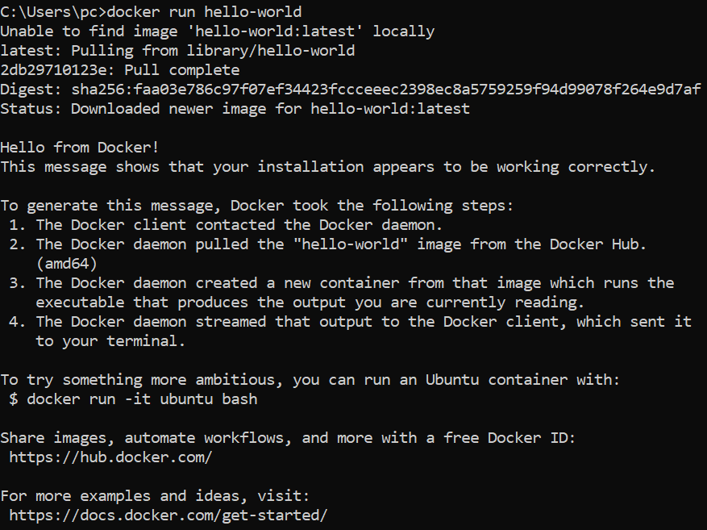
Docker Commands
Docker commands .
Docker version - Runs in command prompot. In order to know that version.
When command-- docker run hello-world.(response see below).
First it is not found image in locallly. Then it is pulled from docker hub. See in process in image.

Slide 13
Creating a Docker Image for your Application
Write a Dockerfile for your application.
Build the image with docker build command.
Host your Docker image on a registry.
Pull and run the image on the target machine.

