Slide 1


FOUNDED
2020
BASE
Malaysia
EXHIBITION PROMOTION
CONTACT
Malaysia’s palm oil expertise, ready for your brand.
info@naturzindustries.com
Cooking oil and palm derivative products for food manufacturers, distributors and OEM partners.
01 / 10
NATURZ INDUSTRIES SDN BHD

Slide 2

BEST FOR YOUR PLATE
Naturz’s best for your plate.
A simple booth message for buyers: dependable vegetable oil products for frying, baking, cooking and food processing.
Reliable. Practical. Export-ready.
02 / 10
BRAND PROMISE

Slide 3
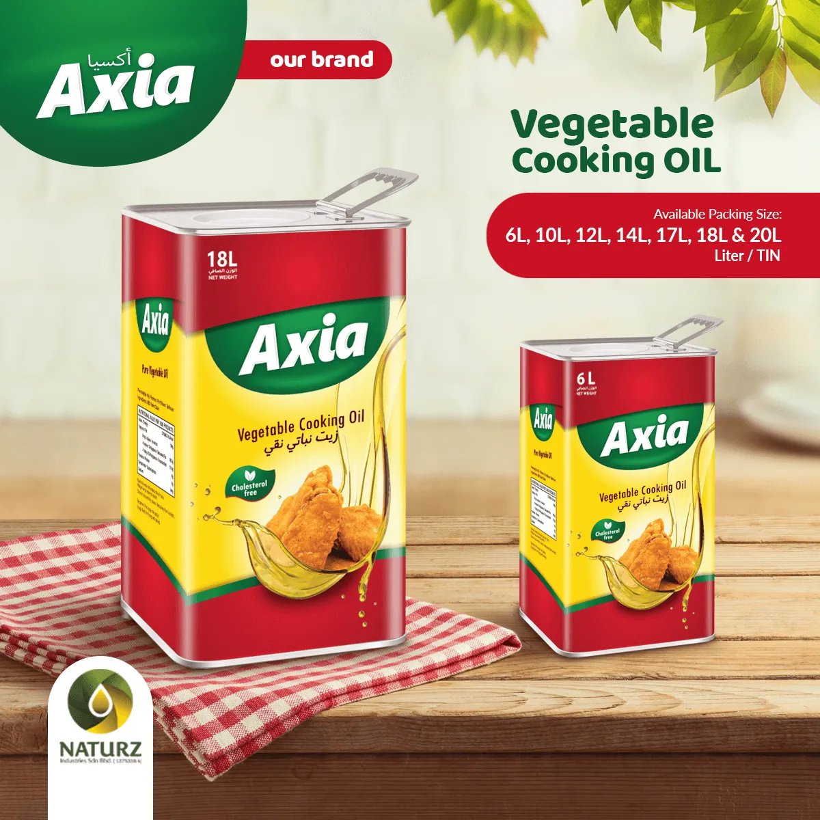
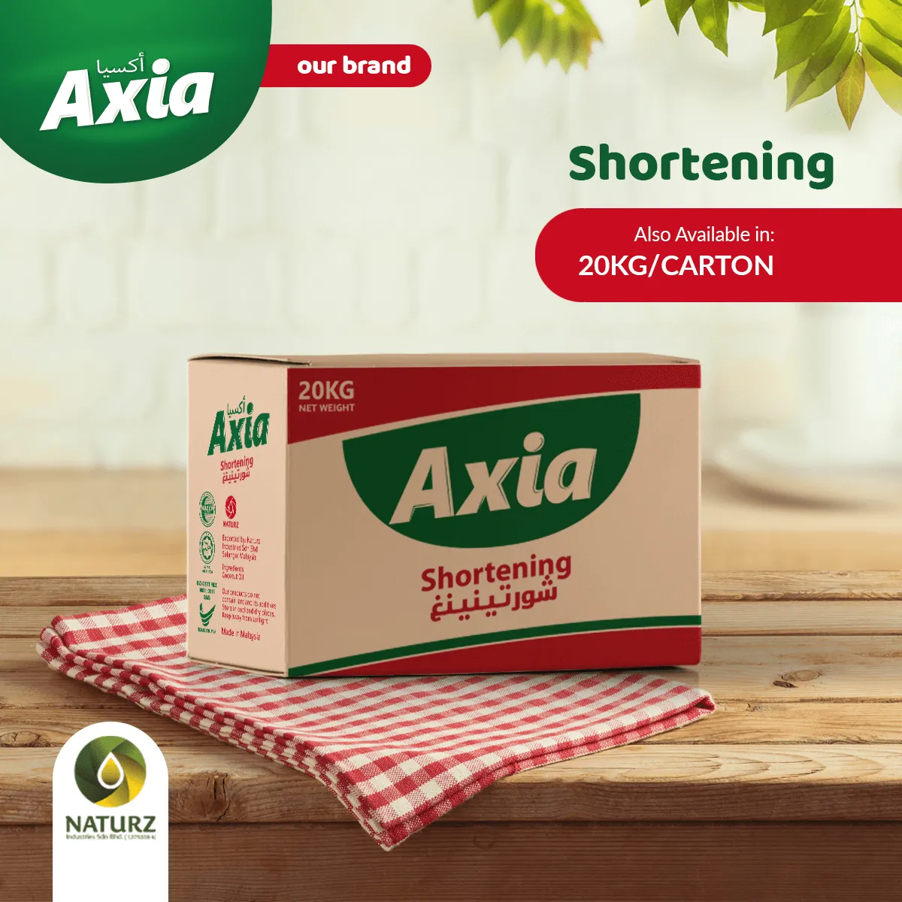
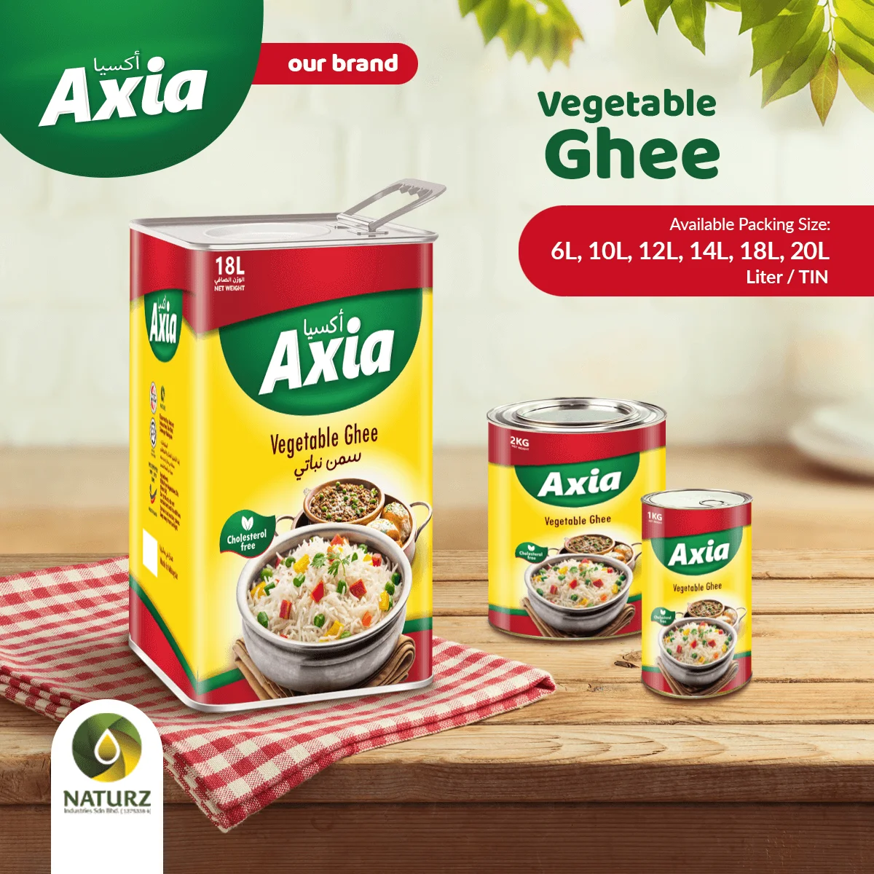
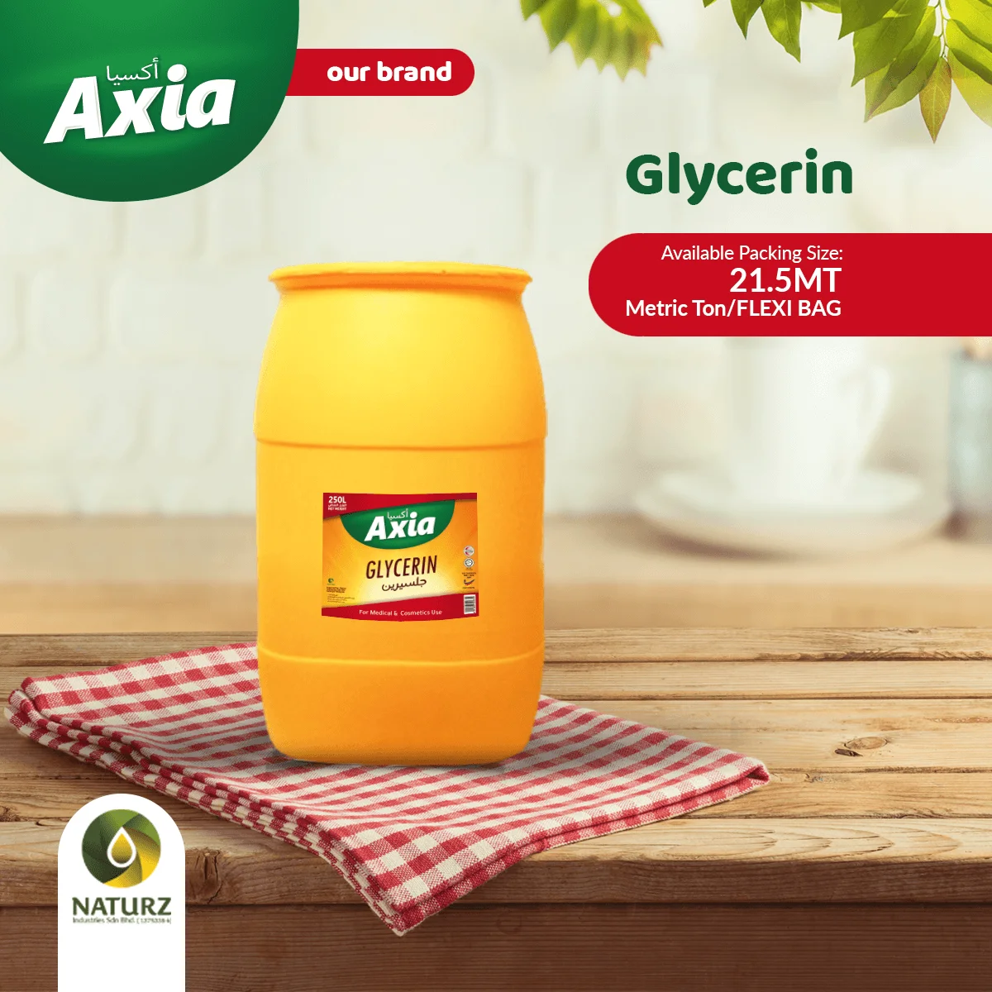
One supplier. Multiple food applications.
Product lines for bulk buyers, distributors, food service, bakery, confectionery and industrial food use.
RBD Palm Olein
Shortening
Vegetable Ghee
Glycerin
CP5, CP6, CP7, CP8 and CP10 grades listed by Naturz.
For bakery, frying and food processing needs.
Stable fat solutions for cooking and formulation.
Palm derivative category available from the portfolio.
03 / 10
PRODUCT RANGE

Slide 4

CORE PRODUCT
RBD Palm Olein for cooking, frying and food processing.
Naturz lists a wide range of palm olein grades for OEM cooking oil service and export buyers.
CP5
CP6
CP7
CP8
CP10
04 / 10
RBD PALM OLEIN

Slide 5
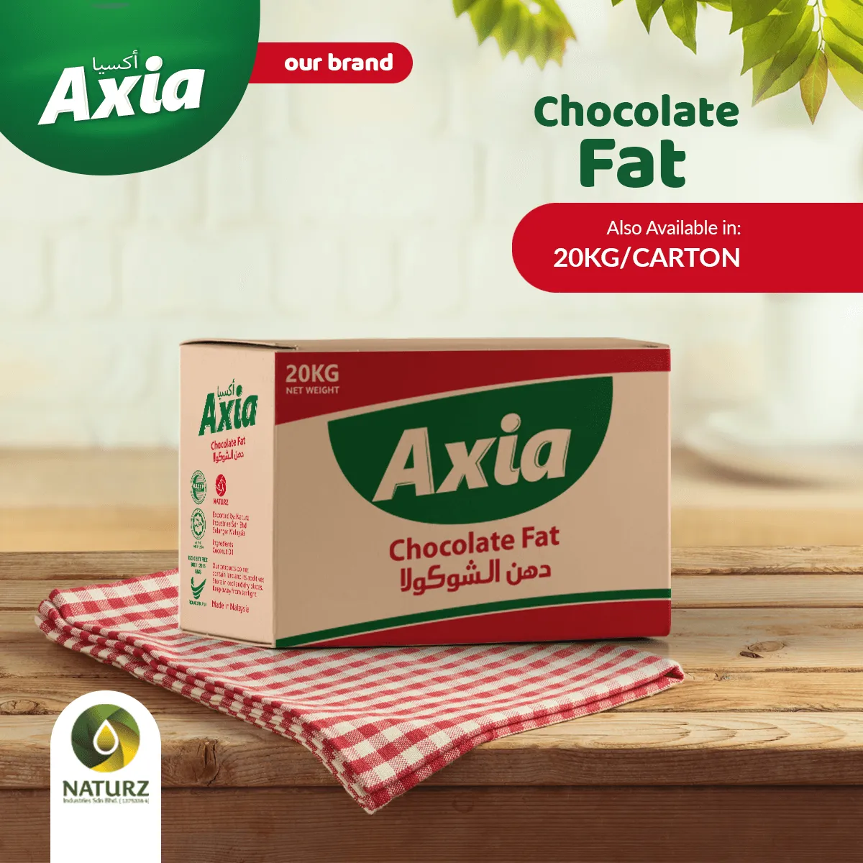
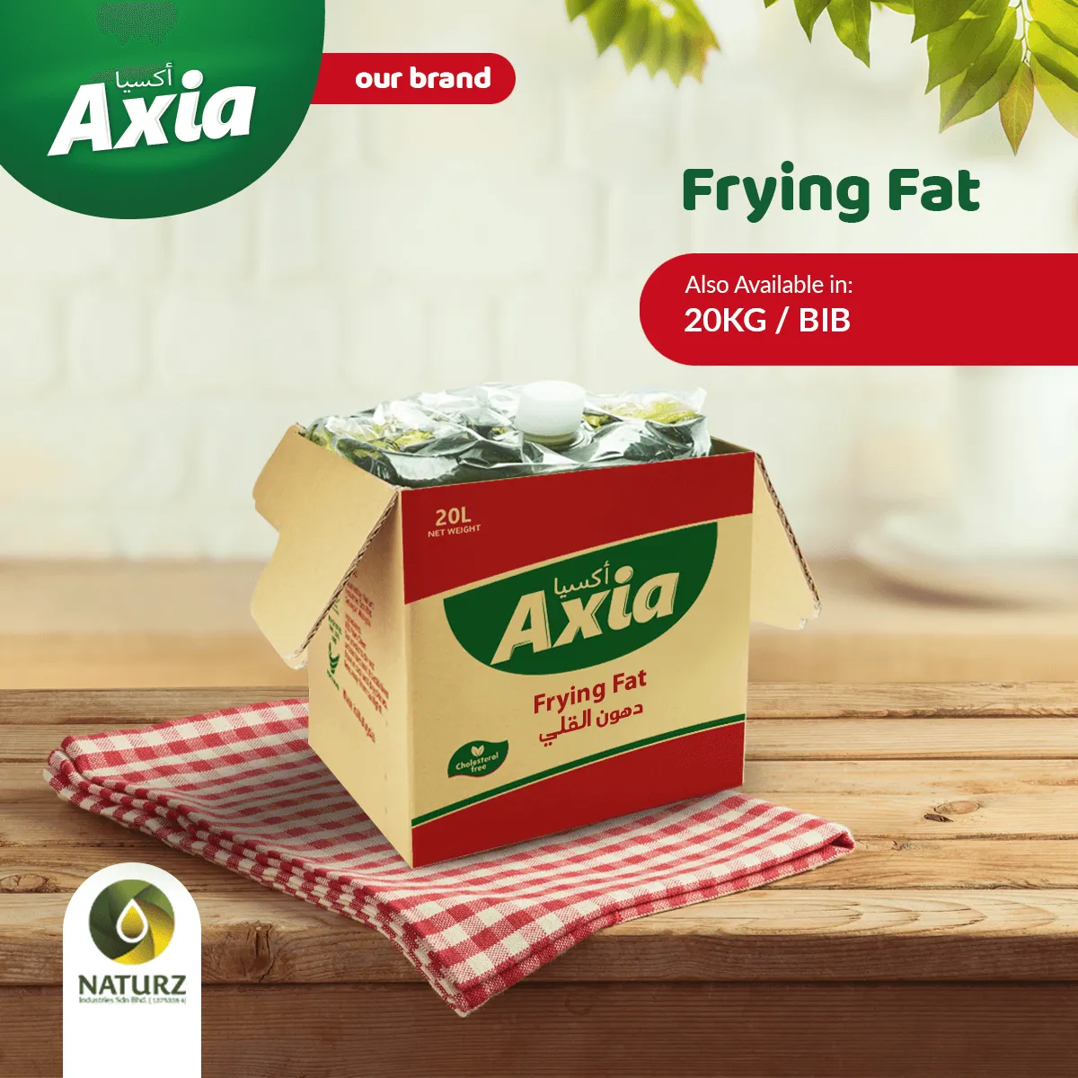
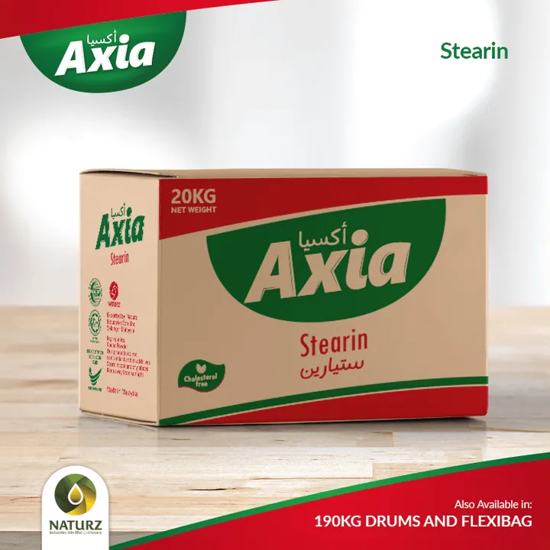
Specialty fats and derivatives for food applications.
A broader portfolio helps buyers discuss bakery, confectionery, food service and industrial formulation needs.
Chocolate Fat
Frying Fat
Palm Stearin
Specialty fat category
Food-service use
Palm derivative line
05 / 10
SPECIALTY FATS

Slide 6
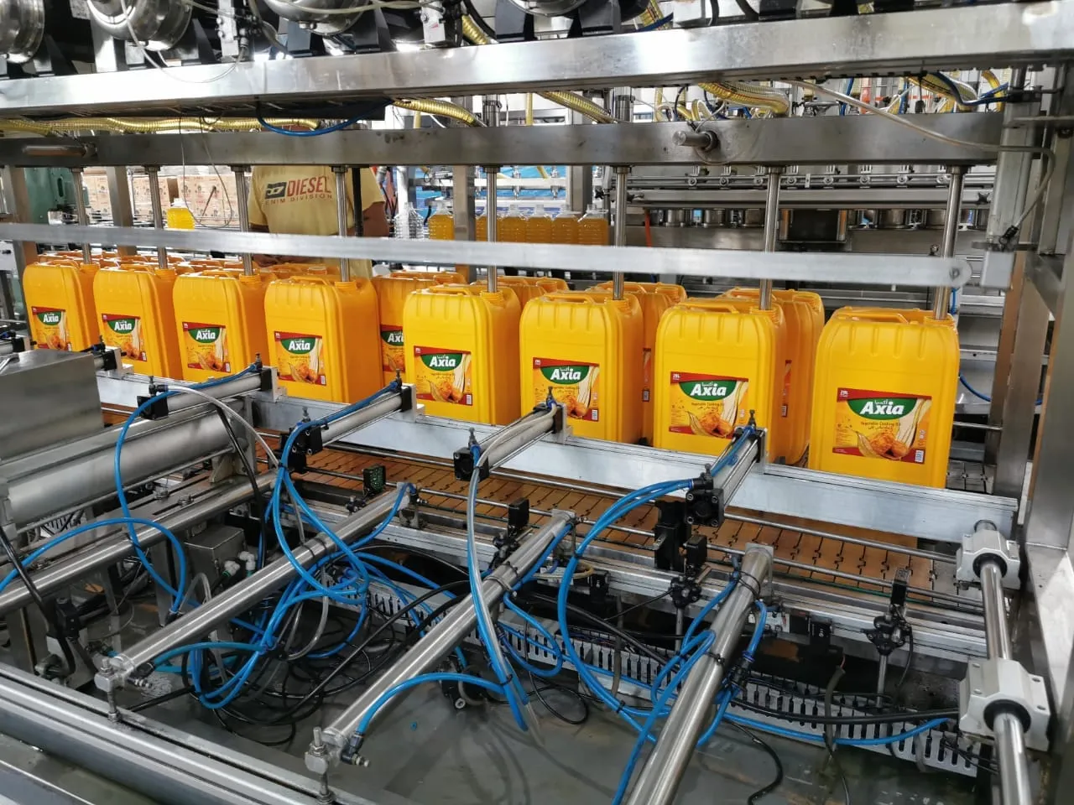
MANUFACTURING + EXPORT
Built for B2B supply conversations.
Naturz describes its business as manufacturing, marketing and exporting palm oil derivatives.
FOUNDED
BASE
FOCUS
2020
Malaysia
Palm derivatives
06 / 10
PRODUCTION READINESS

Slide 7
OEM + EXPORT
Move from product interest to quotation.
Choose product and grade
RBD palm olein, shortening, ghee, frying fat or derivative category.
1
Choose pack format
Bottle, tin, jerry can, carton or buyer-specific packaging discussion.
Use the booth conversation to capture grade, pack format, volume, destination and documentation needs.
2
Start quotation
Share market, volume, documentation needs and timeline.
3
07 / 10
OEM + EXPORT

Slide 8




BUYER CONFIDENCE
Quality conversations start before the quotation.
Use certification and standards cues to guide buyers toward the right documentation questions.
Confirm certificate scope and validity per product, order and destination market.
08 / 10
QUALITY CUES

Slide 9
VISIT OUR BOOTH
Ask for grade, packaging and export quotation.
EMAIL
info@naturzindustries.com
PHONE
+603 5569 1581
Bring product category, market, volume, packaging, documentation and delivery timeline.
MOBILE
+6011 1115 4642
MALAYSIA OFFICE
UOA Business Park, Shah Alam, Selangor, Malaysia.
09 / 10
CONTACT

Slide 10
NATURZ INDUSTRIES
Let’s build your next cooking oil supply program.
Talk to our team about product grade, packaging and export requirements.
Visit naturzindustries.com
info@naturzindustries.com · +603 5569 1581
10 / 10
CLOSING CTA

