Slide 1


Mind the Gap: Towards Secure 1st-order Masking in Software
Kostas Papagiannopoulos
kostaspap88@gmail.com
Nikita Veshchikov
nveshchi@ulb.ac.be

Slide 2
Software Masking Theory and Practice
1

Slide 3


Software Masking: Theory
Split Values
Crypto Primitive: Key-dependent values
Implementation: Device + Leakage function
Side-Channel: Physical observables + Exploitation

Slide 4
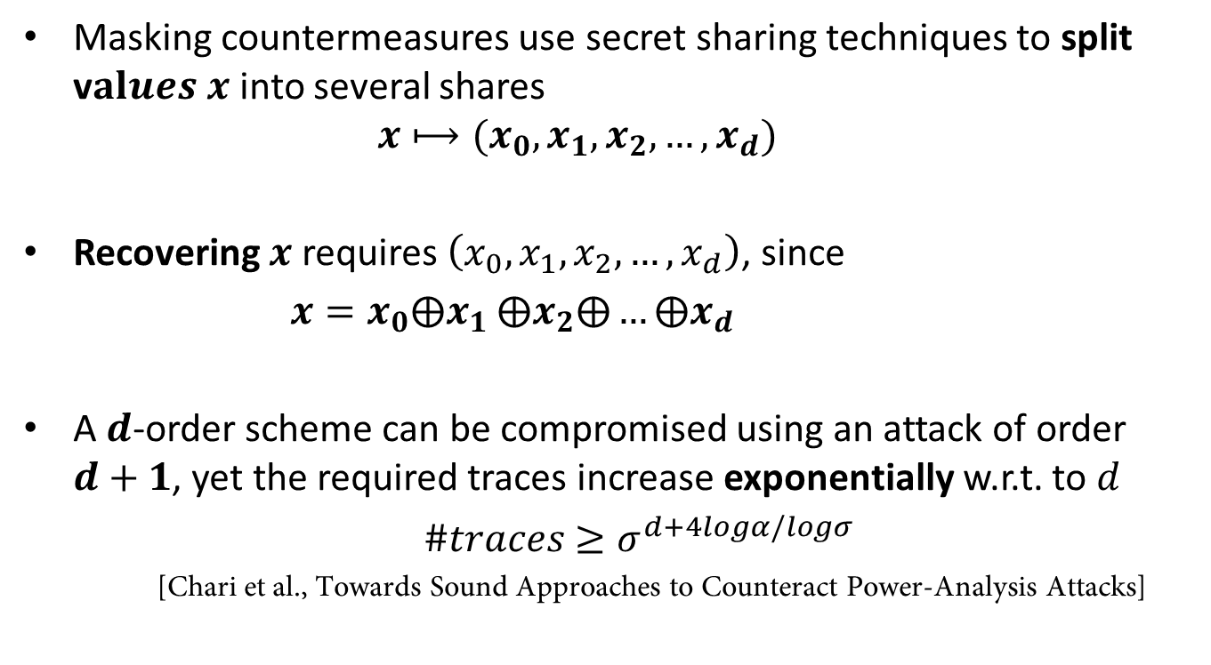
Software Masking: Theory
Masking countermeasures use secret sharing techniques to split v$alues x$into several shares
$$x⟼(x_{0},x_{1},x_{2},…,x_{d})$$
Recovering $x$ requires $\left(x_{0},x_{1},x_{2},…,x_{d}\right)$, since
$x=x_{0}⨁x_{1}$ $⨁x_{2}⨁…⨁x_{d}$
A$d$-order scheme can be compromised using an attack of order $d+1$, yet the required traces increase exponentially w.r.t. to $d$
$\#traces$ $≥σ^{d+4logα/logσ}$
[Chari et al., Towards Sound Approaches to Counteract Power-Analysis Attacks]

Slide 5
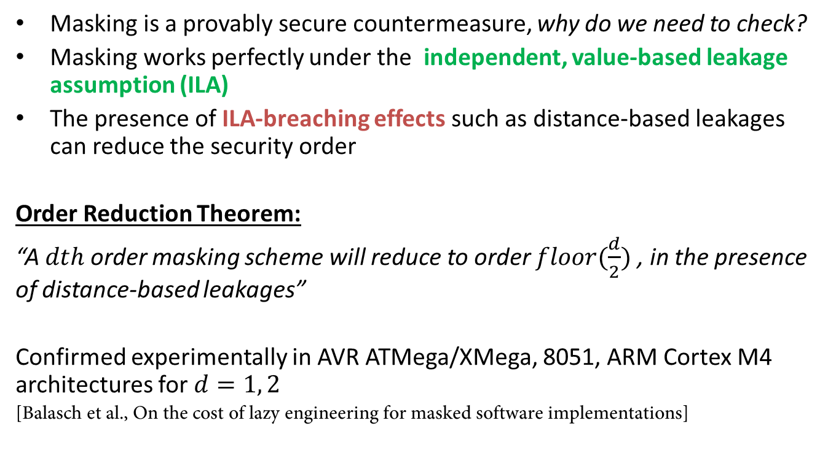
Software Masking: Practice
Masking is a provably secure countermeasure, why do we need to check?
Masking works perfectly under the independent, value-based leakage assumption (ILA)
The presence of ILA-breaching effects such as distance-based leakages can reduce the security order
Order Reduction Theorem:
“A $dth$order masking scheme will reduce to order $floor(\frac{d}{2})$ , in the presence of distance-based leakages”
Confirmed experimentally in AVR ATMega/XMega, 8051, ARM Cortex M4 architectures for $d=1, 2$
[Balasch et al., On the cost of lazy engineering for masked software implementations]

Slide 6

Software Masking: Practice

Slide 7
Software Masking: Goal
Can we implement a 1st-order Boolean masking scheme that can resist 1st-order univariate attacks?
What is the price?

Slide 8
ILA-Breaching Effects Security hazards on ATMega163: Origin and Solutions
2

Slide 9

Overwrite Effect
1 ; share x0 in r17
2 ; share x1 in r23
3 mov r17 , r23
r17
x0
r17
x1
$$\#bitflips \sim x_{0} ⊕ x_{1} \sim x$$

Slide 10
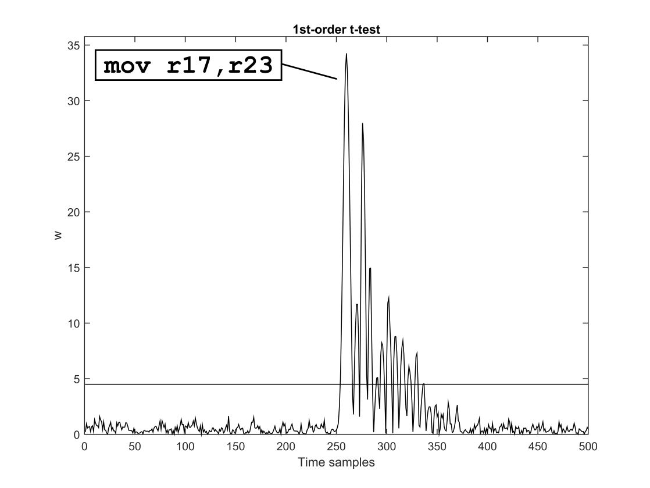
Overwrite Effect
1 ; share x0 in r17
2 ; share x1 in r23
3 mov r17 , r23
Already observed and analyzed in registers [Keccak team, Note on side-channel attacks and their countermeasures] [Coron et al., Conversion of security proofs from one leakage model to another]
We also detect that SRAM memory overwrites can breach ILA
Can be solved by clearing the registers or memory

Slide 11

Memory Remnant Effect
SRAM Memory
1 ; share x0 in 0x0080
2 ; share x1 in 0x0090
3 ldi r27 , 0x00
4 ldi r26 , 0x80
5 ld r17 , X
6 ldi r27 , 0x00
7 ldi r26 , 0x90
8 ld r20 , X
0080 : x0
0090 : x1
Pipeline
x0
$⊳$ x1
ALU
x0

Slide 12
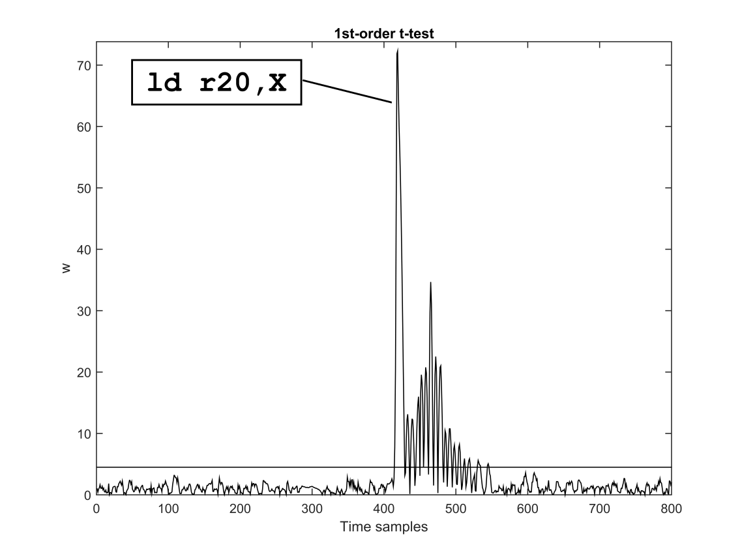
Memory Remnant Effect
1 ; share x0 in 0x0080
2 ; share x1 in 0x0090
3 ldi r27 , 0x00
4 ldi r26 , 0x80
5 ld r17 , X
6 ldi r27 , 0x00
7 ldi r26 , 0x90
8 ld r20 , X
Can be solved by dummy memory accesses or avoiding consecutive accesses to the same family of shares

Slide 13
Neighbour Leakage Effect
1 ; share x0 in r3
2 mov r2 , r2
3 nop ; 5 times
4 mov r3 , r3
Register file, theory
r0
r1
r2
r3
Register file, practice
r0
r1
r2
r3
The effect’s origin is less clear
Multiplexers activate more than one register
Lack of physical separation in the architecture
Hidden registers
Linking leakage effects to architectural choices is non-trivial

Slide 14
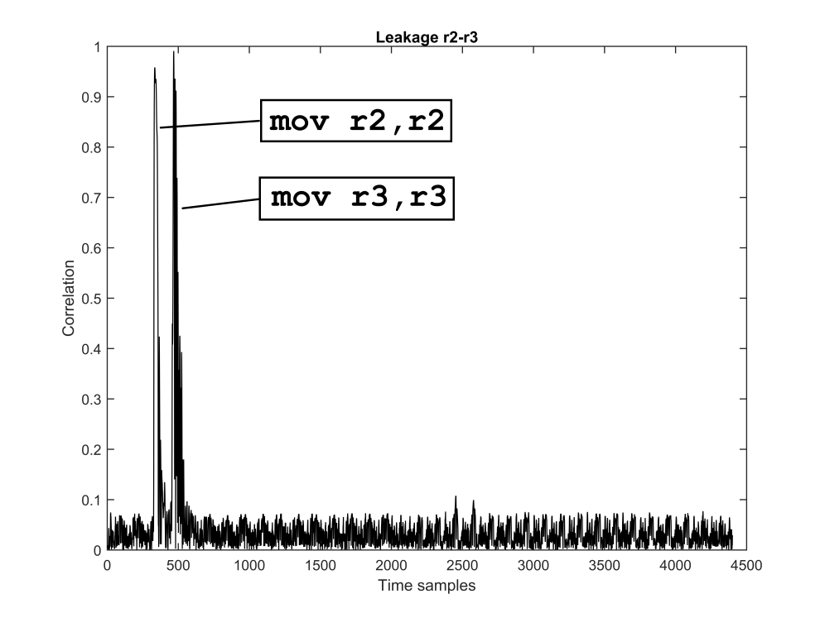
Neighbour Leakage Effect
1 ; share x0 in r2
2 mov r2 , r2
3 nop ; 5 times
4 mov r3 , r3
Correlation with x0
We analyzed the whole register file
Can be solved by avoiding certain registers e.g. r0
Keep shares at a distance in the register file

Slide 15
ASCOLD Detection Tool Assembly-oriented code checking
3

Slide 16
ASCOLD Tool
ASsembly COde Leakage Detection
Open-source tool that parses AVR assembly and detects potential threats
Every storage unit (register, memory position) keeps track of the mask shares and random numbers that are stored in it
SRAM Memory
0080 : x0, y1, t0
0090 : x1, t1
00a0 : rand_1

Slide 17
ASCOLD Tool
Any operation that combines more than a single share of the same family will raise an alarm
Only specified instructions can clean the track of a storage unit (e.g. re-randomization)
Assembly-oriented so device-dependent ILA-breaching effects can be easily integrated as extra rules
Limited to 1st-order masking schemes, under safe re-randomization and uses a conservative approach
Offers an assembly-oriented analysis, complementary to formal verification tools [Barthe et al., Verified proofs of higher-order masking]

Slide 18
Hardened Sbox & Evaluation Secure 1st-order masked implementations
4

Slide 19
Sbox Implementation
Create a 1st-order implementation without ILA-breaching effects
Assembly-based implementation of RECTANGLE Sbox for AVR ATMega163
Optimized bitsliced implementation with minimum multiplicative complexity [Grosso et al., LS-Designs: Bitslice Encryption for Efficient Masked Software Implementations]
1st -order ISW masking, securing 4 non-linear operations per Sbox iteration
Version 1: Standard “non-hardened” 1st-order, without ILA enforcement
Version 2: “Hardened” 1st-order secure Sbox with ILA enforcement
Clear registers (avoid overwriting)
Insert dummy ld instructions (avoid pipeline remnants)
Careful register allocation and distances inside the register file (avoid neighbouring effects)
Version 3: “Fully-hardened” 1st-order secure Sbox with ILA enforcement
Also insert dummy st instructions (avoid pipeline remnants)

Slide 20
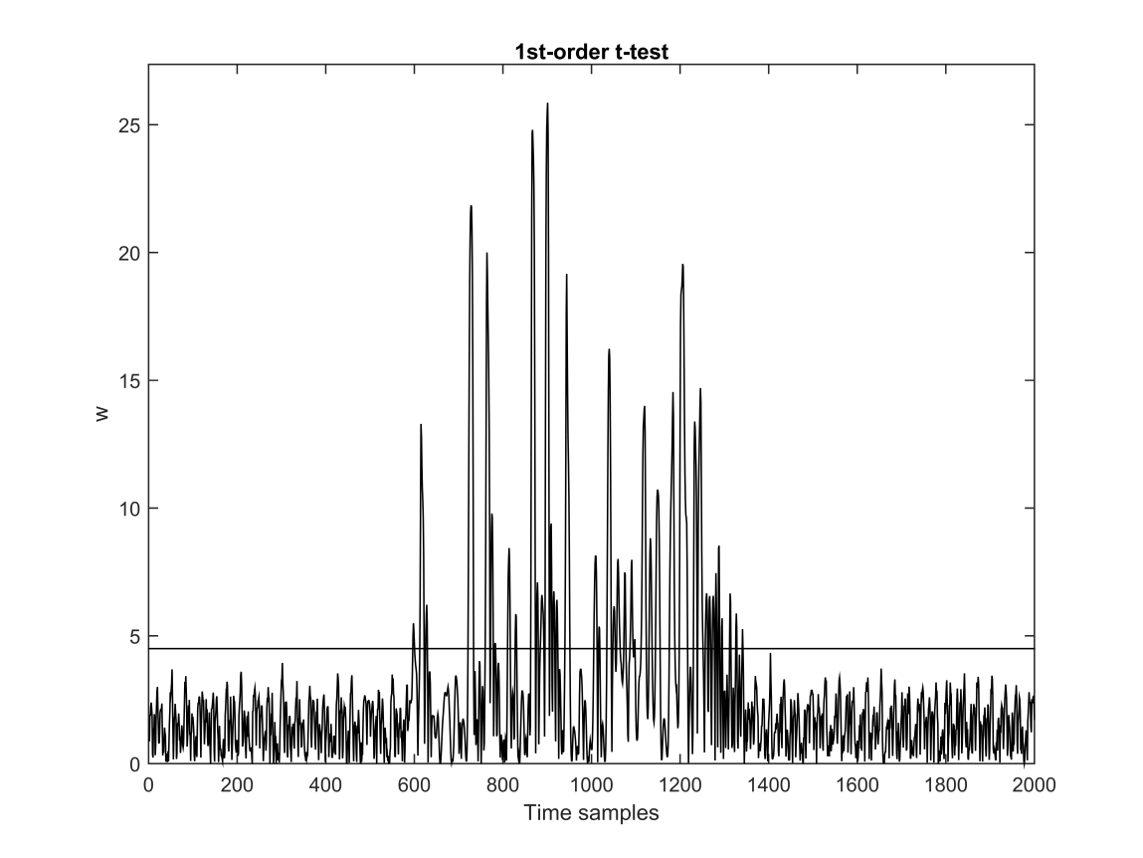
Evaluation: Non-hardened Sbox
Fails 1st-order Welch t-test with 1k fixed vs. 1k random traces (null hypothesis rejection)
Confirms the Order Reduction theorem in practice

Slide 21
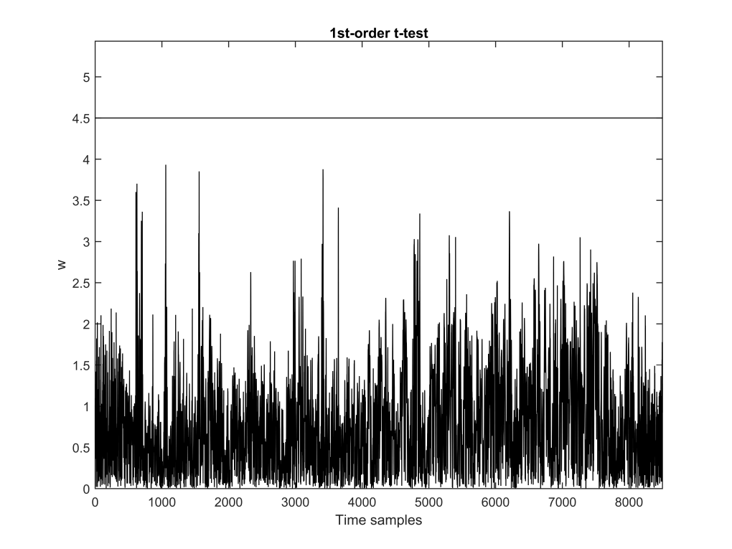
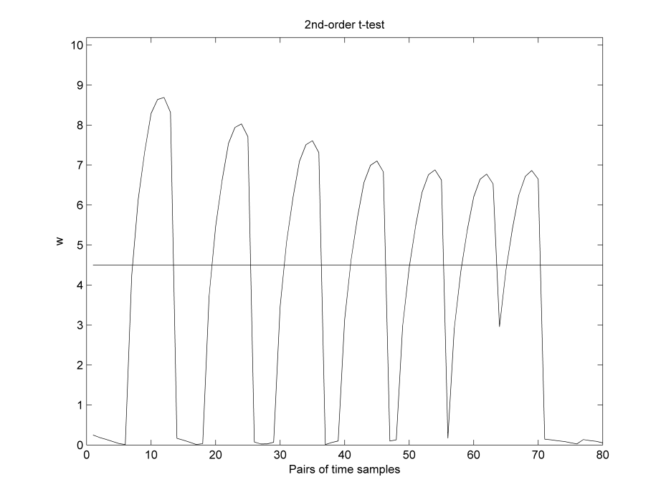
Evaluation: Hardened Sbox
Passes 1st-order Welch t-test with 25k fixed vs. 25k random traces
Fails 1st-order Welch t-test with 50k fixed vs. 50k random traces
Still, for the given device and noise level, 2nd-order leakages can already be detected with 2nd-order Welch t-test with 25k fixed vs. 25k random traces

Slide 22
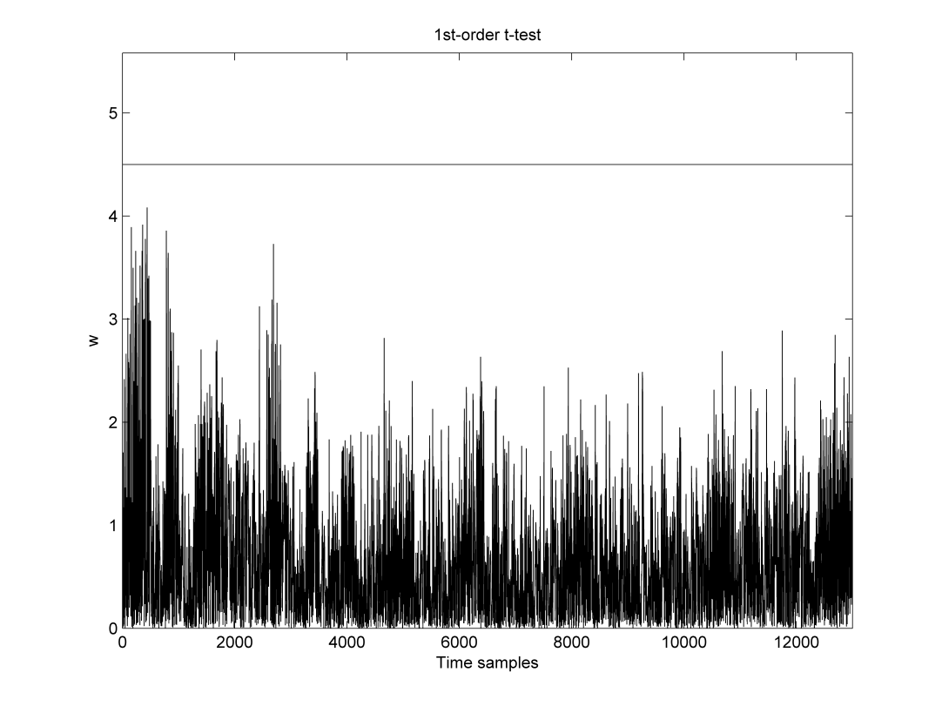
Evaluation: Fully-hardened Sbox
Passes 1st-order Welch t-test with 100k fixed vs. 100k random traces
Goal achieved! 1st-order masking maintains 1st-order univariate security

Slide 23
Implementation Overhead
Cycle count for 8-bit based iterations of RECTANGLE Sbox
The latency cost of a fully-hardened Sbox is more than that of a standard 2nd-order implementation, which achieves the same practical security
Still, keeping the order small reduces RNG requirements which can often be the bottleneck. A 1st-order fully-hardened RECTANGLE with an AES-based pseudo RNG requires 6k cc for generation, while standard 2nd-order requires 18k cc
Version of ISW Masking | Latency (cc) | Throughput (bits/1000cc) | Random Bytes | Theoretical Security | Practical Security
Standard 1st-order | 87 | 91 | 4 | 1 | 0
Hardened 1st-order | 993 | 8 | 4 | 1 | 1
Fully-hardened 1st-order | 1319 | 6 | 4 | 1 | 1
Standard 2nd-order | 775 | 10 | 12 | 2 | 1

Slide 24
Conclusions & Future Directions Effective and Efficient Masking
5

Slide 25
Conclusions
Maintaining the security order of a scheme is tedious yet possible
We can develop 1st-order schemes that are secure against univariate 1st-order attacks
Requires device-dependent effort and an evaluation that depends on the current noise level
The acquired knowledge can be integrated into the ASCOLD tool to assist the countermeasure developer during the coding phase of his work
The ILA enforcement cost is not small, yet its importance is exacerbated in the context of RNG

Slide 26
Criticism & Future directions
Hardening an implementation is just an ad-hoc patch
The underlying problem is the circuit that doesn’t enforce ILA
Assembly offers a blurry image of the circuit behavior
The architecture is usually unknown
We cannot identify all ILA-breaching effects
We are not sure if our solutions are optimal
Experiment-driven fixes are device-dependent and noise-dependent, thus with limited scope
Reducing the cost of hardening is useful, yet it is not the full solution
Strive towards custom hardware that enforces ILA

