Slide 1

A Fault-Resistant Number Theoretic Transform by Polynomial Evaluation and Interpolation
Application to ML-KEM and ML-DSA
Sven Bauer, Fabrizio De Santis, Kristjane Koleci and Anita Aghaie
Supported as part of project Quoryptan under 16KIS2033

Slide 2
Fault Attacks
Inject faults into a device while it is processing a cryptographic secret.
Faults can be transient or permanent.
Faults are injected by operating a device (briefly) outside its specification. Examples: clock glitch, voltage glitch, EM pulse, laser pulse…
Typical fault: instruction skip
Goals:
Force device to behave in a way not intended by developer (e.g., access without permissions).
Obtain faulty signatures or ciphertexts that leak information about a cryptographic secret.

Slide 3
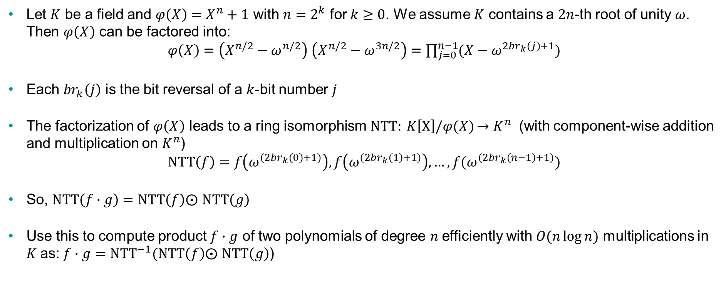
The Number Theoretic Transform (NTT)
Let $K$ be a field and $φ\left(X\right)=X^{n}+1$ with $n=2^{k}$ for $k≥0$. We assume $K$ contains a $2n$-th root of unity $ω$. Then $φ\left(X\right)$ can be factored into:
$φ\left(X\right)=\left(X^{n/2}−ω^{n/2}\right)$ $\left(X^{n/2}−ω^{3n/2}\right)=\prod_{j=0}^{n−1}{(X−ω^{2{br}_{k}\left(j\right)+1})}$
Each ${br}_{k}\left(j\right)$ is the bit reversal of a $k$-bit number $j$
The factorization of $φ\left(X\right)$ leads to a ring isomorphism$NTT: K\left[X\right]/φ(X)$ $→K^{n}$ (with component-wise addition and multiplication on $K^{n}$)
$$NTT\left(f\right)=f\left(ω^{(2{br}_{k}\left(0\right)+1)}\right),f\left(ω^{(2{br}_{k}\left(1\right)+1)}\right),…, f(ω^{(2{br}_{k}\left(n−1\right)+1)})$$
So, $NTT\left(f∙g\right)=NTT\left(f\right)⨀$ $NTT\left(g\right)$
Use this to compute product $f∙g$ of two polynomials of degree $n$efficiently with $O(n\log{n})$ multiplications in $K$as:$f∙g={NTT}^{−1}(NTT\left(f\right)⨀ NTT\left(g\right)$)

Slide 4
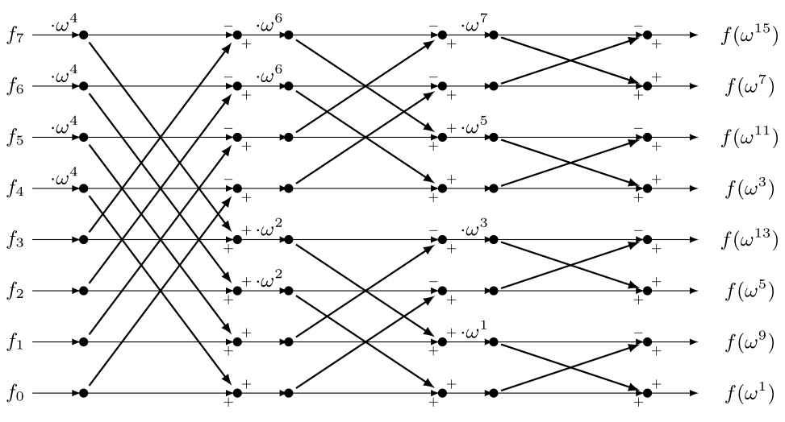
Implementation of the NTT (example n=8)

Slide 5
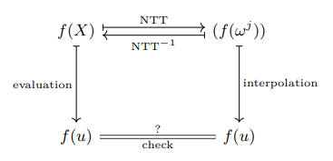
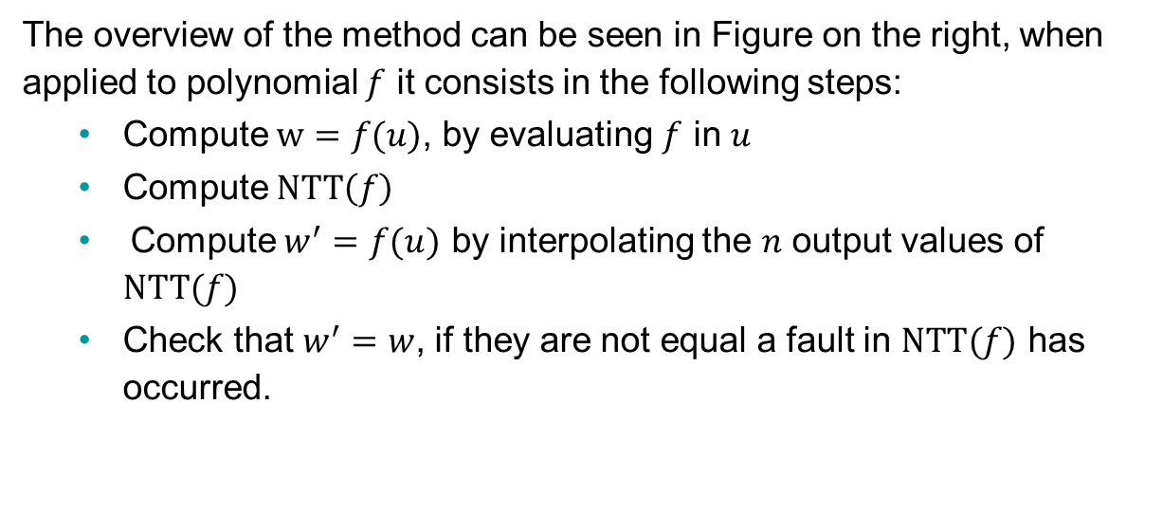
Fault Detection in the NTT with Polynomial Evaluation and Interpolation
The overview of the method can be seen in Figure on the right, when applied to polynomial $f$ it consists in the following steps:
Compute $w=f(u)$, by evaluating $f$ in $u$
Compute $NTT\left(f\right)$
Compute $w^{′}=f(u)$ by interpolating the $n$ output values of $NTT(f)$
Check that $w^{′}=w$, if they are not equal a fault in $NTT(f)$ has occurred.

Slide 6
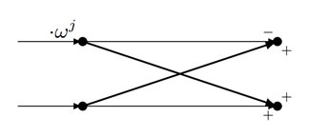
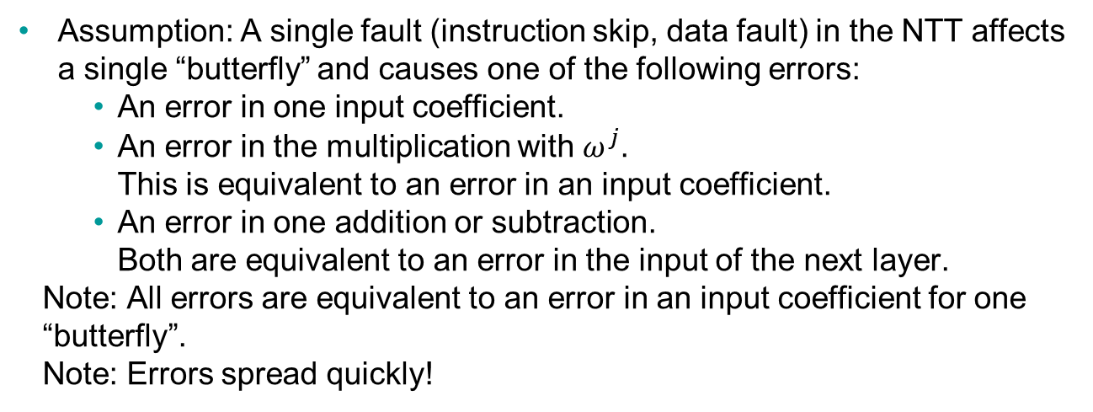
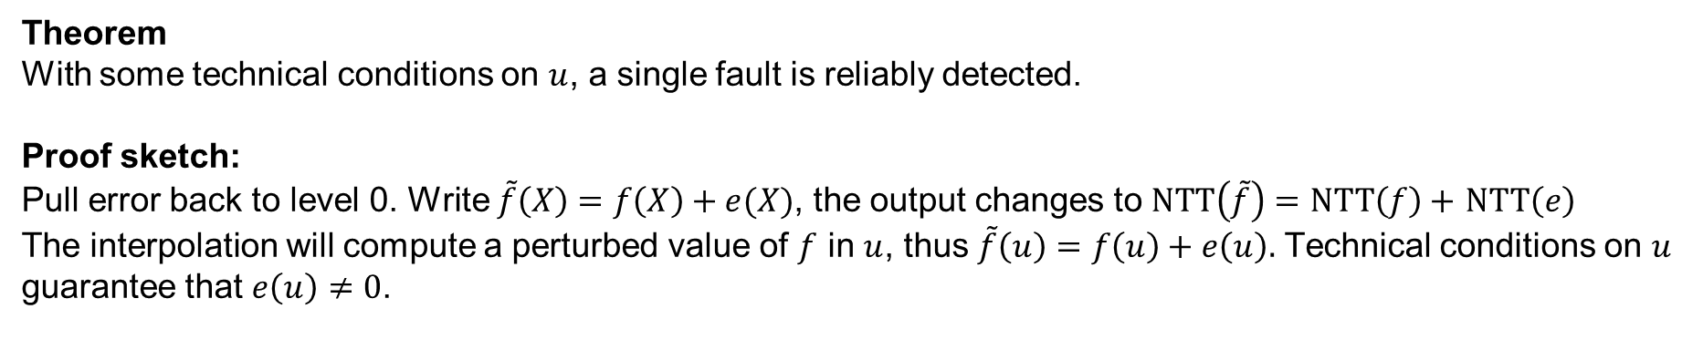
Fault Detection Properties
Assumption: A single fault (instruction skip, data fault) in the NTT affects a single “butterfly” and causes one of the following errors:
An error in one input coefficient.
An error in the multiplication with $ω^{j}$. This is equivalent to an error in an input coefficient.
An error in one addition or subtraction. Both are equivalent to an error in the input of the next layer.
Note: All errors are equivalent to an error in an input coefficient for one “butterfly”.
Note: Errors spread quickly!
Theorem
With some technical conditions on $u$, a single fault is reliably detected.
Proof sketch:
Pull error back to level 0. Write $\tilde{f}\left(X\right)=f\left(X\right)+e(X)$, the output changes to $NTT\left(\tilde{f}\right)=NTT\left(f\right)+$ $NTT\left(e\right)$
The interpolation will compute a perturbed value of $f$ in $u$, thus $\tilde{f}\left(u\right)=f\left(u\right)+e\left(u\right).$ Technical conditions on $u$ guarantee that $e\left(u\right)≠0$.

Slide 7
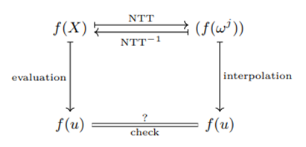
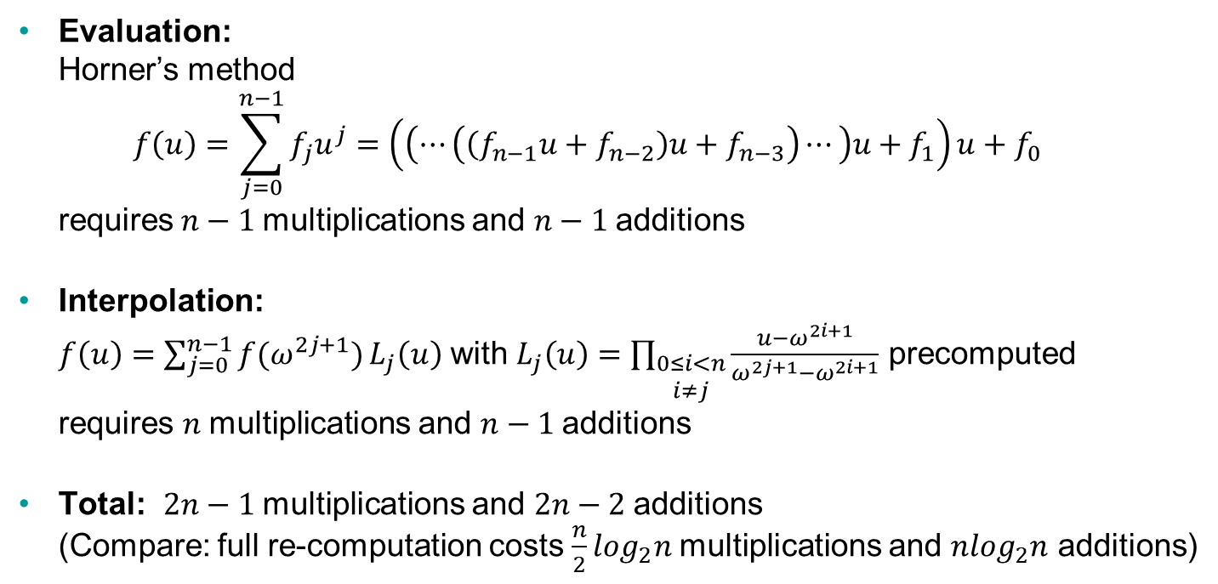
Computational Cost
Evaluation: Horner’s method $f\left(u\right)=\sum_{j=0}^{n−1}{f_{j}u^{j}=\left(\left(⋯\left(\left(f_{n−1}u+f_{n−2}\right)u+f_{n−3}\right)⋯\right)u+f_{1}\right)u+f_{0}}$ $\text{requires} n−1$multiplications and $n−1$additions
Interpolation: $f\left(u\right)=\sum_{j=0}^{n−1}{f(ω^{2j+1})}L_{j}\left(u\right)$ with $L_{j}\left(u\right)=\prod_{\begin{matrix}0≤i<n \\ i≠j\end{matrix}}{\frac{u−ω^{2i+1}}{ω^{2j+1}−ω^{2i+1}}}$ precomputed requires $n$multiplications and $n−1$additions
Total: $2n−1$multiplications and $2n−2$additions (Compare: full re-computation costs $\frac{n}{2}\log_{2}n$multiplications and ${nlog}_{2}n$ additions)

Slide 8
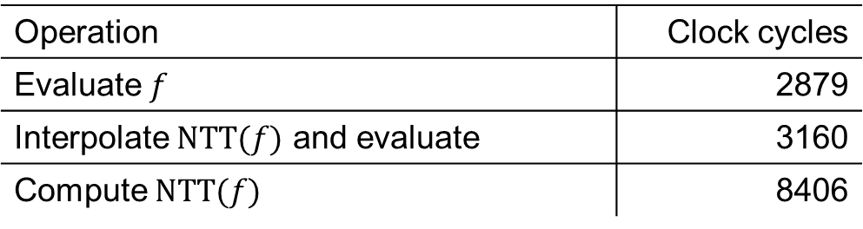
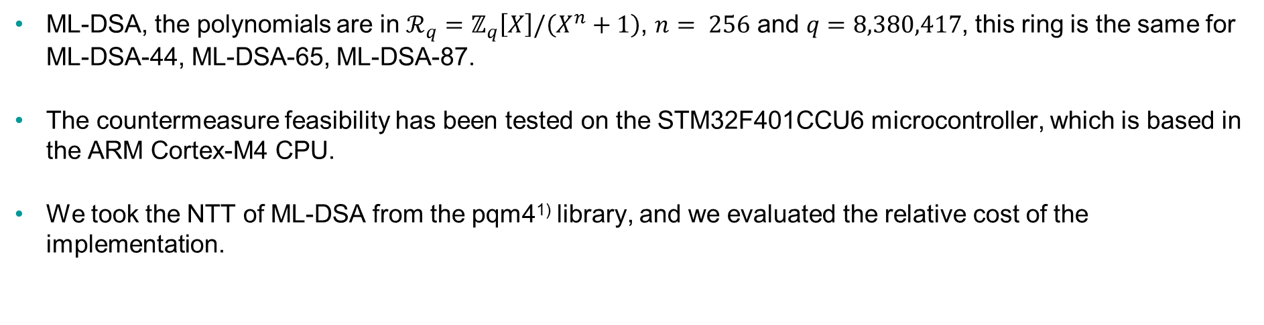
Application to ML-DSA (formerly known as Dilithium)
ML-DSA, the polynomials are in $ℛ_{q}=ℤ_{q}\left[X\right]/\left(X^{n}+1\right)$, $n= 256$ and $q=8,380,417$, this ring is the same for ML-DSA-44, ML-DSA-65, ML-DSA-87.
The countermeasure feasibility has been tested on the STM32F401CCU6 microcontroller, which is based in the ARM Cortex-M4 CPU.
We took the NTT of ML-DSA from the pqm4¹⁾ library, and we evaluated the relative cost of the implementation.
Operation | Clock cycles
Evaluate $f$ | 2879
Interpolate $NTT(f)$ and evaluate | 3160
Compute $NTT(f)$ | 8406
The relative cost of the implementation corresponds to 72% (roughly as expected).
1) https://github.com/mupq/pqm4

Slide 9

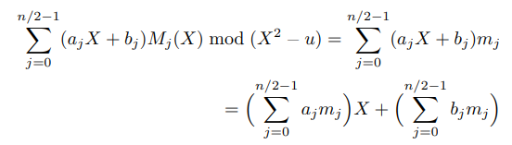
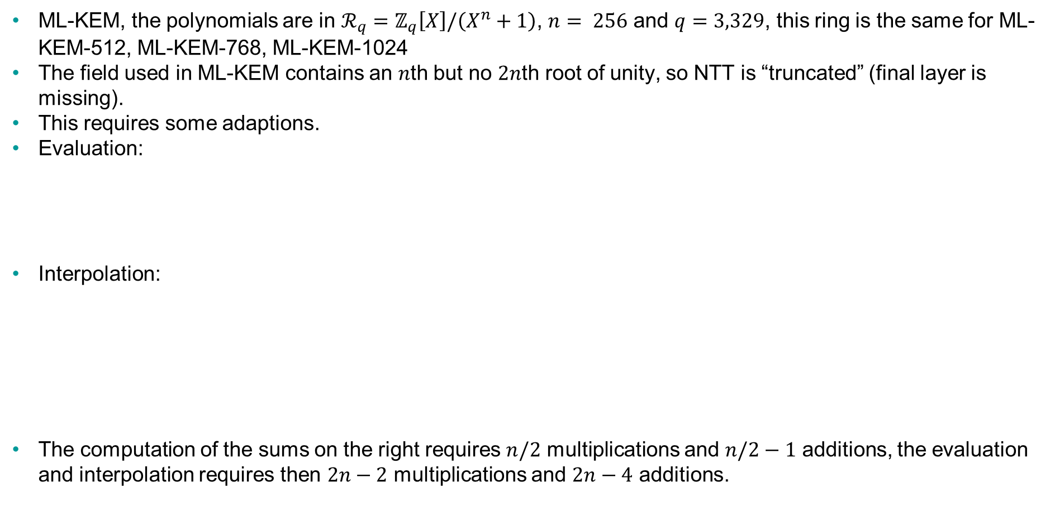
Adapting the Countermeasure to ML-KEM (formerly known as Kyber)
ML-KEM, the polynomials are in $ℛ_{q}=ℤ_{q}\left[X\right]/\left(X^{n}+1\right)$, $n= 256$ and $q=3,329$, this ring is the same for ML-KEM-512, ML-KEM-768, ML-KEM-1024
The field used in ML-KEM contains an $n$th but no $2n$th root of unity, so NTT is “truncated” (final layer is missing).
This requires some adaptions.
Evaluation:
Interpolation:
The computation of the sums on the right requires $n/2$ multiplications and $n/2−1$ additions, the evaluation and interpolation requires then $2n−2$ multiplications and $2n−4$ additions.

Slide 10
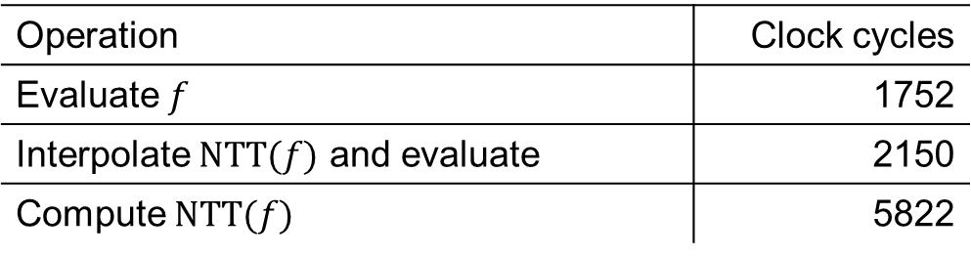
Practical Evaluation for ML-KEM
We took the NTT of ML-KEM from the pqm4¹⁾ library, and we evaluated the relative cost of the implementation on an STM32F401CCU6.
Operation | Clock cycles
Evaluate $f$ | 1752
Interpolate $NTT(f)$ and evaluate | 2150
Compute $NTT(f)$ | 5822
This time, the relative cost of the implementation corresponds to 67%.
1) https://github.com/mupq/pqm4

Slide 11
Remarks
Can detect more than one fault – but only with high probability <1.
Everything carries through to the inverse NTT.
Compatible with side-channel countermeasures based on splitting data into shares (because everything is linear).
Can be used to protect whole chain of NTT, point-wise multiplication, inverse NTT.

Slide 12
Summary
We have seen a method to detect faults in the NTT and the inverse NTT.
Single faults are detected reliably, multiple (random) faults with high probability.
Less overhead than re-computation.
Overhead measured for ML-DSA and ML-KEM on ARM Cortex-M4.

Slide 13
Thank you for your attention Questions?

Slide 14
Sven Bauer Siemens AG
E-mail svenbauer@siemens.com
Fabrizio De Santis Siemens AG
E-mail fabrizio.desantis@siemens.com
Kristjane Koleci Siemens AG
E-mail kristjane.koleci@siemens.com
Anita Aghaie Siemens AG
E-mail anita.aghaie@siemens.com

