Slide 1


A $2.4σ$ observation of the Higgs Boson through the $H→ ZZ→ 4ℓ$ golden channel
Vinh Q. Tran
Vinh Q. Tran
BSc Physics Candidate at MIT
April 22nd, 2025

Slide 2
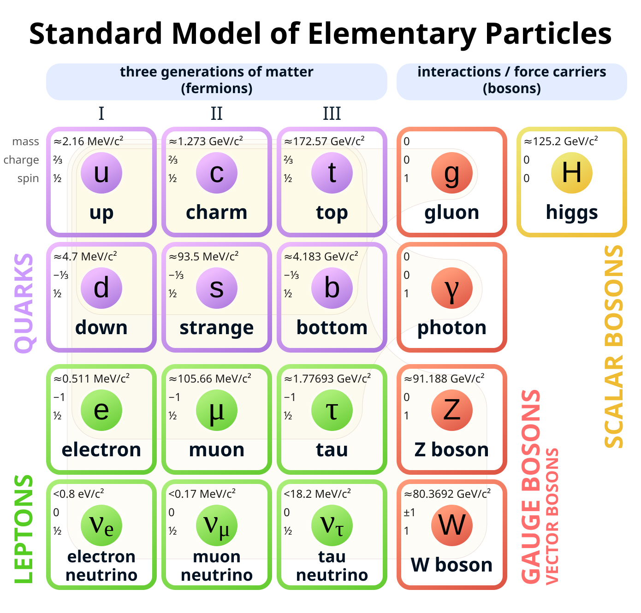
The Standard Model
Describe particles and phenomenon in terms of interactions between fundamental fields.

Slide 3
The Standard Model
Describe particles and phenomenon in terms of interactions between fundamental fields.
Success in explaining three of the four fundamental forces.

Slide 4
The Standard Model
Describe particles and phenomenon in terms of interactions between fundamental fields.
Success in explaining three of the four fundamental forces.
The Higgs field plays a crucial role in the model, in that it allows for a mass-giving mechanism.

Slide 5
The Standard Model
Describe particles and phenomenon in terms of interactions between fundamental fields.
Success in explaining three of the four fundamental forces.
The Higgs field plays a crucial role in the model, in that it allows for a mass-giving mechanism.
Up to the 2000s, evidence for the Higgs boson was still missing.

Slide 6
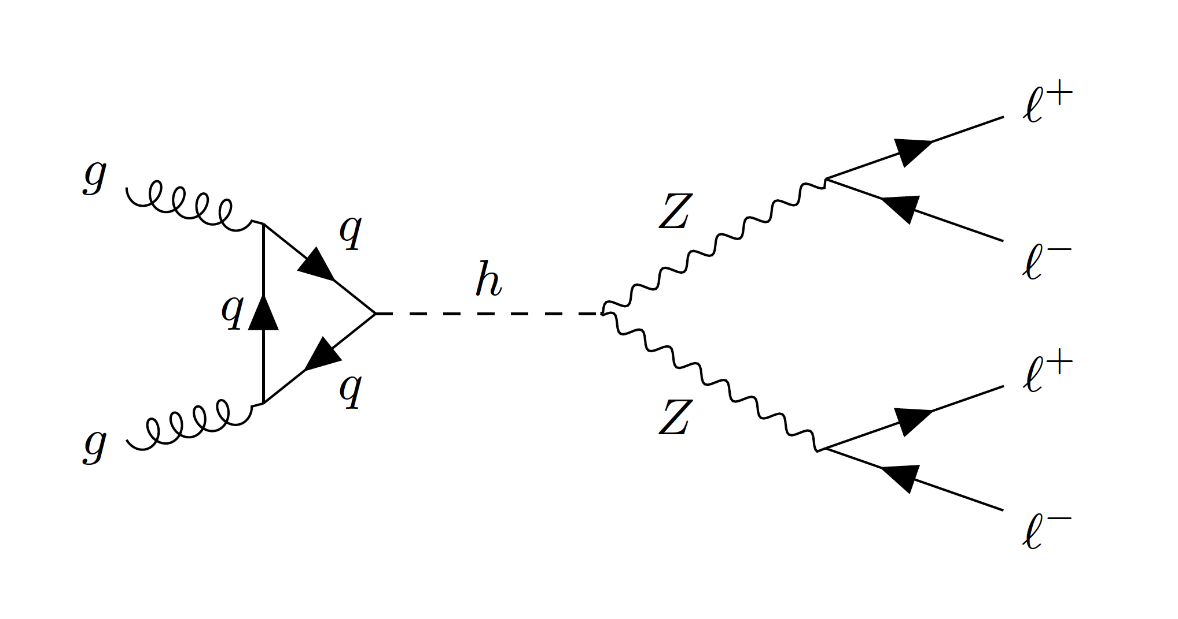
The four-lepton “golden” channel

Slide 7

The four-lepton “golden” channel
No neutrino $→$ No missing energy and information loss.

Slide 8
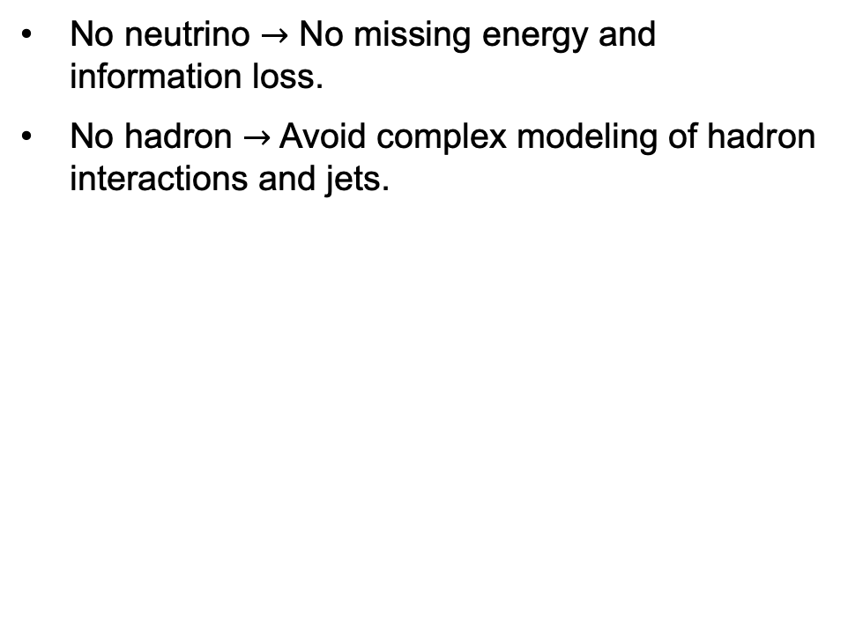
The four-lepton “golden” channel
No neutrino $→$ No missing energy and information loss.
No hadron $→$ Avoid complex modeling of hadron interactions and jets.

Slide 9
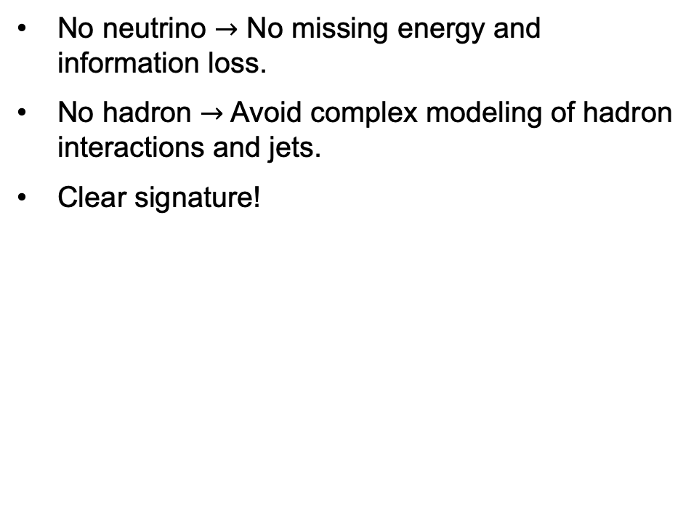
The four-lepton “golden” channel
No neutrino $→$ No missing energy and information loss.
No hadron $→$ Avoid complex modeling of hadron interactions and jets.
Clear signature!

Slide 10
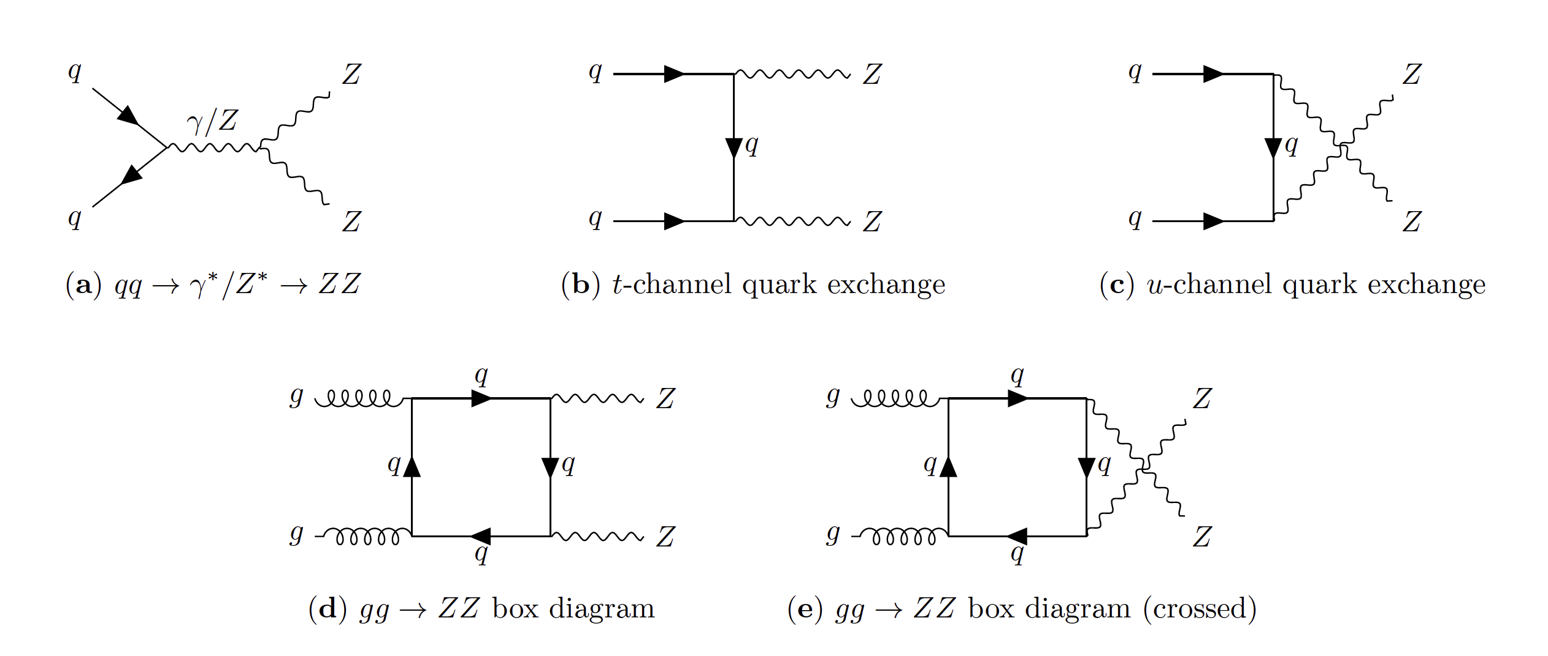
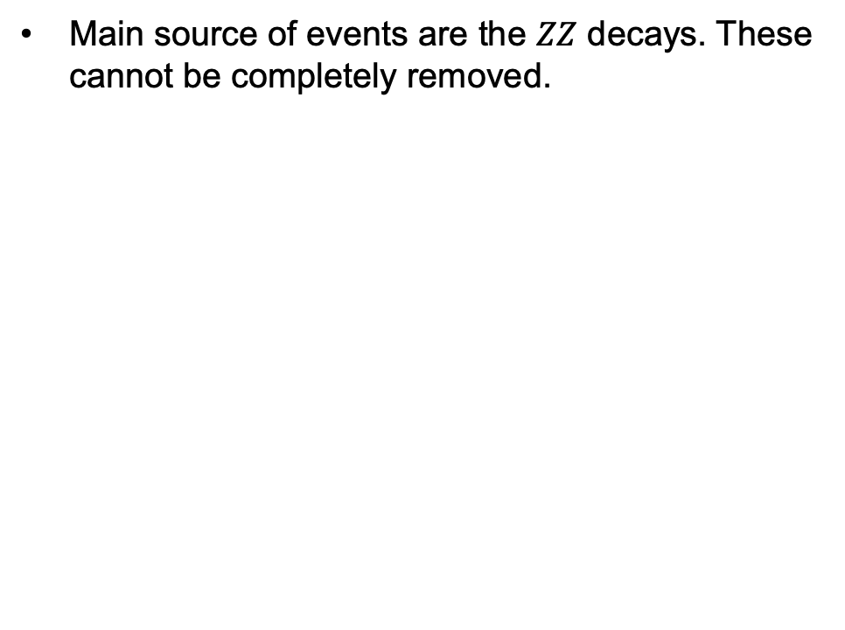
Four-lepton background
Main source of events are the $ZZ$ decays. These cannot be completely removed.

Slide 11
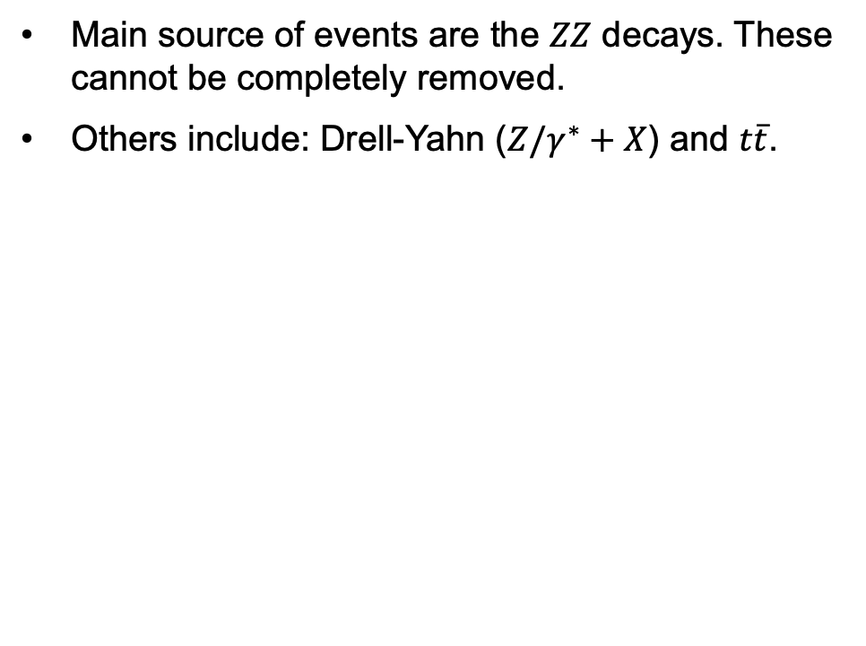
Four-lepton background
Main source of events are the $ZZ$ decays. These cannot be completely removed.
Others include: Drell-Yahn ($Z/γ^{∗}+X$) and $t\overline{t}$.

Slide 12
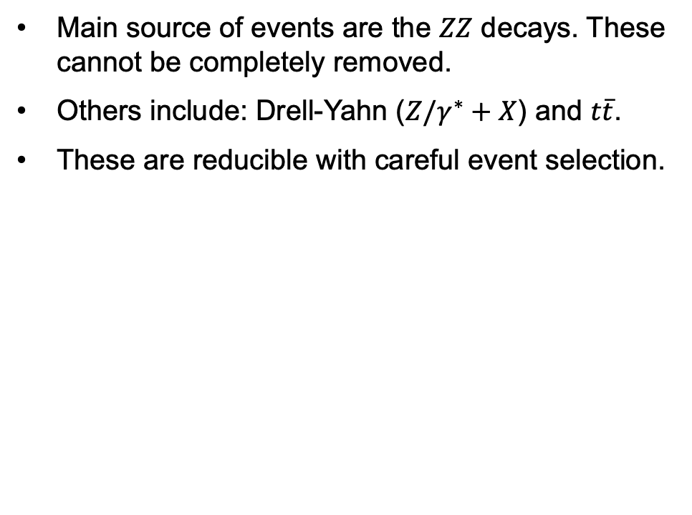
Four-lepton background
Main source of events are the $ZZ$ decays. These cannot be completely removed.
Others include: Drell-Yahn ($Z/γ^{∗}+X$) and $t\overline{t}$.
These are reducible with careful event selection.

Slide 13
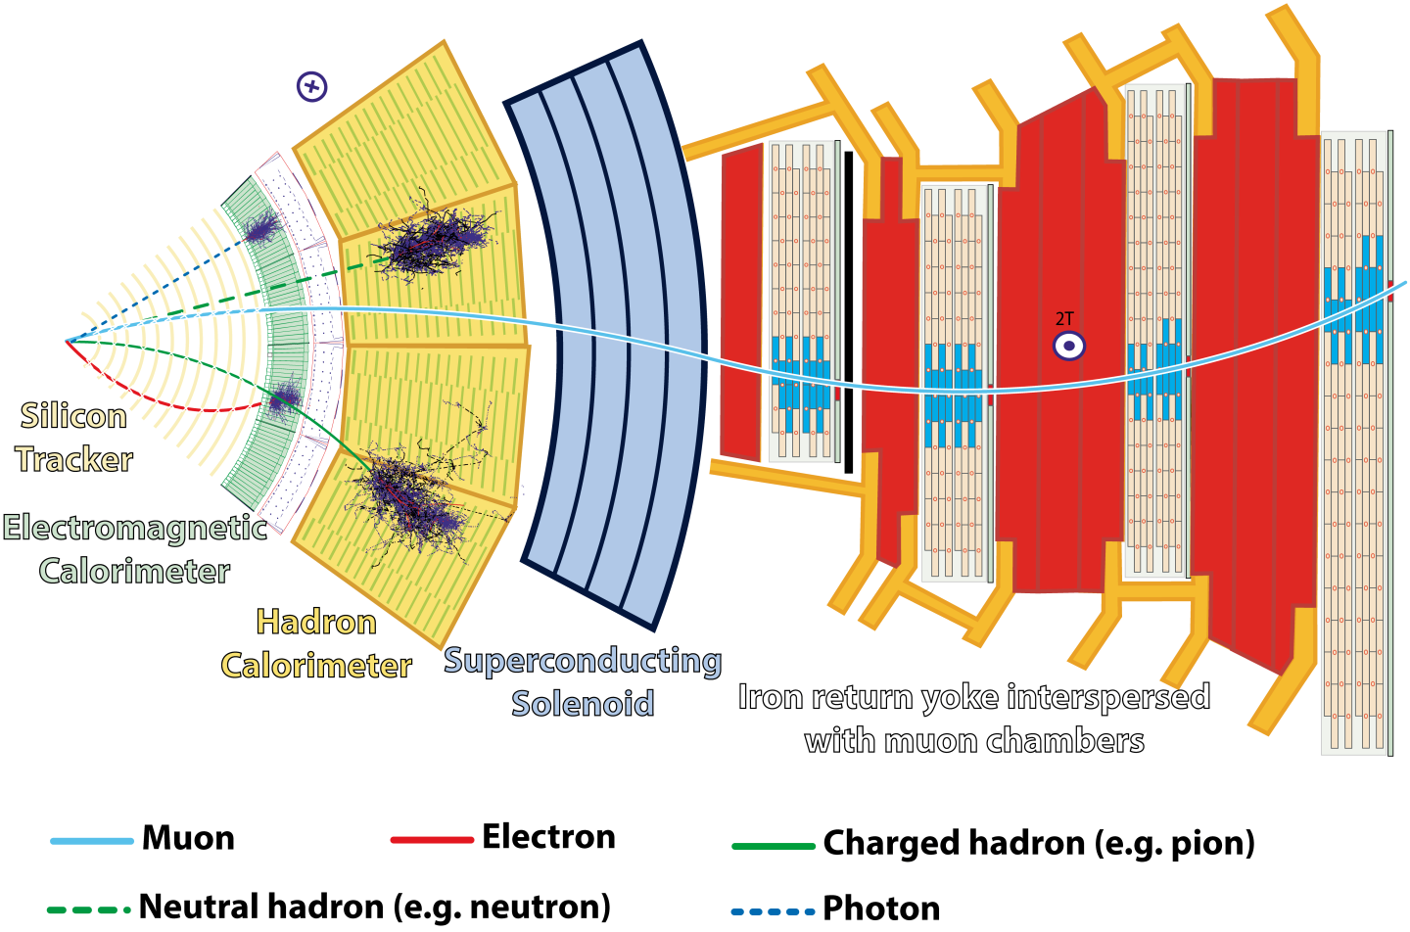
The CMS detector
Compact Muon Solenoid

Slide 14
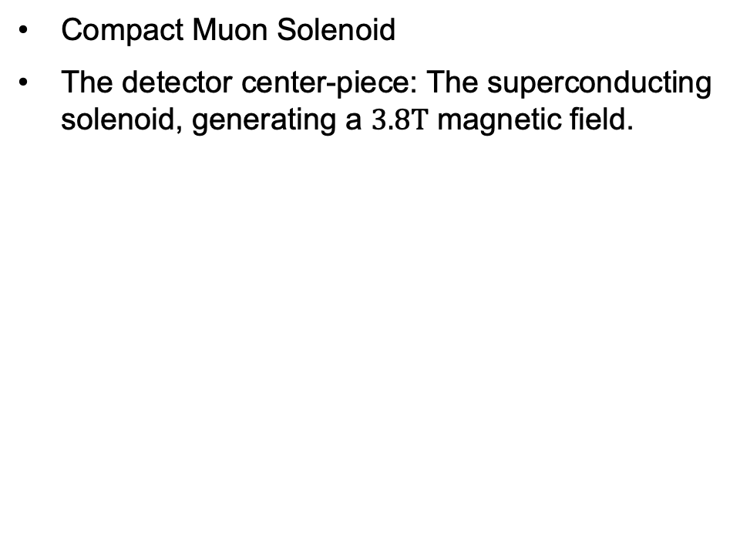
The CMS detector
Compact Muon Solenoid
The detector center-piece: The superconducting solenoid, generating a $3.8T$ magnetic field.

Slide 15
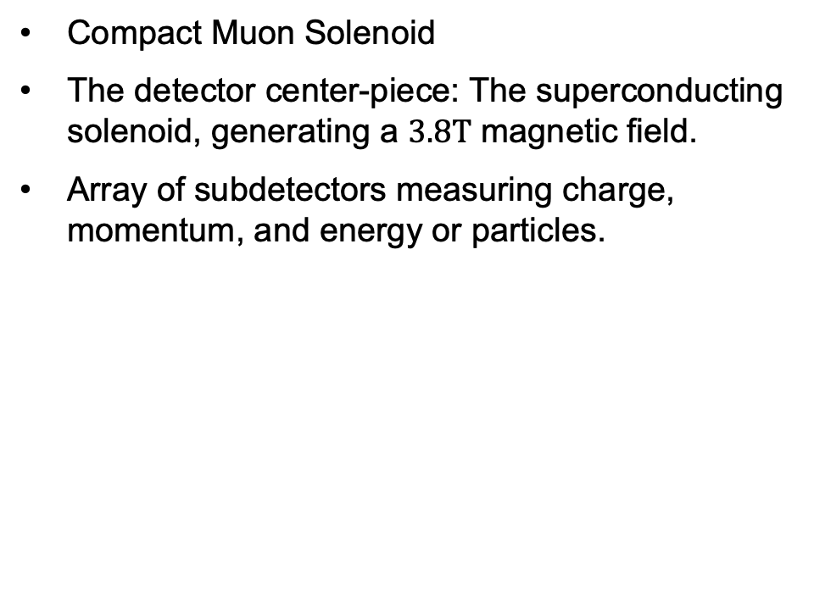
The CMS detector
Compact Muon Solenoid
The detector center-piece: The superconducting solenoid, generating a $3.8T$ magnetic field.
Array of subdetectors measuring charge, momentum, and energy or particles.

Slide 16
The CMS detector
Compact Muon Solenoid
The detector center-piece: The superconducting solenoid, generating a $3.8T$ magnetic field.
Array of subdetectors measuring charge, momentum, and energy or particles.

Slide 17
The CMS detector
Compact Muon Solenoid
The detector center-piece: The superconducting solenoid, generating a $3.8T$ magnetic field.
Array of subdetectors measuring charge, momentum, and energy or particles.

Slide 18
The CMS detector
Compact Muon Solenoid
The detector center-piece: The superconducting solenoid, generating a $3.8T$ magnetic field.
Array of subdetectors measuring charge, momentum, and energy or particles.

Slide 19
The CMS detector
Compact Muon Solenoid
The detector center-piece: The superconducting solenoid, generating a $3.8T$ magnetic field.
Array of subdetectors measuring charge, momentum, and energy or particles.

Slide 20
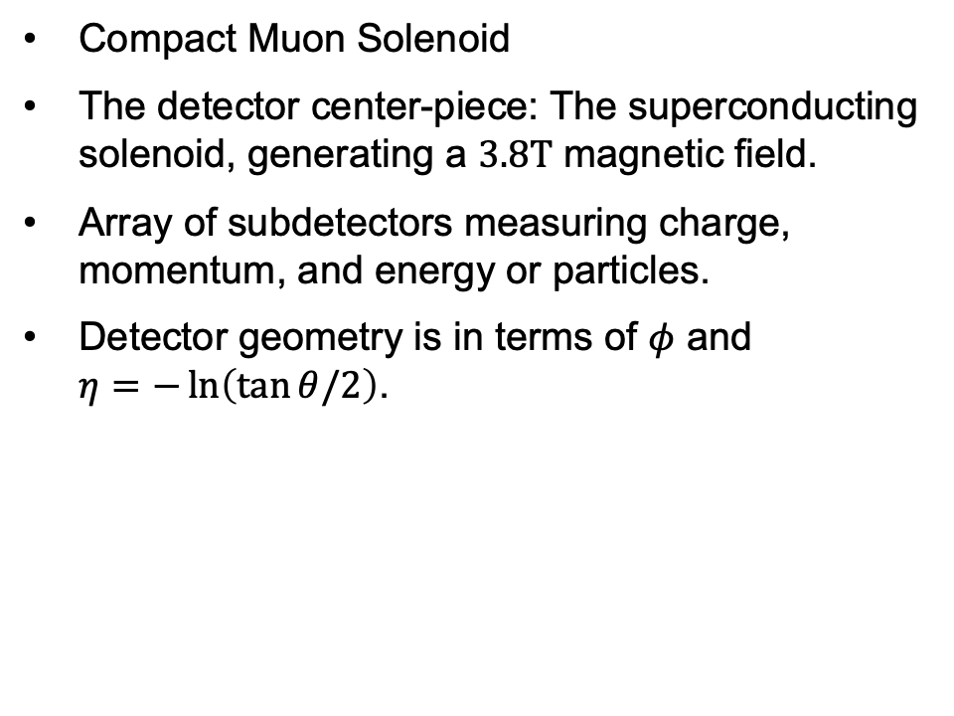
The CMS detector
Compact Muon Solenoid
The detector center-piece: The superconducting solenoid, generating a $3.8T$ magnetic field.
Array of subdetectors measuring charge, momentum, and energy or particles.
Detector geometry is in terms of $φ$ and $η=−\ln\left(\tan{θ/2}\right)$.

Slide 21
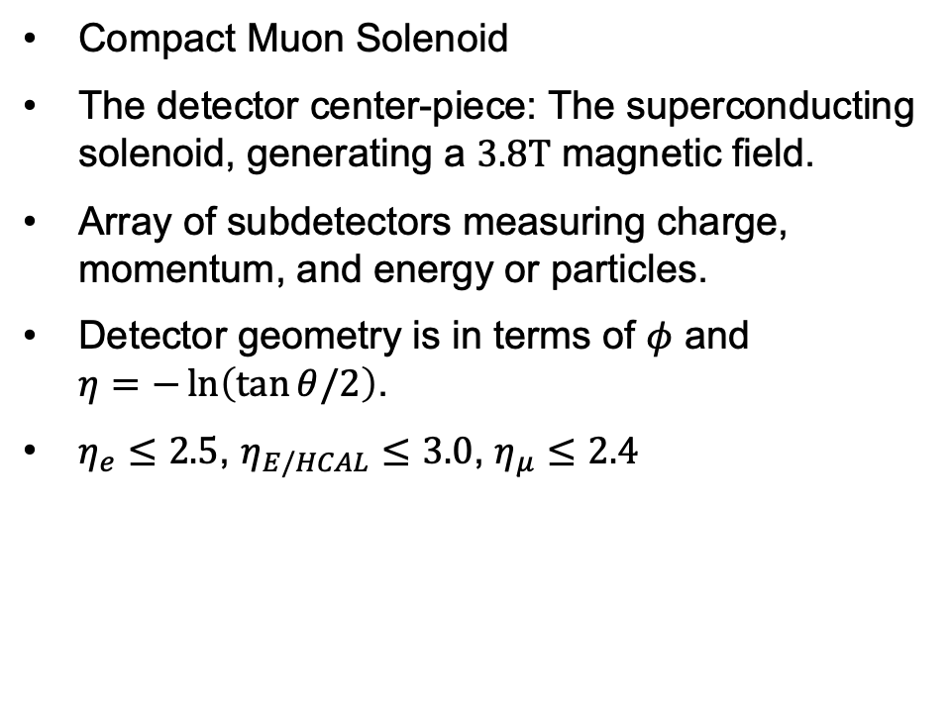
The CMS detector
Compact Muon Solenoid
The detector center-piece: The superconducting solenoid, generating a $3.8T$ magnetic field.
Array of subdetectors measuring charge, momentum, and energy or particles.
Detector geometry is in terms of $φ$ and $η=−\ln\left(\tan{θ/2}\right)$.
$η_{e}≤2.5$, $η_{E/HCAL}≤3.0$, $η_{μ}≤2.4$

Slide 22

Experimental data
Observations are from the CMS 2011-2012 runs with $\sqrt{s}=7, 8 TeV$.

Slide 23
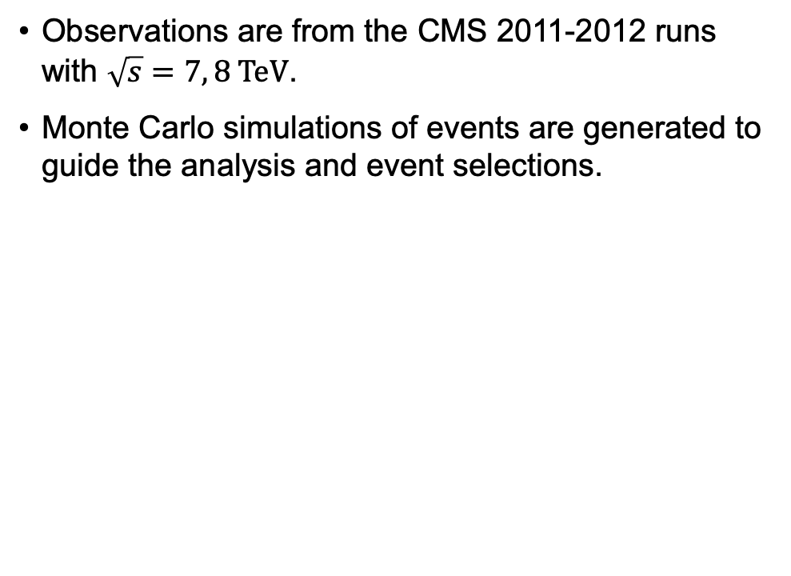
Experimental data
Observations are from the CMS 2011-2012 runs with $\sqrt{s}=7, 8 TeV$.
Monte Carlo simulations of events are generated to guide the analysis and event selections.

Slide 24
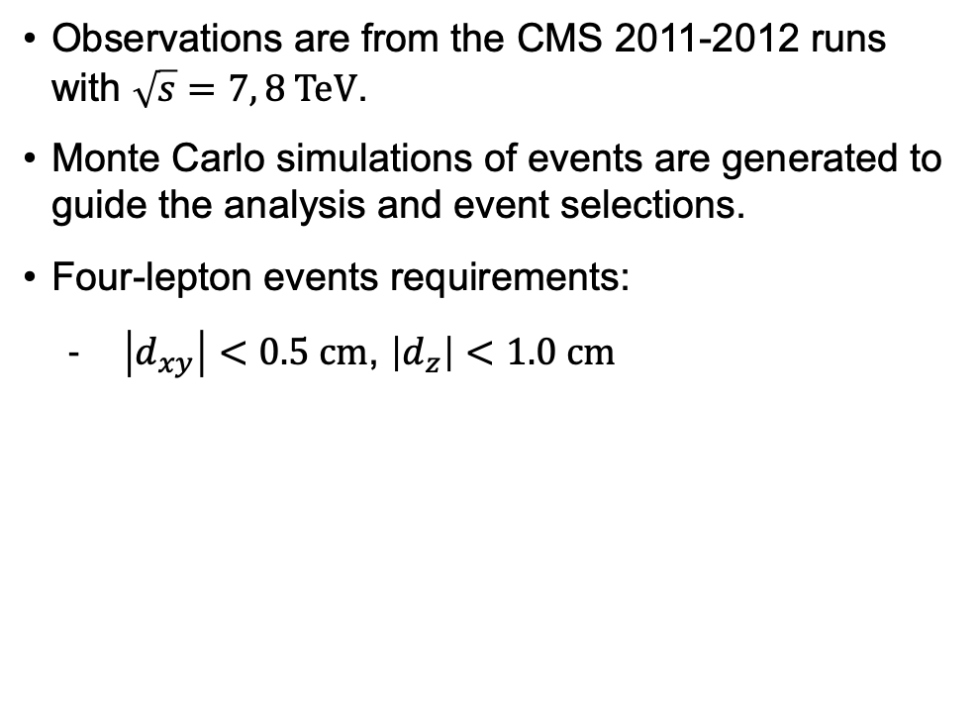
Experimental data
Observations are from the CMS 2011-2012 runs with $\sqrt{s}=7, 8 TeV$.
Monte Carlo simulations of events are generated to guide the analysis and event selections.
Four-lepton events requirements:
$\left|d_{xy}\right|<0.5 cm$, $\left|d_{z}\right|<1.0 cm$

Slide 25
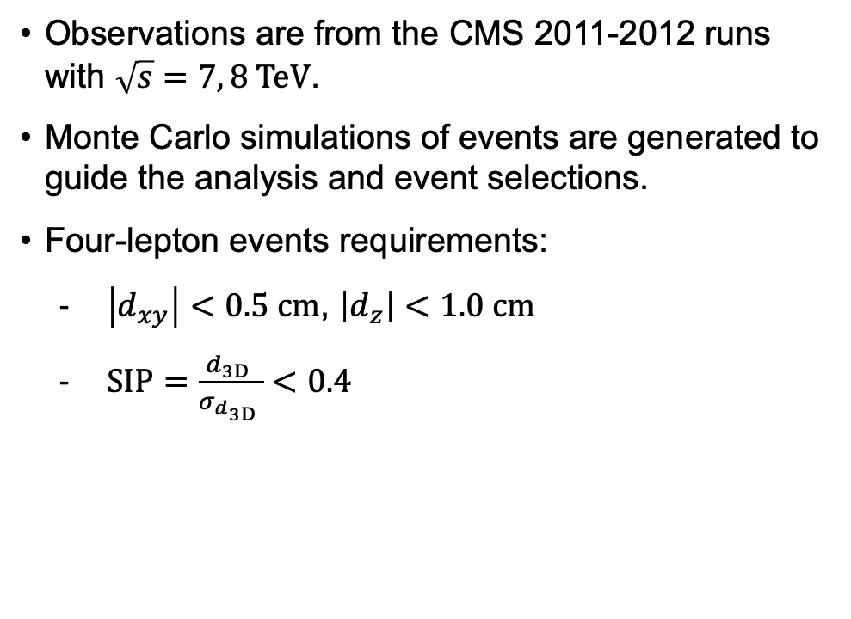
Experimental data
Observations are from the CMS 2011-2012 runs with $\sqrt{s}=7, 8 TeV$.
Monte Carlo simulations of events are generated to guide the analysis and event selections.
Four-lepton events requirements:
$\left|d_{xy}\right|<0.5 cm$, $\left|d_{z}\right|<1.0 cm$
$SIP=\frac{d_{3D }}{σ_{d_{3D }}}<0.4$

Slide 26
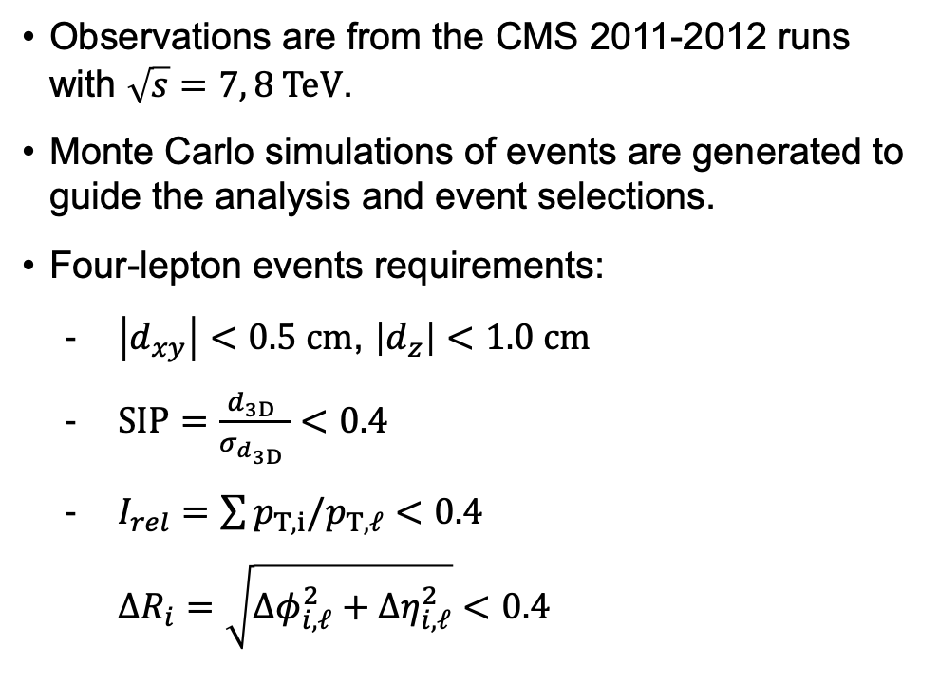
Experimental data
Observations are from the CMS 2011-2012 runs with $\sqrt{s}=7, 8 TeV$.
Monte Carlo simulations of events are generated to guide the analysis and event selections.
Four-lepton events requirements:
$\left|d_{xy}\right|<0.5 cm$, $\left|d_{z}\right|<1.0 cm$
$SIP=\frac{d_{3D }}{σ_{d_{3D }}}<0.4$
$I_{rel}=\sum{p_{T,i}/p_{T,ℓ}}<0.4$
$ΔR_{i}=\sqrt{Δφ_{i,ℓ}^{2}+Δη_{i,ℓ}^{2}}<0.4$

Slide 27
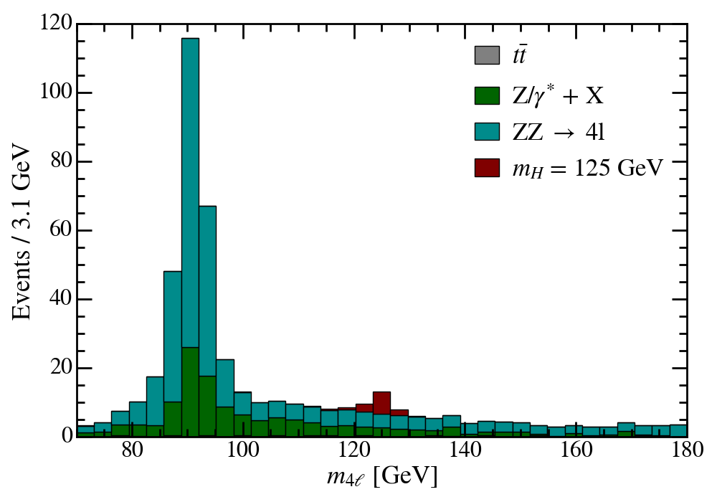

Experimental data
Observations are from the CMS 2011-2012 runs with $\sqrt{s}=7, 8 TeV$.
Monte Carlo simulations of events are generated to guide the analysis and event selections.
Four-lepton events requirements:
$\left|d_{xy}\right|<0.5 cm$, $\left|d_{z}\right|<1.0 cm$
$SIP=\frac{d_{3D }}{σ_{d_{3D }}}<4$
$I_{rel}=\sum{p_{T,i}/p_{T,ℓ}}<0.4$
$ΔR_{i}=\sqrt{Δφ_{i,ℓ}^{2}+Δη_{i,ℓ}^{2}}<0.4$

Slide 28

Kinematics cuts
Charge conservation cut and transverse momentum cut: $\sum_{i}{q_{i}}=0$, $p_{T,e}>7 GeV$, $p_{T,μ}>5 GeV$

Slide 29
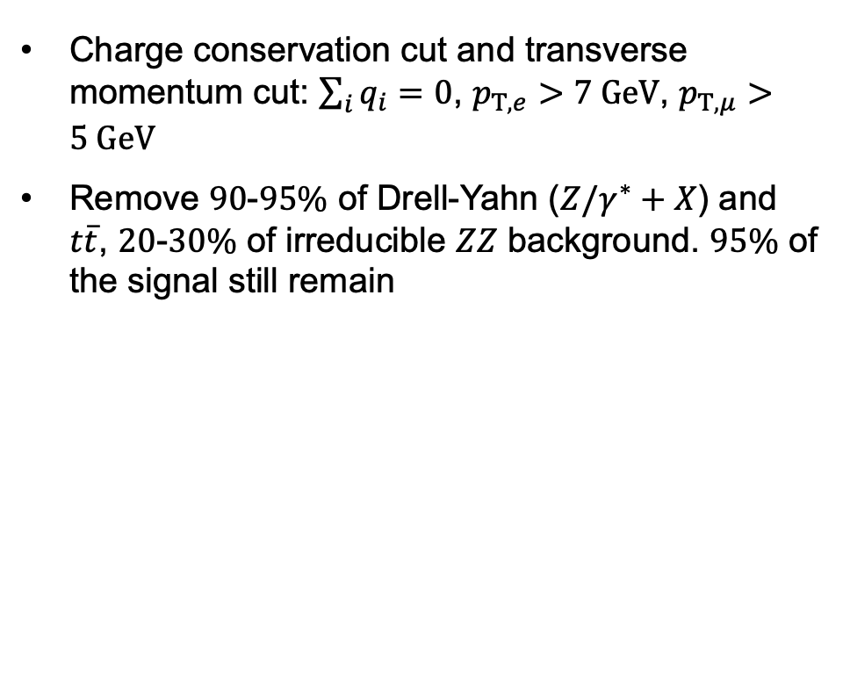
Kinematics cuts
Charge conservation cut and transverse momentum cut: $\sum_{i}{q_{i}}=0$, $p_{T,e}>7 GeV$, $p_{T,μ}>5 GeV$
Remove $90$-$95\%$ of Drell-Yahn ($Z/γ^{∗}+X$) and $t\overline{t}$, $20$-$30\%$ of irreducible $ZZ$ background. $95\%$ of the signal still remain

Slide 30
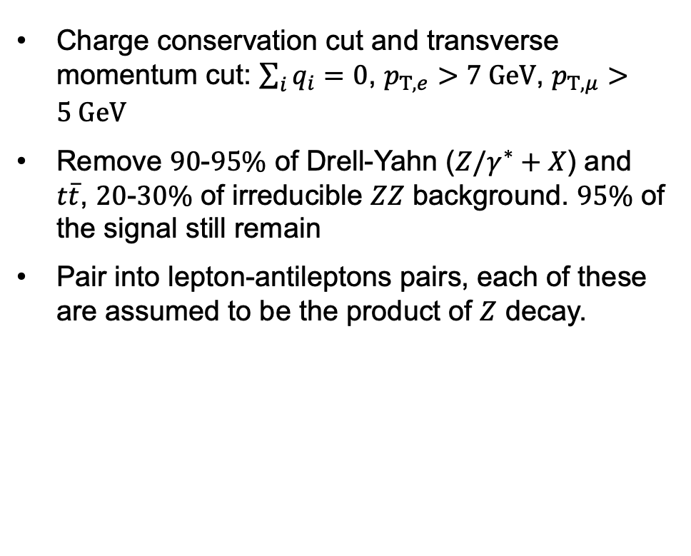
Kinematics cuts
Charge conservation cut and transverse momentum cut: $\sum_{i}{q_{i}}=0$, $p_{T,e}>7 GeV$, $p_{T,μ}>5 GeV$
Remove $90$-$95\%$ of Drell-Yahn ($Z/γ^{∗}+X$) and $t\overline{t}$, $20$-$30\%$ of irreducible $ZZ$ background. $95\%$ of the signal still remain
Pair into lepton-antileptons pairs, each of these are assumed to be the product of $Z$ decay.

Slide 31
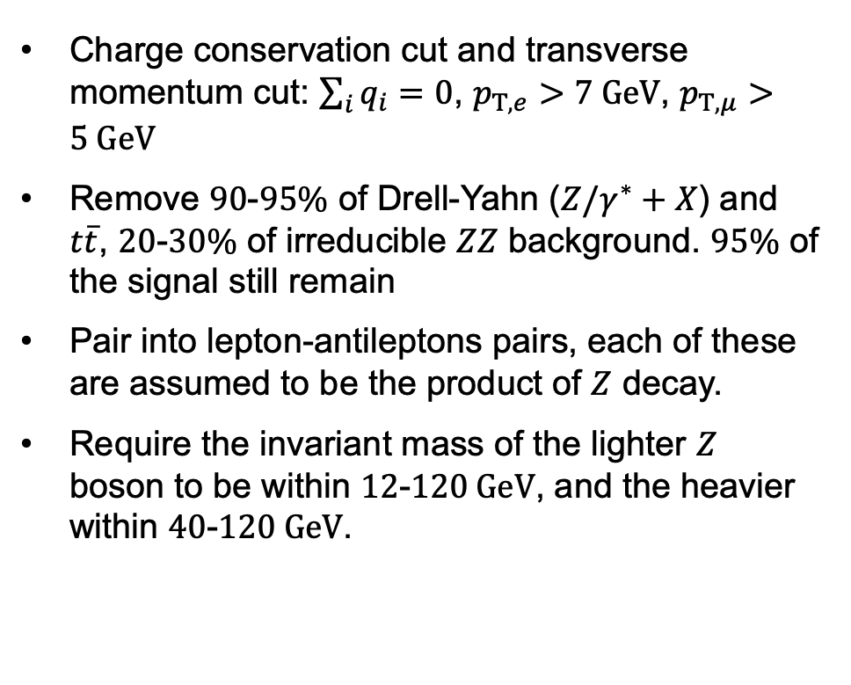
Kinematics cuts
Charge conservation cut and transverse momentum cut: $\sum_{i}{q_{i}}=0$, $p_{T,e}>7 GeV$, $p_{T,μ}>5 GeV$
Remove $90$-$95\%$ of Drell-Yahn ($Z/γ^{∗}+X$) and $t\overline{t}$, $20$-$30\%$ of irreducible $ZZ$ background. $95\%$ of the signal still remain
Pair into lepton-antileptons pairs, each of these are assumed to be the product of $Z$ decay.
Require the invariant mass of the lighter $Z$ boson to be within $12$-$120 GeV$, and the heavier within $40$-$120 GeV$.

Slide 32
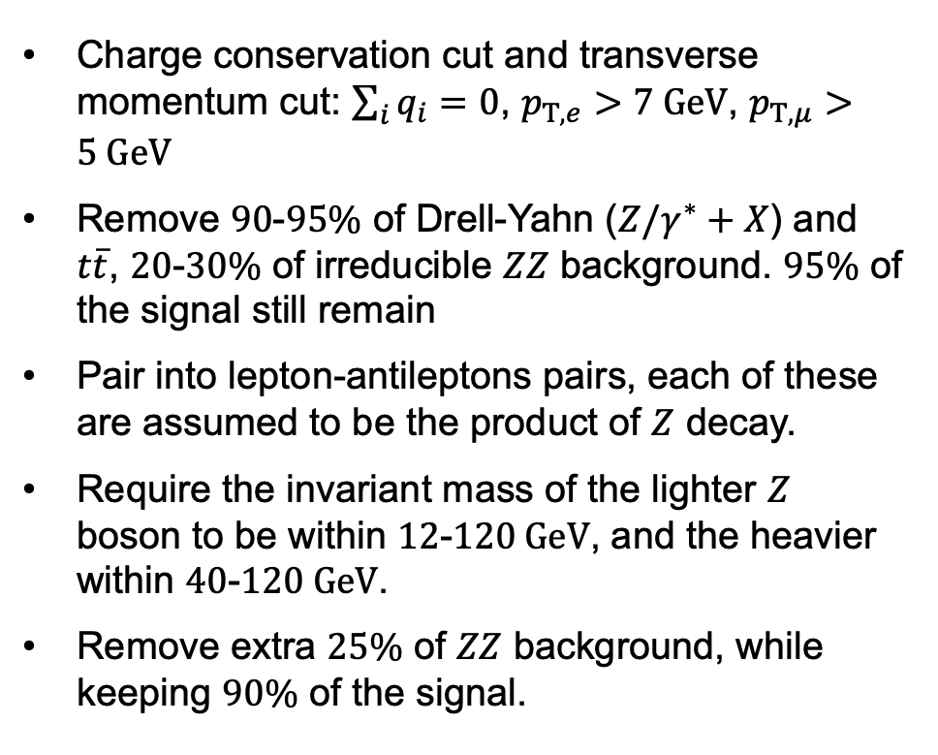
Kinematics cuts
Charge conservation cut and transverse momentum cut: $\sum_{i}{q_{i}}=0$, $p_{T,e}>7 GeV$, $p_{T,μ}>5 GeV$
Remove $90$-$95\%$ of Drell-Yahn ($Z/γ^{∗}+X$) and $t\overline{t}$, $20$-$30\%$ of irreducible $ZZ$ background. $95\%$ of the signal still remain
Pair into lepton-antileptons pairs, each of these are assumed to be the product of $Z$ decay.
Require the invariant mass of the lighter $Z$ boson to be within $12$-$120 GeV$, and the heavier within $40$-$120 GeV$.
Remove extra $25\%$ of $ZZ$ background, while keeping $90\%$ of the signal.

Slide 33
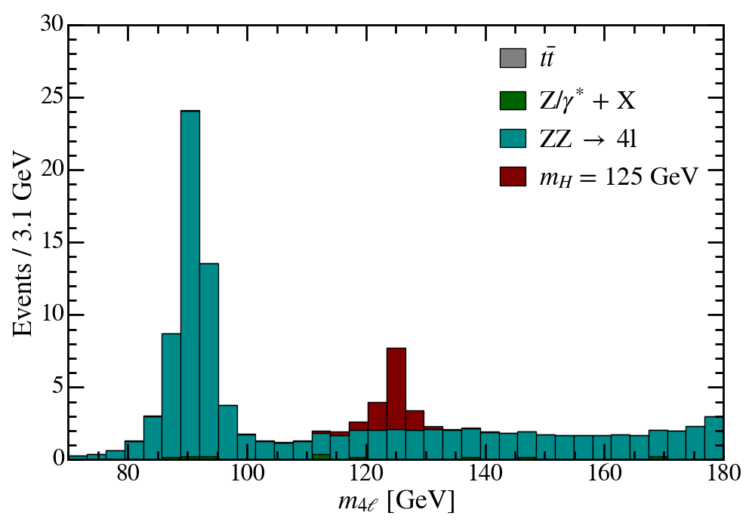
Kinematics cuts
Charge conservation cut and transverse momentum cut: $\sum_{i}{q_{i}}=0$, $p_{T,e}>7 GeV$, $p_{T,μ}>5 GeV$
Remove $90$-$95\%$ of Drell-Yahn ($Z/γ^{∗}+X$) and $t\overline{t}$, $20$-$30\%$ of irreducible $ZZ$ background. $95\%$ of the signal still remain
Pair into lepton-antileptons pairs, each of these are assumed to be the product of $Z$ decay.
Require the invariant mass of the lighter $Z$ boson to be within $12$-$120 GeV$, and the heavier within $40$-$120 GeV$.
Remove extra $25\%$ of $ZZ$ background, while keeping $90\%$ of the signal.

Slide 34




Machine learning cut
$$ℓ$$
$$ℓ$$
MLP
Aggregate
$$ℓ$$
$$ℓ$$
MLP
Graph Convolution Network on a fully-connected graph. Each node represent a lepton.

Slide 35
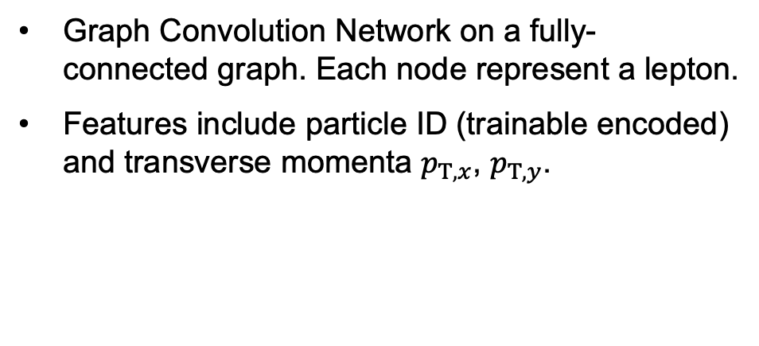
Machine learning cut
$$ℓ$$
$$ℓ$$
MLP
Aggregate
$$ℓ$$
$$ℓ$$
MLP
Graph Convolution Network on a fully-connected graph. Each node represent a lepton.
Features include particle ID (trainable encoded) and transverse momenta $p_{T,x}$, $p_{T,y}$.

Slide 36
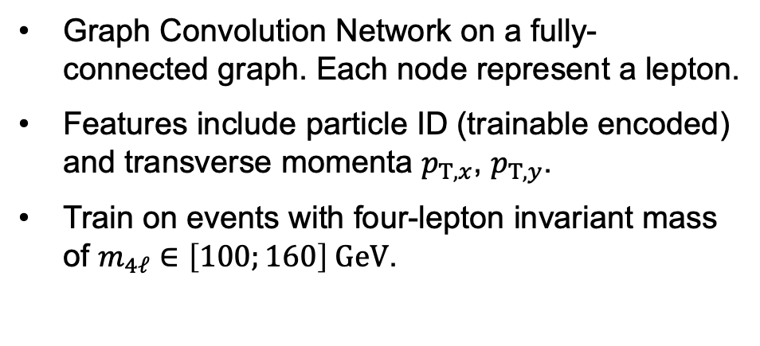
Machine learning cut
$$ℓ$$
$$ℓ$$
MLP
Aggregate
$$ℓ$$
$$ℓ$$
MLP
Graph Convolution Network on a fully-connected graph. Each node represent a lepton.
Features include particle ID (trainable encoded) and transverse momenta $p_{T,x}$, $p_{T,y}$.
Train on events with four-lepton invariant mass of $m_{4ℓ}∈\left[100;160\right] GeV$.

Slide 37
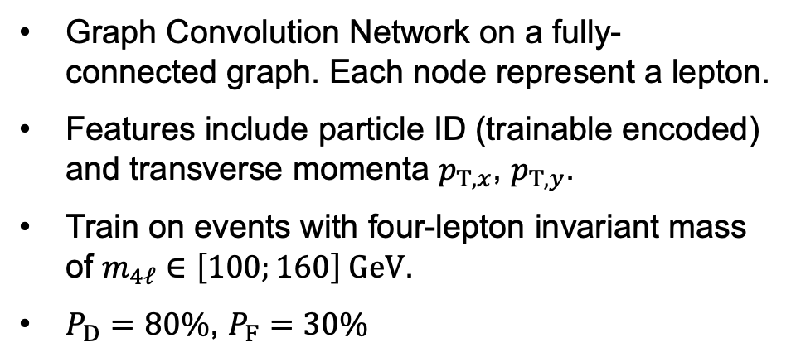
Machine learning cut
$$ℓ$$
$$ℓ$$
MLP
Aggregate
$$ℓ$$
$$ℓ$$
MLP
Graph Convolution Network on a fully-connected graph. Each node represent a lepton.
Features include particle ID (trainable encoded) and transverse momenta $p_{T,x}$, $p_{T,y}$.
Train on events with four-lepton invariant mass of $m_{4ℓ}∈\left[100;160\right] GeV$.
$P_{D}=80\%$, $P_{F}=30\%$

Slide 38
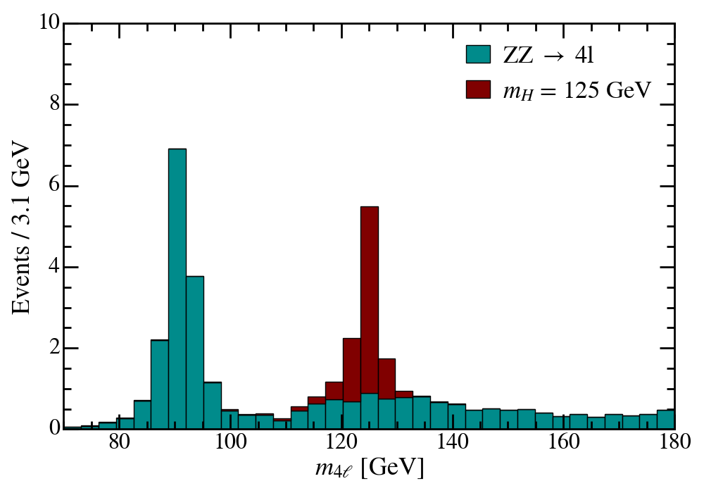
Machine learning cut
$$ℓ$$
$$ℓ$$
MLP
Aggregate
$$ℓ$$
$$ℓ$$
MLP
Graph Convolution Network on a fully-connected graph. Each node represent a lepton.
Features include particle ID (trainable encoded) and transverse momenta $p_{T,x}$, $p_{T,y}$.
Train on events with four-lepton invariant mass of $m_{4ℓ}∈\left[100;160\right] GeV$.
$P_{D}=80\%$, $P_{F}=30\%$

Slide 39
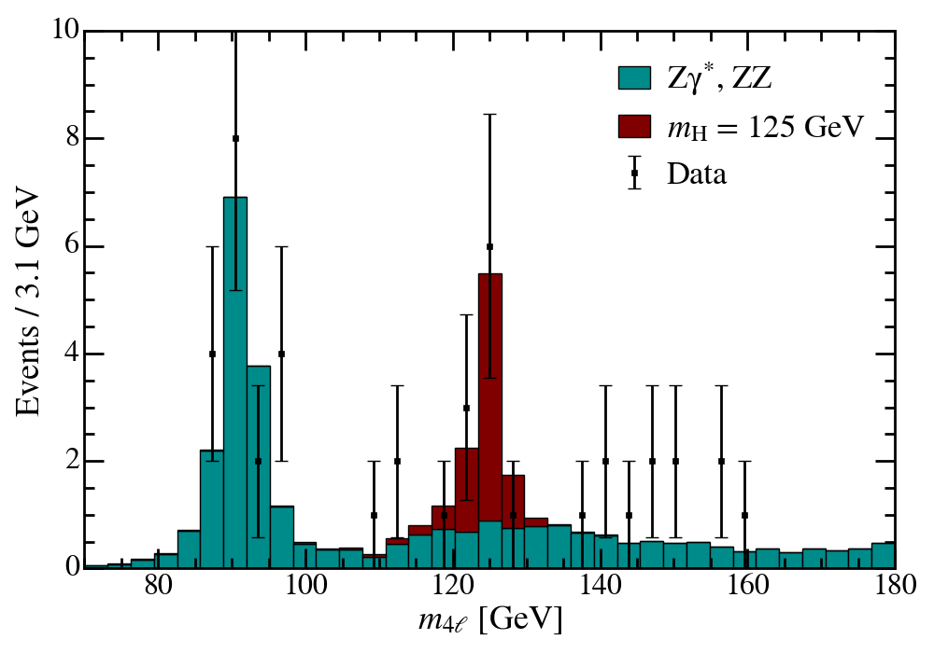
Unblind
The observed event distribution agree well with the Monte Carlo (MC) prediction.

Slide 40

Unblind
The observed event distribution agree well with the Monte Carlo (MC) prediction.
Hypothesis testing:
Null hypothesis $H_{0}$: Only $ZZ$ background, prior characterized by the MC prediction, scaled by a constant factor.

Slide 41
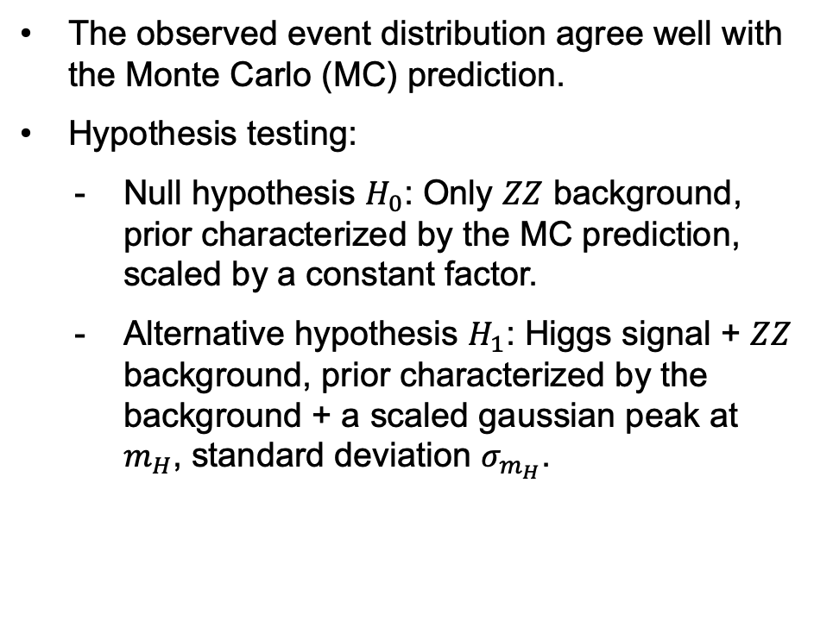
Unblind
The observed event distribution agree well with the Monte Carlo (MC) prediction.
Hypothesis testing:
Null hypothesis $H_{0}$: Only $ZZ$ background, prior characterized by the MC prediction, scaled by a constant factor.
Alternative hypothesis $H_{1}$: Higgs signal + $ZZ$ background, prior characterized by the background + a scaled gaussian peak at $m_{H}$, standard deviation $σ_{m_{H}}$.

Slide 42
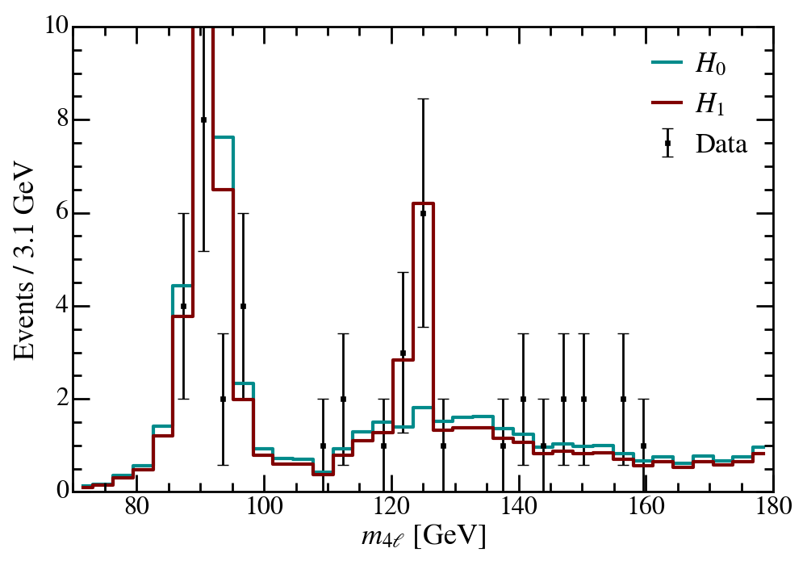
Unblind
The observed event distribution agree well with the Monte Carlo (MC) prediction.
Hypothesis testing:
Null hypothesis $H_{0}$: Only $ZZ$ background, prior characterized by the MC prediction, scaled by a constant factor.
Alternative hypothesis $H_{1}$: Higgs signal + $ZZ$ background, prior characterized by the background + a scaled gaussian peak at $m_{H}$, standard deviation $σ_{m_{H}}$.

Slide 43
p-value
Because of low event counts, we use Poisson-based likelihood fitting.

Slide 44

p-value
Because of low event counts, we use Poisson-based likelihood fitting.
For each $m_{H}$ prior, we perform regression on fixed choices of $σ_{m_{H}}$. However, the p-value is calculated as if $σ_{m_{H}}$ is a free parameter.

Slide 45
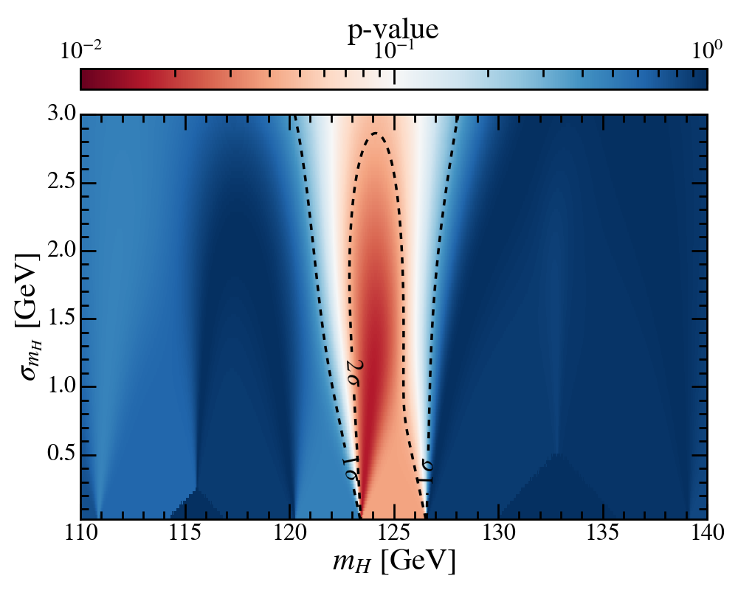

p-value
Because of low event counts, we use Poisson-based likelihood fitting.
For each $m_{H}$ prior, we perform regression on fixed choices of $σ_{m_{H}}$. However, the p-value is calculated as if $σ_{m_{H}}$ is a free parameter.
Significance of $2.4σ$ at $m_{H}≃123.8 GeV$.

Slide 46
Bootstrapping
Bootstrapping: Perturbing the observed data according to the uncertainties and repeat the analysis.

Slide 47
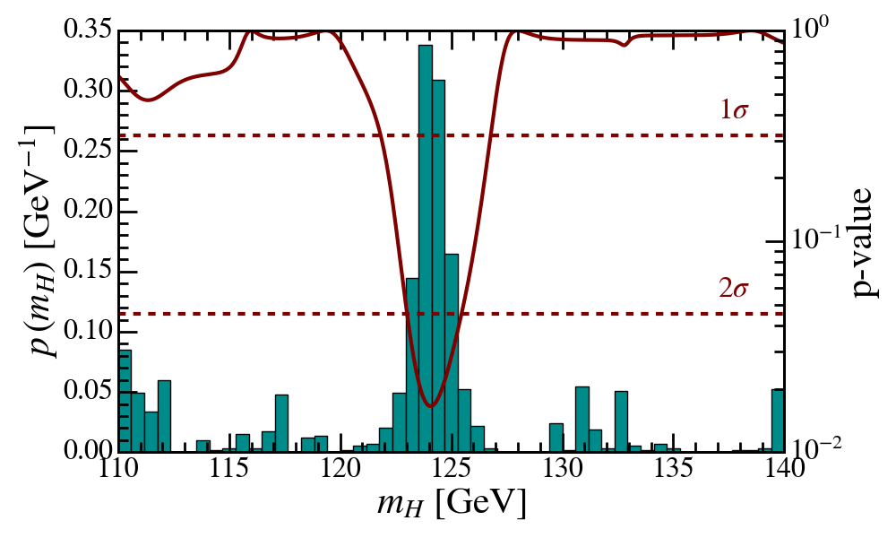
Bootstrapping
Bootstrapping: Perturbing the observed data according to the uncertainties and repeat the analysis.

Slide 48

Bootstrapping
Bootstrapping: Perturbing the observed data according to the uncertainties and repeat the analysis.
The significances remain stable at $2.4σ$.

Slide 49

Bootstrapping
Bootstrapping: Perturbing the observed data according to the uncertainties and repeat the analysis.
The significances remain stable at $2.4σ$.
Higgs mass: $m_{H}=124.22±1.16 GeV$.

Slide 50

Conclusion
A $2.4σ$ observation of Higgs boson through the four-lepton “golden” channel.
Higgs mass of $m_{H}=124.22±1.16 GeV$. Consistent with the theoretical prediction of $m_{H}=125 GeV!$

