Slide 1
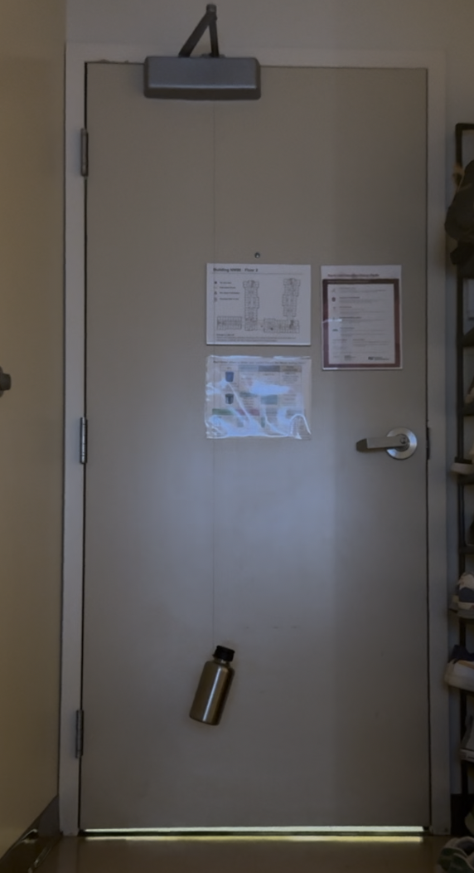
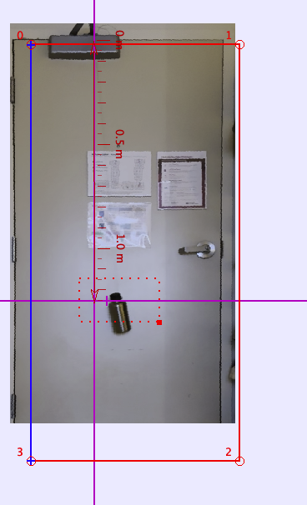
Pendulum Setup
Apparatus:
A 2m wire (from bike), a cylindrical water bottle full of water. The wire is attached to the neck of the water bottle. The other end is tied to the door hinge protruding away from the door.
Procedure:
Measure the width and the height of the door
Tie the string to the full water-bottle.
Tie the other end of the string to the hinge of the door
Perturb the pendulum and take a video
Import the video into Tracker
Adjust the perspective using the door rectangle frame
Calibrate the length using the height of the door
Measure the string length, add half of length of the cylindrical bottle for center of mass
Track the movement of the bottle
Fit a damped oscillation to the t-x graph
Repeat the measurement
Repeat 3-11 for 2 different lengths
Yongao Hu, 8.13 Junior Lab Sp 2025

Slide 2
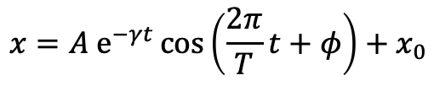
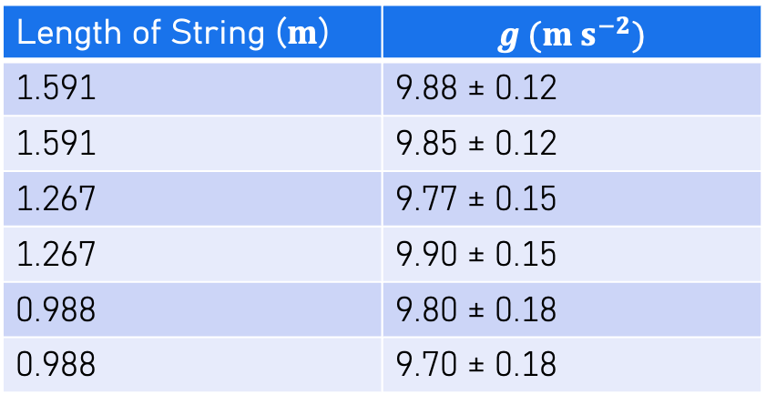

Result
$$x=A e^{−γt}\cos\left(\frac{2π}{T}t+φ\right)+x_{0}$$
Length of String ($m$) | $$g (m s^{−2})$$
1.591 | 9.88 ± 0.12
1.591 | 9.85 ± 0.12
1.267 | 9.77 ± 0.15
1.267 | 9.90 ± 0.15
0.988 | 9.80 ± 0.18
0.988 | 9.70 ± 0.18
Result: $g=9.82±0.03\left(stat\right)±0.15(sys)$
Yongao Hu, 8.13 Junior Lab Sp 2025

