Slide 1


A $2.4σ$ observation of the Higgs Boson through the $H→ ZZ→ 4ℓ$ golden channel
Vinh Q. Tran
Vinh Q. Tran
BSc Physics Candidate at MIT
April 22nd, 2025
Notes:
- Today, I will talk about our result in observing the Higgs boson, an important component of the standard model, that accurately describe the world even in the smallest extreme, using the data from the CMS experiment in the Large Hadron Collider

Slide 2
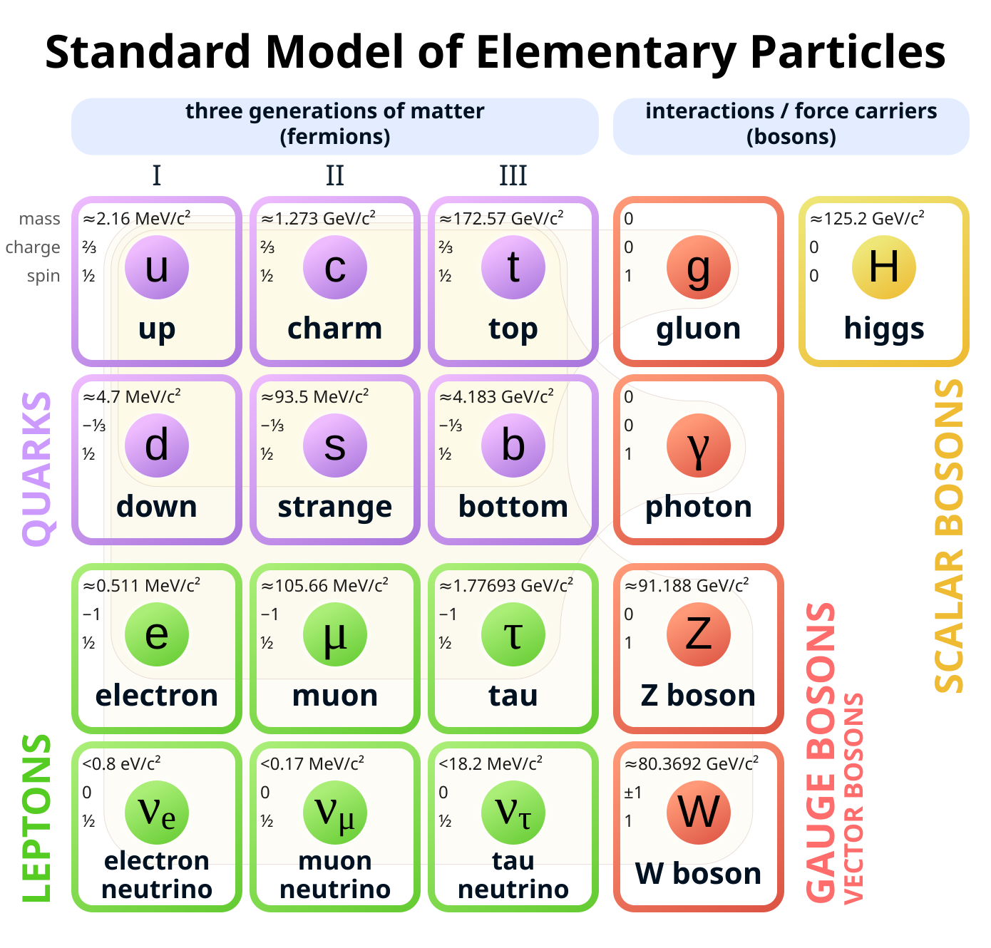
The Standard Model
Describe particles and phenomenon in terms of interactions between fundamental fields.

Slide 3
The Standard Model
Describe particles and phenomenon in terms of interactions between fundamental fields.
Success in explaining three of the four fundamental forces.

Slide 4
The Standard Model
Describe particles and phenomenon in terms of interactions between fundamental fields.
Success in explaining three of the four fundamental forces.
The Higgs field plays a crucial role in the model, in that it allows for a mass-giving mechanism.

Slide 5
The Standard Model
Describe particles and phenomenon in terms of interactions between fundamental fields.
Success in explaining three of the four fundamental forces.
The Higgs field plays a crucial role in the model, in that it allows for a mass-giving mechanism.
Up to the 2000s, evidence for the Higgs boson was still missing.
Notes:
Up to the early 2000s, while evidences for the tau neutrino and top quark have been observed, the Higgs remains elusive.
Here, we present an observation of the Higgs boson, using part of the data collected at the CMS experiment in 2011-2012.

Slide 6
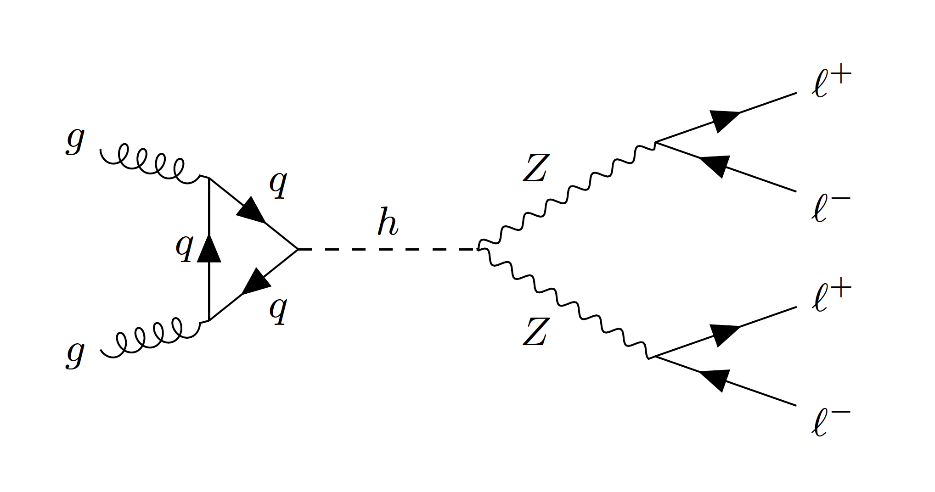
The four-lepton “golden” channel
Notes:
- Our observation of the Higgs focus on the four-leptons channel, which is the result of the Higgs boson decaying into two Z bosons, each of which, in turn, decays into a pair of lepton-antilepton, thus the name, four-lepton channel.

Slide 7

The four-lepton “golden” channel
No neutrino $→$ No missing energy and information loss.
Notes:
- The channel is deemed as the golden channel as the final product include …

Slide 8
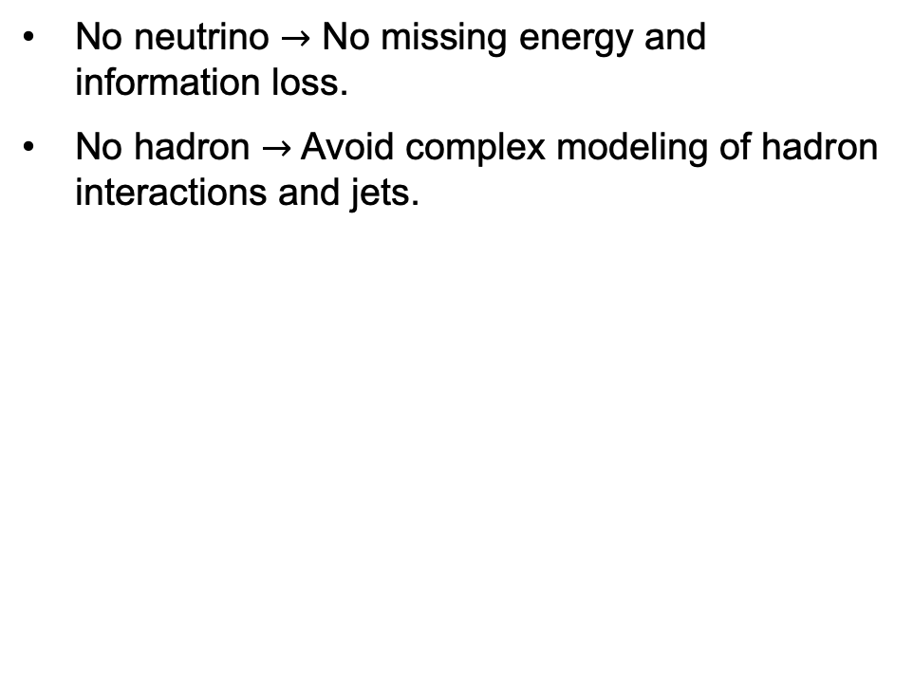
The four-lepton “golden” channel
No neutrino $→$ No missing energy and information loss.
No hadron $→$ Avoid complex modeling of hadron interactions and jets.

Slide 9
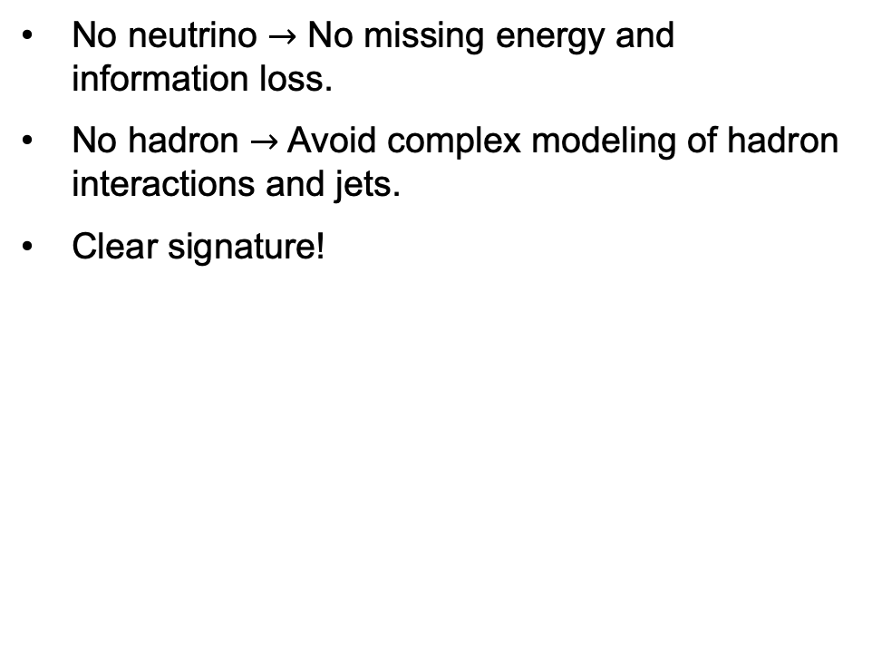
The four-lepton “golden” channel
No neutrino $→$ No missing energy and information loss.
No hadron $→$ Avoid complex modeling of hadron interactions and jets.
Clear signature!

Slide 10
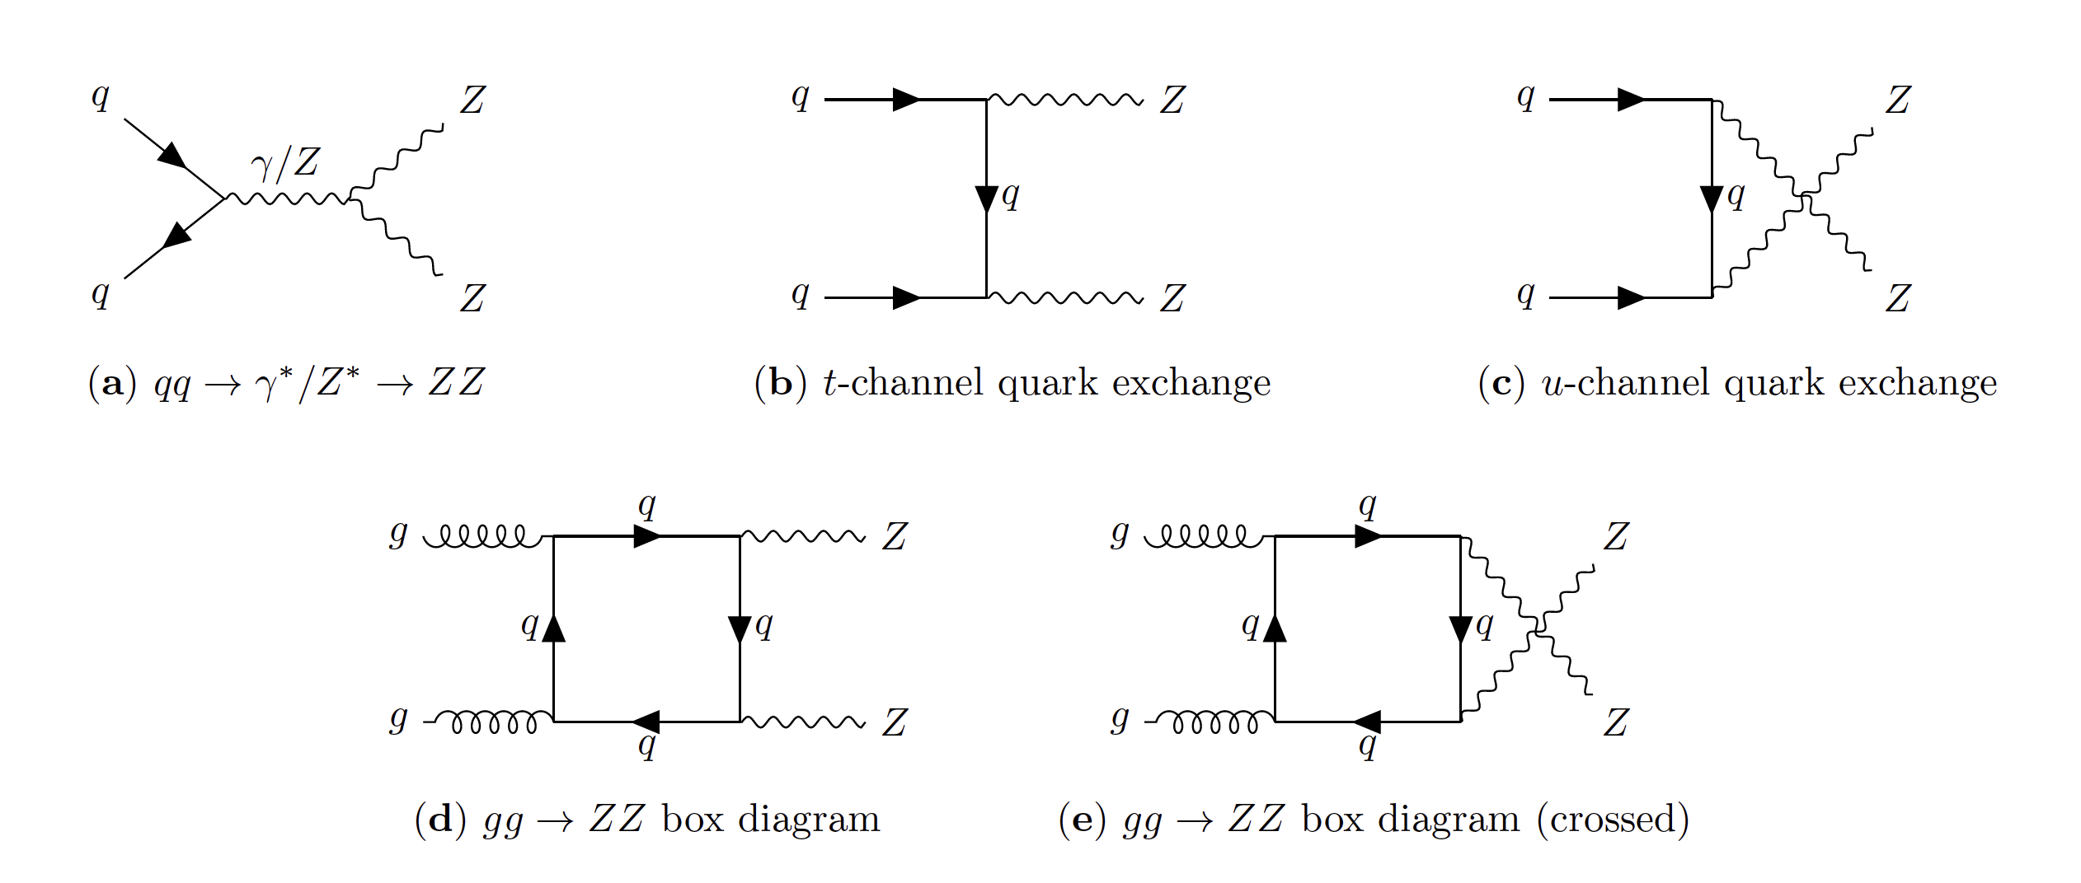
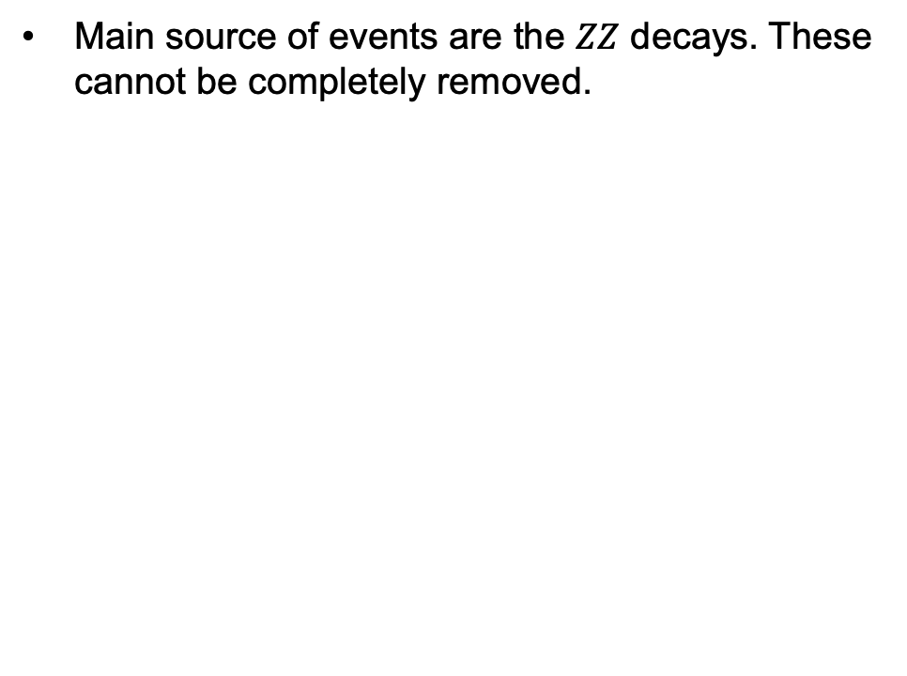
Four-lepton background
Main source of events are the $ZZ$ decays. These cannot be completely removed.

Slide 11
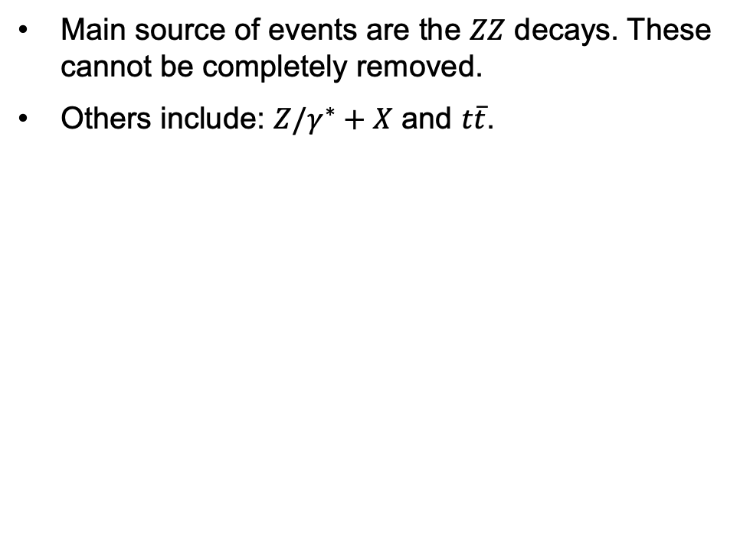
Four-lepton background
Main source of events are the $ZZ$ decays. These cannot be completely removed.
Others include: $Z/γ^{∗}+X$ and $t\overline{t}$.
Notes:
- Others background process includes the Z boson decay coupling with jets, and the top-antitop decays

Slide 12
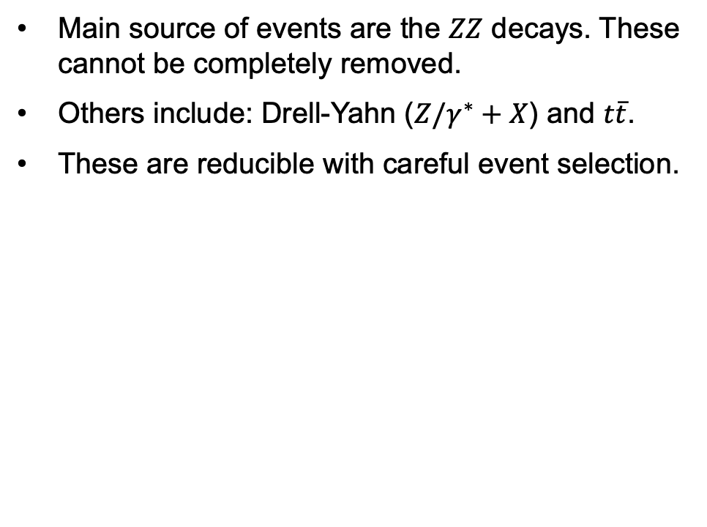
Four-lepton background
Main source of events are the $ZZ$ decays. These cannot be completely removed.
Others include: Drell-Yahn ($Z/γ^{∗}+X$) and $t\overline{t}$.
These are reducible with careful event selection.

Slide 13
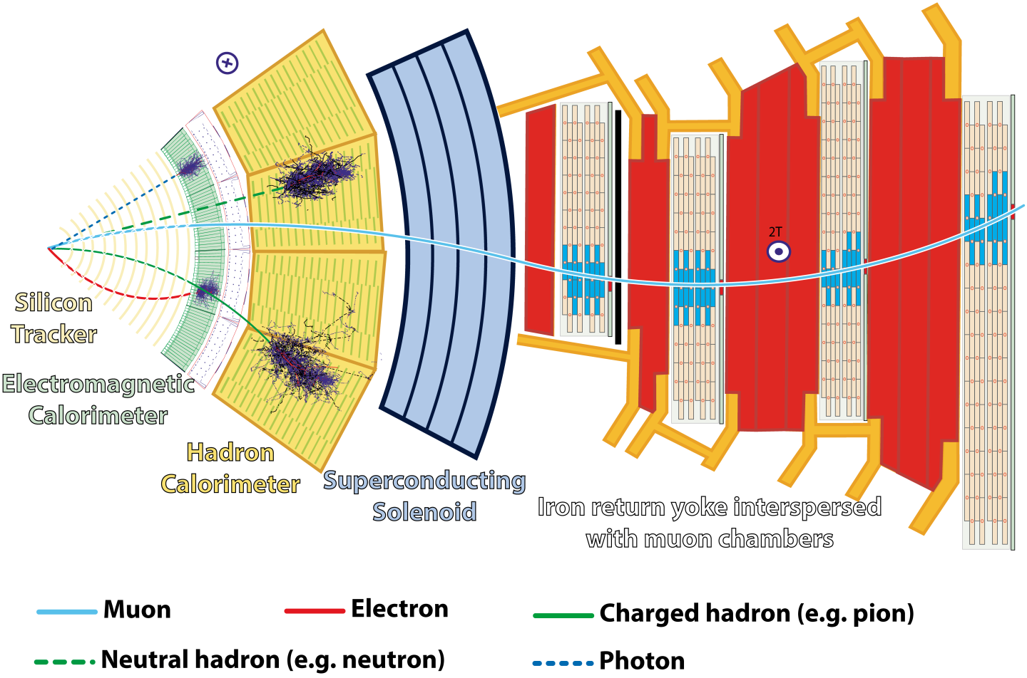
The CMS detector
Compact Muon Solenoid
Notes:
A little bit about the detector
CMS, short for the compact muon solenoid, is one of the two general purpose detectors at the LHC, along side ATLAS

Slide 14
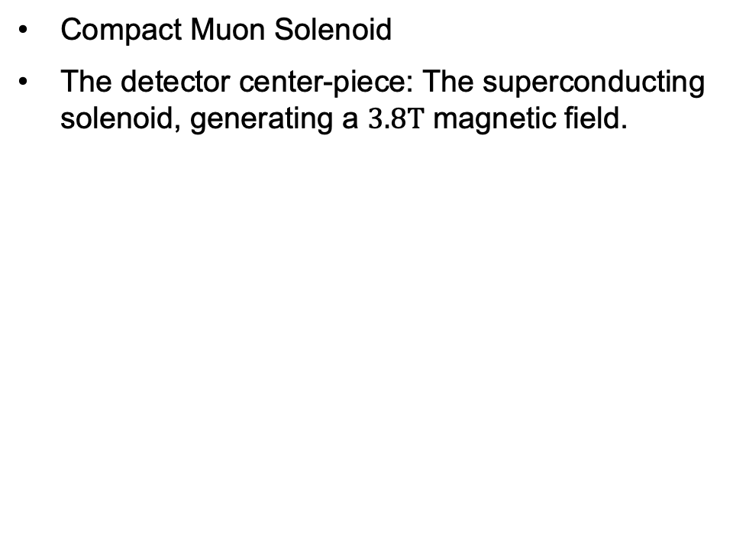
The CMS detector
Compact Muon Solenoid
The detector center-piece: The superconducting solenoid, generating a $3.8T$ magnetic field.
Notes:
- It comprises of a superconducting solenoid, which generate an inner magnetic field of 3.8T and an outer magnetic field of 2T

Slide 15
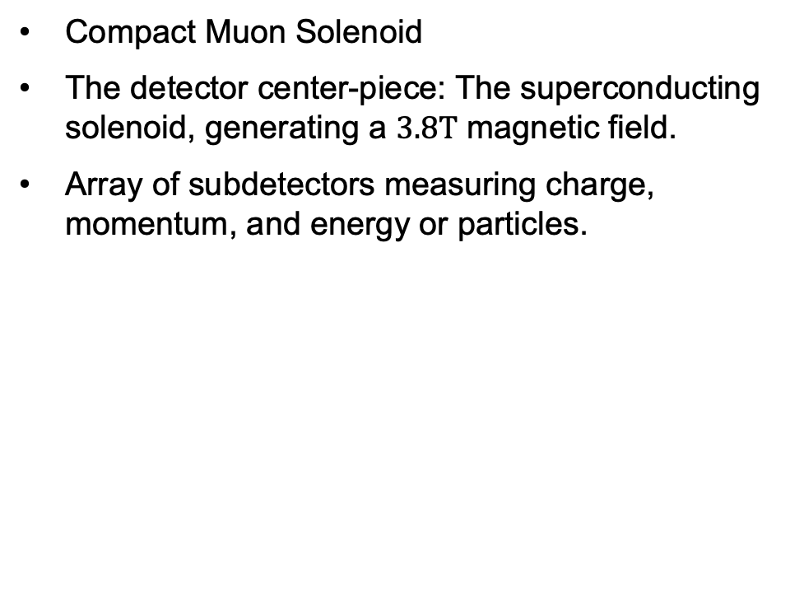
The CMS detector
Compact Muon Solenoid
The detector center-piece: The superconducting solenoid, generating a $3.8T$ magnetic field.
Array of subdetectors measuring charge, momentum, and energy or particles.

Slide 16
The CMS detector
Compact Muon Solenoid
The detector center-piece: The superconducting solenoid, generating a $3.8T$ magnetic field.
Array of subdetectors measuring charge, momentum, and energy or particles.
Notes:
- Including the silicon tracker, which register the curvature of the particle’s track, from which the charge of the particle is measured

Slide 17
The CMS detector
Compact Muon Solenoid
The detector center-piece: The superconducting solenoid, generating a $3.8T$ magnetic field.
Array of subdetectors measuring charge, momentum, and energy or particles.
Notes:
- Next to it is the Electromagnetic Calorimeter, or ECAL, which measure the momentum and energy of electrons and photons

Slide 18
The CMS detector
Compact Muon Solenoid
The detector center-piece: The superconducting solenoid, generating a $3.8T$ magnetic field.
Array of subdetectors measuring charge, momentum, and energy or particles.
Notes:
- Then there is the Hadron Calorimeter (HCAL) which measure the momentum and energy of hadrons

Slide 19
The CMS detector
Compact Muon Solenoid
The detector center-piece: The superconducting solenoid, generating a $3.8T$ magnetic field.
Array of subdetectors measuring charge, momentum, and energy or particles.
Notes:
- Outside of the solenoid is the muon complex, that measure the momentum, energy, and charge of muons

Slide 20
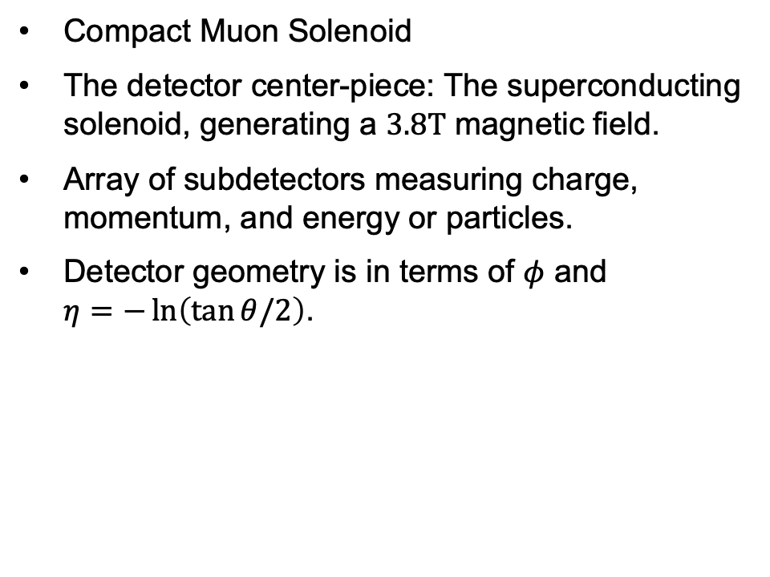
The CMS detector
Compact Muon Solenoid
The detector center-piece: The superconducting solenoid, generating a $3.8T$ magnetic field.
Array of subdetectors measuring charge, momentum, and energy or particles.
Detector geometry is in terms of $φ$ and $η=−\ln\left(\tan{θ/2}\right)$.

Slide 21
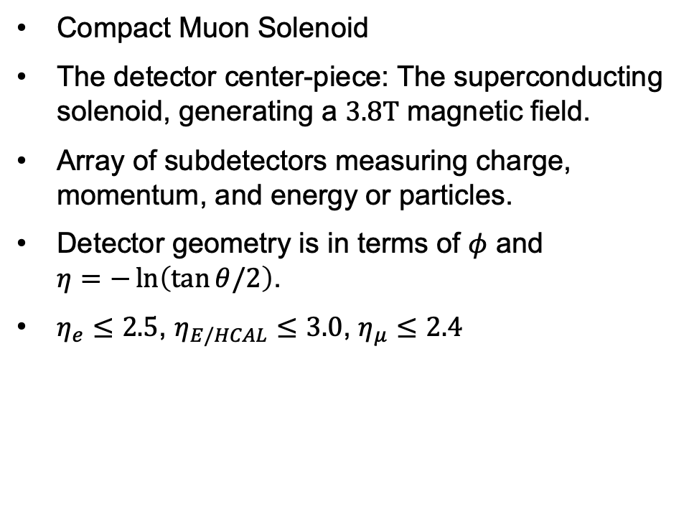
The CMS detector
Compact Muon Solenoid
The detector center-piece: The superconducting solenoid, generating a $3.8T$ magnetic field.
Array of subdetectors measuring charge, momentum, and energy or particles.
Detector geometry is in terms of $φ$ and $η=−\ln\left(\tan{θ/2}\right)$.
$η_{e}≤2.5$, $η_{E/HCAL}≤3.0$, $η_{μ}≤2.4$
Notes:
- The limiting psudorapidity of the …

Slide 22

Experimental data
Observations are from the CMS 2011-2012 runs with $\sqrt{s}=7, 8 TeV$.

Slide 23
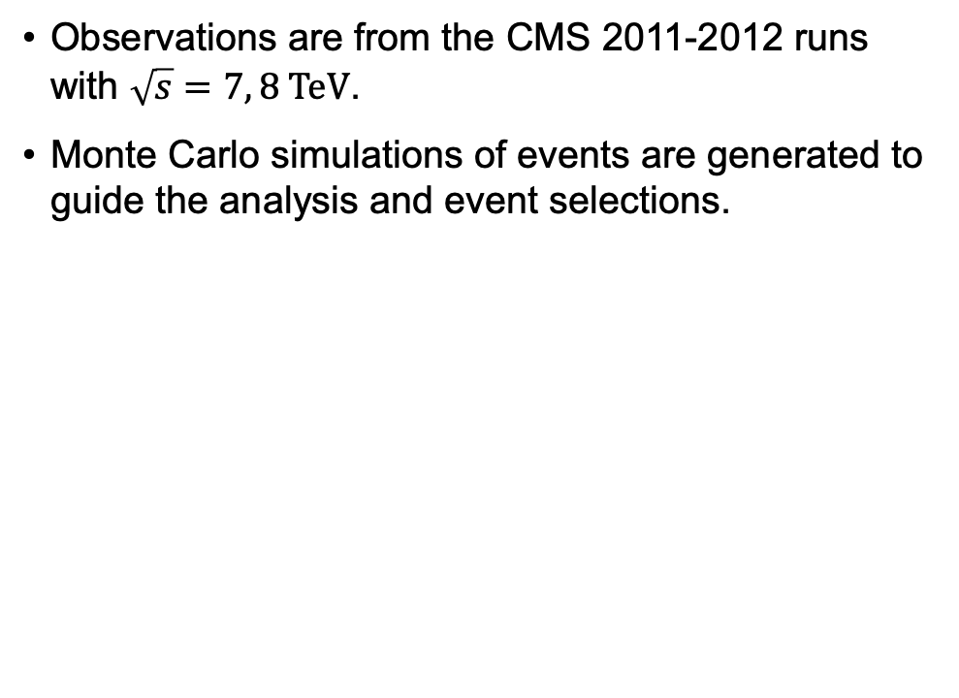
Experimental data
Observations are from the CMS 2011-2012 runs with $\sqrt{s}=7, 8 TeV$.
Monte Carlo simulations of events are generated to guide the analysis and event selections.

Slide 24
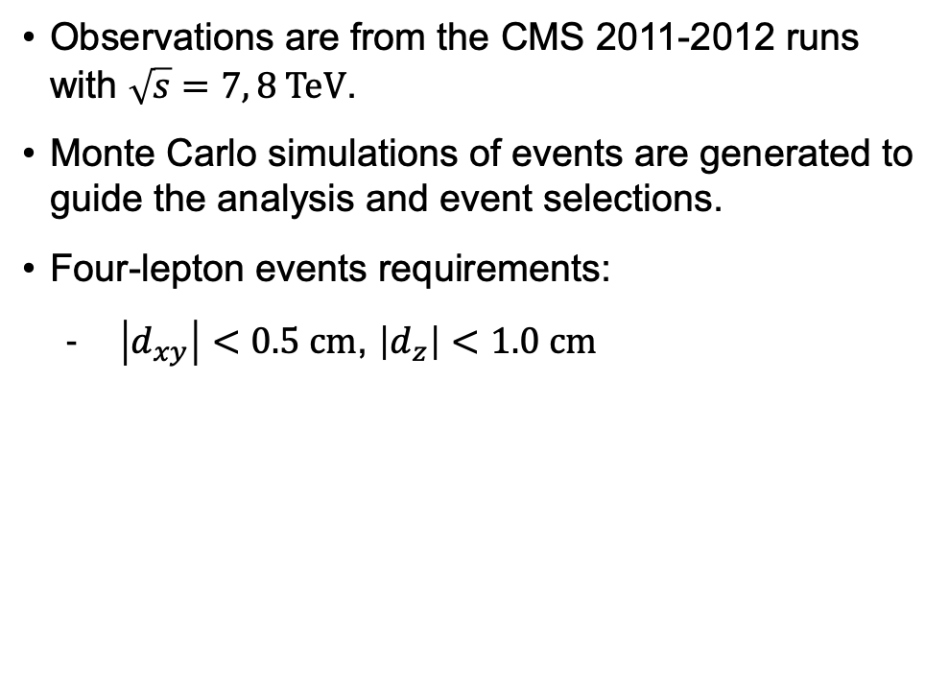
Experimental data
Observations are from the CMS 2011-2012 runs with $\sqrt{s}=7, 8 TeV$.
Monte Carlo simulations of events are generated to guide the analysis and event selections.
Four-lepton events requirements:
$\left|d_{xy}\right|<0.5 cm$, $\left|d_{z}\right|<1.0 cm$
Notes:
- The transverse and longitudinal impact parameter, which is defined as the closest approach of the decay track to the primary vertex, the point protons collide, is limited to …

Slide 25
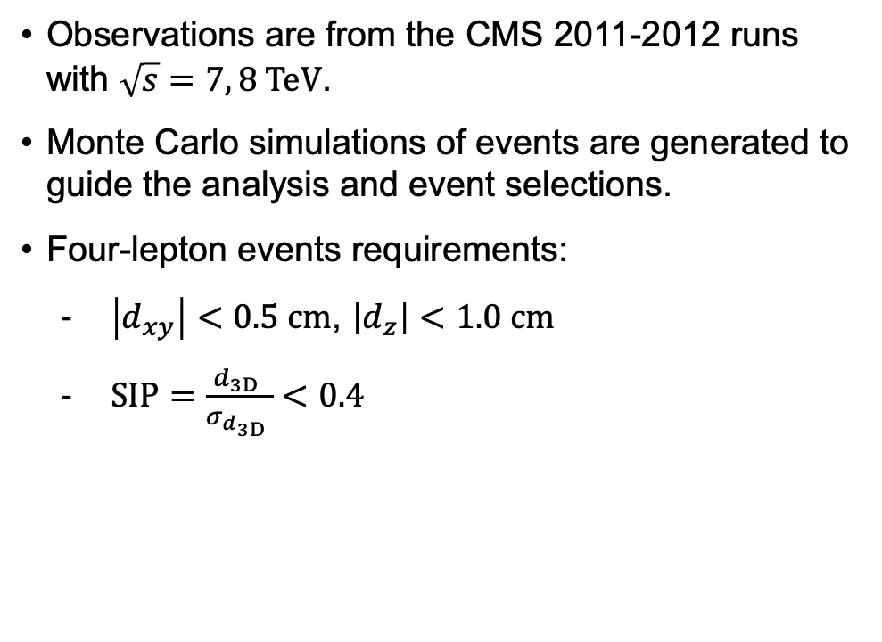
Experimental data
Observations are from the CMS 2011-2012 runs with $\sqrt{s}=7, 8 TeV$.
Monte Carlo simulations of events are generated to guide the analysis and event selections.
Four-lepton events requirements:
$\left|d_{xy}\right|<0.5 cm$, $\left|d_{z}\right|<1.0 cm$
$SIP=\frac{d_{3D }}{σ_{d_{3D }}}<0.4$
Notes:
- The significance of the 3D impact parameter, which is essentially the signal-noise ratio of the 3D impact parameter due to statistical effect is limited to …
- This basically measure how certain it is that particles arise further from the primary vertex, which a low number mean all leptons originate from the same point.

Slide 26
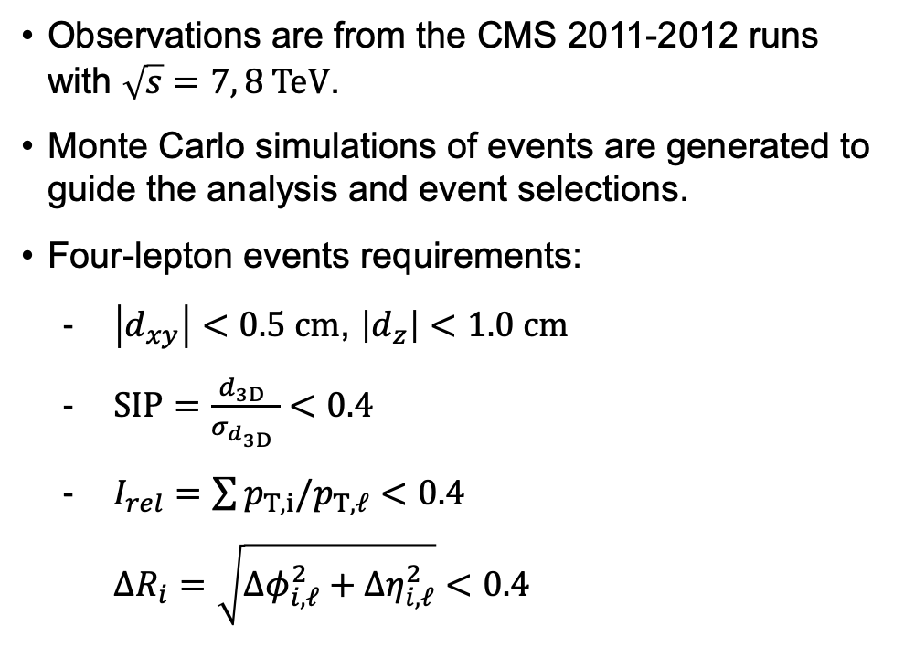
Experimental data
Observations are from the CMS 2011-2012 runs with $\sqrt{s}=7, 8 TeV$.
Monte Carlo simulations of events are generated to guide the analysis and event selections.
Four-lepton events requirements:
$\left|d_{xy}\right|<0.5 cm$, $\left|d_{z}\right|<1.0 cm$
$SIP=\frac{d_{3D }}{σ_{d_{3D }}}<0.4$
$I_{rel}=\sum{p_{T,i}/p_{T,ℓ}}<0.4$
$ΔR_{i}=\sqrt{Δφ_{i,ℓ}^{2}+Δη_{i,ℓ}^{2}}<0.4$
Notes:
- The relative isolation of lepton, which is basically the ratio between the transverse momentum of all particles within certain radius from the leptons and the transverse momentum of the leptons, is limited to 0.4 for the delta R of 0.4.

Slide 27
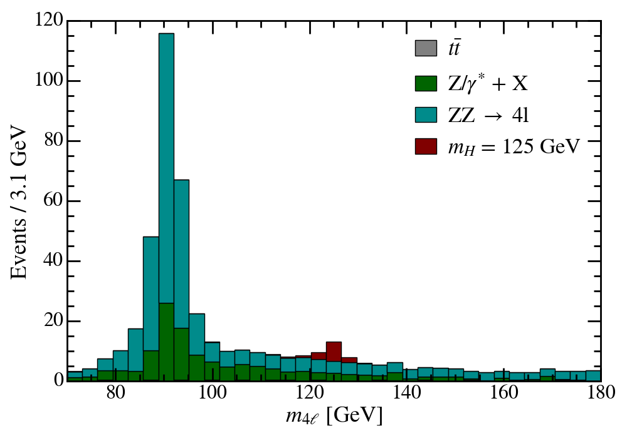
Experimental data
Observations are from the CMS 2011-2012 runs with $\sqrt{s}=7, 8 TeV$.
Monte Carlo simulations of events are generated to guide the analysis and event selections.
Four-lepton events requirements:
$\left|d_{xy}\right|<0.5 cm$, $\left|d_{z}\right|<1.0 cm$
$SIP=\frac{d_{3D }}{σ_{d_{3D }}}<0.4$
$I_{rel}=\sum{p_{T,i}/p_{T,ℓ}}<0.4$
$ΔR_{i}=\sqrt{Δφ_{i,ℓ}^{2}+Δη_{i,ℓ}^{2}}<0.4$
Notes:
- Here what the expected distribution of the four-lepton invariant mass would look like from these selection criteria, basing on the Monte Carlo simulations.

Slide 28

Kinematics cuts
Charge conservation cut and transverse momentum cut: $\sum_{i}{q_{i}}=0$, $p_{T,e}>7 GeV$, $p_{T,μ}>5 GeV$

Slide 29

Kinematics cuts
Charge conservation cut and transverse momentum cut: $\sum_{i}{q_{i}}=0$, $p_{T,e}>7 GeV$, $p_{T,μ}>5 GeV$
Remove $90$-$95\%$ of $Z/γ^{∗}+X$ and $t\overline{t}$, $20$-$30\%$ of irreducible $ZZ$ background. $95\%$ of the signal still remain

Slide 30
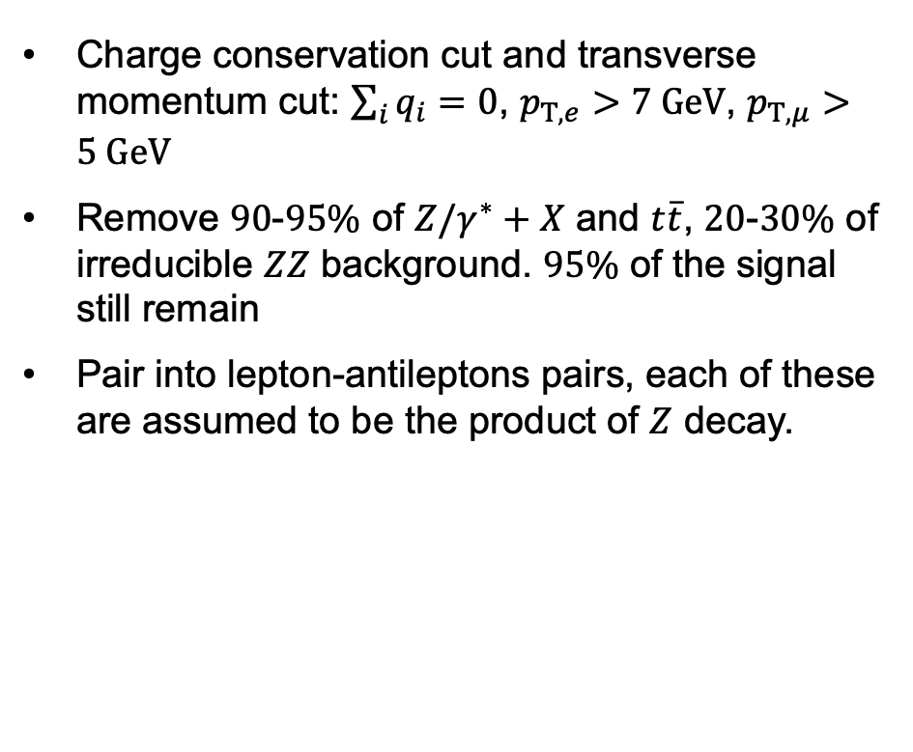
Kinematics cuts
Charge conservation cut and transverse momentum cut: $\sum_{i}{q_{i}}=0$, $p_{T,e}>7 GeV$, $p_{T,μ}>5 GeV$
Remove $90$-$95\%$ of $Z/γ^{∗}+X$ and $t\overline{t}$, $20$-$30\%$ of irreducible $ZZ$ background. $95\%$ of the signal still remain
Pair into lepton-antileptons pairs, each of these are assumed to be the product of $Z$ decay.

Slide 31
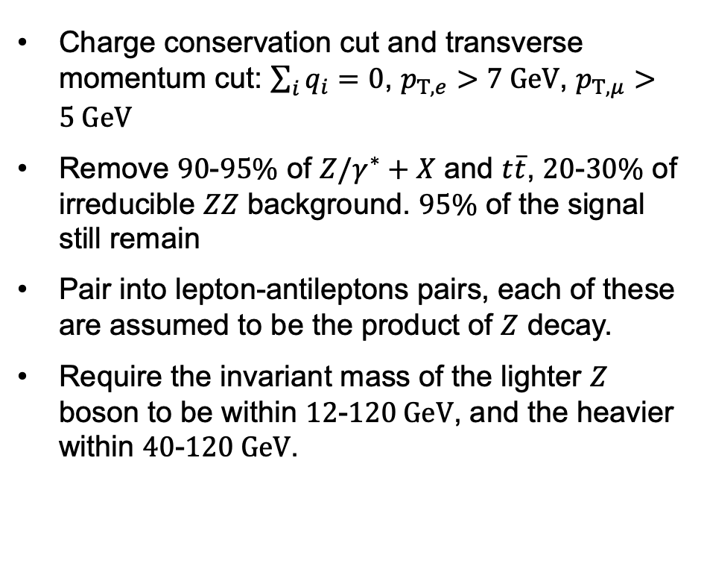
Kinematics cuts
Charge conservation cut and transverse momentum cut: $\sum_{i}{q_{i}}=0$, $p_{T,e}>7 GeV$, $p_{T,μ}>5 GeV$
Remove $90$-$95\%$ of $Z/γ^{∗}+X$ and $t\overline{t}$, $20$-$30\%$ of irreducible $ZZ$ background. $95\%$ of the signal still remain
Pair into lepton-antileptons pairs, each of these are assumed to be the product of $Z$ decay.
Require the invariant mass of the lighter $Z$ boson to be within $12$-$120 GeV$, and the heavier within $40$-$120 GeV$.

Slide 32
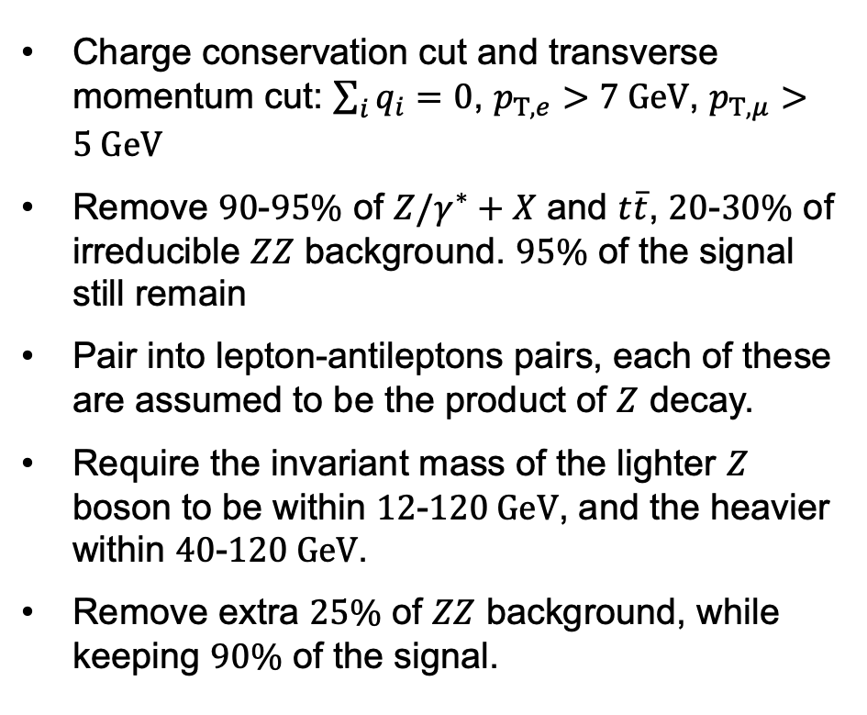
Kinematics cuts
Charge conservation cut and transverse momentum cut: $\sum_{i}{q_{i}}=0$, $p_{T,e}>7 GeV$, $p_{T,μ}>5 GeV$
Remove $90$-$95\%$ of $Z/γ^{∗}+X$ and $t\overline{t}$, $20$-$30\%$ of irreducible $ZZ$ background. $95\%$ of the signal still remain
Pair into lepton-antileptons pairs, each of these are assumed to be the product of $Z$ decay.
Require the invariant mass of the lighter $Z$ boson to be within $12$-$120 GeV$, and the heavier within $40$-$120 GeV$.
Remove extra $25\%$ of $ZZ$ background, while keeping $90\%$ of the signal.

Slide 33
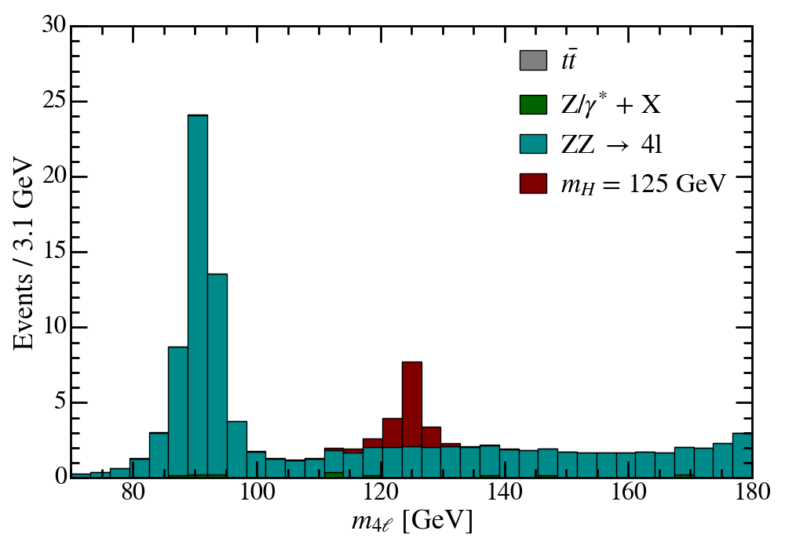
Kinematics cuts
Charge conservation cut and transverse momentum cut: $\sum_{i}{q_{i}}=0$, $p_{T,e}>7 GeV$, $p_{T,μ}>5 GeV$
Remove $90$-$95\%$ of $Z/γ^{∗}+X$ and $t\overline{t}$, $20$-$30\%$ of irreducible $ZZ$ background. $95\%$ of the signal still remain
Pair into lepton-antileptons pairs, each of these are assumed to be the product of $Z$ decay.
Require the invariant mass of the lighter $Z$ boson to be within $12$-$120 GeV$, and the heavier within $40$-$120 GeV$.
Remove extra $25\%$ of $ZZ$ background, while keeping $90\%$ of the signal.

Slide 34




Machine learning cut
$$ℓ$$
$$ℓ$$
MLP
Aggregate
$$ℓ$$
$$ℓ$$
MLP
Graph Convolution Network on a fully-connected graph. Each node represent a lepton.

Slide 35
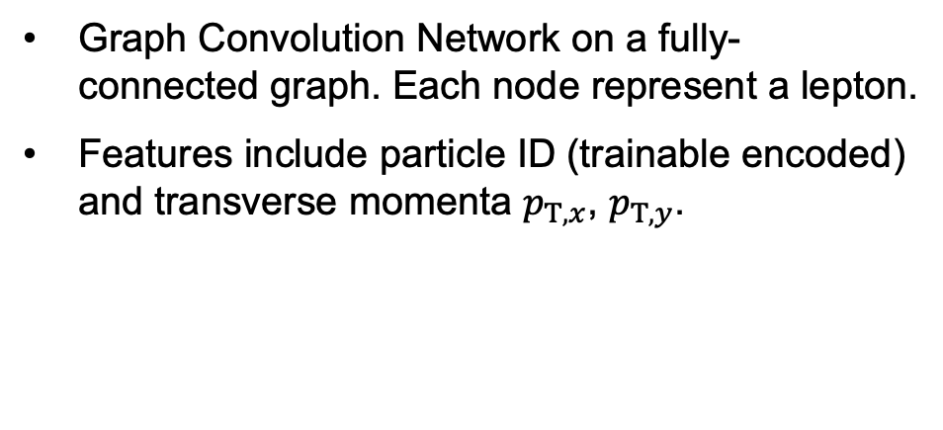
Machine learning cut
$$ℓ$$
$$ℓ$$
MLP
Aggregate
$$ℓ$$
$$ℓ$$
MLP
Graph Convolution Network on a fully-connected graph. Each node represent a lepton.
Features include particle ID (trainable encoded) and transverse momenta $p_{T,x}$, $p_{T,y}$.

Slide 36
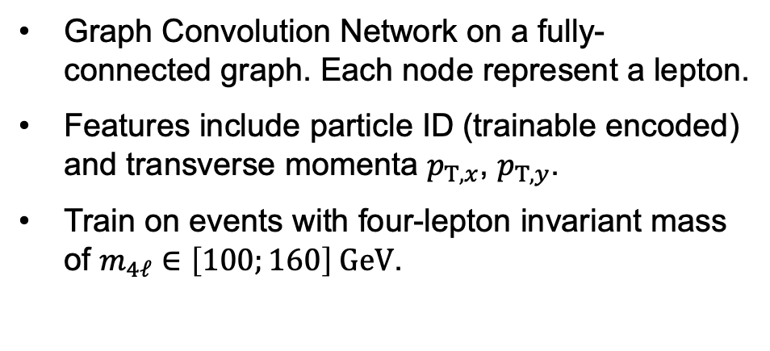
Machine learning cut
$$ℓ$$
$$ℓ$$
MLP
Aggregate
$$ℓ$$
$$ℓ$$
MLP
Graph Convolution Network on a fully-connected graph. Each node represent a lepton.
Features include particle ID (trainable encoded) and transverse momenta $p_{T,x}$, $p_{T,y}$.
Train on events with four-lepton invariant mass of $m_{4ℓ}∈\left[100;160\right] GeV$.

Slide 37
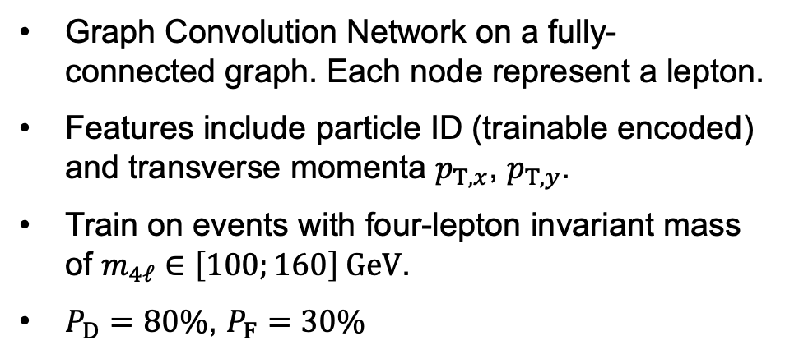
Machine learning cut
$$ℓ$$
$$ℓ$$
MLP
Aggregate
$$ℓ$$
$$ℓ$$
MLP
Graph Convolution Network on a fully-connected graph. Each node represent a lepton.
Features include particle ID (trainable encoded) and transverse momenta $p_{T,x}$, $p_{T,y}$.
Train on events with four-lepton invariant mass of $m_{4ℓ}∈\left[100;160\right] GeV$.
$P_{D}=80\%$, $P_{F}=30\%$

Slide 38
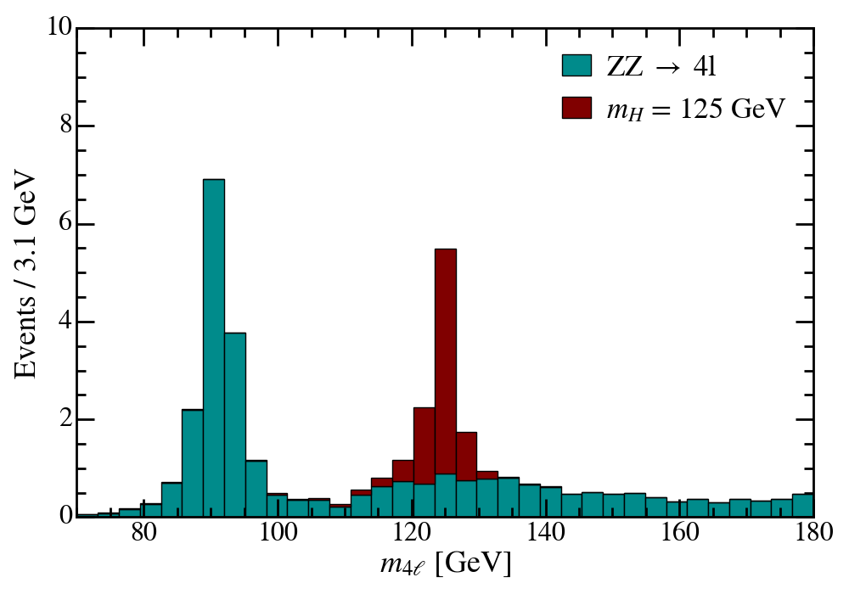
Machine learning cut
$$ℓ$$
$$ℓ$$
MLP
Aggregate
$$ℓ$$
$$ℓ$$
MLP
Graph Convolution Network on a fully-connected graph. Each node represent a lepton.
Features include particle ID (trainable encoded) and transverse momenta $p_{T,x}$, $p_{T,y}$.
Train on events with four-lepton invariant mass of $m_{4ℓ}∈\left[100;160\right] GeV$.
$P_{D}=80\%$, $P_{F}=30\%$

Slide 39
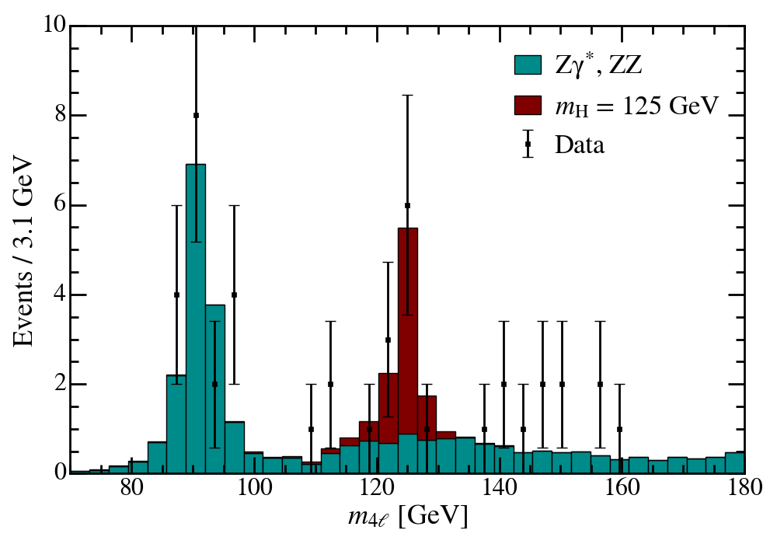
Unblind
The observed event distribution agree well with the Monte Carlo (MC) prediction.

Slide 40

Unblind
The observed event distribution agree well with the Monte Carlo (MC) prediction.
Hypothesis testing:
Null hypothesis $H_{0}$: Only $ZZ$ background, prior characterized by the MC prediction, scaled by a constant factor.

Slide 41
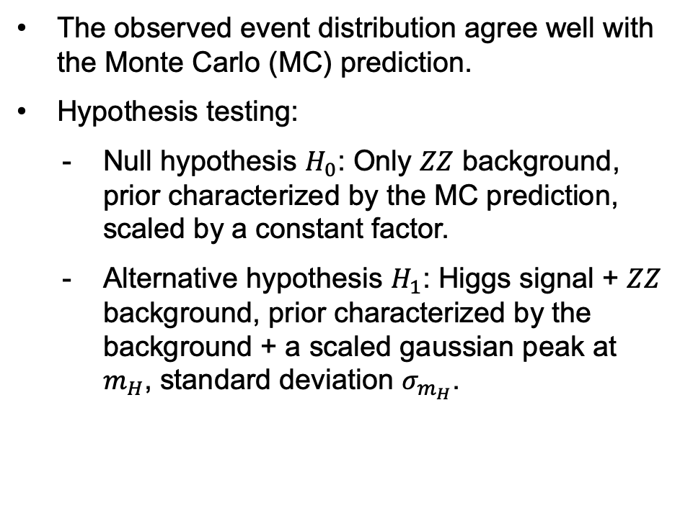
Unblind
The observed event distribution agree well with the Monte Carlo (MC) prediction.
Hypothesis testing:
Null hypothesis $H_{0}$: Only $ZZ$ background, prior characterized by the MC prediction, scaled by a constant factor.
Alternative hypothesis $H_{1}$: Higgs signal + $ZZ$ background, prior characterized by the background + a scaled gaussian peak at $m_{H}$, standard deviation $σ_{m_{H}}$.

Slide 42
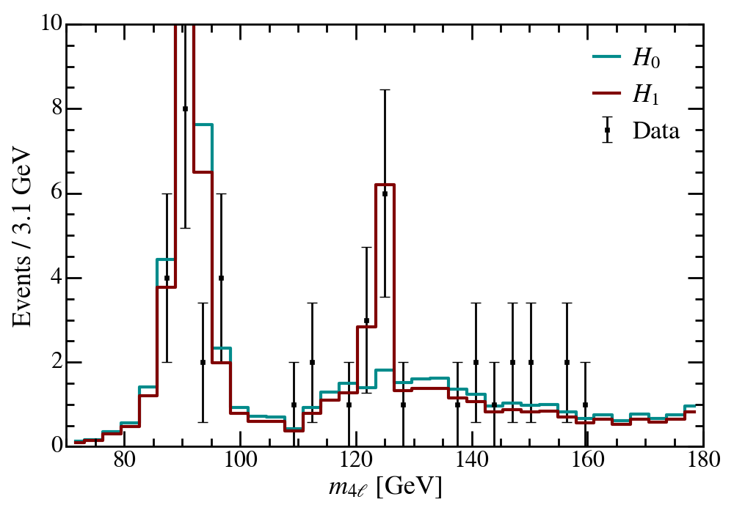
Unblind
The observed event distribution agree well with the Monte Carlo (MC) prediction.
Hypothesis testing:
Null hypothesis $H_{0}$: Only $ZZ$ background, prior characterized by the MC prediction, scaled by a constant factor.
Alternative hypothesis $H_{1}$: Higgs signal + $ZZ$ background, prior characterized by the background + a scaled gaussian peak at $m_{H}$, standard deviation $σ_{m_{H}}$.

Slide 43
p-value
Because of low event counts, we use Poisson-based likelihood fitting.

Slide 44

p-value
Because of low event counts, we use Poisson-based likelihood fitting.
For each $m_{H}$ prior, we perform regression on fixed choices of $σ_{m_{H}}$. However, the p-value is calculated as if $σ_{m_{H}}$ is a free parameter.
Notes:
- This basically mean we are performing a combination of gradient descent and grid search rather than full gradient descent

Slide 45
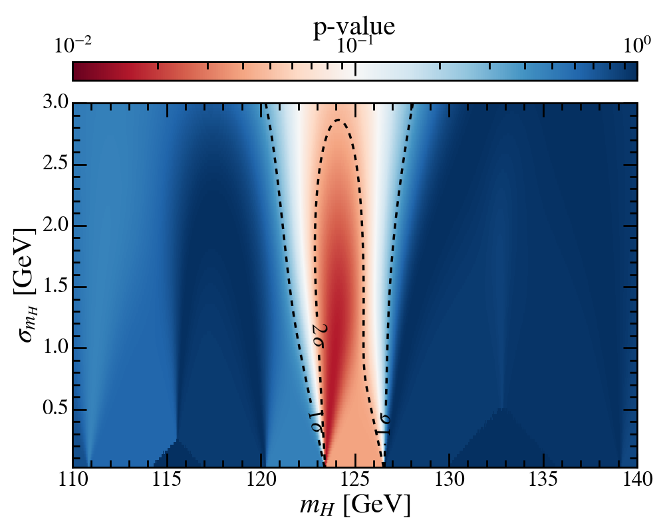

p-value
Because of low event counts, we use Poisson-based likelihood fitting.
For each $m_{H}$ prior, we perform regression on fixed choices of $σ_{m_{H}}$. However, the p-value is calculated as if $σ_{m_{H}}$ is a free parameter.
Significance of $2.4σ$ at $m_{H}≃123.8 GeV$.

Slide 46
Bootstrapping
Bootstrapping: Perturbing the observed data according to the uncertainties and repeat the analysis.

Slide 47
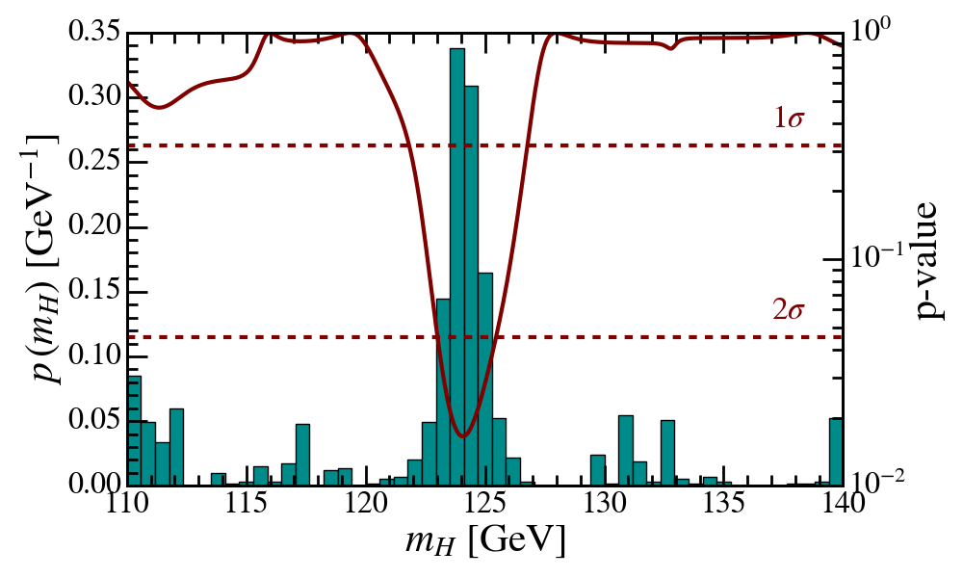
Bootstrapping
Bootstrapping: Perturbing the observed data according to the uncertainties and repeat the analysis.

Slide 48

Bootstrapping
Bootstrapping: Perturbing the observed data according to the uncertainties and repeat the analysis.
The significances remain stable at $2.4σ$.

Slide 49

Bootstrapping
Bootstrapping: Perturbing the observed data according to the uncertainties and repeat the analysis.
The significances remain stable at $2.4σ$.
Higgs mass: $m_{H}=124.22±1.16 GeV$.

Slide 50

Conclusion
A $2.4σ$ observation of Higgs boson through the four-lepton “golden” channel.
Higgs mass of $m_{H}=124.22±1.16 GeV$. Consistent with the theoretical prediction of $m_{H}=125 GeV!$

