Slide 1
Random Number Generator from Atomospheric Muon Detection
Yongao Hu
Junior Lab 8.13 Presentation
May 2025
Notes:
Hi everyone, I’m yongao, and today I am presenting the result of the third experiment, which is the Cosmic watch muon detector experiment. I have constructed a random number generator from the output of the muon detectors.

Slide 2
True Random Number Generator is Hard to Come By
Computer: Deterministic
Pseudo-random number generator
Not truly unpredictable
True random number generator needed for:
Cryptography
Simulations
Scientific Experiments
Notes:
The central question we are addressing in this experiment is a true random number generators. True random numbers are surprisingly difficult to generate because most conventional methods rely on deterministic algorithms, which can only produce pseudo-randomness rather than true unpredictability. Yet, many critical applications — from cryptography to scientific simulations — depend on genuinely random numbers to ensure security and accuracy. This scarcity of reliable, truly random sources has driven researchers to explore natural phenomena as entropy sources. Cosmic muons is considered a candidate for a truly random number generator. By harnessing these naturally random events, we aim to create a robust and fundamentally unpredictable source of randomness.

Slide 3
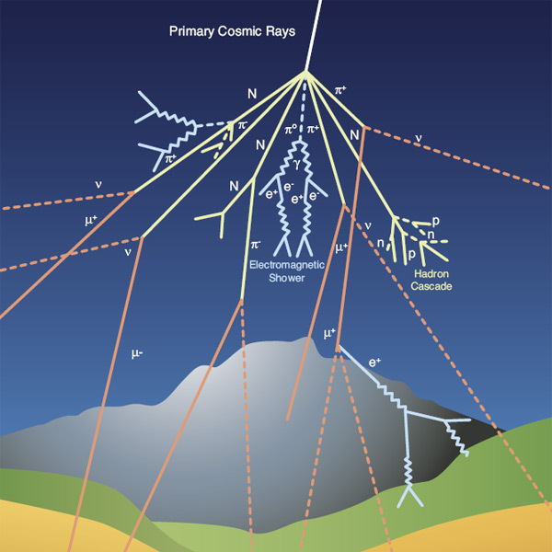
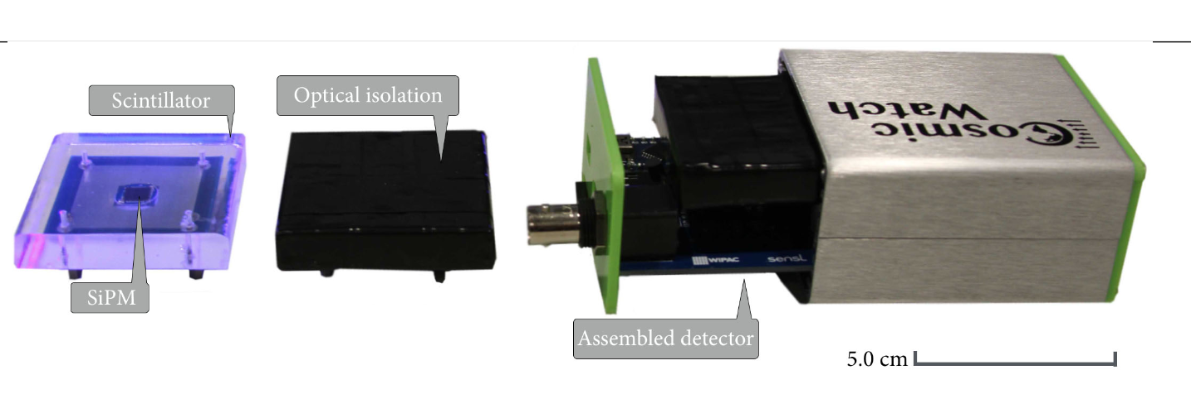
Atmospheric Muons are Produced from Random Cosmic Rays
Image credit: Lab Manual
Image credit: CERN
Notes:
In theory, atomospheric muons are produced by cosmic rays interacting with the Earth's atmosphere. Primary cosmic rays, typically protons or heavier nuclei, collide with atmospheric nuclei at altitudes of 15--20 km, producing showers of secondary particles. Most of the collision energy goes into creating mesons, primarily pions and kaons. Charged mesons decay into muons and neutrinos, while neutral mesons rapidly decay into gamma rays. The cosmic-ray muons observed at ground level predominantly originate from the decay of charged pions, and to a lesser extent from kaon decays. Although the primary cosmic rays are absorbed high in the atmosphere, secondary muons, due to their relatively long lifetime and high energy, can penetrate to the Earth's surface.
The muons are detected using a cosmic watch detector. The scintillator emits light when a muon passes through it, and a photomultiplier tube detects the light and produces an electrical signal. The photomultiplier signal is then processed to determine the time and energy of the muon detection event.
The random nature of the cosmic rays result in random arrival time of the muons, making it an excellent candidate for random number generators.

Slide 4
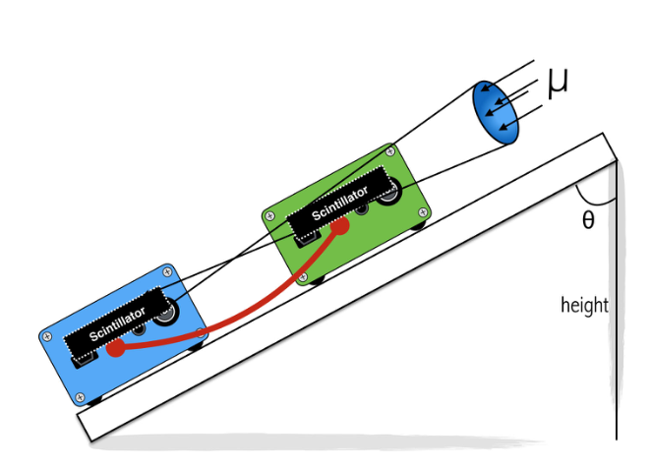
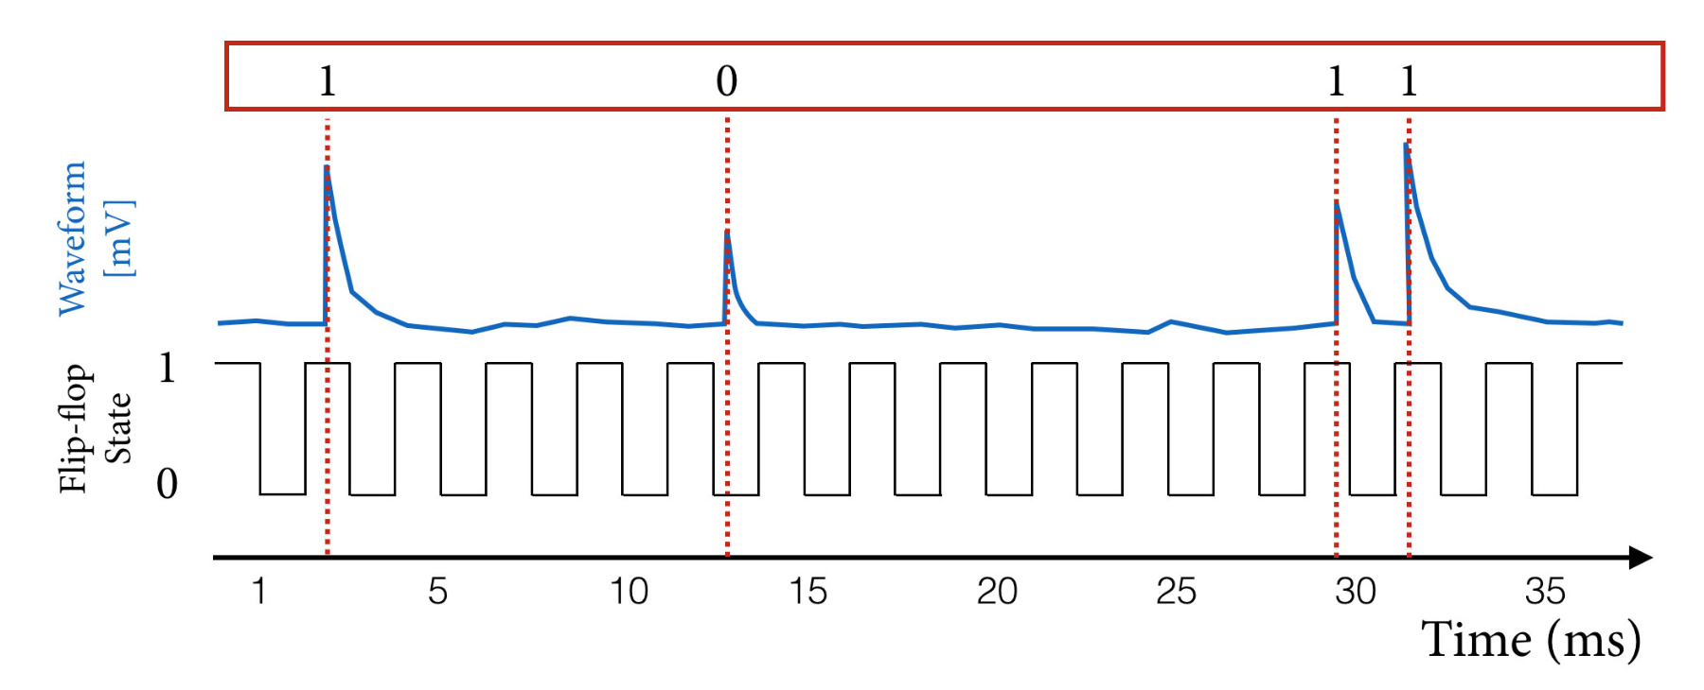
Experimental Setup
Image credit: Lab Manual
We convert coincidental muons to 0 if the timestamp is even or 1 if the timestamp is odd
Notes:
Here is our experiment setup. We put two cosmic watch detectors on a plank. We only count the signal if the muon is simultaneously detected by both detectors, to minimize background noise. We measure it at 10 angles, with each data point taking data for 24-96 hours for good statistics. We take the timestamp of the coincidental muons and convert it to 0 if the timestamp is even or 1 if the timestamp is odd. We then obtain a binary sequence.

Slide 5
Various Statistical Tests for Randomness
Monobit Frequency
Sequence Test
Autocorrelation Function
Compression Ratio
Entropy
Lempel-Ziv Complexity
Angular Dependence
Notes:
We employ various statistical tests for randomness. We run the data thorugh monobit frequency test, sequence test, autocorrelation function test, compression Ratio, Shannon entropy, Lempel-Ziv complexity, and angular dependence test. We will now explain them and present the result of the tests.

Slide 6
Non-parametric Bootstrap for Error Analysis
Generate 10000 synthetic replicas by resampling original indices with replacement (or moving blocks for autocorrelation)
We then pass through the data with the same pipeline.
The standard error is the standard deviation of these replicas.
Notes:
To quantify the uncertainty of every test statistic we use a non-parametric bootstrap: the code first computes the statistic on the full dataset, then generates B synthetic replicas by resampling the original indices with replacement (for independent bits) or in moving blocks of length ≈ √N (for autocorrelation, which needs local time structure). Each replica is passed through the same function, yielding B replicate values whose spread directly estimates the sampling distribution. The bootstrap standard error is just the sample standard deviation of those replicas, and the original statistic ± 1 SE is what we plot and feed into our z-score calculations. This data-driven approach lets us attach reliable error bars to complex, non-linear metrics without ever needing analytic variance formulas.

Slide 7
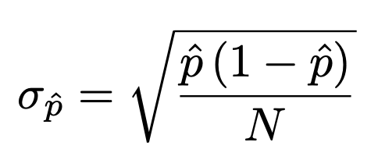
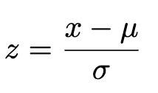
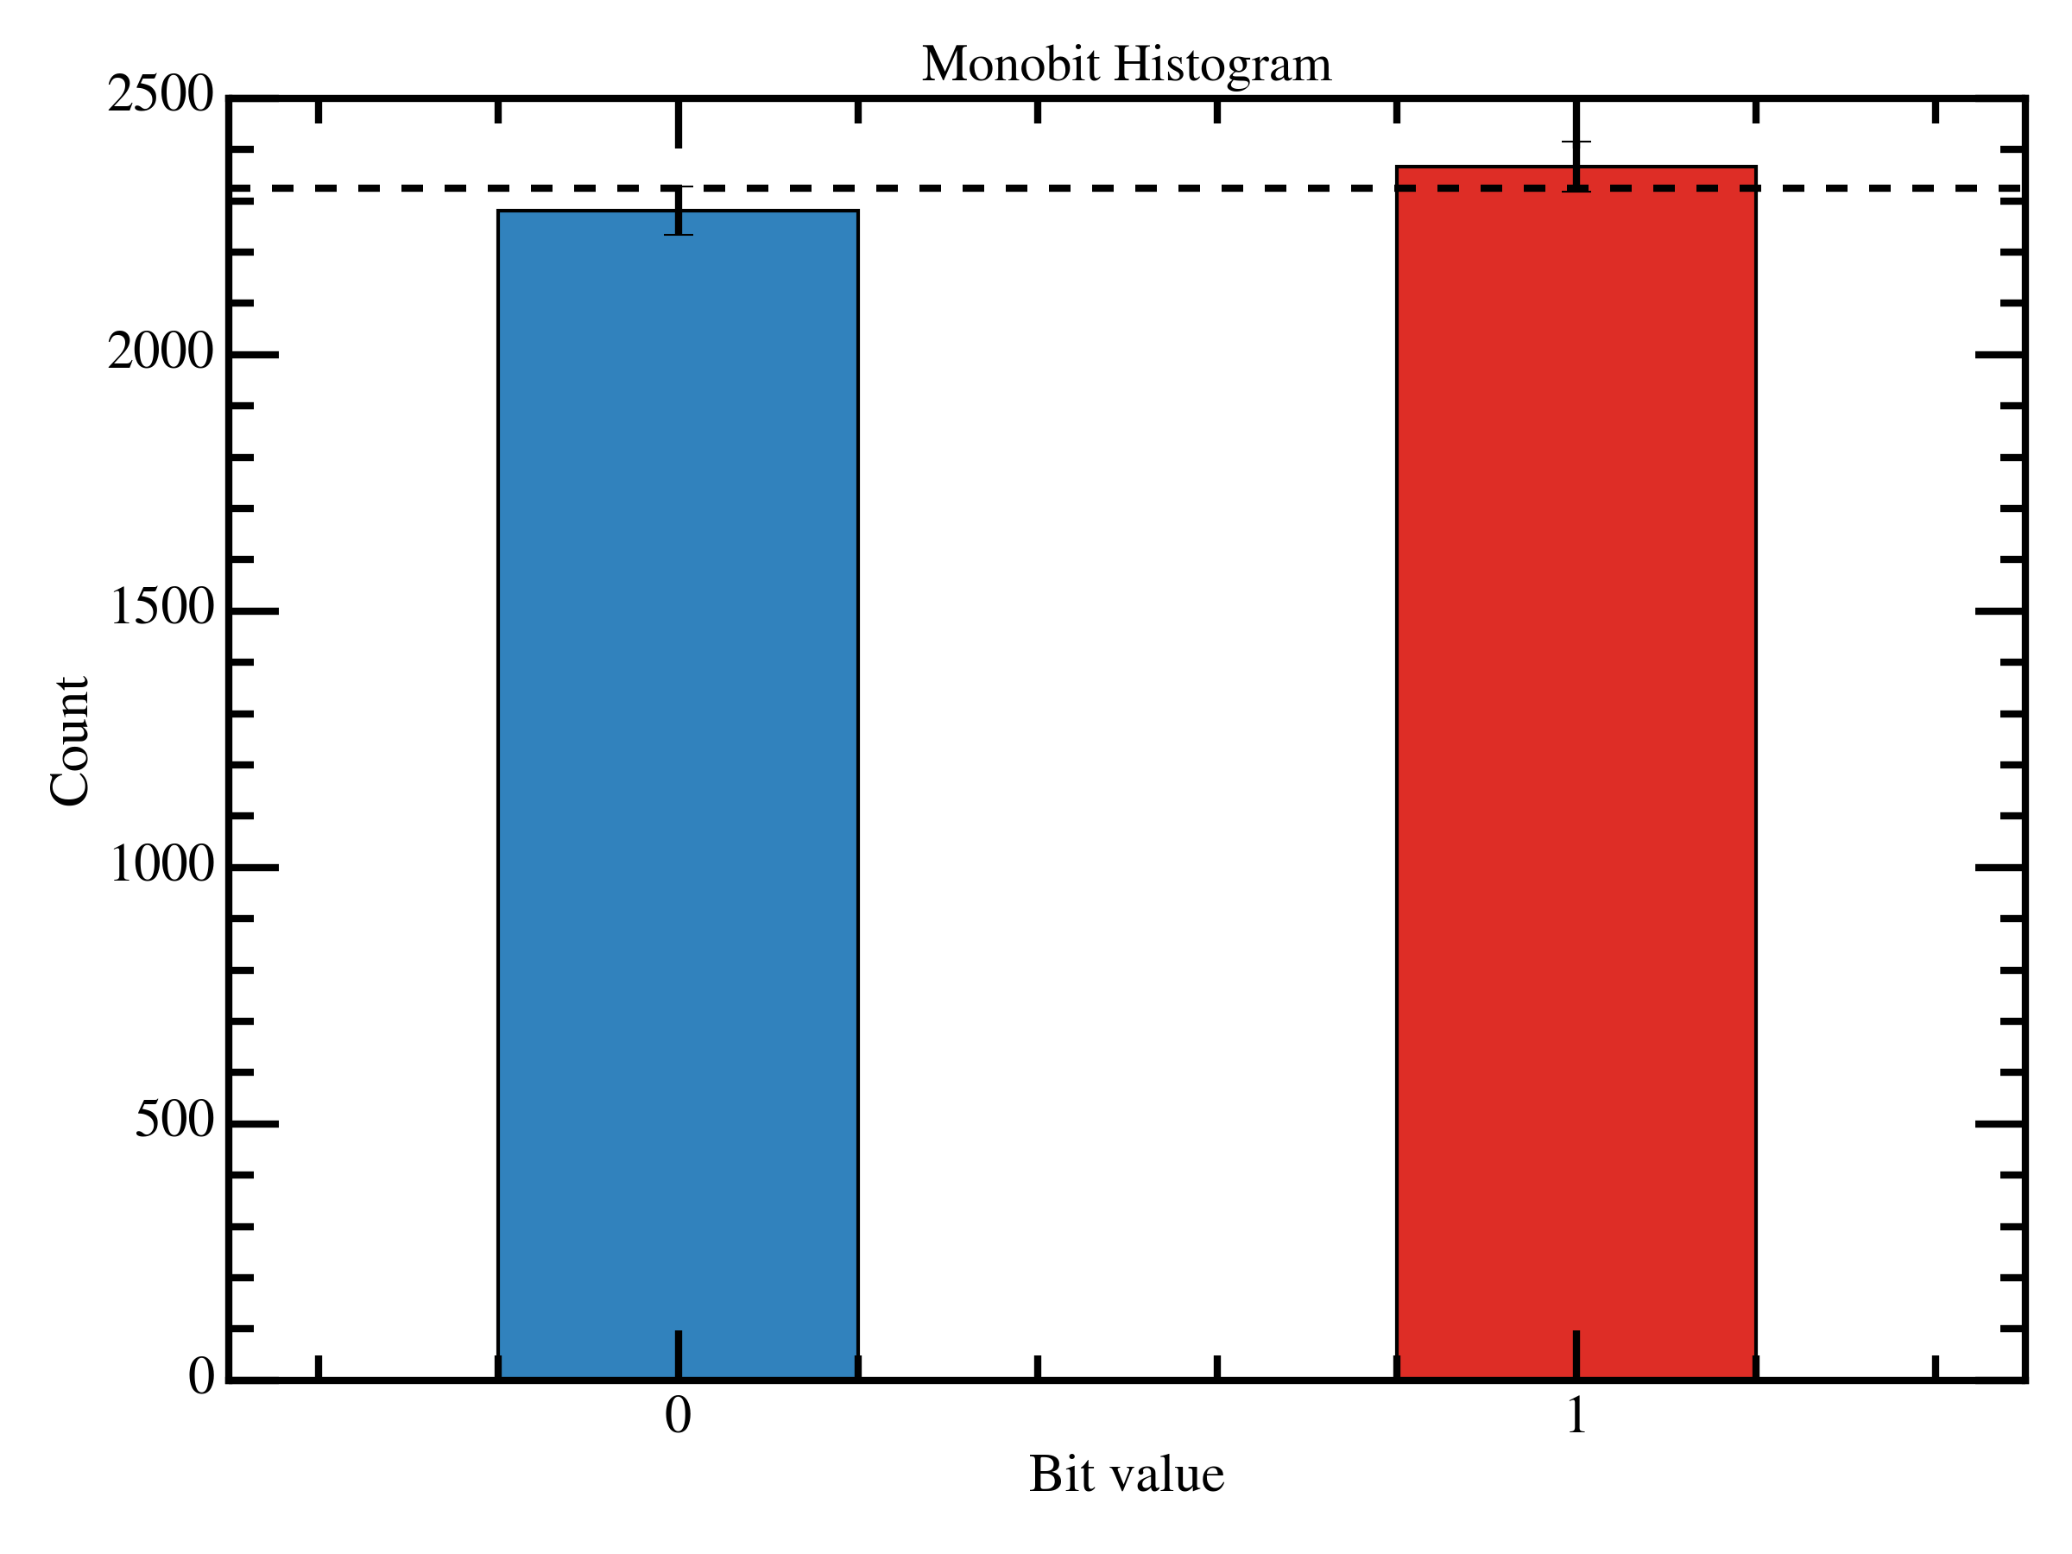
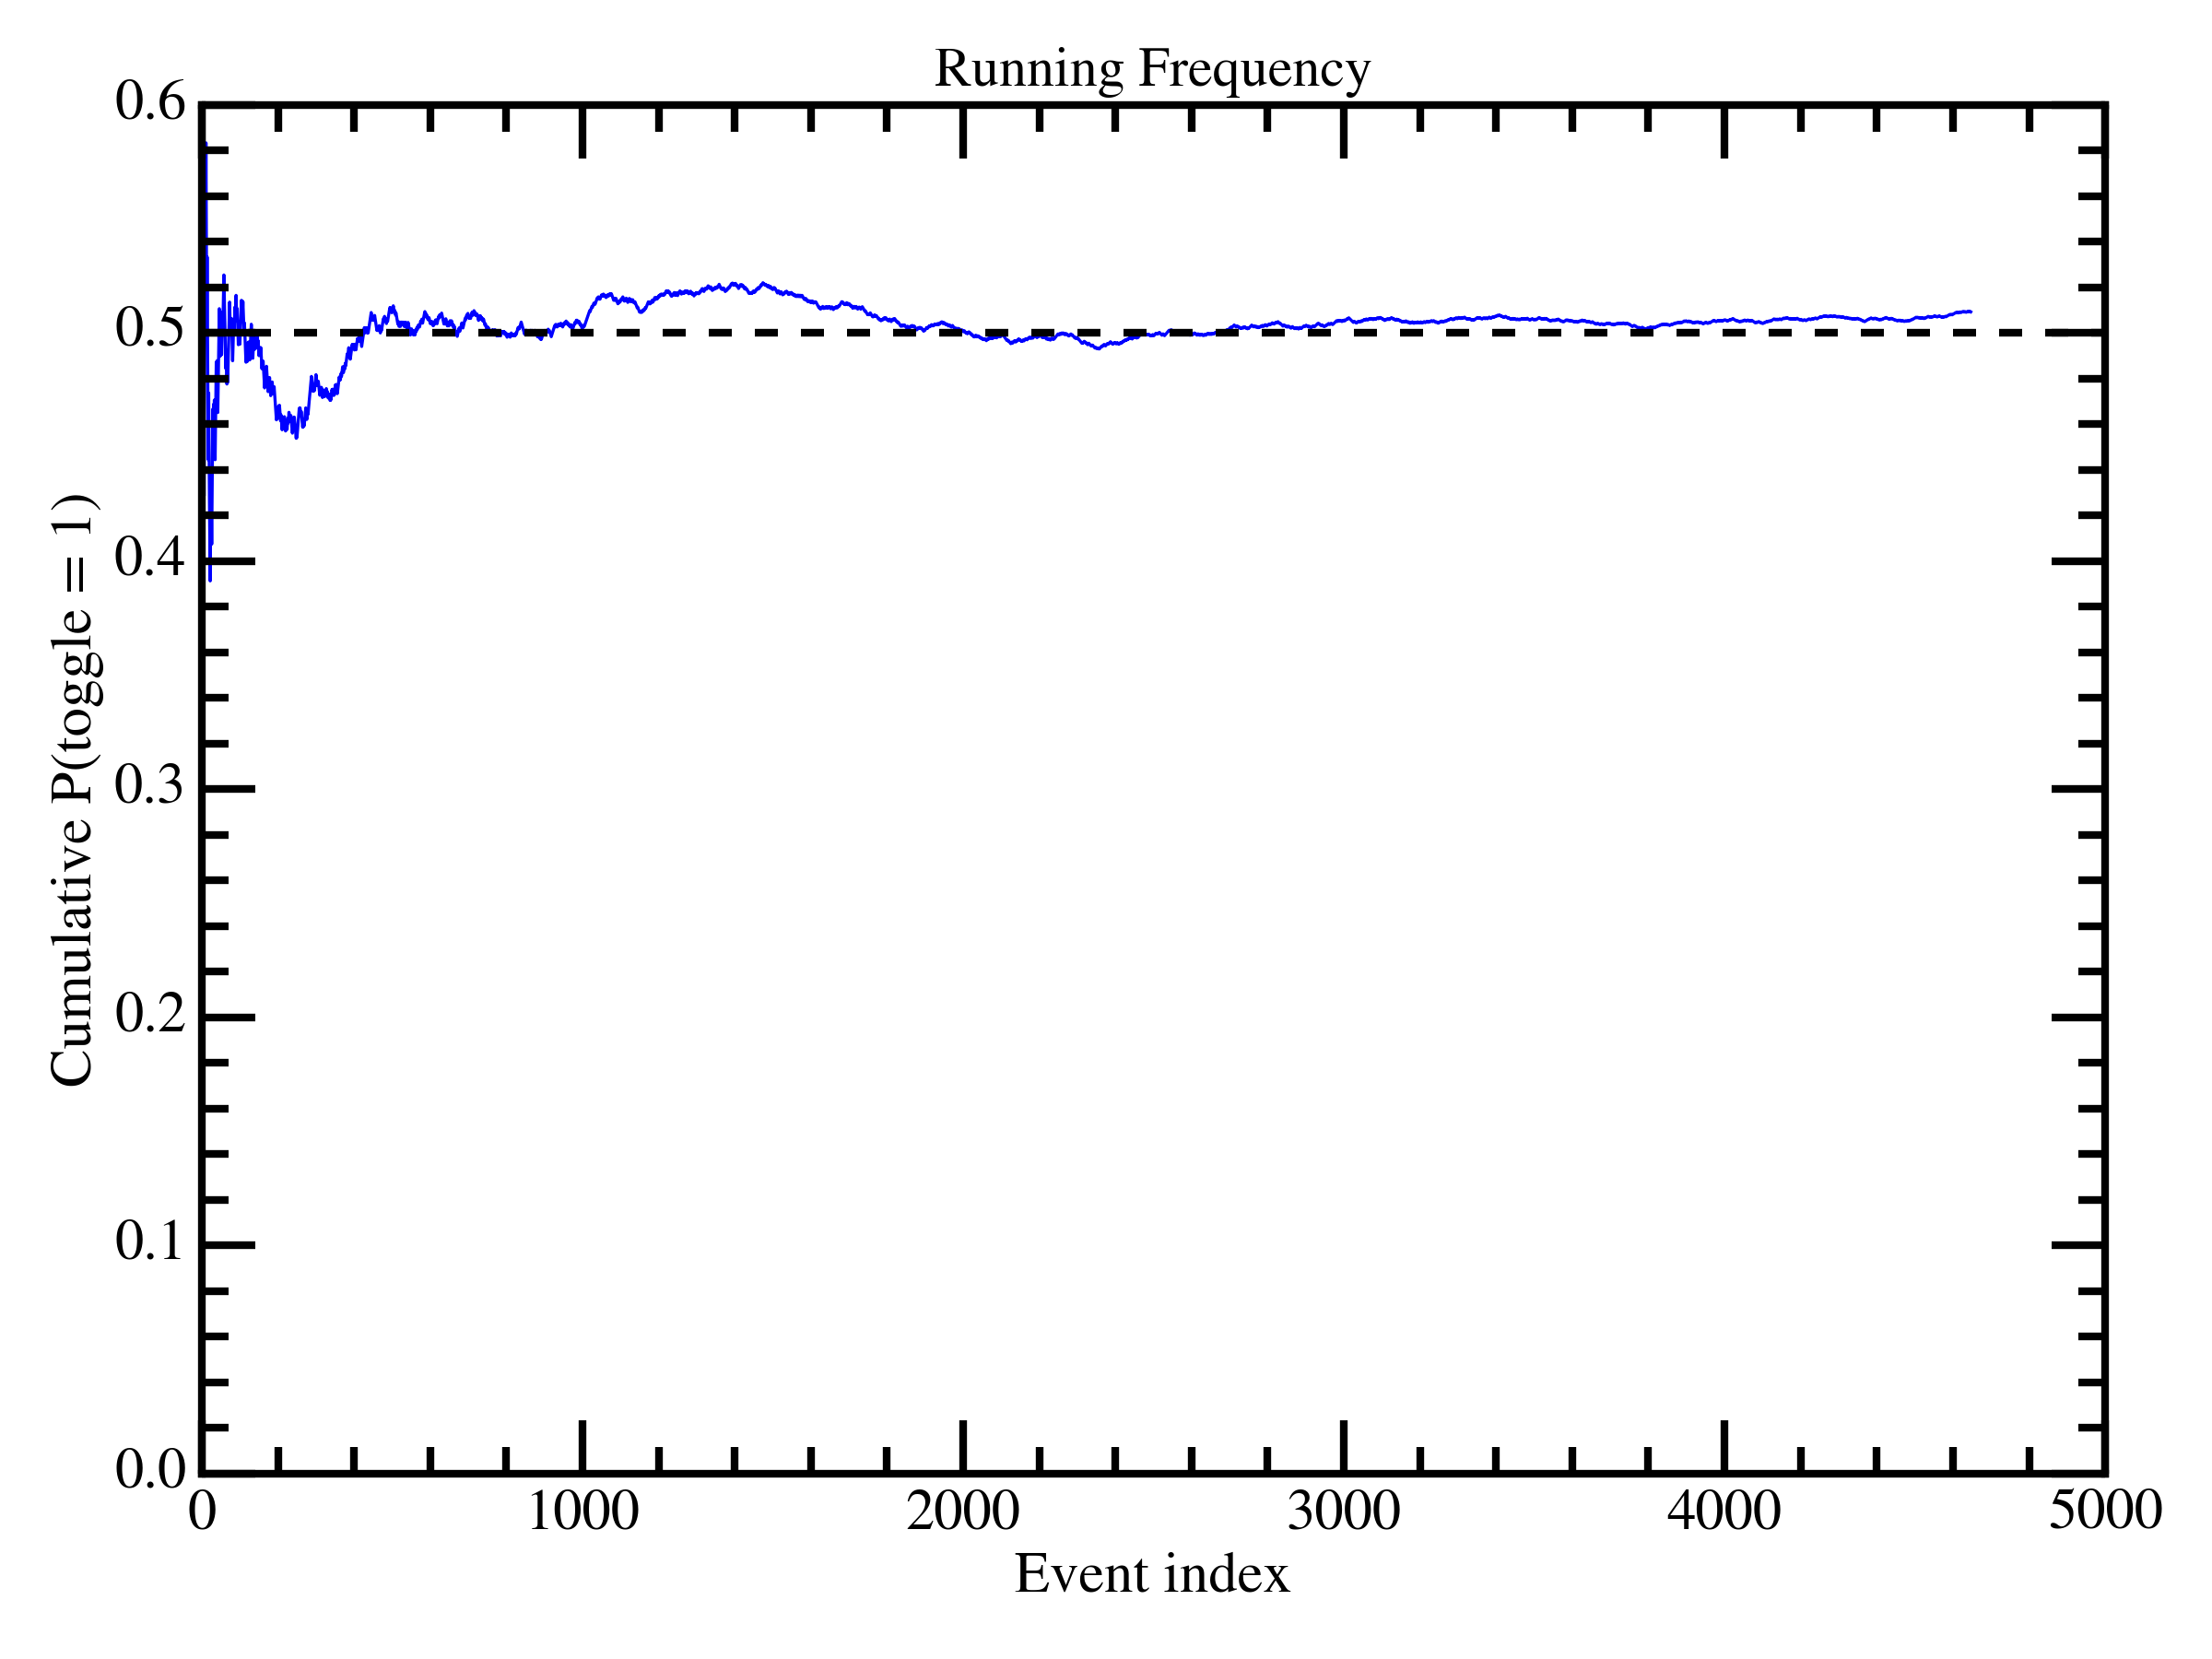
Monobit Frequency and Cumulative Frequency
Observed frequency of 1: $0.50925 ± 0.0073$, $1.27σ$ excess
Notes:
Monobit frequency test is to test the frequency of 0 and 1 in the result. We expect a uniform distribution: 0.5 probability of 0 and 1. We obtain the result here, with cumulative frequency to visualize the result. The error bar is calculated from binary error as shown here, and z-score is calculated from the difference of observed frequency and expected value. The higher z-score is, the less random the data is, or the more that it deviates from the true random hypothesis. Here, the observed frequency of getting 1 is 0.50925 plus minus 0.0073, indicating a 1.27 sigma excess.

Slide 8
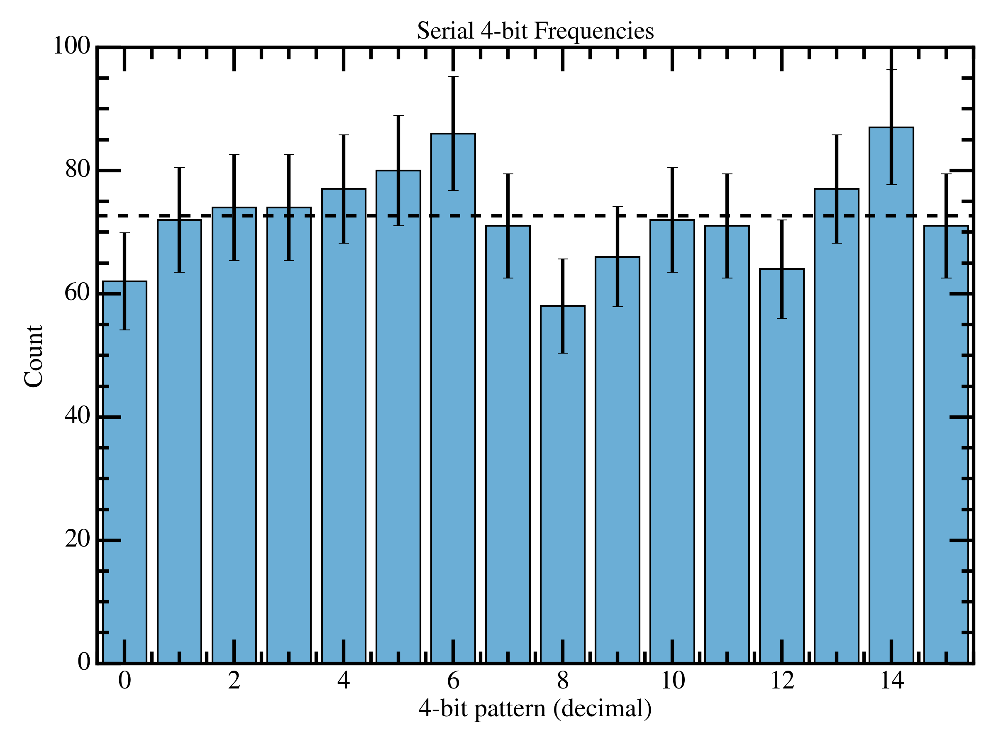
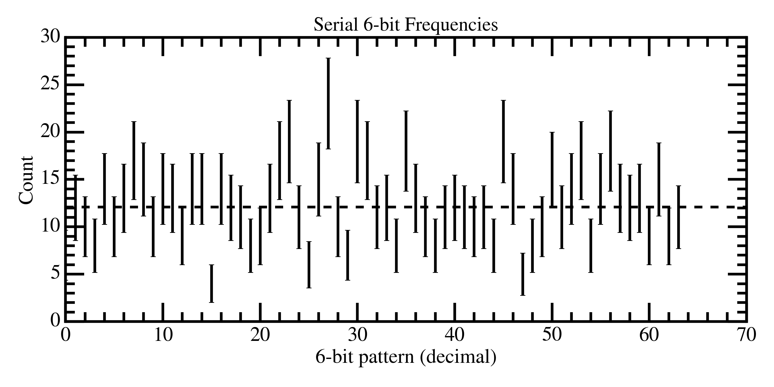
Sequence Test
Converting the binary sequence to n-bit numbers
Uniform if there is no long-range correlation
Notes:
Next, we test if there is any long-range correlation by converting every n-bit of binary sequence into a n-bit number. For example, if we do 4-bit testing, 1111 is converted to 15, while 0011 is converted to 3. We expect a uniform distribution if there is no long-range correlation. We obtain the result here, which is uniform for 4-bit and 6-bit sequence.

Slide 9
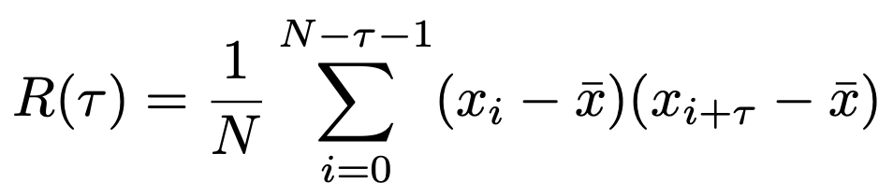
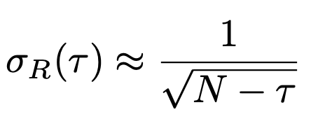
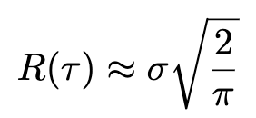
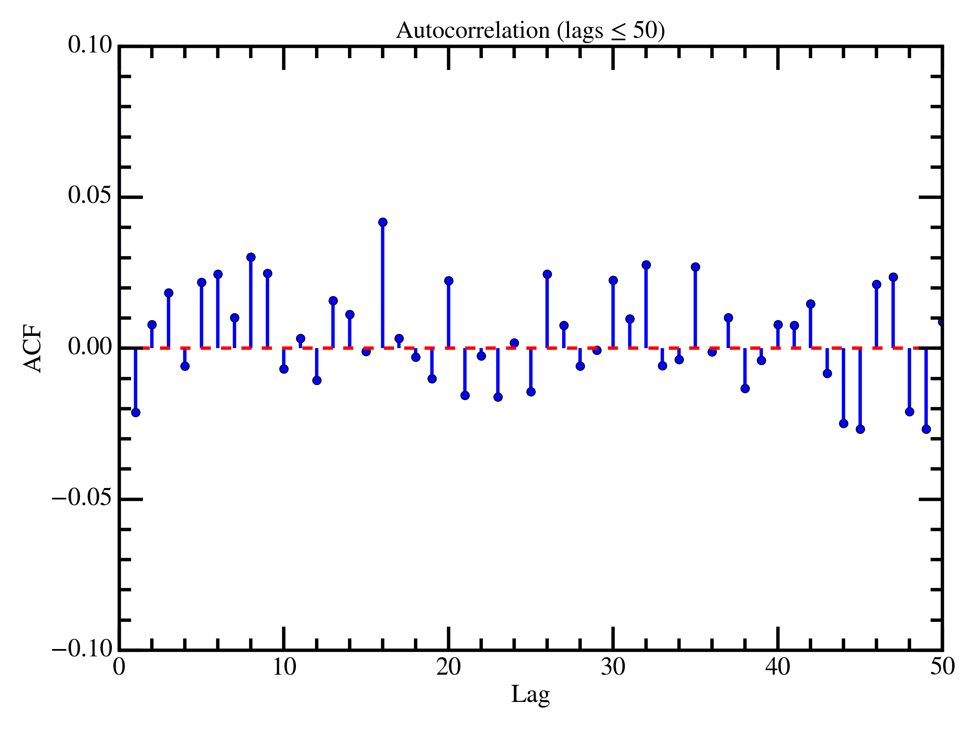
Autocorrelation Function
Observed mean of $\left|R\right|$: $\text{0.0140 }±\text{ 0.0015}$, ${\left|R\right|}_{exp}=0.0117$, $1.52σ$ $\text{excess}$
Notes:
To quantify this long-range correlation, we use the autocorrelation function, which measure how correlated the data is to the time-delayed version of itself, or the digit i and digit i+tau. It is computed with this function, where x bar is the mean of the sequence. We can approximate the error as such and the mean of the function as this. We obtain the observed mean of autocorrelation function to be 0.0140 plus minus 0.0015, compared to 0.0117 expected, indicating a 1.52 sigma excess.

Slide 10
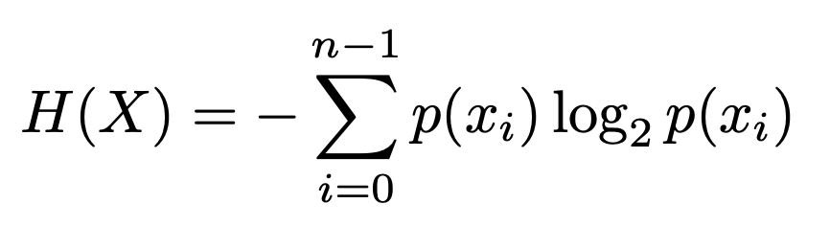
Shannon Entropy
Close to 1 if the data is truly random
Bootstrapping to calculate statistical error
Observed Shannon Entropy: $0.99975± 0.00044$, $0.55σ$ excess
Notes:
Next, we calculate the entropy of the data. Shannon entropy is used in statistics to measure how disorder the data is. For a binary sequence, it is expected to be 1 if the data is truly random. We use bootstrapping to calculate statistical error. The observed Shannon entropy is 0.99975 plus minus 0.00044, indicating a 0.55 sigma excess.

Slide 11
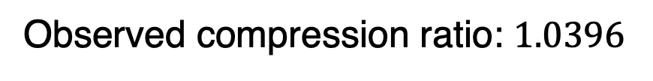
Compression Ratio
Compression algorithm (gzip) exploits the long-range correlation to simplify the data
Close to 1 if the data is truly random
Observed compression ratio: $1.0396$
Notes:
Next, we use a compression ratio to calculate how disordered the data is. Compression algorithm exploits the long-range correlation to reduce the size of the data. A truly random data would be incompressible. We observed a compression ratio of 1.0396, which is higher than 1! The reason is because compression algorithm adds a header; because of that and the data being incompressible, the compressed file is actually larger.

Slide 12
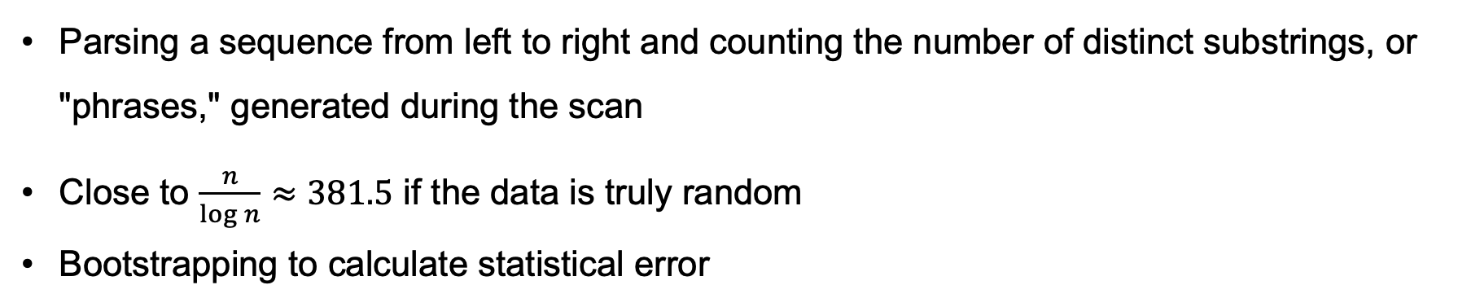
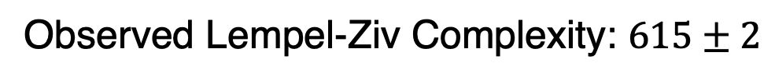
Lempel-Ziv Complexity
Parsing a sequence from left to right and counting the number of distinct substrings, or "phrases," generated during the scan
Close to $\frac{n}{\log{n}}≈381.5$ if the data is truly random
Bootstrapping to calculate statistical error
Observed Lempel-Ziv Complexity: $615±2$
Notes:
The Lempel-Ziv complexity of a finite sequence is computed by parsing it from left to right and counting the number of distinct substrings, or "phrases," generated during the scan. Starting from the first symbol, the algorithm builds the shortest substring that has not yet appeared earlier in the sequence. Each time a new substring is created, it is added to the dictionary of seen phrases, and the parsing moves forward from the next symbol. This procedure continues until the entire sequence is parsed. The total number of distinct phrases generated defines the Lempel-Ziv complexity. If a sequence is random, the complexity grows as n / log n as n gets large. Again, we use bootstrapping to calculate statistical error. We observed LZ complexity of 615 plus minus 2, bigger than the expected value for large n!

Slide 13
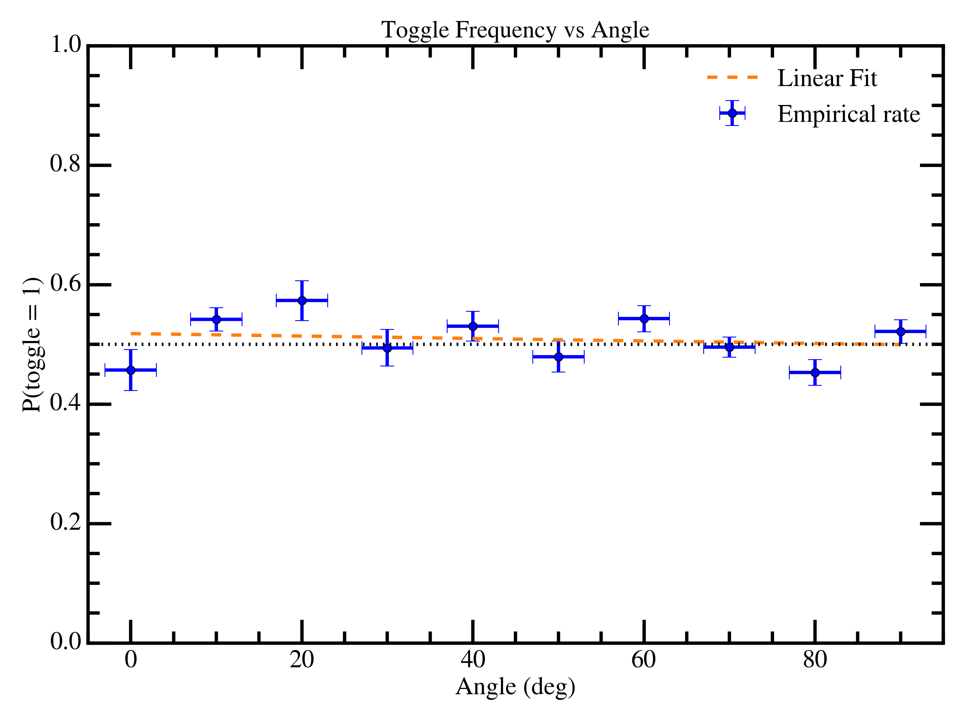
Angular Dependence
Observed angular dependence: $−0.00037± 0.00026$, $1.44σ$ excess
Notes:
Next, we compute the angular dependence of the data. The x-axis error bar is a systematic error of the finite size of the scintillator, and the y-axis is the binary statistical error. We then fit a linear function to test if there is some sort of angular dependence on the probability of getting 1. The observed angular dependence is -0.00037 plus minus 0.00026, indicating a 1.44 sigma excess from 0.

Slide 14
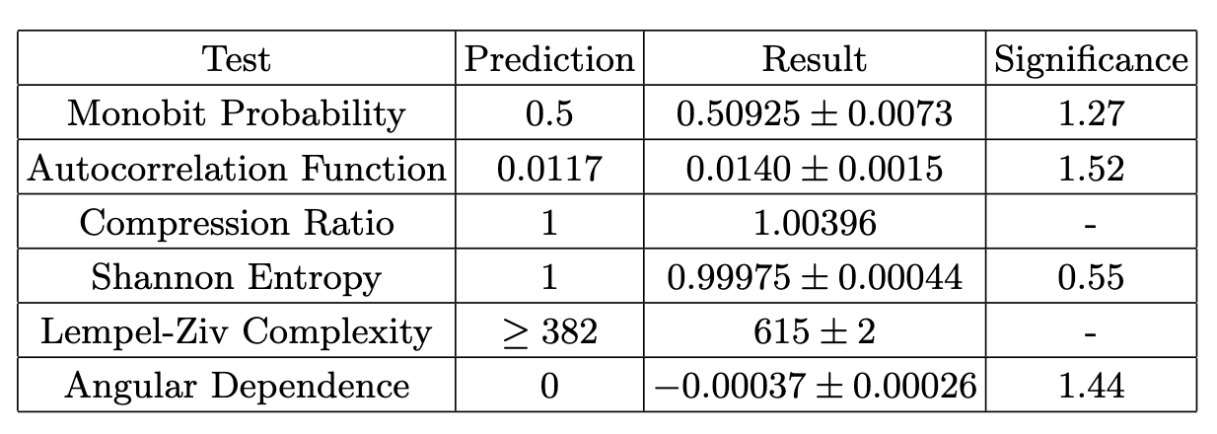
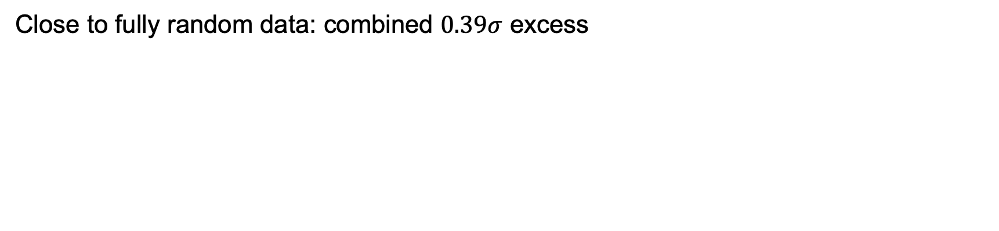
Conclusion: A True Random Number Generator!
Close to fully random data: combined $0.39σ$ excess
Notes:
In conclusion, we have tested the data a variety of ways, and obtain a combined excess of 2.36 sigma level with Stouffer’s two sided method. This is not significant at 5, indicating that the data is close to fully random. The analysis also shows that the muon detection process is not affected by the angle of the detectors. The results of this analysis show that the muon detection process can indeed be used as a source of true random numbers. Thank you!

