Slide 1


Prometheus – Grafana Monitoring system By Hung Pham

Slide 2

1. Overview 2. Features 3. Architecture 4. Demo

Slide 3
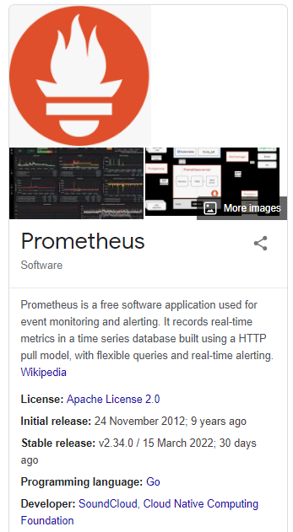
- 2012, Created by SoundCloud.
- 2016, Joining CNCF at the Graduated project maturity level.
Collects and stores its metrics as time series data.
Metrics information is stored with the timestamp at which it was recorded, alongside optional key-value pairs called labels.

Slide 4
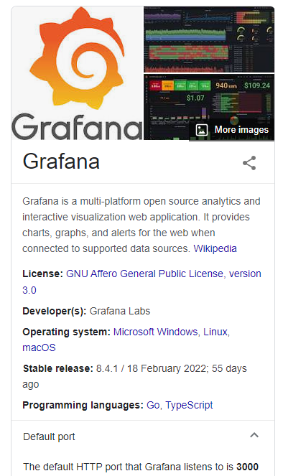
- The composable observability and data visualization platform. - To visualize your metrics no matter where they are stored. - Provide beautiful dashboards, charts, graphs, alerts, …

Slide 5
Prometheus’s main features:
A flexible query language, PromQL.
Time series collection happens via a pull model over HTTP.
Targets are discovered via service discovery or static configuration.
Multiple modes of graphing and dashboarding support (Grafana platform).

Slide 6
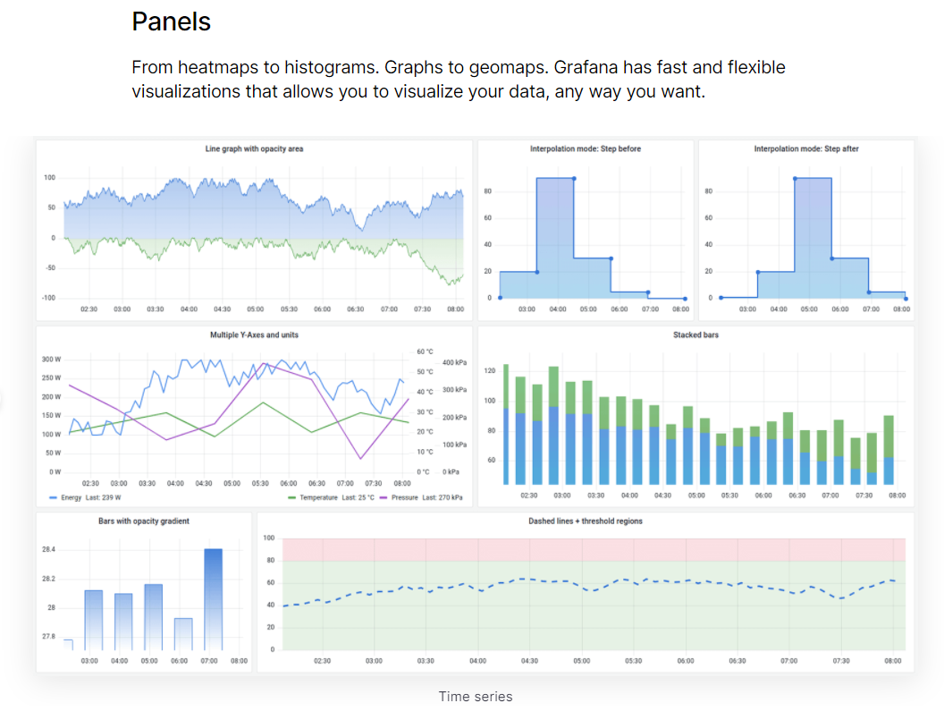
Grafana key features

Slide 7
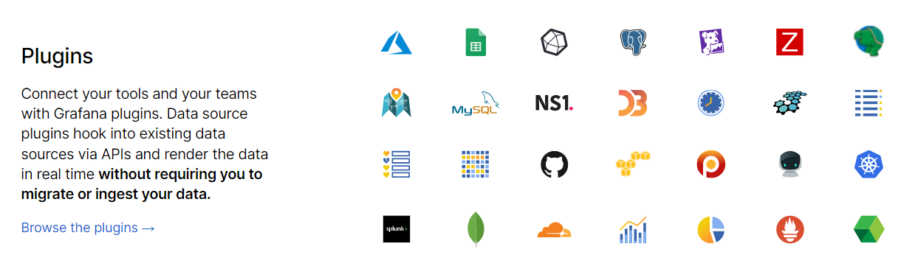

Slide 8
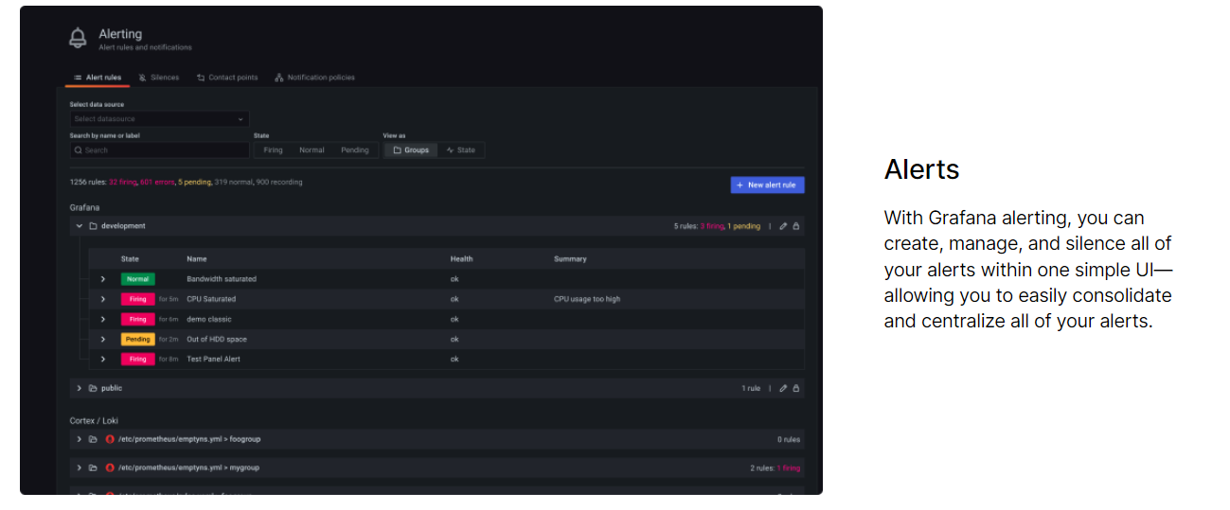

Slide 9
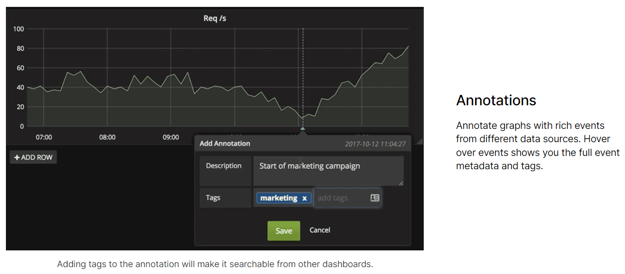

Slide 10
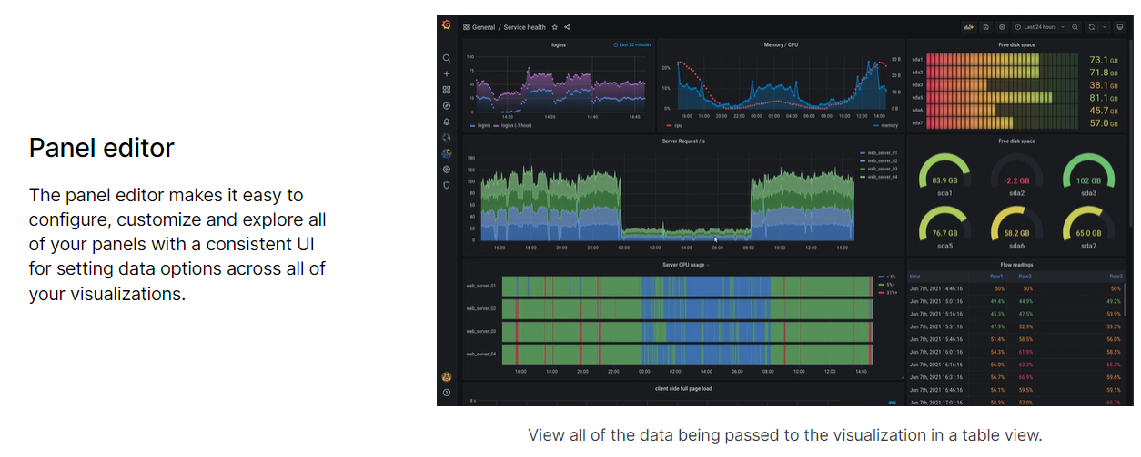

Slide 11
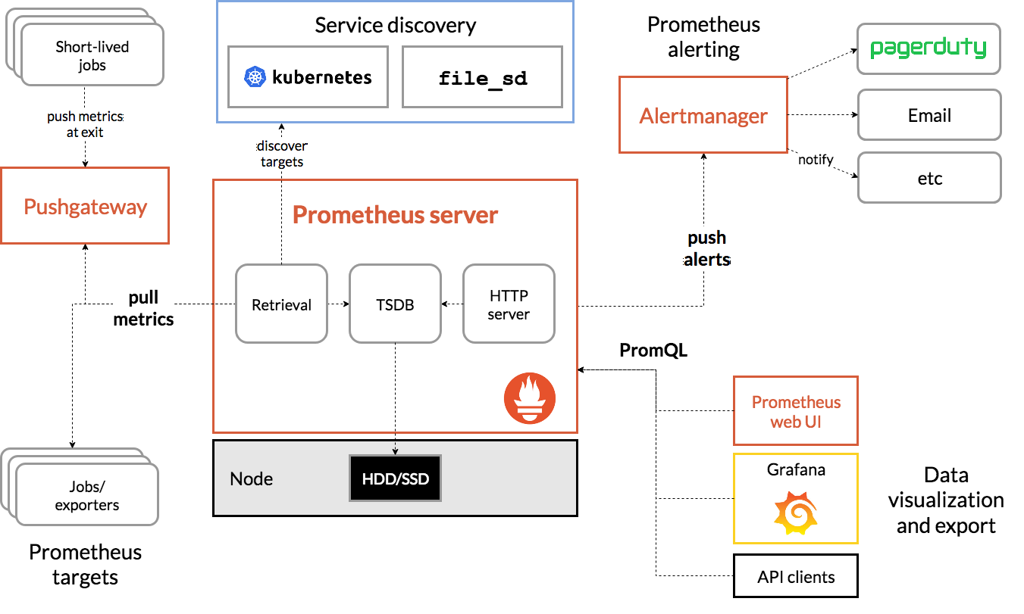

Slide 12
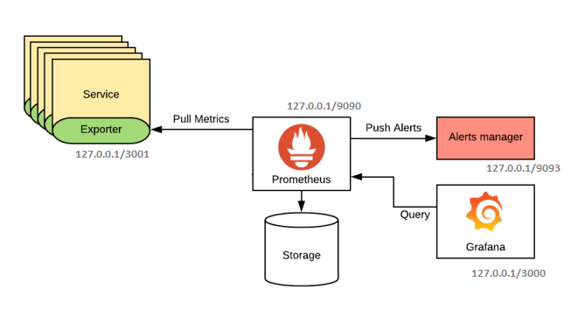




Demo
github.com/vinhhung263/prometheus-nodejs

Slide 13
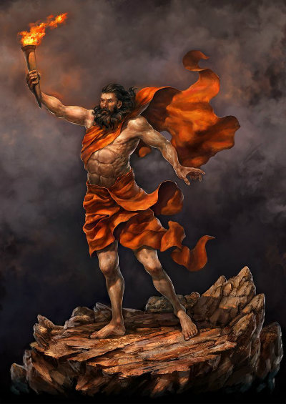
Thanks For Watching!
Do you have any questions?
hung.pham@finviet.com.vn
+84 918 173 262
github.com/vinhhung263
References
[1] https://github.com/RisingStack/example-prometheus-nodejs
[2] https://grafana.com/grafana/
[3] https://prometheus.io/docs/introduction/overview/

