Slide 1

32G mentor-mentee
First year M&M review
Nov, 27 - 2021
Khang tran
Backend 23 group
Renesas Electronics Corporation

Slide 2
Agenda
About Content of presentations. There are 6 part
Introduction Page 03
Achievement and detail status Page 05
Target in 2nd year Page 10
Difficulties and solutions Page 12
Q&A Page 13
Appendix Page 14

Slide 3
1. Introduction 1.1 Mentor –mentee
firstly! Introduction: My name is Khang from BE23 and my mentor is Nguyen Le Minh Hac Who guide to me during to one year later.
MENTEE:
Name: Tran Dang Vinh Khang
Generation: 32G
Code: 2676
Group: Backend 23
MENTOR:
Name: Nguyen Le Minh Hac
Generation: 24G
Code: 1804
Group: Backend 23

Slide 4
1. Introduction 1.2 Mentor –mentee SYSTEM
My Purposes in one year later:
I will Improve the communication between mentee and mentor.
Beside that, I can catch up the skill level of mentor and other experienced team members.
I will increase the productivity instead of supporting from Mentor. (Reduce the support time and increase the productivity of mentee.)
Finally, Meet the requirement of real projects.
About Target:
I will Improve soft skills such as: communication, documentation, report, mindset, etc…
Must achieve level 3 for technical skill after 2 years.
On job training and complete at least 2 years.

Slide 5
2. Achievement and detail status 2.1 Overview: technical skill
From the secondlly of Achievemend and detail status:
The table show of my technical skill during 2 projects.
I achieved lv2 of PG design and verification in U2A6 project and Analog implement in U2B6 project
Focus on MCU product
MCU Product
MCU Product
2020, Oct
2021, Jun
2021, Dec
U2A6 Project:
I can Design analog PG for analog HMs (PLL modules, AWOVDC, HOCOVDC, HOCO, LOCO, MainOSC, THS).
Verify open, short, DRC for analog PG.
Execute and fix ESD resistance by HSSC tool.
Building HSSC environment automatically to check resistance.
Develop script to generate report of RedHawk result automatically.
U2B6 Project:
Implement for analog signal wiring full chip (analog module FLI, analog module SYS,AD0/1/2, ADS,RDC,THS, FCMP).
Verify LVS (ICC2), DRC, StarRC, Eagle.

Slide 6
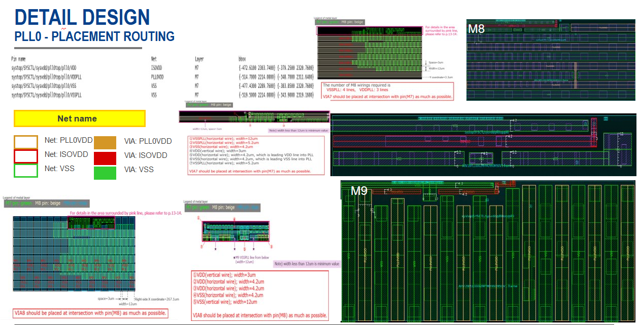
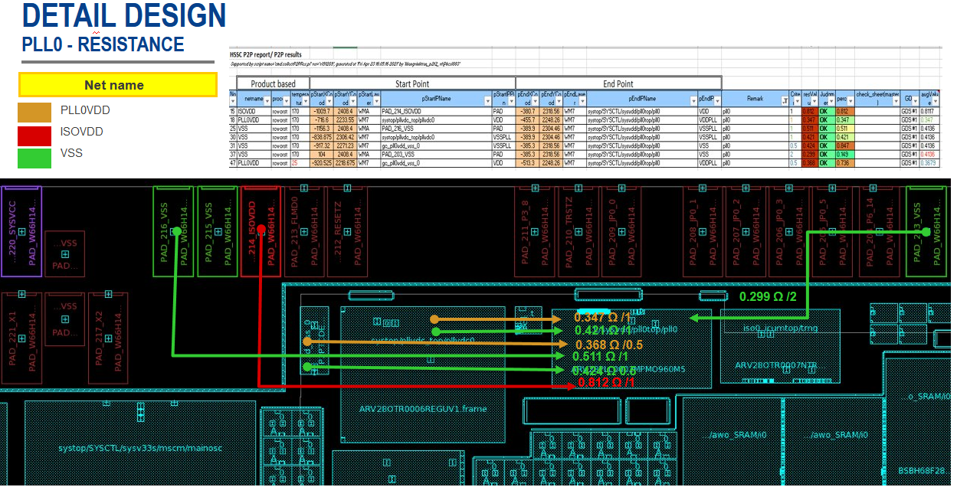
2. Achievement and detail status 2.2 PG design and verification
Achievement of the U2A6 project :
Come to detail status of PG design and verification in U2A6 project:
Understanding specification document of analog hard macro.
Can create some script (TCL) in order to make routing more convenient.
Can use HSSC environment to analyze and measure resistance value.
Having the knowledge how to reduce resistance in order to save routing resource that contribute Floorplan target and satisfy design constraints.
The picture in the left handside:This is patterns I base on the specification and routing as instruction, and there is no more spcing so I should route as narrowas possible in order to leave resource for other HM and right handside It’s show P2P measurement and result resistance.

Slide 7
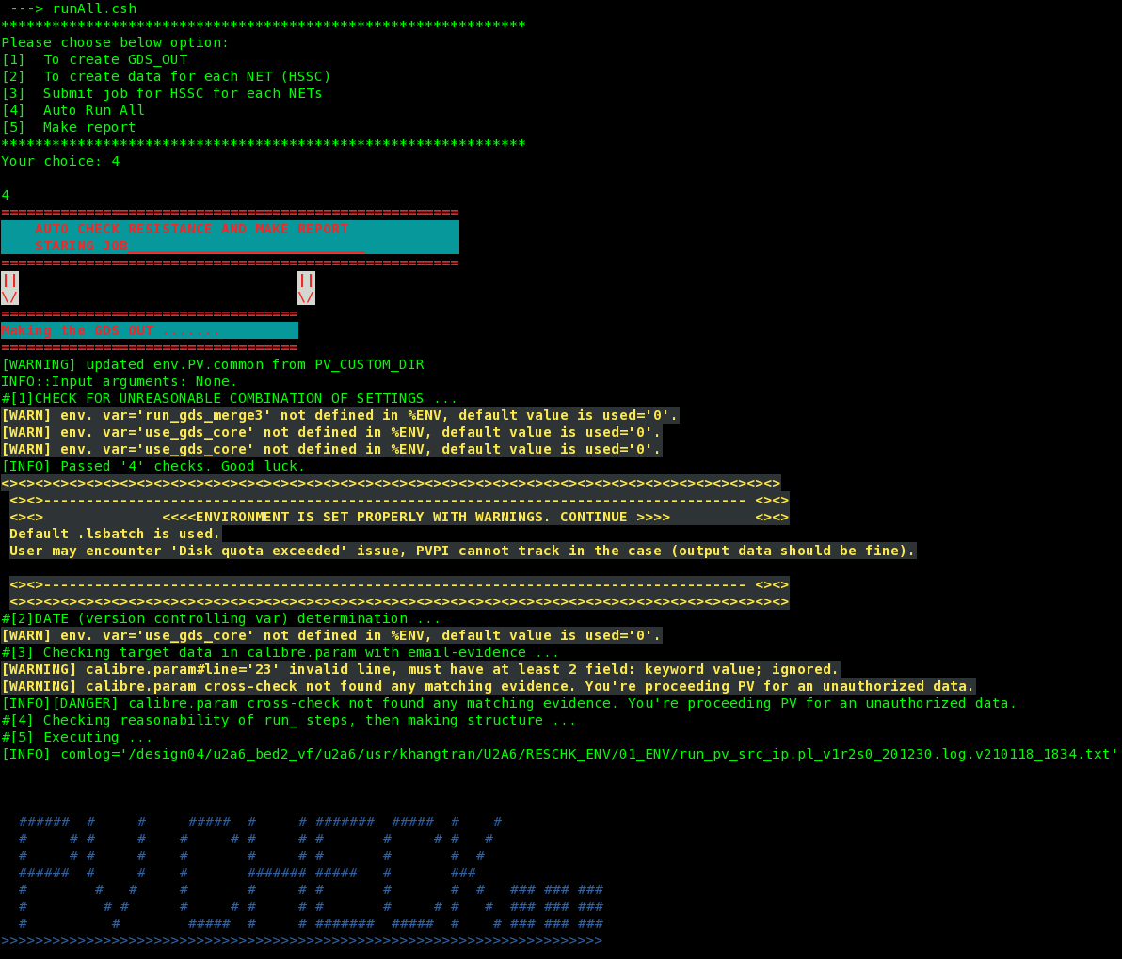
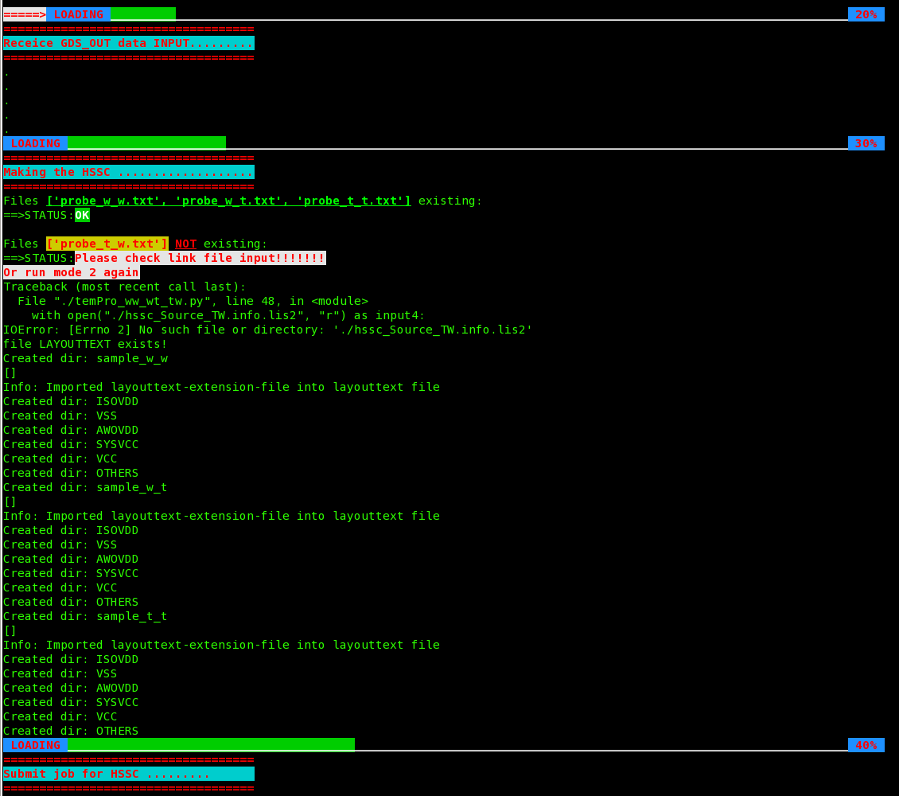
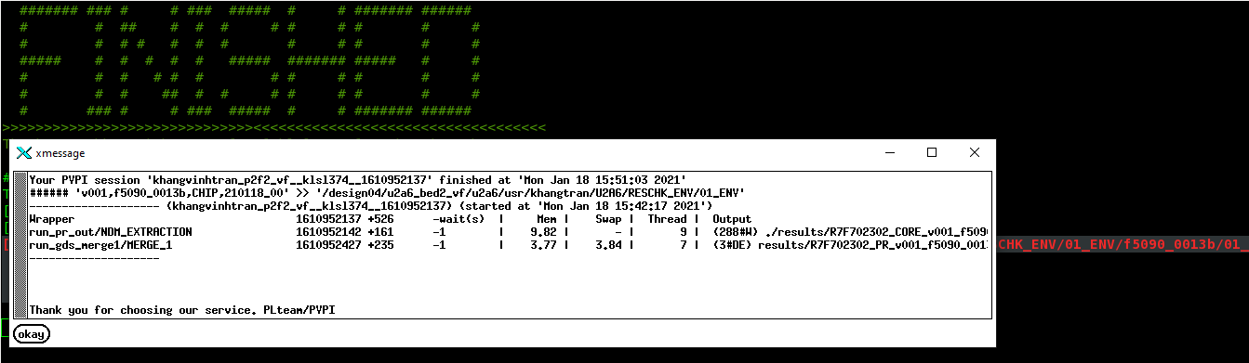
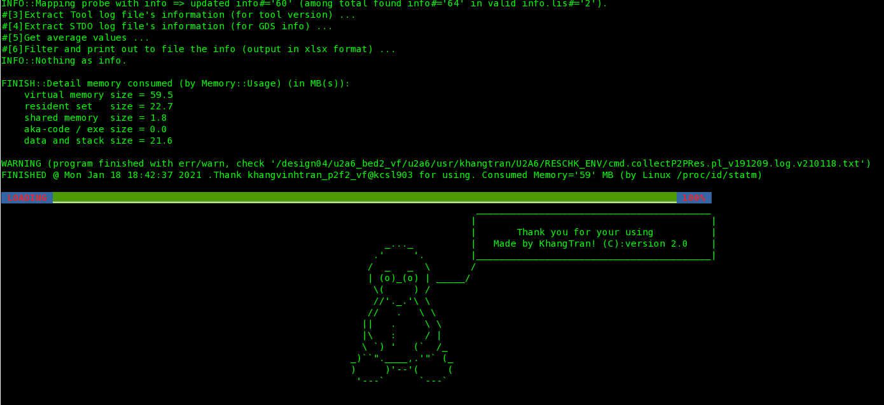
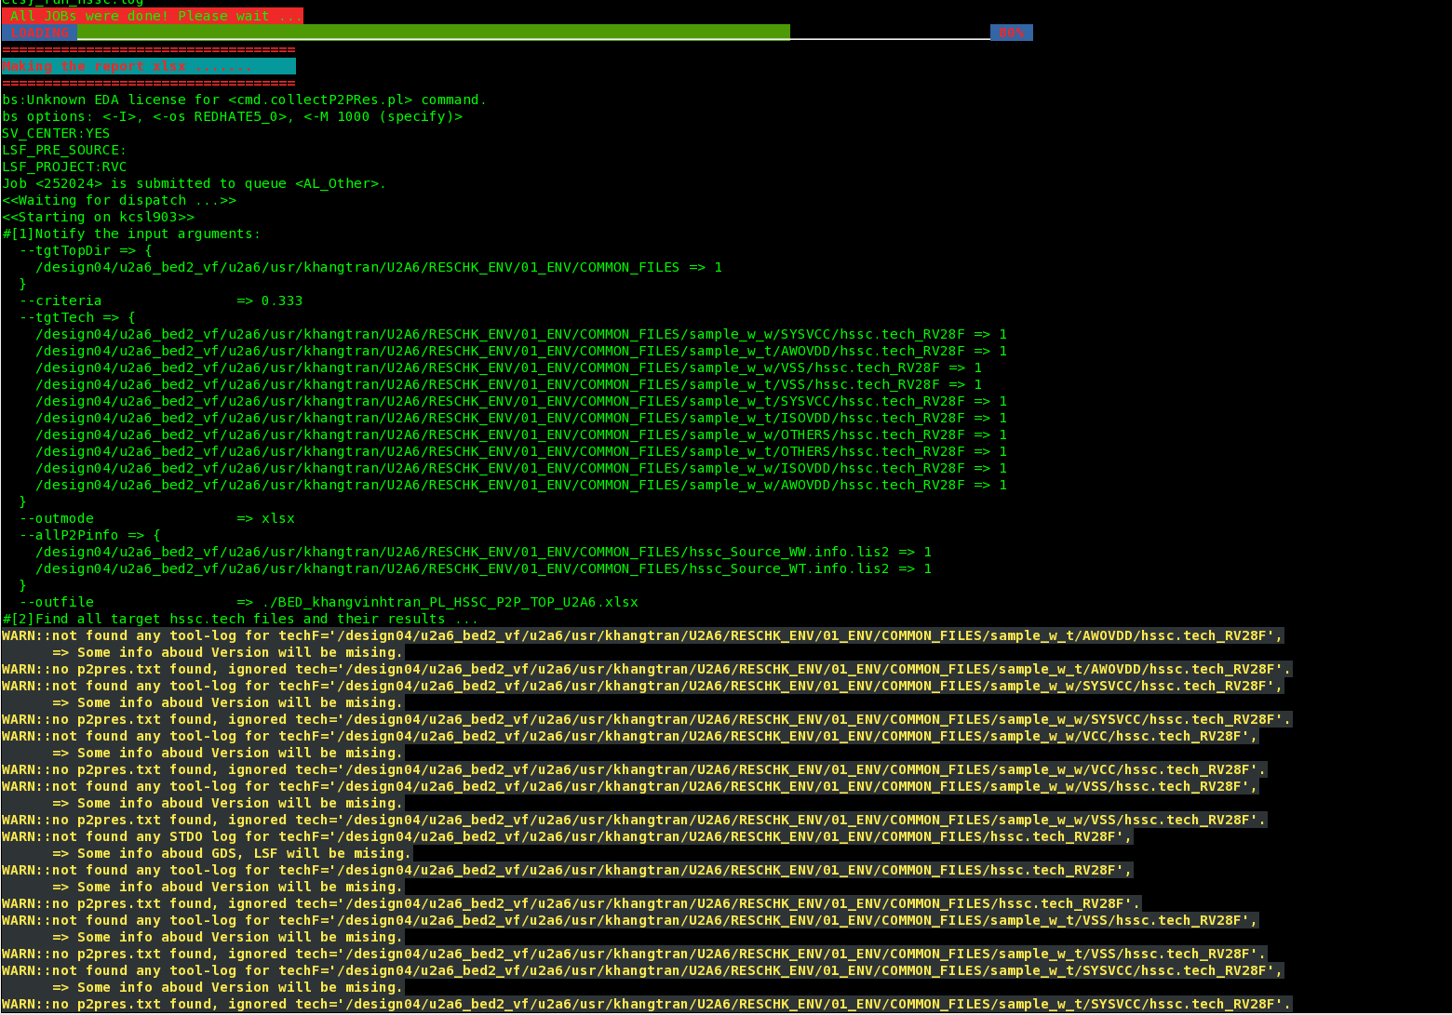
2. Achievement and current status 2.2 PG design and verification
Achievement of the U2A6 project:
From HSSC environment I Base on knowledge about HSSC verification flow. Before I had to setup each file and run manually for each process. So, I have builded the automatically HSSC environment from ICC2 tool to measurment resistance.(one of Kaizen) The environment you need to prepare Input file before executing script, I will show the script operation.
This is option if we want to execute a certain funtion, In order to run auto and generate report, we should
choose option 4 and waiting for the final resul.

Slide 8
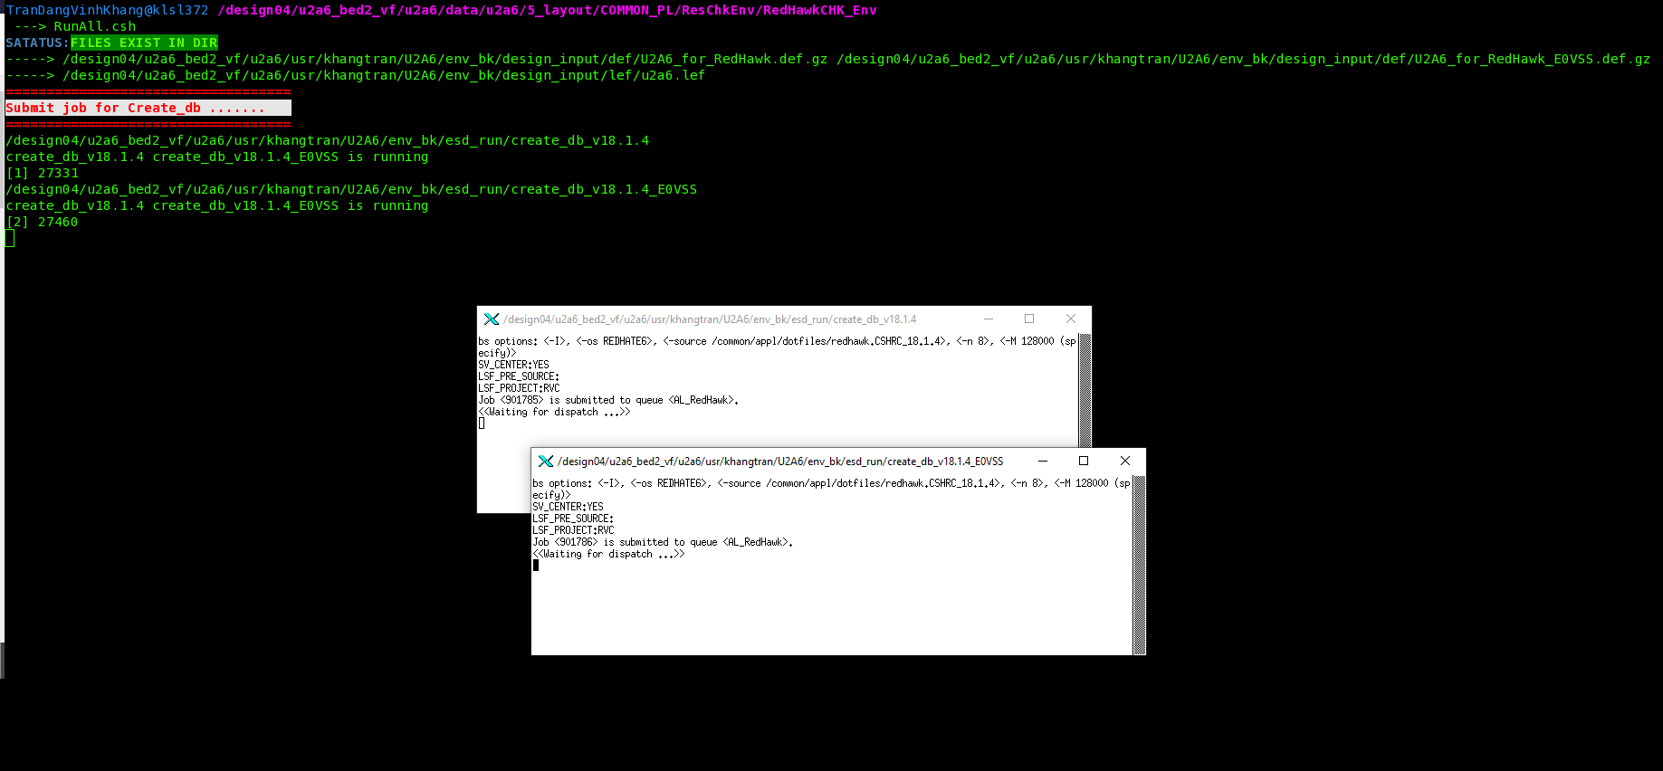
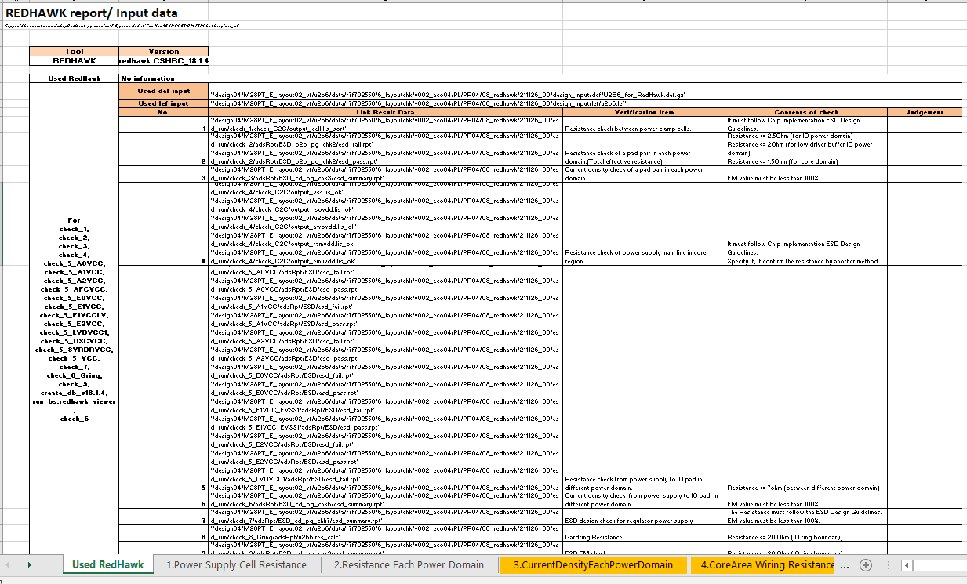
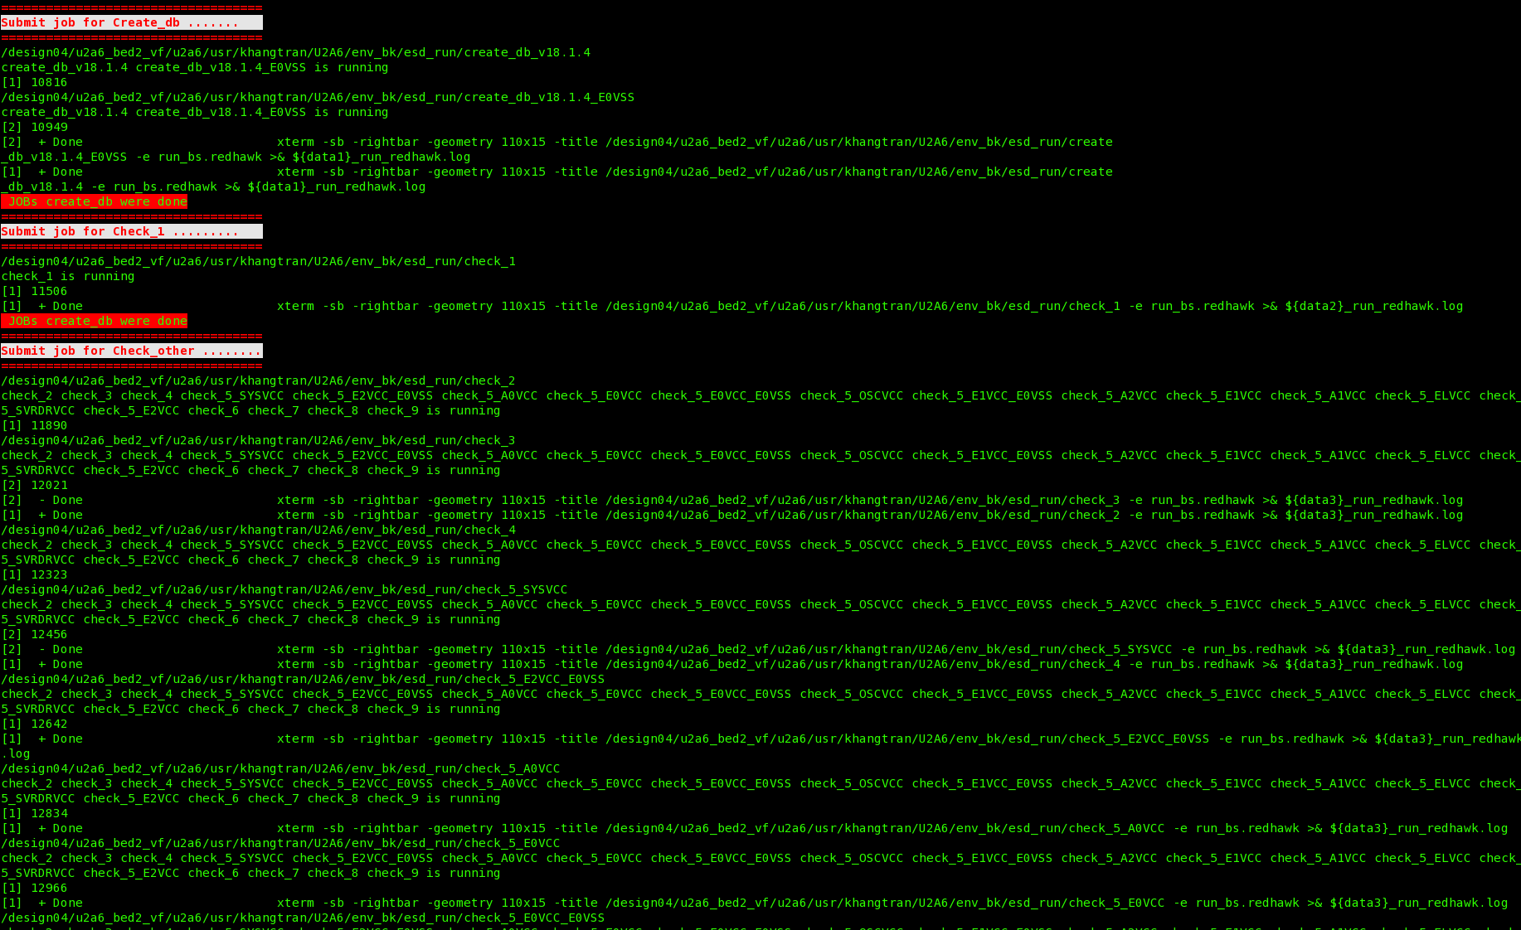
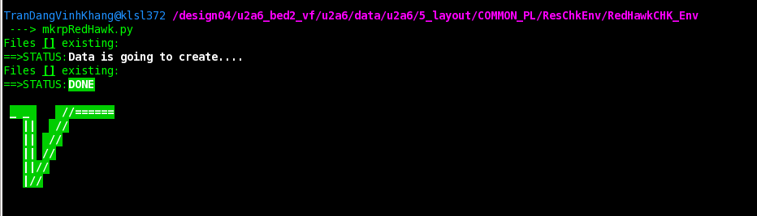
2. Achievement and detail status 2.2 PG design and verification
Achievement of the U2A6 project:
About the Redhawk verification, I Base on the Python language skill to develop scripting environment in order to generate report of RedHawk automatically and feedback to PG designer to improve RedHawk result. (One of Kaizen).
As below picture on the left handside, The script is operating. Begin with checking input exist file from checking one by on item to gennerate report.
And the pictuter on the right handside, it’s the sheet summary result of Redhawk report. On the other hands, Each sheet contain measurement of resistance or current density result Actually! script can automatically judge.

Slide 9
2. Achievement and detail status 2.3 Analog implementation
Achievement of the U2B6 project:
I Contribute to reduce chip dead space by design analog wiring with total area as least as possible.
In the FLI area, In order to reduce dead space, So I have to lessen widh of metal as much as posible.
Can use Custom Compiler tool to support faster routing and reduce manual routing.
Can calculate and estimate resistcance/capacitance to route pattern which satisfiles the constraint:
To reduce capacitance: use high layer, extend shield X3 or more, jump shield.
To reduce resistance: Increase metal width, routing on multiple layer and stack VIA.
Understanding how to make suitable shielding for Analog nets.
The Purposes of suitable shieding for Analog nets in order to avoid to noise.
Understanding how to fix eagle verification.
I can Self-judgement whether it’s pseudo error or not in Eagle report.

Slide 10
3. Target 2nd year 3.1Target: Technical skills
No | Skill items | 1st year result | 2nd year plan (Sep 2021 – Jun 2022)
1 | PG design and verification. | 2 | 3
2 | Analog implementation | 2 | 3
3 | Physical Verification | 1 | 2
Target:
Must achieve level 3 for with target as define in advance.
Deal with task with supporting as less as possible from Mentor.
Can instruct younger engineer in my responsible segment.

Slide 11
3. Target 2nd year 3.2 Target: Soft skills
Soft skills | Target
Communication | Can report problem in group and can negotiate with group member.
Task management | Can estimate schedule and make action to keep schedule

Slide 12
4. Difficalties and solutions
Difficulties
I work with New tool, new environment, it’s rather difficult to get familiar
Countermeasures
Trial previous design to understand tool’s behaviors
Investigate the document, discuss with mentor to receive the guidance. Trial legacy data to understand physical verification
Lack of experienced about Physical verification

Slide 13

5.

Slide 14
6. APPENDIX 6.1 Definition of skill level
Role Level | Definition | Skill Level | Definition
1 | Can do the job with help from others | 1 | Has no knowledge, no experience
2 | Can do the job without any help, if it is within certain degree of difficulty. | 2 | Can do the job with help from others.
3 | Can do any given job without any help | 3 | Can do any given job without any help
4 | Can make his/her experiences into knowledge for others, and apply them to improve the job, as well as train juniors. | 4 | Can analyze and improve/refine the job
5 | Can lead within the company | 5 | Can develop new technologies, and can apply advanced method, and can direct technologies including advanced method.
6 | Can be recognized in the market
7 | Can lead the market

Slide 15
Renesas.com

