Slide 1
CONTENT MANAGEMENT SYSTEM FOR A BLOG
Software Engineering: Group 3
Group member:
Pham Hong Dang ITITIU19009
Le Quy Minh Duc ITITIU20188
Nguyen Vo Thanh Tam ITITWE19012
Dang Quang Vinh ITITIU19247
Vo Trung Duong ITITIU20193

Slide 2
Table of contents
01
02
Introduction
Requirements
02
04
System Design
Demo

Slide 3
01
Introduction
Project Overview
Project Goals
Team Overview
Technologies

Slide 4
About the project
Evolution of the World Wide Web and Internet
A "Blog" is an online journal or informational website

Slide 5
Project Goals
Construct a content management system that accounted for quality standards

Slide 6
Team Members and their Role
Role | Name
Project Manager | Đặng Quang Vinh
Business Analyst | Võ Trùng Dương
Designer | Nguyễn Võ Thanh Tâm
Software Engineer | Lê Quý Minh Đức
Software Engineer | Phạm Hồng Đăng

Slide 7



Technologies
Front-end: React JS
Back-end: Node JS
Database: MongoDB

Slide 8
02
Requirements
Functional Requirements
Non-functional Requirements

Slide 9
Functional Requirements
Register an account
Create/modify blog’s content
Email verification and notification
Add information to the profile

Slide 10
Non-functional Requirements
Security requirements

Slide 11
03
System Design

Slide 12
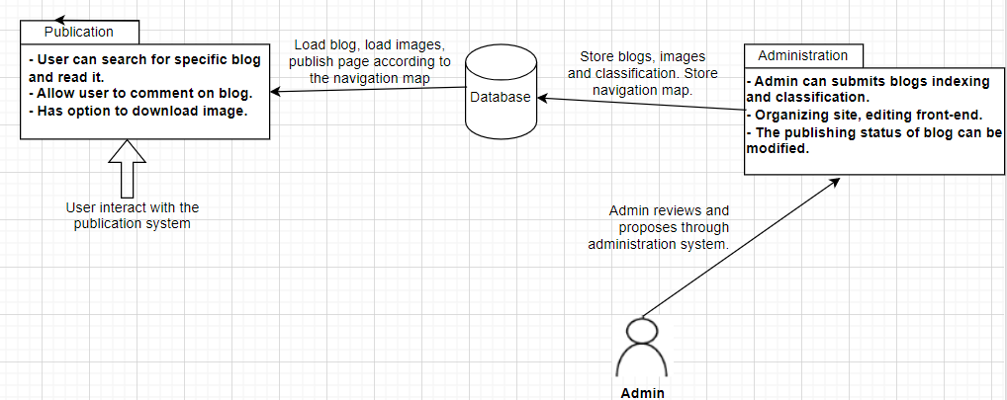
System Architecture

Slide 13
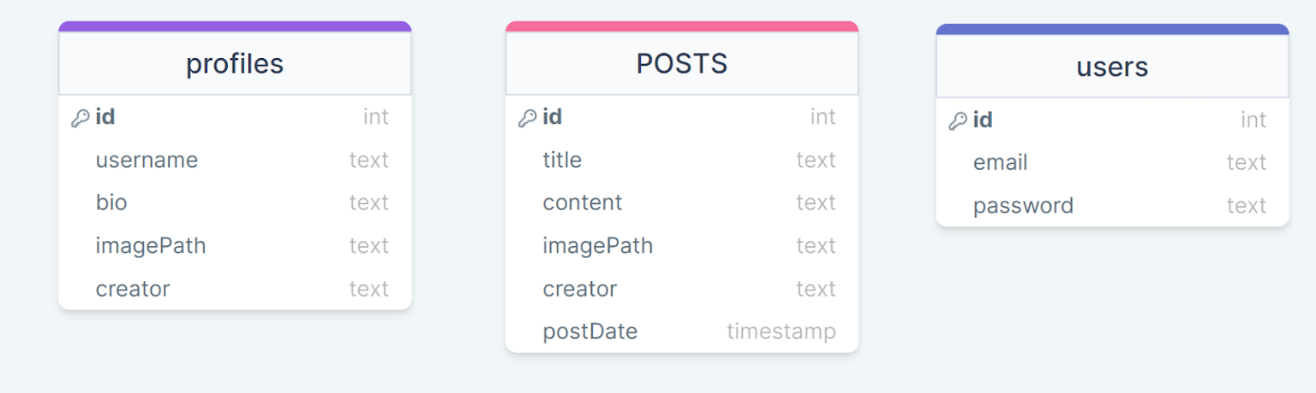
Database Structure

Slide 14
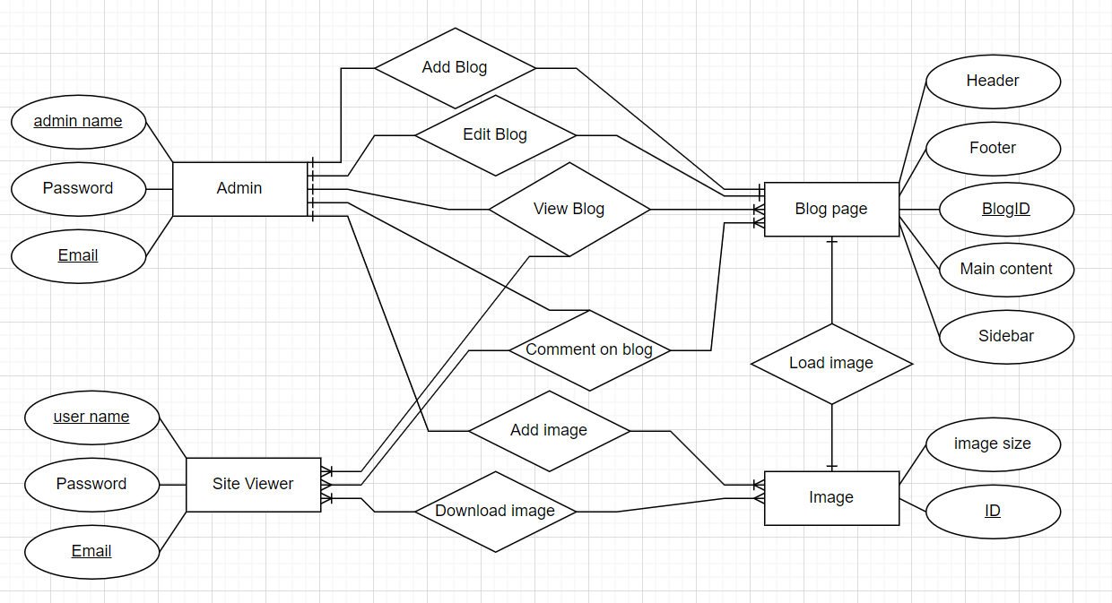
Entity Relational Diagram

Slide 15
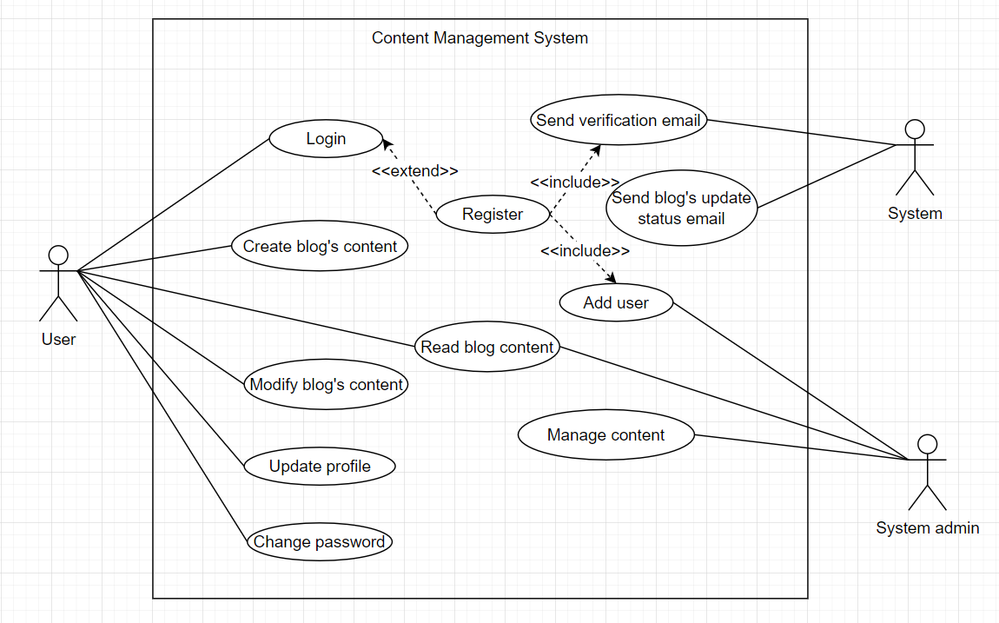
User Case Diagram

Slide 16
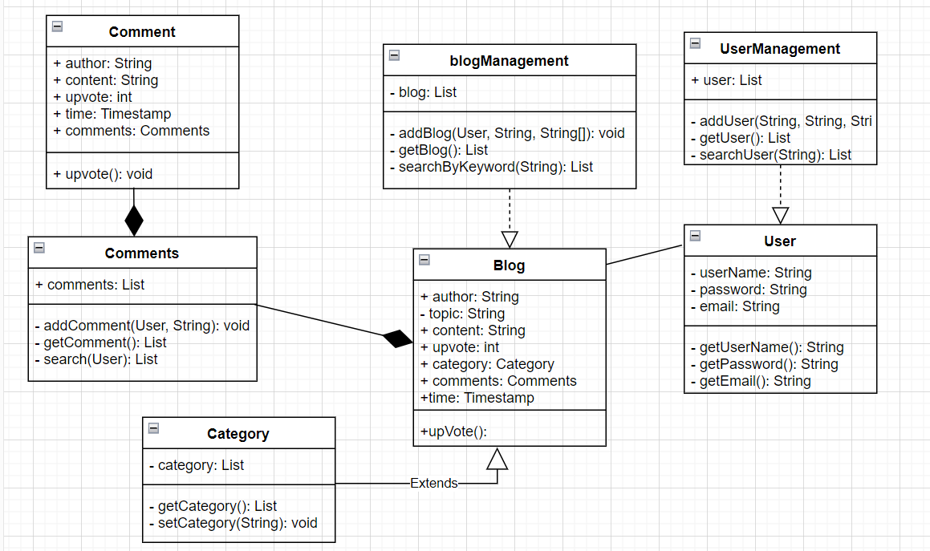
Class Diagram

Slide 17
04
Demo

Slide 18
Thank you!
Does anyone have any questions?

