Slide 1
StockSpace Platform
Warehouse leasing and warehouse management platform
Project presentation and live demonstration

Slide 2
Problem and Objective
• Connect warehouse owners, tenants, staff, inspectors, and administrators on one platform.
• Digitize warehouse discovery, leasing, contracts, inventory operations, payments, and inspections.
• Provide role-based access and traceable transactions for every core workflow.
StockSpace Platform | 2

Slide 3
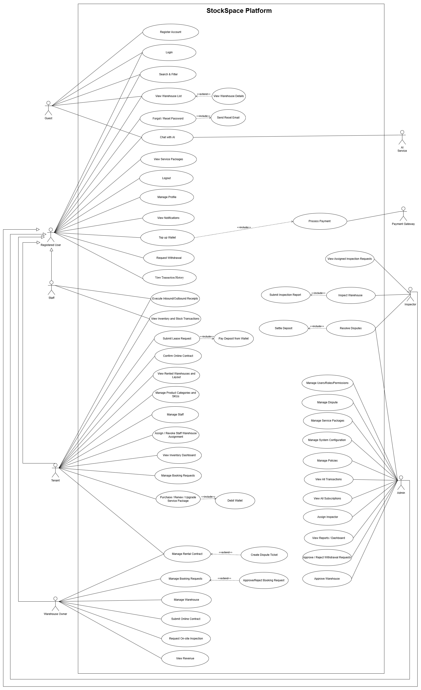
Actors and Registered Use Cases
StockSpace Platform | 3

Slide 4
Core Business Flow
• Search warehouse → submit booking and deposit → owner approval.
• Create and confirm rental contract → manage warehouse layout and staff.
• Create inbound/outbound receipts → track stock → conduct inventory audit.
• Inspection, dispute handling, wallet, subscription, and administration complete the lifecycle.
StockSpace Platform | 4

Slide 5
System Architecture
• Frontend client communicates with a Spring Boot REST API secured by JWT and RBAC.
• PostgreSQL 16 with pgvector stores transactional and knowledge-base data.
• Docker Compose runs the application and database; Nginx and GitHub Actions support deployment.
• Optional integrations: VNPAY, Cloudinary, SMTP, Google OAuth, and OpenRouter.
StockSpace Platform | 5

Slide 6
Implemented Modules
• Authentication, authorization, user/role/permission management, and notifications.
• Warehouse, booking, rental contract, inspection, and dispute workflows.
• WMS: products, SKU, receipts, stock batches, transactions, and inventory audits.
• Wallet, subscriptions, withdrawals, reports, dashboard, and chatbot services.
StockSpace Platform | 6

Slide 7
Data and Security
• Seeded demo accounts cover Admin, Owner, Tenant, Staff, and Inspector.
• Database initialization creates roles, permissions, wallets, packages, policies, UOMs, and system knowledge.
• JWT access and refresh tokens plus permission-based RBAC protect API operations.
• Swagger UI and automated tests provide implementation evidence.
StockSpace Platform | 7

Slide 8
Live Demo Plan
• Guest: search and view warehouses; chatbot and package browsing. • Tenant: booking/deposit, contract confirmation, SKU and staff management. • Owner: warehouse, received booking requests, online contract, inspection request. • Staff: receipts and inventory transactions. • Admin and Inspector: warehouse approval, inspection assignment/reporting, withdrawal decision, and monitoring.
StockSpace Platform | 8

Slide 9
Demo Evidence
• Swagger endpoint responses and role-based authorization.
• Warehouse status, booking status, contract status, receipt status, and stock quantity changes.
• Wallet transaction and withdrawal approval history.
• Admin dashboard, transactions, subscriptions, and inspection report.
StockSpace Platform | 9

Slide 10
Use-Case Completion Summary
• 53 use-case occurrences are mapped from the updated Report 3 diagram. • 45 primary use cases and 8 included/extended subflows. • 51 use cases have complete backend evidence. • 2 items are partial: profile update and Inspector dispute resolution. • The submission includes runnable source, demo seeds, installation instructions, and a traceability table.
StockSpace Platform | 10

Slide 11
Limitations and Future Work
• Enable real VNPAY, SMTP, Google OAuth, and OpenRouter credentials in production only.
• Add self-service profile update and Inspector-specific dispute resolution if required by the final scope.
• Extend operational reports, monitoring, and notification analytics.
StockSpace Platform | 11

Slide 12
Thank You
• Repository: github.com/vinhleechem/StockSpace_BE
• Demo accounts and startup steps: docs/submission/02_SOFTWARE_PACKAGE.md
• Full demo sequence: docs/submission/04_SLIDES_AND_DEMO_SCRIPT.md
• Use-case traceability: docs/submission/05_USE_CASE_TRACEABILITY.md
StockSpace Platform | 12

