Slide 1
Data Science Capstone Project Report
SpaceX Falcon 9 First-Stage Landing Prediction
Author: [Vinh Đức Nguyễn] | Date: [29/09/2026]
GitHub: https://github.com/YOUR-USERNAME/YOUR-REPO

Slide 2
Executive Summary
Methods: data collection (SpaceX REST API + Wikipedia web scraping), data wrangling, EDA with visualization and SQL, interactive analytics (Folium, Plotly Dash), predictive modeling.
Models: Logistic Regression, SVM, Decision Tree and KNN, compared on a held-out test set.
Key results: landing success rises with flight number and booster generation over time; KSC LC-39A has the best launch-site success rate (77%); HEO shows the highest orbit success rate among orbits with multiple launches.
Best model: Logistic Regression, with 75% test accuracy — reliably predicts first-stage landing outcome from launch site, payload mass and booster version.
Data Science Capstone | 2

Slide 3
Introduction
Background: SpaceX advertises Falcon 9 launches at about $62 million, versus $165 million+ for other providers — the saving comes from reusing the first stage.
If we can predict whether the first stage will land, we can estimate the true cost of a launch.
Problem: given launch features (payload, orbit, launch site, booster version, etc.), predict whether the Falcon 9 first stage lands successfully.
Value: useful for a competitor bidding against SpaceX for a rocket launch contract.
Data Science Capstone | 3

Slide 4
Data Collection — SpaceX API
Request
api.spacexdata.com
/v4/launches/past
Parse JSON
(pd.json_normalize)
Look up rocket,
payload, launchpad,
core IDs
Build DataFrame,
keep Falcon 9 only
Key phrases: requests.get(), .json(), helper functions getBoosterVersion / getLaunchSite / getPayloadData / getCoreData
GitHub: https://github.com/YOUR-USERNAME/YOUR-REPO
Data Science Capstone | 4

Slide 5
Data Collection — Web Scraping
Request Wikipedia
'List of Falcon 9 and
Falcon Heavy launches'
BeautifulSoup
parse HTML
Find launch tables
(class 'wikitable')
Extract columns into
dict -> DataFrame -> CSV
Key phrases: requests.get(), BeautifulSoup(html.parser), find_all('table'), pd.DataFrame(launch_dict)
GitHub: https://github.com/YOUR-USERNAME/YOUR-REPO
Data Science Capstone | 5

Slide 6
Data Wrangling Methodology
Load dataset
Check missing
values
Impute PayloadMass
with mean
Count launches per
site / orbit
Create 'Class' label
(1 = landed, 0 = failed)
Outcomes such as True ASDS, True RTLS, True Ocean = 1; False ASDS, False RTLS, None None = 0.
Result: cleaned dataset exported to CSV for EDA and modeling.
GitHub: https://github.com/YOUR-USERNAME/YOUR-REPO
Data Science Capstone | 6

Slide 7
EDA with Data Visualization
Scatter plots: Flight Number vs Launch Site, Payload vs Launch Site, Flight Number vs Orbit, Payload vs Orbit — reveal relationships between features and landing outcome.
Bar chart: success rate by orbit — shows which orbits land most reliably.
Line chart: yearly launch success trend — shows improvement over time.
Feature engineering: one-hot encoding of Orbit, LaunchSite, LandingPad, Serial for modeling.
GitHub: https://github.com/YOUR-USERNAME/YOUR-REPO
Data Science Capstone | 7

Slide 8
EDA with SQL
Loaded the SpaceX table into SQLite and queried with SQL.
Unique launch sites, and sites beginning with 'CCA'.
Total and average payload mass (NASA CRS missions, booster F9 v1.1).
First successful ground-pad landing date.
Boosters with drone-ship success and payload 4,000–6,000 kg.
Mission outcome counts, max-payload boosters, 2015 failed drone-ship landings, and outcome ranking by date range.
GitHub: https://github.com/YOUR-USERNAME/YOUR-REPO
Data Science Capstone | 8

Slide 9
Interactive Visual Analytics
Folium map: circle markers for each launch site, green/red markers for success/failure using MarkerCluster, and lines showing distances to coastline, railway, highway and nearest city.
Plotly Dash app: launch-site dropdown, payload range slider, success pie chart, and payload-vs-outcome scatter plot colored by booster version.
Folium: https://github.com/YOUR-USERNAME/YOUR-REPO/blob/main/folium_map.ipynb
Dash: https://github.com/YOUR-USERNAME/YOUR-REPO/blob/main/spacex_dash_app.py

Slide 10
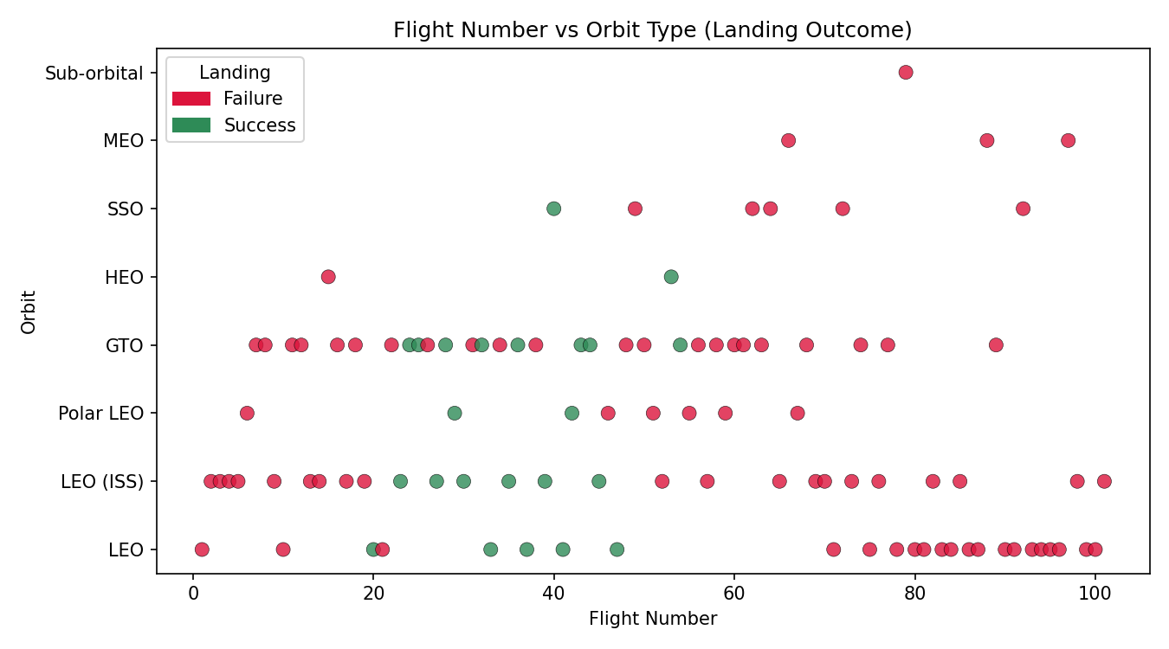
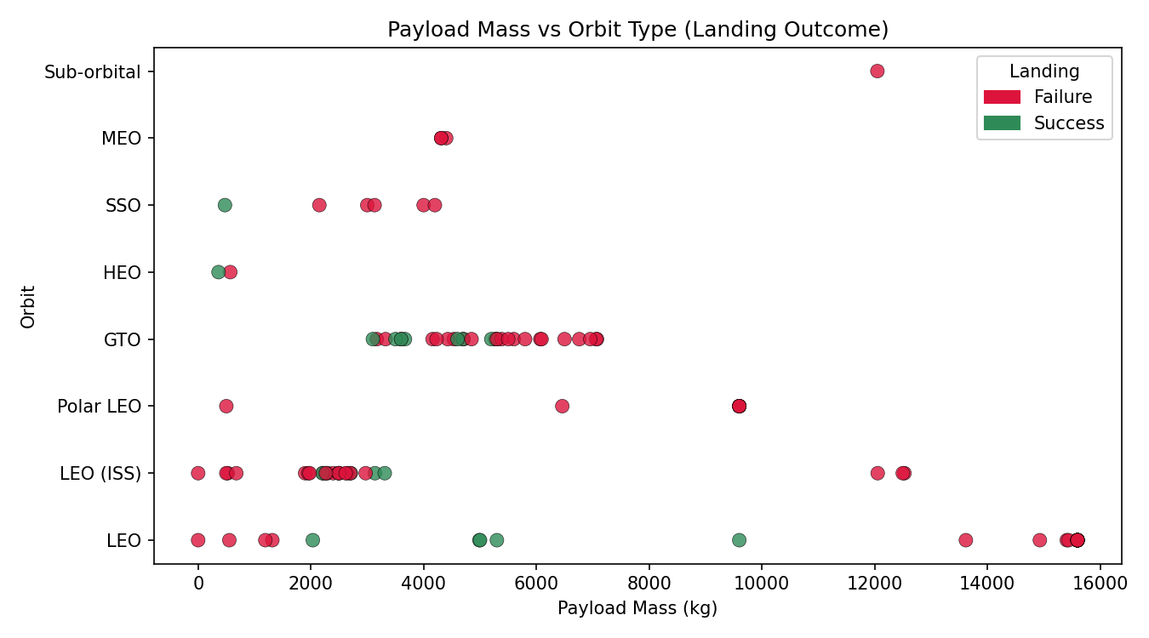
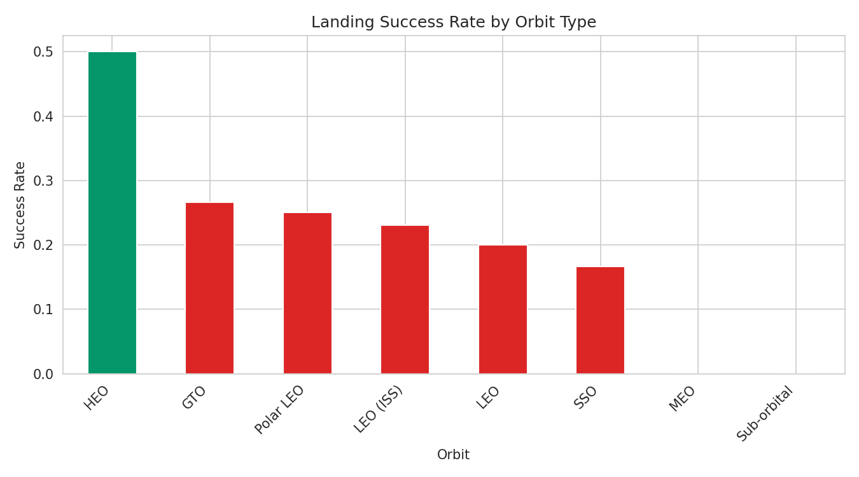
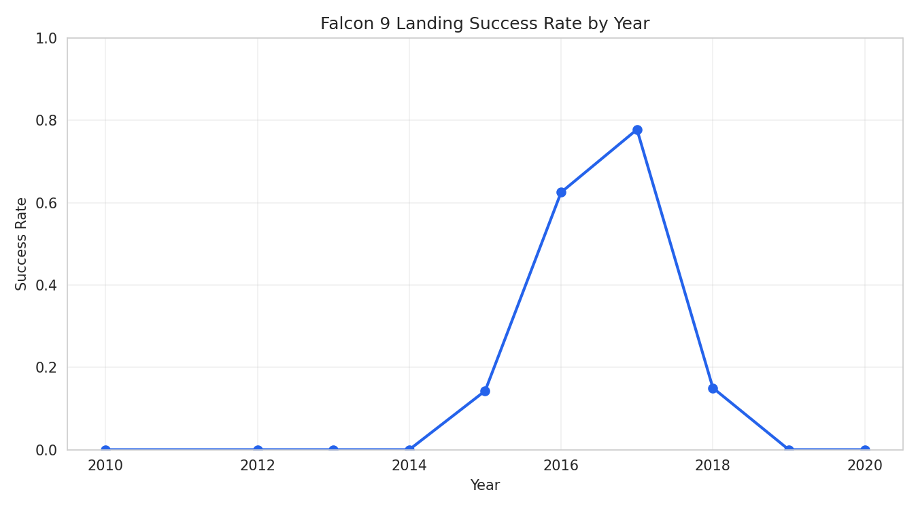
EDA with Visualization — Results
GitHub: https://github.com/YOUR-USERNAME/YOUR-REPO

Slide 11
EDA with SQL — Results
Task | Result
Unique launch sites | CCAFS LC-40, CCAFS SLC-40, KSC LC-39A, VAFB SLC-4E
Total payload (NASA CRS) | 45,596 kg
Avg payload (F9 v1.1) | 2,534.7 kg
First successful ground landing | 2015-12-22
Drone-ship success, 4–6 t payload | F9 FT B1022, B1026, B1021.2, B1031.2
Mission outcomes | Success: 98 / Failure (in flight): 1
Max-payload boosters | F9 B5 B1048.4, B1049.4, B1051.3, B1056.4 (+8 more)
2015 failed drone-ship landings | F9 v1.1 B1012, B1015 — both at CCAFS LC-40
Outcome ranking, 2010-06-04 to 2017-03-20 | No attempt (10) > Drone ship success/failure (5 each) > Ground pad success (3)
GitHub: https://github.com/YOUR-USERNAME/YOUR-REPO

Slide 12
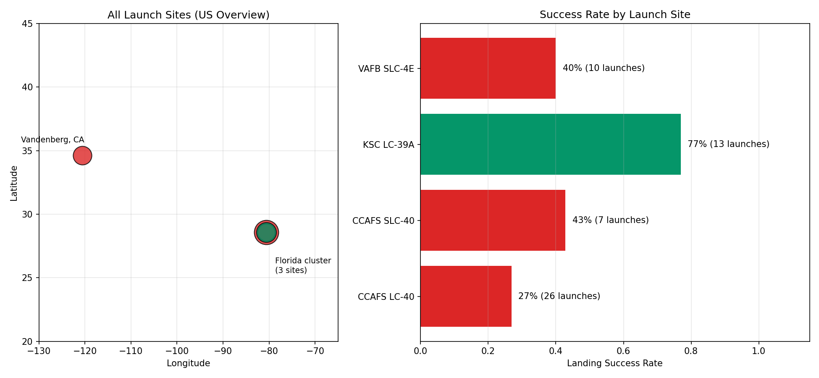
Folium Map — Results
Full interactive Folium map (satellite view, markers, popups, proximity lines) is in the linked notebook.
Folium: https://github.com/YOUR-USERNAME/YOUR-REPO/blob/main/folium_map.ipynb

Slide 13
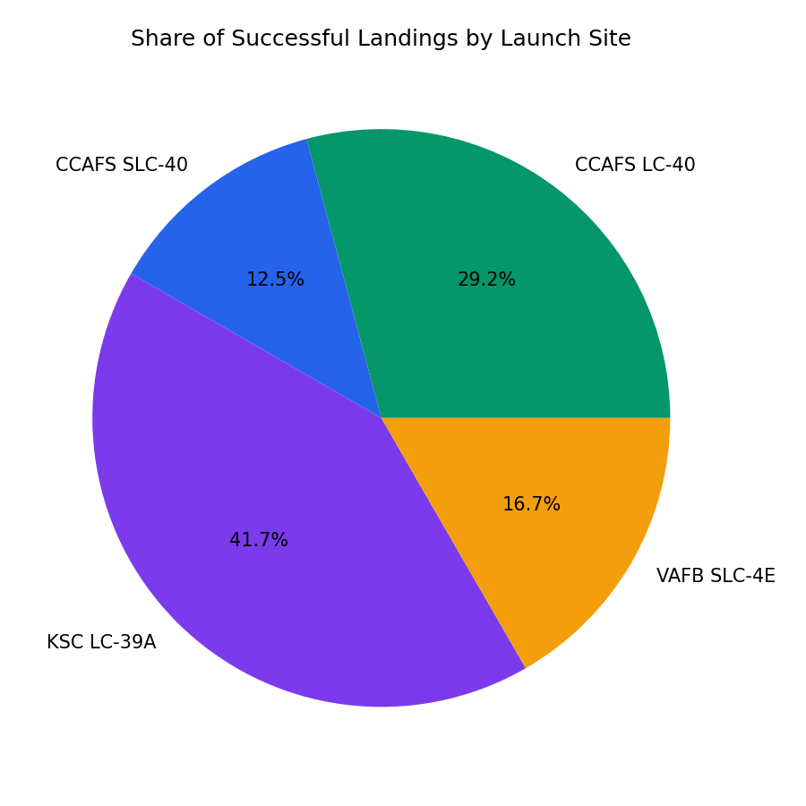
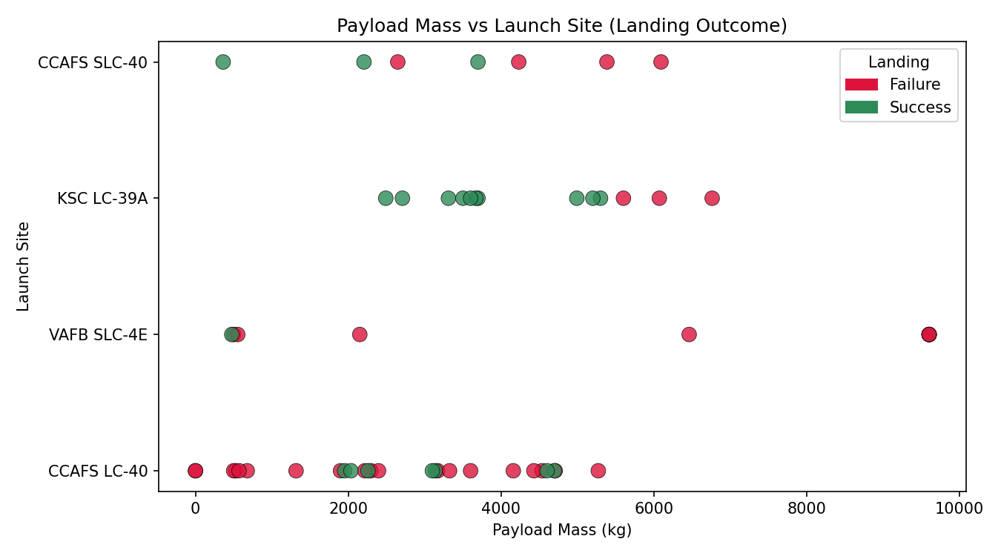
Plotly Dash — Results
Dash: https://github.com/YOUR-USERNAME/YOUR-REPO/blob/main/spacex_dash_app.py

Slide 14
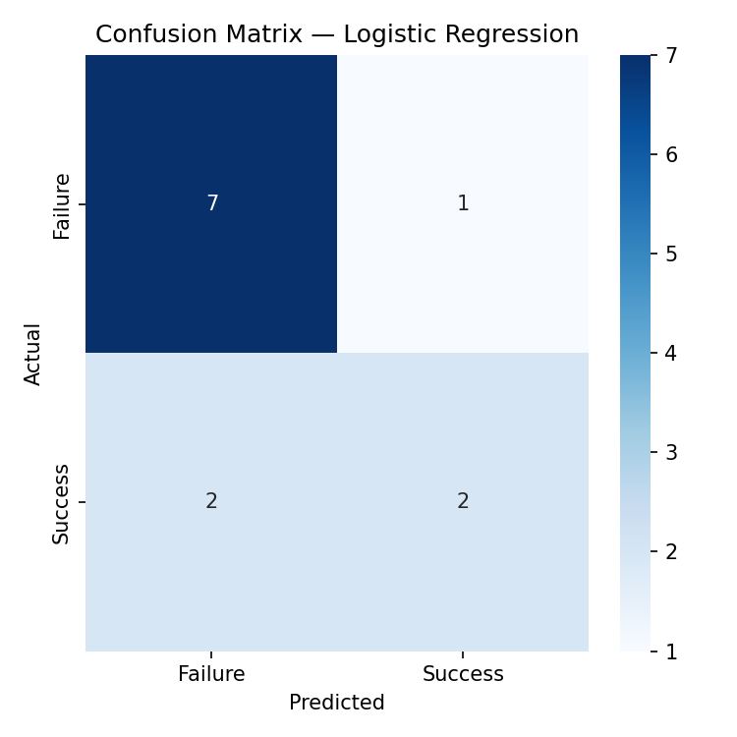
Predictive Analysis
75.0%
66.7%
58.3%
58.3%
Log. Reg.
SVM
Decision Tree
KNN
Best model: Logistic Regression — highest test accuracy (75.0%) among the four models compared.
Main error type: false positives — the model sometimes predicts a landing that actually fails.
Features used: launch site, payload mass, booster version category (one-hot encoded), standardized before training.
GitHub: https://github.com/YOUR-USERNAME/YOUR-REPO

Slide 15
Conclusion
Landing success improves with experience: later flights and newer boosters (FT / Block 5) land more reliably — B5 reaches 100% success in this dataset.
Launch site and booster version are the strongest predictors of success; KSC LC-39A stands out with a 77% site success rate.
Best classifier (Logistic Regression) reaches 75% accuracy; the small test set (12 launches) means results should be validated on more data before high-stakes use.
Insight: the learning curve of reusability lets a competitor estimate SpaceX's launch cost and price bids accordingly.
Next steps: add weather data, use ensemble models (Random Forest, XGBoost), and deploy the Dash app for live monitoring.
GitHub: https://github.com/YOUR-USERNAME/YOUR-REPO

