Slide 1



06/20/2024
PROJECT WEB APPLICATION
Welcome
NAME OF PROJECT:
PRESENTED BY:
PRESENTED TO:
uTuBe
Vo Hoai Bao -ITITIU21038
Nguyen Phuc Vinh - ITITIU21350
Advisor. Nguyen Trung Nghia

Slide 2


03 | Overview
04 | About Us
05 | Plan
06 | Design
08 | Technique
09 | Database
11 | Back End
15 | Front End - Demo
17 | References
18 | Conclusion
Agenda

Slide 3

Overview
03/19
Creating a video platform in the video-sharing industry.
01
Comprehensive Development Approach
02
Core Functionalities
03
Learning and Impact

Slide 4



Our team
04/19
Vo Hoai Bao
Nguyen Phuc Vinh
Front End
Back End

Slide 5


Plan
05/19
05/05 - 16/06
1st Quarter
2nd Quarter
3rd Quarter
4th Quarter
List all features and design
Connect client and server
Build functionalities
Testting
Workflow: https://github.com/vinhngph/uTube.git

Slide 6


06/19
Design
Use case, class diagram, and logic flow
Use Case Diagram
Class Diagram
Logic Flow
Interactions between users and a system
Structure of a system
Logically System

Slide 7
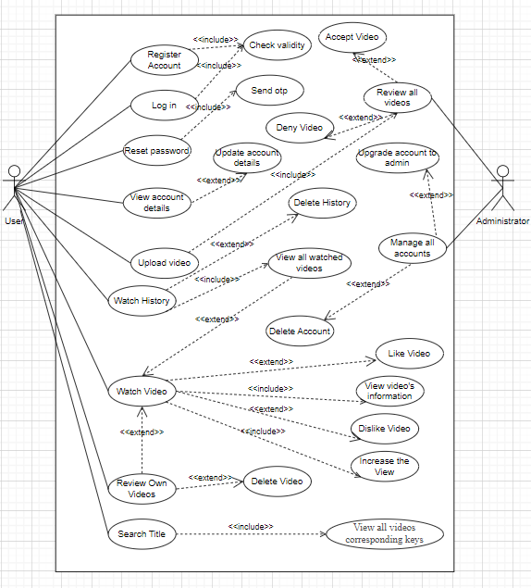
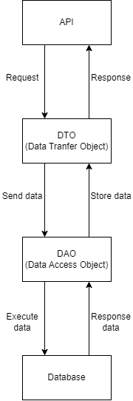
07/19

Slide 8
Technique
08/19
Server
Database
Servlets
MySQL
Client
Management
React
Vite
Ant Design Framework
Microsoft Excel
Trello
Docs
Github
Deployment
Communication
Docker
AWS EC2
Discord
Facebook

Slide 9
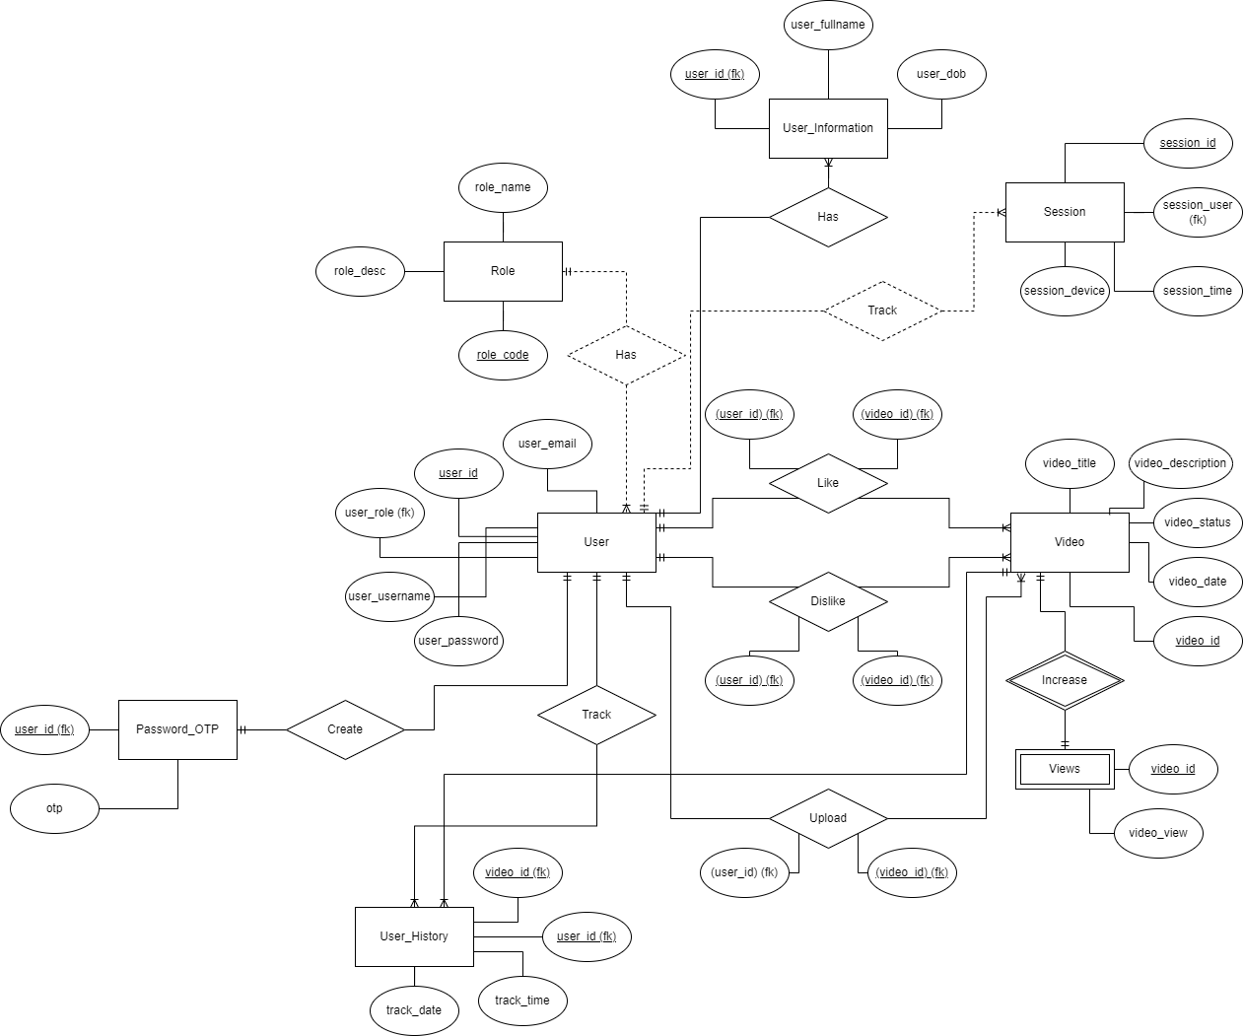
Database
09/19
ERD

Slide 10
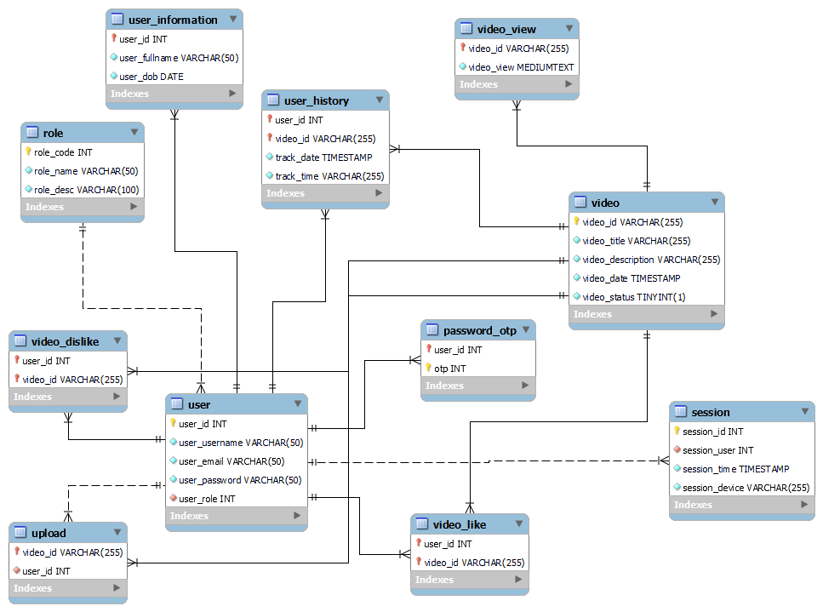
Database
10/19
Relational Schema

Slide 11
Back End
11/19
Features
Account management
Upload video
Watch video
Video management
History tracking

Slide 12
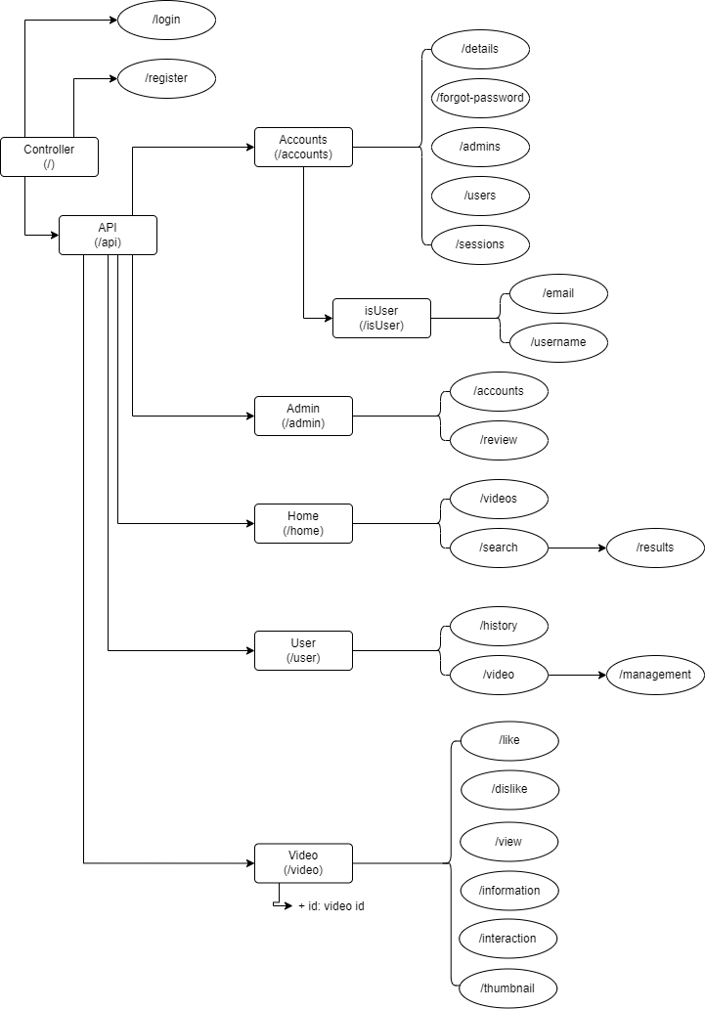
Back End
12/19
APIs

Slide 13
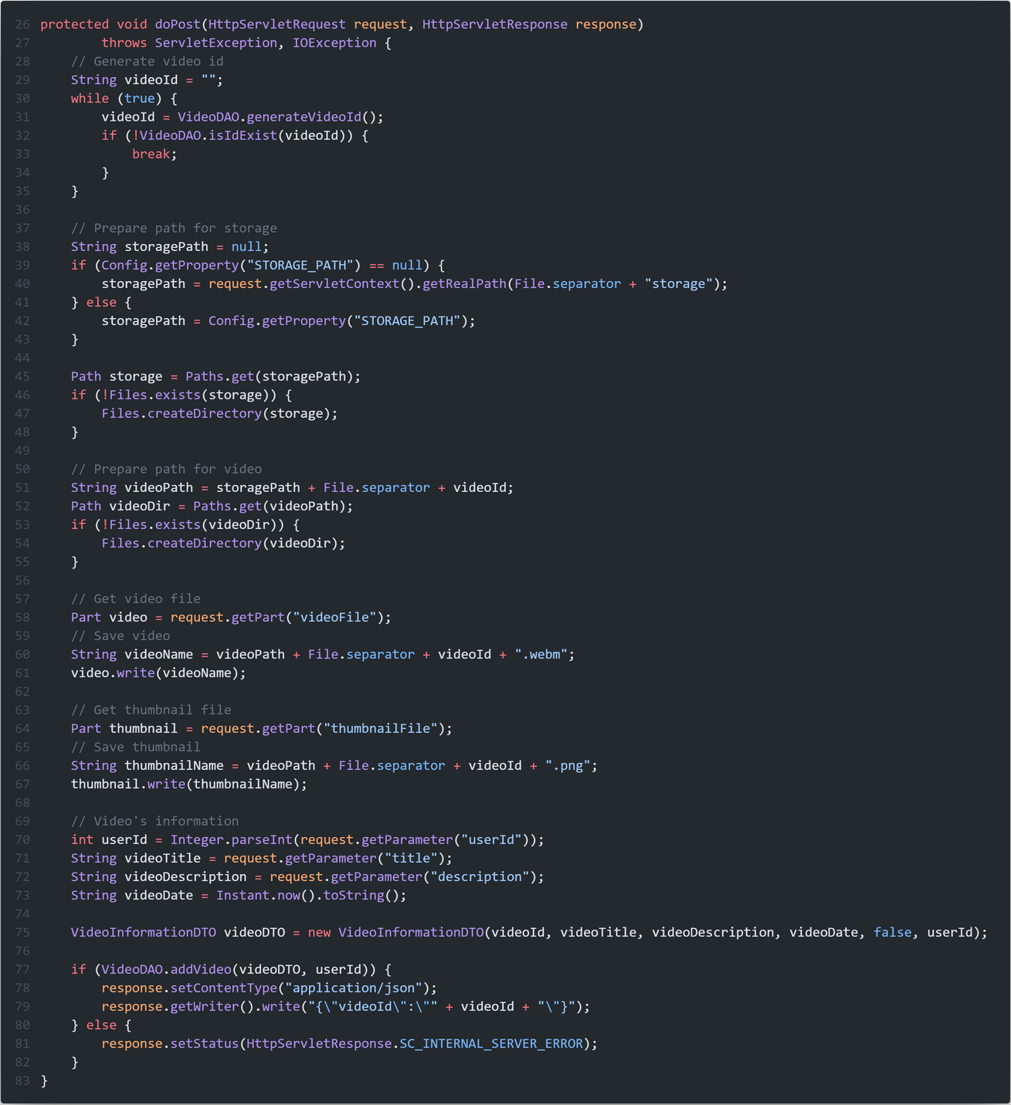
Video uploading
13/19
Feature

Slide 14
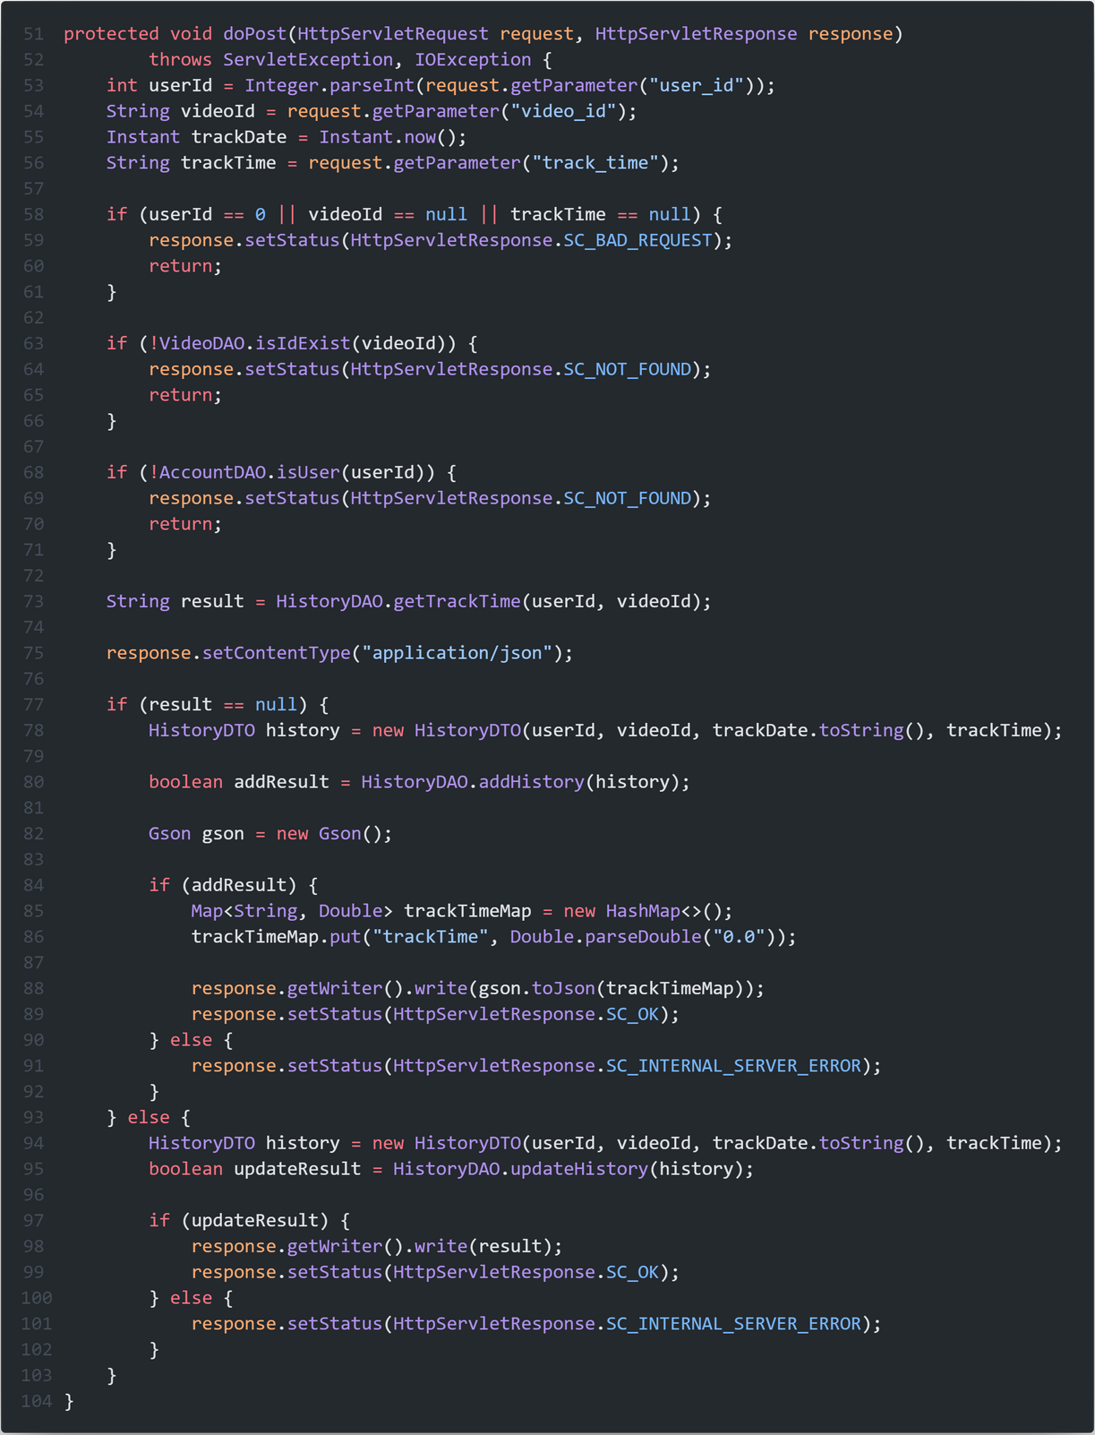
History tracking
14/19
Feature

Slide 15
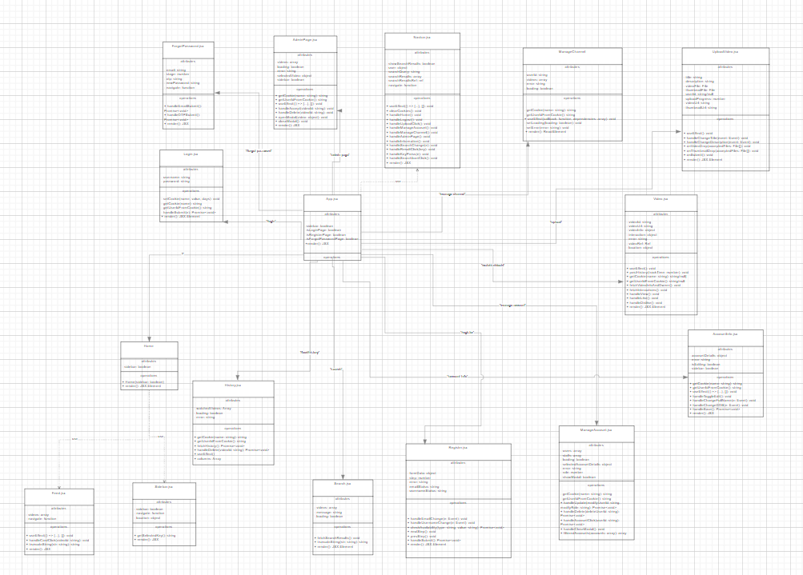
Front End
15/19
UI/UX for Web Project
12 APIs
‘/login’.
‘/register’
‘/forgot-password’
‘/’: Homepage
‘/upload’
‘/account-info’
‘/admin-page’
‘/manage-account’
‘/manage-channel’
‘/watch/:videoId’
‘/search’
‘feed/history’

Slide 16
16/19
Demo
Show what we have!

Slide 17
References
17/19
Front End
https://vitejs.dev/guide/ https://ant.design/ https://www.w3schools.com/ https://github.com/ant-design/ant-design-pro
Back End
https://docs.oracle.com/javaee/7/tutorial/servlets.htm https://dev.mysql.com/doc/ https://www.mysqltutorial.org/ https://docs.docker.com/ https://docs.aws.amazon.com/ https://docs.docker.com/samples/mysql/ https://www.javatpoint.com/example-to-connect-to-the-mysql-database

Slide 18
Conclusion
18/19
Design
Implementaion
Demonstration

Slide 19
19/19
Thank You for Listening

