Slide 1
git for beginners // with some basic commands

Slide 2





#WhoAmI ?
@vinhnx
http://vinhnx.github.com
http://github.com/vinhnx
http://gplus.to/vinhnx
vinhnguyen2308 [at] gmail [dot] com

Slide 3
a brief introduction
“In software development, Git (/ɡɪt/) is a
distributed revision control
and source code management (SCM) system
with an emphasis on speed…
Git was initially designed and developed
by Linus Torvalds for Linux kernel development…”
- Git (Wikipedia) -

Slide 4
tl;dr
Installing git in your development machine
MAC:
http://code.google.com/p/git-osx-installer
http://mac.github.com/
Windows:
http://code.google.com/p/msysgit
http://windows.github.com/ <- highly recommended! -If you’re using Windows PC like me ;)
Eclipse plugins:
http://eclipse.github.com/
Mobile:
http://mobile.github.com/

Slide 5
Let’s get
started!

Slide 6
Setup name & email
→ git config --global user.name "Your Name“
→ git config --global user.email "your_email@whatever.com"

Slide 7
Setup line ending preferences
* For Unix/Mac users:
→ git config --global core.autocrlf input
→ git config --global core.safecrlf true
* For Windows users:
→ git config --global core.autocrlf true
→ git config --global core.safecrlf true

Slide 8
your first
commit

Slide 9
→ mkdir lerepo
→ cd lerepo
→ git init
Initialized emtpy Git repository /somedir/lerepo/.git/
→ echo “oh hai” > hai.txt
→ git add hai.txt
→ git commit –m “first commit”
[master (root-commit) 8970fa6] first commit
1 file changed, 1 insertion(+)
create mode 100644 hai.txt
Me: Think of repo (repository) as a folder.
Them: Repo (repository) is commonly refers to a location for storage, often for safety or preservation.
-> read this for more details

Slide 10
git add means telling git that “I want you to index this/these file(s)!”
Say, you already had another file in your repository, named, script.js.
→ ls -l
total 2
-rw-r--r-- 1 admin None 7 Oct 1 10:23 hai.txt
-rwxr-xr-x 1 Administrators None 47 Oct 1 10:57 script.js
… and you want to add both files. (hai.txt & script.js)
→ git add hai.txt script.js
→ git commit –m “index all the files”
[master (root-commit) 8d018aa] index all the files
2 files changed, 4 insertions(+)
create mode 100644 hai.txt
create mode 100644 script.js

Slide 11
… but in come cases, you just want to add only specific file(s) manually, just tell git so:
→ git add hai.txt
→ git commit –m “updated hai.txt”
[master (root-commit) 8970fa6] first commit
1 file changed, 1 insertion(+)
create mode 100644 hai.txt

Slide 12

cool,
now what?!

Slide 13
checking status –-before indexing (staging)
→ git status
# On branch master
#
# Initial commit
#
# Untracked files:
# (use "git add <file>..." to include in what will be committed)
#
# hai.txt
nothing added to commit but untracked files present (use "git add" to track)

Slide 14

checking status --after indexing (staging)
→ git status -sb
# On branch master
nothing to commit (working directory clean)

Slide 15
quick tip

Slide 16

viewing status the short/clean way
→ git status -sb
## Initial commit on master
?? hai.txt
English, Do You Speak It?
You are now on branch master
Your file (hai.txt) has been modified
… but you haven’t staged it yet
… so, your index is unclean === dirty ☹

Slide 17
history
lesson

Slide 18
→ git log --pretty=oneline
56230b1 updated hai.txt (Vinh Nguyen, 33 seconds ago)
8d018aa index all the files (Vinh Nguyen, 13 minutes ago)

Slide 19
quick tip
(again)

Slide 20
The Ultimate Log Format
→ git log --pretty=format:"%h %ad | %s%d [%an]" --graph --date=short
Take a look in detail:
--pretty="..." defines the format of the output.
%h is the abbreviated hash of the commit
%d are any decorations on that commit (e.g. branch heads or tags)
%ad is the author date
%s is the comment
%an is the author name
--graph informs git to display the commit tree in an ASCII graph layout
--date=short keeps the date format nice and short
Ref: http://gitimmersion.com/lab_10.html

Slide 21

Your first
Github repo

Slide 22


your first github repo
Register an account at github.com.
Create new repo.
Fill in information.
Copy your SSH.. Eg: git@github.com:yourname/your-repo-name.git
In your terminal/command prompt/whatever. Type in, with hub is your remote name (optional)
Let me check
→ git remote add hub git@github.com:yourname/your-repo-name.git
→ git remote –v
hub git@github.com:yourname/your-repo-name.git (fetch)
hub git@github.com:yourname/your-repo-name.git (push)

Slide 23
not
so fast…
(another tip)

Slide 24
It’s recommended to run git status again to check whether if files are staged properly and most importantly, your current working branch
** [in default, we are all working for on master branch].
** a branch is like your feature lab – wherein you can experiment something cool. If “it just works”, merge it to master branch for your final code, else you may forget or abandon it …
→ git status
# On branch master
nothing to commit (working directory clean)
Kay, things seem rather good up to now! ☺
Press arrow right to next slides…

Slide 25
cat
:3

Slide 26
cat
(not really)
-file

Slide 27
In order to check and see more information for what we have done in recent activities. You can run this:
→ git cat-file –p HEAD
tree 56230b16f2e04c1a385008f78ad761152fdf0480
parent 8d018aa81664cf7caad20a3ab7bcd6d03354a18b
author Vinh Nguyen <name@mail.com> 1349065326 +0100
committer Vinh Nguyen <name@mail.com> 1349065326 +0100
updated hai.txt
Right now, don’t bother the cat-file -p command.
What does HEAD mean, it’s simply your current branch/ last committed stage. (Don’t confuse with Index (staging area) and working tree (the stage of files in checkout)). -- See this for more details:
Now you have information about your most recently commit (HEAD === master), You can inspect last 2, by HEAD^n with n is an specific number, eg: HEAD^1.
Remember the 5W, the what/when/where/who/why
Still remember history?! Can you spot what in common ? ☺
→ git log --pretty=oneline
56230b1 updated hai.txt (Vinh Nguyen, 33 seconds ago)
8d018aa index all the files (Vinh Nguyen, 13 minutes ago)

Slide 28
Noticed that in your log, we have 2 commits up to now, represented by the first 7 characters of SHA (Secure Hash Algorithm).
56230b1 8d018aa
And surprisingly, but not quite, in your git cat-file –p HEAD command, we now see them again. What the fuzz?
tree 56230b16f2e04c1a385008f78ad761152fdf0480
parent 8d018aa81664cf7caad20a3ab7bcd6d03354a18b
author Vinh Nguyen <name@mail.com> 1349065326 +0100
committer Vinh Nguyen <name@mail.com> 1349065326 +0100
updated hai.txt
Git is just connection of dots. Think of it as a graphical base, a dot/node represented by a branch in a tree, dot will be our working HEAD. Tree with SHA 56230b1 is a child of its parent as SHA 8d018aa.
Read again, we may notice git cat-file –p HEAD, we now have more information like: author of last commit, name of committer, time when commit occurred, and the message of last commit…

Slide 29
push

Slide 30
Kay, back to push topic.
Now your Github repo is ready for continous development.
Why don’t we push it?
→ git push –f hub master
Counting objects: 7, done.
Delta compression using up to 4 threads.
Compressing objects: 100% (4/4), done.
Writing objects: 100% (7/7), 594 bytes, done.
Total 7 (delta 0), reused 0 (delta 0)
To git@github.com/yourname/your-repo-name.git
+ c80efd2…40807b2 master -> master(force update)

Slide 31
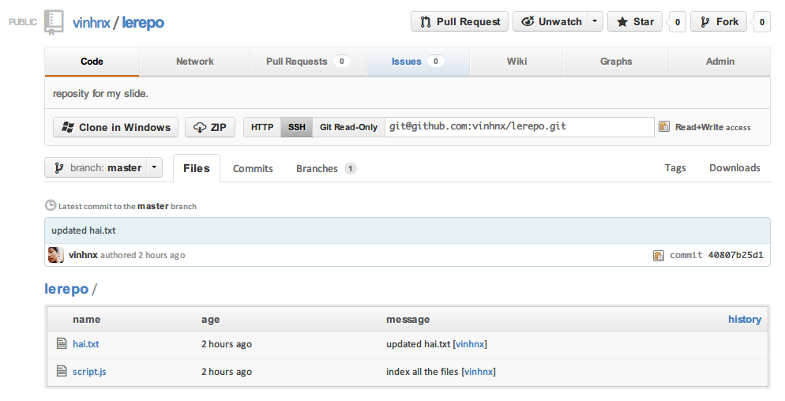

Slide 32
summary
& more

Slide 33
# BASIC COMMAND …
## note: command with slash ‘/’ in between can be optionally chosen, eg: -s/-b, you can choose either –s or –b
→ git init # to initialize a git repo
… hardcore hacking …
→ git status –s/–b/-sb # show file added to staging area, files with changes, untracked files
→ git log hai.txt # show recent commits on hai.txt
→ git add ./–A/[file/files] # adding file(s) to index
→ git commit –m “commit message” # message of a commit
### working remotely
→ git remote add/delete [remote.name] [git.url] # adding/deleting remote
→ git push [remote.name] [branch.name] # update the [remote] with your commit from [branch.name]
→ git pull # fetch changes from remote and merge into current branch
→ git fetch [remote.name] # update the remote-tracking branch for [remote.name] (default is origin)

Slide 34
# EVEN MORE COMMAND …
## note: HEAD === most recent commit on your working branch. As I said before, default is master.
→ git add [dir] # add all files in [dir] directory
→ git add .
### add all files under current directory, untracked file included
→ git rm [file1] [files2] … [fileN] # remove n files from the project
→ git reset HEAD [file] # remove specified file from next commit
### branching
→ git checkout –b [branch.name] # create a new branch and switch to it
→ git branch –d [branch.name] # delete a branch
→ git rev-parse HEAD # show me SHA of last commit
→ git cat-file –t HEAD # what type of last commit in current working branch
→ git cat-file –p HEAD # all your last commit’s information belong to us ;)
→ git clone # clone a repo

Slide 35
tweaking
git
(make it more awesome)

Slide 36
# Add colors to your ~/.gitconfig file:
[color]
ui = auto
[color "branch"]
current = yellow reverse
local = yellow
remote = green
[color "diff"]
meta = yellow bold
frag = magenta bold
old = red bold
new = green bold
[color "status"]
added = yellow
changed = green
untracked = cyan
# Highlight whitespace in diffs [color]
ui = true
[color "diff"]
whitespace = red reverse
[core]
whitespace=fix,-indent-with-non-tab,trailing-space,cr-at-eol
# Show files ignored by git: ign = ls-files -o -i --exclude-standard
# Add aliases to your ~/.gitconfig file:
[alias]
st = status
ci = commit
br = branch
co = checkout
df = diff
dc = diff --cached
lg = log -p
ls = ls-files
lol = log --graph --decorate --pretty=oneline --abbrev-commit
lola = log --graph --decorate --pretty=oneline --abbrev-commit --all

Slide 37
ref
Gitref: http://gitref.org
Github help: https://help.github.com/
Git-scm: http://git-scm.org/
Pro git book: http://git-scm.com/book
Advanced Git by Github's Matthew McCullough
http://marakana.com/s/advanced_git_graphs__hashes__compression_matthew_mccullough_github,1280/index.html
Introduction to Git with Scott Chacon of GitHub
http://marakana.com/s/video_introduction_to_git_with_scott_chacon_of_github,399/index.html
Git Magic - Tommy MacWilliam '13 from Harvard
http://cs50.tv/2011/fall/seminars/Git_magic/Git_magic.mp4
→ git help [command]
} must watch!

Slide 38
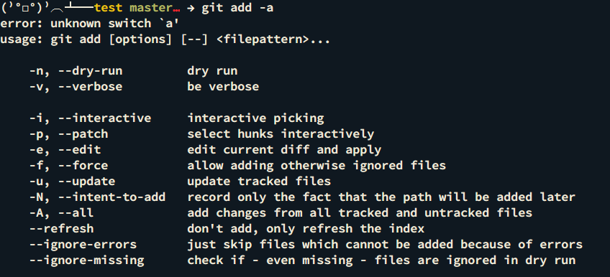
typo? …don’t worry ;)

Slide 39


Slide 40
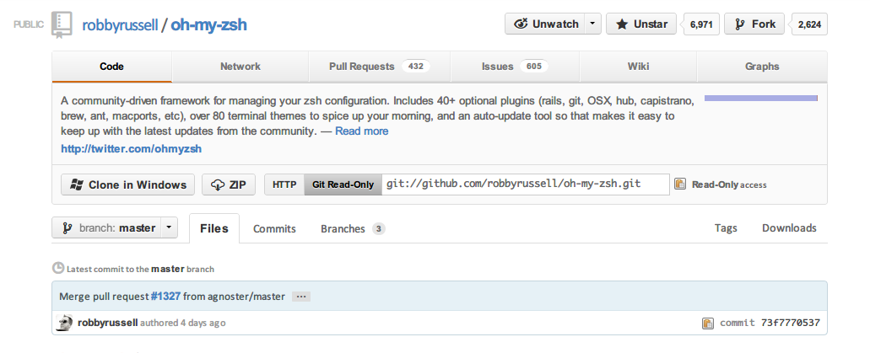
last but totally not least
https://github.com/robbyrussell/oh-my-zsh
"oh-my-zsh: your life in a shell" -- fox

Slide 41

[tab]
awesome, autocomplete is awesome!!!

Slide 42
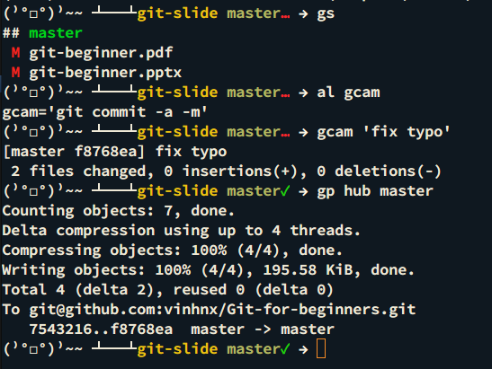
“yourself, don’t repeat” -- DRY
save times
write less
do more
with alias…

Slide 43
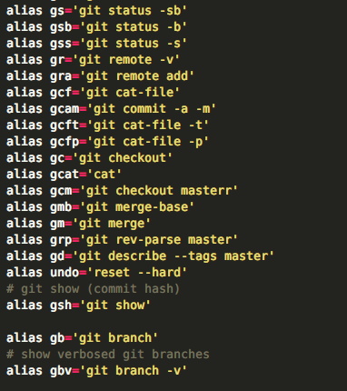

https://gist.github.com/3844446
(or open .zshrc file
in your favorite text editor
and make
some noises changes)
** it’s located in ~/.zshrc

Slide 44
Well, that’s it!
I hope these could help you
get acquainted with fundamental about
git.
;)

Slide 45

Thanks!
@vinhnx

