Slide 1
Financial News Sentiment Analysis (FNSA) and Business Use Cases
October 5, 2024

Slide 2
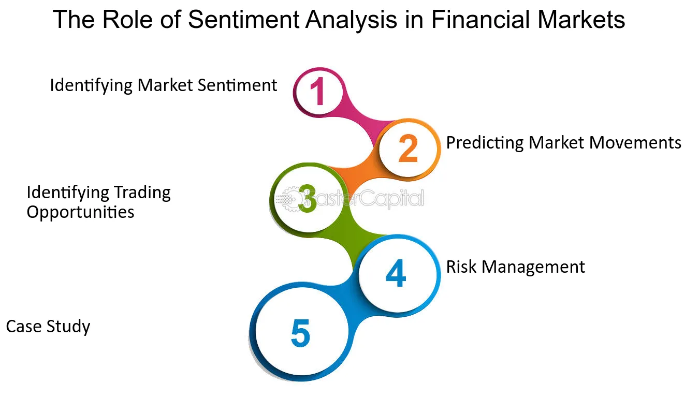
FNSA - Problem Statement
Sentiment analysis is a technique used in natural language processing (NLP) to determine the emotional tone or attitude expressed in a piece of text. It aims to classify the sentiment behind the text as positive, negative, or neutral.
Emotions, opinions, and market sentiment can have a profound impact on financial markets. Thus, sentiment analysis is important for the following purposes:
Identifying Market Sentiment
Predicting Market Movement
Identifying Trading Opportunities
Risk Management
Others: Competitor and Industry Analysis

Slide 3
FNSA – Dataset Selection
The selected dataset: (FinancialPhraseBank) contains the sentiments for financial news headlines from the perspective of a retail investor. Link: https://www.kaggle.com/datasets/ankurzing/sentiment-analysis-for-financial-news/data
Dataset Content: The dataset contains two columns, "Sentiment" and "News Headline". The sentiment can be negative, neutral or positive.
Fine-tuning large language models (LLMs) for sentiment analysis plays a critical role in improving the accuracy, efficiency, and adaptability of sentiment detection systems. LLMs, like GPT or BERT, are pretrained on massive amounts of general-purpose text, but fine-tuning helps tailor them to perform well in specific tasks like sentiment analysis by training them on labeled sentiment data. Here's how fine-tuning enhances their performance:
1. Task Specialization: LLMs are excellent at understanding general language, fine-tuning allows the model to specialize in the task of sentiment analysis. By training the model on a dataset with labeled sentiments (positive, negative, neutral, etc.), the LLM learns to associate certain words, phrases, or patterns with specific sentiment classes.
2. Handling Domain-Specific Language:
Fine-tuning helps the model better understand industry-specific jargon, terminology, or slang that may not be adequately represented in its general pretraining. In sectors like finance, where terms like "volatility," "bullish," or "market crash" have very specific implications, fine-tuning helps the model interpret these correctly in the context of sentiment.
→ we are going to fine tune LLM to do sentiment analysis on FinancialPhraseBank dataset.

Slide 4
FNSA – Business Use Case
FNSA on FinancialPhraseBank dataset to classify a news as positive/negative/neutral ones aims to helping investors, financial institutions, and corporations make more informed decisions in an automatic and fast way. By automatically gauging the emotional tone and implications of news, it enables stakeholders to extract actionable insights from vast amounts of data. Here are the business use cases which we can concentrate in this project:
Market Sentiment Tracking
Risk Management
Customer Sentiment and Service Improvement
Decision Making in Trading Strategies/ Portfolio Optimization/ Asset Allocation
However, for a demo for the effectiveness of FNSA on FinancialPhraseBank dataset, in this project, we provide a web-based automatic news crawling system and sentiment analysis to show the customers/stakeholders the view of the current market news with their manual selection or input through keywords.

Slide 5
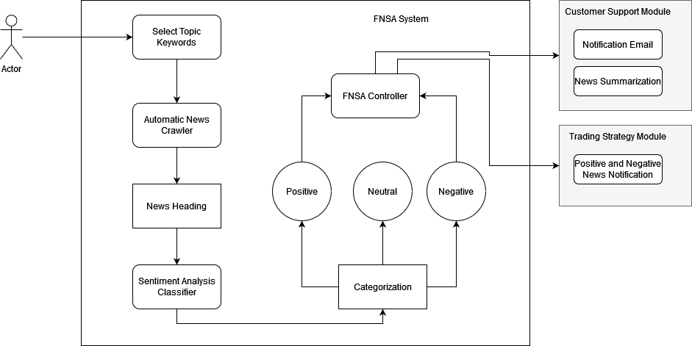
FNSA – Solution design

Slide 6
Sentiment Analysis - Investigation
For Sentiment Analysis, there are some following algorithm approaches:
Lexicon-based approach: use a pre-defined dictionary of positive and negative words
Supervised approach: a machine learning-based approach that depends on an annotated dataset. This approach includes 4 main steps: text pre-processing, text representation(tokenization), model training and model testing
LLM-based approach: LLMs, like GPT or BERT, are pretrained on massive amounts of general-purpose text, but fine-tuning helps tailor them to perform well in specific tasks like sentiment analysis by training them on labeled sentiment data

Slide 7
Sentiment Analysis using LLM (Llama2)
Data preparation
Data Cleaning
Data Preprocessing
Training/Fine-tuning Llama2 model
Evaluation and Improvements

Slide 8
Data Cleaning and Pre-processing
Data Cleaning
Removing Special Characters: Special characters, including punctuation and HTML tags, can clutter your text. Removing them makes the text cleaner and more readable.
Stop/Non/Short Word Removal:Stop words are common words like “and,” “the,” and “in” that don’t provide much value in NLP. Removing them reduces noise.
Lowercasing and Accents: Normalizing text by converting it to lowercase and removing accents ensures consistency in your text data.
Data Pre-processing: Llama2 is a GPT-chat model and hence does a text-generation task. Each news headline will be modified with the following prompt format:
Analyze the sentiment of the news headline enclosed in square brackets,
determine if it is positive, neutral, or negative, and return the answer as
the corresponding sentiment label "positive" or "neutral" or "negative".
{news_headline}= {sentiment}"""

Slide 9
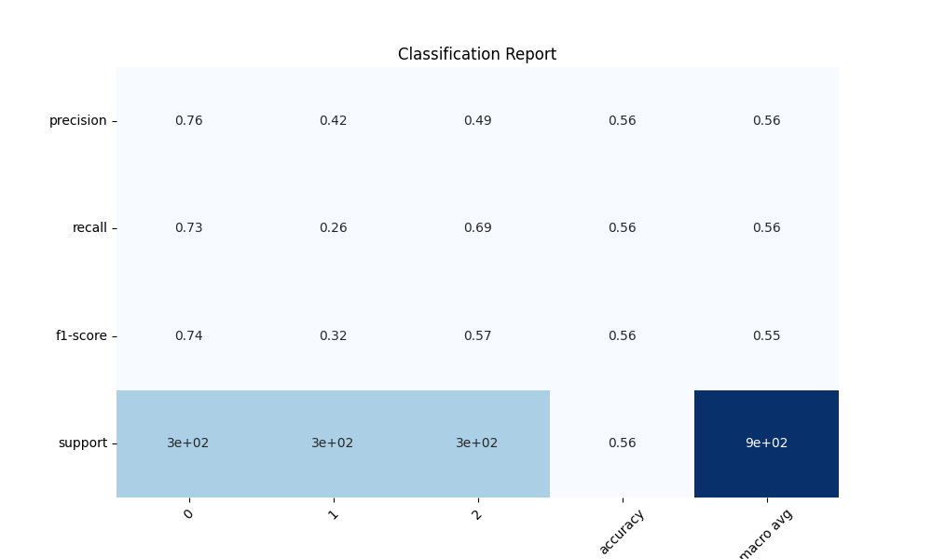

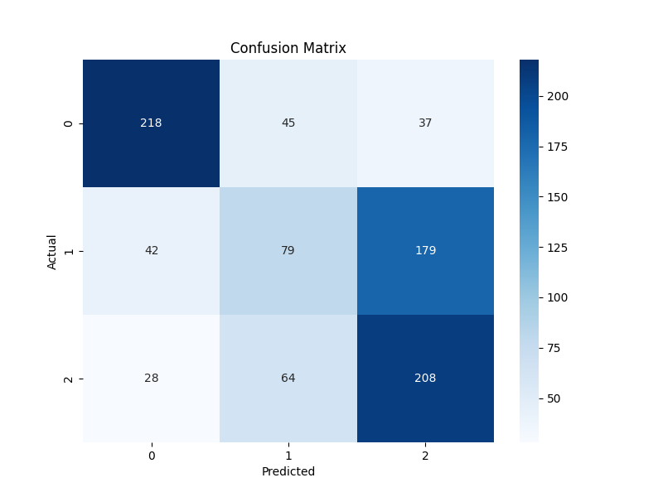
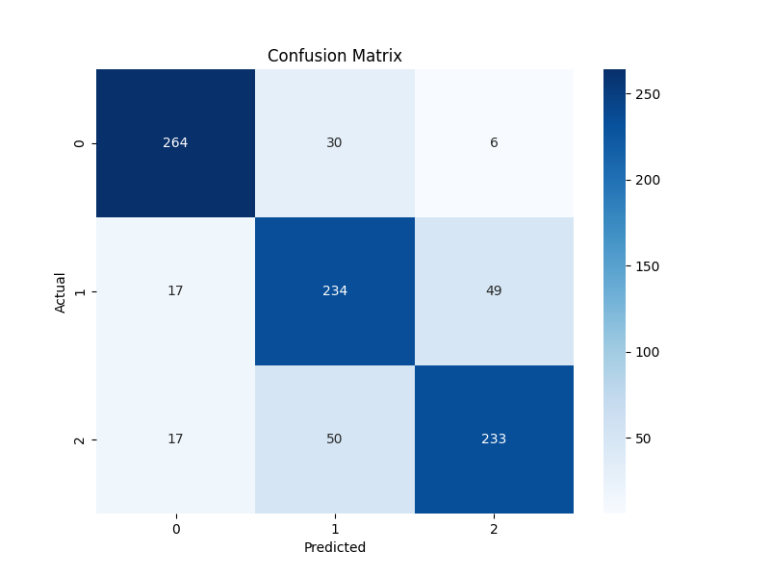
FNSA – Finetuning Llama2 - Evaluation
Using LORA for model adaptation with r= 64, alpha =32,
Dropout = 0.1
Before fine-tuning
After fine-tuning
0- negative
1- neutral
2- positive

Slide 10

FNSA – Evaluation – Compare to Baseline Methods
Comparison between ours and baseline method
BERT (Only tokenizer) → LSTM
T5/Llama2 Finetuning (Ours)
LSTM
Our Llama2 finetuning

Slide 11
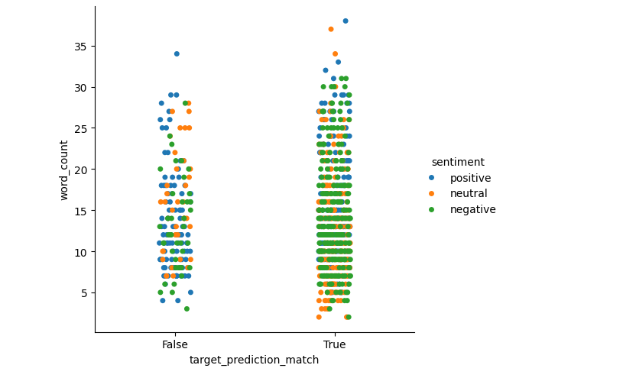
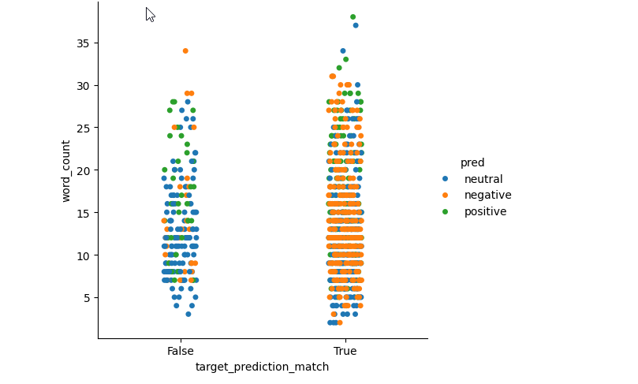
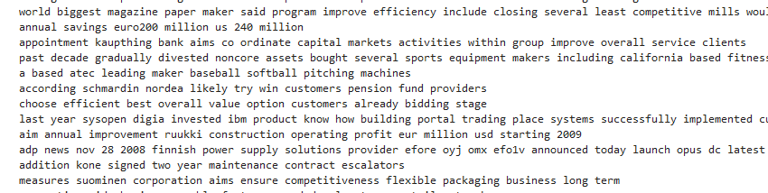
FNSA – Evaluation and Error analysis
Due to the achieved results, our LLama2 finetuning has good performance with average F1-score/ accuracy/ precision of 81%. From confusion matrix, we can see that the miss-classification between neutral and positive news is considerably large.
Due to the prediction results on the test set, we also count the word number in each text which is mis-classified and compared to all correctly-classified cases. Most mis-classified cases have the new headings whose number of words is less than 20. A small number of words in headings is not the main reason for a mis-classification because as in the figure, there are some headings with a few words that have been classified correctly
However, due to the figure, a short heading is usually classified as neutral possibly because it contains not enough information to be able to classify them correctly. To improve the accuracy of the sentiment analysis model, we aim to collect more news information by possibly including the summary of news in the future so that we can achieve a news sentiment classifier with higher accuracy.
Example of mis-classified headings

Slide 12
FNC – Conclusion and Improvement
Task | Achievement | Improvement
Finetuning LLama2 | Average Accuracy/Precision/F1-score: 81% | My laptop has not enough GPU for training with more options on Lora settings → can enhance the model performance after finetuning
Finetuning T5/ Roberta | NA | T5/Roberta with encoder/decoder architecture can enhance the model performance – have not tested yet
Data Correction | Only data cleaning/ pre-processing before fine-tuning | Through error analysis, some headings with spelling errors and non-English words. These words should be corrected or translated.
News summarization collection | NA | As analyzed, the news summary can be helpful to have a better classifier for this news sentiment analysis

Slide 13
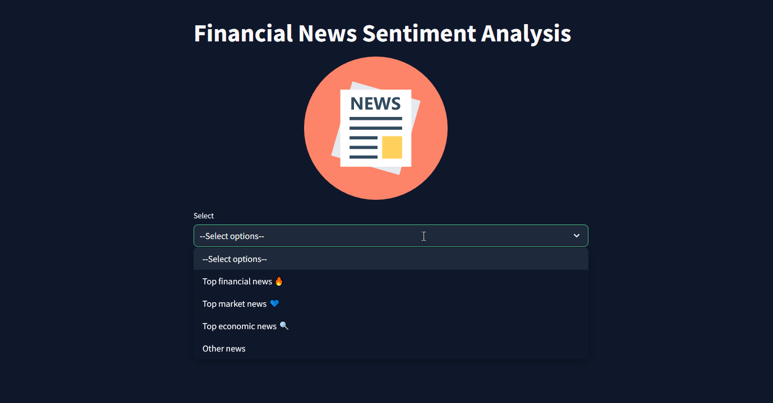
FNC – Application
App crawls data from news google rss feed and classify them as negative/neutral/positive one. The information can be notified per email to users or helpful to make a decision on trading strategies. However, our project only stop at crawling and classification.

Slide 14
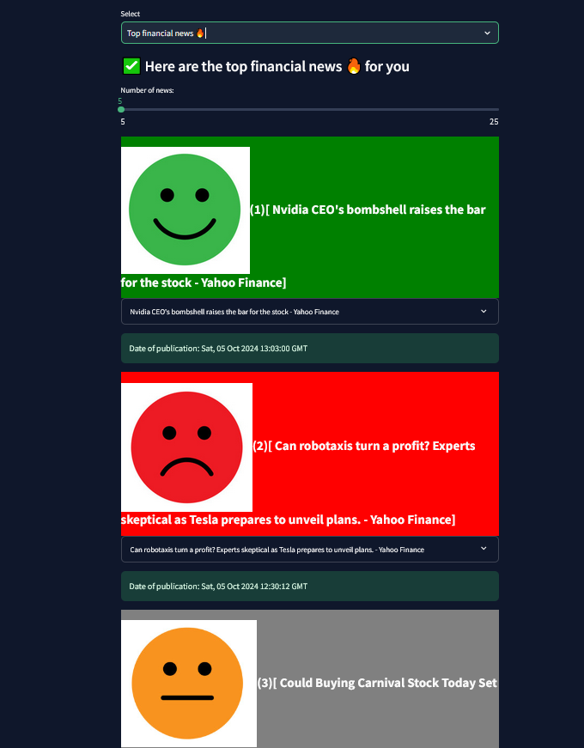
FNC – Features
Financial News Crawling and Classification
Market News Crawling and Classification
Economic News Crawling and Classification
Others: input the topic name
Besides, you can select the number of hot latest news that you expect to see.

