Slide 1
z-Tree
Zurich Toolbox for Readymade Economic Experiments

Slide 2
Advantages:
Client-server programs (zTree is the server; zLeaf is the Client)
Matching protocols
Dummy-proof
Disadvantages:
Somewhat inflexible:
Built for certain purposes -- challenging for new purposes; e.g., extensive form games, verbal exchanges
Screen design is limited (forget color design, pictures, animation, displays of extensive form games)

Slide 3
Especially good for:
Public goods games
Ultimatum game* and other bargaining experiments
One-sided and double auctions
2x2 normal form games

Slide 4
Starting zTree (Let’s do this together)
In the C Drive, find the zTree directory
Enter the directory (double click on it)
Click on zTree

Slide 5
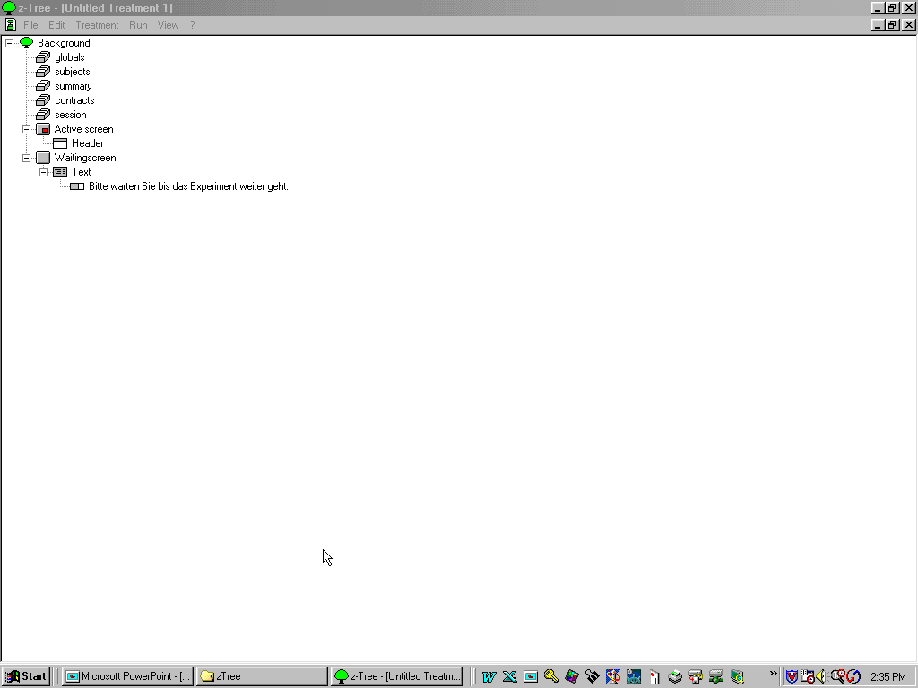
The common elements of all stages may be inserted and defined in the “Background.” The programs of the background are run at the beginning of a period. They are used for defining constants. In the background itself, when you double click it, some central parameters of the treatments can be viewed and changed.
Go ahead and double click on the tree icon titled Background.

Slide 6
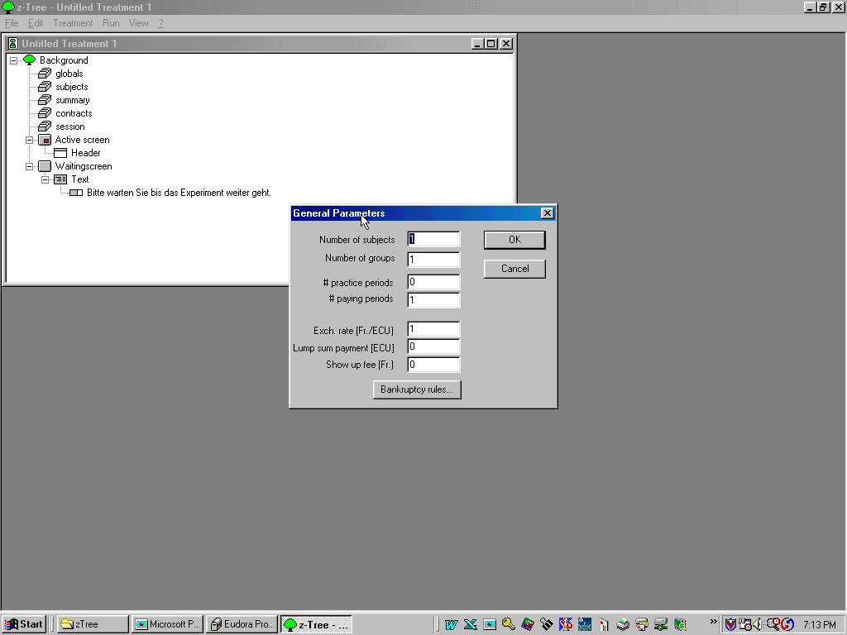

Slide 7
Number of subjects: This number is constant for the entire session. Therefore, all treatments must have the same number of subjects.
Number of groups: Number of groups to which subjects are assigned. Group matching may be variable or fixed.
Number of trial periods: Number of periods for which no pay is earned. The number entered may be negative, in which case the period counter starts later. If, for instance, the number of trial periods is -2 and the number of paying periods is 10, then the treatment extends from period 3 to 10.
Number of paying periods:Number of periods in which subjects are paid.

Slide 8
Exchange Rate: Amount in $ per experimental token earned.
Lump sum payment: # of tokens credited at the beginning of period 1 of the treatment.
Show up fee: credited at the start of the session
Bankruptcy rules: What to do if the subject is starting to lose money.

Slide 9
Preparing Clients

Slide 10
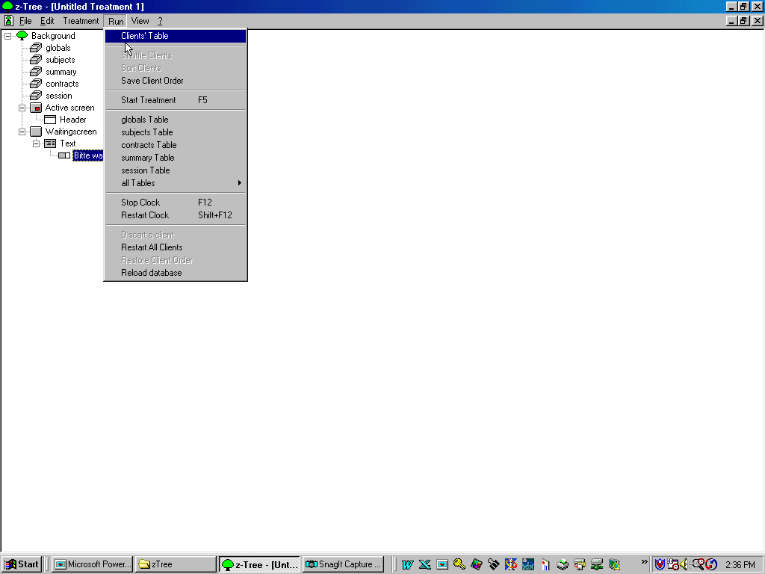

Slide 11
Creating Clients
Step 1: Find the IP address of the server
Go to computer from which you are running the server program
Find IP address: Go to start menu, click on run
Type cmd
In the DOS window, type ‘ipconfig’
Step 2: Make as many zLeaf shortcuts as you need clients
Click on the zLeaf icon with the right mouse button. Make a shortcut. Then copy with CTRL-C. Then CTRL-V. Repeat as many times as you need.

Slide 12
Step 3: Give the clients different names
Click once on each zLeaf shortcut name. Change it to whatever you want.
Click once the zLeaf shortcut icon with the RIGHT mouse button. On the menu, choose properties.
In ‘target’, enter /name new_name
Step 4: Give the clients the IP address of the server and set language
COMMAND LINE OPTIONS:
In ‘target’
zleaf /language en /name client2 /server adr /size width x height

Slide 13
The interface elements
Let’s look again at our zTree code.
All elements of the treatment are arranged hierarchically in a code. The basic objects are Stages. Stages contain programs and screens, screens contain boxes, and boxes contain items.

Slide 14
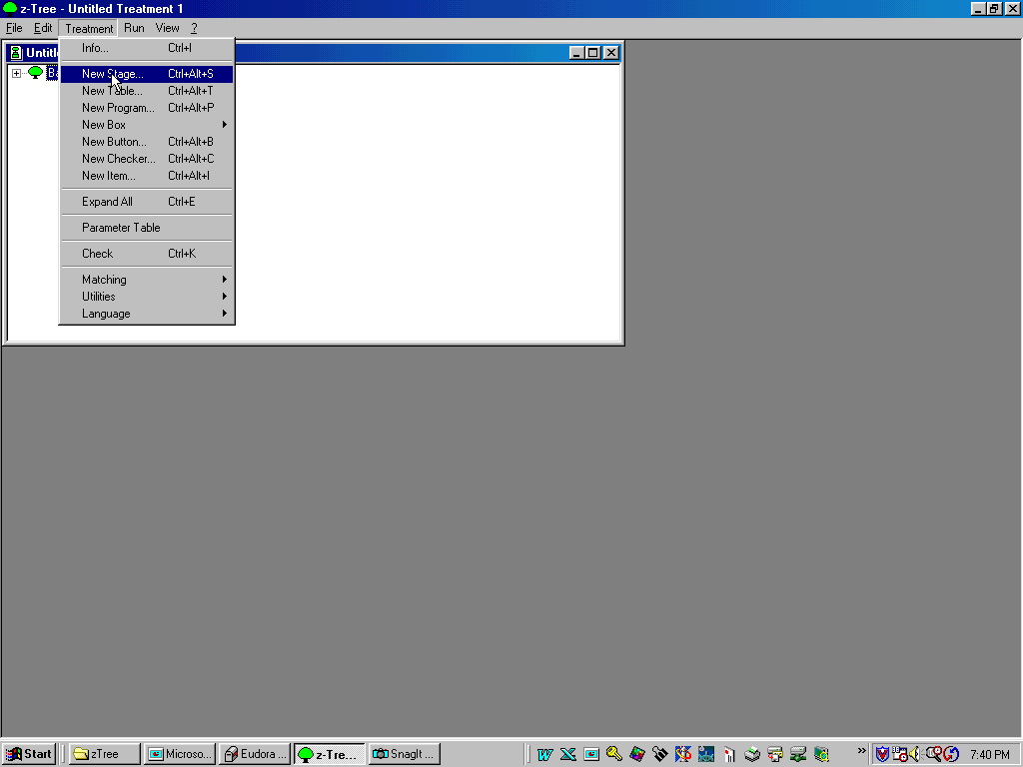

Slide 15
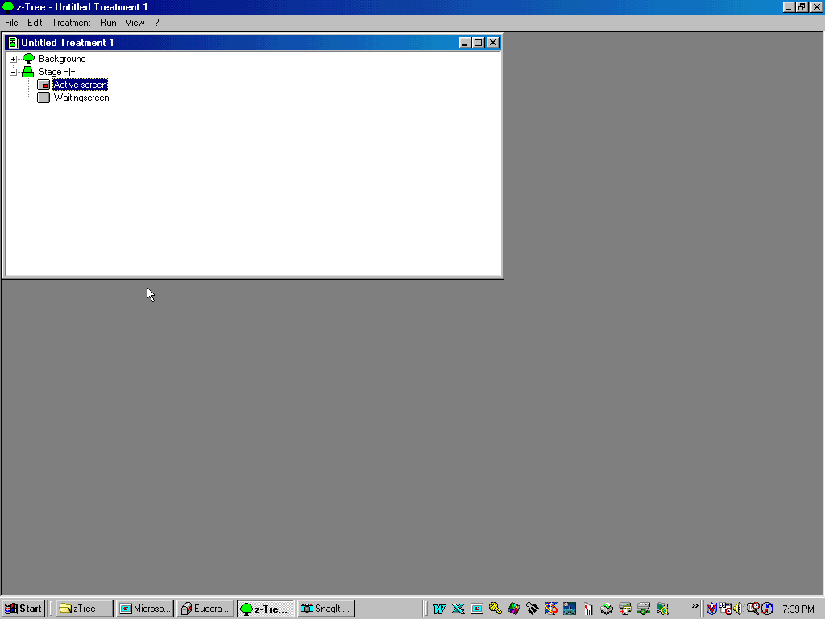

Slide 16
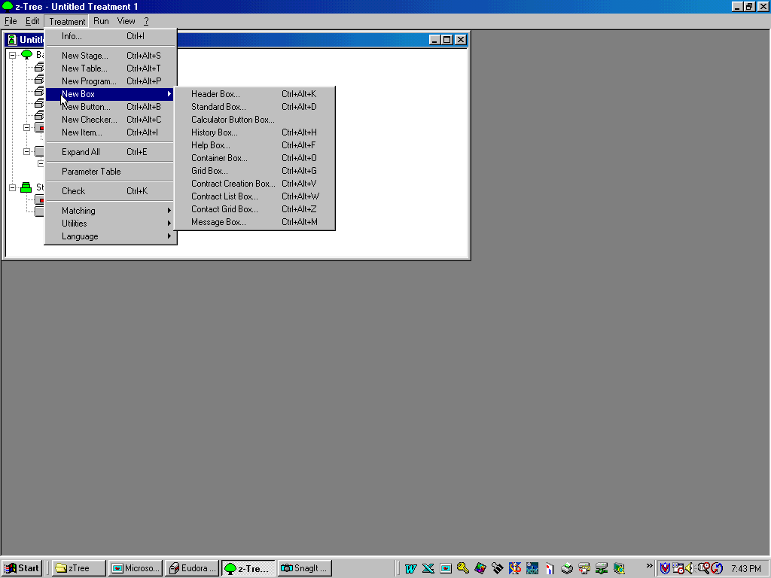

Slide 17
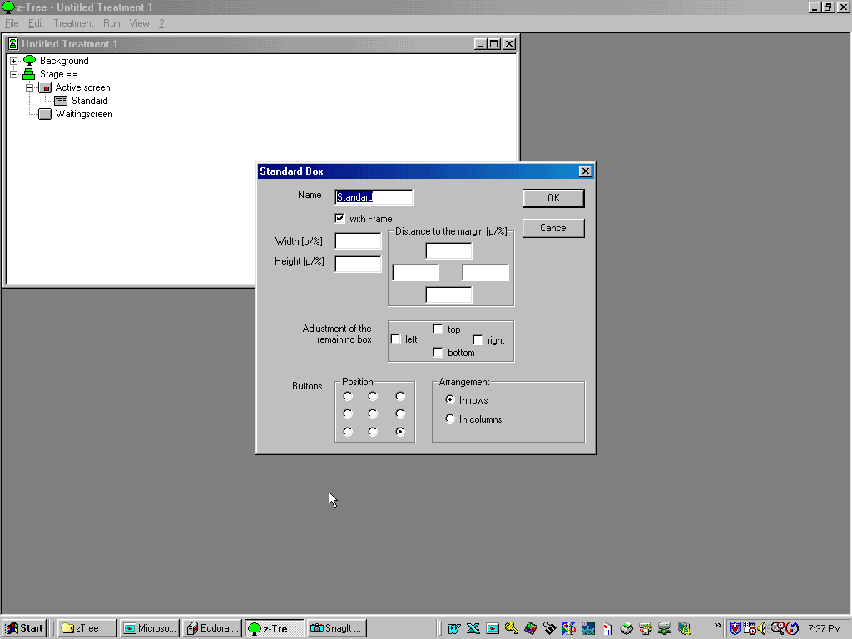

Slide 18
Interface elements:
BOXES:
1. Help Box
2. Header Box
3. Standard Box
The subjects’ screens are made up of boxes. These are rectangular parts of the screen. The boxes are positioned within the “remaining box” in the order in which they appear in the stage tree. In the beginning,the “remaining box”constitutes the whole screen. It is later adjusted according to the definition of the boxes.

Slide 19
Name: For documentation only
With frame: Is there a frame a round the box.
Width: In pixels or percent
Height: Same
Dist to margin: In pixels or percent
Adjustment: Where is the remaining box cut-off, if at all.

Slide 20
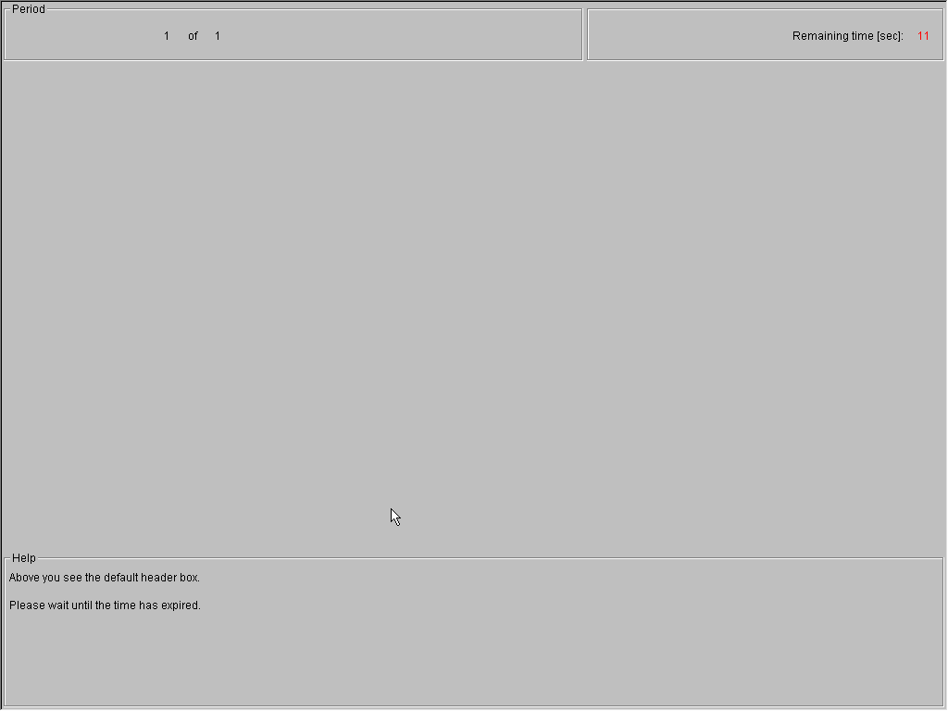
The Header Box

Slide 21
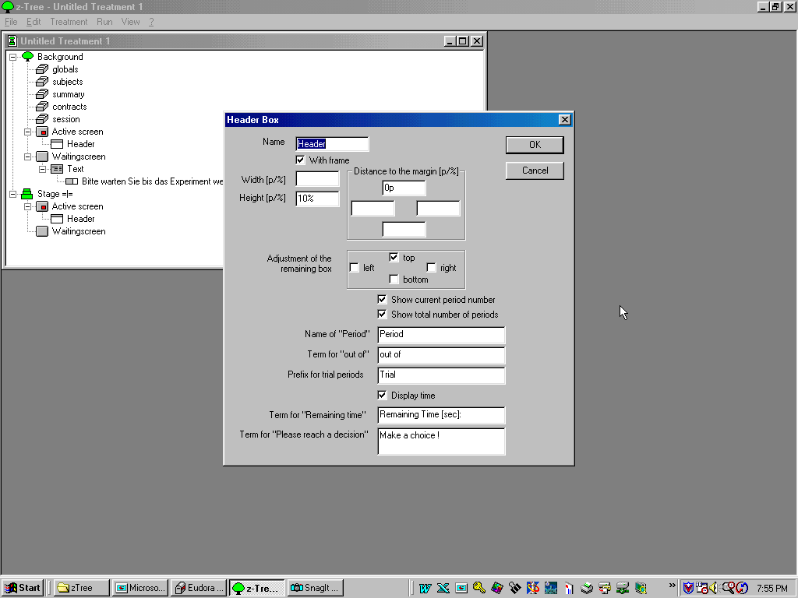

Slide 22
ITEMS in Boxes:
radio
radioline
checkbox
slider
scrollbar
text
OTHER: Checker, Button, History, Grid, Container Boxes.

Slide 23
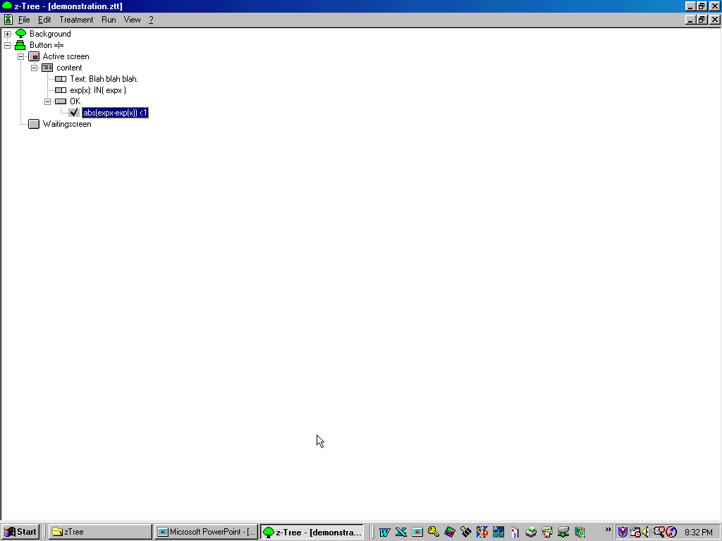
Text, input, Button, and Checker

Slide 24
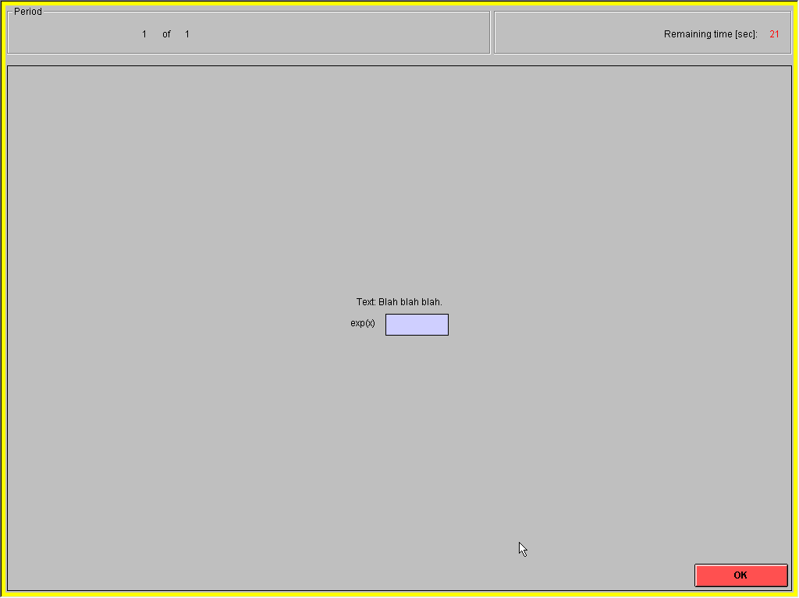

Slide 25
Your first zTree program
1. Click on zTree
2. Put your cursor on the globals icon.
3. Go to the menu item Treatment, choose New Stage. Click OK
4. Put the Mouse cursor on the Active Screen icon
5. Go to Treatment and choose New Box. Then Standard. Click OK.
6. Put the Mouse cursor on the Standard icon
7. Go to Treatment and choose New Button. Then click OK.
8. Find the client (zLeaf) you created. Click.
9. Once the Leaf appears on the screen, go to the Tree, go to Run on the menu, and click Start Treatment. Congratulations.
10. Click OK on your first program.

Slide 26
TABLES
Information on the state of the experiment is stored in a database. The database consists of tables. The lines of a table are called records.
There are four types of tables:
1. Subjects - contains a record for each subject. The variables Period, Subject, Group, Profit, TotalProfit, and Particpate are always defined.
2. Globals: Variables that don’t change over subjects.
3. Summary - An overview of the game. One entry per period.
4. Contracts - Mainly for market experiments. No need today.

Slide 27
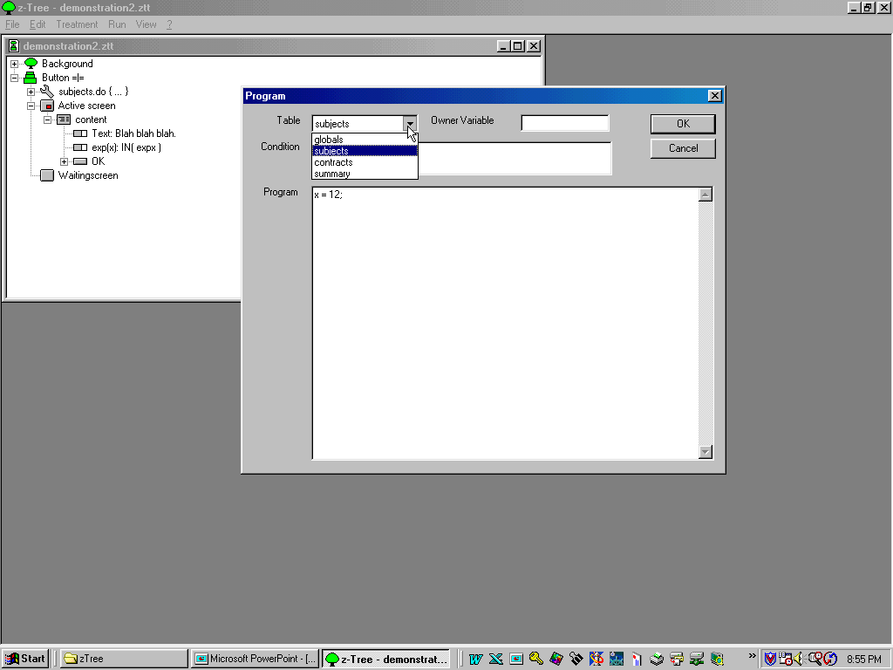
TABLES

Slide 28
zTree Data Files
Quit zTree by pressing Alt-F4. Then look at your zTree directory. Identify the xls file and open it. You will see lines corresponding to the four tables we just named.
The data is stored in files. The names of the files consist of data and starting time. During a session that starts on Dec 7, 2000 at 8:36pm, the following files are created:
001207UH.pay - names and profits of subjects.
001207UH.adr - addresses of the subjects
001207UH.xls - all tables that were shown during the session. The MAIN file for data analysis.
001207UH.sbj - Answers to questionnaires and the roles that were played. Without names.
001207UH.gsf - GameSafe in binary form.

