Slide 1
zTree Workshop:
Fundamentals of zTree
Justin Esarey
Florida State University
Department of Political Science
July 11th, 2005

Slide 2
What is zTree?
Zurich Toolbox for Readymade Economic Experiments
Consists of two programs
  zTree (the programming environment and experiment server)
  zLeaf (the client program for subjects)
Designed primarily for public goods games, structured bargaining experiments, posted-offer-markets and double auctions

Slide 3
What You Will Need to Program in zTree
zTree and zLeaf Programs (zTree.exe and zLeaf.exe)
  Available at http://www.som.yale.edu/faculty/Sunder/ExperimentalEconomics/ExpEcon.html
zTree Tutorial Manual (ztree21tutorial.pdf)
  A “guided tour” of zTree’s capabilities; more instructional
zTree Reference Manual (ztree21ref.pdf)
  An organized reference of zTree code

Slide 4
Readings to Do
Today
  Basic Experiments and Questionnaires (Tutorial pp. 7-16, 77-81)
Tomorrow
  Running Experiments and Recovering Data (Tutorial pp. 83-89)
  Functions and Control Structures (Tutorial pp. 17-41)

Slide 5
Programming A Simple Public Goods Game
Recall the idea of a Public Goods Game:
  Some group of people, size N, receive an endowment of money
  Every person chooses some proportion of their endowment to contribute
  Total contributions are multiplied by X > 1, then everyone receives that amount back
  Total payoff = (Endowment – Contribution) + (X * Total Contributions) / N

Slide 6
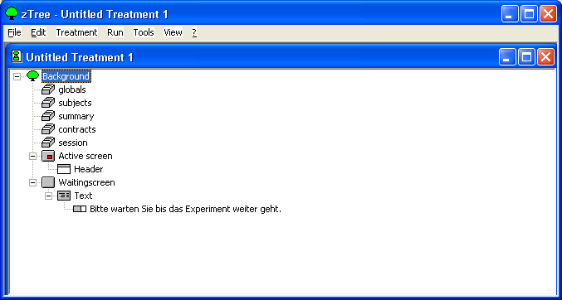
Opening zTree
Es ist nicht englisch!

Slide 7
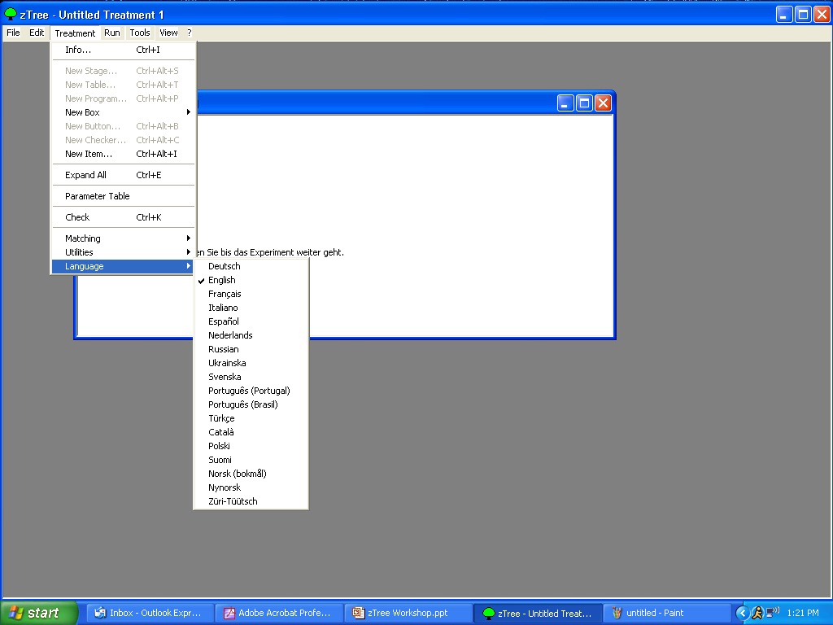
Changing the language setting will not affect currently open treatments. You need to open a new treatment to have the defaults set to English.
You must change the language setting every time you open zTree, even if your program was written under the “English” setting, because otherwise server messages will display in German when you run the program.

Slide 8
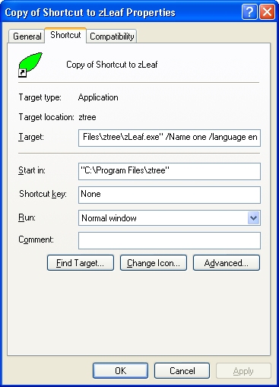
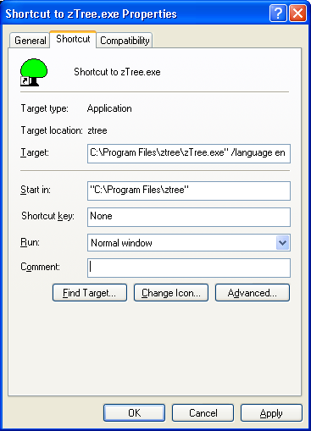
Setting Language by Default

Slide 9
Stages of a Simple Public Goods Game
Subjects are broken into groups of N
Subjects receive their endowment
Subjects make a choice for contribution
Calculate the size of the total public contribution and multiply by X
Report earnings (endowment kept + share of the public good) to all subjects
(Repeat?)

Slide 10
Terminology
Stage: In an experiment, one screen display on which a subject can take one or a few actions
Treatment: A related series of stages through which subjects pass; can be repeating
Session: A series of treatments all performed on the same subjects in sequence

Slide 11
Stages of a Simple Public Goods Game
Subjects are broken into groups of N
Subjects receive their endowment
Subjects make a choice for contribution
Calculate the size of the total public contribution and multiply by X
Report earnings (endowment kept + share of the public good) to all subjects
Background Stage
Stage 1
Stage 2

Slide 12
More Terminology
Program: A set of procedures used to assign variables, calculate payoffs, store information, etc.
Active Screen: The screen on which subjects see information and make decisions
Waiting Screen: A “placeholder” screen that subjects see after they make decisions in a stage and are waiting for other subjects to finish the stage

Slide 13
Stages of a Simple Public Goods Game
Subjects are broken into groups of N
Subjects receive their endowment
Subjects make a choice for contribution
Calculate the size of the total public contribution and multiply by X
Report earnings (endowment kept + share of the public good) to all subjects
program
program
Background Stage
active screen
Stage 1
program
active screen
Stage 2

Slide 14
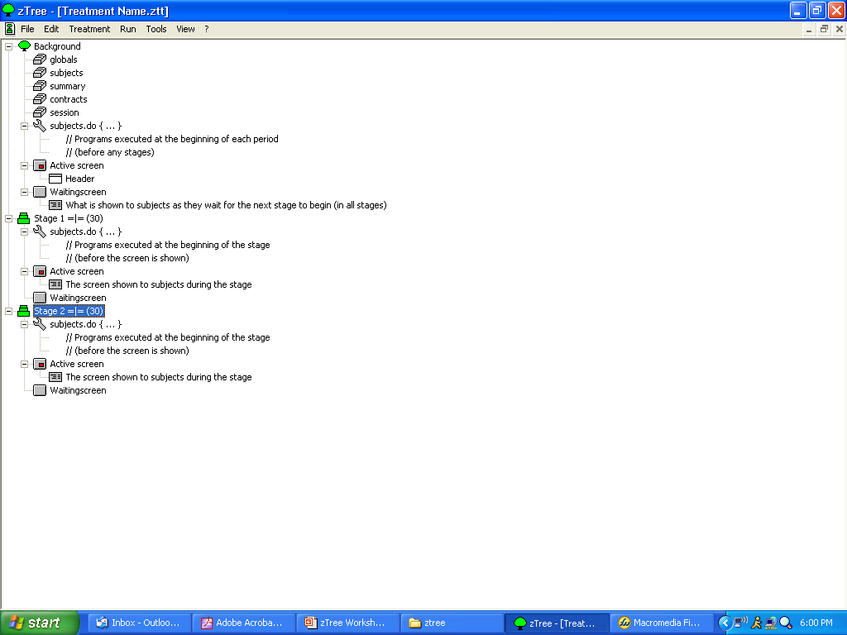
Order
of
Execution

Slide 15
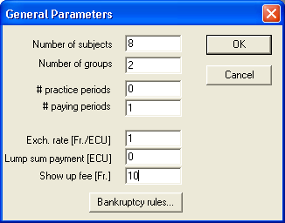
Step 1: Setting the General Background Parameters
Double-click on Background to show the General Parameters dialog
Set Number of Subjects to the right size (in this case, 8)
Set Number of Groups to the right size (in this case, 2)
Set Practice Periods to 0 (we will discuss this later)
Set Paying Periods to 1 (no repetitions of the treatment)

Slide 16
Setting the Background Parameters (Continued)
Exchange rate
  Most economic experiments involve some form of cash reward
  The reward unit within the program (Experimental Currency Units, or ECUs) can be denominated differently than the cash reward
  We set a 1 ECU = $1 (or “1 Franc”) exchange rate – subjects see their real payoffs during the experiment
Lump Sum Payment: ECUs you give the subject that can change during the experiment (a “bankroll”)
Show-up Fee: Dollars / Francs that are paid at the end of the experiment (XEFS standard is $10)

Slide 17
Step 2: Set Non-General Background Parameters for the Experiment
Think about what variable parameters we have in this experiment…
the number of subjects (gen. background)
the number of periods (gen. background)
X – the “efficiency factor”
the size of the endowment
Set these in a list at the top of the program – makes them easy to change for different treatments

Slide 18
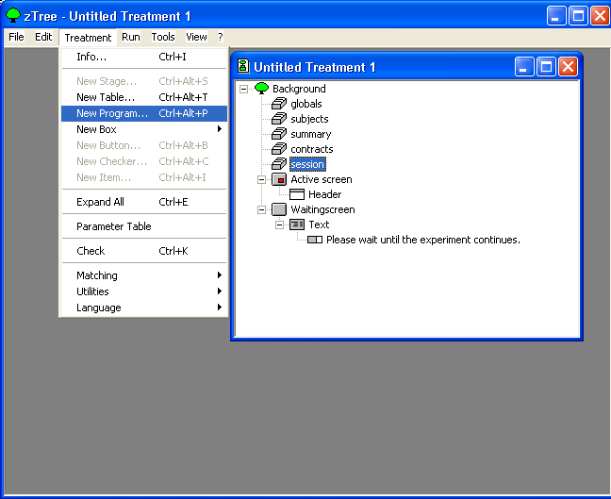
Create a Program to Store the Variables
Place cursor on Session
Select New Program from the Treatment menu

Slide 19
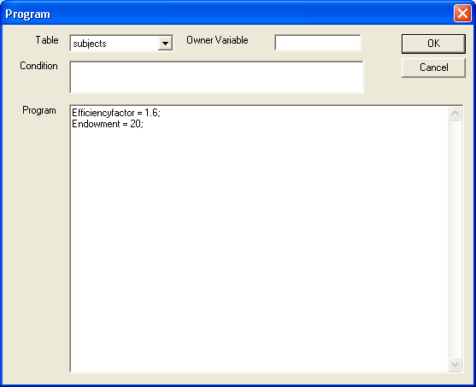
Creating a New Program
Under Table select Subjects
Create two variable names for X and the Endowment
Syntax:
  variablename = {number};
Press OK

Slide 20
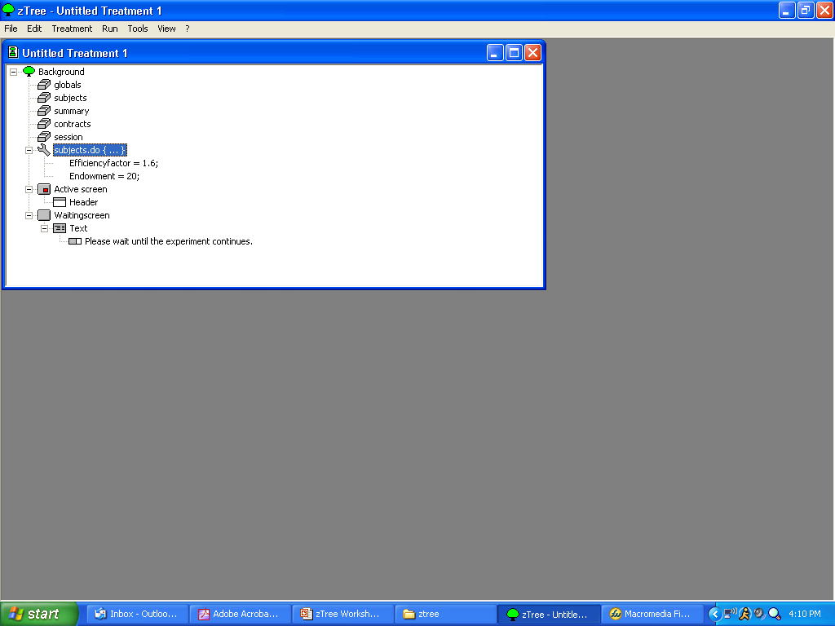

Slide 21
About “Tables” of Variables
zTree stores variables in several different tables:
  Subjects – holds variables that may be different between subjects and between periods (most reliable)
  Globals – holds variables that will be the same for all subjects but may differ between periods (have had trouble with this in the past)
  Summary – like the subjects table, but used to display running statistics of an experiment for the experimenter on the server
  Contracts – holds buy and/or sell offers in auctions
  Session – holds variables that may differ across subjects but persists across treatments
In most cases, the Subjects table is appropriate

Slide 22
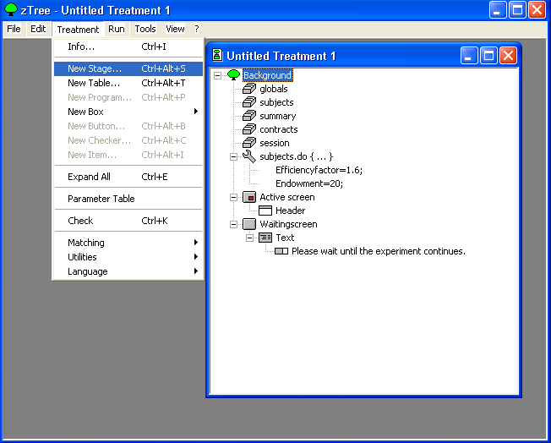
Step 3: Ask Subjects for Contributions
Place cursor on Background
Select New Stage from the Treatment menu

Slide 23
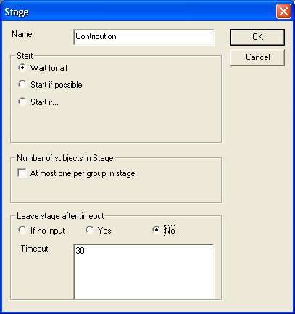
Creating a New Stage
Give the stage a name, like “Contribution”
Under the Start menu, select Wait for all (so that all subjects enter stage together)
Leave At most one… unchecked (used to make choices sequential)
Under Leave stage after timeout, select No (makes time limit non-binding)
Under Timeout, select 30 (seconds)

Slide 24
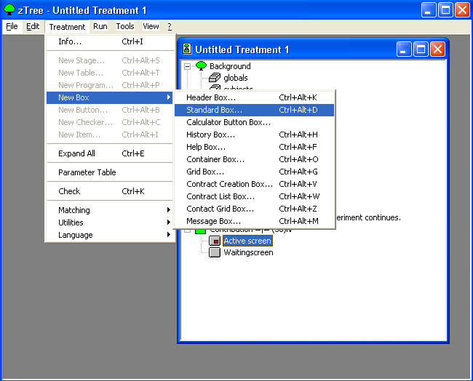
Creating a Screen for Subjects to Enter Contribution
Place cursor on Active Screen
Select New Box→Standard Box from the Treatment menu

Slide 25
Terminology
Box: A container in which text displays and entry buttons are placed on the Active Screen

Slide 26
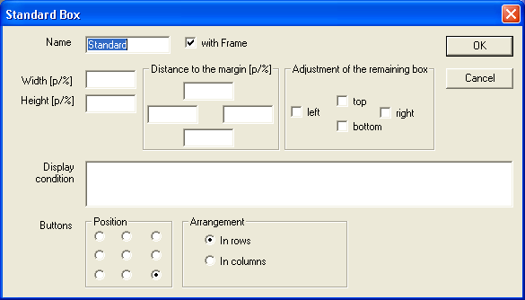
Creating a New Box
1
2
3
4
5
6
7

Slide 27
Legend of Box Creation Screen
Label of the box (not shown to subjects)
Size of the box, in points or percent of the remaining screen
Distance away from the (remaining) screen edge in points or percent
Adjustment of the remaining box (whether to “cut off” the screen above, below, to the left, or to the right of the current box
Display Condition (if present, Boolean expression that must be true in order for box to be shown)
Button Position (where to place buttons in this box)
Arrangement (how to arrange buttons)

Slide 28
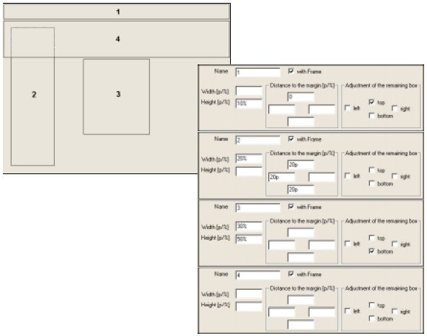

Slide 29
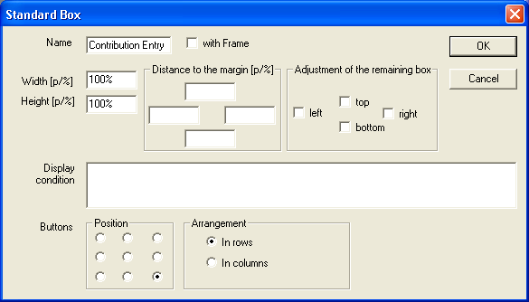
Finishing Creation of The Box

Slide 30
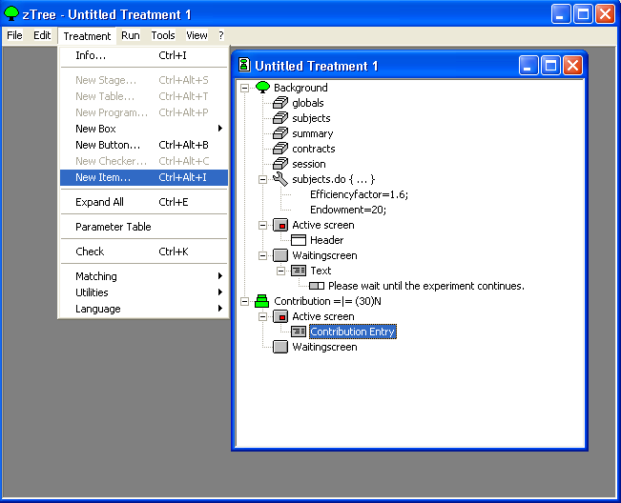
Putting an Item into the Box
Place cursor on Contribution Entry
Select New Item from the Treatment menu

Slide 31
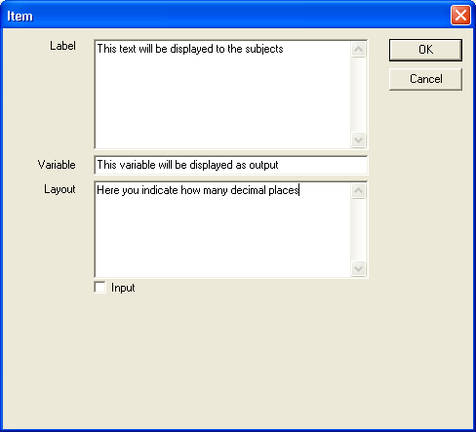
Creating the Text to Display

Slide 32
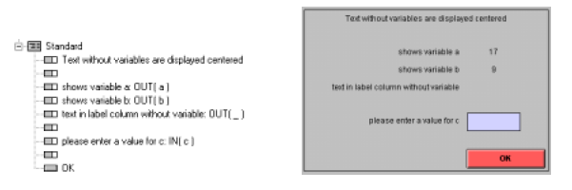
Ways to Display Information in an Item

Slide 33
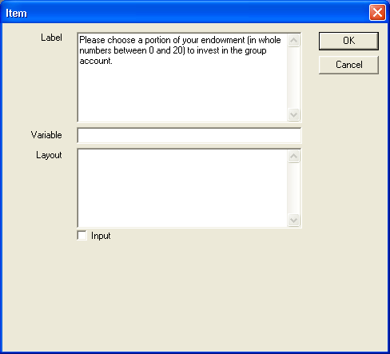
Finishing the Item Text: A Title Box

Slide 34
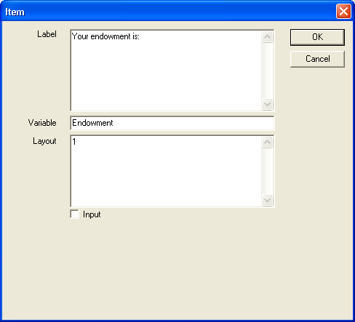
A New Item: Showing the Endowment

Slide 35
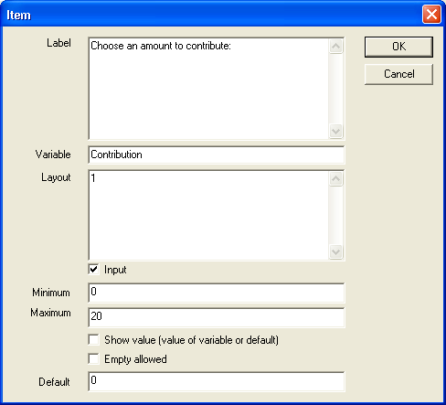
The Final Item: An Input Box for Contribution

Slide 36
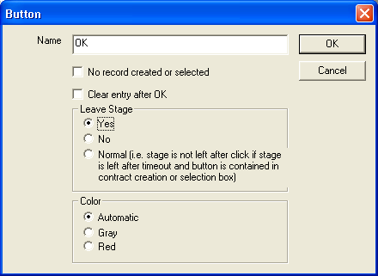
A Button to End the Stage
Place cursor on the last item under Active Screen
Select New Button from the Treatment menu
Set the button as shown

Slide 37
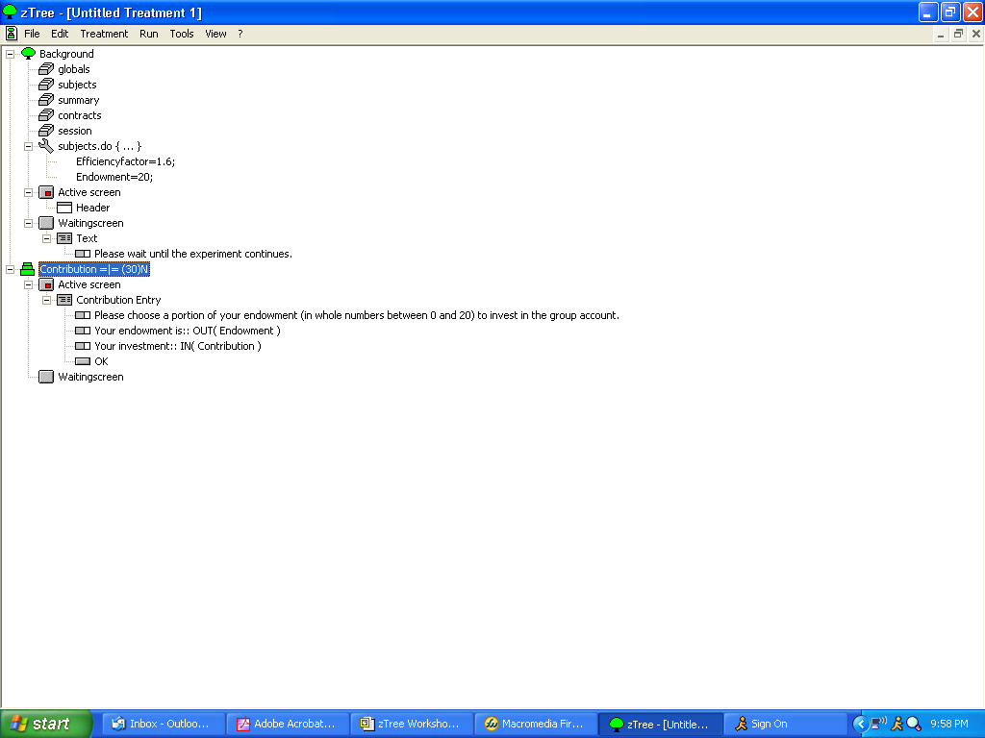

Slide 38
Step 3: Calculate Public Good
Create a new stage, call it “Display Outcomes”
Highlight the new stage, then create a new program
Enter this code into the program:
  Pgood=Efficiencyfactor*sum(same(Group), Contribution);
  Note this command: sum(same(Group), Contribution) – this tells the computer to sum up the variable “Contribution” for everyone in the same Group

Slide 39
More Programs
Create another program under the last one, and enter the following code:
  N = count(same(Group));
  This command tells the computer to count the number of people with the same group number
Create a new program under the last one, and enter this code in:
  Profit = Pgood / N + (Endowment – Contribution);
  Note: Profit is a reserved variable name that zTree uses to record the amount paid to a subject (in ECUs) in every period
Programs MUST be separate: you cannot use a variable created by a program in another expression until the program has been completely executed

Slide 40
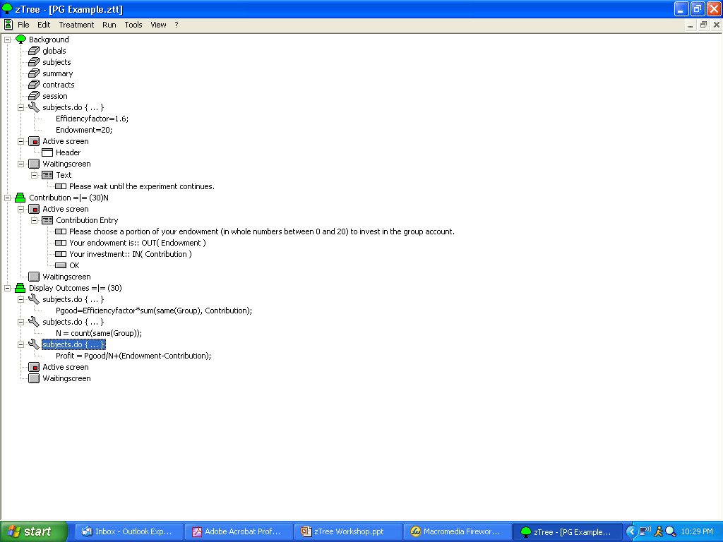

Slide 41
Step 4: Display Outcomes
Create a new Standard box, call it “Final Outcome”
  Set the box to take up the entire screen
Add items to the box:
  Place a title on the results
  Display the amount the subject kept
  Display the amount of the subject’s own contribution
  Display the total contribution of the group
  Display the subject’s share of the contribution
  Display the final earnings of the subject
  Put a button in to leave the stage

Slide 42
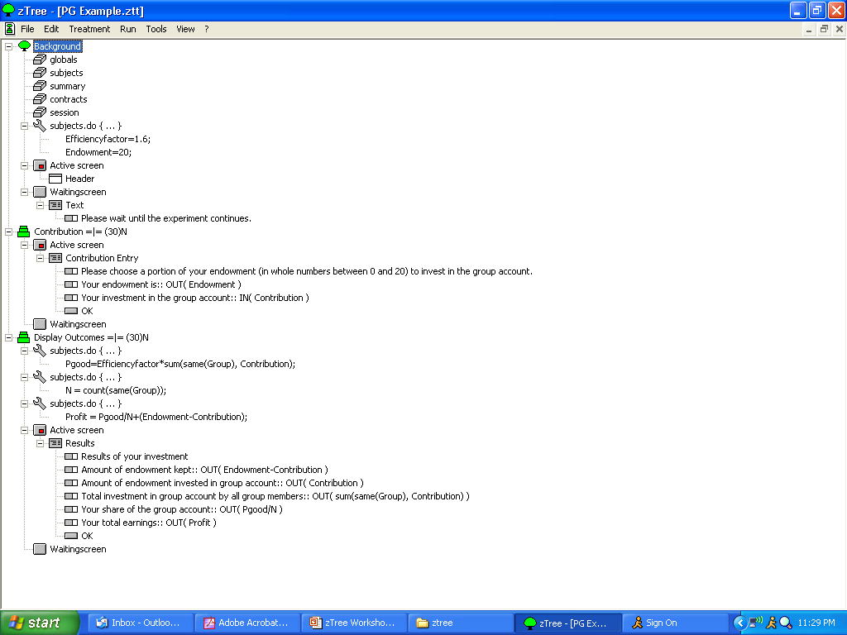

Slide 43
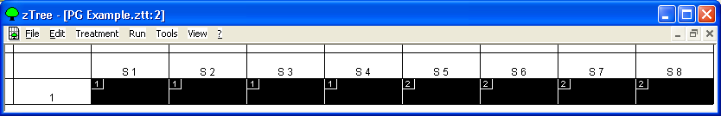
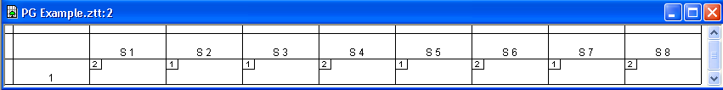
Set Group Matching Protocol
Select Treatment→Parameter Table
Select all of the cells corresponding to the different subjects in Period 1
Select Treatment→Matching→Stranger

Slide 44
That’s It!
Save the file using File→Save
We are now ready to run an experiment

Slide 45
Suggested Homework
Try modifying today’s program into a “Common Pool Resource” Game (Ostrom et al. APSR article, “Covenants With and Without a Sword”)
8 agents have a given number of work hours in a day (say, 10) and can allocate them between harvesting a common pool resource (x) and leisure (10-x)
CPR yields diminishing returns to increasingly intense harvesting
Payoff = x*(23X-.25X^2)+5(10-x), where X=sum(x) over all subjects

Slide 46
Questionnaires

Slide 47
Questionnaires
You must run a questionnaire at the end of an experiment in order to retrieve the data from that experiment
Questionnaires can be simple, just names and social security numbers, or involve more complicated surveys
Today, we will do a simple example of a questionnaire and show more complicated examples later

Slide 48
Create a Questionnaire
Go to File→New Questionnaire
Double-click on “Adress” (the German spelling of Address, I think)

Slide 49
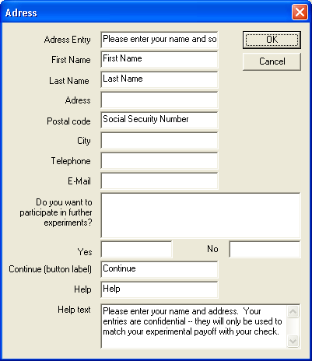
Basic Questions in Questionnaire
What you enter into the blank will correspond to what the header on the answer blank will read; for example, you can use the “Postal Code” blank to gather information about Social Security Numbers
Label on the “OK” Button
Questions left blank will not be asked to the subjects.

Slide 50
Adding a Final Display Screen
Select (single-click) “Adress”, then go to Questionnaire→New Question Form
You can add items to this question form, just like you do with a box in a normal treatment
Typical items to display might include:
  The variable FinalProfit – total earnings from the experiment, not including the show-up fee
  The variable ShowUpFee
Create items (with labels) to display these variables

Slide 51
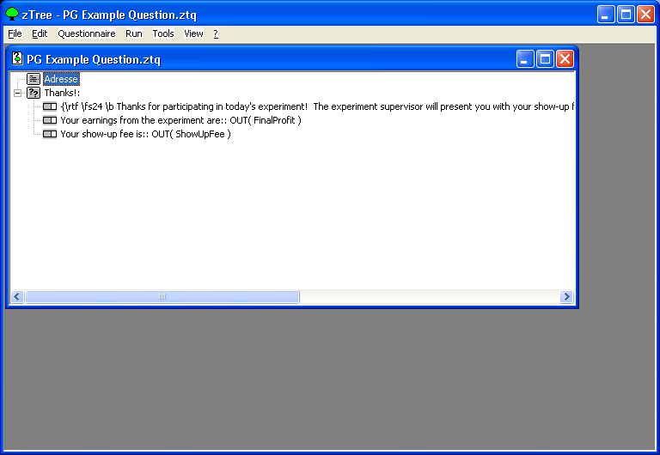
The Final Questionnaire

Slide 52
Running a Session

Slide 53
Running an Experiment
Open zTree and Treatment Files on the Experimenter Server
  Make sure language is set correctly
  Set Matching protocol (if necessary)
Open zLeaf on every Subject computer
  Make sure language and names are set up correctly on zLeaf programs
  Check to make sure clients are connected
Run experiment treatments
  Monitor Subjects table and Clients table
Run questionnaire; read Payment files
Collect data and split tables

Slide 54
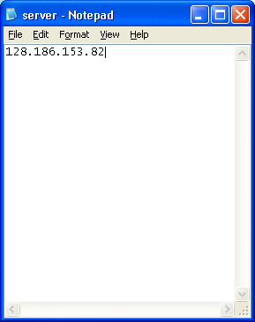
zTree’s Advantage: Easy Networking
All you need to do is open zTree on the experimenter PC first, then open zLeaf on each client PC
Make sure that, in the same directory as zLeaf, there is a notepad file called server.eec with the IP address of the server computer on it

Slide 55
Setting Language and Name on zLeaf
Create a shortcut to the zLeaf on each Subject client
In the Target blank, put in:
  /Name <the desired name>
Put in a different name for each Subject client computer so that you can tell them apart

Slide 56
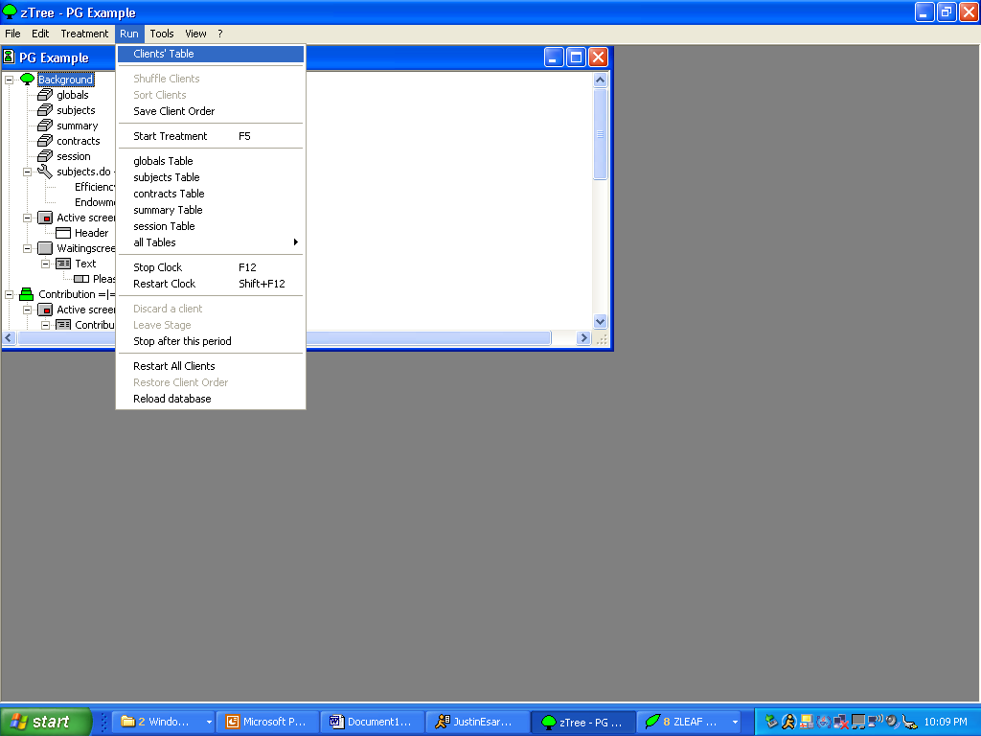
Verifying that Clients are Connected: The Clients Table

Slide 57
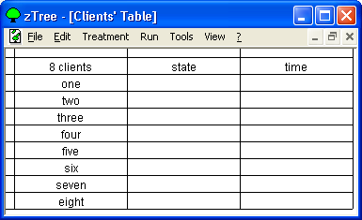
Eight Clients (Named Correctly) Are Connected to this Server

Slide 58
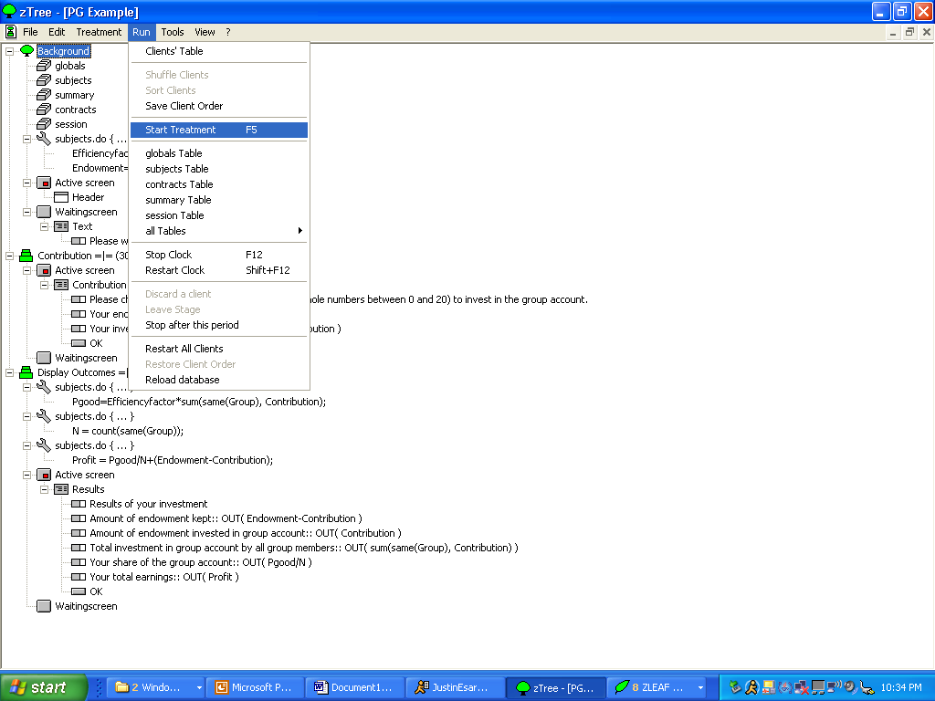
Starting the Treatment

Slide 59
Monitor Subject Progress
The Clients table and the Subjects table provide most of the important information

Slide 60
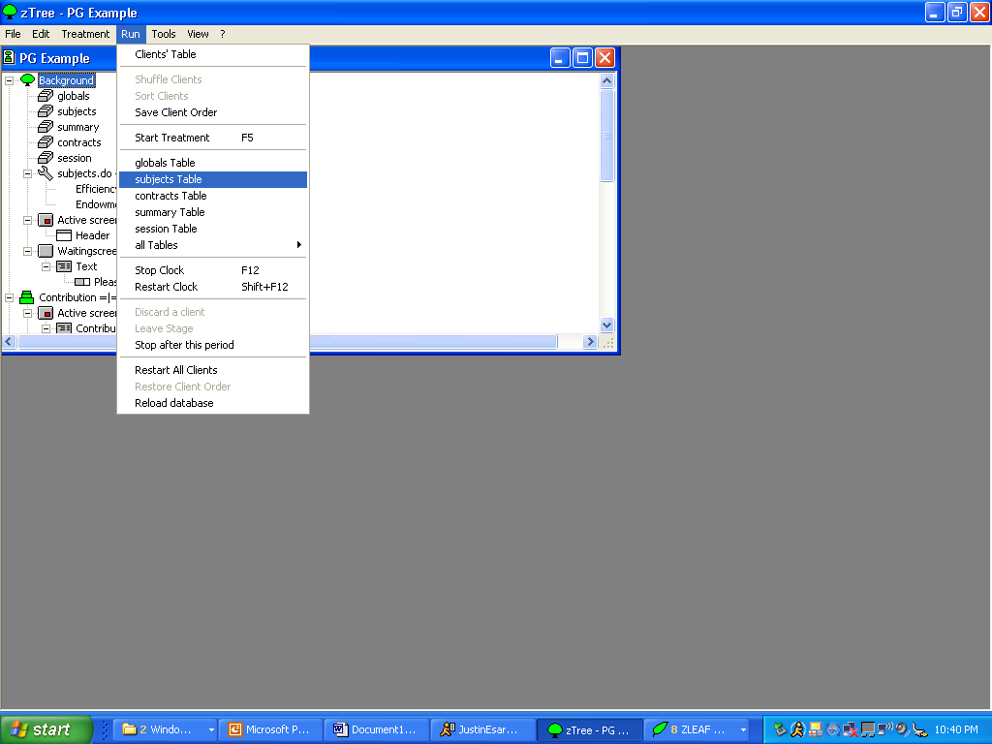
Opening the Subjects Table

Slide 61
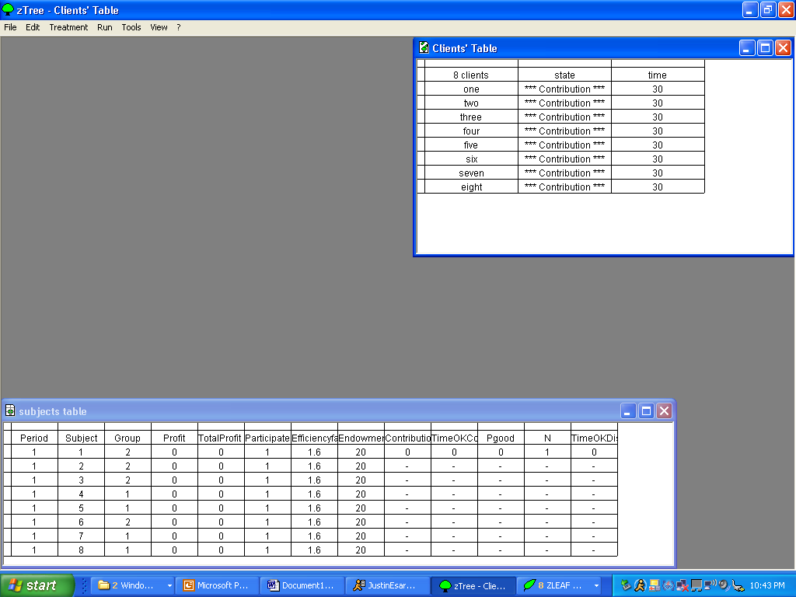
Information in Client and Subject Tables
Time Remaining in Stage
Current Stage that Subject is in
Variable Values for Each Subject

Slide 62
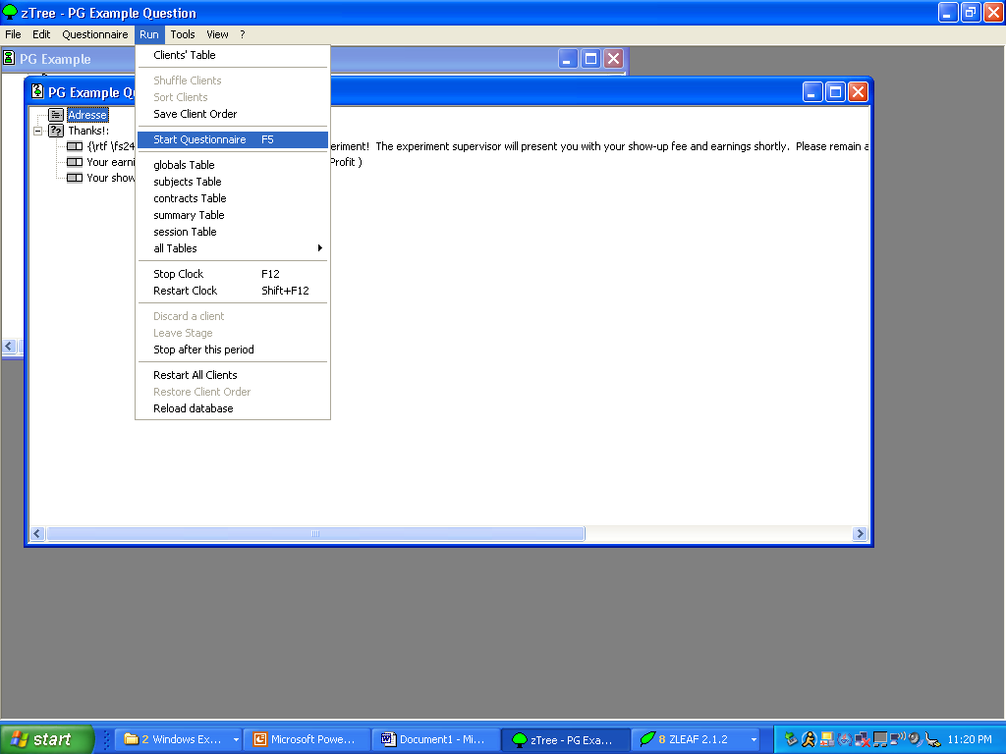
Starting the Questionnaire

Slide 63
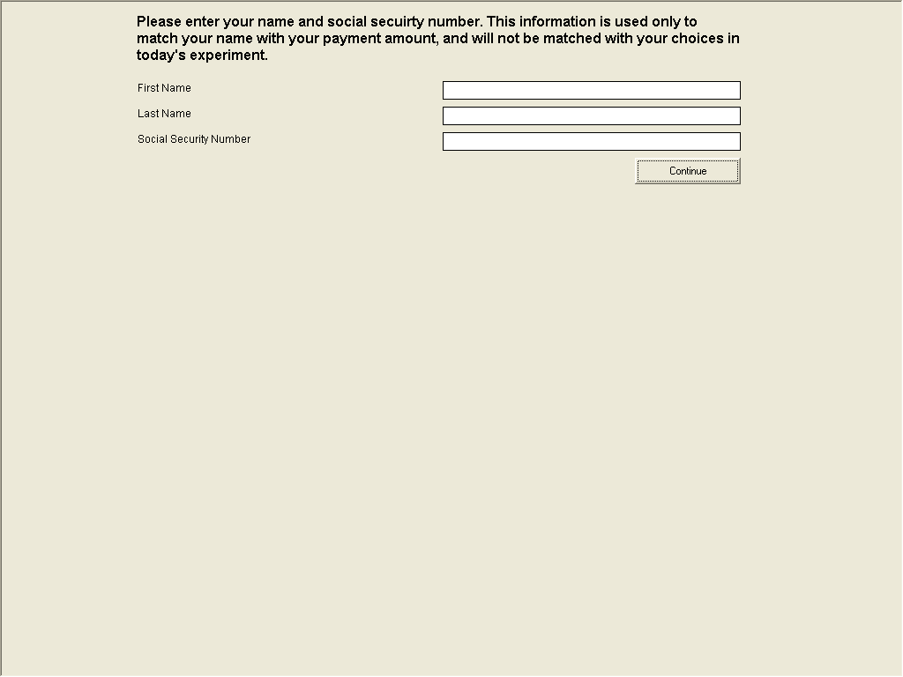
The “Adress” Form Shown

Slide 64
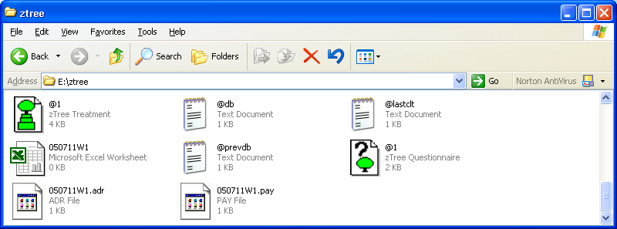
The Payment File
Once every subject has finished the questionnaire (as you can monitor in the Clients table) a payment file will be written
Open this file in Excel to see payoffs

Slide 65
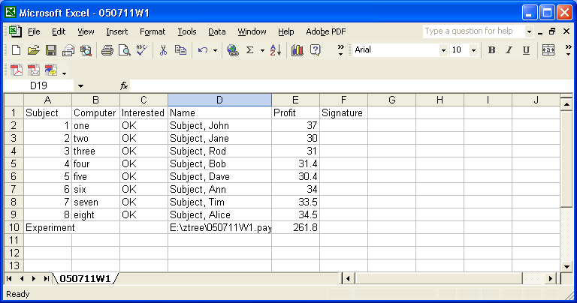
Payment File Details

Slide 66
Collecting and Organizing the Data
zTree names files according to date plus a random code:
  YYMMDDCC.xxx
  Y = Year, M = Month, D = Day, C = code
Several files are of interest
  Subject file: .sbj (Questionnaire answers stored here)
  Gamesafe: .gsf (Internal zTree Storage)
  Collected Tables: .xls (Variables from Treatment)

Slide 67
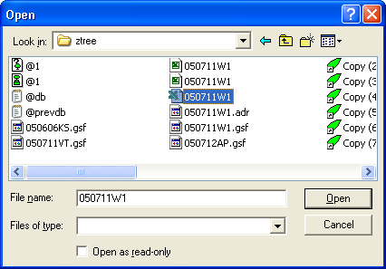
Split Tables/Treatments Apart
Close zTree
Make sure zTree is really closed (use Ctrl-Alt-Delete and close any instances of zTree
Re-open zTree, select Tools→Separate Tables
Select the .xls file from the last treatment

Slide 68
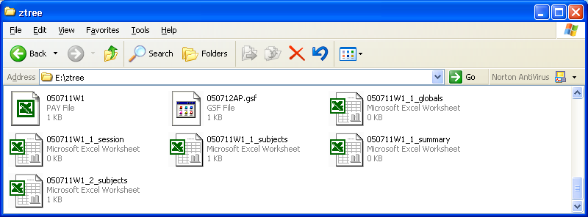
New Files Created
Treatment Number
Table Name

Slide 69
Sample Treatment Run
On your desktop, create a shortcut to zLeaf
Call it /Name <number>, where I give you the number

Slide 70
How can you test programs on your own?
Open your treatment with zTree
Open as many zLeaf Shortcuts on your own computer as necessary to run the treatment
  Name them differently to help differentiate them
Run treatment in zTree as normal, switching among zLeafs (using Alt-Tab) to make entries

Slide 71
More Complicated Programs: Functions and Simple Control Statements

Slide 72
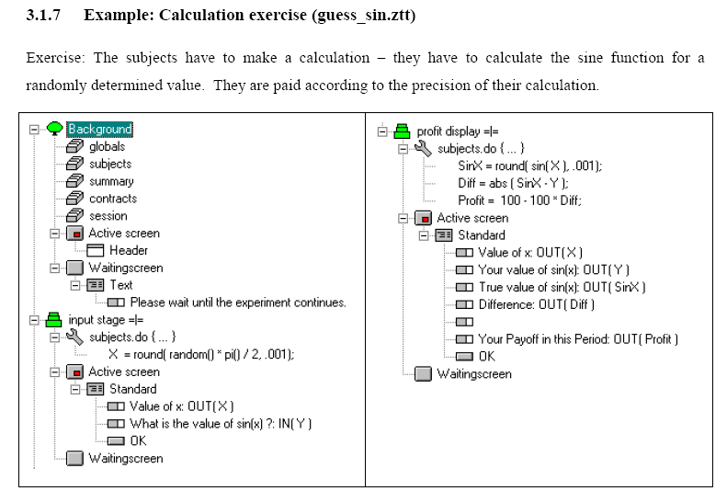
Guess the Sine Function

Slide 73
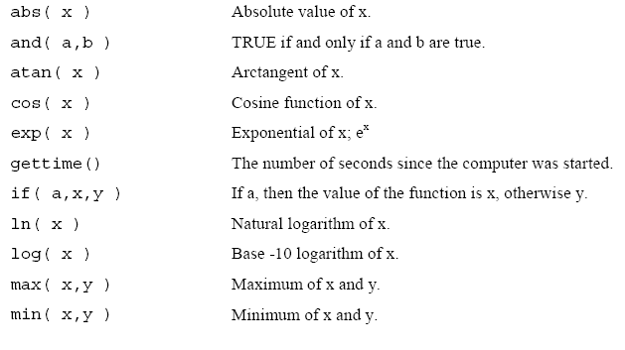
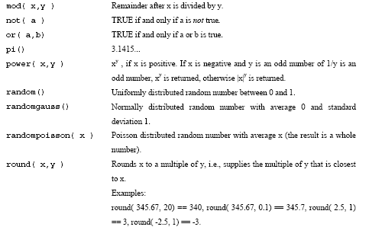
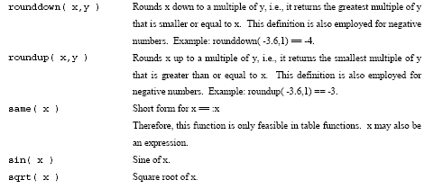
zTree Implements Many Mathematical Functions

Slide 74

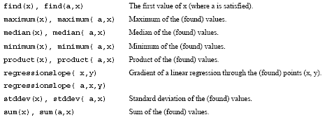
zTree also Implements Many “Table” Functions

Slide 75
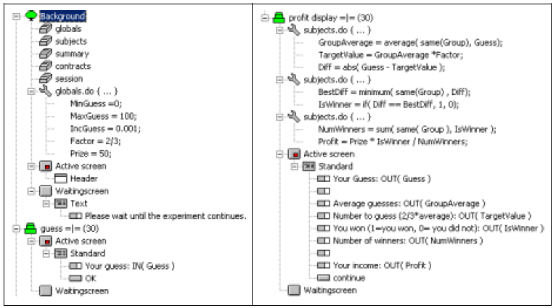
Another Example: A “Guess the Average” Game

Slide 76
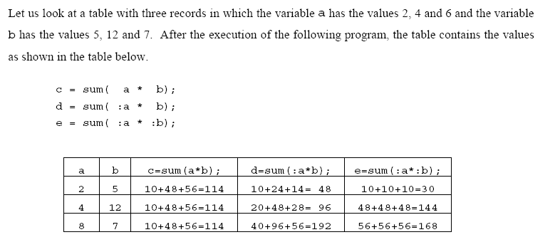
The Scope Operator Within Tables

Slide 77

The Scope Operator Between Tables
Suppose that the above program is being executed in table A, and that there is a variable v present in tables A, B, and C
Note that the syntax B.function() executed in table A draws variables from table B for execution; the scope operator moves the execution to the next higher table

Slide 78
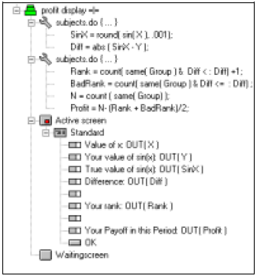
Techniques: Ranking Subjects
Give subjects a rank – ties go to a lower number
Give subjects a rank – ties go to a higher number
In the case of a tie, reward subject according to their “average” rank

Slide 79
Ranking Subjects & the Scope Operator
As the function works through each line of the table, compare the value of Diff for each subject in the table to the value of Diff for the subject on this line

Slide 80
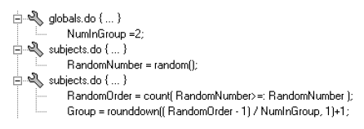
Programming in Group Matching Automatically Using a Function
Rank subjects according to a random variable, then assign them into groups according to their ranks

Slide 81
The Scope Operator Between Tables
Table C
Table B
Table A

Slide 82

Conditional Execution of Programs
You can write programs such that statements are executed only if certain conditions are true
If c is False, do this
Condition
If c is True, do this
(optional)

Slide 83

Example of Conditional Execution
In this case, the value of the variable p is contingent on the period and the identity of the subject

Slide 84
Comparison Symbols (if is case sensitive)
if(x==y)
  If x is equal to y
  MUST be two signs
if(x==y & x==z)
  If “x equals y” AND “x equals z” are both true
if(x==y | x==z)
  If either “x equals y” OR “x equals z” are true
if(x!=y)
  If x is NOT equal to y
if(x>y)
  If x is greater than y
if(x<=y)
  If x is less than or equal y

Slide 85


Entire Programs and Display Boxes Can Also be Conditional

Slide 86

Participation in a Stage can be Conditional

Slide 87
More Complicated Programs: Display Options

Slide 88

Recall Item Layouts Inside of Boxes

Slide 89

Layout Options

Slide 90
In-Class Exercise
Start with game222.ztt
Tasks:
  Make the Choice Variable a binary radio button choice
  Only show the final profit display to the first subject

Slide 91
More Complicated Item Layouts: Displaying Variables in Text
Variable outputs can be displayed in the “label” portion of a label layout
In the “label” portion of the item box, enter code that looks something like this:
Tells program that there will be embedded variables in this text
Regular text
Variable name
Layout
Embedded Variable

Slide 92

An Example of Embedding Variables

Slide 93
Double-Embedding of Variables
This displays the value of Profit if positive and the text “negative” if it is negative
You could have put the variable name Profit in the double-embedding (and I always do), but in this case it is not necessary

Slide 94

Font Size and Formatting in Labels
Label formatting is controlled using RTF tags (rich text formatting)
What will Display
Code

Slide 95

Example of RTF Formatting: Bankruptcy Warning

Slide 96

Embedded Variables and RTF Formatting Tags

Slide 97

Non-Standard Boxes

Slide 98


Grid
Boxes

Slide 99


Help
Boxes

Slide 100


History Boxes

Slide 101


Container Boxes
A Container box holds other, smaller boxes
Use it to easily organize other boxes

Slide 102

Example: Using Container Boxes
Container boxes divide the screen into columns; boxes in the Container divide the column into cells; one item is placed into each box

Slide 103
More Complicated Programs: Arrays and Iterators

Slide 104

Storing Vectors
zTree can store vectors of values by creating array objects
Values for elements of the array are assigned using this syntax: arrayname[i]=1;

Slide 105

Arrays and Iterator Functions
Arrays can be used in conjunction with iterator functions in order to quickly assign a series of values
Iterators repeatedly execute a portion of a program, incrementing the value of a variable as it goes
Iterator statements must be appended to other functions, like “sum” or “do” using a syntax like iterator(i,10).sum(arrayname[i], v)

Slide 106

Example of Iterator Syntax Used with Arrays

Slide 107
Things zTree Cannot do With Arrays
Store matrices (or arrays that have other arrays as elements)
Do matrix multiplication or other matrix operations

Slide 108
More Complicated Programs: Storing Past Histories

Slide 109
Storing Information From Previous Periods
Sometimes, you may wish to present historical information from previous periods to subjects
The problem: zTree only remembers the value of a variable one period prior
  These previous values are stored in a table called OLDtable; so, the previous variables in the subjects table can be called from the table called OLDsubjects

Slide 110

How Can You Maintain a History Longer than One Period?
At the end of the treatment, insert a program like the one at left; this program moves values from multiple periods ago into sequential boxes, finally discarding them after 4 periods
History1 | History2 | History3 | History4
Current Value
1 Period Ago
2 Periods Ago
3 Periods Ago
4 Periods Ago
5 Periods Ago

Slide 111

Histories, Continued
Creating histories with multiple storage boxes means that zTree’s access to one period worth of history is sufficient
Put the following program at the beginning of the treatment:
iterator(i, 14).do {
}

Slide 112
More Complicated Programs: Popup Windows Between Stages

Slide 113
Pauses and Prompts In Programs
Suppose you want a program to pause and bring up a message to the experimenter between phases in an experiment. What do you do?
Open the Parameter Table that we used for Parameter Matching before

Slide 114

Parameter Table
Double click on the Period number at the beginning of which you want the computer to pause

Slide 115

Period Prompts: The Dialog Box

Slide 116
In-Class Assignment
Work with some pre-programmed treatments I wrote for experimental programs
  Grouped Public Goods (Ahn Isaac and Salmon)
  Endogenous Tax Choice (Barrilleaux Esarey and Salmon)
  Endogenous Network Creation (Ahn Esarey and Scholz)

