Slide 1
Investigating the relation between production and comprehension
Session 6
Vinicius Macuch Silva
Cognitive Modeling group

Slide 2
Production-comprehension cycle
Percepts
Phonology
Semantics
Syntax
Signal
Phonology
Motor commands

Slide 3
Production and comprehension in dialogue processing
Dialogue processing > nature of the mental lexicon
Mental lexicon > fixed resource
How do language users put this knowledge to use?
Acquisition <> Processing
Small units (words or morphemes)

Slide 4
Production and comprehension in dialogue processing
Fixed and semi-fixed constructions
Meanings established through conversation
Routinization
Complex expressions and traditional lexical units
Lexicon > constant, dynamic updating

Slide 5
Dialogue as alignment
Mechanistic psychology of dialogue > interactive-alignment account of dialogue
Success in conversation > aligned situation models
Situation models > space, time, causality, intentionality, character identity
Similar representations

Slide 6
Dialogue as alignment
Alignment as an automatic processs
Conversation pressures > little “other modeling”
Aligned representations at all levels of representation
Alignment at one level is enhanced by alignment at another level

Slide 7
Dialogue as alignment
Interlocutors converge on particular referring expressions (Garrod & Anderson, 1987)
Interlocutors mirror each others' [idiosyncratic] descriptions (Brenann & Clark, 1996)
Retain distinctions when no longer needed
Interlocutors are primed by each other to employ the same form
Priming btw comprehension and production > parity

Slide 8
Dialogue as alignment
Interlocutors align syntactically
the cricketer giving the plate to the diver vs. the cricketer giving the diver the plate (Branigan et al., 2000)
Repetitions of lexical items and semantic relations btw lexical items enhance syntactic priming
the nun giving the book to the clown > the cowboy giving the banana to the burglar vs. the cowboy handing the banana to the burglar (Branigan et al., 2000)
the sheep that's red (vs. the red sheep) > the goat that's red vs. the book that's red (Cleland & Pickering, 2000)

Slide 9
Interactive alignment and routinization
Repeated expressions > routine in dialogue (Pickering & Garrod, 2004)
Fixed expression (fixed lexical meaning, possibly semi-productive)
Stock phrases, idioms, cliches > routines
Routines established for the purposes of a particular exchange
Experimental elicitation

Slide 10
Interactive alignment and routinization
Interactive alignment > priming of different levels of representation and the links thereof
Strong activation > routinization
New memory traces associated with an expression
Lexicalized

Slide 11
Interactive alignment and routinization
[Jackendoff, 2002] Linguistic representations - Either stored and accessed online or constructed online
Stored and accessed online > lexical item
Traditional lexical item > phonological-syntactic mapping mapped onto semantic/ conceptual representation
Complex lexical items (fixed or semi-productive idioms) > partial mappings

Slide 12
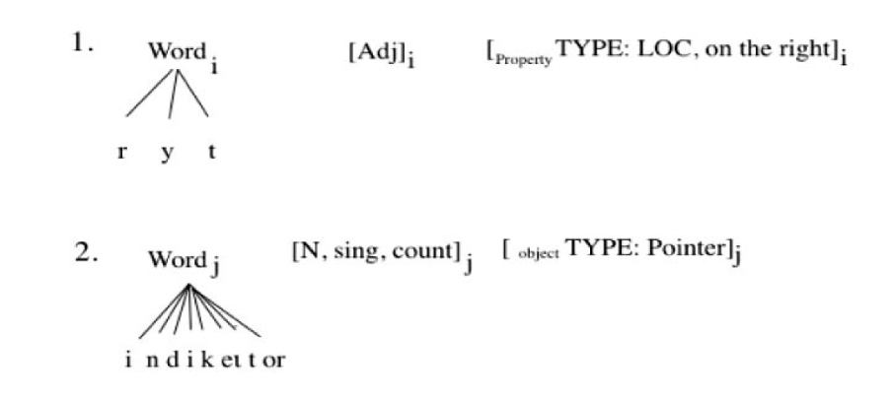

Slide 13
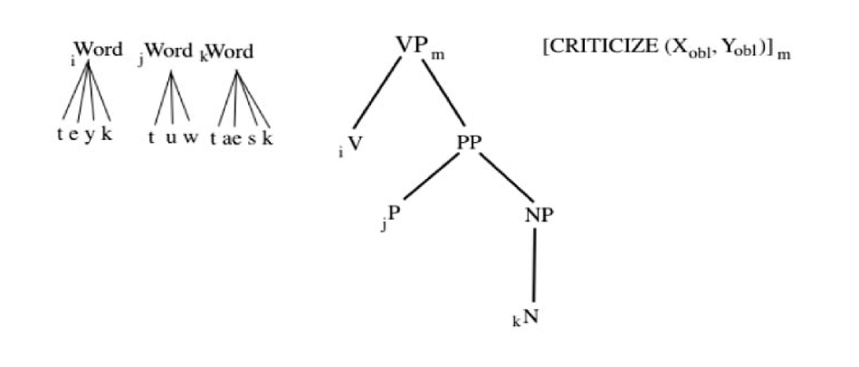

Slide 14
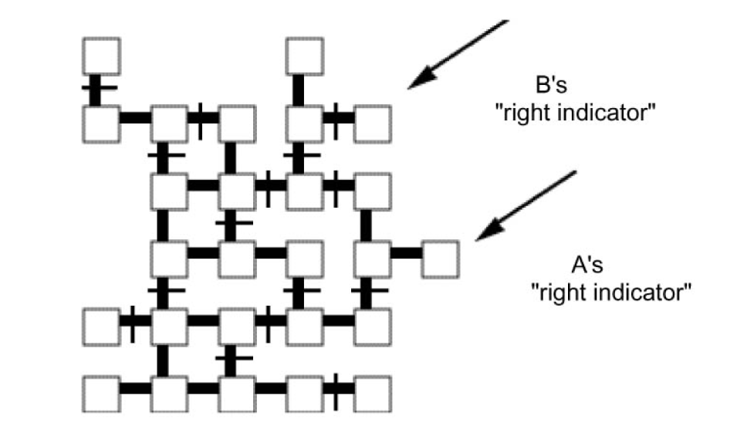
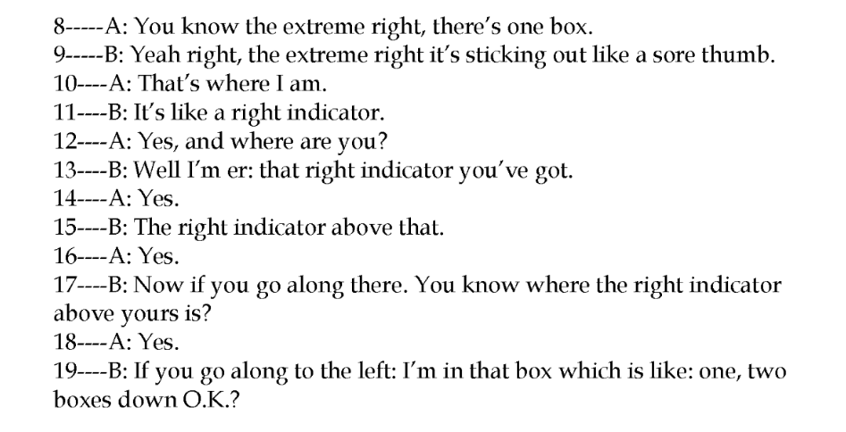

Slide 15
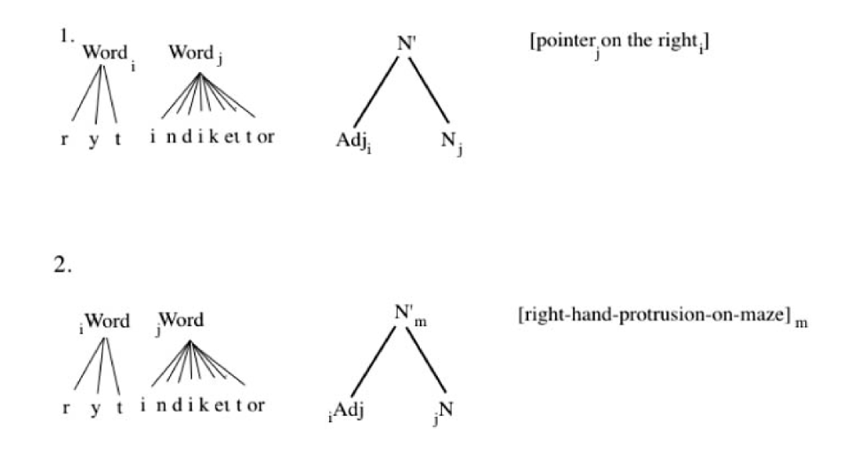

Slide 16
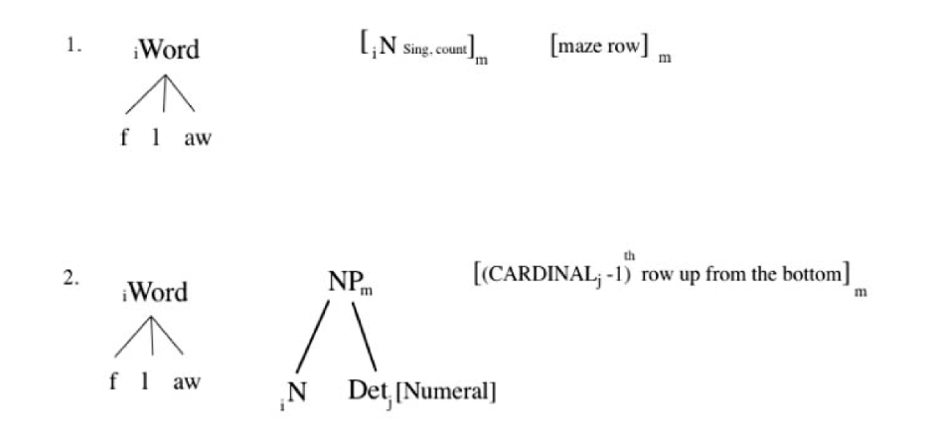

Slide 17
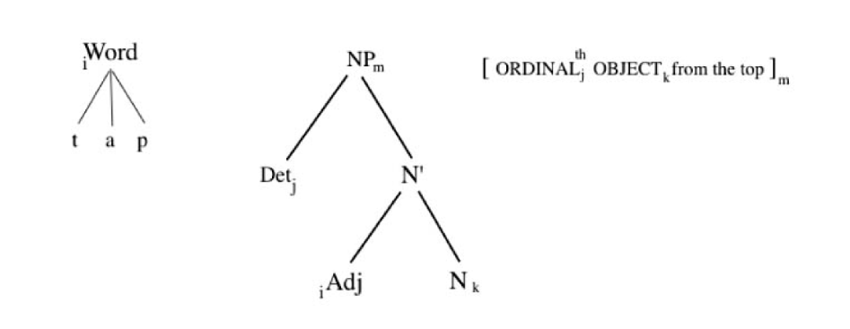

Slide 18
Interactive alignment and routinization
Routinization > positing of links btw different representational levels
Routines > partly or completely fixed interpretations at multiple levels
Prediction > choice difficulty in the presence of multiple alternatives is reduced when expression becomes a routine

Slide 19
Implications of routinization
Routines can persist beyond individual exchanges (Garrod & Doherty, 1994)
Routinization ≈ processes of language acquisition
Word learning is akin to routinization

