Slide 1
Investigating language comprehension at the discourse level
Session 5
Vinicius Macuch Silva
Cognitive Modeling group

Slide 2
Theories and data
Framework
Gricean pragmatics
Theory
Relevance theory
Data
Reading times

Slide 3
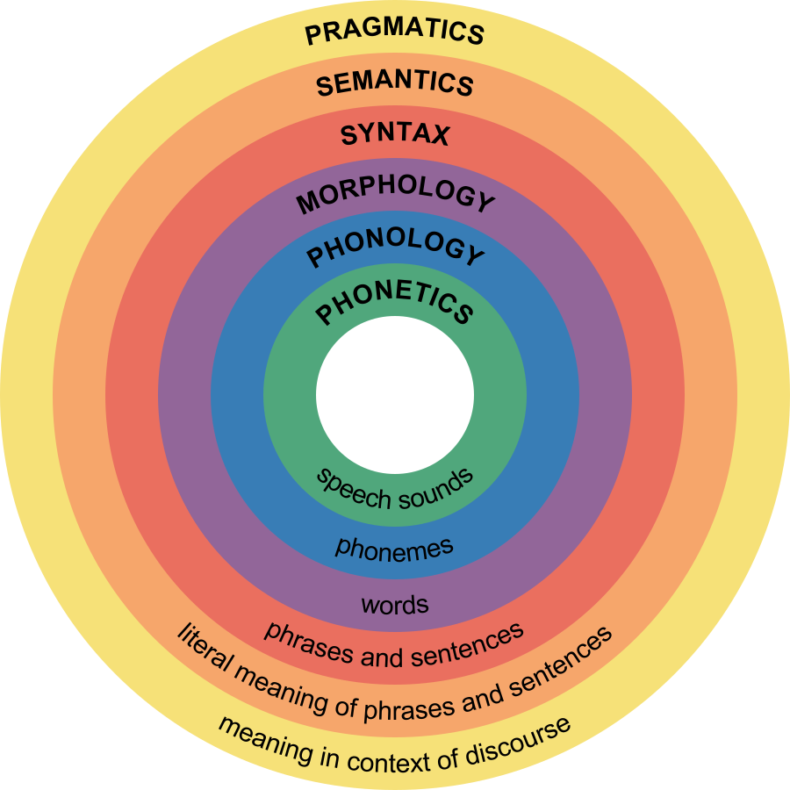
Pragmatics
Implicatures
Information status
Reference
Meaning extension
Prominence

Slide 4
Reference resolution

Slide 5
Reference resolution
An Arab Camel-driver having completed the lading of his Camel, asked him which he would like best, to go up hill or down hill. The poor beast replied, not without a touch of reason: “Why do you ask me? Is it that the level way through the desert is closed?”

Slide 6
Information status
New vs. given referents
Dichotomy (via e.g. definiteness)
Partly new vs. partly given
Givenness continuum
Processing advantage of given over new/ inferred information (Haviland & Clark, 1974)
(a) We got some beer out of the trunk. The beer was warm.
(b) We checked the picnic supplies. The beer was warm.

Slide 7
Referential prominence
Referents are stored in a certain ranked order
Prominence - property btw referents that singles out a referent from the set of referents (i.e. the most prominent referential candidate)
Which features contribute to prominence in discourse?
How do speakers refer to referents of different prominece in ongoing discourse?

Slide 8
Referential prominence
An inverse relation btw the prominence of a referent and the explicitness of a linguistic form used by a speaker
Hearers use form-specific constraints during reference tracking
Centering Theory
Most prominent referent in prior discourse is picked up by a pronoun
George jumped out from behind a tree and frightened Debbie. He was surprised at her hysterical reaction. He/ George never thinks about how others might feel. (Gordon et al., 2003)

Slide 9
Referential prominence
Role of different factors in reference resolution
a single feature determines referential prominence
multiple weighted features
form-specific mappings
Numerous features
Morphosyntactic, grammatical function, linear order, distance, agentivity, animacy, topicality, givenness, coherence structure

Slide 10
Referential prominence
Asymmetry in interpretive preferences for different types of referring expressions
Put the cup on the saucer. Now put it/ that over by the lamp. (Brown-Schimdt et al., 2005)
Given-new ordering (given > new)
On the hospital reception desk are leaning a doctor and a nurse, and it is almost two o'clock. After a moment,
(a) doctor-object glances-at patient-subject (= the patient glanced at the doctor)
(b) doctor-subject glances-at patient-object (= the doctor glanced at the patient)
The patient is holding a pair of scissors. (Kaiser & Trueswell, 2004)

Slide 11
Inferences

Slide 12
Inferences
Speaker's meaning > reconstruction of the speaker's [potential] intentions
Trade-off btw saying as much as one can and no more than is required
The ham sandwich is sitting at Table 20.

Slide 13
Meaning extension
Referential transfer
The woman who ordered the ham sandwich is sitting at Table 20.
Reconceptualization
(a) The ham sandwich wants a coke and #has gone stale.
(b) The ham sandwich wants a coke and asks for the check.
Other cases of meaning transfer
processing cost: container-for-content & animal-for-statue
no processing cost: content-for-container & producer-for-product

Slide 14
Meaning extension
Type shift from object-denoting entity to an event
The girl began the book.
The author began the book.
The girl read the book.
Where does the extra information required for the type shift come from?
Lexicon vs. general inferences and world knowledge
Interplay btw conversational principles of brevity and clarity

Slide 15
Implicature
Inference at a more global level > speaker's intention is inferred from the conversational setting
Scalar implicatures > the more informative meaning evokes processing effort
Are scalar implicatures drawn automatically?
Default accounts (Levinson, Chierchia) > yes, but cancellable (e.g. some, in fact all)
Relevance theory (Sperber & Wilson) > not necessarily, as only contextually relevant meaning is computed

Slide 16
Implicature
(a) Mary asked John whether he intended to host all his relatives in his tiny apartment. John replied that he intended to host some of his relatives. The rest would stay in a nearby hotel.
(b) Mary was surprised to see John cleaning his apartment and she asked the reason why. John told her that he intended to host some of his relatives. The rest would stay in a nearby hotel. (Breheny et al., 2006)

Slide 17
Implicature
Particularized conversational implicature > arise in certain contexts and rely on common ground
Nick and Paul are taking the same history class. Students in this class have to give a 20 minute presentation to the class on some topic. Nick gave his presentation
(a) and then decided to ask Paul what he thought of it.
(b) and it was truly horrible. He decides to ask Paul what he thought of it.
(c) and it was excellent. He decides to ask Paul what he thought of it.
Nick: What did you think of my presentation?
Paul: It's hard to give a good presentation. (Holtgraves, 1998)

Slide 18
The role of underlying principles in meaning interpretation
“Reading between the lines”
General conversational principles that guide linguistic communication
Informativeness > instantiation of the principle of economony and least effort
General model of meaning that uniefies different pragmatic processing phenomena

