Slide 1
Contract Testing In Theory and Practice
Vinod Baradwaj

Slide 2
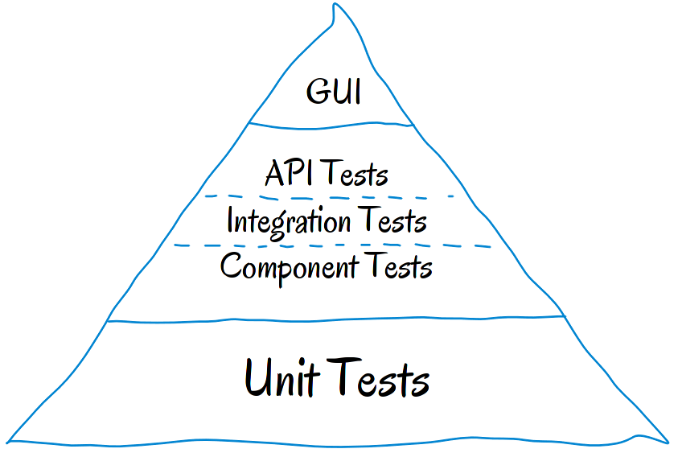
Test Pyramid

Slide 3
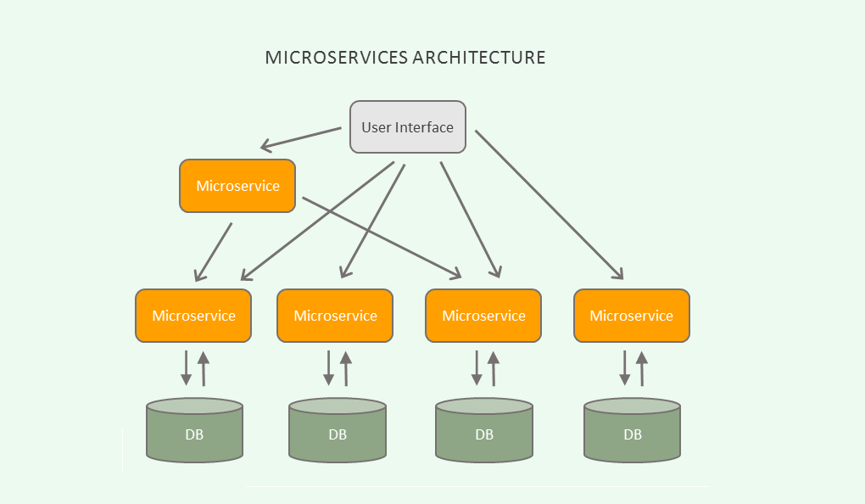
MicroServices

Slide 4
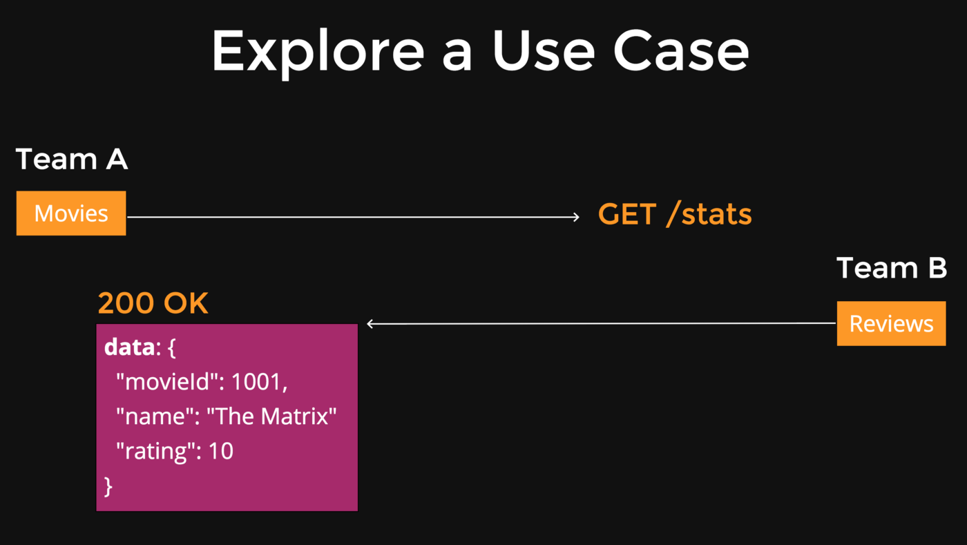
Testing Microservices

Slide 5
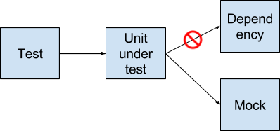
Testing Microservices
Option 1 - Mocks

Slide 6
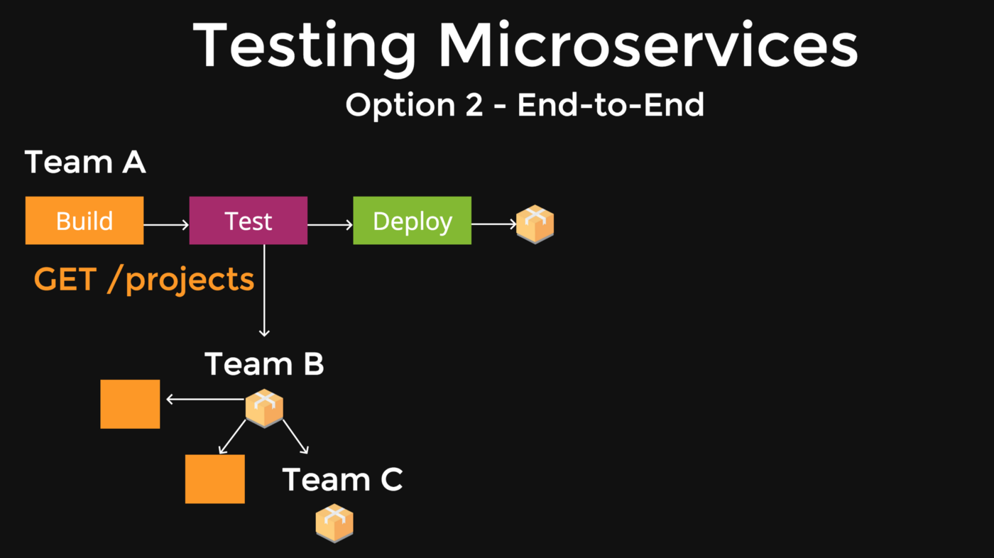
Testing Microservices

Slide 7
Say goodbye to end-to-end testing
Testing microservices shouldn't involve setting up complex end-to-end test environments, creating lengthy integration suites and managing test data. Stop wasting time, and start releasing.

Slide 8
Introduction to Contract Testing
Contract testing is a technique for testing an integration point by checking each application in isolation to ensure the messages it sends or receives conform to a shared understanding that is documented in a "contract". For applications that communicate via HTTP, these "messages" would be the HTTP request and response, and for an application that used queues, this would be the message that goes on the queue.
In practice, a common way of implementing contract tests is to check that all the calls to your test doubles return the same results as a call to the real application would.

Slide 9
Breaking it down to a simple analogy
I want to go to a new specialist tech shop during lunchtime but it’s along a route I have never walked before and I am worried that I won’t have enough time to get there and back before my 2pm meeting. I need information on how long this journey will take.
Given my current resources, there are 2 approaches I could take - Walk there, timing the walk and double the elapsed time to work out the journey total. Check an online route mapper for the estimates for the route.
One option is a lot faster than the other, has no dependencies and gets me fairly near the answers I want but omits lower level detail (windspeed, gradient) of the journey that I would learn by timing the walk myself.
This is exactly what contract testing does. It mocks or interrogates a response to allow you to get some of the information about functions you require.

Slide 10
Advantages
All the benefits of using mocks — quick tests, easy environment setup, and deterministic tests.
All the benefits of a fully deployed E2E — reliability and confidence when deploying to production.

Slide 11
Contract Testing - Terminologies
Service Consumer -A component that initiates a HTTP request to another component.
Service Provider -A server that responds to an HTTP request from another component.
Contract file - Contains the JSON serialised interactions (requests and responses) defined in the consumer tests.
Mock Service Provider - Used by consumer tests to mock out the actual service provider, meaning that integration-like tests can be run without requiring the actual service provider to be available.
Service agreement - A promise from the service provider to return a specific response after the service consumer provides a specific request.
Internal Service Consumer - This is another system in your company that uses your services for things like authentication, auditing permissions or data.
External Service Consumer - This is a party external to your company that consumers your service as a part of their tech offering

Slide 12
What do I need in order to test in this way?
Know your role - Are you the provider or the consumer?
API Docs - Nothing can be done without proper docs
Testing tool - Pact, Spring Cloud Contract, Hoverfly, etc
Define your scope of testing

Slide 13
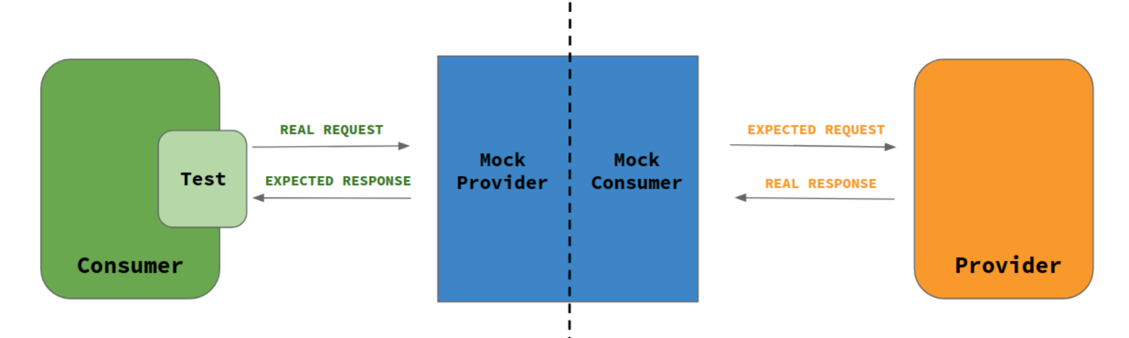
Working of Contract Tests

Slide 14
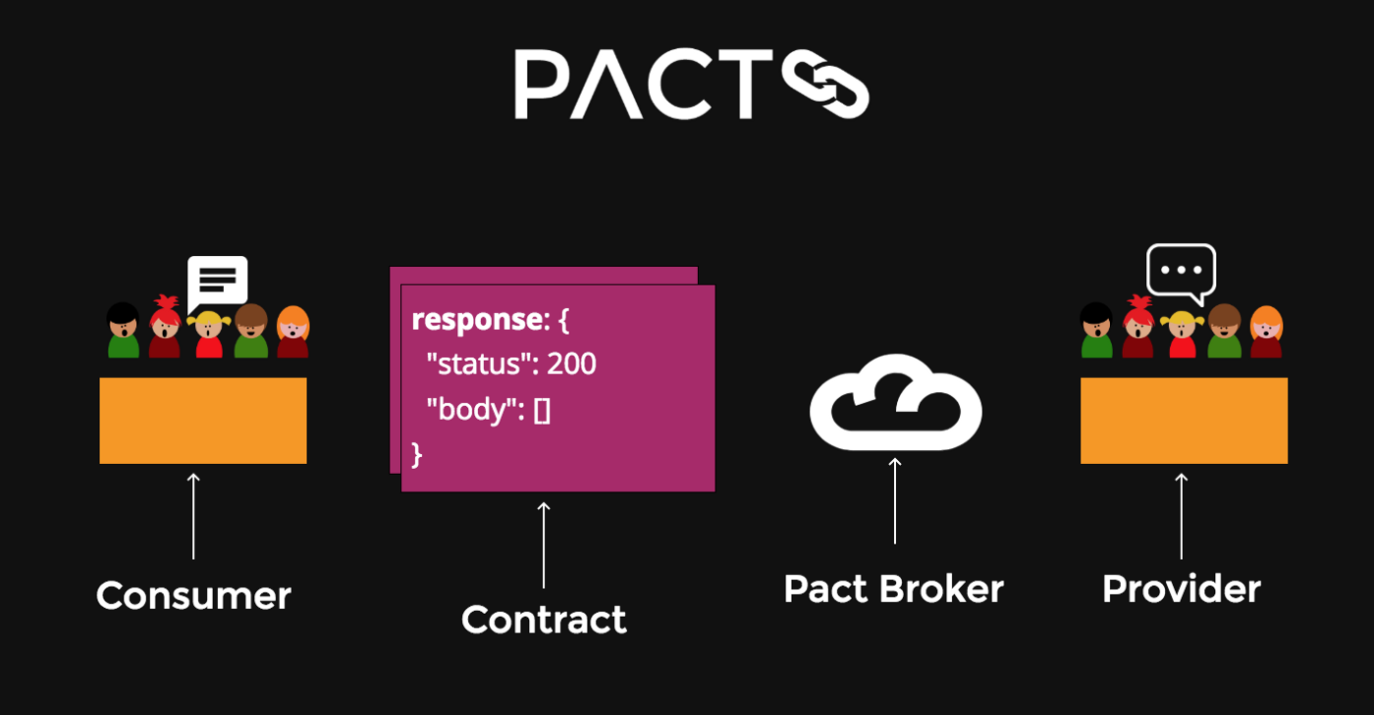
Terminologies in Pact

Slide 15
Consumer Driven Contract Test

Slide 16
Provider Verification

Slide 17
Overview of Pact Workflow

Slide 18
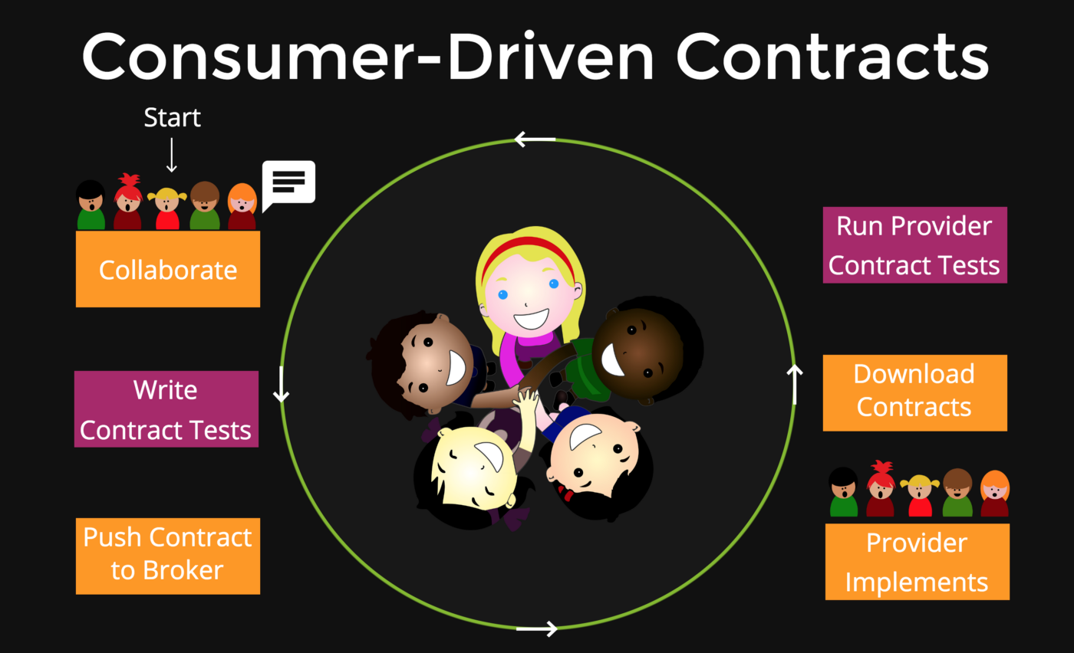
Pact Lifecycle

Slide 19
Benefits
Waste reduction — if the contract is consumer driven then the interactions that are built are actually per an expectation, instead of being generic endpoints and interactions that no one uses.
Win both Confidence and Speed — If you bring up a full E2E environment with dependencies that’s going to be reliable, but very complicated and slow. If you use mocks, you get the other half of it — easy and fast, but not so reliable.
True release independence — Services can be deployed independently, not requiring a full system, with high confidence for API contracts being uphold.
Insight into API consumers — Using the Pact broker you get insight into all consumer and provider connections as well as the specific usage of an API response per consumer.

Slide 20
QA

Slide 21
Thank You...

