Slide 1
Academic journal submission recommendation system
Member: Li Chenghao, Xiong Yucong

Slide 2
1.Introduction

Slide 3
Introduction
Designed a computer science journal submission recommendation system
Use crawlers to obtain data sets
Model:
Abstract-based paper similarity matching
Prediction of paper review cycle based on linear fitting
Notes:
为了帮助研究者选择适合的投稿期刊，我们提出了一种计算机科学学术期刊投稿推荐系统。系统使用爬虫获取论文信息，采用基于摘要进行论文相似度匹配和基于线性拟合的审稿周期预测的模型向用户推荐适合投稿的期刊。

Slide 4
2.Data Collection

Slide 5
Data collection
Journal scope: 19 international academic journals in computer science
Grade range: CCF(China Computer Federation)-A, CCF-B
Field scope: computer architecture, software engineering, database, computer graphics and multimedia, human-computer interaction and ubiquitous computing, computer network, network and information security, intersection
Time range: All papers published from 2011 to 2020

Slide 6
Data collection
Publisher information collected:
Publisher name
URL
Journal information collected :
Journal name
Research Topics
URL
Field
Notes:
每一个期刊都会将其发表的论文分为若干研究主题，每个研究主题下包含若干论文。这些研究主题一般可以在期刊网站上找到。
期刊的领域指的是中国计算机学会将期刊分类的领域

Slide 7
Data collection
Paper information collected:
Title
Doi
Journal
Research Topics
Key words
Abstract
Review cycle information (received time\publication time\ revise time\accepted time)
Notes:
每一个期刊都会将其发表的论文分为若干研究主题，每个研究主题下包含若干论文。这些研究主题一般可以在期刊网站上找到。
期刊的领域指的是中国计算机学会将期刊分类的领域

Slide 8
3. Journal review time prediction module

Slide 9
System introduction
The system consists of two modules
(1) Paper similarity matching module
(2) Paper review cycle prediction module
System input:
Keyword a, abstract b, paper similarity matching score proportion c
Calculate the paper review cycle prediction score of each journal based on keyword a; calculate the paper similarity matching score of each journal based on abstract b; finally, linearly add the two scores to calculate the total based on the paper similarity matching score proportion c score

Slide 10
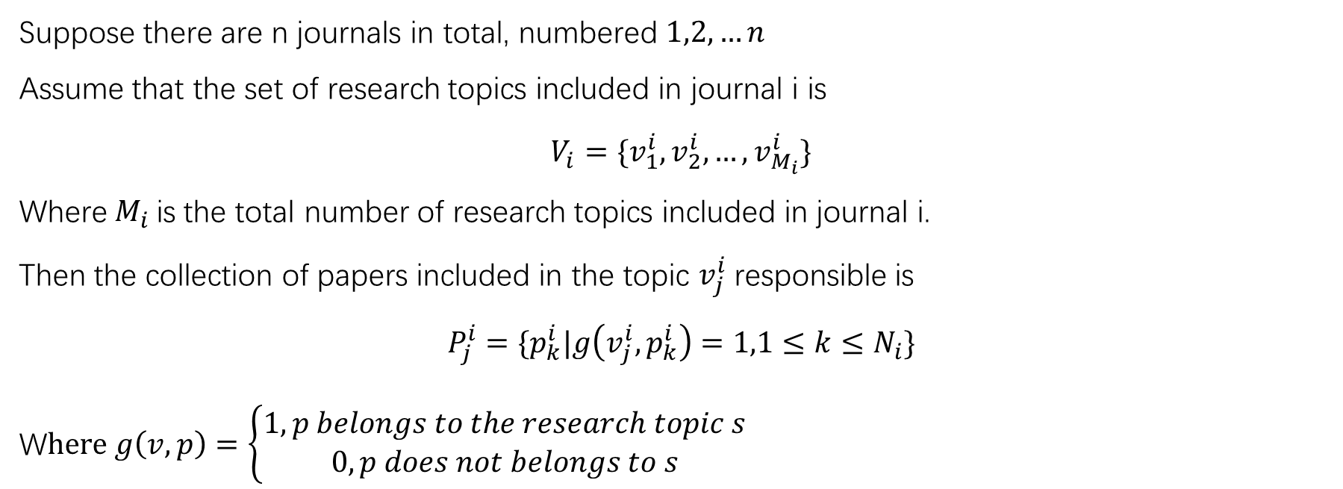
Journal review time prediction module
Suppose there are n journals in total, numbered $1,2,…n$
Assume that the set of research topics included in journal i is
$$V_{i}=\{v_{1}^{i},v_{2}^{i},…,v_{M_{i}}^{i}\}$$
Where$M_{i}$is the total number of research topics included in journal i.
Then the collection of papers included in the topic $v_{j}^{i}$responsible is
$$P_{j}^{i}=\{p_{k}^{i}|g\left(v_{j}^{i},p_{k}^{i}\right)=1,1≤k≤N_{i}\}$$
W$here g\left(v,p\right)=\left\{\begin{aligned}1,p belongs to the research topic s& \\ 0,p does not belongs to s\end{aligned}\right.$

Slide 11
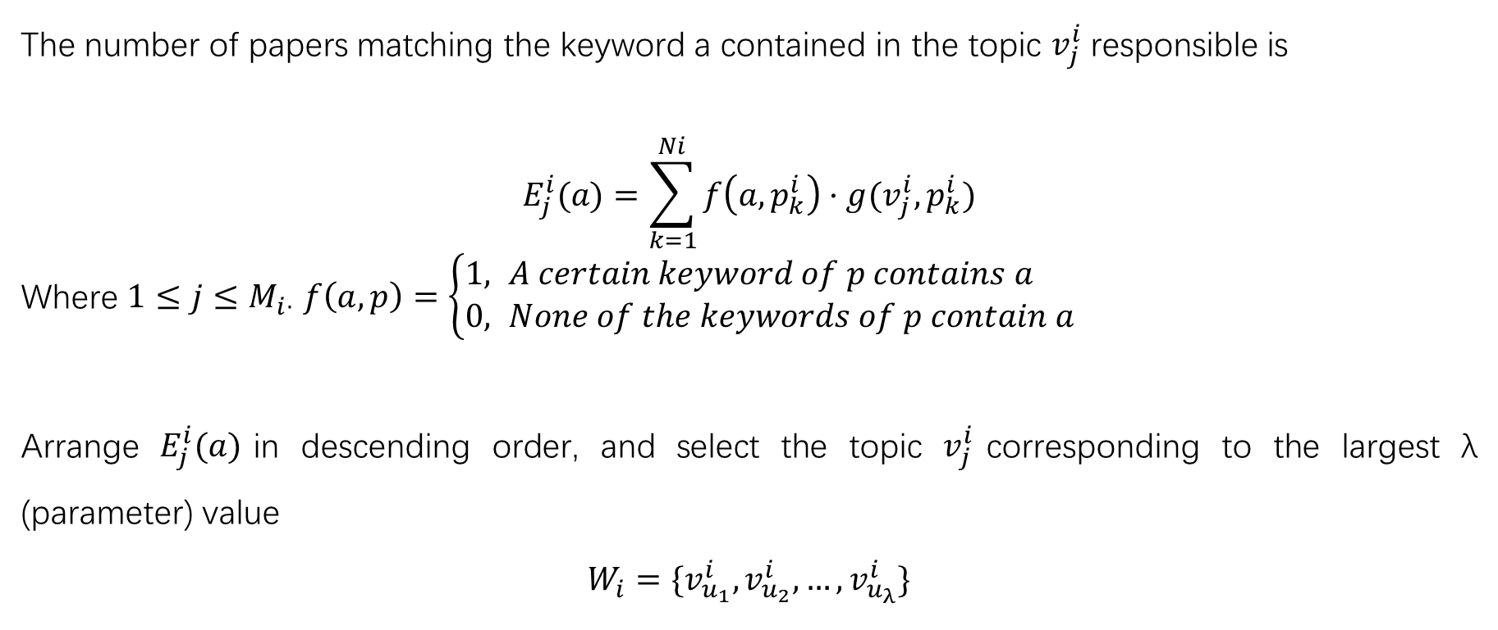
Journal review time prediction module
The number of papers matching the keyword a contained in the topic $v_{j}^{i}$responsible is
$$E_{j}^{i}(a)=\sum_{k=1}^{Ni}{f\left(a,p_{k}^{i}\right)·g(v_{j}^{i},p_{k}^{i})}$$
Where $1≤j≤M_{i}$. $f\left(a,p\right)=\left\{\begin{aligned}1, &A certain keyword of p contains a \\ 0, &None of the keywords of p contain a\end{aligned}\right.$
Arrange $E_{j}^{i}(a)$in descending order, and select the topic $v_{j}^{i}$corresponding to the largest λ (parameter) value
$$W_{i}=\{v_{u_{1}}^{i},v_{u_{2}}^{i},…,v_{u_{λ}}^{i}\}$$

Slide 12
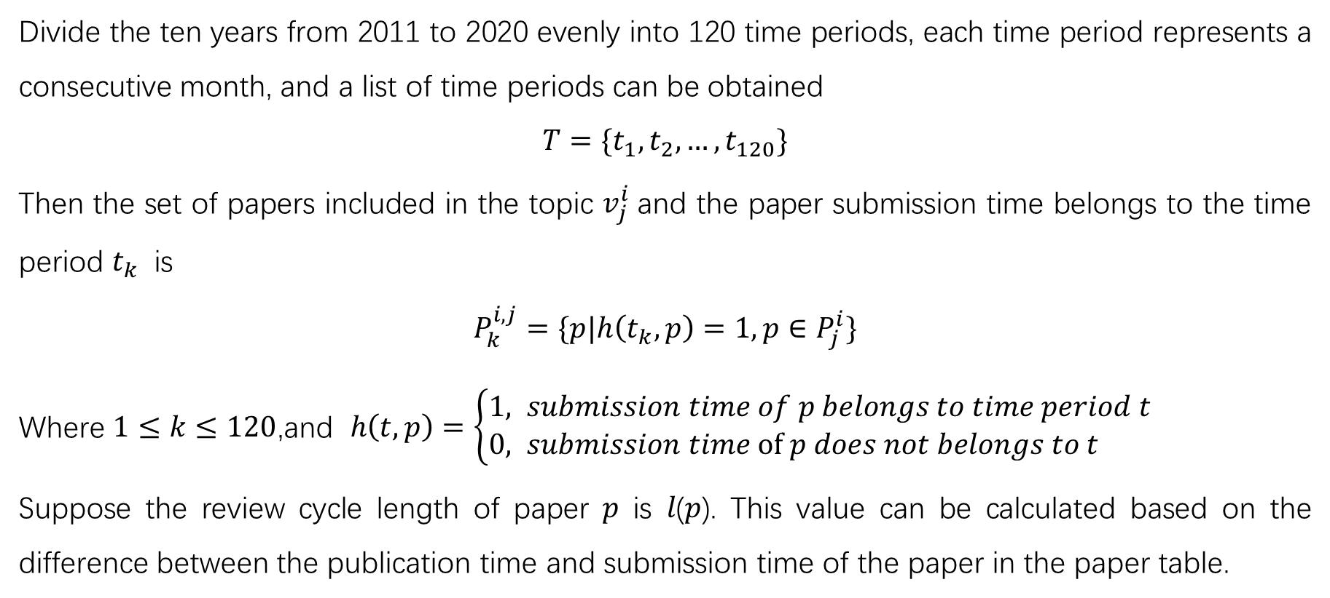
Journal review time prediction module
Divide the ten years from 2011 to 2020 evenly into 120 time periods, each time period represents a consecutive month, and a list of time periods can be obtained
$$T=\{t_{1},t_{2},…,t_{120}\}$$
Then the set of papers included in the topic $v_{j}^{i}$and the paper submission time belongs to the time period $t_{k}$ is
$$P_{k}^{i,j}=\{p|h\left(t_{k},p\right)=1,p∈P_{j}^{i}\}$$
Where $1≤k≤120$,and $h\left(t,p\right)=\left\{\begin{aligned}1, &submission time of p belongs to time period t \\ 0, &submission time of p does not belongs to t\end{aligned}\right.$
Suppose the review cycle length of paper 𝑝 is 𝑙(𝑝). This value can be calculated based on the difference between the publication time and submission time of the paper in the paper table.

Slide 13
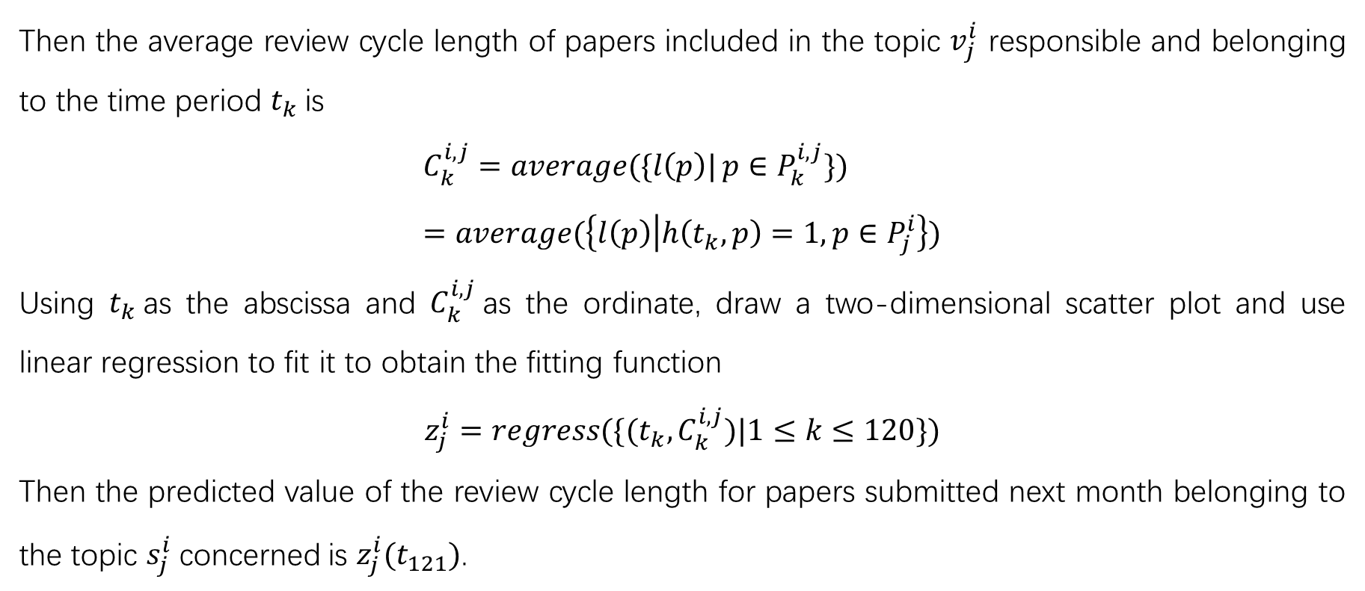
Journal review time prediction module
Then the average review cycle length of papers included in the topic $v_{j}^{i}$ responsible and belonging to the time period $t_{k}$is
$$C_{k}^{i,j}=\operatorname{average}{(\{l\left(p\right)|}p∈P_{k}^{i,j}\}) \\ =\operatorname{average}{(\left\{l\left(p\right) | h\left(t_{k},p\right)=1,p∈P_{j}^{i}\right\})}$$
Using $t_{k}$as the abscissa and $C_{k}^{i,j}$as the ordinate, draw a two-dimensional scatter plot and use linear regression to fit it to obtain the fitting function
$$z_{j}^{i}=regress(\{(t_{k},C_{k}^{i,j})|1≤k≤120\})$$
Then the predicted value of the review cycle length for papers submitted next month belonging to the topic $s_{j}^{i}$concerned is $z_{j}^{i}(t_{121})$.

Slide 14
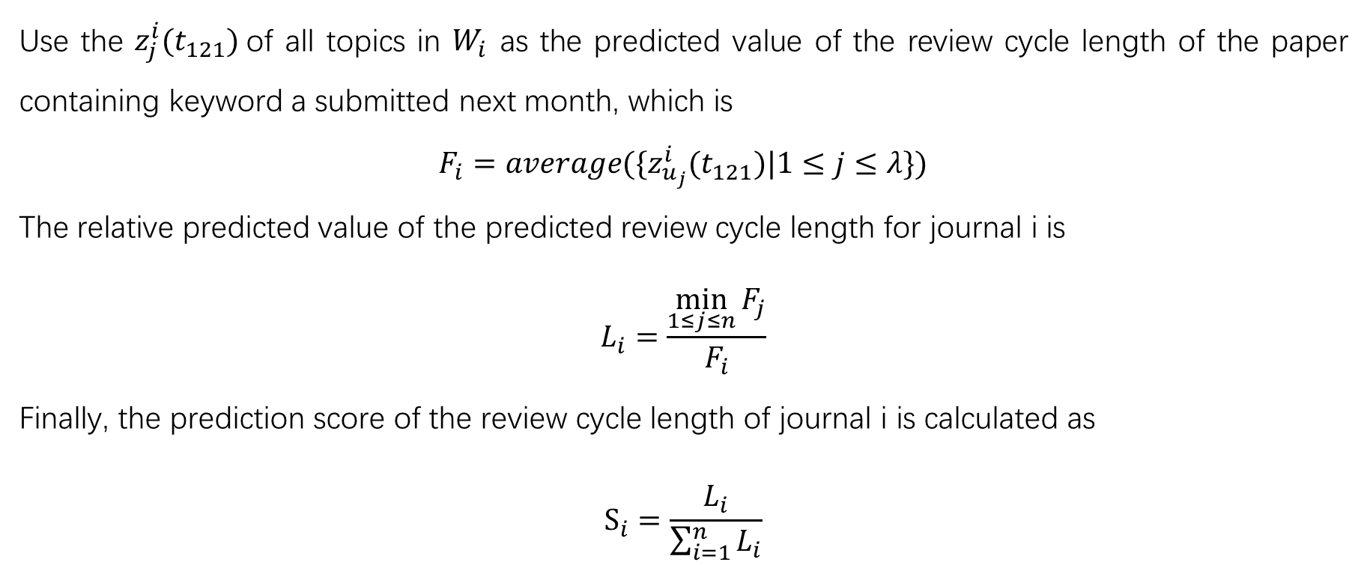
Journal review time prediction module
Use the $z_{j}^{i}(t_{121})$of all topics in $W_{i}$ as the predicted value of the review cycle length of the paper containing keyword a submitted next month, which is
$$F_{i}=average(\{z_{u_{j}}^{i}(t_{121})|1≤j≤λ\})$$
The relative predicted value of the predicted review cycle length for journal i is
$$L_{i}=\frac{\min_{1≤j≤n}{F_{j}}}{F_{i}}$$
Finally, the prediction score of the review cycle length of journal i is calculated as
$$S_{i}=\frac{L_{i}}{\sum_{i=1}^{n}{L_{i}}}$$

Slide 15
4. Abstract-based paper similarity matching

Slide 16
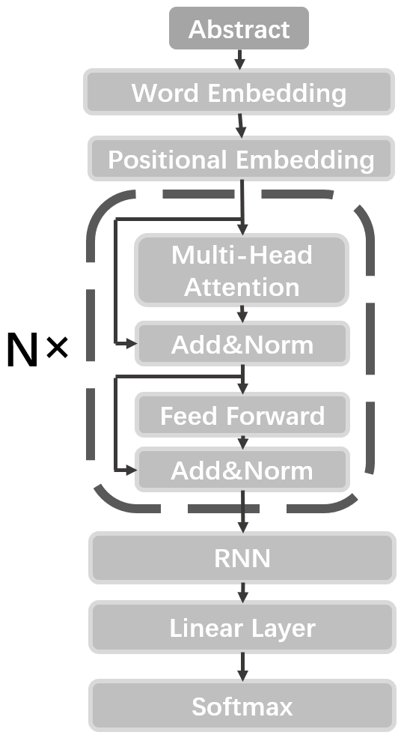
Model
This Model is based on Transformer Encoder and Recurrent Neural Network.
NLTK package is used to tokenize the text.
Punctuation marks and numbers are removed.
Word2Vec is used to embed words.
The encoder has 3 blocks.
The encoder extracts information.
The RNN gathers the scattered information.

Slide 17
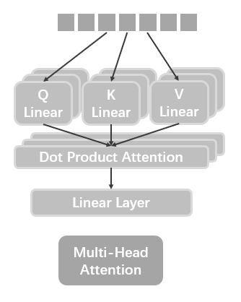
Multi-Head Attention
The input tensor is processed by Q, K, V linear layers respectively.
The dot product of Q, K, Vs are calculated.
8 heads are in this module.
All products of those heads are put into a linear layer.

Slide 18

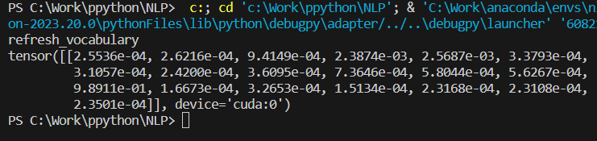
Introduction
Essay’s abstract are put into the model as input.
The journal publishing the essay is the label.
19 journals and 9657 essays published on them are collected as training dataset.
The test dataset includes 4140 essays published on those journals.
The hit@1 accuracy reached 43% and hit@3 accuracy reached 53%

Slide 19
