Slide 1
Ensemble Clustering

Slide 2
Ensemble Clustering
clustering algorithm 1
partition 1
combine
clustering algorithm 2
unlabeled
data
partition 2
Final
partition
……
……
… …
clustering algorithm N
partition N
Combine multiple partitions of given data into a single partition of better quality
Notes:
<número>

Slide 3
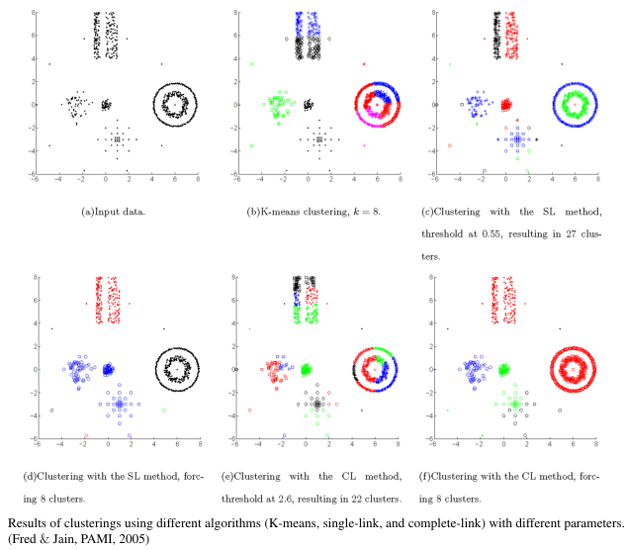
Why Ensemble Clustering?
Different clustering algorithms may produce different partitions because they impose different structure on the data; No single clustering algorithm is optimal
Different realizations of the same algorithm may generate different partitions

Slide 4
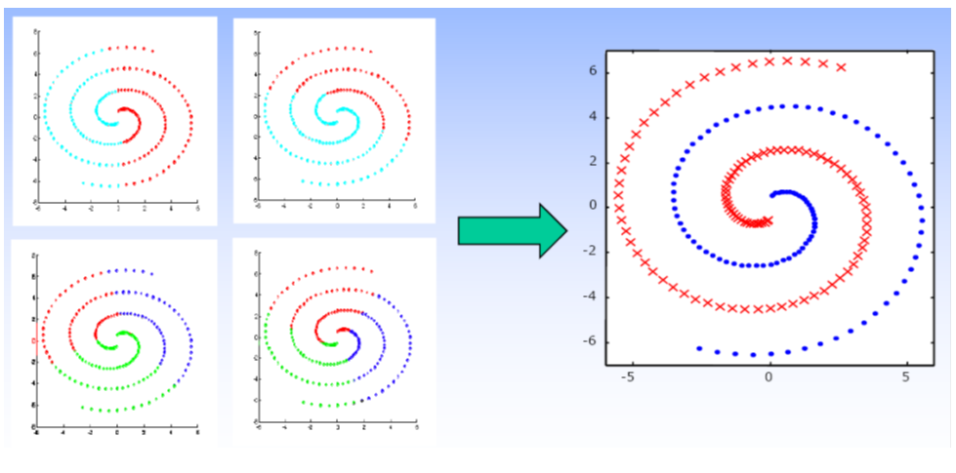
Why Ensemble Clustering?
Goal
Exploit the complementary nature of different partitions
Each partition can be viewed as taking a different “look” or “cut” through data
Punch, Topchy, and Jain, PAMI, 2005

Slide 5
Challenge I: how to Generate clustering ensembles?
Produce a clustering ensemble by either
Using different clustering algorithms
E.g. K-means, Hierarchical Clustering, Fuzzy C-means, Spectral Clustering, Gaussian Mixture Model,….
Running the same algorithm many times with different parameters or initializations, e.g.,
run K-means algorithm N times using randomly initialized clusters centers
use different dissimilarity measures
use different number of clusters
Using different samples of the data
E.g. many different bootstrap samples from the givendata
Random projections (feature extraction)
E.g. project the data onto a random subspace
Feature selection
E.g. use different subsets of features

Slide 6
Challenge II: how to combine multiple partitions?
According to (Vega-Pons & Ruiz-Shulcloper, 2011), ensemble clustering algorithms can be divided into
Median partition based approaches
Object co-occurrence based approaches
Relabeling/voting based methods
Co-association matrix based methods
Graph based methods

Slide 7
Median partition based approaches
Basic idea: find a partition P that maximizes the similarity between P and all the N partitions in the ensemble: P1, P2, …, PN
Need to define the similarity between two partitions
Normalized mutual information (Strehl & Ghosh, 2002)
Utility function (Topchy, Jain, and Punch, 2005)
Fowlkes-Mallows index (Fowlkes & Mallows, 1983)
Purity and inverse purity (Zhao & Karypis, 2005)
P2
P1
S2
P3
S1
S3
P
SN
SN-1
… ….
PN
PN-1

Slide 8
Relabeling/voting based methods
Basic idea: first find the corresponding cluster labels among multiple partitions, then obtain the consensus partition through a voting process. (Ayad & Kamel, 2007; Dimitriadou et. al, 2002; Dudoit & Fridlyand, 2003; Fischer & Buhmann, 2003; Tumer & Agogino, 2008; etc)
Re-labeling
Voting
 | P₁ | P₂ | P₃
v₁ | 1 | 3 | 2
v₂ | 1 | 3 | 2
v₃ | 2 | 1 | 2
v₄ | 2 | 1 | 3
v₅ | 3 | 2 | 1
v₆ | 3 | 2 | 1
 | P₁ | P₂ | P₃
v₁ | 1 | 1 | 1
v₂ | 1 | 1 | 1
v₃ | 2 | 2 | 1
v₄ | 2 | 2 | 2
v₅ | 3 | 3 | 3
v₆ | 3 | 3 | 3
P*
1
1
2
2
3
3
Hungarian
algorithm
<número>
Notes:
<número>

Slide 9
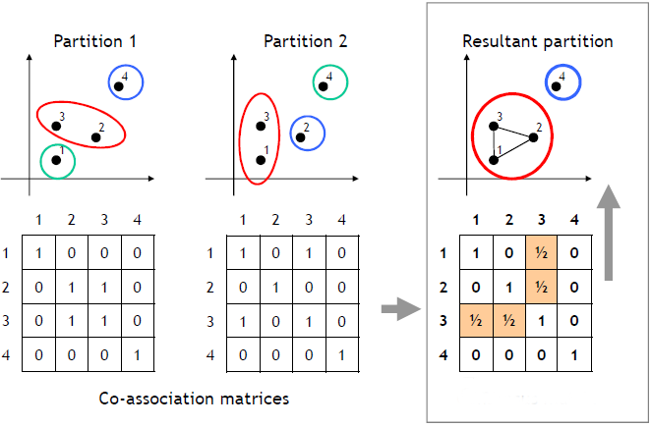
Co-association matrix based methods
Basic idea: first compute a co-association matrix based on multiple data partitions, then apply a similarity-based clustering algorithm (e.g., single link and normalized cut) to the co-association matrix to obtain the final partition of the data. (Fred & Jain, 2005; Iam-On et. al, 2008; Vega-Pons & Ruiz-Shulcloper, 2009; Wang et. al, 2009; Li et. al, 2007; etc)
<número>
Notes:
<número>

Slide 10
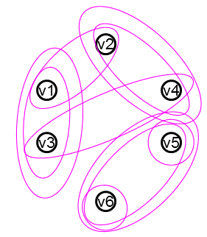
Graph based methods
Basic idea: construct a weighted graph to represent multiple clustering results from the ensemble, then find the optimal partition of data by minimizing the graph cut (Fern & Brodley, 2004; Strehl & Ghosh, 2002; etc)
 | P₁ | P₂ | P₃
v₁ | 1 | 1 | 1
v₂ | 1 | 2 | 2
v₃ | 2 | 1 | 1
v₄ | 2 | 2 | 2
v₅ | 3 | 3 | 3
v₆ | 3 | 4 | 3
P*
1
2
1
2
3
3
Graph
clustering
<número>
Notes:
<número>

Slide 11
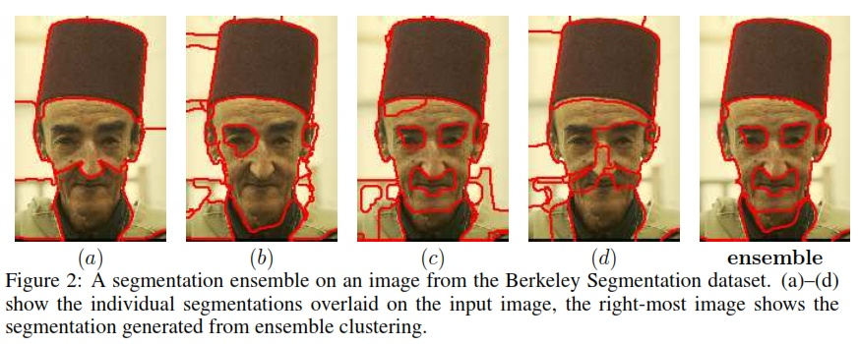
ENSEMBLE CLUSTERING IN IMAGE SEGMENTATION
Ensemble Clustering using Semideﬁnite Programming, Singh et al, NIPS 2007

Slide 12
Other research problems
Ensemble Clustering Theory
Ensemble clustering converges to true clustering as the number of partitions in the ensemble increases (Topchy, Law, Jain, and Fred, ICDM, 2004)
Bound the error incurred by approximation (Gionis, Mannila, and Tsaparas, TKDD, 2007)
Bound the error when some partitions in the ensemble are extremely bad (Yi, Yang, Jin, and Jain, ICDM, 2012)
Partition selection
Adaptive selection (Azimi & Fern, IJCAI, 2009)
Diversity analysis (Kuncheva & Whitaker, Machine Learning, 2003)
<número>
Notes:
<número>

