Slide 1
Automatizing Platform Translations with AI
Localize.biz + OpenAI API

Slide 2




Current situation
Manual translations…
Automatic translations…
Time-consuming
Costly
Not adapted
to context
Not adapted
to company-specific
vocabulary

Slide 3
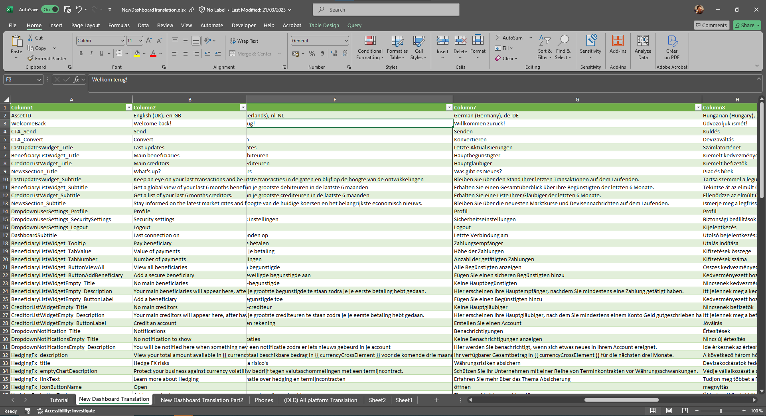



Manual translations
Employees have other
things to do
Coordination is very
time-consuming
Translations often
based on personal
opinion

Slide 4
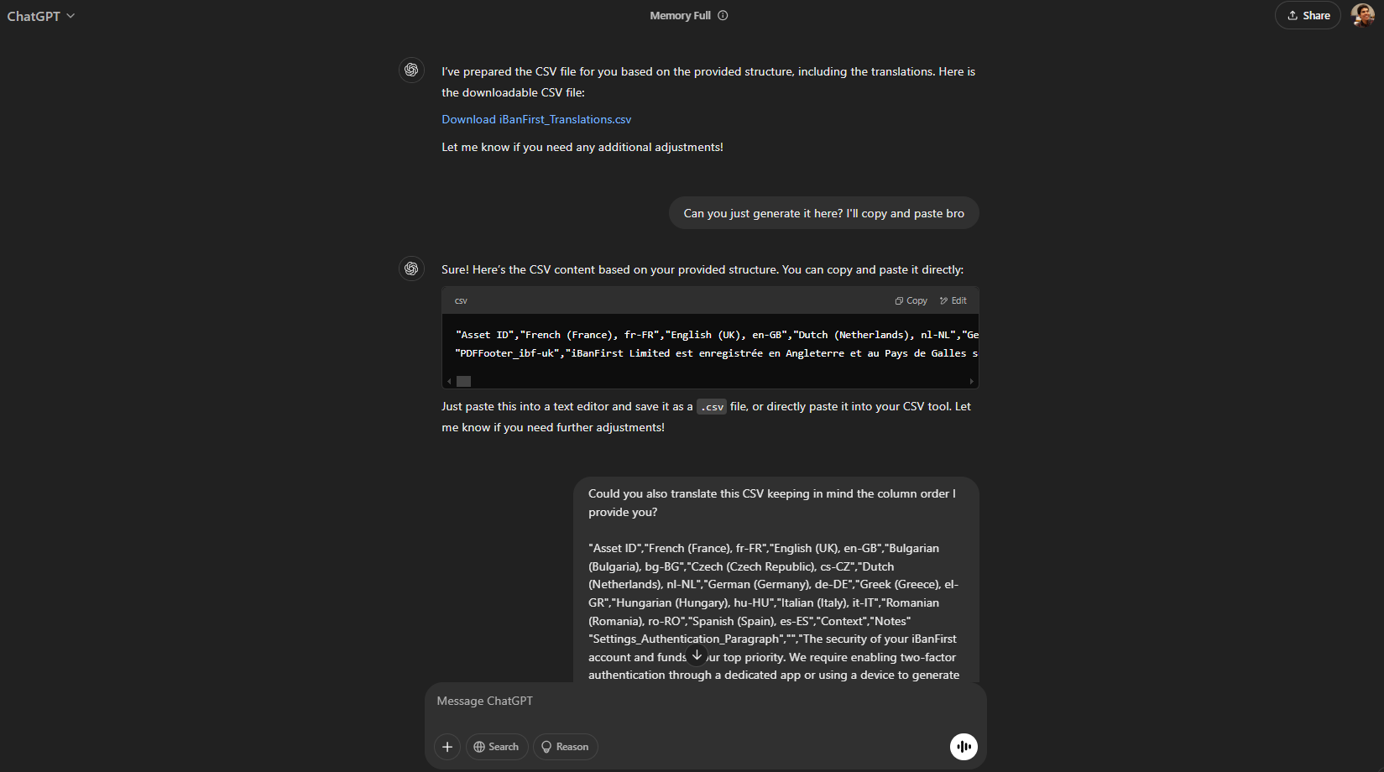



Automatic translations
Still very manual
file management
Rewrite prompt at
each time
Prompt often
incomplete generated
imprecise translations

Slide 5





Proposal
Glossary
Specific vocabulary
Tone (formal/informal)
.json
Translations
Manager API
Prompt
Business context
Application context
HTML Tags, Links
Variables
Date format
AI Model
Current: manual .json export
Future: integration with API

Slide 6

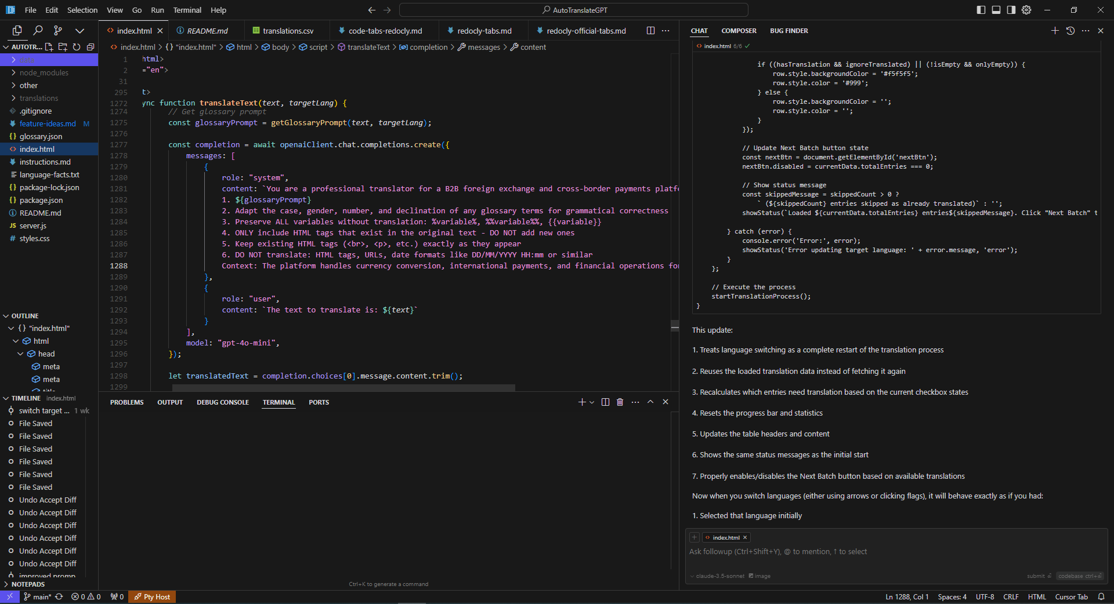

Tools
Cursor IDE
AI Model
Claude-3.5-Sonnet
(Anthropic)

Slide 7
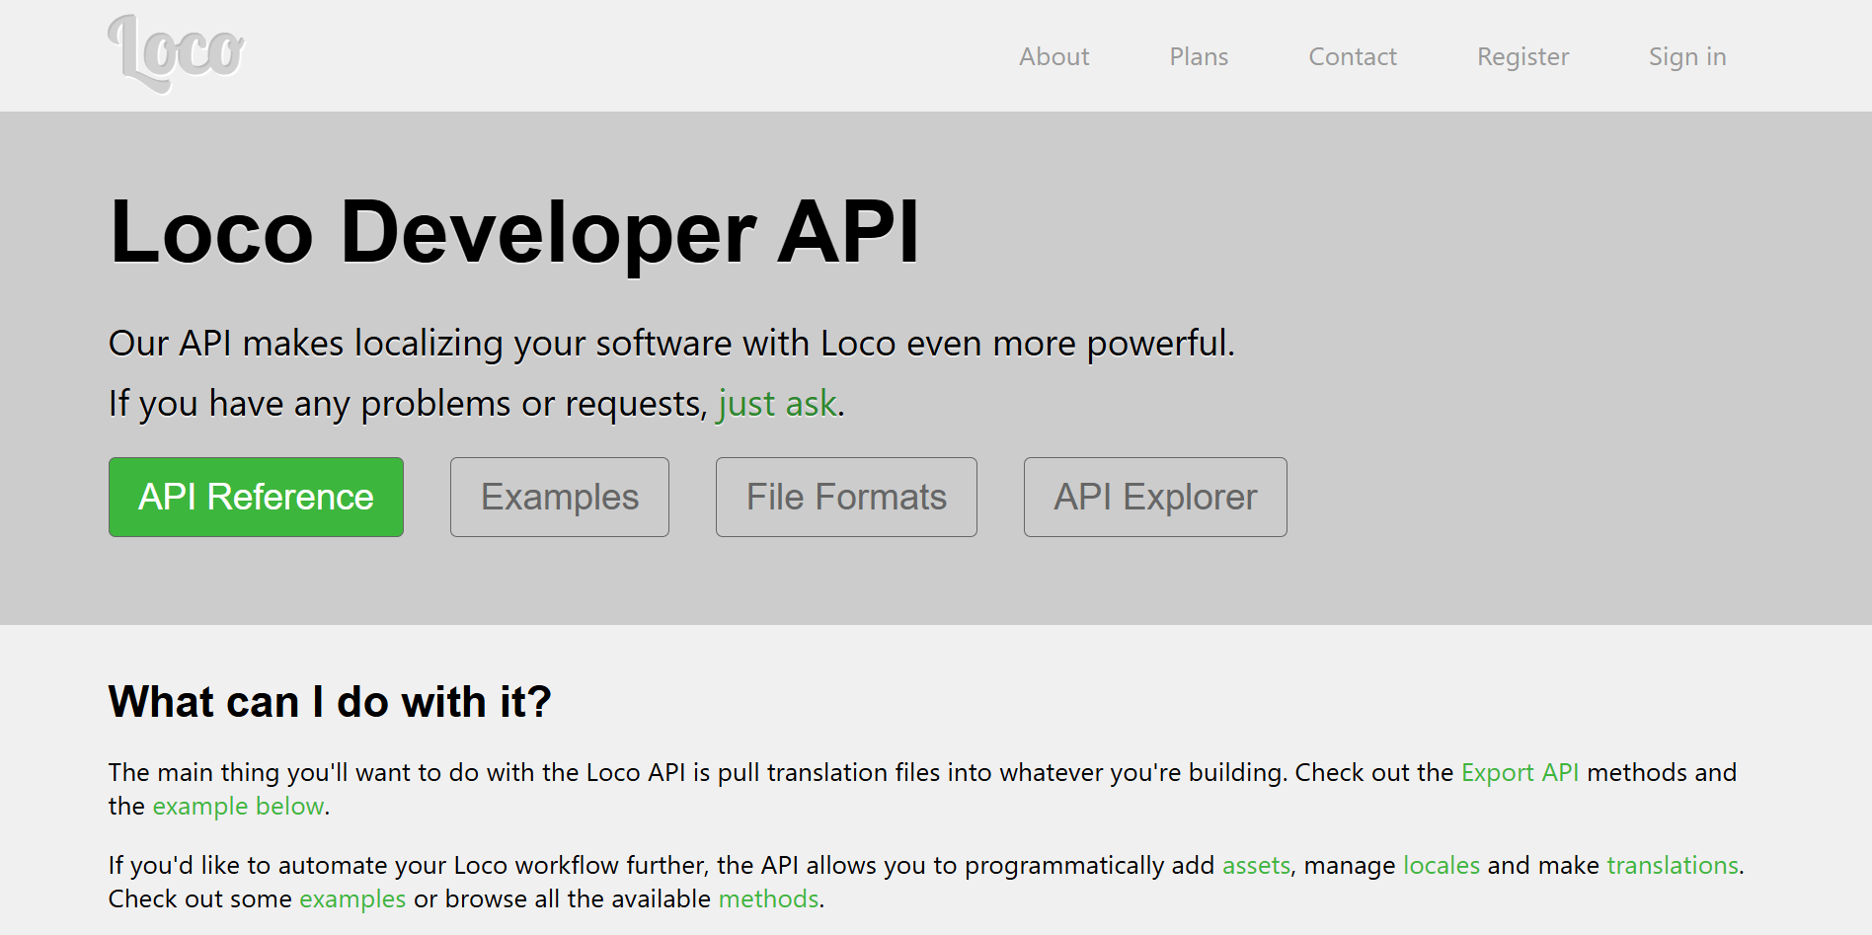
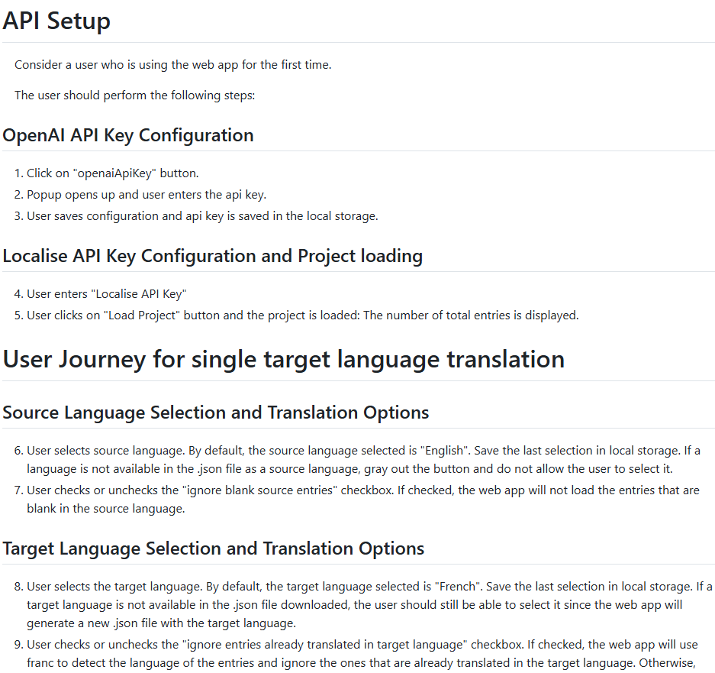
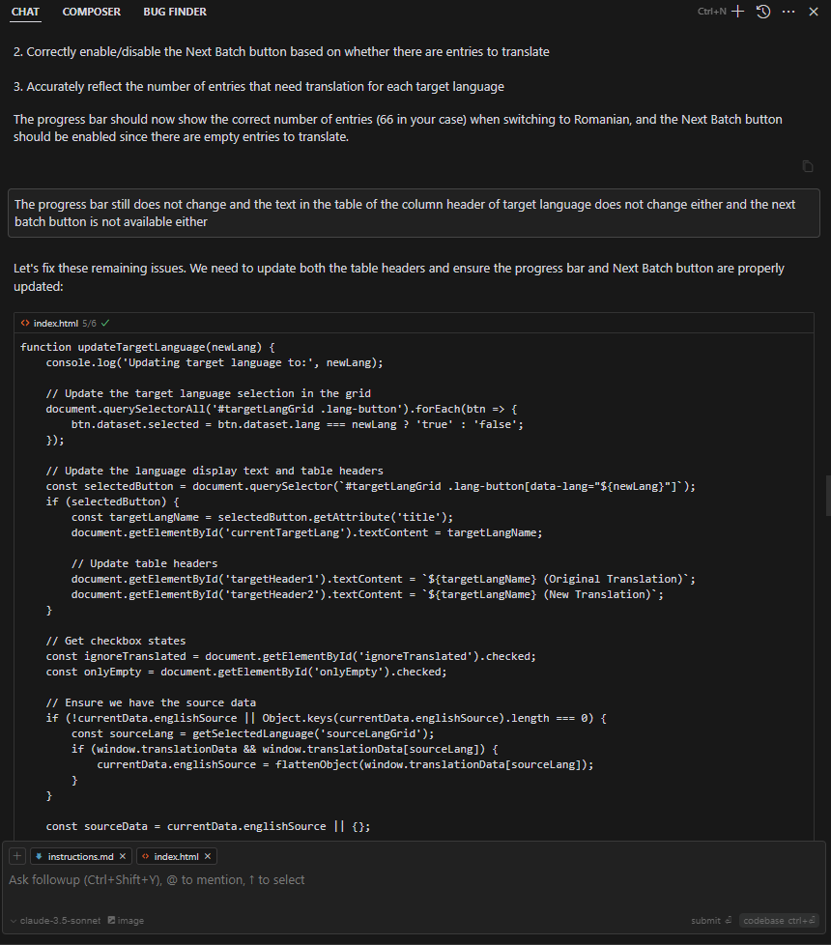
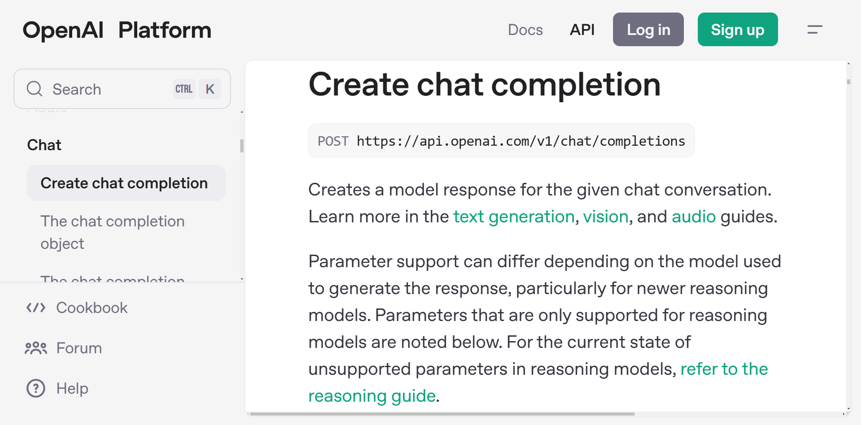
Inputs
API Docs
Detailed specs
A lot of chatting…
/instructions.md

Slide 8
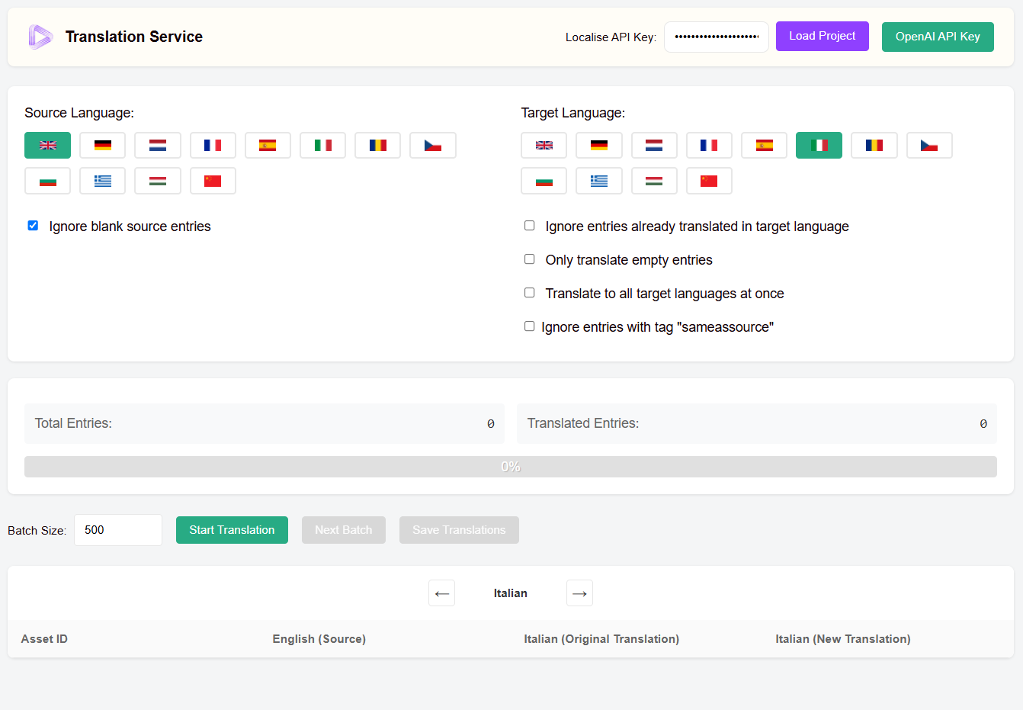
DEMONSTRATION
Glossary
Language detector
Checkboxes
Prompt example
Prompt with glossary example
JSON export (no more excel)

Slide 9
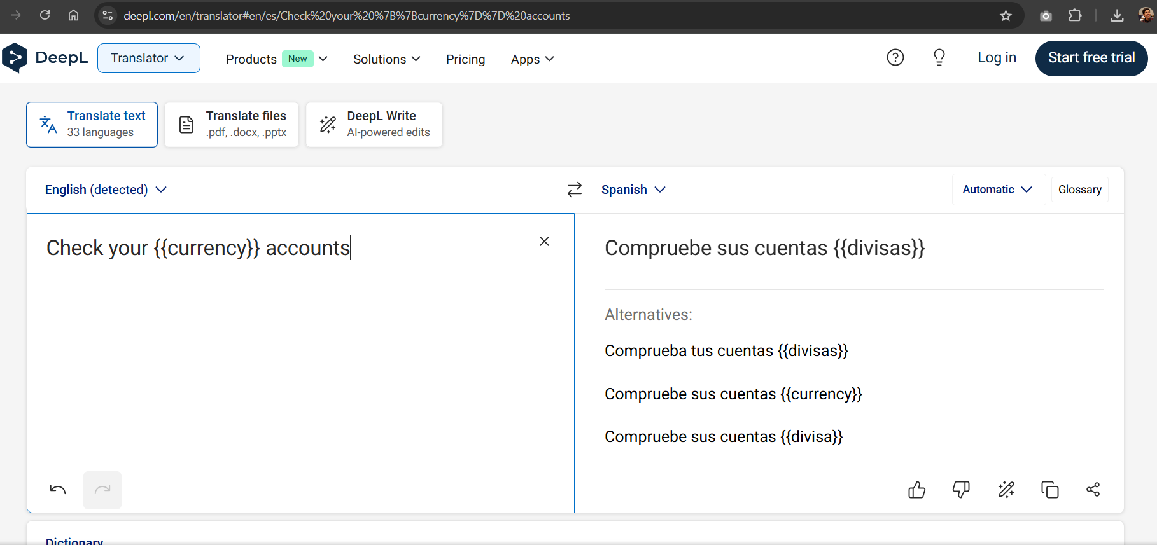
Variables

