Slide 1

5
CHAPTER
METHODS
Copyright © 2013 by John Wiley & Sons. All rights reserved.
Slides by Donald W. Smith
TechNeTrain.com
Final Draft
10/29/2011

Slide 2
Chapter Goals
To be able to implement methods
To become familiar with the concept of parameter passing
To develop strategies for decomposing complex tasks into simpler ones
To be able to determine the scope of a variable
To learn how to think recursively (optional)
In this chapter, you will learn how to design and implement your own methods. Using the process of stepwise refinement, you will be able to break up complex tasks into sets of cooperating methods.
Copyright © 2013 by John Wiley & Sons. All rights reserved.
Page <number>

Slide 3

Contents
Methods as Black Boxes
Implementing Methods
Parameter Passing
Return Values
Methods without Return Values
Problem Solving:
  Reusable Methods
  Stepwise Refinement
Variable Scope
Recursive Methods (optional)
Copyright © 2013 by John Wiley & Sons. All rights reserved.
Page <number>

Slide 4
5.1 Methods as Black Boxes
A method is a sequence of instructions with a name
  You declare a method by defining a named block of code
  You call a method in order to execute its instructions
public static void main(String[] args)
{
double result = Math.pow(2, 3);
. . .
}
A method packages a computation consisting of multiple steps into a form that can be easily understood and reused.
Copyright © 2013 by John Wiley & Sons. All rights reserved.
Page <number>

Slide 5
What is a method?
Some methods you have already used are:
  Math.pow()
  String.length()
  Character.isDigit()
  Scanner.nextInt()
  main()
They have:
  May have a capitalized name and a dot (.) before them
  A method name
    Follow the same rules as variable names, camelHump style
  ( ) - a set of parenthesis at the end
    A place to provide the method input information
Copyright © 2013 by John Wiley & Sons. All rights reserved.
Page <number>

Slide 6
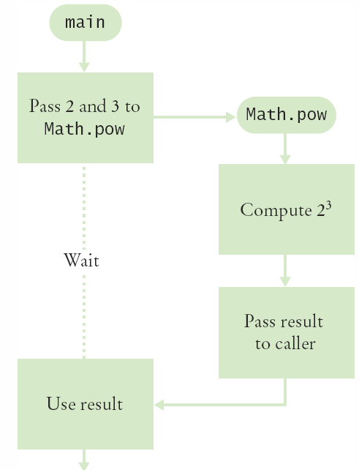
Flowchart of Calling a Method
public static void main(String[] args)
{
double result = Math.pow(2, 3);
. . .
}
One method ‘calls’ another
  main calls Math.pow()
  Passes two arguments
    2 and 3
  Math.pow starts
    Uses variables (2, 3)
    Does its job
    Returns the answer
  main uses result
Copyright © 2013 by John Wiley & Sons. All rights reserved.
Page <number>

Slide 7
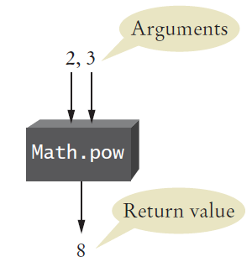
Arguments and Return Values
public static void main(String[] args)
{
double result = Math.pow(2,3);
. . .
}
main ‘passes’ two arguments (2 and 3) to Math.pow
Math.pow calculates and returns a value of 8 to main
main stores the return value to variable ‘result’
Copyright © 2013 by John Wiley & Sons. All rights reserved.
Page <number>

Slide 8
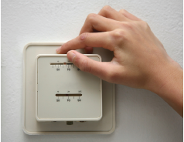
Black Box Analogy
A thermostat is a ‘black box’
  Set a desired temperature
  Turns on heater/AC as required
  You don’t have to know how it really works!
    How does it know the current temp?
    What signals/commands does it send to the heater or A/C?
Use methods like ‘black boxes’
  Pass the method what it needs to do its job
  Receive the answer
Copyright © 2013 by John Wiley & Sons. All rights reserved.
Page <number>

Slide 9
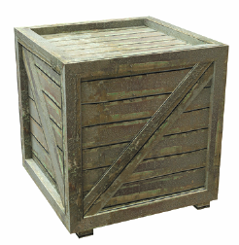
5.2 Implementing Methods
A method to calculate the volume of a cube
  What does it need to do its job?
  What does it answer with?
When writing this method:
  Pick a name for the method (cubeVolume).
  Declare a variable for each incoming argument
  (double sideLength) (called parameter variables)
  Specify the type of the return value ( double )
  Add modifiers such as public static
    (see Chapter 8)
When declaring a method, you provide a name for the method, a variable for each argument, and a type for the result
public static double cubeVolume(double sideLength)
Copyright © 2013 by John Wiley & Sons. All rights reserved.
Page <number>

Slide 10
Inside the Box
Then write the body of the method
  The body is surrounded by curly braces { }
  The body contains the variable declarations and statements that are executed when the method is called
  It will also return the calculated answer
public static double cubeVolume(double sideLength)
{
double volume = sideLength * sideLength * sideLength;
return volume;
}
Copyright © 2013 by John Wiley & Sons. All rights reserved.
Page <number>

Slide 11
Back from the Box
The values returned from cubeVolume are stored in local variables inside main
The results are then printed out
public static void main(String[] args)
{
double result1 = cubeVolume(2);
double result2 = cubeVolume(10);
System.out.println("A cube of side length 2 has volume
" + result1);
System.out.println("A cube of side length 10 has volume
" + result2);
}
Copyright © 2013 by John Wiley & Sons. All rights reserved.
Page <number>

Slide 12
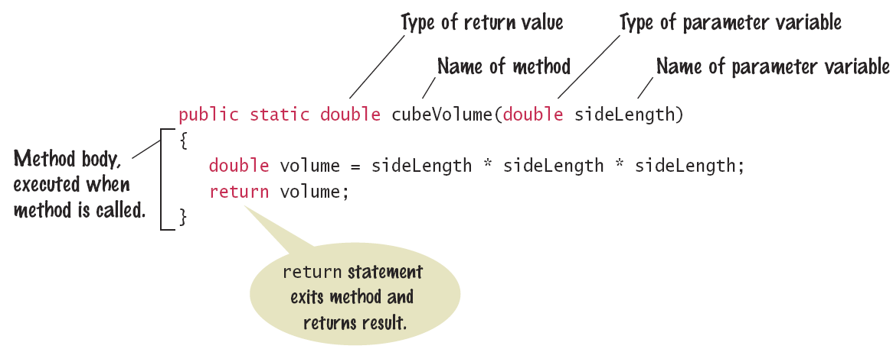
Syntax 5.1: Method Declaration
Copyright © 2013 by John Wiley & Sons. All rights reserved.
Page <number>

Slide 13
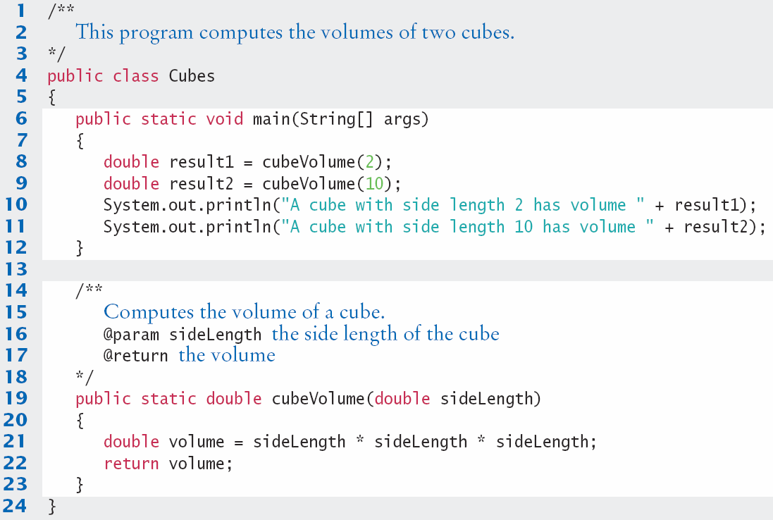
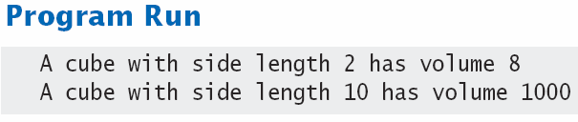
Cubes.java
Copyright © 2013 by John Wiley & Sons. All rights reserved.
Page <number>

Slide 14

Method Comments
Write a Javadoc comment above each method
Start with /**
  Note the purpose of the method
  @param Describe each parameter variable
  @return Describe the return value
End with */
/**
Computes the volume of a cube.
@param sideLength the side length of the cube
@return the volume
*/
public static double cubeVolume(double sideLength)
Copyright © 2013 by John Wiley & Sons. All rights reserved.
Page <number>

Slide 15



5.3 Parameter Passing
Parameter variables receive the argument values supplied in the method call
  They both must be the same type
The argument value may be:
  The contents of a variable
  A ‘literal’ value (2)
  aka. ‘actual parameter’ or argument
The parameter variable is:
  Declared in the called method
  Initialized with the value of the argument value
  Used as a variable inside the called method
  aka. ‘formal parameter’
Calling Method
out
Argument value
Parameter variable
in
Called Method
Copyright © 2013 by John Wiley & Sons. All rights reserved.
Page <number>

Slide 16




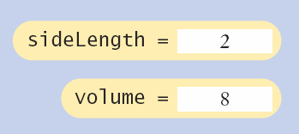
Parameter Passing Steps
public static void main(String[] args)
{
double result1 = cubeVolume(2);
. . .
}
public static double cubeVolume(double sideLength)
{
double volume = sideLength * sideLength * sideLength;
return volume;
}
Copyright © 2013 by John Wiley & Sons. All rights reserved.
Page <number>

Slide 17


Common Error 5.1
Trying to Modify Arguments
  A copy of the argument values is passed
  Called method (addTax) can modify local copy (price)
    But not original
    in calling method
      total
public static void main(String[] args)
{
double total = 10;
addTax(total, 7.5);
}
total
10.0
copy
public static int addTax(double price, double rate)
{
double tax = price * rate / 100;
price = price + tax; // Has no effect outside the method
return tax;
}
price
10.75
Copyright © 2013 by John Wiley & Sons. All rights reserved.
Page <number>

Slide 18
5.4 Return Values
Methods can (optionally) return one value
  Declare a return type in the method declaration
  Add a return statement that returns a value
    A return statement does two things:
      Immediately terminates the method
      Passes the return value back to the calling method
return type
public static double cubeVolume (double sideLength)
{
double volume = sideLength * sideLength * sideLength;
return volume;
}
The return value may be a value, a variable or a calculation
  Type must match return type
return statement
Copyright © 2013 by John Wiley & Sons. All rights reserved.
Page <number>

Slide 19
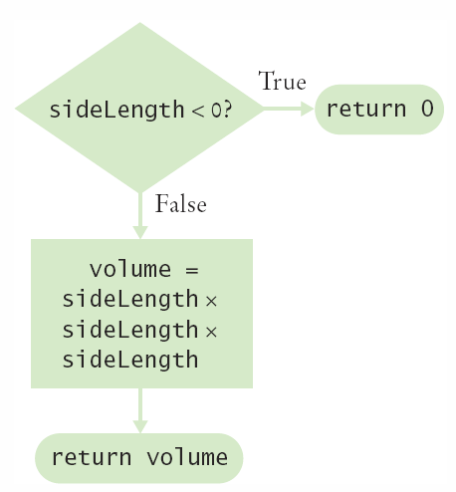
Multiple return Statements
A method can use multiple return statements
  But every branch must have a return statement
public static double cubeVolume(double sideLength)
{
if (sideLength < 0)
{
return 0;
}
return sideLength * sideLength * sideLength;
}
Copyright © 2013 by John Wiley & Sons. All rights reserved.
Page <number>

Slide 20
Common Error 5.2
Missing return Statement
  Make sure all conditions are handled
  In this case, x could be equal to 0
    No return statement for this condition
    The compiler will complain if any branch has no return statement
public static int sign(double x)
{
if (x < 0) { return -1; }
if (x > 0) { return 1; }
// Error: missing return value if x equals 0
}
Copyright © 2013 by John Wiley & Sons. All rights reserved.
Page <number>

Slide 21
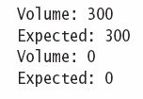
Implementing a Method: Steps
Describe what the method should do.
Determine the method’s “inputs”.
Determine the types of parameter values and the return value.
Write pseudocode for obtaining the desired result.
Implement the method body.
Test your method.
  Design test cases and code
public static double pyramidVolume(double height, double baseLength)
{
double baseArea = baseLength * baseLength;
return height * baseArea / 3;
}
Copyright © 2013 by John Wiley & Sons. All rights reserved.
Page <number>

Slide 22

5.5 Methods without Return Values
Methods are not required to return a value
  The return type of void means nothing is returned
  No return statement is required
  The method can generate output though!
...
boxString(“Hello”);
...
public static void boxString(String str)
{
int n = str.length();
for (int i = 0; i < n + 2; i++)
{ System.out.print("-"); }
System.out.println();
System.out.println("!" + str + "!");
for (int i = 0; i < n + 2; i++)
{ System.out.print("-"); }
System.out.println();
}
Copyright © 2013 by John Wiley & Sons. All rights reserved.
Page <number>

Slide 23
Using return Without a Value
You can use the return statement without a value
  In methods with void return type
  The method will terminate immediately!
public static void boxString(String str)
{
int n = str.length();
if (n == 0)
{
return; // Return immediately
}
for (int i = 0; i < n + 2; i++) { System.out.print("-"); }
System.out.println();
System.out.println("!" + str + "!");
for (int i = 0; i < n + 2; i++) { System.out.print("-"); }
System.out.println();
}
Copyright © 2013 by John Wiley & Sons. All rights reserved.
Page <number>

Slide 24
5.6 Problem Solving: Reusable Methods
Find Repetitive Code
  May have different values but same logic
int hours;
do
{
System.out.print("Enter a value between 1 and 12: ");
hours = in.nextInt();
}
while (hours < 1 || hours > 12);
int minutes;
do
{
System.out.print("Enter a value between 0 and 59: ");
minutes = in.nextInt();
}
while (minutes < 0 || minutes > 59);
1 - 12
0 - 59
Copyright © 2013 by John Wiley & Sons. All rights reserved.
Page <number>

Slide 25
Write a ‘Parameterized’ Method
/**
Prompts a user to enter a value in a given range until the user
provides a valid input.
@param low the low end of the range
@param high the high end of the range
@return the value provided by the user
*/
public static int readValueBetween(int low, int high)
{
int input;
do
{
System.out.print("Enter between " + low + " and " + high + ": ");
Scanner in = new Scanner(System.in);
input = in.nextInt();
}
while (input < low || input > high);
return input;
}
1, 12
0, 59
8
Copyright © 2013 by John Wiley & Sons. All rights reserved.
Page <number>

Slide 26
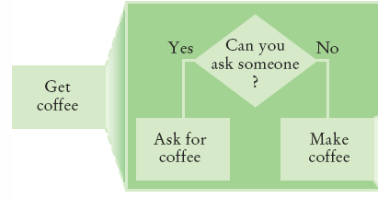
5.7 Problem Solving
Stepwise Refinement
  To solve a difficult task, break it down into simpler tasks
  Then keep breaking down the simpler tasks into even simpler ones, until you are left with tasks that you know how to solve
Copyright © 2013 by John Wiley & Sons. All rights reserved.
Page <number>

Slide 27
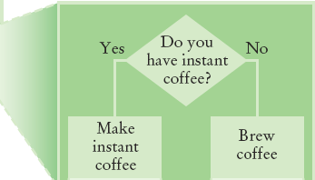
Get Coffee
If you must make coffee, there are two ways:
  Make Instant Coffee
  Brew Coffee
Copyright © 2013 by John Wiley & Sons. All rights reserved.
Page <number>

Slide 28
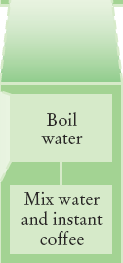
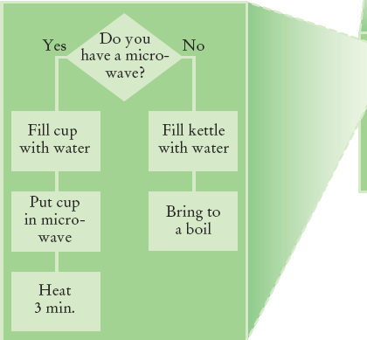
Instant Coffee
Two ways to boil water
  1) Use Microwave
  2) Use Kettle on Stove
Copyright © 2013 by John Wiley & Sons. All rights reserved.
Page <number>

Slide 29
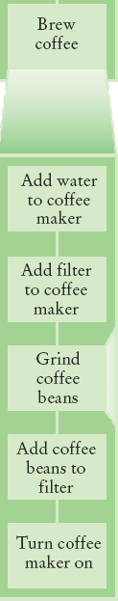
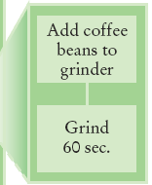
Brew Coffee
Assumes coffee maker
  Add water
  Add filter
  Grind Coffee
    Add beans to grinder
    Grind 60 seconds
  Fill filter with ground coffee
  Turn coffee maker on
Steps are easily done
Copyright © 2013 by John Wiley & Sons. All rights reserved.
Page <number>

Slide 30
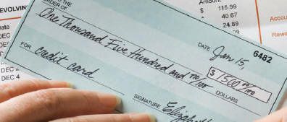
Stepwise Refinement Example
When printing a check, it is customary to write the check amount both as a number (“$274.15”) and as a text string (“two hundred seventy four dollars and 15 cents”). Write a program to turn a number into a text string.
Wow, sounds difficult!
Break it down
  Let’s take the dollar part (274) and come up with a plan
  Take an Integer from 0 – 999
  Return a String
  Still pretty hard…
Copyright © 2013 by John Wiley & Sons. All rights reserved.
Page <number>

Slide 31
Stepwise Refinement Example
Take it digit by digit (2, 7, 4) – left to right
Handle the first digit (hundreds)
  If empty, we’re done with hundreds
  Get first digit (Integer from 1 – 9)
  Get digit name (“one”, “two ”, “three”…)
  Add the word “ hundred”
  Sounds easy!
Second digit (tens)
  Get second digit (Integer from 0 – 9)
  If 0, we are done with tens… handle third digit
  If 1, … may be eleven, twelve.. Teens… Not easy!
    Let’s look at each possibility left (1x-9x)…
Copyright © 2013 by John Wiley & Sons. All rights reserved.
Page <number>

Slide 32
Stepwise Refinement Example
If second digit is a 0
  Get third digit (Integer from 0 – 9)
  Get digit name (“”, “one”, “two”…) … Same as before?
  Sounds easy!
If second digit is a 1
  Get third digit (Integer from 0 – 9)
  Return a String (“ten”, “eleven”, “twelve”…)
If second digit is a 2-9
  Start with string “twenty”, “thirty”, “forty”…
  Get third digit (Integer from 0 – 9)
  Get digit name (“”, “one”, “two”…) … Same as before
  Sounds easy!
Copyright © 2013 by John Wiley & Sons. All rights reserved.
Page <number>

Slide 33
Name the Sub-Tasks
digitName
  Takes an Integer from 0 – 9
  Return a String (“”, “one”, “two”…)
tensName (second digit >= 20)
  Takes an Integer from 0 – 9
  Return a String (“twenty”, “thirty”…) plus
    digitName(third digit)
teenName
  Takes an Integer from 0 – 9
  Return a String (“ten”, “eleven”…)
Copyright © 2013 by John Wiley & Sons. All rights reserved.
Page <number>

Slide 34
Write Pseudocode
part = number (The part that still needs to be converted)
name = "" (The name of the number)
If part >= 100
name = name of hundreds in part + " hundred"
Remove hundreds from part.
If part >= 20
Append tensName(part) to name.
Remove tens from part.
Else if part >= 10
Append teenName(part) to name.
part = 0
If (part > 0)
Append digitName(part) to name.
Identify methods that we can use (or re-use!) to do the work.
Copyright © 2013 by John Wiley & Sons. All rights reserved.
Page <number>

Slide 35
Plan The Methods
Decide on name, parameter(s) and types and return type
String digitName (int number)
  Return a String (“”, “one”, “two”…)
String tensName (int number)
  Return a String (“twenty”, “thirty”…) plus
    Return from digitName(thirdDigit)
String teenName (int number)
  Return a String (“ten”, “eleven”…)
Copyright © 2013 by John Wiley & Sons. All rights reserved.
Page <number>

Slide 36
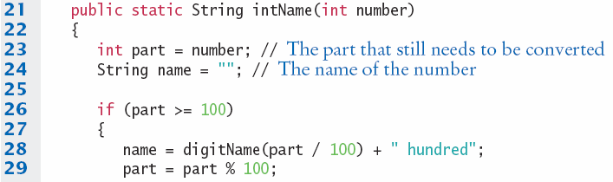
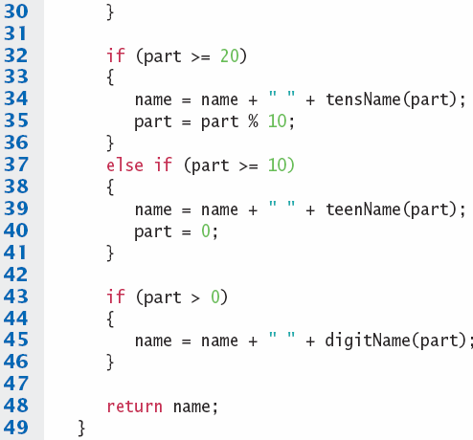
Convert to Java: intName method
main calls intName
  Does all the work
  Returns a String
Uses methods:
  tensName
  teenName
  digitName
Copyright © 2013 by John Wiley & Sons. All rights reserved.
Page <number>

Slide 37
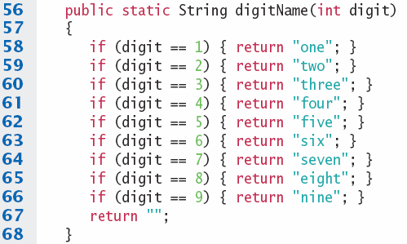
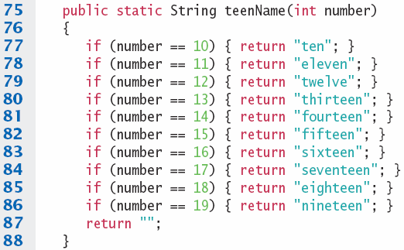
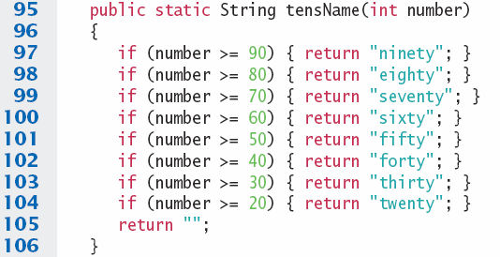

digitName, teenName, tensName
Copyright © 2013 by John Wiley & Sons. All rights reserved.
Page <number>

Slide 38
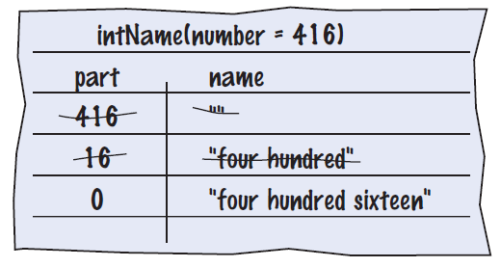

Programming Tips
Keep methods short
  If more than one screen, break into ‘sub’ methods
Trace your methods
  One line for each step
  Columns for key variables
Use Stubs as you write larger programs
  Unfinished methods that return a ‘dummy’ value
public static String digitName(int digit)
{
return "mumble";
}
Copyright © 2013 by John Wiley & Sons. All rights reserved.
Page <number>

Slide 39
5.8 Variable Scope
The scope of a variable is the part of the program in which
it is visible.
Variables can be declared:
  Inside a method
    Known as ‘local variables’
    Only available inside this method
    Parameter variables are like local variables
  Inside a block of code { }
    Sometimes called ‘block scope’
    If declared inside block { ends at end of block }
  Outside of a method
    Sometimes called ‘global scope’
    Can be used (and changed) by code in any method
How do you choose?
Copyright © 2013 by John Wiley & Sons. All rights reserved.
Page <number>

Slide 40
Examples of Scope
  sum is a local variable in main
  square is only visible inside the for loop block
  i is only visible inside the for loop
public static void main(String[] args)
{
int sum = 0;
for (int i = 1; i <= 10; i++)
{
int square = i * i;
sum = sum + square;
}
System.out.println(sum);
}
sum
i
square
The scope of a variable is the part of the program in which
it is visible.
Copyright © 2013 by John Wiley & Sons. All rights reserved.
Page <number>

Slide 41
Local Variables of Methods
Variables declared inside one method are not visible to other methods
  sideLength is local to main
  Using it outside main will cause a compiler error
public static void main(String[] args)
{
double sideLength = 10;
int result = cubeVolume();
System.out.println(result);
}
public static double cubeVolume()
{
return sideLength * sideLength * sideLength; // ERROR
}
Copyright © 2013 by John Wiley & Sons. All rights reserved.
Page <number>

Slide 42
Re-using names for local variables
Variables declared inside one method are not visible to other methods
  result is local to square and result is local to main
  They are two different variables and do not overlap
public static int square(int n)
{
int result = n * n;
return result;
}
public static void main(String[] args)
{
int result = square(3) + square(4);
System.out.println(result);
}
result
result
Copyright © 2013 by John Wiley & Sons. All rights reserved.
Page <number>

Slide 43
Re-using names for block variables
Variables declared inside one block are not visible to other methods
  i is inside the first for block and i is inside the second
  They are two different variables and do not overlap
public static void main(String[] args)
{
int sum = 0;
for (int i = 1; i <= 10; i++)
{
sum = sum + i;
}
for (int i = 1; i <= 10; i++)
{
sum = sum + i * i;
}
System.out.println(sum);
}
i
i
Copyright © 2013 by John Wiley & Sons. All rights reserved.
Page <number>

Slide 44
Overlapping Scope
Variables (including parameter variables) must have unique names within their scope
  n has local scope and n is in a block inside that scope
  The compiler will complain when the block scope n is declared
public static int sumOfSquares(int n)
{
int sum = 0;
for (int i = 1; i <= n; i++)
{
int n = i * i; // ERROR
sum = sum + n;
}
return sum;
}
Local n
block scope n
Copyright © 2013 by John Wiley & Sons. All rights reserved.
Page <number>

Slide 45
Global and Local Overlapping
Global and Local (method) variables can overlap
  The local same will be used when it is in scope
  No access to global same when local same is in scope
public class Scoper
{
public static int same; // ‘global’
public static void main(String[] args)
{
int same = 0; // local
for (int i = 1; i <= 10; i++)
{
int square = i * i;
same = same + square;
}
System.out.println(same);
}
}
same
same
Variables in different scopes with
the same name will compile, but
it is not a good idea
Copyright © 2013 by John Wiley & Sons. All rights reserved.
Page <number>

Slide 46
5.9 Recursive Methods (optional)
A recursive method is a method that calls itself
A recursive computation solves a problem by using the solution of the same problem with simpler inputs
For a recursion to terminate, there must be special cases for the simplest inputs
Copyright © 2013 by John Wiley & Sons. All rights reserved.
Page <number>

Slide 47
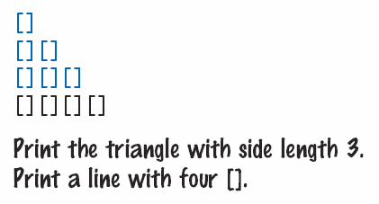
Recursive Triangle Example
public static void printTriangle(int sideLength)
{
if (sideLength < 1) { return; }
printTriangle(sideLength - 1);
for (int i = 0; i < sideLength; i++)
{
System.out.print("[]");
}
System.out.println();
}
Special Case
Recursive Call
The method will call itself (and not output anything) until sideLength becomes < 1
It will then use the return statement and each of the previous iterations will print their results
  1, 2, 3 then 4
Copyright © 2013 by John Wiley & Sons. All rights reserved.
Page <number>

Slide 48
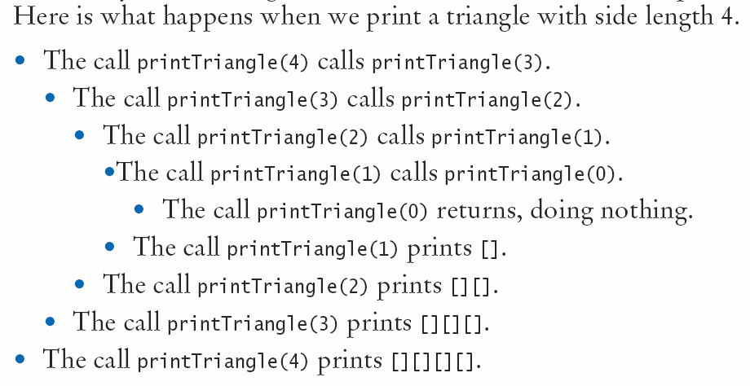
Recursive Calls and Returns
Copyright © 2013 by John Wiley & Sons. All rights reserved.
Page <number>

Slide 49
Summary: Methods
A method is a named sequence of instructions.
Arguments are supplied when a method is called. The return value is the result that the method computes.
When declaring a method, you provide a name for the method, a variable for each argument, and a type for the result.
Method comments explain the purpose of the method, the meaning of the parameters and return value, as well as any special requirements.
Parameter variables hold the arguments supplied in the method call.
Copyright © 2013 by John Wiley & Sons. All rights reserved.
Page <number>

Slide 50
Summary: Method Returns
The return statement terminates a method call and yields the method result.
  Turn computations that can be reused into methods.
  Use a return type of void to indicate that a method does not return a value.
Use the process of stepwise refinement to decompose complex tasks into simpler ones.
  When you discover that you need a method, write a description of the parameter variables and return values.
  A method may require simpler methods to carry out its work.
Copyright © 2013 by John Wiley & Sons. All rights reserved.
Page <number>

Slide 51
Summary: Scope
The scope of a variable is the part of the program in which it is visible.
  Two local or parameter variables can have the same name, provided that their scopes do not overlap.
  You can use the same variable name within different methods since their scope does not overlap.
  Local variables declared inside one method are not visible to code inside other methods
Copyright © 2013 by John Wiley & Sons. All rights reserved.
Page <number>

Slide 52
Summary: Recursion
A recursive computation solves a problem by using the solution of the same problem with simpler inputs.
  For a recursion to terminate, there must be special cases for the simplest inputs.
  The key to finding a recursive solution is reducing the input to a simpler input for the same problem.
  When designing a recursive solution, do not worry about multiple nested calls. Simply focus on reducing a problem to a slightly simpler one.
Copyright © 2013 by John Wiley & Sons. All rights reserved.
Page <number>

