Slide 1
Arquiteturas de Sistemas Distribuídos
Adaptado por Vinícius Hax a partir dos slides “Chapter 2: Architectures” de Tanenbaum e Van Steen

Slide 2
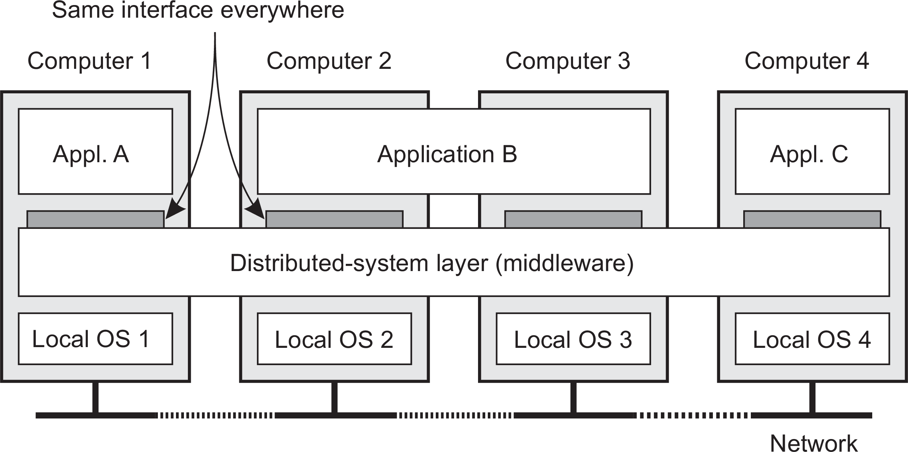
Architectures
Middleware and distributed systems
Middleware: the OS of distributed systems
What does it contain?
Commonly used components and functions that need not be implemented by applications separately.

Slide 3
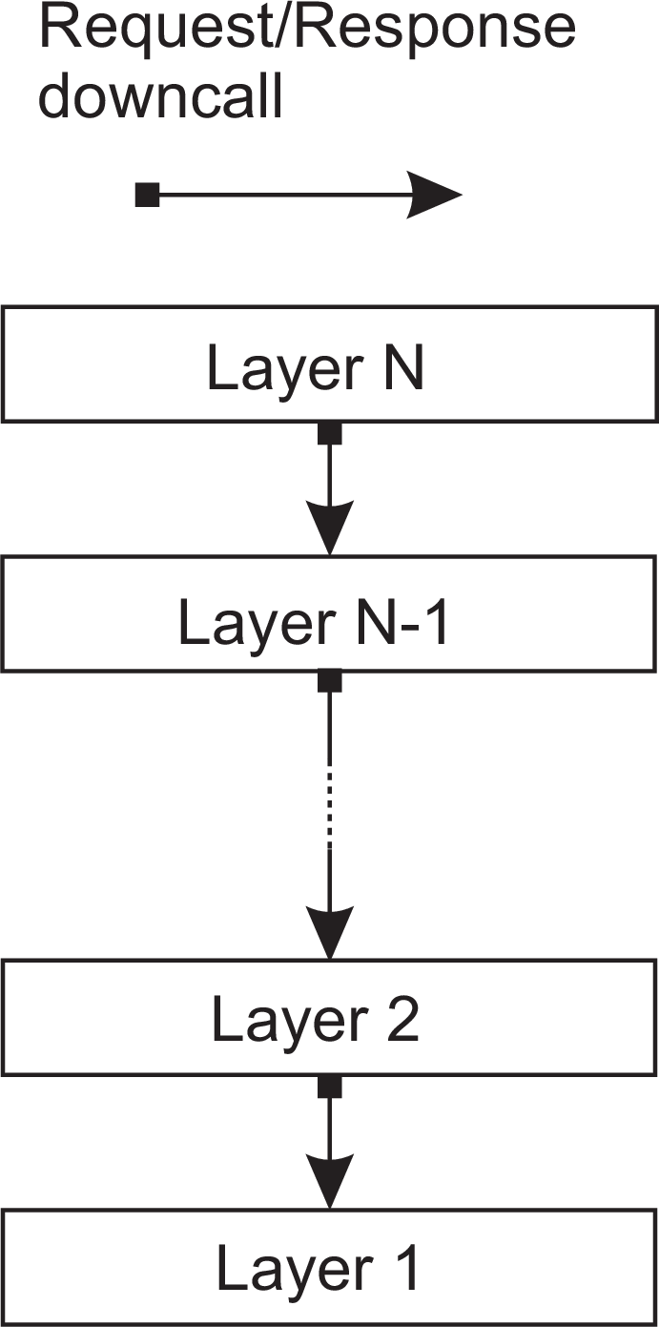
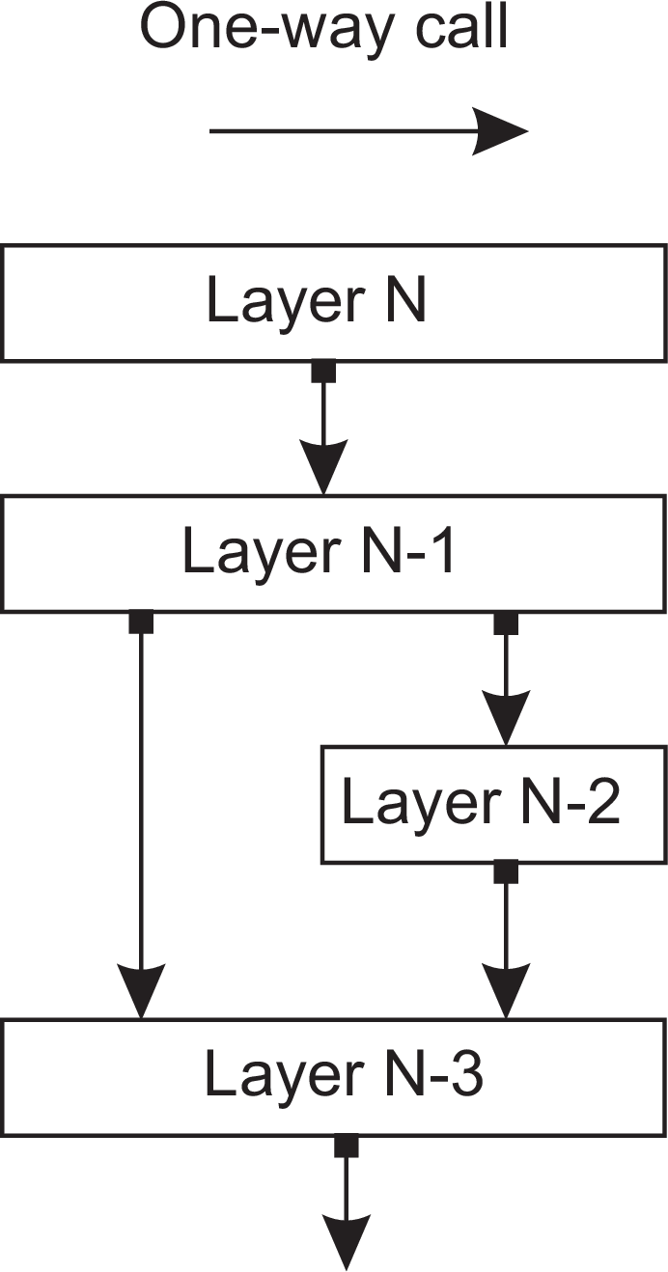
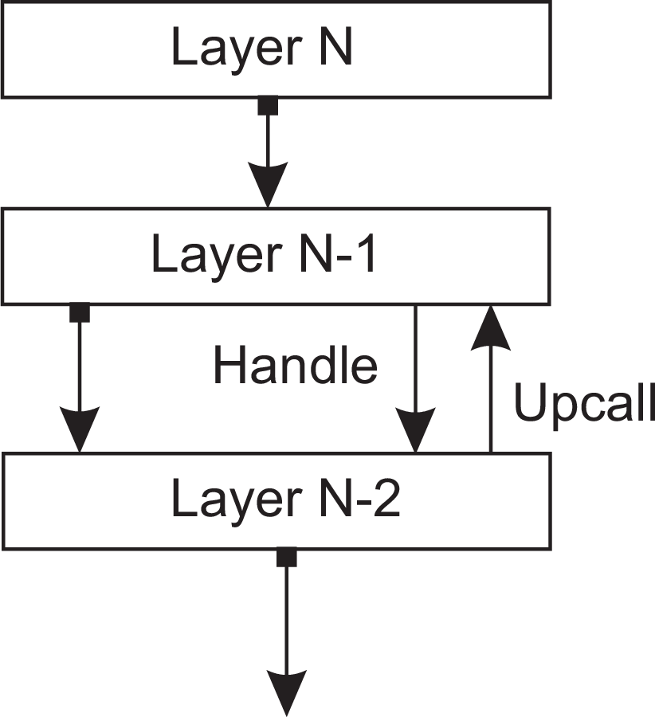
Architectures
Architectural styles
Layered architecture
Different layered organizations
(a)
(b)
(c)
Layered architectures

Slide 4
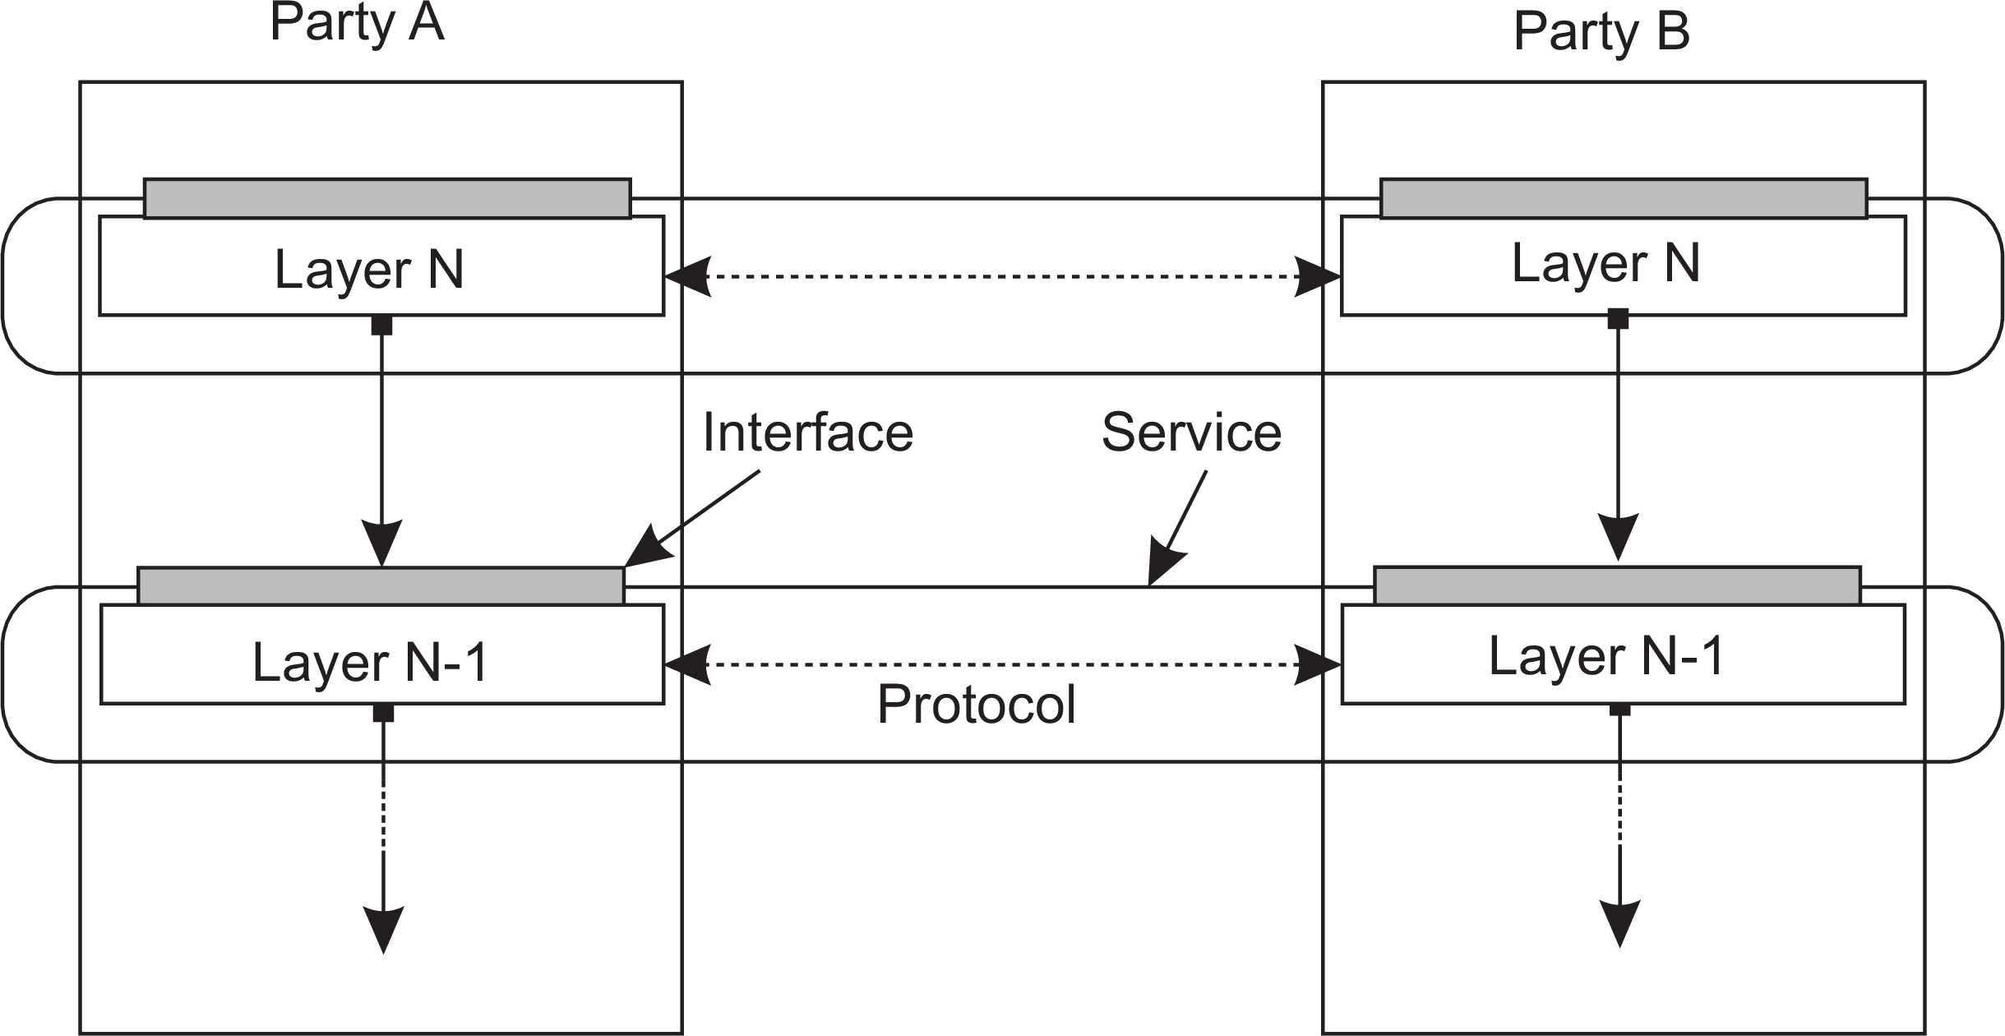
Architectures
Architectural styles
Example: communication protocols
Protocol, service, interface
Layered architectures

Slide 5
Architectures
Architectural styles
Two-party communication
Server
1 from socket import *
2
3 s = socket(AF_INET, SOCK_STREAM)
4 (conn, addr) = s.accept() # returns new socket and addr. client
5 while True: # forever
6
7
8
9
data = conn.recv(1024) # receive data from client
if not data: break # stop if client stopped
msg = data.decode()+"*" # process the incoming data into a response
conn.send(msg.encode()) # return the response
10 conn.close() # close the connection
Client
1 from socket import *
2
3 s = socket(AF_INET, SOCK_STREAM)
4 s.connect((HOST, PORT)) # connect to server (block until accepted)
5 msg = "Hello World" # compose a message
6 s.send(msg.encode()) # send the message
7 data = s.recv(1024) # receive the response
8 print(data.decode()) # print the result
9 s.close() # close the connection
Layered architectures

Slide 6
Application Layering
Architectures
Traditional three-layered view
Application-interface layer contains units for interfacing to users or external applications
Processing layer contains the functions of an application, i.e., without specific data
Data layer contains the data that a client wants to manipulate through the application components
Layered architectures

Slide 7
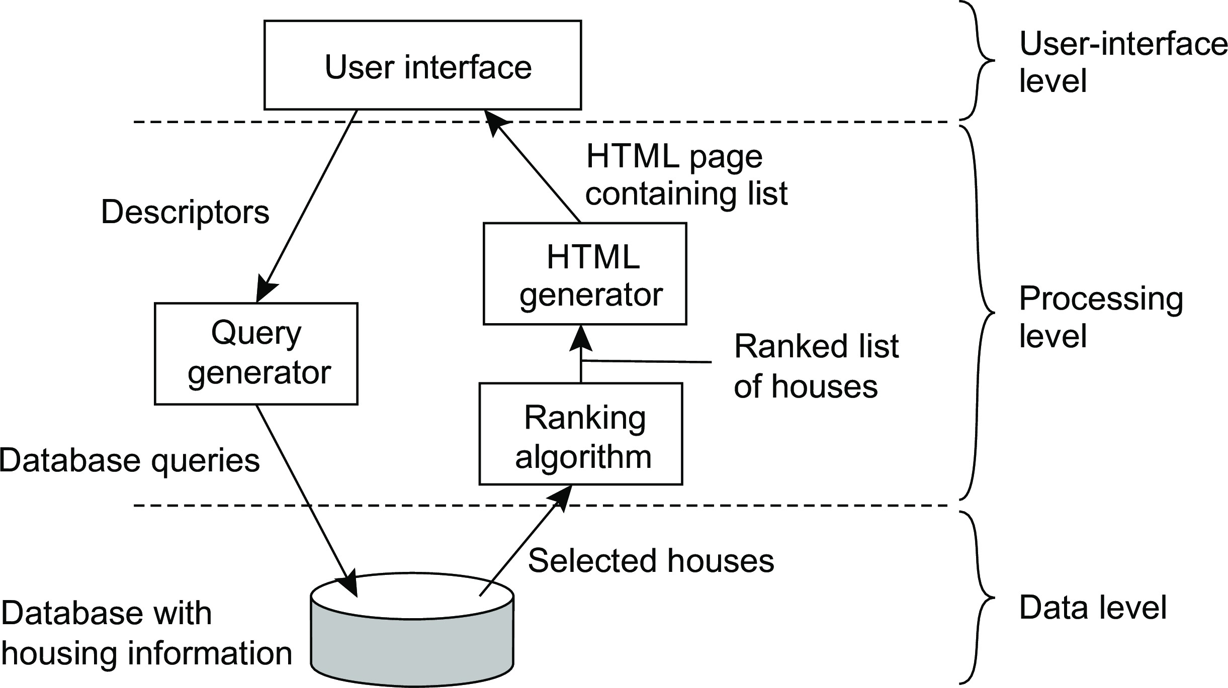
Architectures
Architectural styles
Application Layering
Example: a simple search engine
Layered architectures

Slide 8
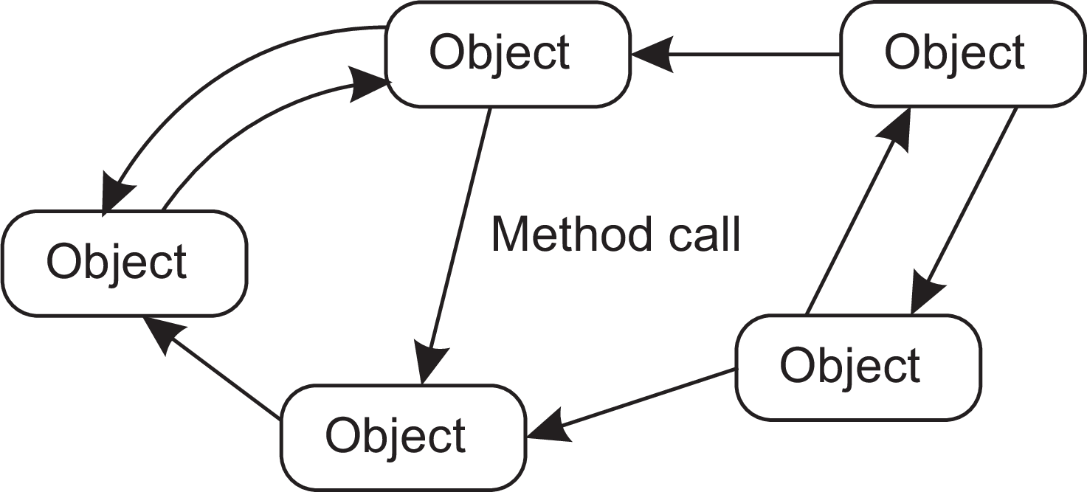
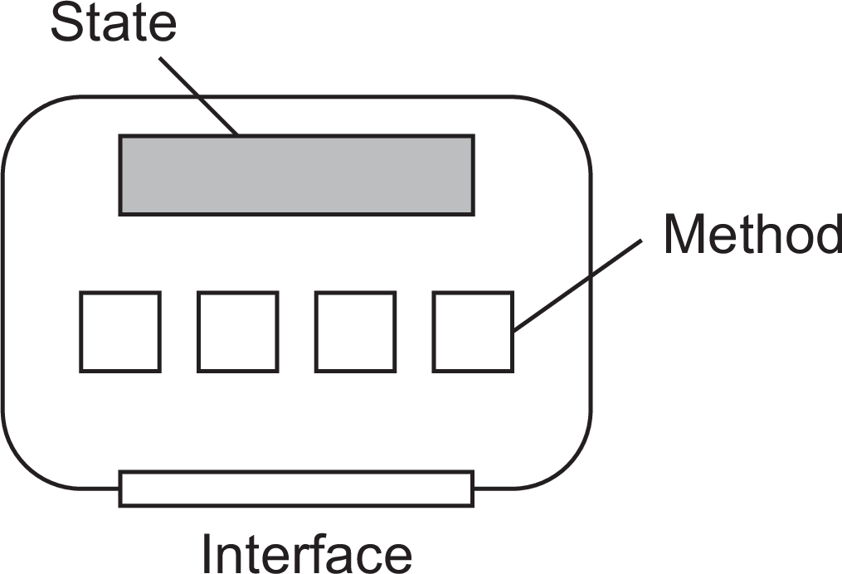
Object-based style
Architectures
Essence
Components are objects, connected to each other through procedure calls. Objects may be placed on different machines; calls can thus execute across a network.
Encapsulation
Objects are said to encapsulate data and offer methods on that data without revealing the internal implementation.
Service-oriented architectures

Slide 9
RESTful architectures
Architectures
Essence
View a distributed system as a collection of resources, individually managed by components. Resources may be added, removed, retrieved, and modified by (remote) applications.
Resources are identified through a single naming scheme
All services offer the same interface
Messages sent to or from a service are fully self-described
After executing an operation at a service, that component forgets everything about the caller
Basic operations
Operation | Description
PUT | Create a new resource
GET | Retrieve the state of a resource in some representation
DELETE | Delete a resource
POST | Modify a resource by transferring a new state
Service-oriented architectures

Slide 10
Example: Amazon’s Simple Storage Service
Architectures
Essence
Objects (i.e., files) are placed into buckets (i.e., directories). Buckets cannot be placed into buckets. Operations on ObjectName in bucket BucketName require the following identifier:
http://BucketName.s3.amazonaws.com/ObjectName
Typical operations
All operations are carried out by sending HTTP requests:
Create a bucket/object: PUT, along with the URI
Listing objects: GET on a bucket name
Reading an object: GET on a full URI
Service-oriented architectures

Slide 11
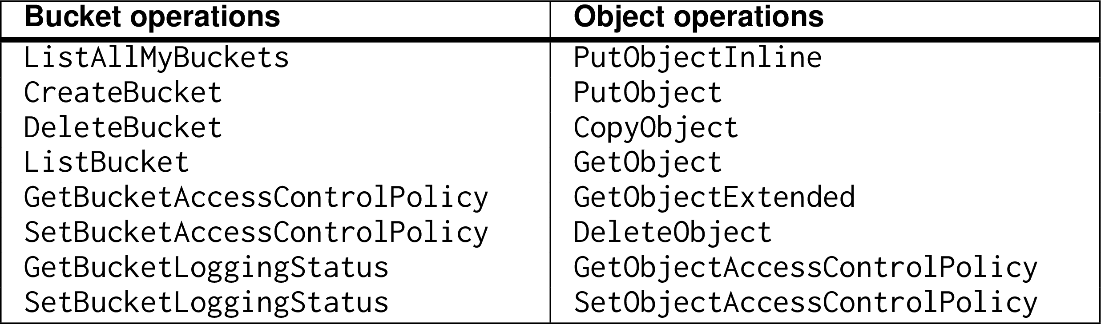
On interfaces
Architectures
Issue
Many people like RESTful approaches because the interface to a service is so simple. The catch is that much needs to be done in the parameter space.
Amazon S3 SOAP interface
Service-oriented architectures

Slide 12
On interfaces
Architectures
Simplifications
Assume an interface bucket offering an operation create, requiring an input string such as mybucket, for creating a bucket “mybucket.”
Service-oriented architectures

Slide 13
On interfaces
Architectures
Simplifications
Assume an interface bucket offering an operation create, requiring an input string such as mybucket, for creating a bucket “mybucket.”
SOAP
import bucket bucket.create("mybucket")
Service-oriented architectures

Slide 14
On interfaces
Architectures
Simplifications
Assume an interface bucket offering an operation create, requiring an input string such as mybucket, for creating a bucket “mybucket.”
SOAP
import bucket bucket.create("mybucket")
RESTful
PUT "https://mybucket.s3.amazonsws.com/"
Service-oriented architectures

Slide 15
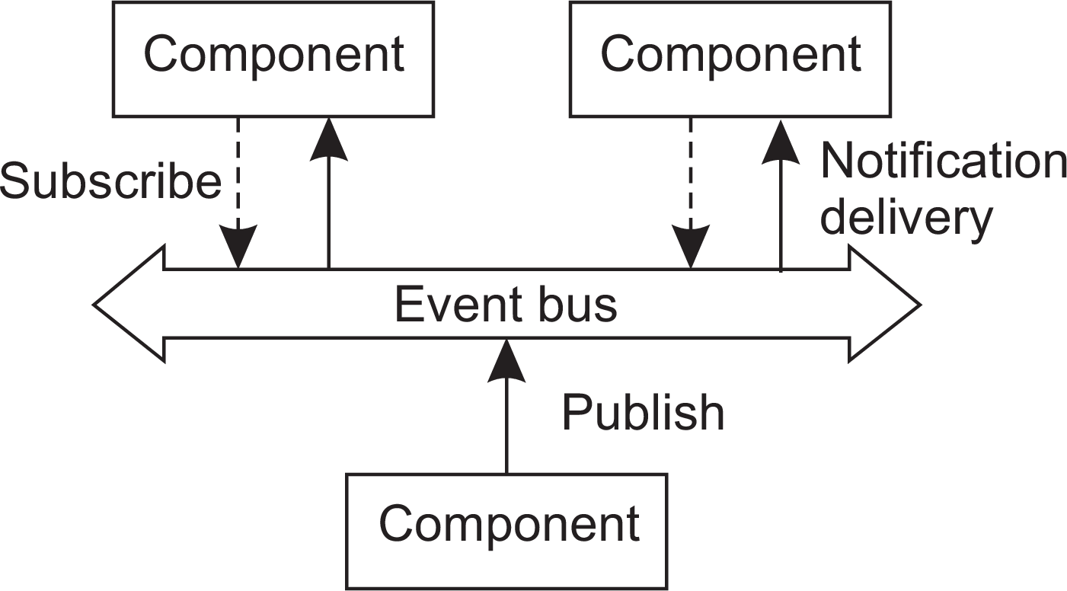
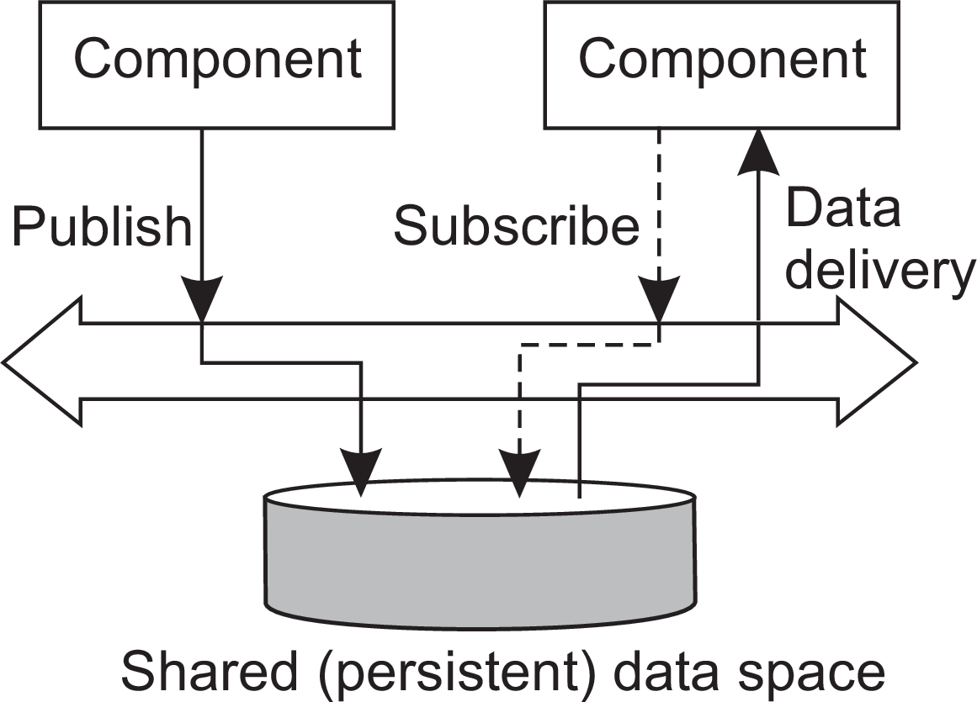
Architectures
Architectural styles
Event based
Temporal and coupling
 | Temporally coupled | Temporally decoupled
Referentially coupled | Direct | Mailbox
Referentially decoupled | Event-based | Shared data space
Event-based and Shared data space
Publish-subscribe architectures

Slide 16
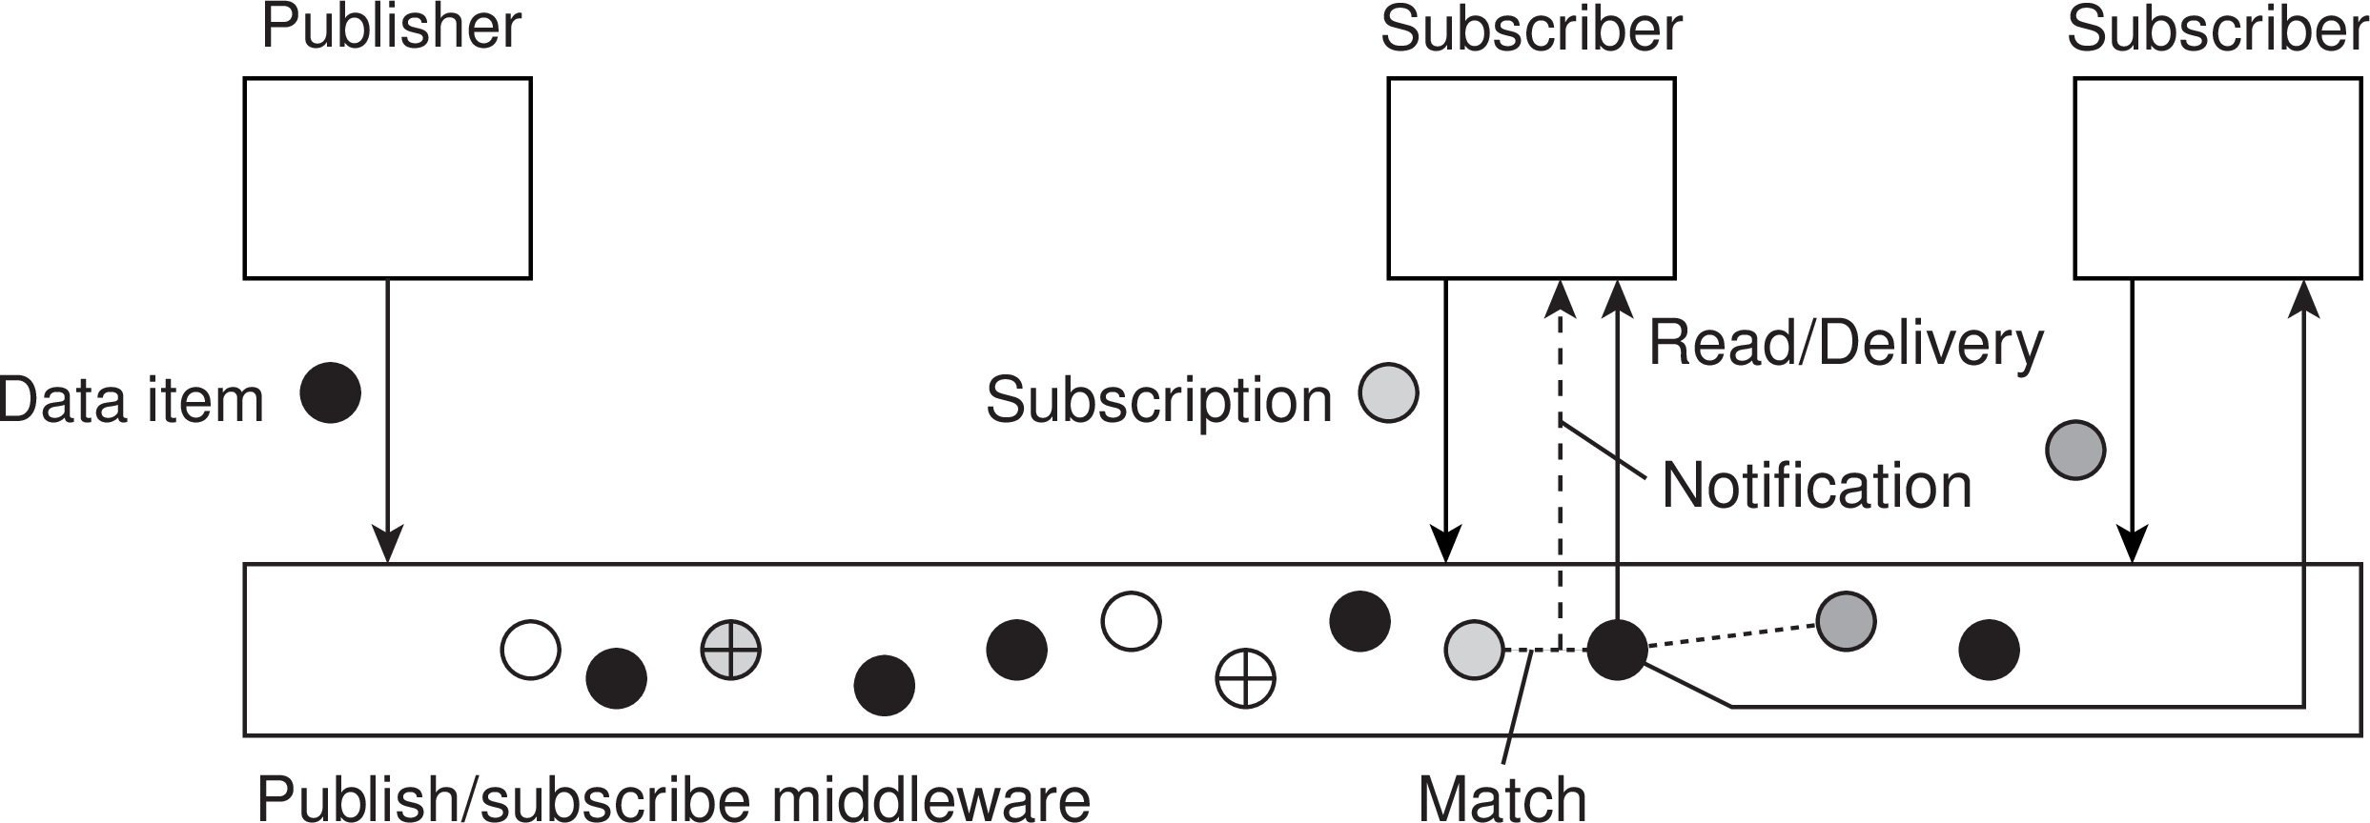
Architectures
Architectural styles
Publish and subscribe
Issue: how to match events?
Assume events are described by (attribute,value) pairs
topic-based subscription: specify a “attribute = value” series
content-based subscription: specify a “attribute ∈ range” series
Publish-subscribe architectures

Slide 17
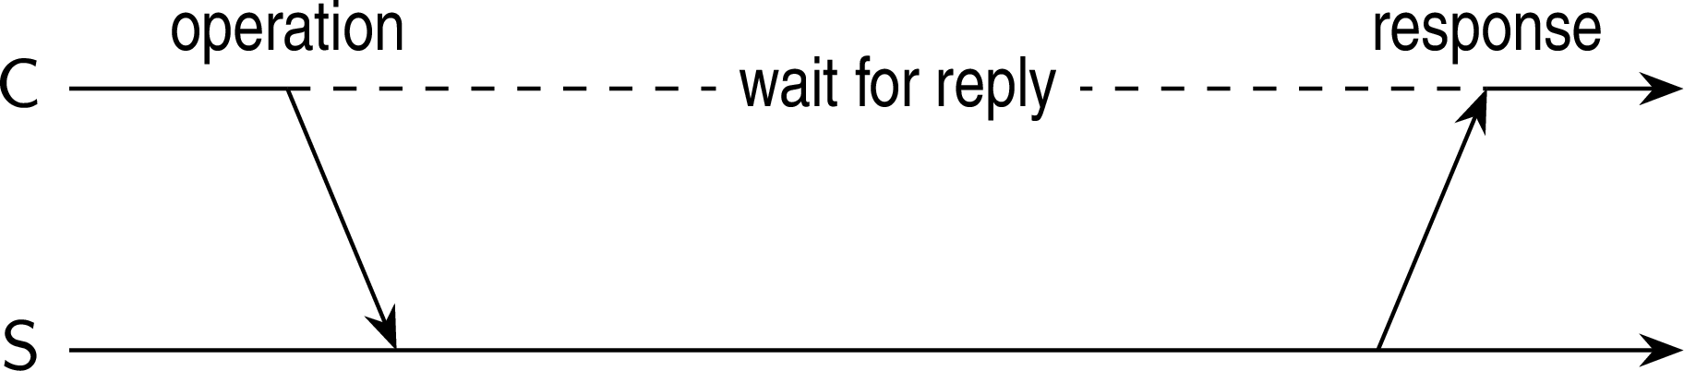
Architectures
Layered-system architectures
Centralized system architectures
Basic Client–Server Model
Characteristics:
There are processes offering services (servers)
There are processes that use services (clients)
Clients and servers can be on different machines
Clients follow request/reply model regarding using services
Simple client-server architecture

Slide 18
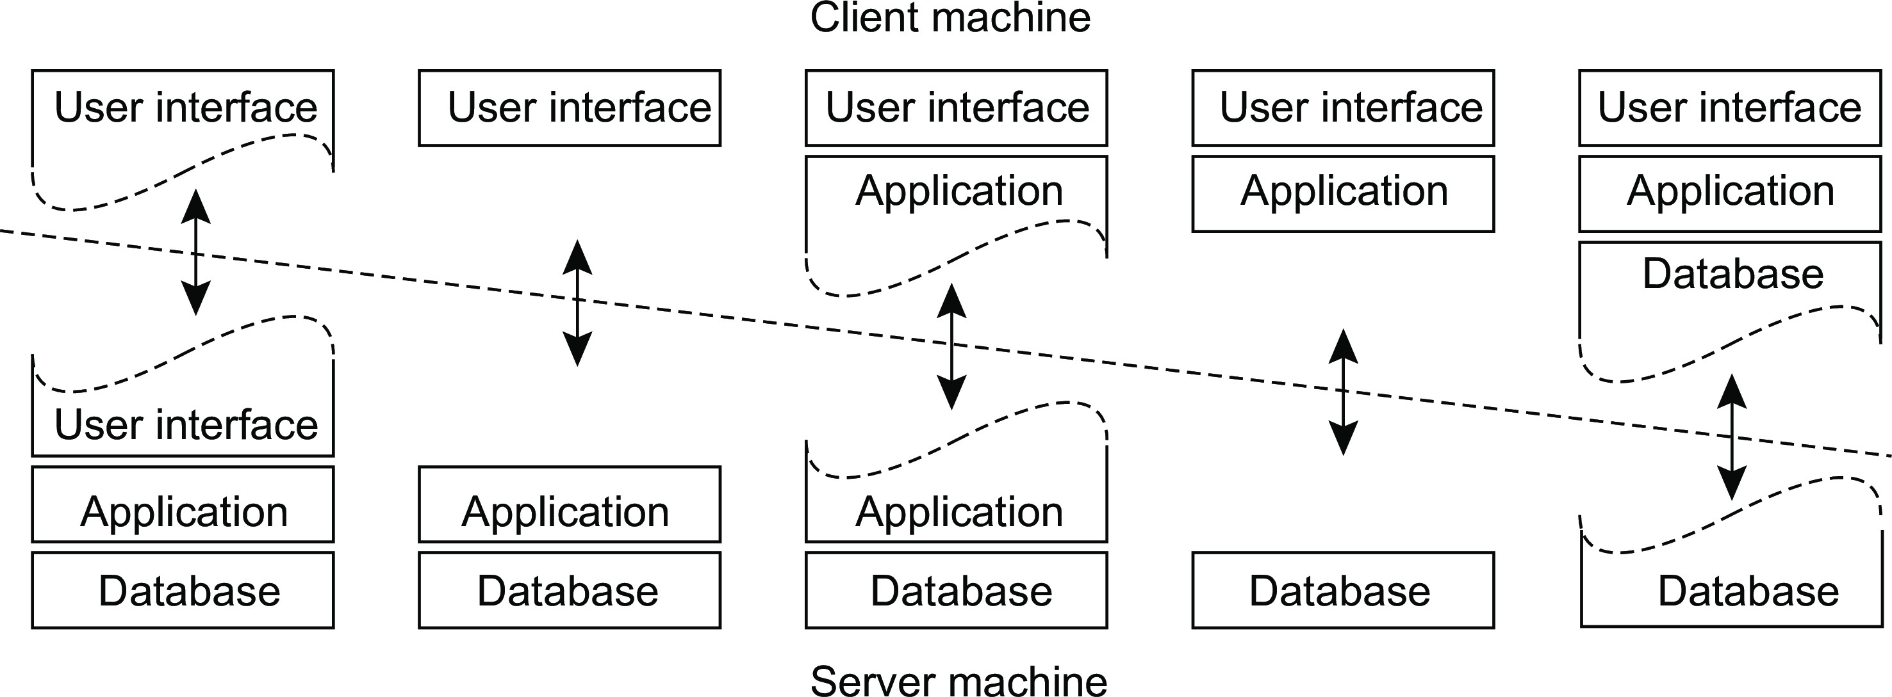
Architectures
Layered-system architectures
Multi-tiered centralized system architectures
Some traditional organizations
Single-tiered: dumb terminal/mainframe configuration
Two-tiered: client/single server configuration
Three-tiered: each layer on separate machine
Traditional two-tiered configurations
(a)
(b)
(c)
(d)
(e)
Multitiered Architectures

Slide 19
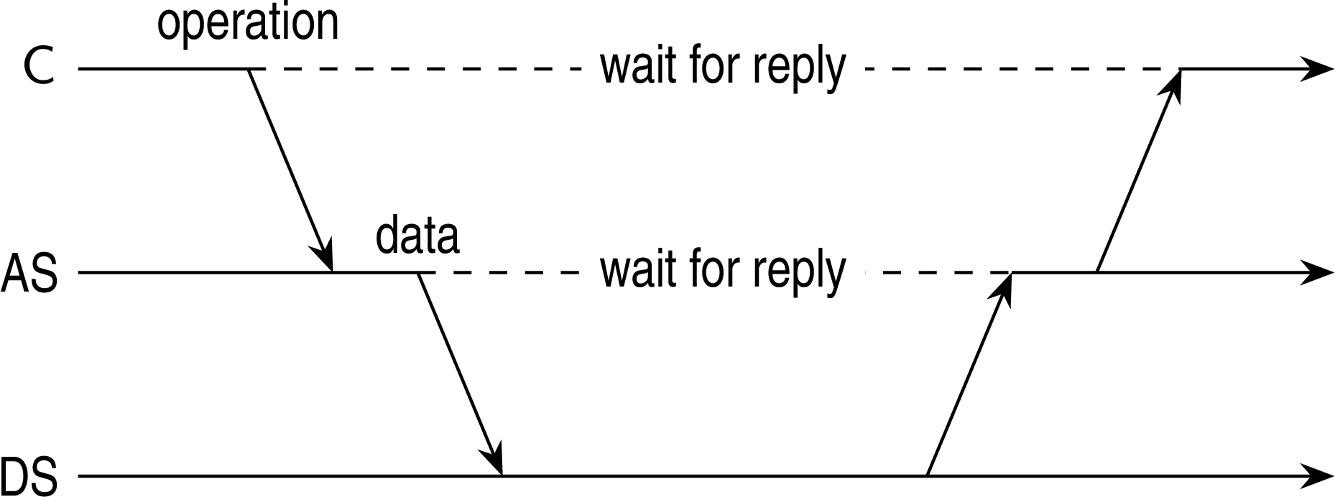
Architectures
Layered-system architectures
Being client and server at the same time
Three-tiered architecture
Multitiered Architectures

Slide 20
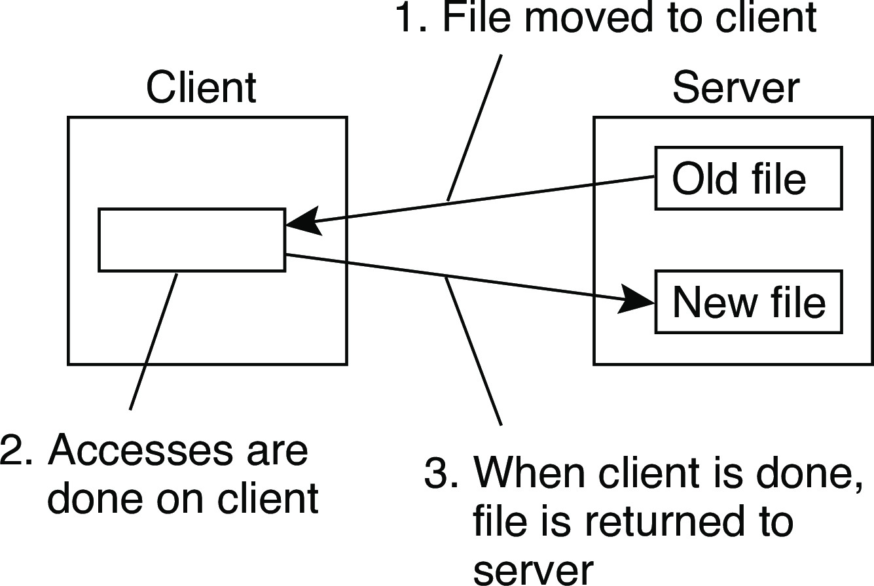
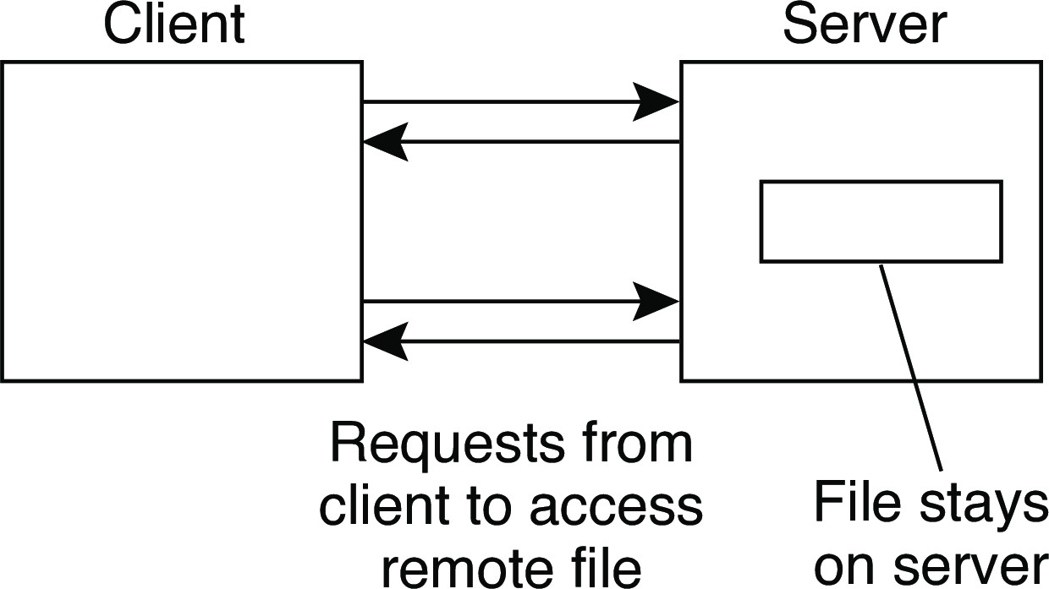
Example: The Network File System
Architectures
Foundations
Each NFS server provides a standardized view of its local file system: each server supports the same model, regardless the implementation of the file system.
The NFS remote access model
Remote access Upload/download
Note
FTP is a typical upload/download model. The same can be said for systems like Dropbox.
Example: The Network File System

Slide 21
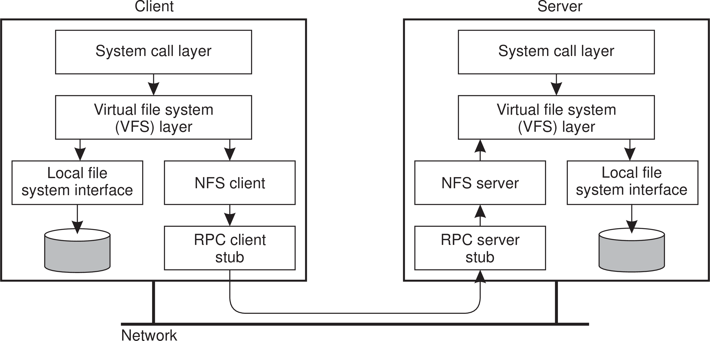
Architectures
Layered-system architectures
NFS architecture
Example: The Network File System

Slide 22
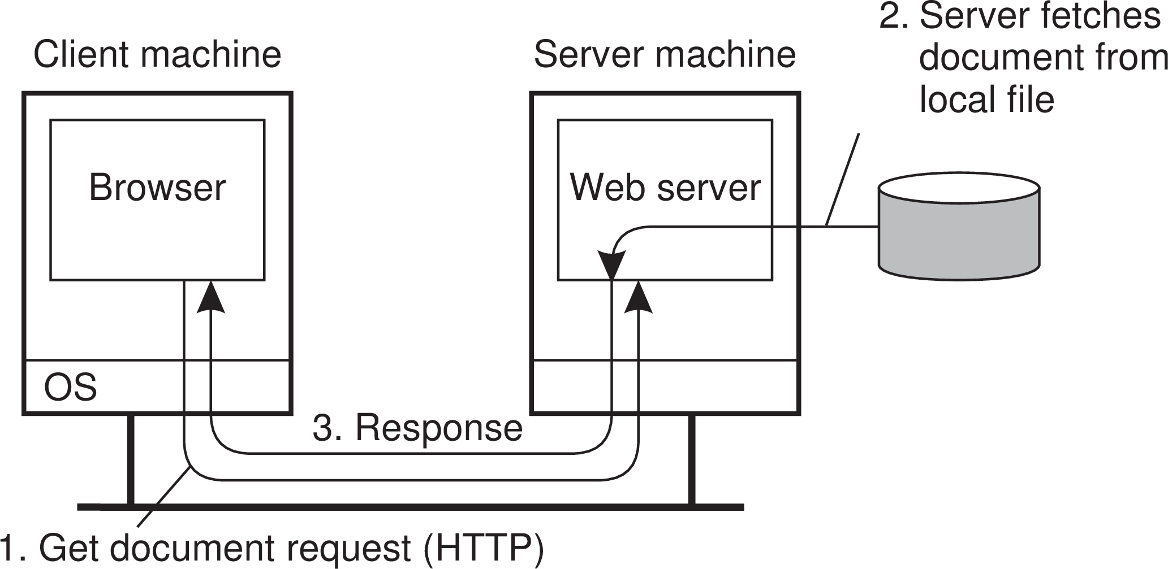
Architectures
Layered-system architectures
Example: Simple Web servers
Back in the old days...
...life was simple:
A website consisted as a collection of HTML files
HTML files could be referred to each other by a hyperlink
A Web server essentially needed only a hyperlink to fetch a file
•
A browser took care of properly rendering the content of a file
Example: The Web

Slide 23
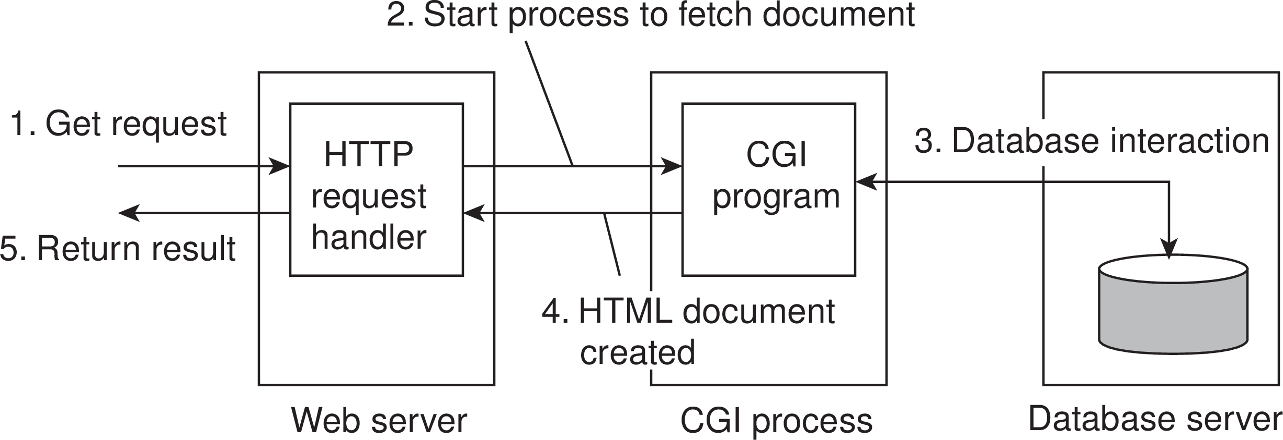
Architectures
Layered-system architectures
Example (cnt’d): Less simple Web servers
Still back in the old days...
...life became a bit more complicated:
A website was built around a database with content
A Webpage could still be referred to by a hyperlink
A Web server essentially needed only a hyperlink to fetch a file
A separate program (Common Gateway Interface) composed a page
•
A browser took care of properly rendering the content of a file
Example: The Web

Slide 24
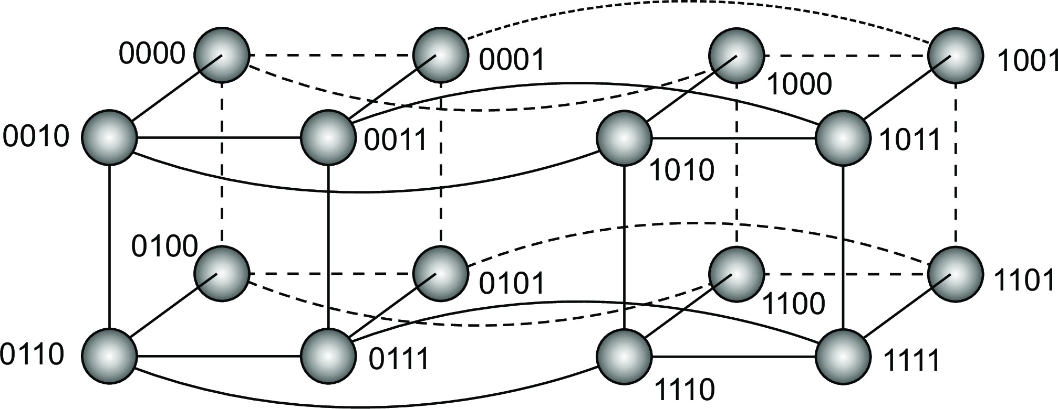
Structured P2P
Architectures
Essence
Make use of a semantic-free index: each data item is uniquely associated with a key, in turn used as an index. Common practice: use a hash function
key(data item) = hash(data item’s value).
P2P system now responsible for storing (key,value) pairs.
Simple example: hypercube
Looking up d with key k ∈ {0, 1, 2,..., 2⁴ − 1} means routing request to node with identifier k .
Structured peer-to-peer systems

Slide 25
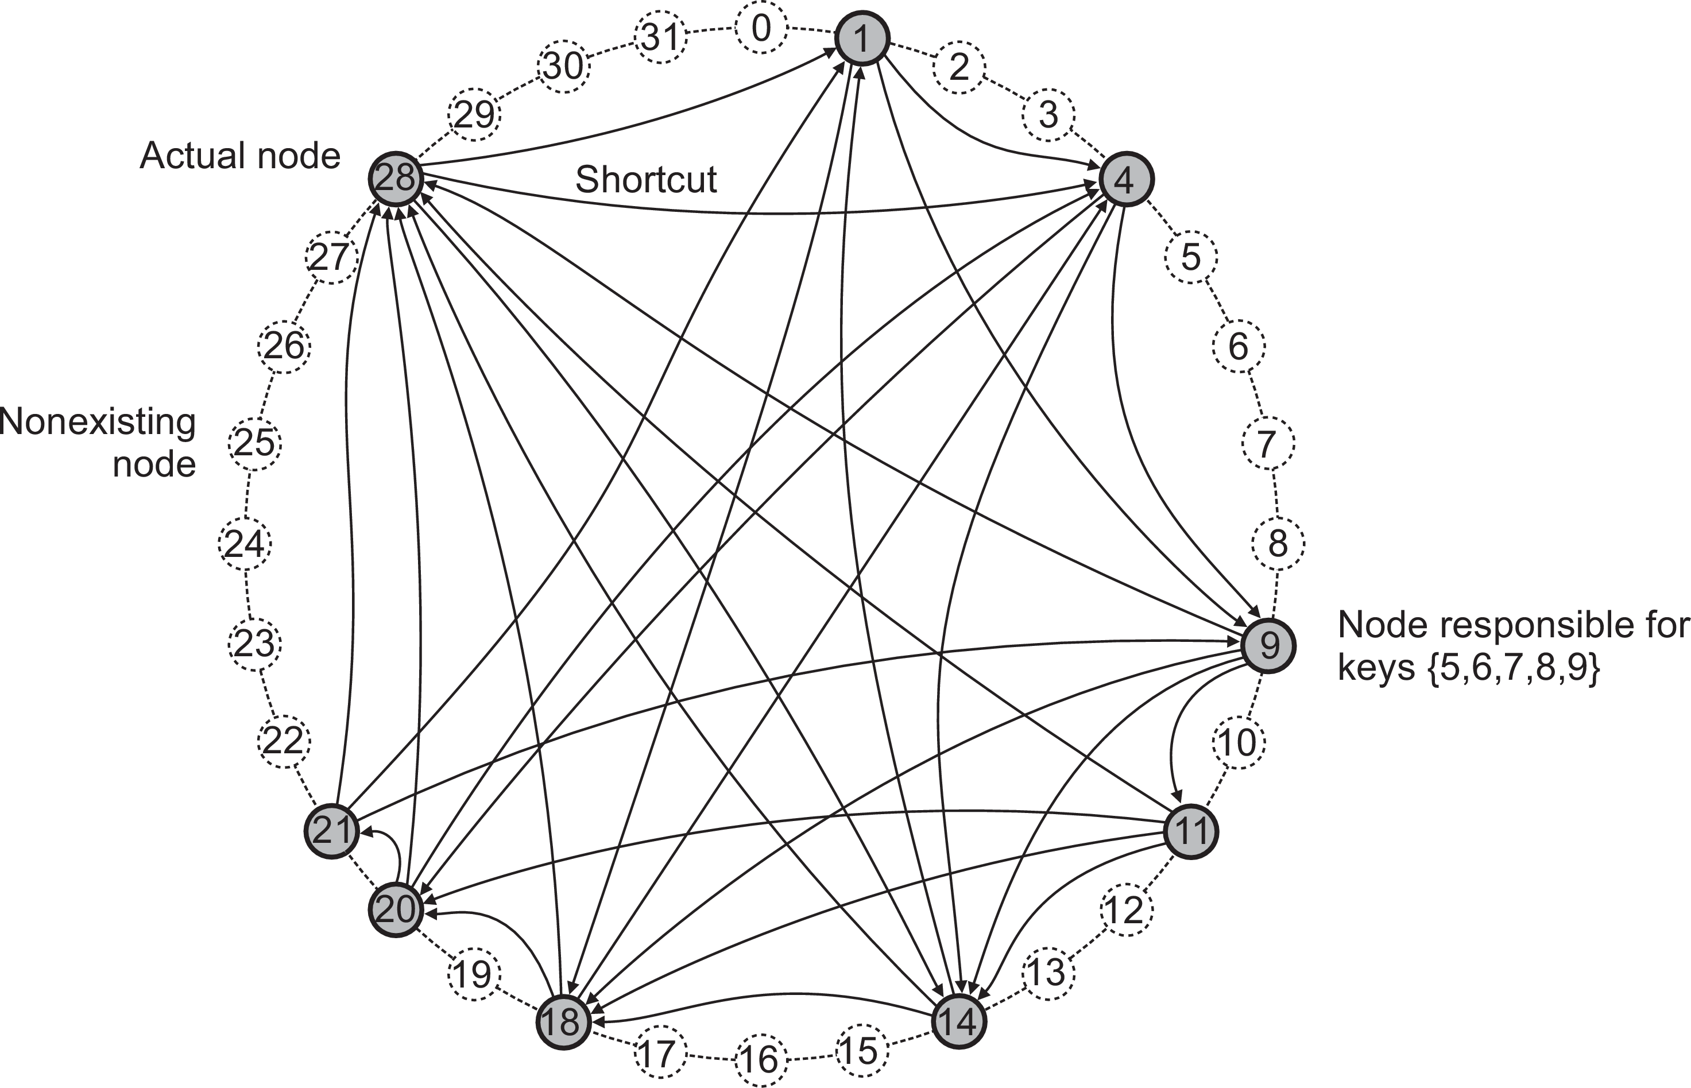
Architectures
Symmetrically distributed system architectures
Example: Chord
lookup(3)@9 : 28 → 1 → 4
Structured peer-to-peer systems

Slide 26
Unstructured P2P
Architectures
Essence
Each node maintains an ad hoc list of neighbors.
Searching
Flooding: issuing node u passes request for d to all neighbors. Request is ignored when receiving node had seen it before. Otherwise, v searches locally for d (recursively). May be limited by a Time-To-Live: a maximum number of hops.
Random walk: issuing node u passes request for d to randomly chosen neighbor, v . If v does not have d , it forwards request to one of its randomly chosen neighbors, and so on.
Unstructured peer-to-peer systems

Slide 27
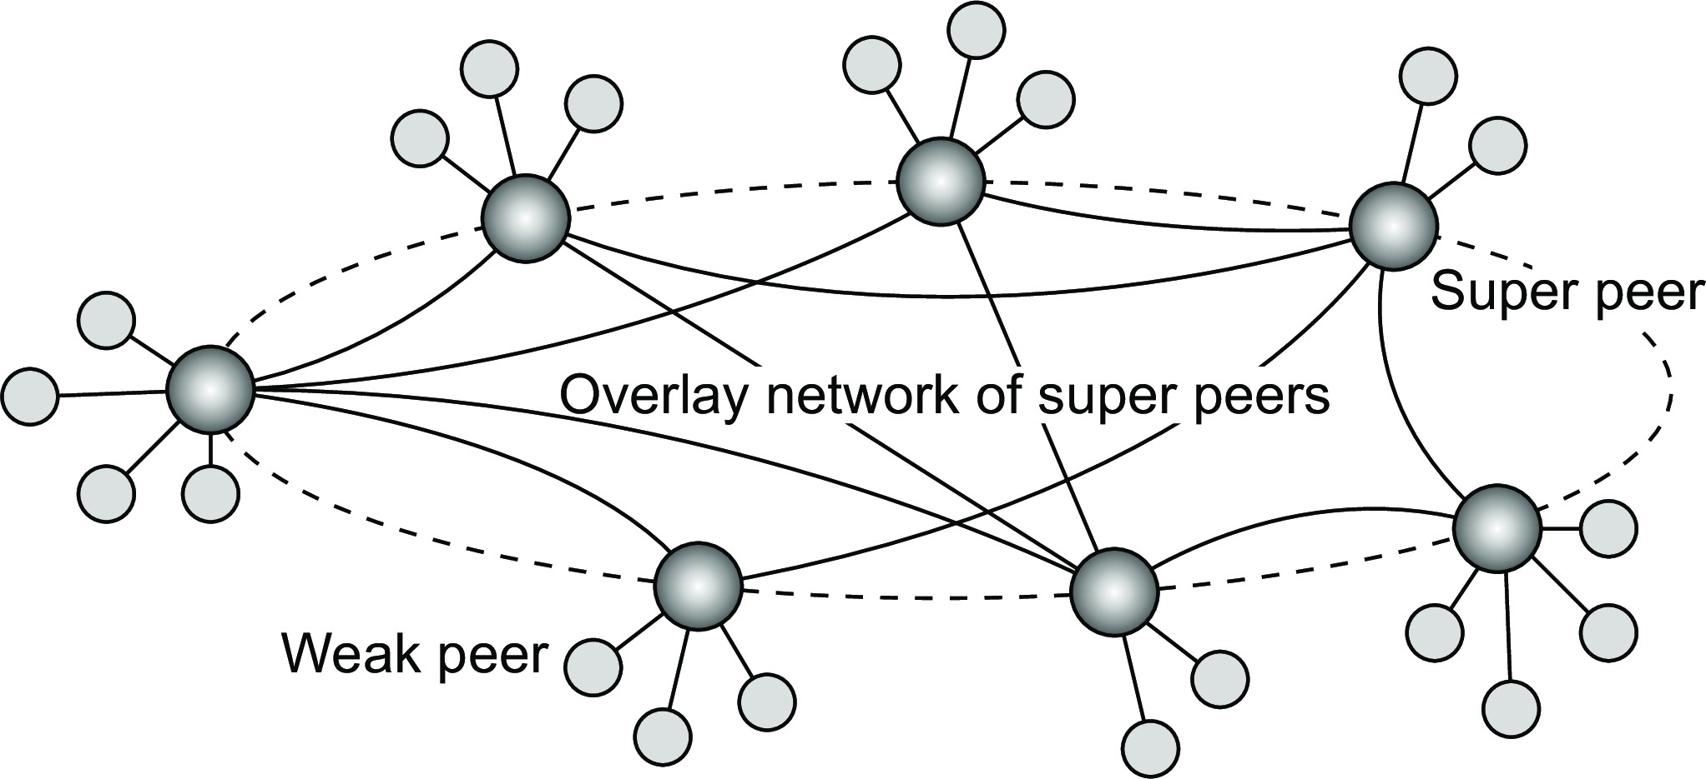
Super-peer networks
Architectures
Essence
It is sometimes sensible to break the symmetry in pure peer-to-peer networks:
When searching in unstructured P2P systems, having index servers improves performance
Hierarchically organized peer-to-peer networks

Slide 28
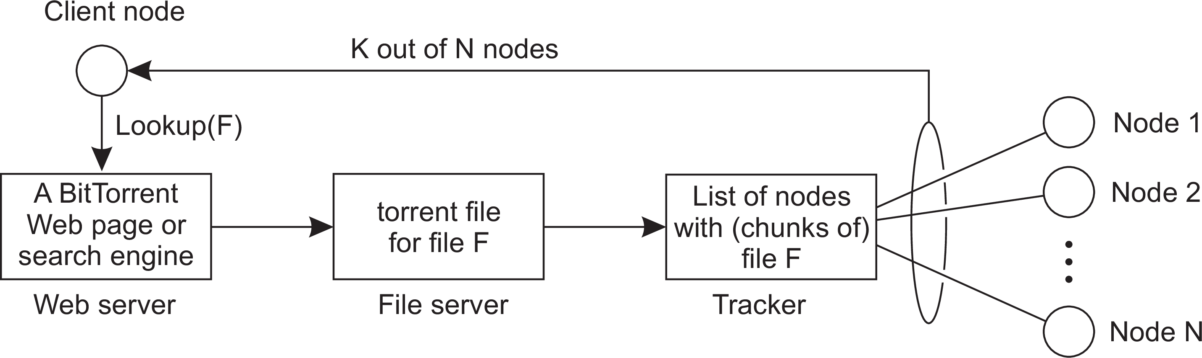
Collaboration: The BitTorrent case
Architectures
Principle: search for a file F
Lookup file at a global directory ⇒ returns a torrent file
Torrent file contains reference to tracker: a server keeping an accurate account of active nodes that have (chunks of) F .
P can join swarm, get a chunk for free, and then trade a copy of that chunk for another one with a peer Q also in the swarm.
Example: BitTorrent

Slide 29
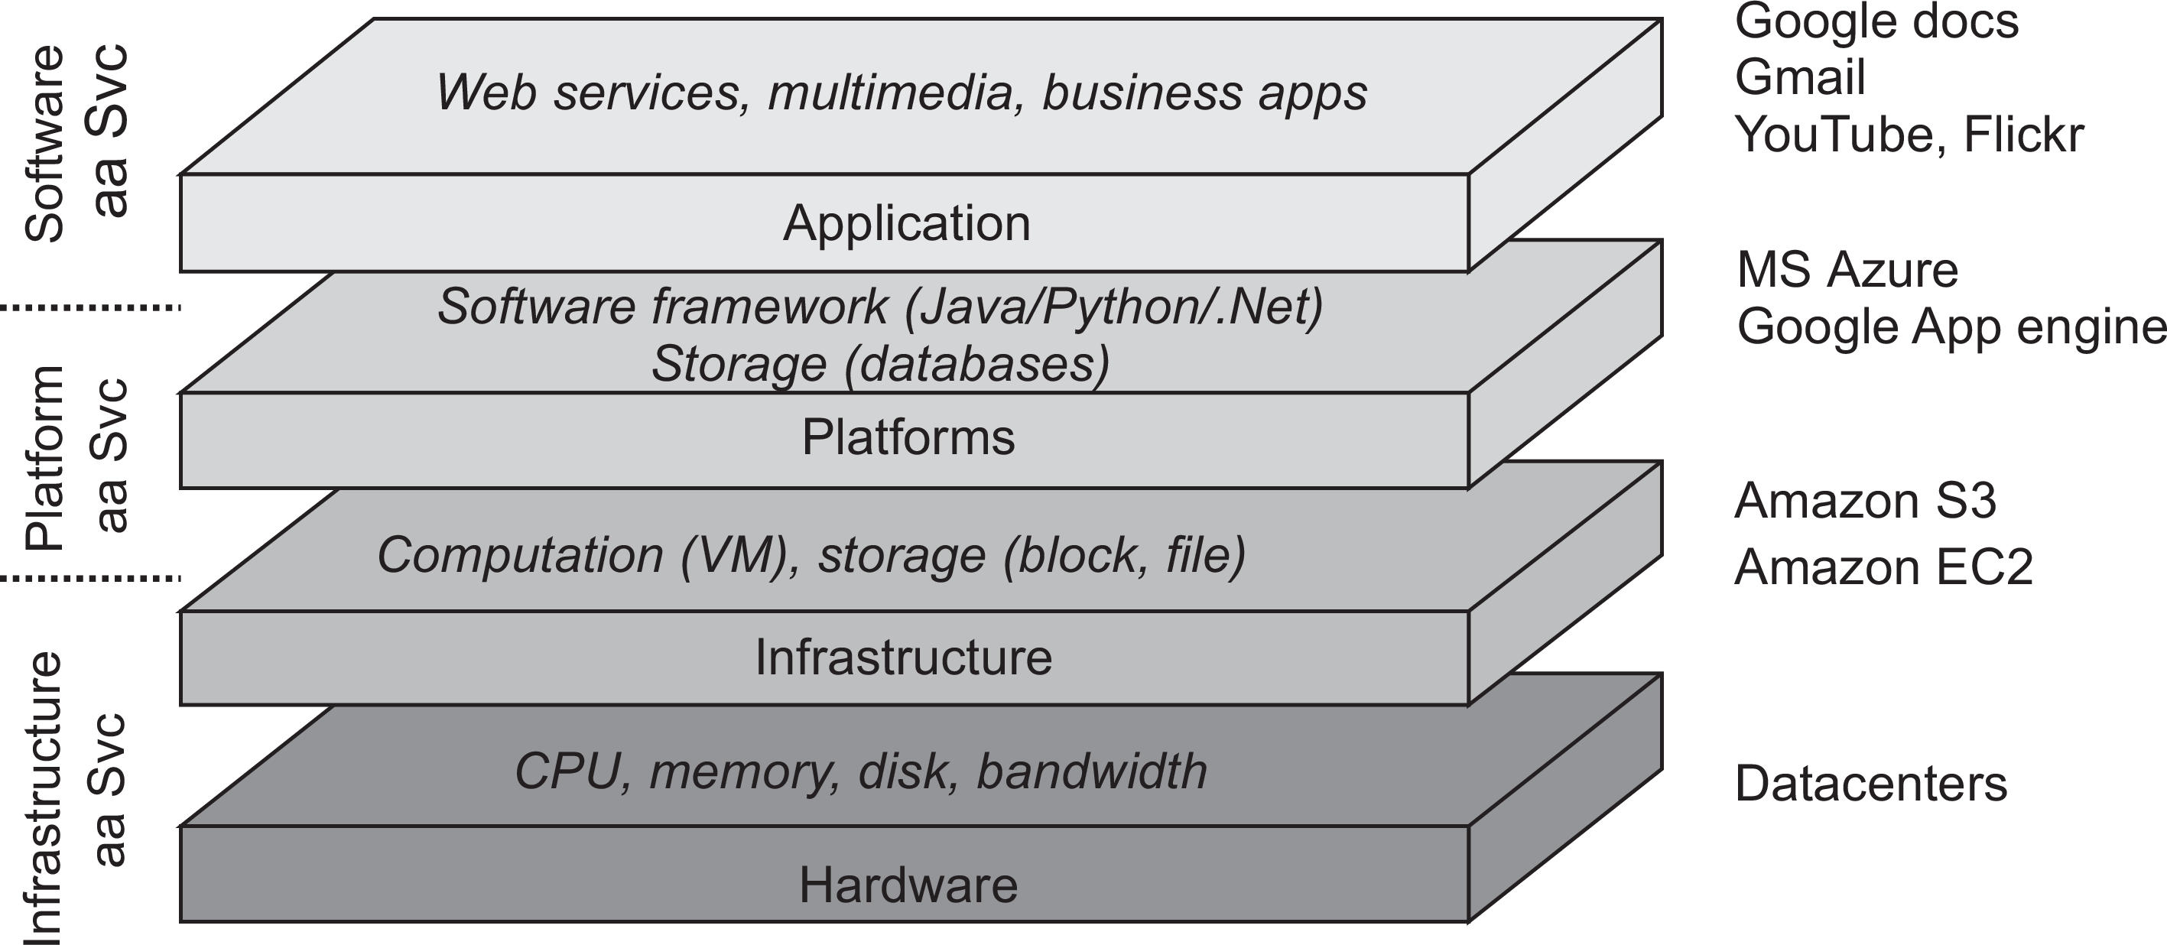
Architectures
Hybrid system architectures
Cloud computing
Cloud computing

Slide 30
Cloud computing
Architectures
Make a distinction between four layers
Hardware: Processors, routers, power and cooling systems. Customers normally never get to see these.
Infrastructure: Deploys virtualization techniques. Evolves around allocating and managing virtual storage devices and virtual servers.
Platform: Provides higher-level abstractions for storage and such. Example: Amazon S3 storage system offers an API for (locally created) files to be organized and stored in so-called buckets.
Application: Actual applications, such as office suites (text processors, spreadsheet applications, presentation applications). Comparable to the suite of apps shipped with OSes.
Cloud computing

Slide 31
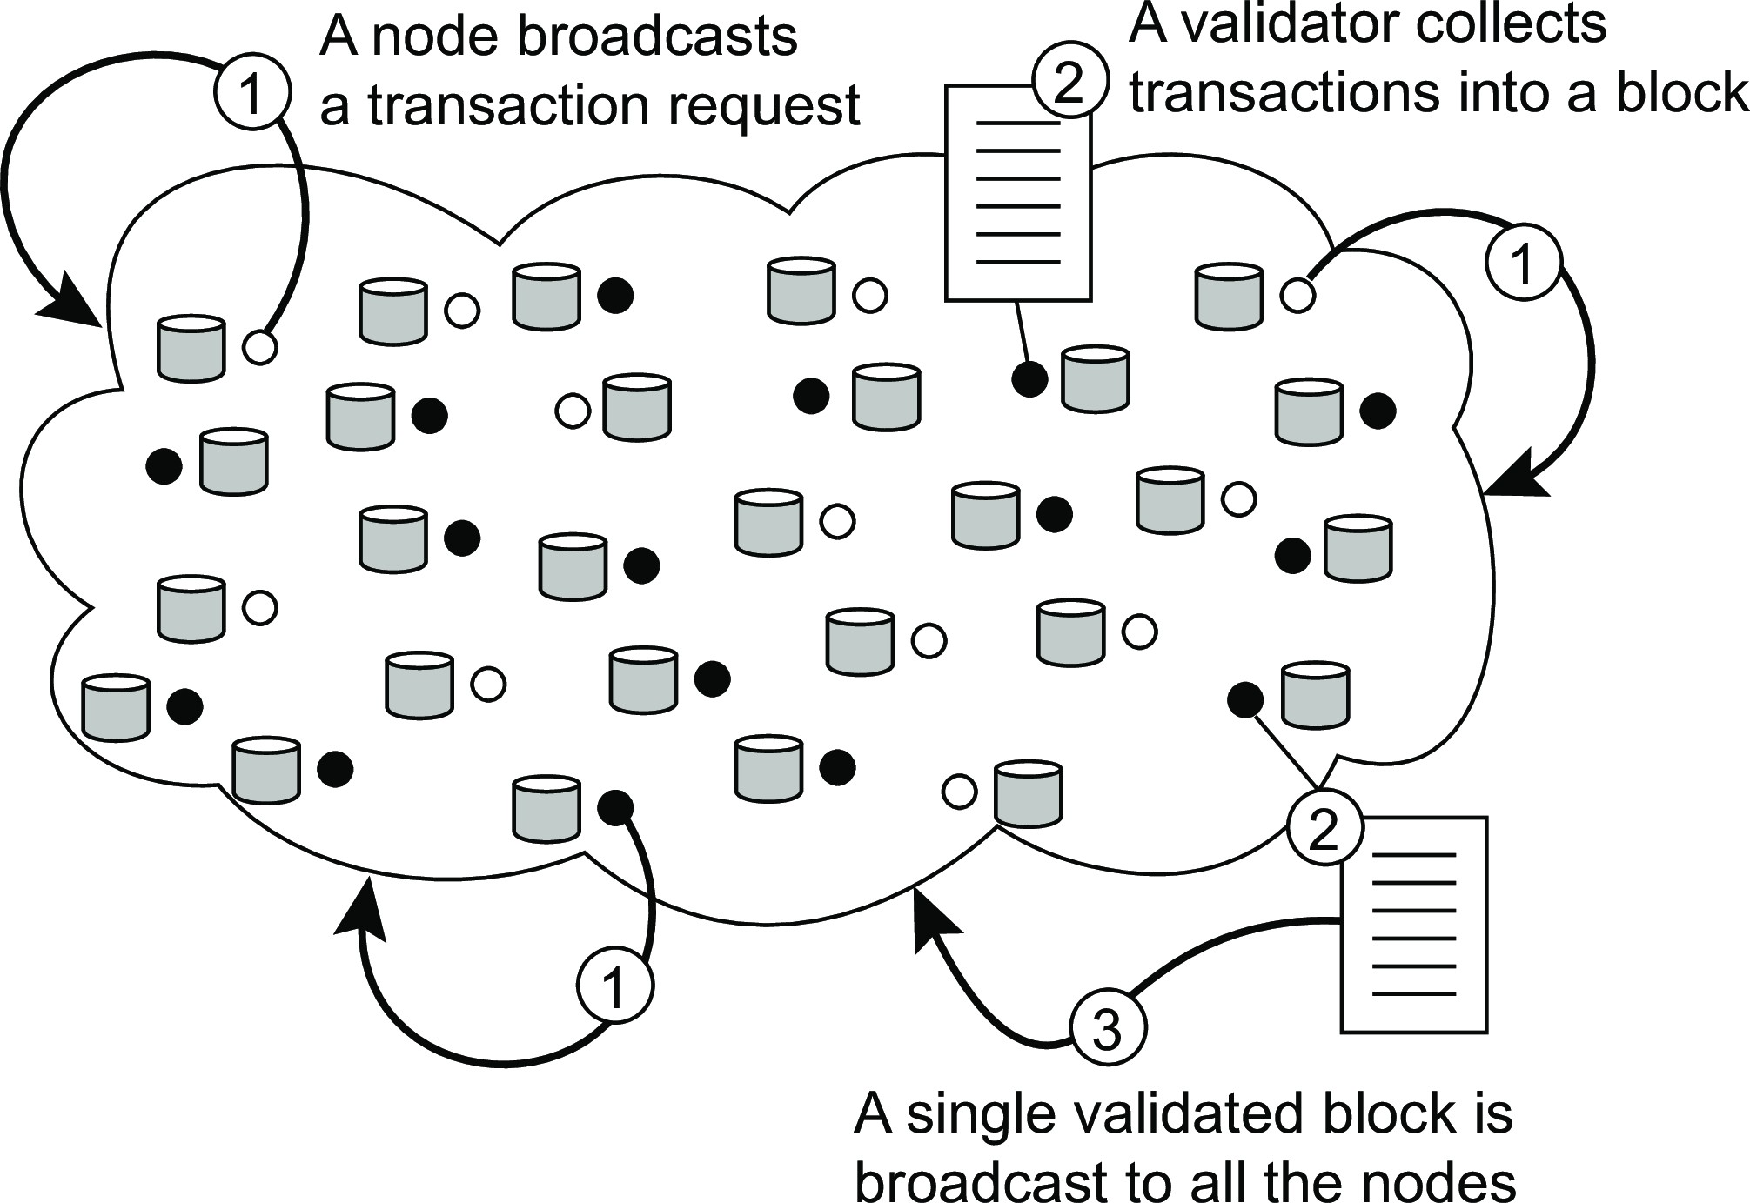
Architectures
Hybrid system architectures
Blockchains
Principle working of a blockchain system
Blockchain architectures

Slide 32
Architectures
Hybrid system architectures
Blockchains
Principle working of a blockchain system
Observations
Blocks are organized into an unforgeable append-only chain
Each block in the blockchain is immutable ⇒ massive replication
The real snag lies in who is allowed to append a block to a chain
Blockchain architectures

