Slide 1


Integrative Project In Industrial Electronics and Computers Engineering
Sensoring System for Superficial Sea Streams
5S – Drifter
Professors: Luis Gonçalves and Sergio Lopes
Student: Vinicius C. A. Carvalho - PG56208

Slide 2
Agenda
Introduction
Project Statement
Project Statement Analysis
Analysis
Requirements and Constraints
Requirements
Constraints
State of the Art
System Architecture
Design
Implementation

Slide 3
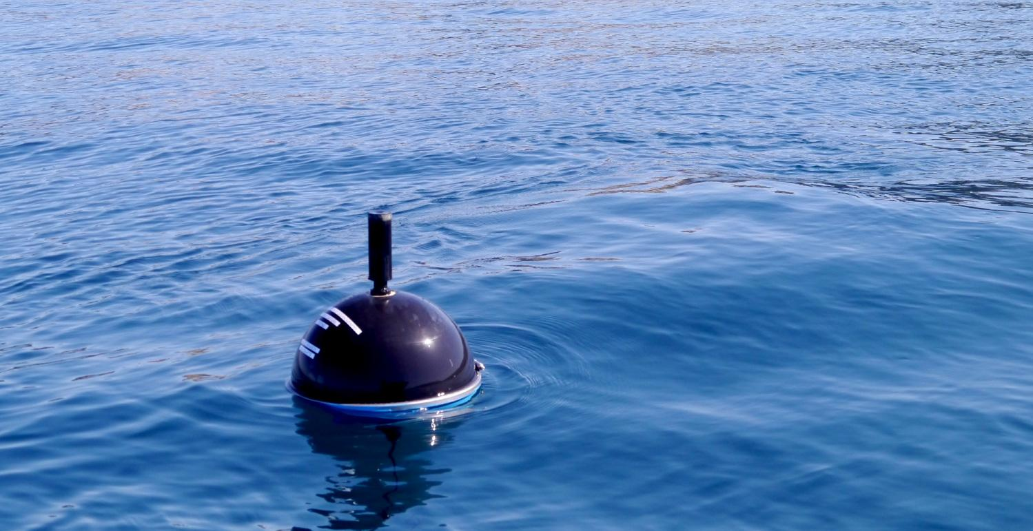
Introduction

Slide 4
Project Statement
The ocean is one of the man greatest mystery even before the written history. Humanity made the world ours over the water, from the Portuguese greatests discoveries, braving the raging ocean to the newest oil tanker demanding ever newer technology in order to tame the sea for safer and smoother sailing.
Nowadays scientists believe only 20% to 26% of the ocean is discovered with the actual technology which means that humanity know as much about our so grate sky as our own seas.
5S ocean drifter is a equipment made to acquire date from superficial sea streams and expand the oceanographic knowledge about it. Better knowledge of the ocean lead to further development in diverse areas. Granting safety,security and efficiency over the blue giant.

Slide 5
Project Statement Analysis
5S, an acronym for Sensoring System for Surface Sea Streams is a low-cost, low-power solution to acquire data with the focus to last autonomously for the longest time possible. The drifter has to attain its GPS coordinates in order to track its current and average velocity, alongside with the water temperature and a accelerometer information to gather information about the wave intensity. All this data will be stored locally and transmitted by a protocol, yet to be defined, with a JSON format in order to be received by a database that already is implemented.

Slide 6
Analysis
Microcontroller
GNSS and Internet Protocol
Sensors
IMU
Temperature
Batteries

Slide 7
Requirements
Search and selection of hardware components
Low Power and Low Cost
Software/Hardware design
Communication within modules and peripherals
PCB design*
Renewable energy*
5S outer shell as a 3D design
Product realization
Laboratory Tests
Documentation
* On analysis

Slide 8
Constraints
The project must
Be presented for evaluation within deadline
Be validated at the ocean.
Have an autonomy of a month at minimum
Due to the low power consumption and lab availability, an STM32 will be used.

Slide 9
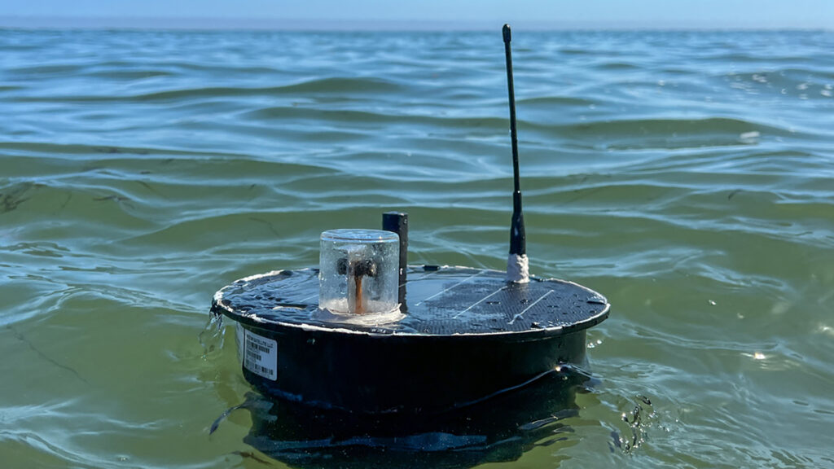

State of Art

Slide 10
State of Art
Border Control
Climate Modeling
Traffic management
Aquaculture management
Public oceanographic research
Marine spatial planning
Defense and security

Slide 11
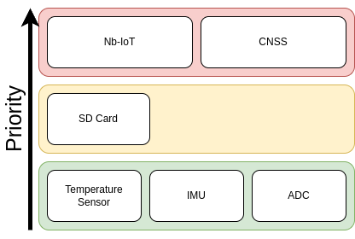
System Architecture

Slide 12
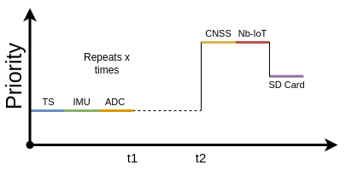
System Architecture

Slide 13
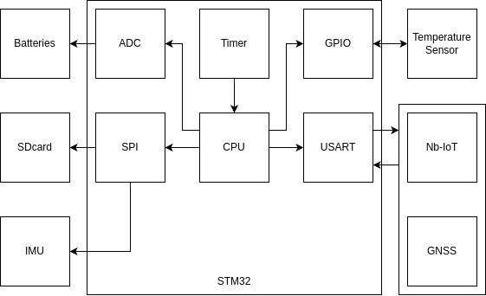
System Architecture

Slide 14
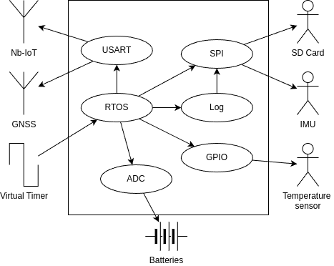
System Architecture

Slide 15
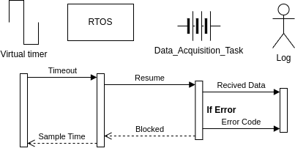
System Architecture

Slide 16
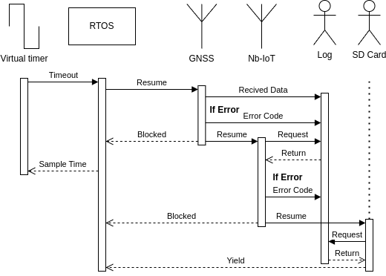
System Architecture

Slide 17
Design
Microcontroller: STM32
GNSS and Nb-IoT: ST87M01 evaluation kIT
Sensors
IMU: ISM330BX
Temperature: DS18B20
Batteries
Solar energy
Controller: AEM10941
Panel: SM111K06L
Batteries:

Slide 18
Design

Slide 19
Implementation

Slide 20
Thanks :D
Any questions?

