Slide 1


Integrative Project In Industrial Electronics and Computers Engineering
Sensoring System for Superficial Sea Streams
5S – Drifter
Professors: Luis Gonçalves and Sergio Lopes
Student: Vinicius C. A. Carvalho - PG56208

Slide 2
Agenda
Introduction
Project Statement
Project Statement Analysis
Analysis
Requirements and Constraints
Requirements
Constraints
State of the Art
System Architecture

Slide 3
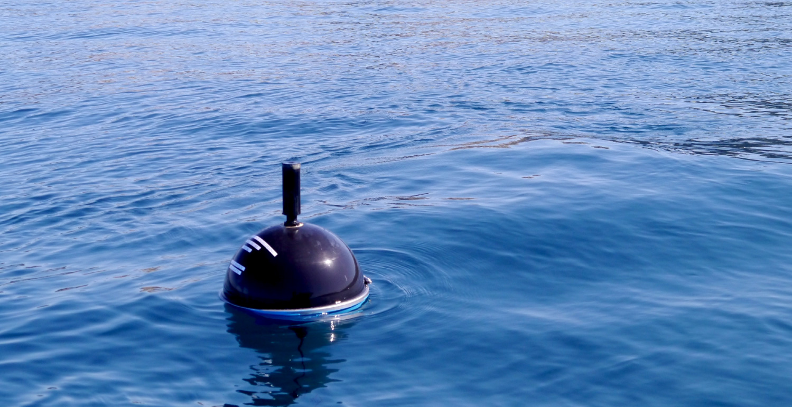
Introduction

Slide 4
Project Statement

Slide 5
Project Statement Analysis

Slide 6
Analysis
Introduction
Project Statement
Project Statement Analysis
Analysis
Requirements and Constraints
Requirements
Constraints
State of the Art
System Architecture

Slide 7
Requirements
Search and selection of hardware components
Low Power and Low Cost
Software/Hardware design
Communication within modules and peripherals
PCB design*
5S outer shell as a 3D design
Product realization
Laboratory Tests
Documentation
* On analysis

Slide 8
Constraints
The project must
Be presented for evaluation within deadline
Be validated at the ocean.
Have a autonomy of a month at minimum

Slide 9
State of Art
Introduction
Project Statement
Project Statement Analysis
Analysis
Requirements and Constraints
Requirements
Constraints
State of the Art
System Architecture

Slide 10
Thanks :D
Any questions?

