Slide 1


Integrative Project In Industrial Electronics and Computers Engineering
Sensoring System for Superficial Sea Streams
5S – Drifter
Professors: Luis Gonçalves and Sergio Lopes
Student: Vinicius C. A. Carvalho - PG56208

Slide 2
Agenda
Introduction
Project Statement
Project Statement Analysis
Analysis
Requirements and Constraints
Requirements
Constraints
State of the Art
System Architecture

Slide 3
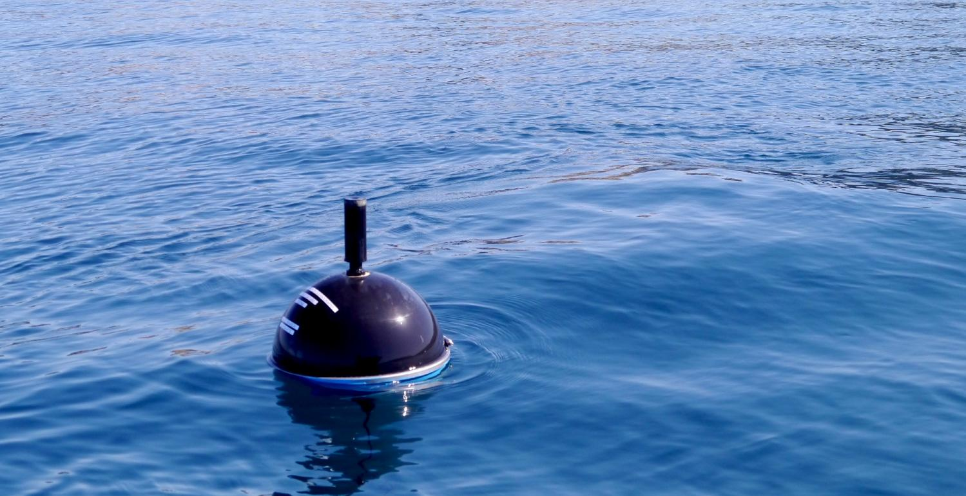
Introduction

Slide 4
Project Statement

Slide 5
Project Statement Analysis

Slide 6
Analysis

Slide 7
Requirements
Search and selection of hardware components
Low Power and Low Cost
Software/Hardware design
Communication within modules and peripherals
PCB design*
Renewable energy
5S outer shell as a 3D design
Product realization
Laboratory Tests
Documentation
* On analysis

Slide 8
Constraints
The project must
Be presented for evaluation within deadline
Be validated at the ocean.
Have a autonomy of a month at minimum
Due to the low power consumption and lab availability, it will be used a STM32.

Slide 9
State of Art

Slide 10
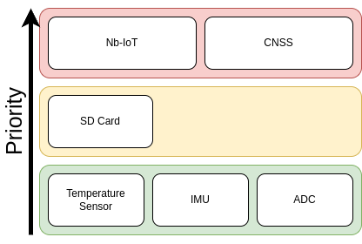
System Architecture

Slide 11
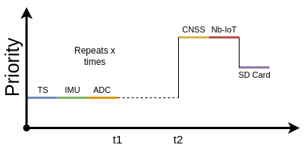
System Architecture

Slide 12
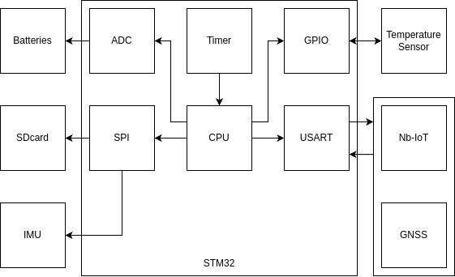
System Architecture

Slide 13
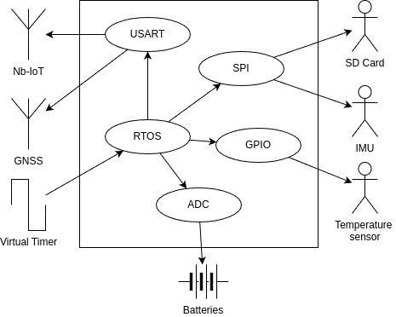
System Architecture

Slide 14
System Architecture

Slide 15
Thanks :D
Any questions?

