Slide 1
HW5: Parallelization

Slide 2
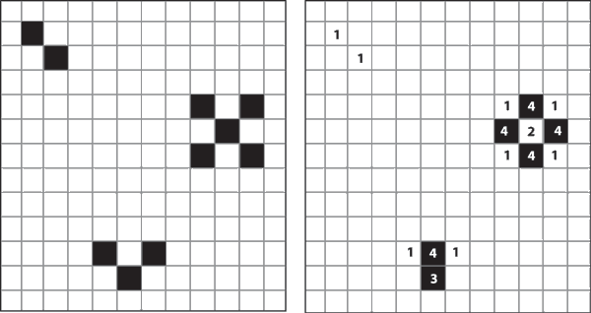
Conway’s Game of Life
Simple 2D universe with simple rules, complex results!
1. Any live cell with fewer than two live neighbors dies
2. Any live cell with more than three live neighbors dies
3. Any live cell with two or three live neighbors lives on
4. Any dead cell with three live neighbors becomes alive

Slide 3


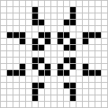
Interesting Stable Patterns
Glider
LightWeight
Space Ship
Pulsar

Slide 4

“Gosper’s glider gun”

Slide 5

Typical Random Initial Universe
DEMO
NOTE: board wraps around (top/bottom, L/R)

Slide 6
Key Part of the Code:
for (curgen = 0; curgen < gens_max; curgen++)
for (i = 0; i < nrows; i++){
for (j = 0; j < ncols; j++){
int inorth = mod (i-1, nrows); int isouth = mod (i+1, nrows);
int jwest = mod (j-1, ncols); int jeast = mod (j+1, ncols);
const char neighbor_count =
BOARD (inboard, inorth, jwest) + BOARD (inboard, inorth, j) +
BOARD (inboard, inorth, jeast) + BOARD (inboard, i, jwest) +
BOARD (inboard, i, jeast) + BOARD (inboard, isouth, jwest) +
BOARD (inboard, isouth, j) + BOARD (inboard, isouth, jeast);
BOARD(outboard, i, j) = alivep (neighbor_count, BOARD (inboard, i, j));
}
}
SWAP_BOARDS( outboard, inboard );
}

Slide 7
HW5: Your Goal
Improve performance via parallelization
  use pthreads
  use at least 2 threads (probably 4 since 4 CPUs on UG*)
Further improve performance via other optimizations by putting what we learnt all together
  hand code optimizations
  cache optimizations
  locks/synchronization
  better cell representation
  eliminating redundancy and/or unnecessary work
  compiler flags

Slide 8
UG Machine Architecture
32KB, 8-way data cache
32KB, 8-way inst cache
Multi-chip Module
Processor Chip
Processor Chip
P
P
P
P
L1
Caches
L1
Caches
L1
Caches
L1
Caches
L2 Cache
L2 Cache
12 MB (2X 6MB), 16-way Unified L2 cache

Slide 9
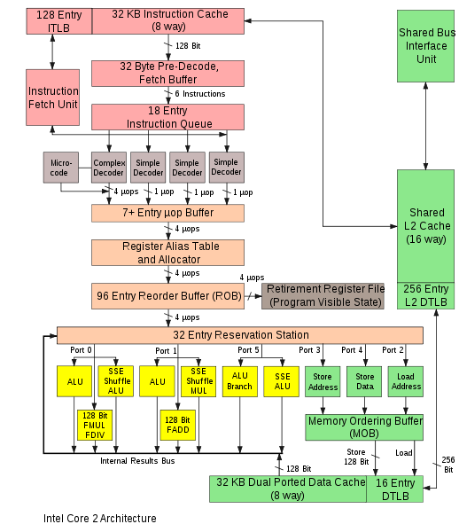
Core2 Architecture (2006): UG machines

Slide 10
UG Machines CPU Core Arch. Features
64-bit instructions
Deeply pipelined
  14 stages
  Branches are predicted
Superscalar
  Can issue multiple instructions at the same time
  Can issue instructions out-of-order

Slide 11
Core 2 Memory Hierarchy
L1/L2 cache: 64 B blocks
6 MB
~4 GB
~500 GB
L1
I-cache
L2 unified cache
Main Memory
Disk
32 KB
C
P
U
R
e
g
L1
D-cache
Latency:
3 cycles
16 cycles
100 cycles
10s of millions
8-way
associative!
16-way
associative!
Reminder: Conflict misses are not an issue nowadays
Staying within on-chip cache capacity is key
Notes:
8 way associative is almost as good as fully associative
64B blocks, 32 KB = 512 Blocks
8 way associative = 64 sets

Slide 12
Get Memory System Details: lstopo
Run lstopo on UG machine, gives:
Machine (3829MB) + Socket #0
L2 #0 (6144KB)
L1 #0 (32KB)+Core #0+PU #0 (phys=0)
L1 #1 (32KB)+Core #1+PU #1 (phys=1)
L2 #1 (6144KB)
L1 #2 (32KB) + Core #2 + PU #2 (phys=2)
L1 #3 (32KB) + Core #3 + PU #3 (phys=3)
4GB RAM
2X 6MB L2 cache
2 cores per L2
32KB L1 cache per core

Slide 13
Get More Cache Details: L1 dcache
ls /sys/devices/system/cpu/cpu0/cache/index0
  coherency_line_size: 64 // 64B cache lines
  level: 1 // L1 cache
  number_of_sets
  physical_line_partition
  shared_cpu_list
  shared_cpu_map
  size:
  type: data // data cache
  ways_of_associativity: 8 // 8-way set associative

Slide 14
Get More Cache Details: L2 cache
ls /sys/devices/system/cpu/cpu0/cache/index2
  coherency_line_size: 64 // 64B cache lines
  level: 2 // L2 cache
  number_of_sets
  physical_line_partition
  shared_cpu_list
  shared_cpu_map
  size: 6144K
  type: Unified // unified cache, means instructions and data
  ways_of_associativity: 24 // 24-way set associative

Slide 15
Access Hardware Counters: perf
The tool ‘perf’ allows you to access performance counters
  way easier than it used to be
To measure L1 cache load misses for program foo, run:
perf stat -e L1-dcache-load-misses foo
7803 L1-dcache-load-misses # 0.000 M/sec
To see a list of all events you can measure:
perf list
Note: you can measure multiple events at once

