Slide 2
Ophtalmology

Slide 3
Eye

Slide 4
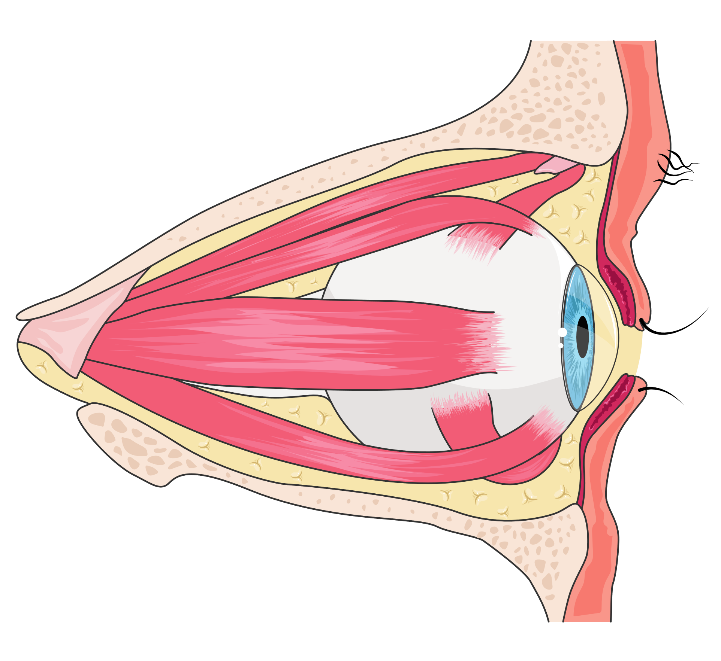
Eye muscles

Slide 5
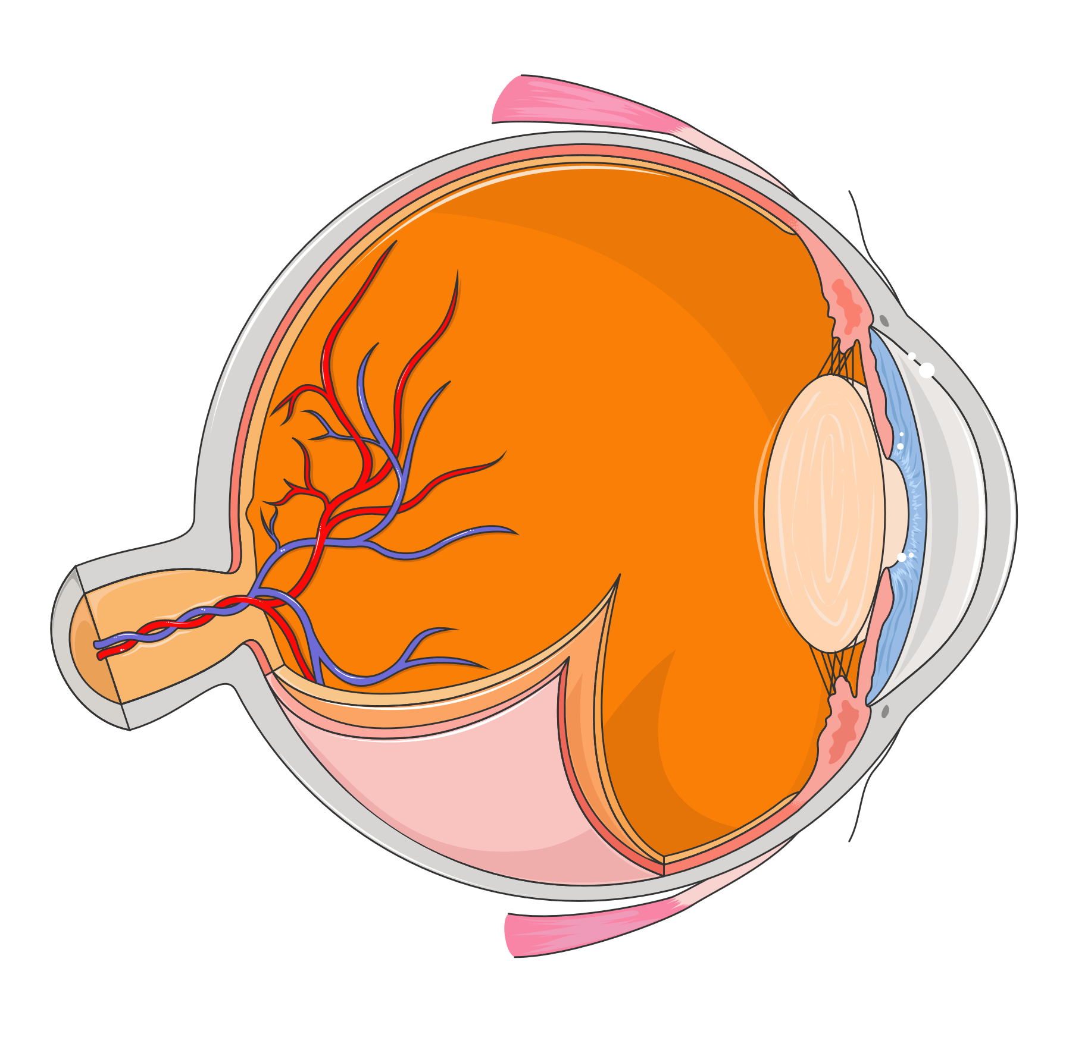
Eye structure

Slide 6
Retina (1)

Slide 7
Retina (2)

Slide 8
Tear duct

Slide 9
Optical pathways
Left
Right
Optic nerve
Optic chiasm
Optic tract
Lateral geniculate nucleus
Optic radiations
Visual cortex

Slide 10
Vision (1)
Normal eye

Slide 11
Vision (2)
Long-sighted eye
Astigmatic eye

Slide 12
Vision (3)
Short-sighted eye

Slide 13
Cataract

Slide 14
Macular degeneration

Slide 15
Diabetic retinopathy

Slide 16
Glaucoma
Open-angle glaucoma
Angle-closure glaucoma

Slide 17
Conjunctivitis

Slide 18
Glasses and contact lenses

Slide 19
Lenses types
Convergent
Divergent
Double
convex lens
Plano-convex
lens
Positive
meniscus lens
Double
concave lens
Plano-concave
lens
Negative
meniscus lens

