Slide 2
ENT

Slide 3
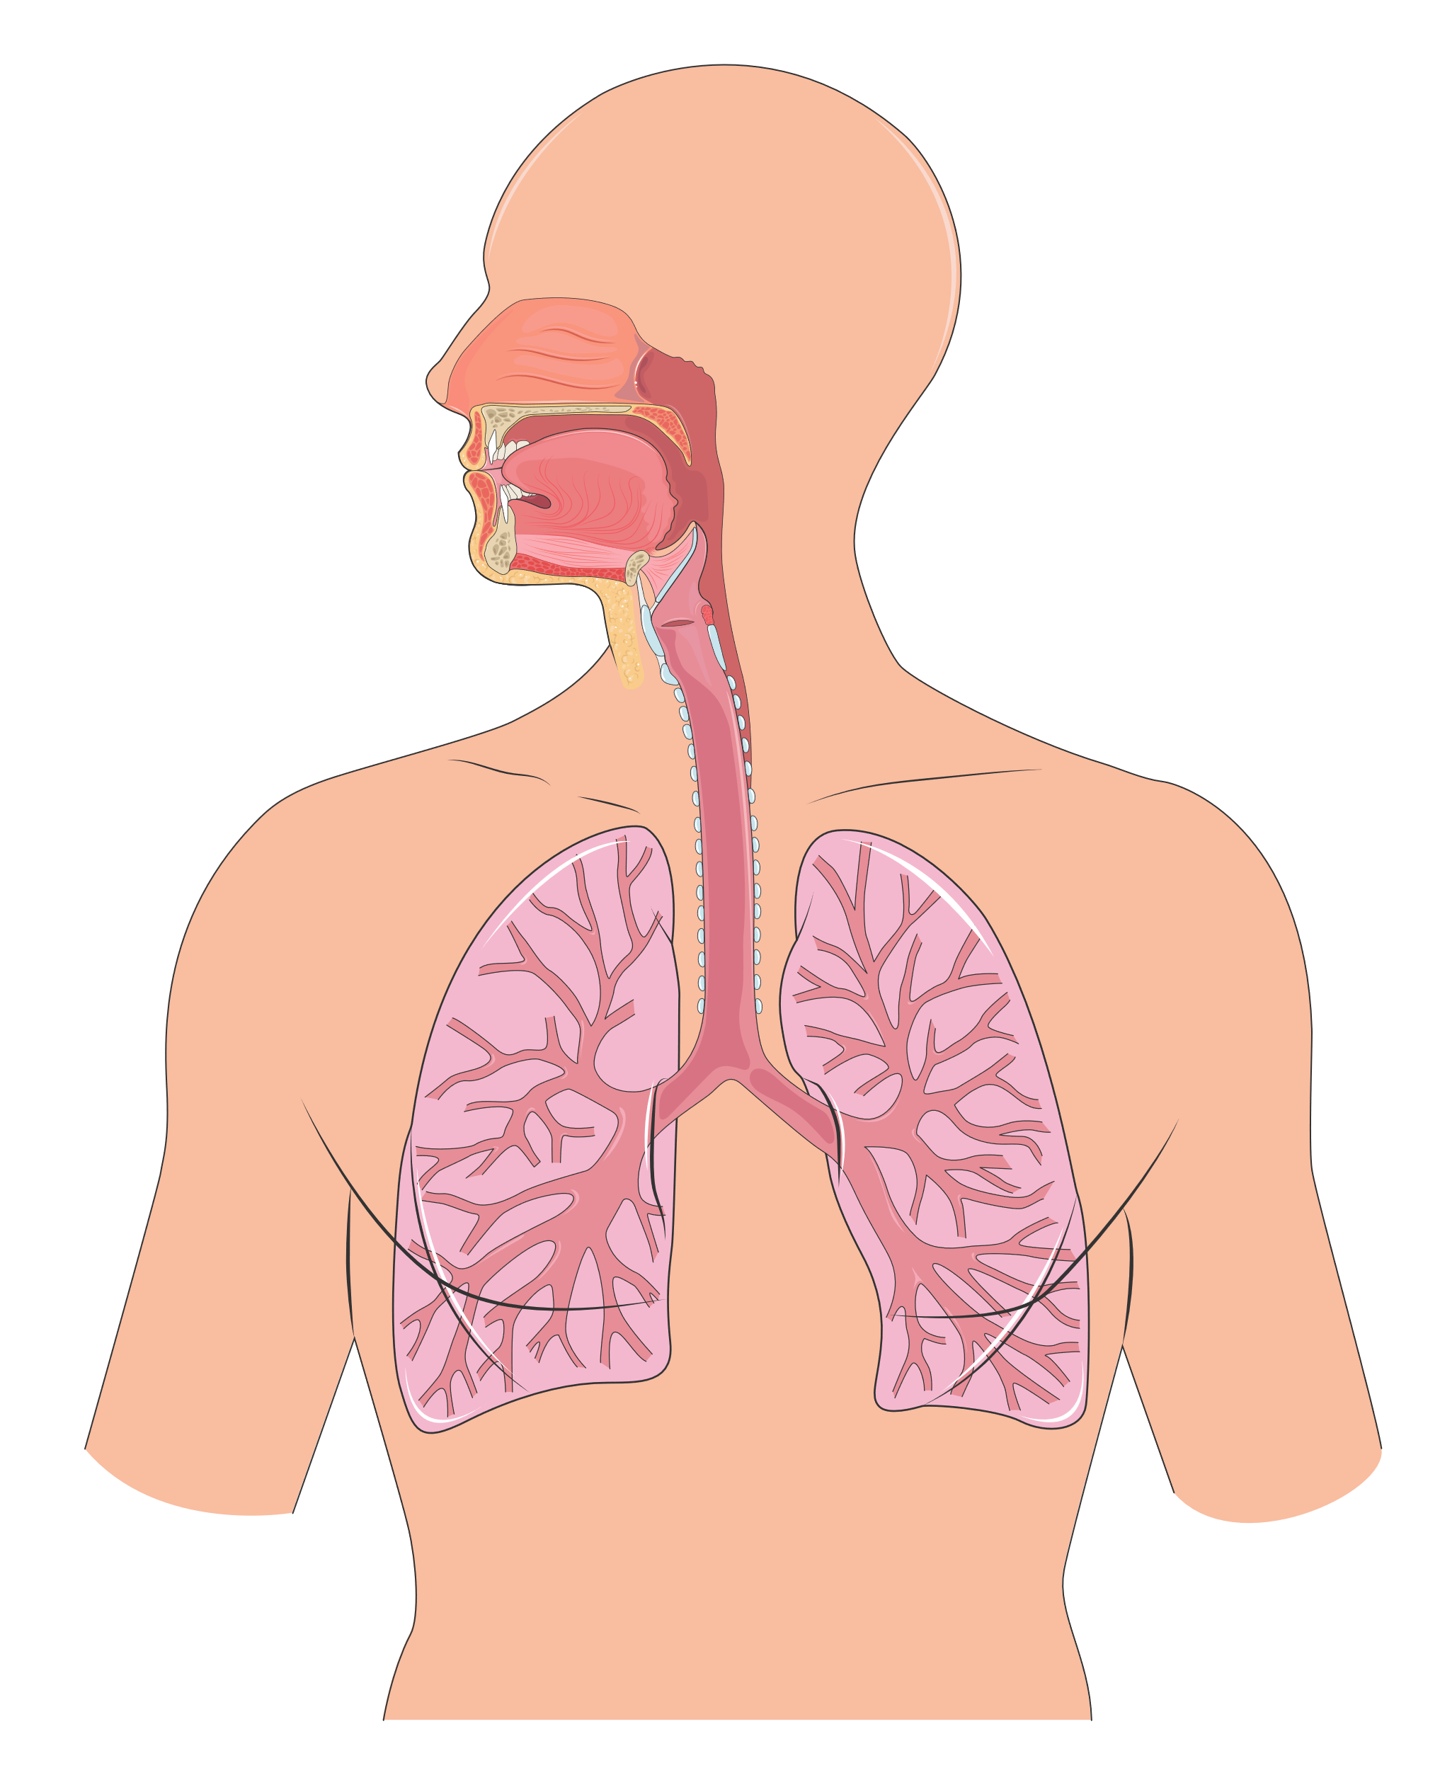
Conducting zone
Nose
Pharynx
Larynx
Trachea
Bronchus
Bronchiole

Slide 4
Nasal cavity

Slide 5
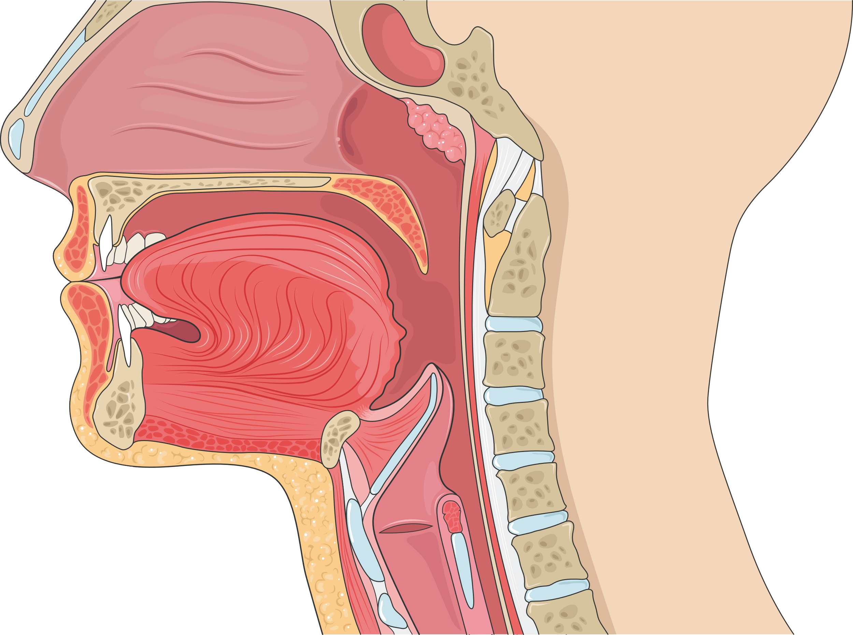
Swallowing system

Slide 6
Olfactory bulb

Slide 7
Paranasal sinuses

Slide 8
Oral cavity
Upper lip
Palate
Uvula
Palatine tonsil
Tongue
Lower lip

Slide 9
Vocal cords
Rest
Phonation

Slide 10
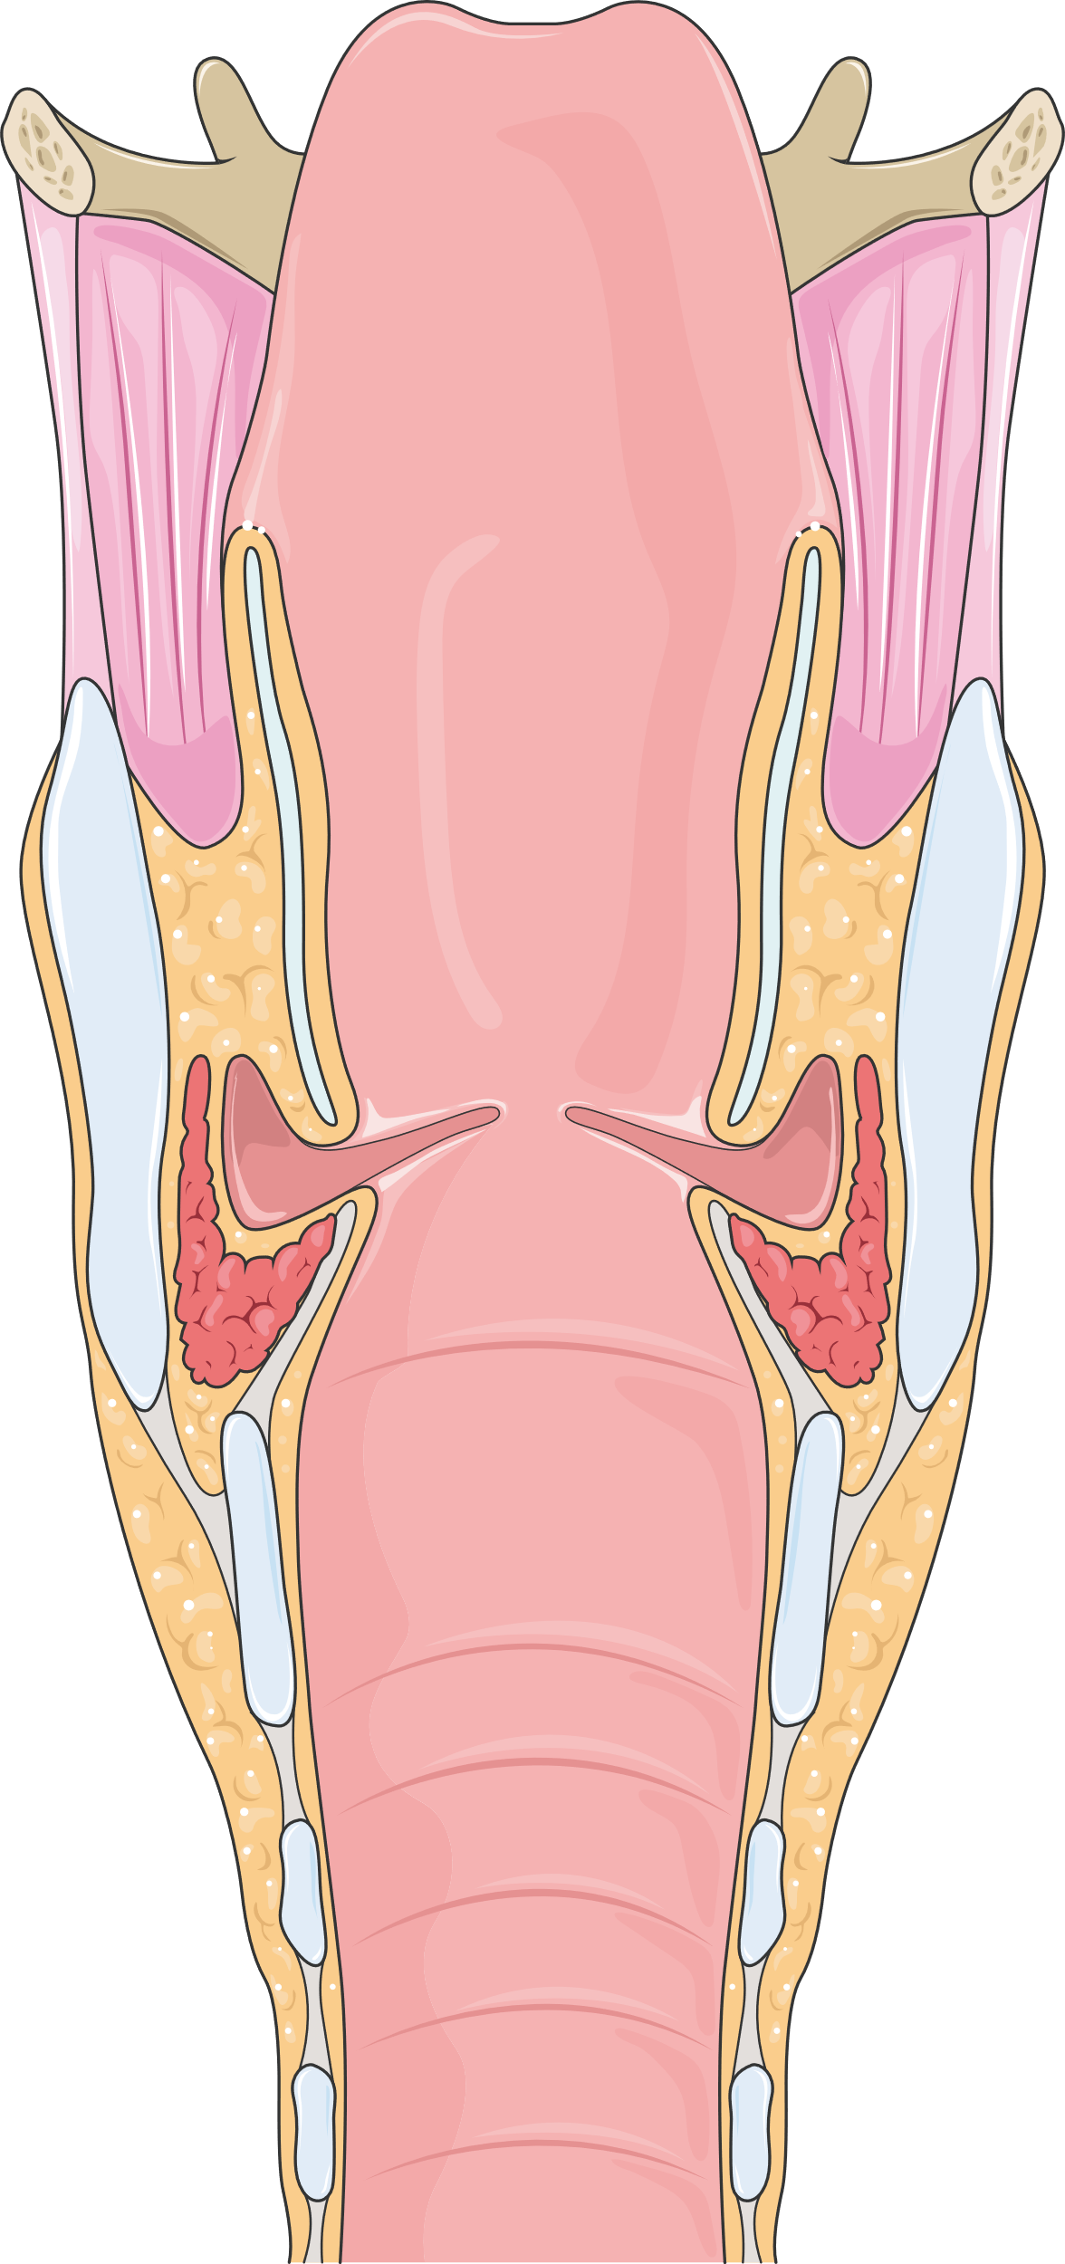
Larynx

Slide 11
Ear
Anvil
Auditive nerve
Hammer
Cochlea
Stirrup
Eardrum

Slide 12
Organ of Corti

Slide 13
Sinusitis

