Slide 2
Emergency Equipment

Slide 3
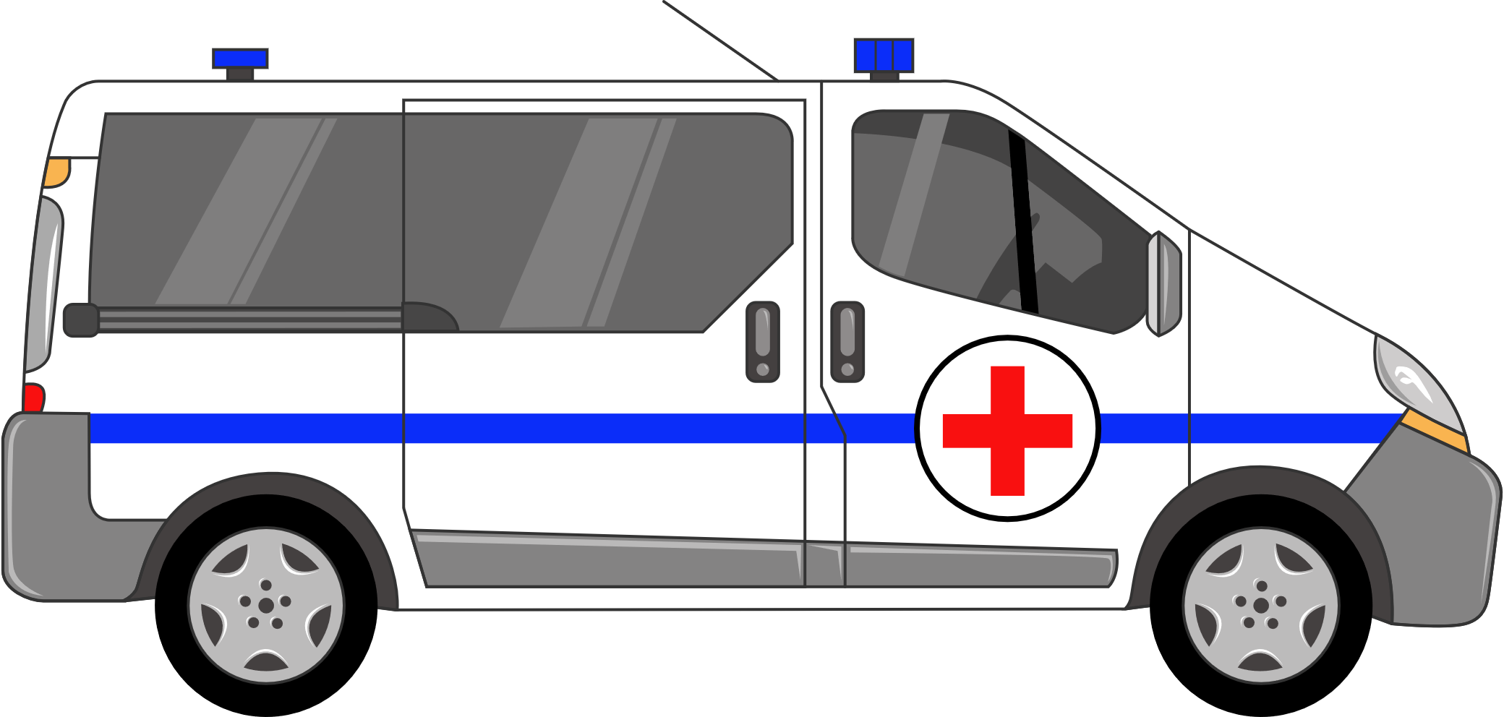
Ambulance

Slide 4
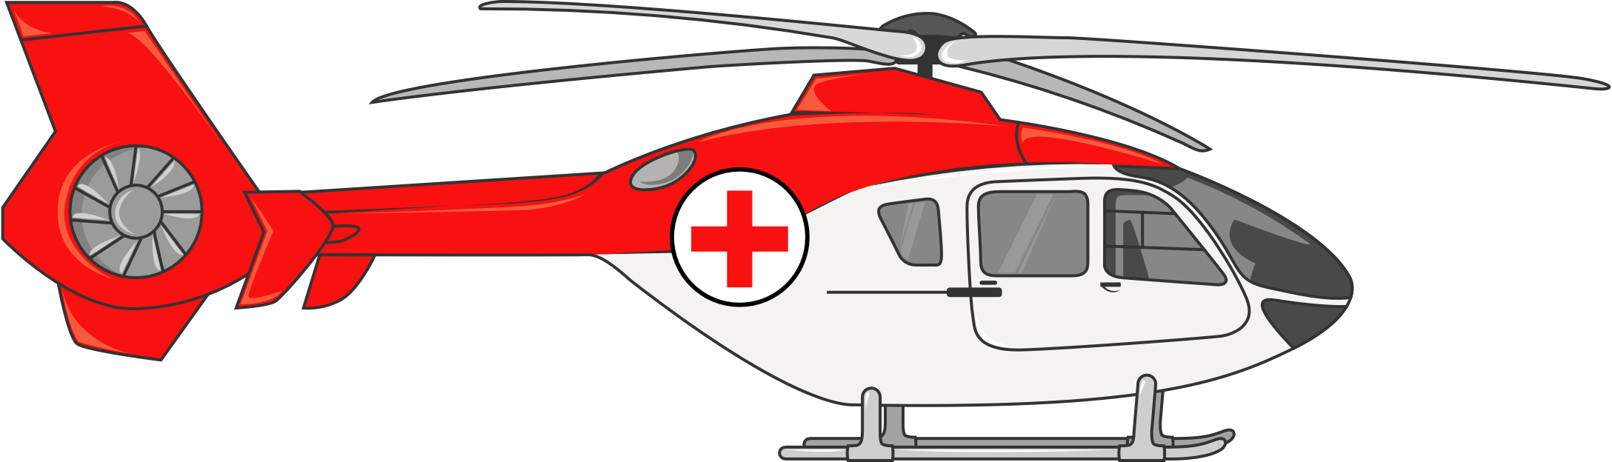
Helicopter

Slide 5
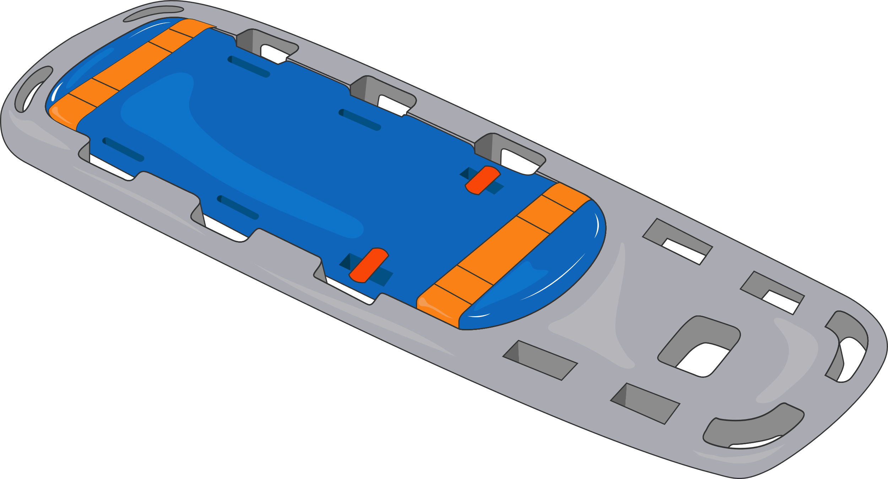
Stretcher

Slide 6

Emergency kit / bag

