Slide 1


Guardians of Asgard
Saxon tears : Our Favorite seasoning

Slide 2


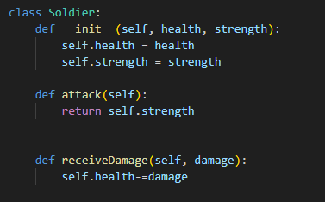

Soldier
Soldier acts as the parent class
Contains the attack and receiveDamage methods that our warriours need in battle by the other classes

Slide 3
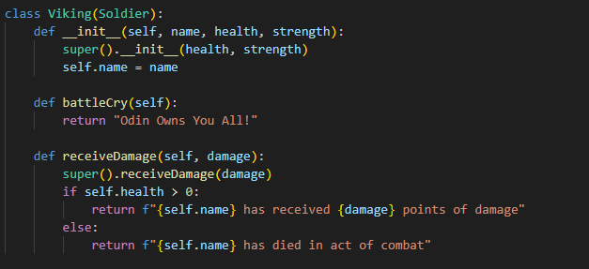
Vikings
Vikings here are the child class that inherit methods from the Soldier class with the super function
Inherits the receiveDamage method from the Parent soldier class
The super function adjusts the health of the vikings

Slide 4
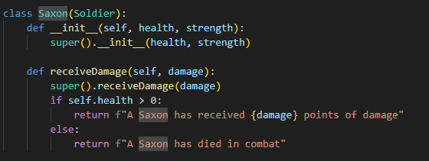
Saxons
Just like the Vikings , Saxons inherit health and strength from the parent class Soldier (super function)

Slide 5
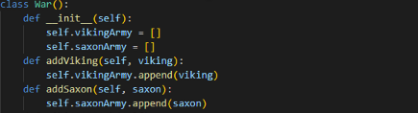
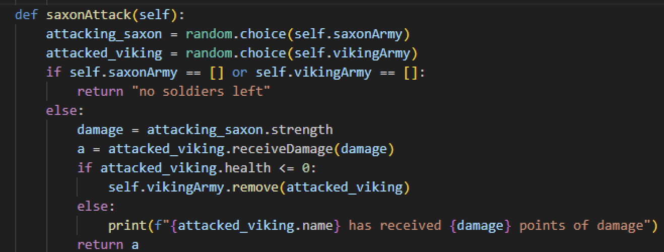
War

Slide 6
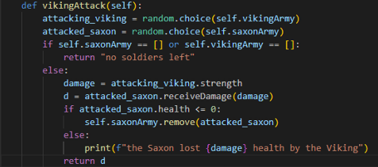
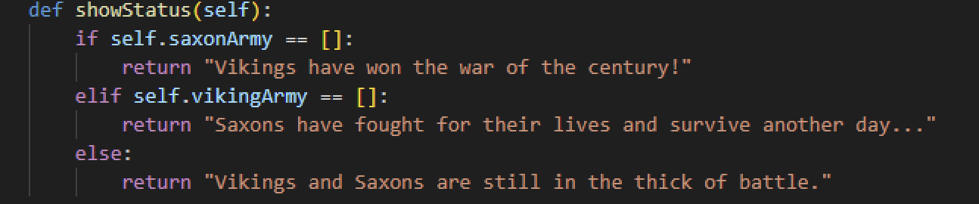
Challenges and how we overcame them : War
Be cautious to print the outcome of a function, it could get called again if you don’t do it right
Testing the code(putting pass in not used functions and using the correct test code)
Figuring out where the health should be subtracted(only in the soldier class)

Slide 7
Farewell , all you mortals. Thanks for your time and attention

