Slide 1


Slide 2
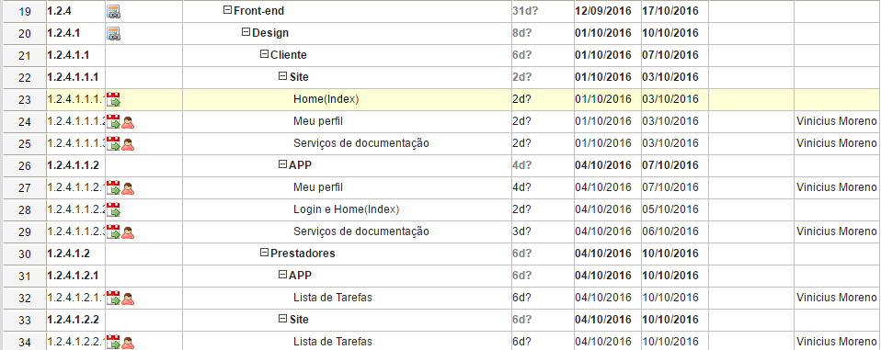
Vinicius Moreno

Slide 3
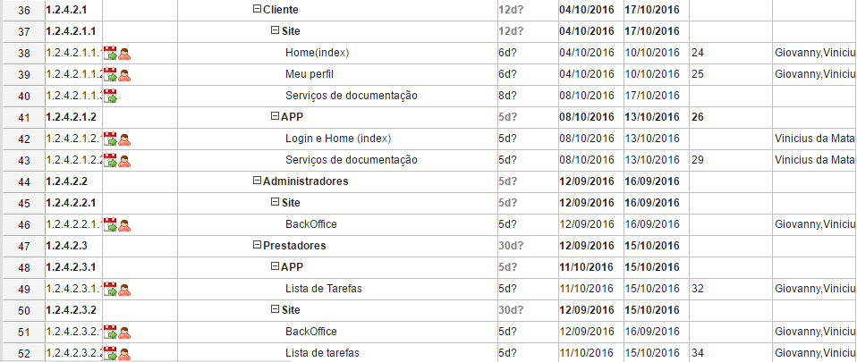
Giovanny Rafa Vinicius Renan

Slide 4
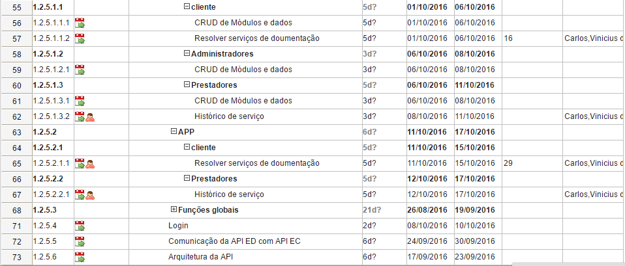
Carlos Kelvin Renan Vinicius

Slide 5


