Slide 1



Spring vs Quarkus: Framework comparison
Vinicius Antonio Gai
https://www.linkedin.com/in/viniciusagai/ https://github.com/viniciustoni

Slide 2
It’s not YET covered
Performance comparison
It’s hard to have conclusions into simple apps
Probably I’ll never do it in here, the diff is not that big and each case is one case
Reactive Programming
It’s a future plan for this presentation/code base
Honestly speaking: No time yet for it and Mutiny makes the code quite “dirty”
Native images
Mostly because my Spring project was not fully yet prepare for that
KUDOS to Quarkus, because it was easy and almost no issues on run it with Native image

Slide 3
Agenda
What is Quarkus
Spring vs Quarkus- Overview
From Spring to Quarkus: How did I approach it?
Challenges/Problems
Code demo
What I liked on Quarkus

Slide 4
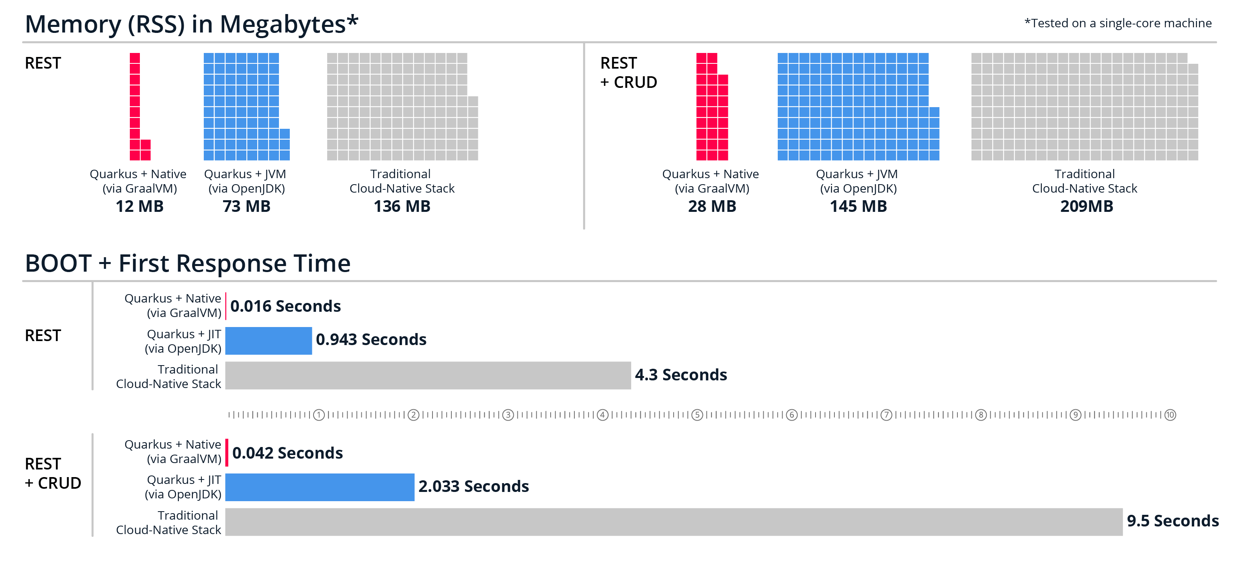
What is Quarkus
A modern, kubernetes-native Java framework
Optimized for fast startup times and small memory footprint
Native image support

Slide 5
Spring vs Quarkus - Overview
Developer: VMWare (Pivotal)
Initial release: June 2004
Spring boot at April 2014
Fully native image support: Nov 2022
Active community with an extensive documentation and resources
Spring modules
ComponentScan/Proxy at runtime
Flexible at runtime, however decrease performance
Developer: RedHat
First release: March 2019
Already similar to “spring-boot”
Fully native image support from beginning
Quickly increasing popularity
Powerfull dev tools
Quarkus extensions
Build-time static analysis and proxy creation
Increases the startup time

Slide 6
From Spring to Quarkus: How did I approach it?
Thinking on a Spring way
How to create beans?
How are the scope of the beans?
Write the code in spring and then convert to Quarkus
Searching for already existing plugins/extensions/modules
Using only Quarkus libs
Avoiding spring extensions: https://quarkus.io/extensions/?search-regex=spring
Simple PoC app with RestAPI that connects to the database

Slide 7
Challenges/Problems
Documentation is good. However, they are not cover complex scenarios and the community is still growing
Not a big community in comparison with Spring
Database:
Dynamic procedure calls
spring-jdbc is more mature than Quarkus one – It requires custom code to work the same way
Mongo
Spring-mongo is also more mature
Projections requires new DTOs/Entities

Slide 8
Code demo
GitHub with code: https://github.com/viniciustoni/spring_vs_quarkus
Search for // DIFF: on the code for some comments about the differences

Slide 9
What I liked on Quarkus
Using Jakarta specification
AdminUI – Without any extra dependency or configuration
Quarkus dev:
It runs under maven/gradle/cli
Live reload with background compilation
Free of charge
Quarkus extensions
From one side: I don’t like so much due the coupling with the framework
BUT form the other side: The integration with other extensions is much smother plus its native image friendly

Slide 10
What I liked on Quarkus
Hibernate Panache
Optimized for native images
Integration with Testcontainers on tests
Requires us to clean up the jdbc.url, however only this change is needed
How we override beans on test using @Mock instead of @Bean / @Primary on spring

Slide 11
Questions

Slide 12
References
https://quarkus.io/
https://quarkus.io/blog/quarkus-for-spring-developers/
https://www.geeksforgeeks.org/difference-between-spring-boot-and-quarkus/
https://quarkus.io/guides/hibernate-orm-panache
https://spring.io/

