Slide 1
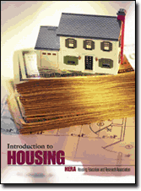
Welcome to...
Companion PowerPoint Presentation for the Introduction to Housing textbook

Slide 2


Homeownership

Slide 3
Quick Facts
Homeownership has both advantages & disadvantages. It is not always the best choice at a given time.
Buying your first home requires planning & saving.
Prepare a checklist to help you shop for a home.
Prequalify for a mortgage to see how much home you can afford.
There are several government programs for first-time & low- to moderate-income home buyers.

Slide 4
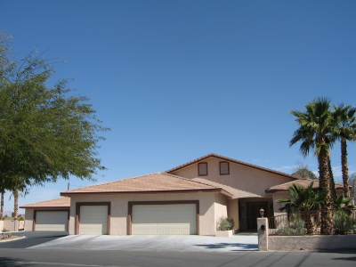
Homeownership: The American Dream
Buying a home is one of the most important decisions a family can make. It has serious financial & emotional implications and is a major part of the American dream.

Slide 5
Advantages
Forced savings plan because your mortgage principal payments are retained as equity in the home
Usually a good long-term investment– value will most likely increase over time
Deduct property taxes & interest payments from income tax
Over time mortgage payments become cheaper in "real" dollars

Slide 6

As equity builds, you can step up to a larger home or borrow against your home (home equity loan) to finance large purchases
Homeownership can enhance a family's sense of control over their lives & environment, as well as promote stronger community ties
You can customize the
home to suit special
needs & tastes

Slide 7
Disadvantages
Monthly payments (principal, interest, taxes & insurance) may be higher than rent payments
You must pay for regular maintenance & periodic repairs
Owning is less flexible than renting; most first-time home buyers live in a home for 7 years
Like any investment, there is no guarantee that value will increase

Slide 8

What Do We Want? (Professional Builder magazine, 2006)
Boomers (age 41-60)
No stairs—ranch style homes preferred, but first-floor master suites and/or personal elevators acceptable
Fireplaces
Low-maintenance surfaces such as granite & quartz
Pedestrian-friendly communities with trails & amenities for fitness & social interaction
Emphasis on quality & detailing instead of square footage

Slide 9

Gen XERS (26-40) & Echo Boomers (18-25)
Smart-home technology—every room wired for phones, modems & DSL
Home entertainment centers in the family room—the center of activity
Built-in wiring & conduits for flat-screen TVs, with wires & cords out of site
Breakfast bar or nook as secondary eating space
Green/environmentally
sensitive features

Slide 10

Features Important to All 3 Groups
Large, open kitchens to prepare food & entertain guests; they are the “new living room”
Kitchen islands no wider than 40”
Quality kitchen cabinets
High quality, high-performance appliances
Separate tub &
shower

Slide 11
Prepare for Homeownership
Buying your first home involves planning & saving—attend a home buyer education class to help you prepare for homeownership
Possible obstacles:
High Cost
Explore alternatives to the conventional single-family detached house: condo, manufactured home, or older home (generally can afford a house 2.5 times gross annual income)

Slide 12

Credit
Pay off your debt & delay major purchases until after you purchase a home
Get a copy of your credit report to see if any problems exist
www.equifax.com
If your credit is not great,
check out subprime loans

Slide 13
Downpayment
Most conventional mortgages--20% of the purchase price
However, there are ways to reduce downpayments to the 0 to 5% range:
--government-insured mortgages
--local housing agencies & lenders may have programs for first-time home buyers
--curtail your spending & ask relatives

Slide 14
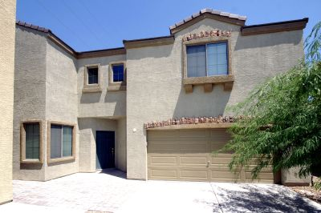
Closing Costs
Right of ownership passes from seller to buyer at the closing
Can reach several thousands of dollars
Some of the programs that help with downpayments can also help with closing costs

Slide 15
Long-term Affordability
Monthly principal, interest, property taxes & insurance (PITI) costs
No more than 28% of your gross monthly income should go to PITI (front-end ratio)
Monthly PITI payments plus any other long-term debt payments should not exceed 36% of your gross monthly income (back-end ratio)
Also need a cushion to cover maintenance & repairs

Slide 16
Project
You have been offered two jobs, one in Jackson, MS, and the other in LA. Go to relevant real estate Web sites & select two comparable homes. Describe each home including its price & features, and attach a picture. Given that 28% of your income can go towards housing, how much would you have to earn to afford each home? Which would you choose?

Slide 17
Initial Selection of Homes
Once you are financially ready to purchase a home, locate one that meets your values, needs, wants & budget
Where to look?
--Real estate section of the local newspaper
--Real estate shopper guides
--Real estate Web sites
--Driving, biking & walking through neighborhoods
--Stop at model/open houses

Slide 18
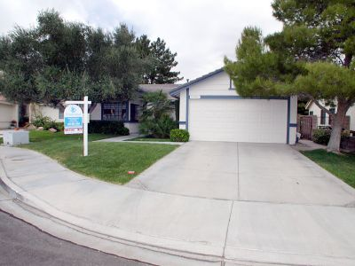

Select a Real Estate Agent
Select a real estate agent to help narrow your choices
Agents are a valuable source of information because they are knowledgeable about homes for sale in a specific area

Slide 19
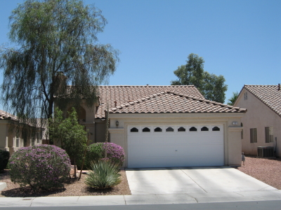
Criteria for selecting an agent:
--trust
--rapport
--track record
--level of commitment to first-time home buyers

Slide 20
As you consider different homes, evaluate each based on values, needs, wants & financial issues
Be flexible, realistic & responsible—
Your first home will most likely not be your dream home
Develop a checklist:
Can you & your family be happy
living in this home?

Slide 21
House Hunting Checklist
(Ideas of what to include, but your list must be personalized based on your needs)
Is the neighborhood safe?
Are the homes in the neighborhood maintained?
Does the house have enough bedrooms & bathrooms?
Is there adequate storage space?
Are there high quality schools in the area?

Slide 22
Is the location of the house and neighborhood convenient?
Is there a homeowners association?
Is the area quiet?
Does the floor plan suit your lifestyle?
Is the house energy efficient?
Is the yard easy to care for?
What community services are available?

Slide 23

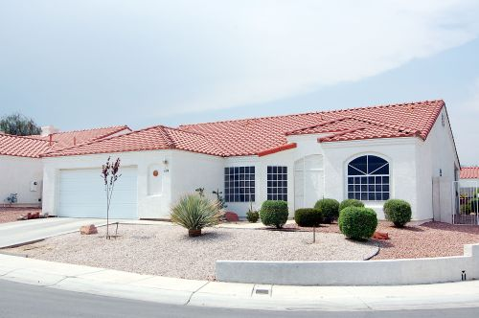
Are the appliances & fixtures adequate?
What are the average maintenance costs for the house?
How high are local property taxes?

Slide 24
Obtain Financing
While you shop for a home, also shop for a mortgage
Get pre-qualified so you have a better idea of affordability (price range of homes that you can afford)
Mortgage lenders include: commercial banks, savings & loan institutions, mortgage brokers & credit unions

Slide 25
Two possibilities for low- and moderate-income home buyers are:
Fannie Mae's Community Home Buyers Program
Freddie Mac's Affordable Gold Program
Government agencies—
FHA
VA
RHS
State housing & finance authority

Slide 26
Besides downpayment, carefully compare mortgage options based on these criteria:
Annual percentage rate (APR)
Total yearly cost of a mortgage as a percentage of the loan amount
Includes the contract interest rate, mortgage insurance & points (each point equals 1% of the loan amount)

Slide 27

Interest rate lock-ins
Lock in a low rate as soon as possible

Slide 28
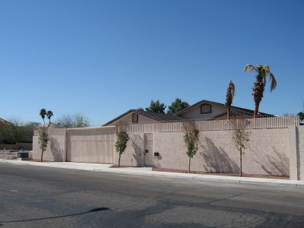
Application & origination fees
Minimize fees to cover processing, credit check, appraisal, points & other overhead costs

Slide 29
Term
For most first-time home buyers a 30-year term to pay off the mortgage is appropriate
Determine if you want a fixed or adjustable rate mortgage
A fixed rate mortgage
Loans are fully amortized with a fixed interest rate for the entire term -- both the principal & interest are paid off at the end of the loan

Slide 30
An adjustable rate mortgage (ARM)
Interest rate adjusted periodically, usually every 1, 3, or 5 years based on an index written into the loan agreement
Might initially get a lower interest rate, but future increases may mean higher monthly payments

Slide 31
Negotiate and Enter Into Contract
Make a purchase offer
Offer is typically given to the real estate agent who presents it to the seller (earnest money)
Get a home inspection report--a qualified inspector provides an objective opinion about home’s condition
Purchase contract

Slide 32
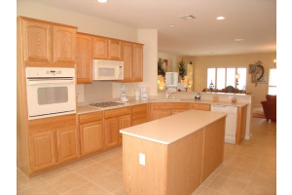
Loan Approval
Obtain actual financing for home
Lender will ask about your income, expenses, credit history, employment, & the terms of purchase offer
You complete application form & pay an application fee, pay for a credit report & appraisal, receive an estimate of closing costs & truth-in-lending statement
Loan processing occurs

Slide 33
Closing
Final step is the closing, a meeting between you, your lender, the seller &
other interested parties
Review & sign loan documents
Exchange of documents between buyer, seller & lender
Disbursement of funds
You receive the deed to the property
& join the ranks of homeowners!

Slide 34
Potential Difficulties
Discrimination
Against the law—Fair Housing Act
Fair housing—several consumer laws or acts prohibiting discrimination
Subprime & predatory lending
Credit impaired borrowers can benefit with a subprime mortgage
Predatory lending consists of unfair or abusive loan terms, involving a number of predatory practices

Slide 35
Postpurchase Concerns
Keeping up with maintenance & repairs (avoid an expensive crisis)
Create a maintenance fund
Remodeling & improvements—make informed decisions in selecting the project, contractor, or deciding to do it yourself
Refinancing—may be a good idea when interest rates go down
Foreclosure prevention
Loss mitigation tools such as a loan modification

