Slide 1
Clustering Logistic Regression
Vinit and Nurul

Slide 2
Problem Statement
Lower back pain can be caused by a variety of problems with any parts of the complex, interconnected network of spinal muscles, nerves, bones, discs or tendons in the lumbar spine. This data set is about to identify a person is abnormal or normal using collected physical spine details.
Using the dataset the client would like to be one step ahead and check whether his new patients who come to visit him have a lower back problem or the symptoms could be indications of some other problem.
P.S – The dataset does not contain the target variable.

Slide 3
Methodology – Clustering
Clustering:
Clustering is “the process of organizing objects into groups whose members are similar in some way”.
A cluster is therefore a collection of objects which are “similar” between them and are “dissimilar” to the objects belonging to other clusters.
Applications:
Business: To segment customers into smaller groups for analysis and marketing activities.
Marketing: Finding groups of customers with similar behavior from the data with past buying records.
Psychology and Medicine: To detect patterns in the spatial or temporal distribution of a disease.

Slide 4
Methodology – Logistic Regression
Logistic Regression:
Logistic Regression is a statistical method for analyzing a dataset with one or more independent variables that determine a binary outcome.
Logistic Regression is a classification algorithm.
Applications:
Predictive Analysis: Forecasting future opportunities and risks is the most prominent application of regression analysis.
Correcting Errors: Regression is not only great for lending empirical support to management decisions but also for identifying errors in judgment.

Slide 5
Observations and Libraries Used
Observations:
The dataset does not have any NA values.
It does not contain any target variable.
310 observations, 12 numeric variables.
Libraries Used:
cluster
plotROC
ROCR
Caret
InformationValue

Slide 6
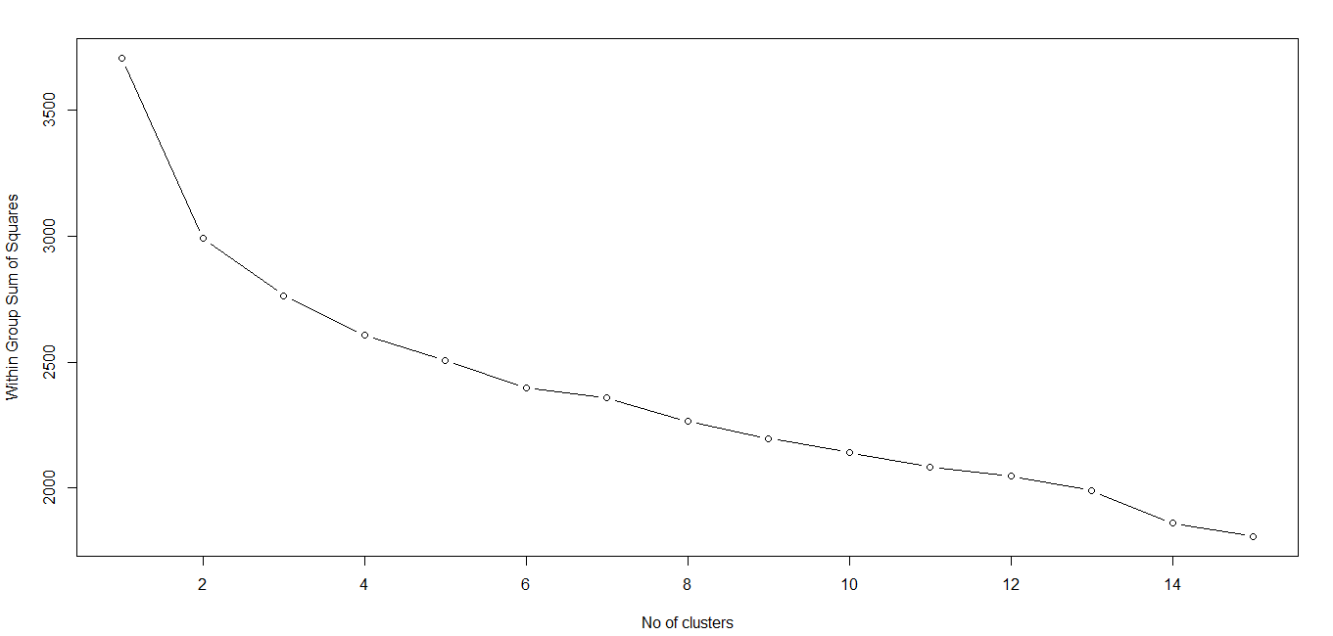
Model Building
Scaled the data
Calculating within sum of squares of variance in a cluster
Plotting the “Scree Plot”
Note: Scree Plot used to determine the required number of clusters

Slide 7
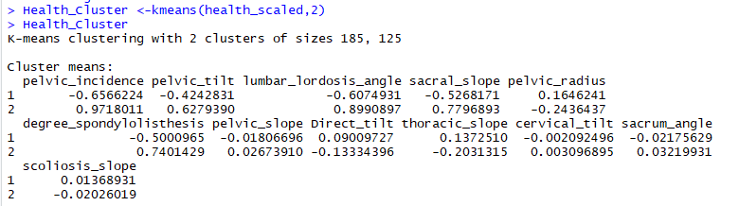

Model Building (Contd.)
Clustering using kmeans

Slide 8
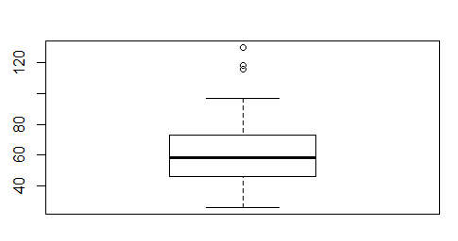
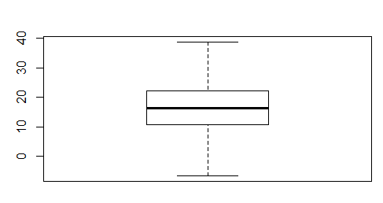
Model Building (Contd.)
Handling the outliers for all 12 variables
Sample Boxplot with and without outliers for one of the variables

Slide 9

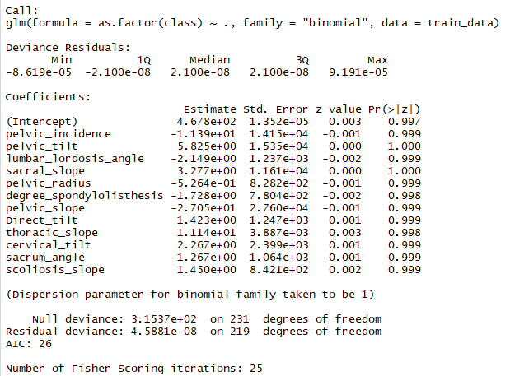
Model Building (Contd.)
Dividing the dataset into “train” and “test” datasets
Using the Logistic Regression model

Slide 10
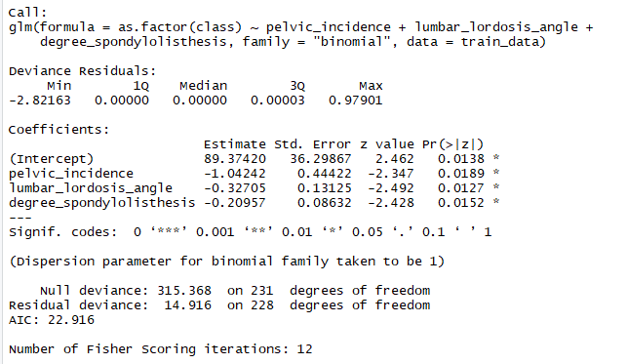
Model Building (Contd.)
Using the Logistic Regression model

Slide 11

Model Building (Contd.)
Using the Logistic Regression model (Prediction and Confusion Matrix)

Slide 12
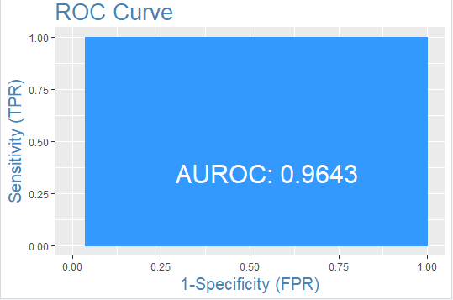
Model Building (Contd.)
Using the Logistic Regression model - ROC (Receiver Operating Characteristics) and ks_stat (Kolmogorov-Smirnov stat)

Slide 13
Conclusion
Area under the ROC curve is 0.9643. Hence, it is a good model.
Since ks_stat value is 0.9043, the fit is good.

Slide 14
Thank You

