Slide 1
E – Commerce Data Analysis

Slide 2
Objective:
Development of a Sales dashboard for different product categories.
Benefits:
Gives region wise Sales
Trend of Sales and Profit according to Month
Helps in finding frequency of orders in terms of aging
Slicer for different product categories

Slide 3
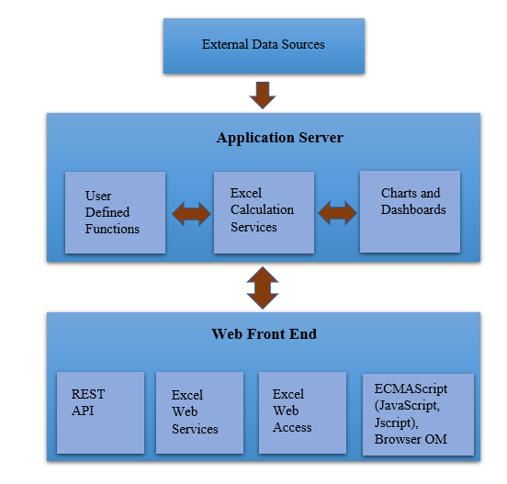
Architecture

Slide 4
Data Validation & Data Transformation
Name Validation – Validation of file name as per DSA. We have created a reges pattern for validation. After it checks for the date format and time format if these requirements are satisfied, we move such files to “Good_Data_Folders” else “Bad_Data_Folders”.
Number of Columns – Validation of number of columns present in the files, and if it doesn’t match then the file is moved to “Bad_Data_Folders”.
Name of Columns – The name of the columns is validated and should be the same as given in the schema file. If not, then the file is moved to “Bad_Data_Folders”.
Data type of columns – The data type of columns is given in the scheme file. It is validated when we insert the files into database. If the datatype is wrong, them the file is moved to “Bad_Data_Folders”.
Null values in the columns – If any of the columns in a file have all the values as NULL or missing, we discarded such a file and move it to “Bad_Data_Folders”.

Slide 5
Q & A
Q1) What’s the source of data?
The data is provided by an online E – Commerce Company.
Q2) What was the type of data?
The data was the combination of numerical and categorical values.
Q3) What’s the complete flow you followed in this project?
Refer slide 4 for better understanding.
Q4) After the File validation what you do with incomplete files or files which didn’t pass the validation?
Files like these are removed to the archive folder and a list of those files has been shared with the client and we removed the bad data folder.

Slide 6
Q5) How logs are managed?
We are using different logs as per the steps that we follow in validation and modelling like File Validation, Data insertion, Dashboard Creation etc.
Q6) What techniques were you using for data pre-processing?
Removing unwanted attributes
Visualizing relation of independent variables with each other and output variables
Checking distribution of continuous values
Cleaning data and inputting if null values are present
Converting categorical data into numeric values
Scaling the data
Q7) What are the different stages of deployment?
Once the dashboard is completed, we can share the dashboard through various sources like google sheets, Excel, Web Pages etc.

Slide 7
Insights
Cards Visual:
From the cards we can see that the total sales is 80,23,381 where the highest sales is in Fashion product category with 52,12,097 sales and the lowest in Electronics with 394738.
From the cards we can see that the quantity sold is 1,45,521 where the highest quantity sold is in Fashion product category with 92071 quantity and the lowest in Electronics with 8211.
From the cards we can see that the total profit is 37,29,903 where the highest profit is in Fashion product category with 2483853 profit and the lowest in Electronics with 174175.

Slide 8
Insights cont..
Histogram:
From the histogram it is obvious that most number of orders are in the category 2 – 5 days with 19646 orders and lowest number of orders are in the category >10 with 4891 orders.
Monthly Sales & Profit Bar graph:
The maximum sales and profit was obtained in the month December with 693037 sales and 523402 profit.
The minimum sales and profit was obtained in the month February with 610240 sales and 286103 profit.
When we look in the product category wise:
Electronics: Maximum sales (39240) & profit (17419) is in October and minimum sales (29644) and profit (12679) is in July and February respectively.

Slide 9
Insights cont..
Fashion: Maximum sales (452066) & profit (216460) is in December and minimum sales (397420) & profit (191681) is in February.
Home & Furniture: Maximum sales (119095) & profit (53137) is in July and minimum sales (97361) & profit (42989) is in February.
Auto & Accessories: Maximum sales (97347) & profit (43305) is in October and minimum sales (85683) and profit (38238) is in February and August respectively.
Region wise Sales Bar Graph:
The maximum sales was obtained in the Central region with 1735900 sales.
The minimum sales was obtained in the Canada region with 60003 sales.
When we look in the product category wise:
Product Category | Maximum Sales | Minimum Sales
Auto & Accessories | 227929 (Central) | 10382 (Canada)
Electronics | 82750 (Central) | 4602 (Canada)
Fashion | 1146920 (Central) | 33606 (Canada)
Home & Furniture | 278301 (Central) | 11413 (Canada)

Slide 10
Insights Cont…
Product Category | Sales | Profit | Quantity
Auto & Accessories | 1097139 | 4,84,278 | 22395
Electronic | 394738 | 1,74,175 | 8211
Fashion | 5212097 | 24,83,853 | 92071
Home & Furniture | 1319407 | 5,87,598 | 31055
In Auto & Accessories Tyre makes the most sales (223250) and profit (1,32,303), whereas Car Mat makes the least sales (44604) and Car Seat Covers makes the least profit (20,007).
In Electronic Apple Laptop makes the most sales (55250) and profit (33,025), whereas Keyboard makes the least sales (7293) and profit (3290).
In Fashion T-shirts makes the most sales (692912) and profit (4,07718), whereas Sneakers makes the least sales (173290) and Sports wear makes the least profit (47,240).

Slide 11
Insights Cont…
In Home & Furniture Towels makes the most sales (234384) and profit (1,31,159), whereas Curtains makes the least sales (34952) and profit (16,102).
Overall T-shirts makes the highest sales & profit, whereas Keyboard the lowest.
Consumer segment makes the highest sales (4135221) & profit (19,15,712), whereas Home Office segment makes the lowest sales (146660) & profit (6,85,428).
United States is the country with highest sales (1562170) and profit (7,24,694), whereas Swaziland the lowest sales (226) and profit (56.46)
California state has the highest sales (308437) & profit (1,42,897).
The average shipping cost is highest in country Eritren (11.32) and the lowest in Swaziland (2.82)

Slide 12
Insights Cont…
Southeast Asian region has the highest average shipping cost (7.53) and Caribbean region has the lowest (7.14).
In case of the Order priority, the most number of orders are in medium priority (29433) and the lowest in low priority (2424).
In case of the Ship mode, the most number of orders are in Standard Class (30775) and the lowest in same day (2209).
The highest profit is made by from the customer Leon Sissman (7,960) and the lowest by Beasley Pawlan (1,825).
The highest quantity is purchased by the customer Mcclain O’Donnell (353) and the lowest by Oconnor Nelson (80).

